Slide 1
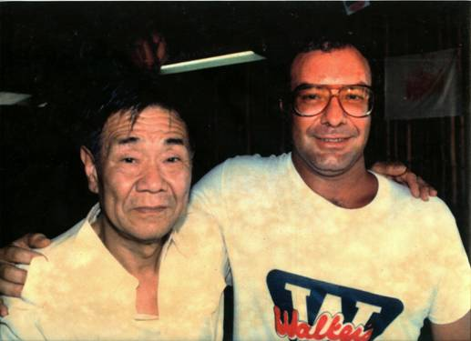
Shoichi Yokoi remembered by Jeff Pleadwell

Slide 2
Seaside Museum @ Jeff’s Pirates Cove
Museum opened December 12, 2000

Slide 3
Sargent Shoichi Yokoi, IJA March 31, 1915 – September 22, 1997

Slide 4
Yokoi’s Cave, Bubulao, Talofofo

Slide 5
Discovered by Jesus Duenas and Manuel De Garcia

Slide 6
1957 to 24 January 1972

Slide 7
Yokoi Became A Celebrity
Movie:
Books:
Yokoi shoichi: guamu-to 28 nen no nazo o ou
or
Yokoi and His Twenty-Eight Years of Secret Life on Guam

Slide 8
Entrance to Yokoi’s Cave

Slide 9
Inside the Cave

Slide 16
At Guam Memorial Hospital

Slide 19
Time for the video of Jeff interviewing Manuel De Gracia at Yokoi’s Cave

