Slide 1
The Invasion of Tinian July 24 to 1 August 1944

Slide 2
Summer of 1944

Slide 3
The Three Invasions
June 15
July 24
July 21

Slide 4
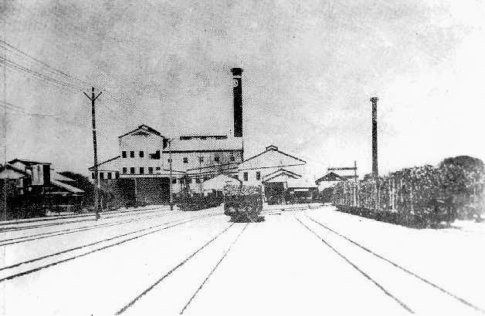
Pre-war Tinian

Slide 5
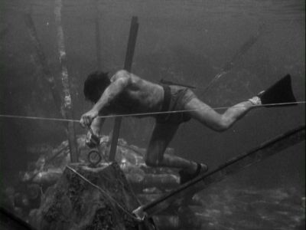
UDT Team 7 Reconnaissance Night of July 10-11

Slide 6
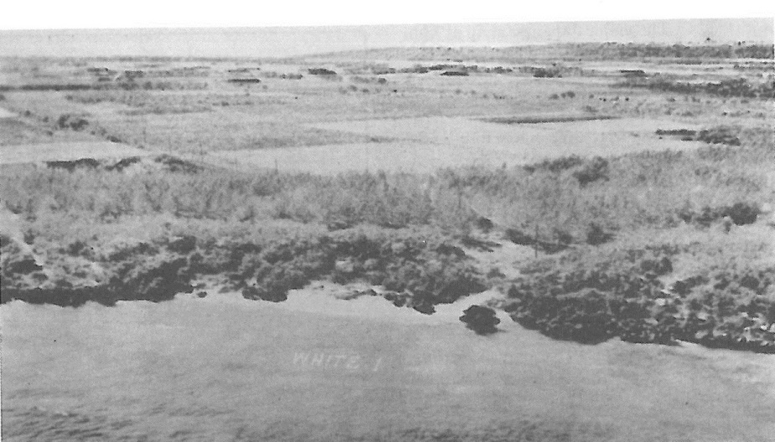
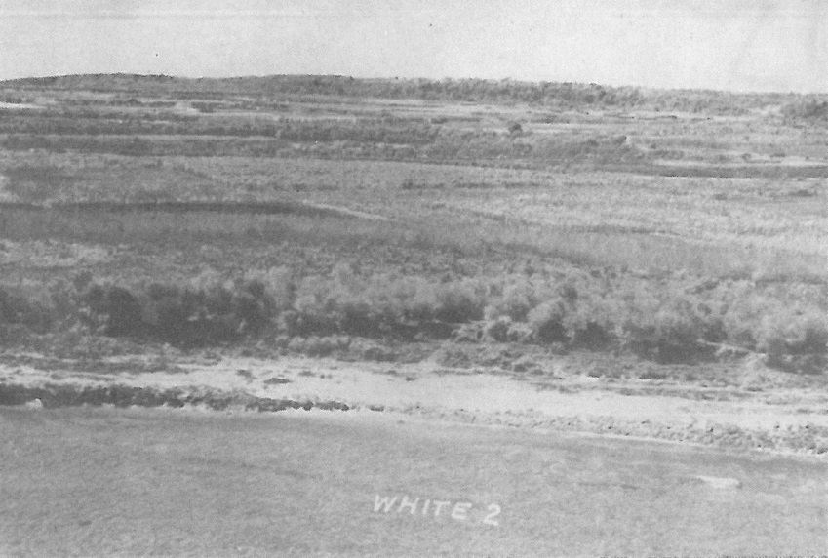
White Beach 2
Unai Chulu
White Beach 1
Unai Babui

Slide 7
Japanese Forces
Colonel Kiyochi Ogata, Imperial Japanese Army
American Forces
Major General Harry Schmidt, USMC
2nd Marine Division
4th Marine Division
Amphibious tractor, motor transport, service, medical and Army artillery
Total: 41,364
50th Infantry Regiment
56th Naval Guard Unit
Naval construction, hospital, and air personnel
Total: 9,162

Slide 8
Japanese defenses

Slide 9
Pre-invasion Bombardment 22 to 24 July

Slide 10
Jig Day: 24 July 1944, Initial feint to the southern beaches

Slide 11
Air Support
Artillery firing from Saipan
From aircraft carriers and Army Air Force P-47s flying from Isley Field on Saipan
155 mm howitzers lined up along the beach

Slide 12
0750 the marines landed simultaneously on both beaches

Slide 13
15,614 marines ashore by the end of the first day

Slide 14
`
The Marines achieved Mt. Maga that day and dug in about 1630 with emplacing machine guns, strung barbed wire in front of their positions, and cited artillery to the rear.
About midnight the Japanese attacked with infantry and tanks.
Marines firepower broke the Japanese attack.
The Marines suffered 100 causalities and the battlefield was littered with 1,241 Japanese bodies in the morning.

Slide 15
The Drive South

Slide 17
The first use of napalm
A mixture of aluminum soap powder, oil, and gasoline that created a thick jelly that flows under pressure
and sticks to a target as it burns.

Slide 18
Tinian Town captured 30 July

Slide 19
Up the cliff on 31 July of Carolinas Plateau Island secured 1 August

Slide 20
Tinian transformed into two Twentieth Army Air Force Bases: North Field: 313th Bombardment Wing West Field: 58th Bombardment Wing

Slide 21
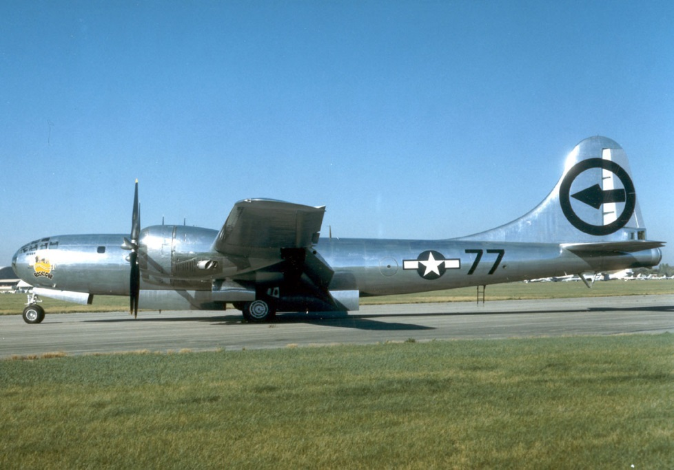
August 6, 1945: Hiroshima August 9, 1945: Nagasaki

Slide 22
Casualities
United States
Marines:
Wounded 1,571
Died 328
Navy:
Wounded 245 Killed 63
Japan
Killed 5,542
Captured 252
Civilians
Survivors 13,000
Last Japanese straggler, a civilian found 16 February 1950

Slide 23
Military Training Today

Slide 24
Tinian Landing Beaches, Ushi Point and North Field National Historic Landmark
Ushi Point Airfield Administration Building
Atomic Bomb Loading Pit

Slide 25
Carolinas Shinto Shrine
Suicide Cliff
Memorial

Slide 26
San Jose Village
Japanese police station

Slide 27
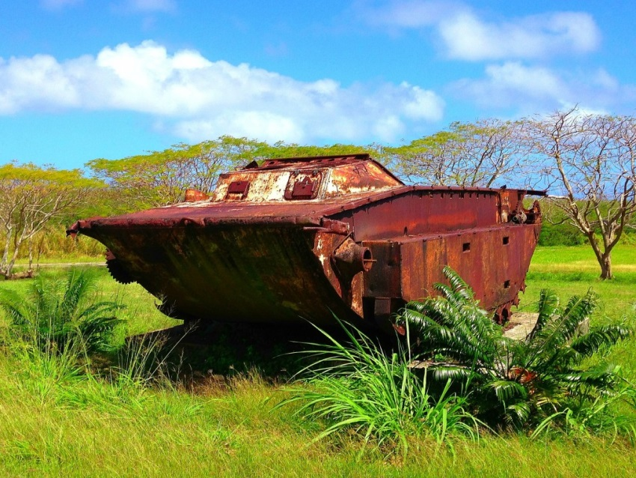
Dave Lotz, Cultural Resources program manager, War in the Pacific National Historical Park, Guam and American Memorial Park, Saipan
david_lotz@nps.gov
Questions
&
Comments

