Slide 1
The Invasion of Saipan 15 June to 9 July 1944

Slide 2
Pre-war Saipan
Japanese since 1914

Slide 3
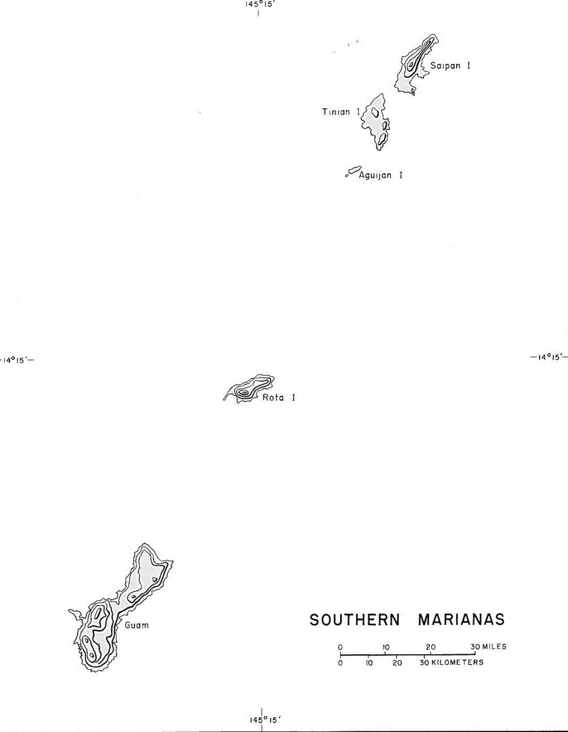
15 June
24 July
21 July

Slide 4
Pre-Invasion Intelligence Gathering

Slide 5
Pre-invasion shelling and bombardment commencing 11 June

Slide 6
Saipan June 1944

Slide 7
Japanese Defense of the Island
Sited artillery
Fortified headlands
Concealed positions
Overlapping fields of fire
Natural obstacles
“Destroy the enemy landing force on the beach.”
Fortifications and reinforcements incomplete primarily due to U.S. Navy submarine sinking of Japanese transports carrying troops, equipment, and construction material.

Slide 8
Opposing commanders
Lt. General Holland Smith, USMC
Lt. General Yoshitsuga Saito, IJA

Slide 9
Saipan Invasion
15 June 1944
USA
2nd Marine Division
4th Marine Division
27th Army Infantry Division
71,000 military personnel
Japan
43rd Infantry Division
47th Mixed Brigade
Numerous provisional units
32,000 military personnel

Slide 10
The Invasion Beaches
2nd Marine Division
Red Beaches:
6th Marines
Green Beaches:
8th Marines
4th Marine Division
Blue Beaches:
23rd Marines
Yellow Beaches:
25th Marines

Slide 11
15 June 1944
0400 bombardment commenced

Slide 12
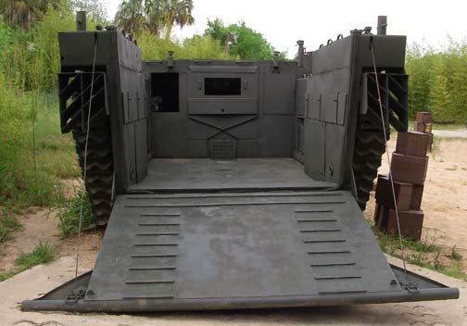
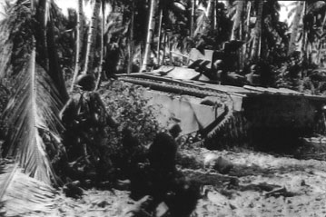
LVT, Amtrac Landing Vehicle Tracked, Amphibian Tractor

Slide 13
8 waves of LVTs and 96 LVTs per wave spaced 5 to 8 minutes apart took 27 minutes to reach the beaches of western Saipan, from offshore, across the reef, and through the lagoon under continual enemy fire commencing with the initial LVT ashore at 0857.

Slide 14
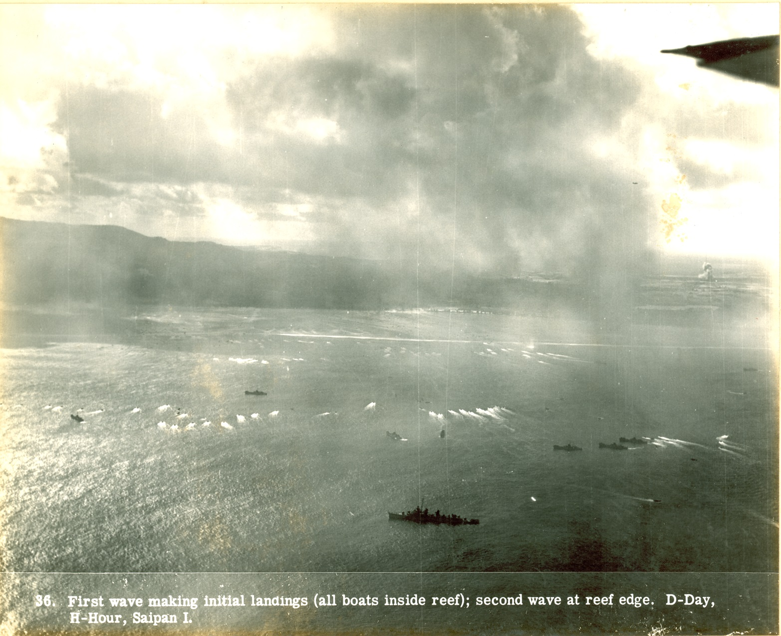

Slide 15
As the invasion progressed
A casualty of the invasion that still remains today
Landing of the 27th Division later on 16 June

Slide 16
Into the evening
20,000 Marines ashore by the end of the day
Japanese counterattack lead by tanks destroyed

Slide 17
American positions at the end of the first day

Slide 18
Capture of Aslito Field on 17 June

Slide 19
Laulau Bay reached 18 June

Slide 20
22 June, Driving north

Slide 21
Marines reached Garapan 25 June

Slide 22
25 June, the 29th Marines reached the summit of 1,554’ Mount Tapotchau

Slide 23
Naftan Point, Japanese counterattack the night of 26 June

Slide 24
By 27 June US forces had cleared the central mountains of the Japanese

Slide 25
Papago Valley, “Death Valley” 23 to 30 June
Attacked by the 27th Division

Slide 26
24 June: General Holland Smith, USMC relieves Lt. General Ralph Smith, USA as commander of the 27th Infantry. Replaced by General Major General Sanderford Jarman, USA
Left: General Smith
Top: General Jarman

Slide 27
2 - 4 July: Garapan and Flores Point reached

Slide 28
6 July: Advance along the west coast through Tanapag

Slide 29
Gyokusai the night of 6 July
4,311 dead Japanese counted
406 American dead

Slide 30
9 July: Marpi Point is reached
Est. 1,000 Japanese died rather than surrender
Island declared secured

Slide 31
Military casualties
U.S.: 3,426 dead
Japan: 23,811 dead

Slide 32
Civilian causalities
938 Carolinians and Chamorros died
8,500 estimated Japanese and Korean civilians died
3,129 Carolinians and Chamorros survived
11,431 Japanese and Koreans survived

Slide 33
Ramifications of the Battle of Saipan
General Hdeki Tojo Resigns as Japan’s Prime Minister
Firebombing of Japan’s cities

Slide 34
Holdouts existed beyond the end of the war
Captain Sakae Oba and 45 surrendered on 1 December 1945
On 31 May 1952, two Japanese, Kamigawara Toshiji and Toshiyoshi Ide, were discovered in the remote jungle of the Talofofo area living in an American tent at the base of a cliff. They has been surviving on snails, eels, rats, and fruit.

Slide 35
Saipan Today
Landing Beaches
Aslito/Isely Field

Slide 36
Saipan Today
American Memorial Park
Marpi Point

Slide 37
Questions and Comments
Dave Lotz, Cultural Resources Program Manager, War in the Pacific National Historical Park, Guam and American Memorial Park, Saipan
david_lotz@nps.gov

