Slide 1
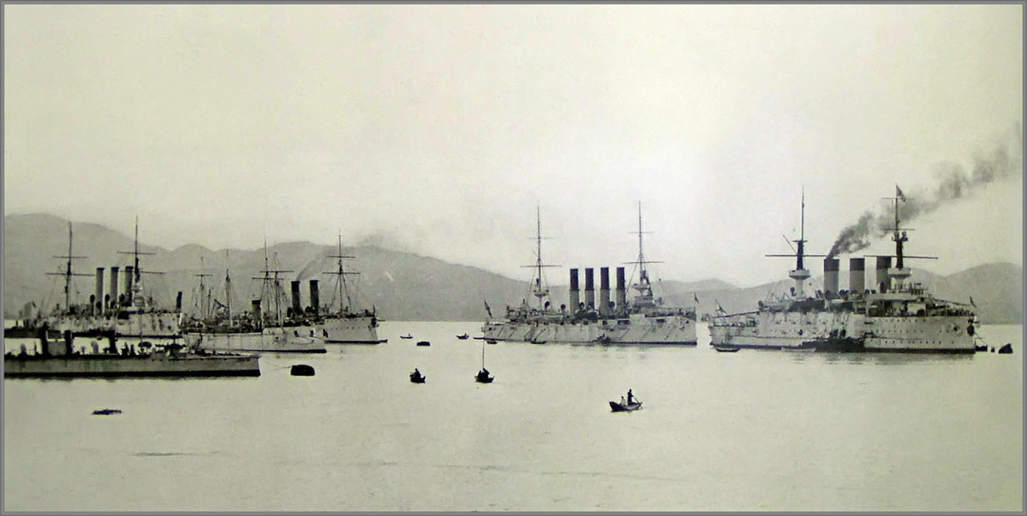
The German East Asia Squadron 1914

Slide 2
Imperial Germany

Slide 3
The German Empire in 1914

Slide 4
Germany in the Pacific 1899 acquired Micronesia from Spain

Slide 5
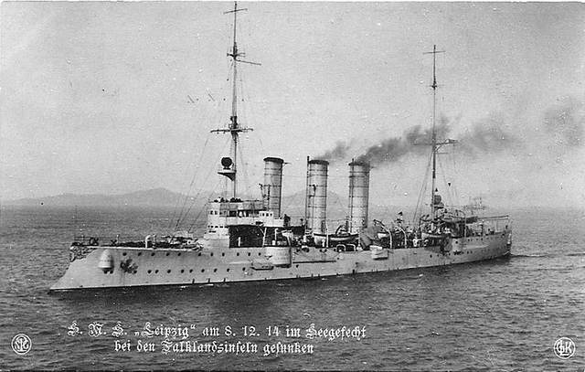
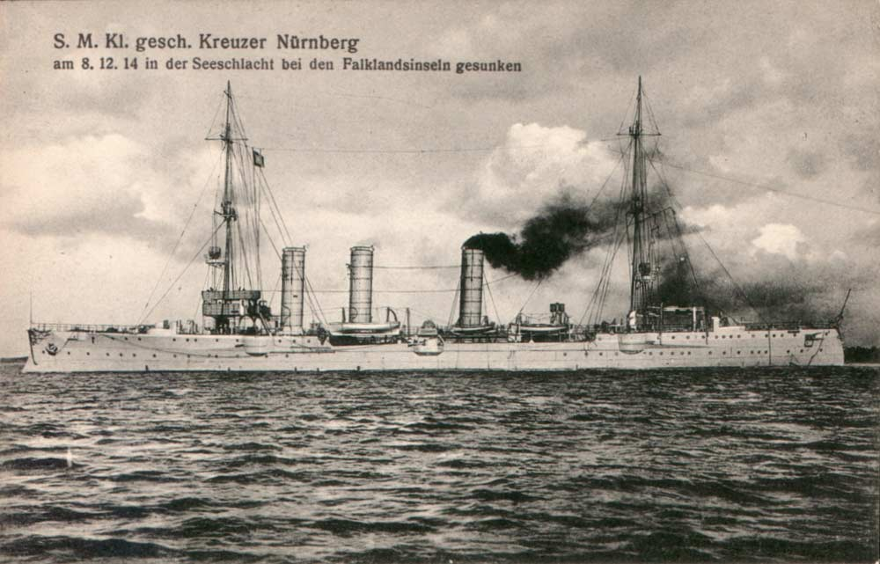
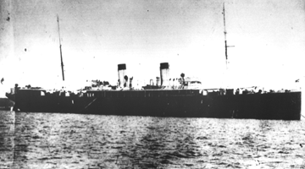
Warships of the East Asia Squadron
Scharnhorst
Gneisenau
Dresden
Emden
Leipzig
Nurnberg
Cormoran

Slide 6
Admiral Graf Maximilian von Spee 1861 - 1914

Slide 7
Pagan, August 13, 1914

Slide 9
Battle of Cornell, Chile 1 November 1914

Slide 10
Cape Horn passage November 27-28, 1914

Slide 11
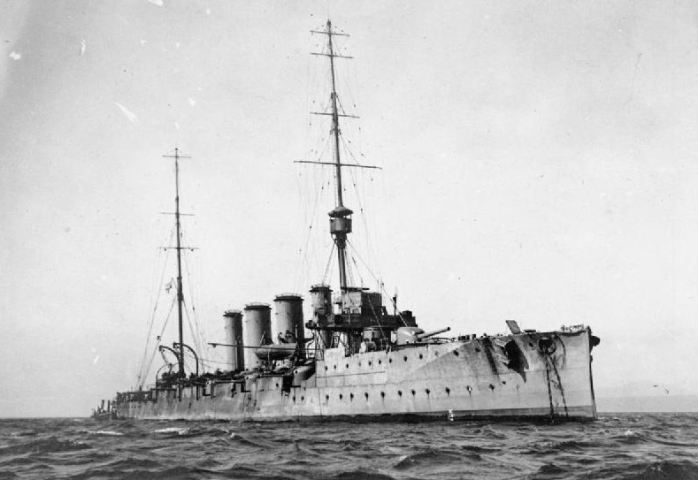
HMS Invincible and Inflexible mounting 12 inch guns arrived at Falklands the day before from the Grand Fleet.
Joined the Glascow, Cornwall, and Kent, 6 inch gun cruisers.

Slide 13
Battle of the Falkland islands 8 December 1914

Slide 14
Sunk were Scharnhorst, Gneisenau, Nurnberg, and Leipzig

Slide 15
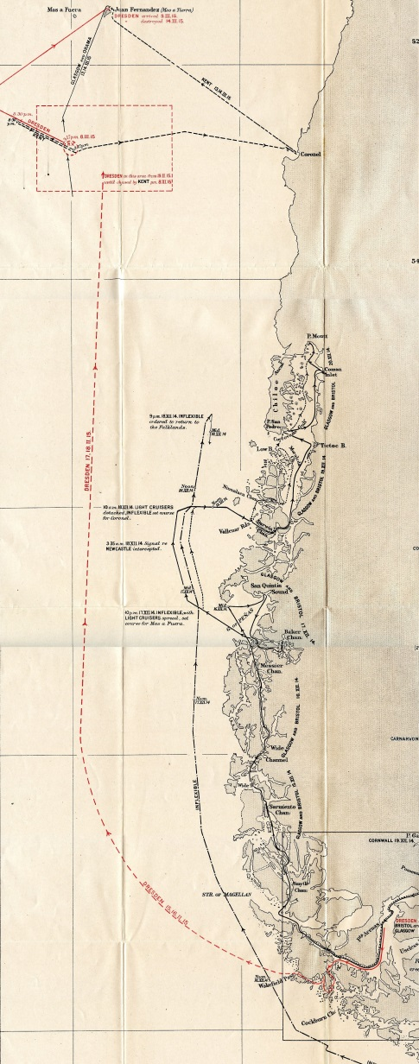
Dresden escaped to the Mas a Tierra, Chile to be sunk by HMS Kent and HMS Glasgow on 14 March 1915

Slide 16
SMS Emden demise at Cocos Island sunk by HMS Sydney, 9 November 1914

Slide 17
Cormoran separated from the Squadron at Majuro and for safety, to elude the enemy, and to seek coal.

Slide 18
Cormoran arrived at Apra Harbor on 14 December 1914

Slide 19
From December 1914 to April 1917 Cormoran and crew interned on Guam

Slide 20
On 2 April 1917 President Wilson asks Congress for a declaration of war against Germany which was passed on April 6.

Slide 21
On Guam the morning of 7 April, when ordered to surrender, Captain Zuchschwerdt, ordered the Cormoran scuttled. At 0803 explosive charges were detonated that sunk the ship
Captain Adalbert Zuckschwerdt

Slide 22
SMS Cormoran lies in the harbor touching Tokai Maru that was sunk by the USS Snapper on 27 August 1943

Slide 23
The officers and crew were held as POWs at 2 locations awaiting transportation to the USA
Camp Asan
Camp Barnett

Slide 24
The Cormoran crew left Guam on 29 April on the USAT Thomas for San Francisco as POWs
Fort Douglas,
Utah
Fort McPherson, Georgia

Slide 25
Six German sailors died and were buried in the Agana Naval Cemetery

Slide 26
For further information

Slide 27
For further information

Slide 28
Dave Lotz, Cultural Resources Program Manager, War in the Pacific National Historical Park, Guam and American Memorial Park, Saipan
david_lotz@nps.gov
671-477-7278 ext 1008

