Slide 1
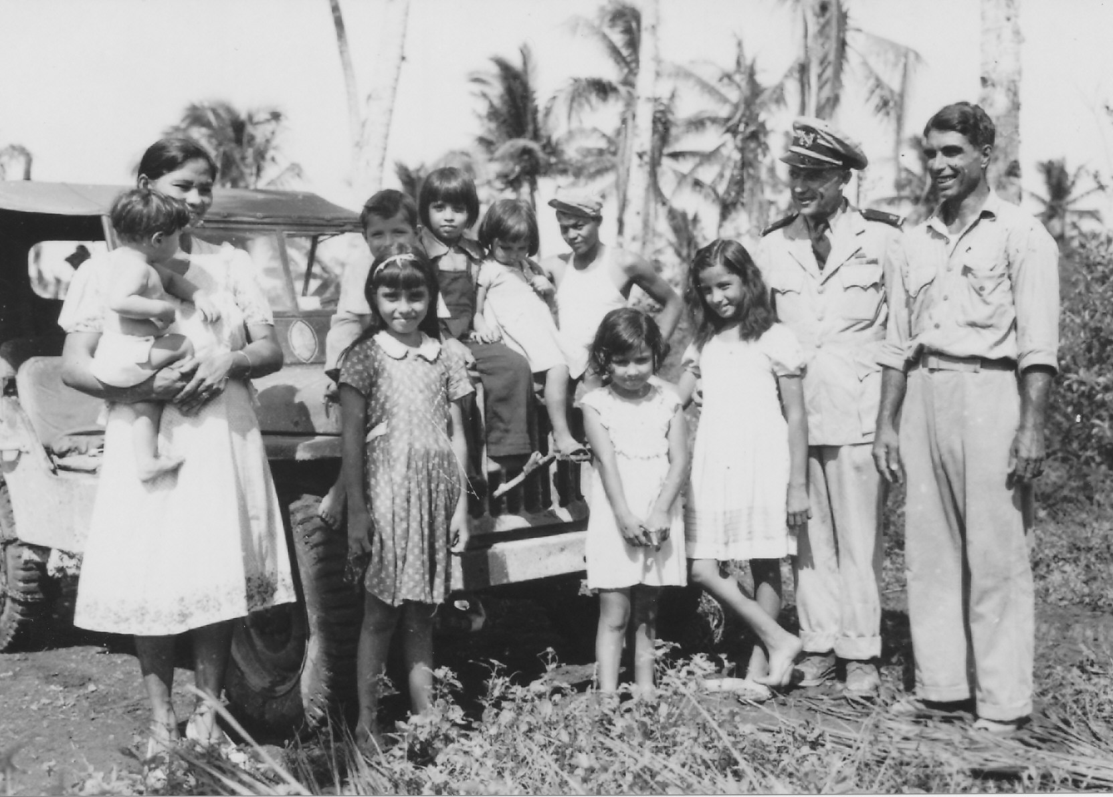
The Artero Family and George Tweed

Slide 2
RM1c George Tweed, USN
Born July 2, 1902
Enlisted U.S. Navy 1922
Transferred to Guam 1939
Family evacuated Oct. 1941
Tweed and 5 other U.S. Navy men did not surrender when Japanese invaded the island on Dec. 10, 1941
The other five were killed by the Japanese in Sept. and Oct. 1941.

Slide 3
Tweed traveled around the island being kept by loyal Chamorros until he finally headed to the northwest coast of the island and met Antonio Artero on Oct. 21, 1942.

Slide 4
Tweed’s Cave at Pigua

Slide 5
19 Months at Tweed’s Cave

Slide 6
July 10, 1944
Sighted ships offshore
USS McCall

Slide 7
Returned to Guam after the Liberation

Slide 8
Stateside Celebrity
Visiting Mother
Family Awaiting Return

Slide 9
Book and Movie

Slide 10
Retired from the U.S. Navy as a Lieutenant in 1948
Died on January 16, 1989 and buried at Eagle Point National Cemetery, Oregon

Slide 11
Today at NCTS
Tweed’s Cave
Double Reef Beach

Slide 12
Artero Family and George Tweed

Slide 13
Artero Family and George Tweed

Slide 14
Artero Family and George Tweed

Slide 15
Artero Family and George Tweed

Slide 16
Artero Family and George Tweed

Slide 17
Photographs from the collections of:
Carmen Kasperbauer
Franklin Artero
Dave Lotz
War in the Pacific National Historical Park

