Slide 1
Liberation Basics: The Epic Chronology of Guam's Liberation from the Japanese that Commenced on July 21, 1944.

Slide 2
Summer 1944
11 June: US Navy Invasion Armada arrives in the Mariana islands
15 June: US invades Saipan
19 June: US Navy defeats Japanese navy in the Battle of the Philippine Sea

Slide 3
Recapture of Guam due to
Location for B-29 bases
The best harbor in the Mariana Islands
A logistics and headquarters location
A native population loyal to the United States

Slide 5
American Forces
3rd Marine Division
1st Provisional Marine Brigade
77th Army Infantry Division
55,000 men
Major General Roy Geiger, USMC

Slide 6
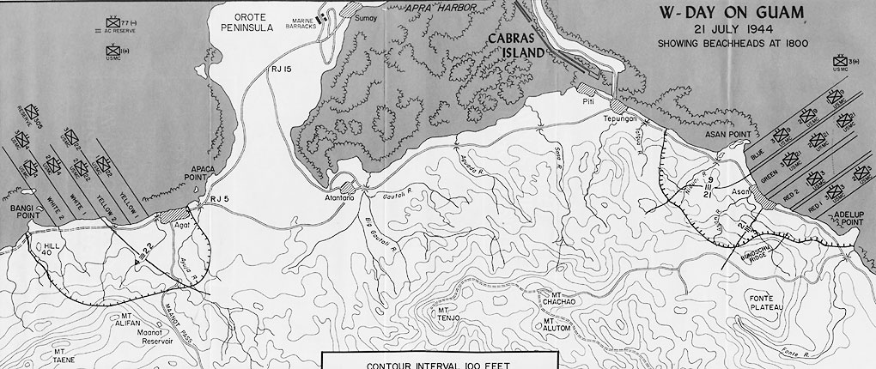
Invasion Plan

Slide 7
6 Battleships
4 Heavy Cruisers
2 Light Cruisers
7 Destroyers
358 LVTs,
Amphibious Tractors
100 DUKWs

Slide 8
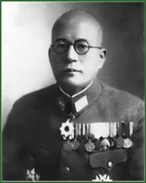
Japanese Forces
29th Army Division
54th Naval Guard Force
Several Independent Brigades
18,500 men
Lt. General
Hideyoshi Obata
Lt. General
Takeshi Takashina

Slide 9
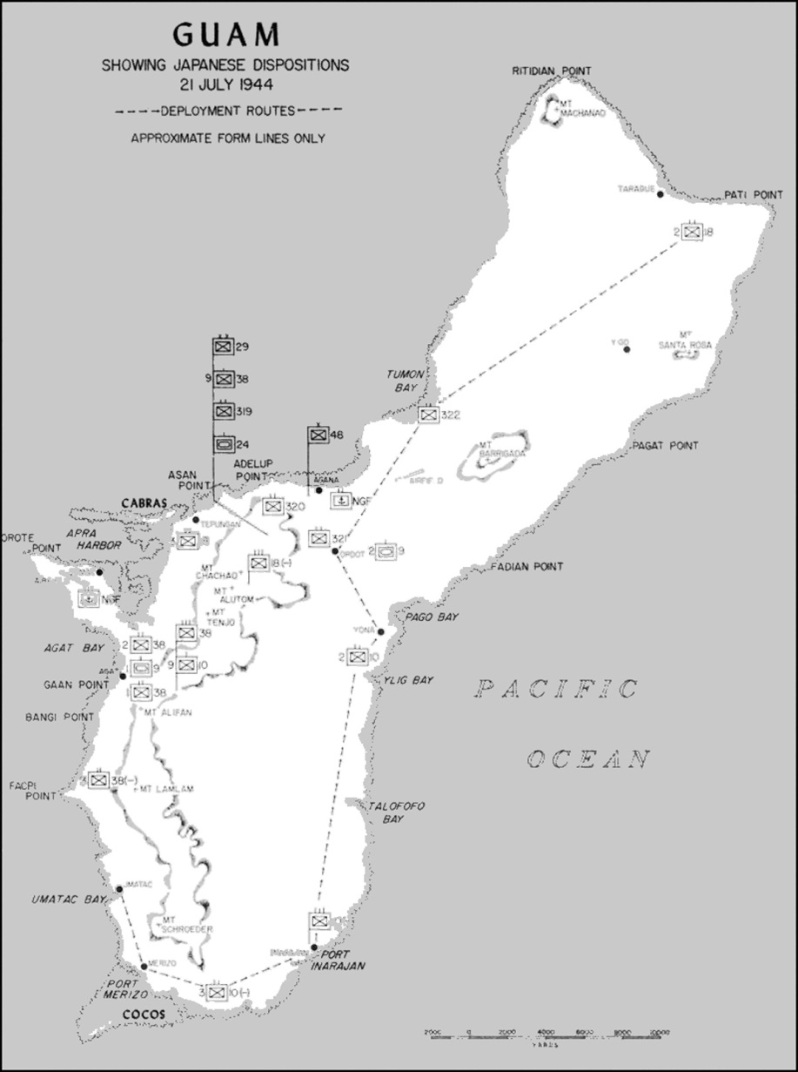
Japanese Defenses
19 20-cm coastal defense guns
8 15-cm coastal defense guns
22 12.7-cm coastal defense guns
6 105-mm howitzers
38 75-mm field guns
57-mm antiaircraft guns
2 57-mm antitank guns
20 37-mm antitank guns
4 25-mm antiaircraft guns
38 tanks

Slide 10
Japanese Fortifications and Guns

Slide 11
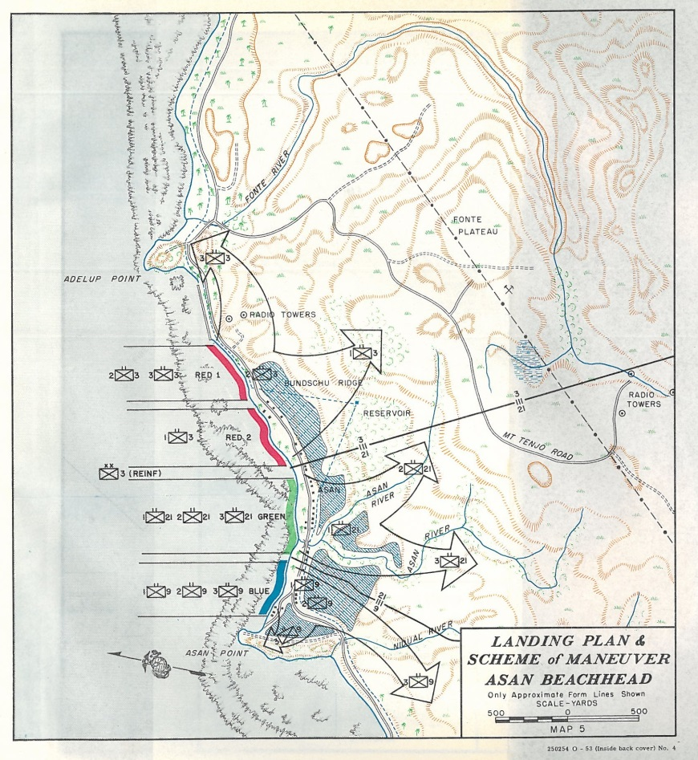
Asan Beach
Third Marine Division

Slide 12
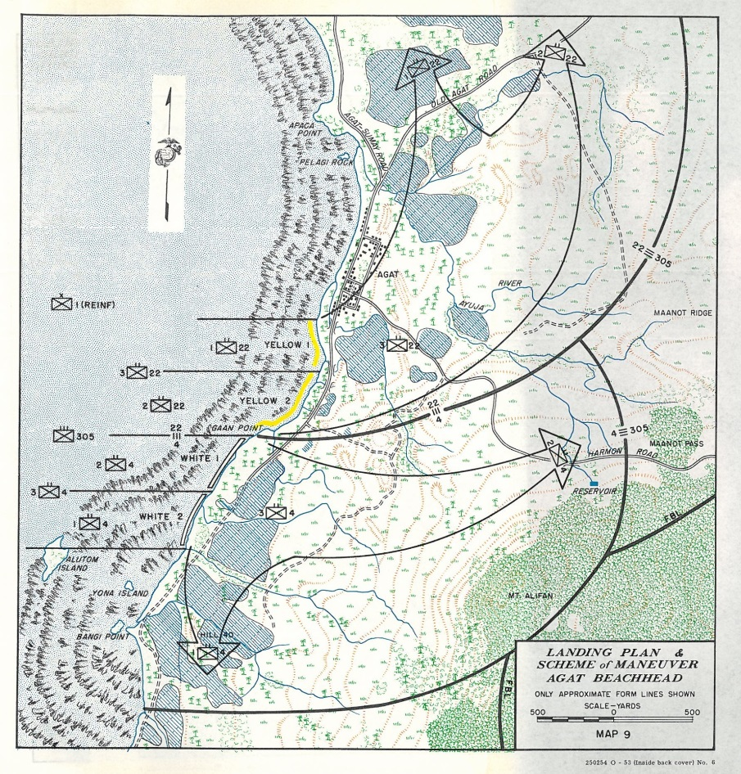
Agat Beach
First Provisional Marine Brigade and
77th Army Infantry Division

Slide 13
Heading to the beaches at 0740

Slide 14
On the beaches beginning at 0832

Slide 15
To the Force Beachhead Line
21 to 29 July

Slide 16
Japanese Counterattack
Night of 25 – 26 July

Slide 17
Sealing off Orote Peninsula, 24 July

Slide 18
Orote Peninsula Captured 25 to 29 July

Slide 19
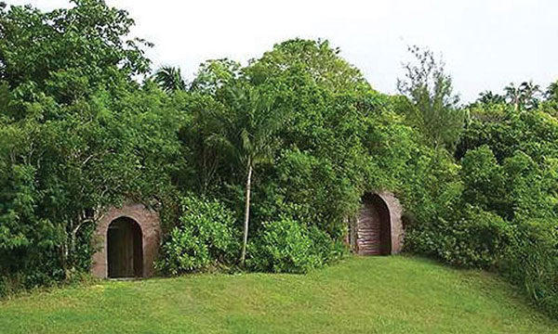
Fonte Plateau Japanese last stand 29 July

Slide 21
Army patrols to the south 28 July to 2 August

Slide 22
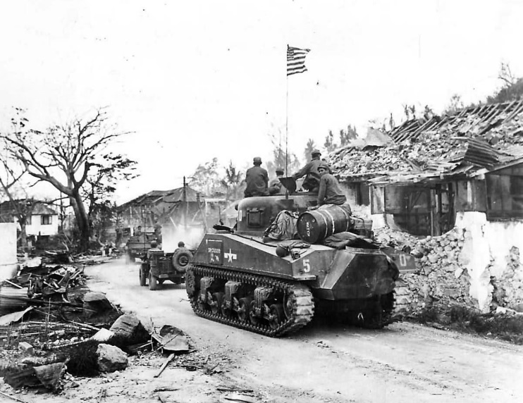
Through Agana and heading north 31 July to 1 August

Slide 23
Advancing north 3 to 4 August

Slide 24
Continuing north 3 to 7 August

Slide 25
The Drive North completed 7 to 9 August

Slide 26
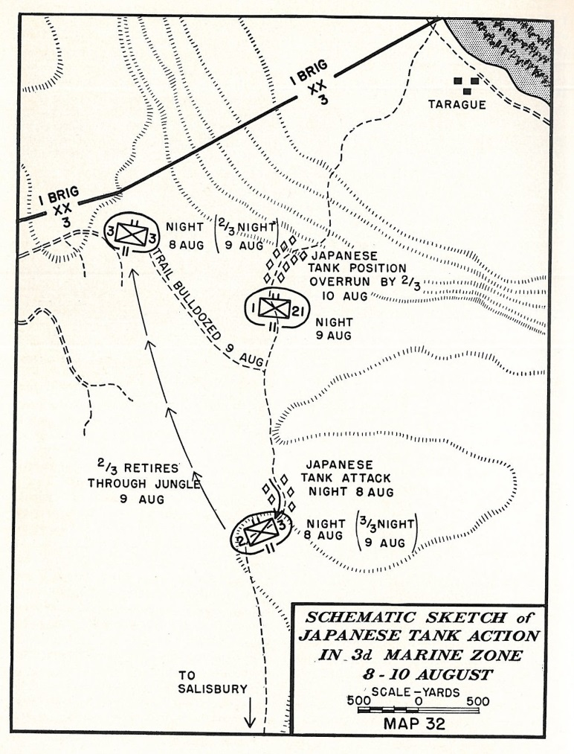
Tarague tank action 8 to 10 August

Slide 27
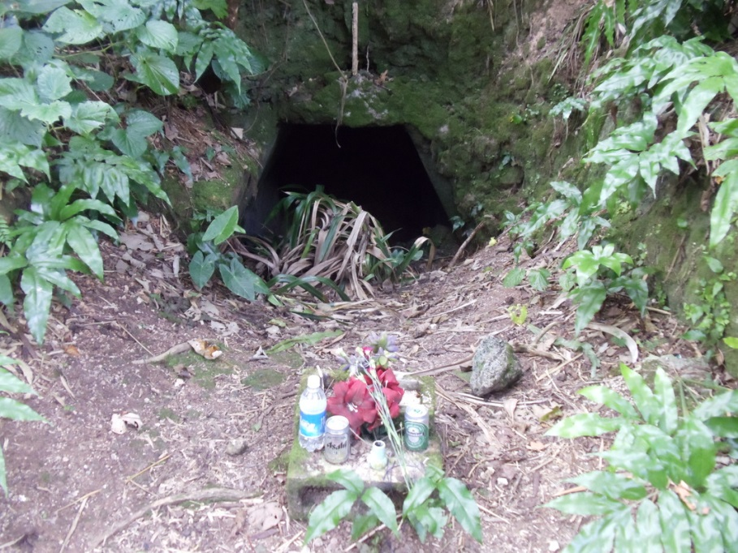
Yigo Command Post
Japanese Lt. Gen. Hideyoshi Obata last position was attacked on August 11, 1944 by the 306th Regiment of the 77th Infantry Division of the U.S. Army. "Throwing white phosphorus grenades and using pole charges and more than 400 blocks of TNT, they blew up the front of the caverns, closing them." The bunkers were opened by American engineers three days later and 60 bodies were found, including that of General Obata.

Slide 28
14,721 Chamorros Liberated

Slide 29
Guam Combat Patrol
Hunted stragglers for several years
Sargent Yokoi
hide out until 1972

Slide 30
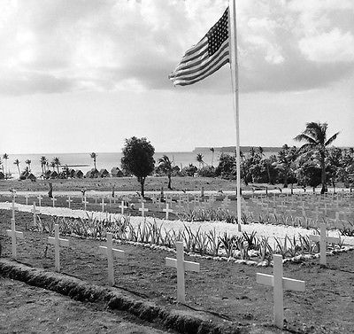
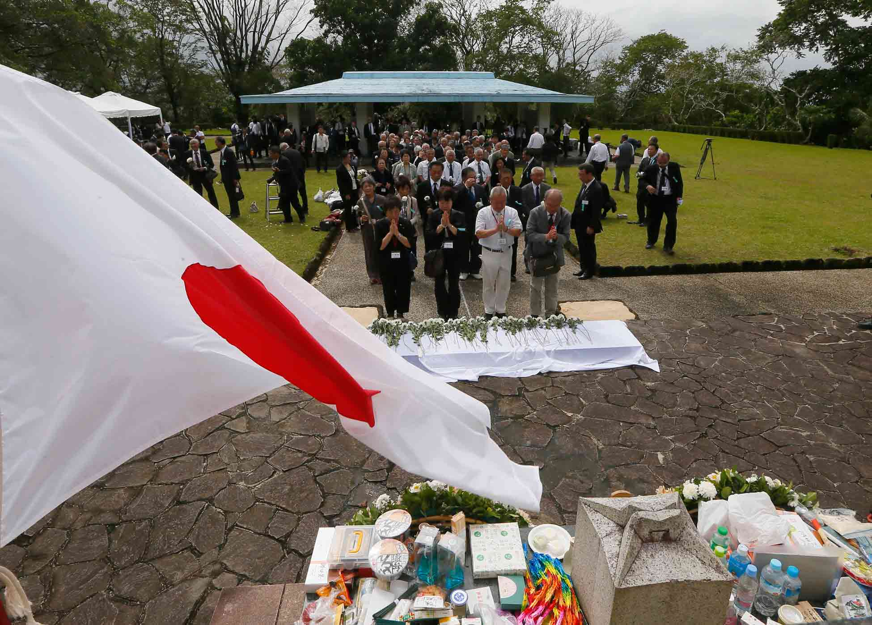
Casualities
American
Chamorro 1,170
Military 1,777
Japanese
Military 18,337

Slide 31
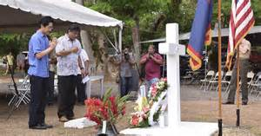
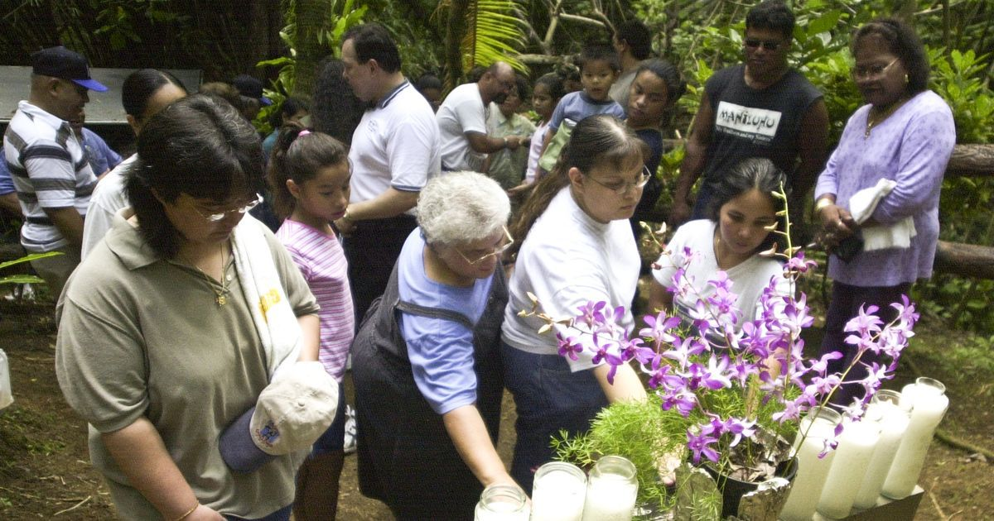
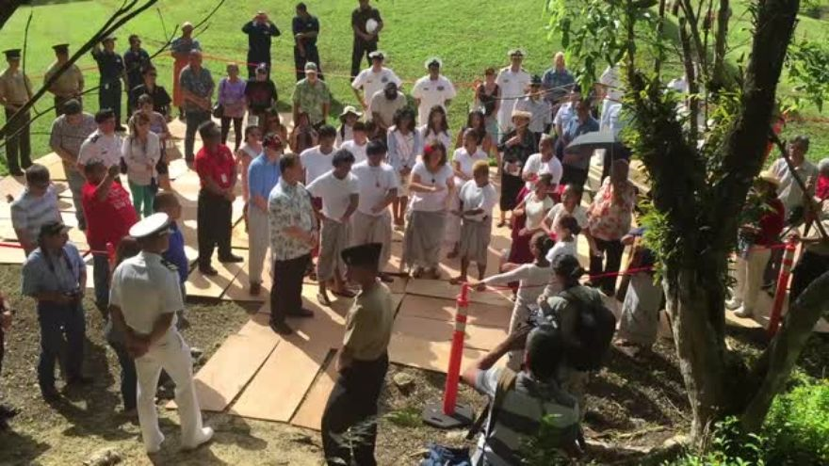
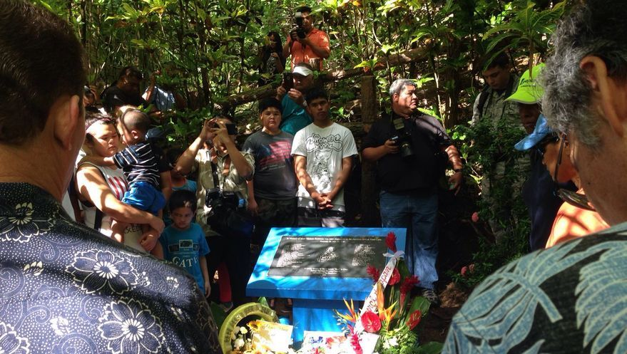
Liberation Day
Commemoration

Slide 32
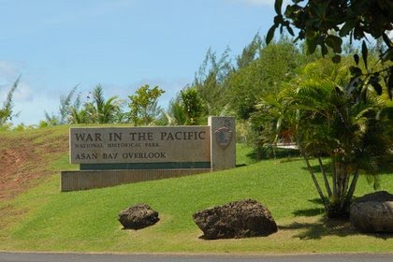
Dave Lotz, Cultural Resources Program Manager, War in the Pacific National Historical Park, Guam and American Memorial Park, Saipan
david_lotz@nps.gov
Commander Marvin Michael Dodge, USN Ret.
Questions & Comments

