Slide 1
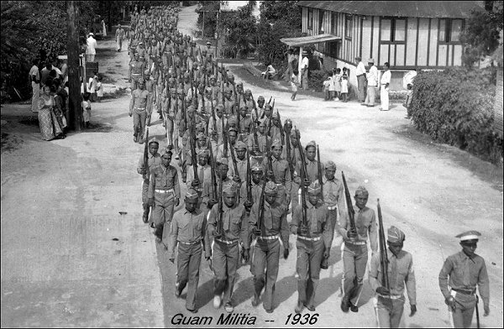
Defending Guam December 1941

Slide 2
Western Pacific Pre-World War II

Slide 3
Japanese Mandated Mariana islands

Slide 4
Pre-War Guam

Slide 5
Pre-War Guam

Slide 6
Navy rule on Guam
Governor’s Palace and Libugon Tile Factory

Slide 7
U.S. Naval rule
Libugon Naval Radio Station and Gaiety Theater in Agana

Slide 8
U.S. Military presence
Marine Barracks Guam and USS R. L. Barnes

Slide 9
Visitors to Guam
USS Augusta in 1934 and Pan Am Clippers beginning in 1935

Slide 10
Reinforcements passing by Guam on the way to the Philippines in 1940 and 1941

Slide 11
Japanese military development in the Northern Marianas late 1930s

Slide 12
USS Henderson evacuates military dependents from Guam on 17 October 1941

Slide 13
8 December 1941
0545 Governor McMillin notified that Pearl Harbor attacked
0830 first Japanese air raid on Guam struck Sumay hitting the Pan American Hotel, Standard Oil fuel tanks, and the Marine Barracks along with naval ships in the harbor.
Three dead.
Nakajima E8N Dave seaplane

Slide 14
Agana and Apra Harbor
Feast of the
Immaculate Conception
USS Penguin heads to sea

Slide 15
Japanese Invasion Force for Guam
Rear Admiral Aritomo Goto, with 3 cruisers, 4 destroyers, 12 transports, and small vessels left Haha Jima on 4 December 1941

Slide 16
Landings at Ipan, Umatac, Tumon, and Alupang

Slide 17
Japanese South Seas Detachment
American forces
5,500 Army Troops
400 Naval Landing
Force
274 Naval personnel
153 Marines
120 Insular Force
Guard

Slide 18
The night of 9-10 December 1941
Japanese Daihatsu
landing barges
First sighting of the Japanese at the Talofofo Lookout at 2330 of 9 December

Slide 19
Main Japanese Landing
At 0215 at Alupang Beach and Tumon Bay to head to Agana

Slide 20
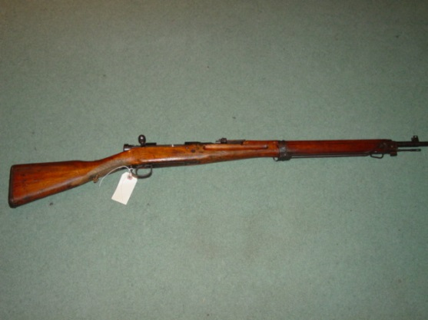
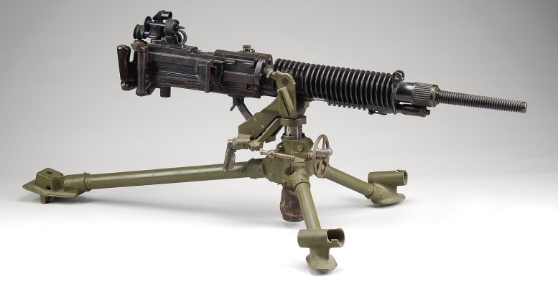
Comparison of Weapons
American
Japanese

Slide 21
Early morning 10 December 1941 Agana, Guam
The Japanese approached from the east.
Defensive positons established along the beach and at the Plaza de Espana by U.S. Navy personnel and the Insular Guard Force

Slide 22
Insular Guard Force defended the Plaza
Machine gun positions at the northwest, northeast, and southeast corners.

Slide 23
Governor McMillin surrenders at 0545

Slide 24
Immediate Japanese Rule Imposed
Guam residents ordered to the Plaza de Espana to receive passes and prisoners confined to the Cathedral

Slide 25
Japanese businesses and farming

Slide 26
Agana Naval Cemetery
Mass burial of dead Americans and later a monument was erected by the Japanese to those who died.

Slide 27
Causalities
American
17 Americans
30+ Chamorros
Japanese
None to hundreds

Slide 28
The Americans
Boarded the Argentina Maru on 10 January 1942 for Zentsuji, Japan. Most would spend the war in Japan. A few would be repatriated in 1942.
Six refused to surrender.
Five would be dead by the end of 1942

Slide 29
Guam Cable Station at Sumay

Slide 30
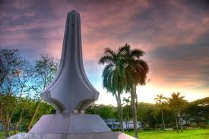
Dave Lotz, Cultural Resources program manager, War in the Pacific National Historical Park, Guam and American Memorial Park, Saipan
david_lotz@nps.gov
Commander Marvin Michael Dodge, USN Ret.
Questions & Comment

