Slide 1
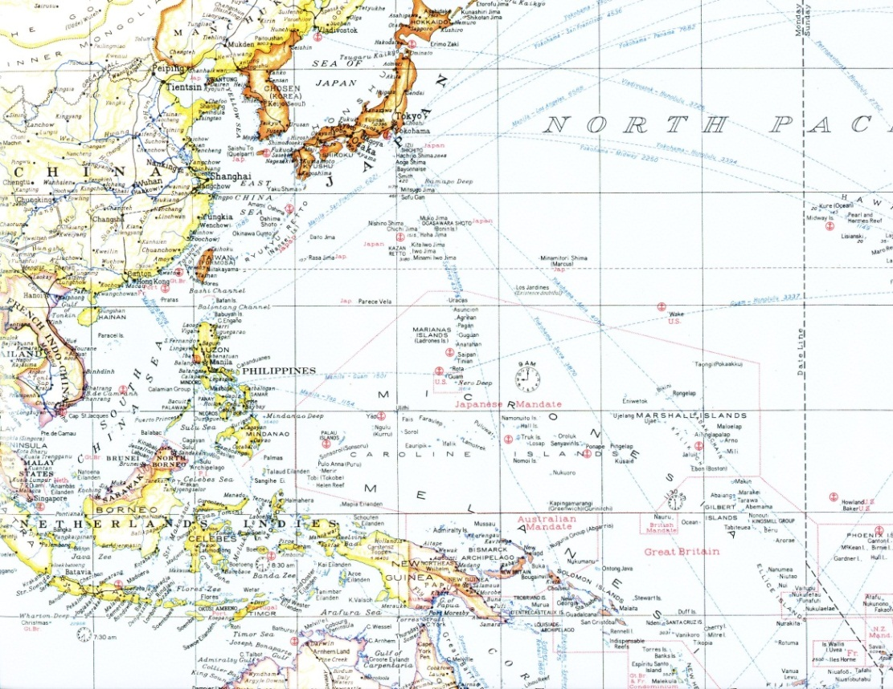
National Park Service, U.S. Department of the Interior
War in the Pacific National Historical Park
Commander Marvin Michael Dodge, USN (Ret.)
Dave Lotz, Cultural Resources Program Manager. NPS
History Revealed:
Battle of the Philippine Sea
June 19-20,
1944

Slide 2
Imperial Japanese Navy
Vice Admiral Jisaburo Ozawa
Commander, Mobile Fleet
Admiral Soemu Toyoda
CinC, Combined Fleet

Slide 3
United States Navy
Admiral Ray Spruance
Commander, Fifth Fleet
Vice Admiral Marc Mitscher
Commander Task Force 58

Slide 4
Fifth aircraft carrier battle of the war
Imperial Japanese Navy:
9 aircraft carriers
U.S. Navy:
15 aircraft carriers

Slide 5
Accompanying warships
5 battleships
11 cruisers
27 destroyers
7 battleships
18 cruisers
67 destroyers

Slide 6
Carrier Fighters
Mitsubishi A6M5 Zero-Sen (Zeke)
Grumman F6F-3 Hellcat
Crew: One
Speed: 346 mph max
Range: 1,118 miles
Weapons: three 13.2 mm machine guns and two 20 mm machine guns
Number: 225
Crew: One
Speed: 380 mph max
Range: 1,530 miles
Weapons: six 0.50 in machine guns
Number: 466

Slide 7
Carrier Dive Bombers
Yokosuka D4Y1 Suisei (Judy)
Curtiss SB2C-1C Helldiver
Crew: Two
Speed: 342 mph
Range: 910 miles
Weapons: 1,235 lbs. of bombs
two 7.7 mm machine guns
one 7.92 mm machine gun
Number: 108
Crew: Two
Speed: 295 mph max
Range: 1,165 miles
Weapons: 2,000 lbs. of bombs
two 20 mm cannons
Number: 154

Slide 8
Older Carrier Dive Bombers
Aichi D3A2 (Val)
Douglas SBD-5 Dauntless
Crew: Two
Speed: 239 mph max
Range: 913 miles
Weapons: 816 lbs. of bombs
three 7.7 mm machine guns
Number: 27
Crew: Two
Speed: 255 mph max
Range: 773 miles
Weapons: 2,250 lbs. of bombs
two 0.50 in machine guns
two 0.30 in machine guns
Number: 79

Slide 9
Carrier Torpedo Bombers
Nakajima B6N1 Tenzan (Jill)
Grumman TBM-1C Avengers
Crew:
Speed: 298 mph max
Range: 1,892 miles
Weapons: 1,764 lbs. torpedo/bomb
two 7.7 mm machine guns
Number: 99
Crew: Three
Speed: 267 mph max
Range: 1,130 miles
Weapons: 2,000 lbs. torpedo/bombs
two 0.50 in machine guns
one 0.30 in machine gun
Number: 193

Slide 10
Aircraft numbers
Japanese Navy
United States Navy
Carrier Fighters 225
Carrier Dive Bombers 135
Carrier Torp. Bombers 99
Land Based 420
Seaplanes 0
TOTAL 879
Carrier Fighters 466
Carrier Dive Bombers 233
Carrier Torp. Bombers 193
Land Based 0
Seaplanes 17
TOTAL 907

Slide 11
Pilots
Japanese
American

Slide 12
Fleet Approaches, 0001K 19 June 1944
Japanese Navy steaming east from the Philippines.
U.S. Navy positioned to the west of the Mariana Islands to defend the Saipan invasion of June 15, 1944.

Slide 13
Considerations
Prevailing Winds from the Northeast.
Japanese controlled nearby airfields on Rota, Tinian and Guam.
Japanese knew the locations of the American carriers days prior to the battle.
The U.S. Navy did not know the locations of the Japanese carriers with the exception of infrequent submarine sightings.

Slide 14
Tactical considerations
Admiral Spruance primary purpose was to protect the invasion of Saipan.
Admiral Spruance concerned the Japanese might divide forces and execute an “end around”.
Admiral Lee, commander of USN battleships, did not want a night surface engagement.

Slide 15
Submarines
American: Deployed to first sight and report the approaching Japanese fleet; Then attack.
Japanese: Had been eliminated around the Mariana Islands

Slide 16
Marianas Turkey Shoot
June 19: Aerial battle over the U.S. Carriers and over Guam
June 20: Chase and attack on the Japanese carriers to the west

Slide 17
Aftermath
Japanese losses
United States losses
Aircraft: 550-645
Ships: 3 carriers, 2 oilers
Men: 2,987 est.
Aircraft: 123
Ships: none
Men: 99
Elimination of Japanese Navy’s carrier air power
Downfall of the Tojo government in Japan
Successful American invasions of Saipan, Guam, and Tinian
Continued 1944 westward offensive of the United States in the Pacific with invasions of Peleliu and the Philippines

Slide 18
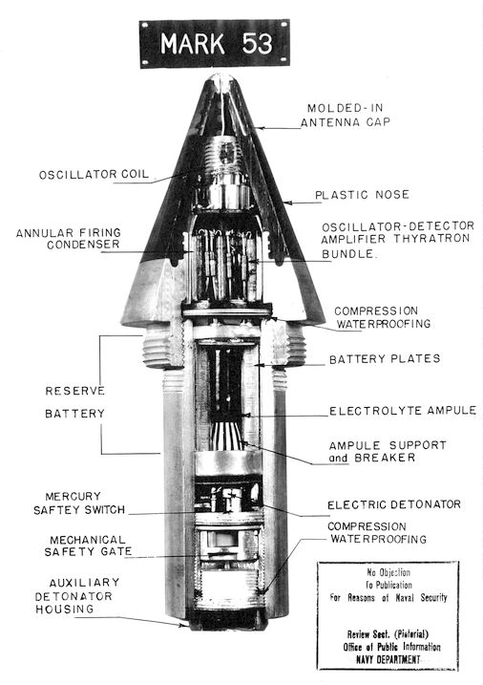
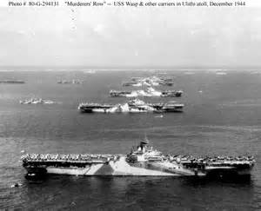
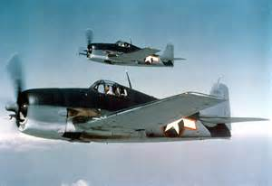
Key factors for the U.S. victory
American pilot training
American tactics
American technology
Advanced American ships and aircraft

Slide 19
“It was like an old time turkey shoot down home!”

Slide 20
Remnants
Off Umatac Bay
At Hamanatsu-Minami SDB, Japan

Slide 21
Stateside Remnants
USS Hornet, Alameda, CA
USS Yorktown, Charleston, SC

Slide 22
Thanks for your interest in our heritage and park!

