Slide 1
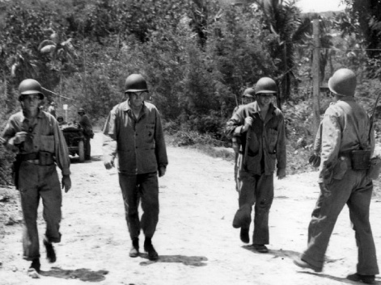
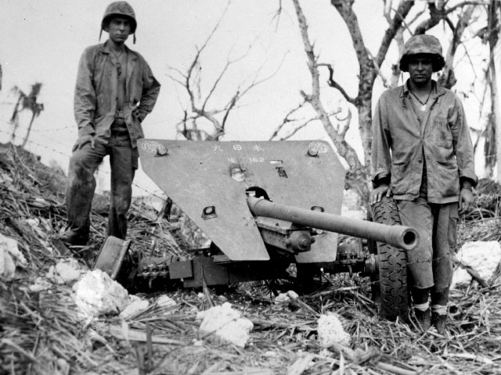
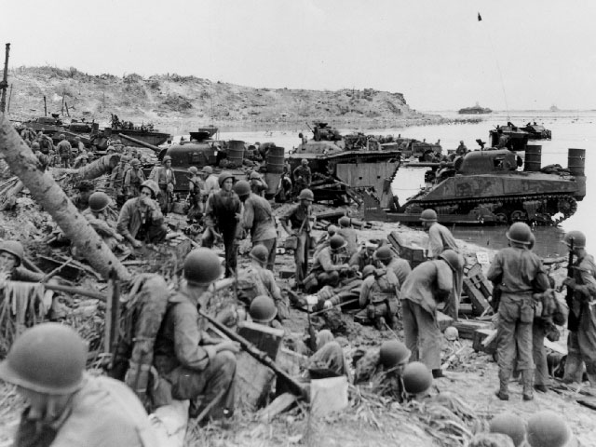
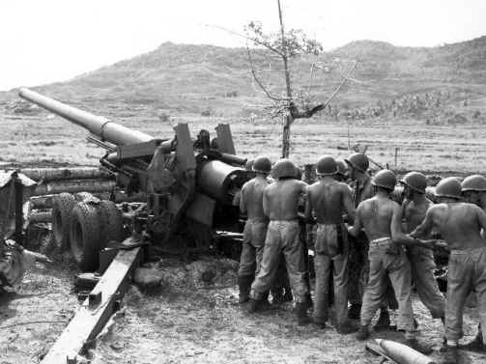
The United States Marine Corps Role in the Recapture of Guam from the Japanese
Notes:
Center Photo: This clutter of tanks, amphibious tractors, Leathernecks, and equipment near Adelup Point on the Asan Beachhead is depicted an hour and a half after the first wave hit the beach. A field dressing station (foreground) is in operation while Marines grab a fast smoke or rest before getting others to move inland. July 21, 1944. (National Archives 80-G-238994)

Slide 2
The U.S. landing force on Guam in July 1944 numbered 55,000 men.
Marines shooting at Japanese snipers. July 28, 1944.
Notes:
Photo: Three Marines and their machine gun put a nest of Japanese snipers out of business. The fox hole was about 100 yards off the Guam beach. The Marines, left to right: Gunnery Sergeant J. Paget, Privates L.C. Whether and V.A. Sot. July 28, 1944.(National Archives 80-G- 239015)

Slide 3
The bulk of the landing force on the morning of July 21 belonged to the 3rd Marine Division who landed on the northern beaches at Asan, and the First Provisional Marine Brigade, who landed on the southern beaches near Agat.
US Marine Corp Major General Allen Turnage. July 29, 1944.
Notes:
Photo: US Marine Corp Major General Allen H. Turnage, (second from left) Commanding General 3rd Marine Division, walks along a dusty road towards the front lines, Asan Beachhead, Guam. Peabody is third from left. July 29, 1944.(National Archives 80-G-239007)

Slide 4
The First Provisional Marine Brigade had been organized just a few months before, and included the 4th and 22nd Marines. The men of this brigade had seen action in the Pacific at Bougainville and Guadalcanal.
A Marine Corps Tank. August 3, 1944.
Notes:
Photo: A Marine Corps tank and riflemen move along a Guam road, as they force the Japanese farther back into the hills. August 3, 1944. (National Archives 80-G-239427).

Slide 5
In the 21days of battle, the Marines lost over a thousand men. Thousands more were wounded in action. At the end of the period, there were over twice as many enemy dead.
Standing in front of a Japanese anti-tank gun. July 1944.
Notes:
Photo: What appears to be a Japanese anti-tank gun mounted on rubber tired wheels, was left behind for the Marines at Guam. July 1944.(USMC photo #93127).

Slide 6
Analyzing Photographs & Prints
1) Observe
2) Reflect
Identify and note details.
Ask yourself the following questions:
What did I notice first?
What people and objects are shown?
How are they arranged?
What is the physical setting?
What, if any, words do I see?
What other details can I see?
Generate and test hypotheses about the image.
Why do you think this image was made?
What’s happening in the image?
When do you think it was made?
Who do you think was the audience for this image?
What tools were used to create this?
What can you learn from examining this image?
What’s missing from this image?
If someone made this today, what would be different? What would be the same?

Slide 7
Now Let’s Analyze!
Write a caption for each of the following images that you see.
OR
Predict what will happen one minute after the scene shown in the following images.

Slide 8
Preparing for invasion at Agat Beachhead. July 24, 1944.
Notes:
Photo: Yellow beach 2, Agat beachhead. On meadow (rice paddy) about 150 yards in, a 155mm howitzer is seen firing on Orote peninsula. July 24, 1944.(USMC photo # 91646).

Slide 9
Marines carrying a wounded soldier down a 200 ft slope. July 23, 1944.
Notes:
Photo: Difficulty Marines had carrying wounded down 200ft slope. July 23, 1944. (USMC photo # 90,893)

Slide 10
A Japanese bus stop sign in Asan. July 25, 1944.
Notes:
Photo: No. 3 Japanese bus stop sign on the road near the Asan beachhead. In photo is Richard C. Bryson. July 25, 1944.(USMC photo # 90,459)

Slide 11
Marines on a tractor loaded with ammunition. July 27, 1944.
Notes:
Photo: Marines advancing on Guam. A tractor pulling a vehicle loaded with ammunition and water follows Marines along a twisting road on Guam leading up to the front lines. Another tractor drawn vehicle (left background) moves closer to the front lines. July 27, 1944.(National Archives 80-G-238975)

Slide 12
Marine blasting a pillbox at Orote Peninsula. July 28, 1944.
Notes:
Photo: US Marines blasting Japanese from pillboxes on the old Marine golf course near old Marines Barracks. Orote Peninsula. July 28, 1944. (USMC photo # 93,450).

Slide 13
US Marine using flame throwers to force Japanese soldiers out of their hiding places. July 29, 1944.
Notes:
Photo: US Marine (extreme left) using a flame thrower to burn the enemy out of a hidden Japanese pillbox. July 29, 1944. (National Archives 80-G-239004)

Slide 14
Marines unloading supplies. July 29, 1944.
Notes:
Photo: Marines form a bucket brigade for the unloading of supplies out of an amphibious tractor on a beach at Guam. July 29, 1944. (National Archives 80-G- 238968).

Slide 15
Swabbing the bore of a 155 mm rifle. July 29, 1944.
Notes:
Photo: Men swabbing bore of 155mm rifle, No. 4 gun, 'CE Battery, 7th 155mm Gun Bn, 3rd Amphib. Corps Artillery. July 29,1944.(USMC photo #91,346).

Slide 16
Preparing to advance up Agat beachhead, July 1944.
Notes:
Marines laying down the final preparation for barrage on a Japanese installation prior to advancing position 1000 yards north of Agat. July 1944. (USMC photo #91,377).

Slide 17
Marines throwing grenades at Japanese troops. August 3, 1944.
Notes:
Photo: Marines throwing hand grenades at Japanese troops on the other side of the rice paddy. August 3, 1944.(National Archives 80-G-239420).

Slide 18
Agat Beach Bridge. August 5, 1944.
Notes:
Photo: Leathernecks of the First Provisional Marine Brigade on Guam as they head for the scene of battle. Agat beachhead- excellent view of a bridge. August 5, 1944. (National Archives 80-G-239317).

Slide 19
Marine in the Asan Chapel. August 3, 1944.
Notes:
Photo: Marine Sergeant Carroll J. Williford stands amid the debris of a Catholic chapel in the village of Nagas on the Asan Beachhead. The chapel, with walls two feet thick, was wrecked by the pre-invasion bombardment. August 3, 1944. (National Archives 80-G-239426).

Slide 20
Marines at Chorrito Cliff.
Notes:
Photo: Three Marines from the front coming along a seashore road at Chorito Cliff with Adelup point shown in background. The wrecked house on the summit may be seen. The entire rocky point is honey combed with caves in which the Japanese were still hiding when this picture was taken.(USMC photo # 90,864)

Slide 21
3) Further Investigation
Analyzing Photographs & Prints
Ask questions to lead to more observations and reflections about these photos.
What do you wonder about…
Who?
What?
When?
Where?
Why?
How?
How would you expand or alter your textbook explanations of history based on these primary sources you just looked at?
Consider how these photos support or challenge information and understanding of World War II. How would you refine or revise the way history could be taught in schools?

Slide 22
Bibliography
War in the Pacific National Historical Park. USMC. nps.gov. National Park Service, n.d. Web. March 2011.
Notes:
Photo:

