Slide 1
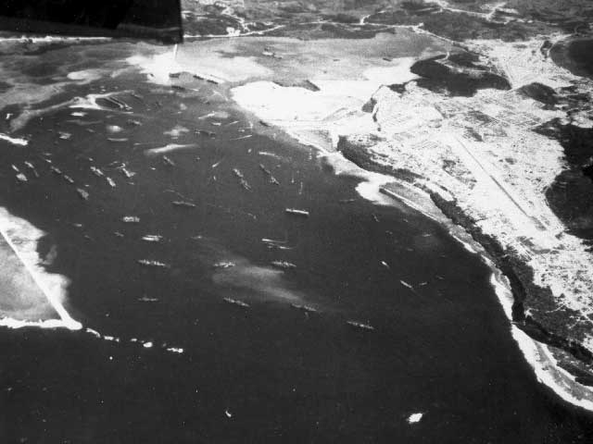
Orote in Ruins
Orote Field played a significant role in the World War II battles between the Japanese and Americans on Guam.
Notes:
History of Orote Field (PRIOR TO WW2): A pioneering effort in military aviation in the western Pacific began when a U.S. Marine Squadron arrived in Guam on March 17, 1921, including 10 pilots and 90 enlisted men. The Marine unit constructed an air station near the water at Sumay village, including a hangar for their amphibious aircraft. In 1926, a new administration office was constructed which housed the squadron offices, sick bay, dental office, aerological office and guardhouse. In early 1927, the squadron was sent to China to protect American lives during the Chinese civil war and became stationed at Olongapo, in the Philippines, which they used as a base to patrol the Chinese coast. Only a handful of men remained here until September 23, 1928, when Patrol Squadron 3-M, consisting of 85 enlisted men and 4 to 6 officers, was assigned to Guam. But shortly thereafter, the naval air station was closed on February 24, 1931, as a cost-saving measure.

Slide 2
The Japanese occupied Guam from December 13, 1941 to July 9, 1944.
This is an aerial view of the Orote airfield on the Orote Peninsula and Apra Harbor
During that time, the Japanese military government constructed Orote Field, a land-based airfield, using Korean and Guamanian labor.
Notes:
Photo Description: The Orote airfield on the Orote Peninsula and Apra Harbor. At center right is a aerial view of the Orote Airfield, which was constructed by the Japanese 1942-1944, and enlarged and improved by the US Navy after August 11, 1944. Marine planes (VMF-225) began flying their first combat missions over Guam from the captured Japanese Orote field on August 7, 1944. Apra Harbor is in the center of the photo (National Archives 80-G- 346025).
Note: The Japanese assigned the defense of Orote Peninsula to the 54th Independent Guard Unit under command of Air Group Commander Asaichi Tamai.

Slide 3
This is an aerial view of Orote Peninsula. August 7, 1944.
On February 23, 1944, American carrier based airplanes attacked the field, and other American raids soon followed.
During the Battle of the Philippine Sea against the Americans, the field was used by the Japanese carrier-based airplanes to refuel and rearm.
Notes:
Photo Description: Aerial view of the Orote Peninsula. August 7, 1944. (National Archives 80-G-239716).

Slide 4
This is an aerial view, altitude about 1,000 feet of the end of Orote Peninsula airfield and town of Sumay. July 22, 1944.
American raids on June 19, 1944 destroyed the landing fields, the aircraft on the ground and such aircraft that managed to take off.
American pilots reported extremely intense anti-aircraft fire around Orote Field.
Fifteen Japanese airplanes crashed while attempting to land on Orote Field that day.
Notes:
Photo Description: Aerial view, altitude about 1,000 feet. View of end of Orote Peninsula airfield and town of Sumay. July 22, 1944 (National Archives 80-G-242193).

Slide 5
This is Orote Peninsula where Marines have just finished cleaning out Japanese resistance. July 31, 1944.
After the invasion on July 21, 1944, the 1st Provincial Marine Brigade, under command of Lt. General Lemuel C. Shepherd, fought its way through the village of Agat to the base of Orote Peninsula.
Notes:
Photo Description: Aerial photo of airstrip and Orote Peninsula where Marines have just finished cleaning out Japanese resistance. July 31, 1944. (USMC # 87994)

Slide 6
In Agat, the Japanese had constructed an elaborate interlocking system of pillboxes, strongpoints and trenches. Regiments of the 1st Provisional Marine Brigade, the 4th and 22nd, fought their way through the area.
Marines and field pieces, pulled by trucks, move across the airfield as they took it over from the Japanese. July 1944.
Notes:
Photo Description: Taking over. Marines and field pieces, pulled by trucks, move across the airfield at Orote Peninsula, Guam as they took it over from the Japanese. July 1944. (USMC# 88086)

Slide 7
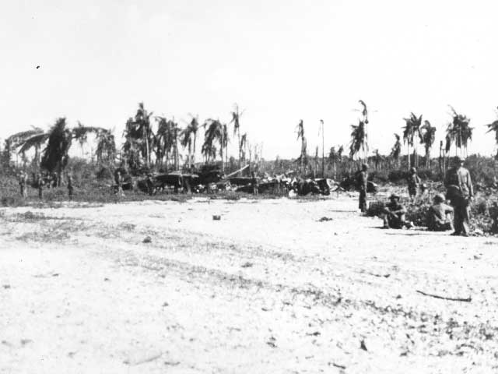
Japanese planes destroyed on the ground by gunfire next to Orote peninsula. July 1944.
On June 20, 1944, numerous actions occurred in the immediate vicinity of Orote Field between American carrier airplanes and Japanese aircrafts seeking refuge at Orote Field after flying from their carriers.
Notes:
Photo Description: Wrecked war bird. Marines examine a wrecked Japanese plane on the Orote Peninsula Airfield, Guam. The plane was one of many damaged beyond repair by aerial bombings and naval shelling, before the field fell to the Leathernecks (USMC #88170)

Slide 8
Numerous dogfights took place in the air above Orote Field and numerous strikes by American airplanes destroyed Japanese facilities and airplanes on the ground.
This was significant because it denied the Japanese the use of a crucial airfield in the battle.
This is a Japanese tank forced out of action on Orote.
Notes:
Photo Description: A Japanese tank forced out of action on Orote.

Slide 9
Shortly before midnight on July 26, 1944, the Japanese trapped on the peninsula staged a suicide attack and were completely wiped out.
The advancing Marines still met heavy Japanese resistance in the vicinity of the airfield, where the Japanese fought from caves and coconut bunkers.
Aerial view of the Japanese air field on the Orote Peninsula. August 7, 1944.
Notes:
Photo Description: Aerial view of the Japanese air field on the Orote Peninsula. August 7, 1944. (National Archives 80-G-239723).

Slide 10
The peninsula was declared secure on July 29, 1944. It is estimated that the Japanese lost more than 3,000 men defending Orote Peninsula.
Orote Peninsula airfield, AC-47 at left of center. August 10, 1944.
Notes:
Photo Description: Orote Peninsula airfield, AC-47 at left of center. August 10, 1944. (National Archives 80-G-287316)

Slide 11
Orote Field was used by Marine air power for close combat support missions during the liberation of Guam. This was accomplished by Marine Air Group (MAG-21) flying Corsairs from Orote Field.
This photo is of the taxiway on the Orote Peninsula Airfield. October 5, 1944.
Notes:
Photo Description: This photo is of the taxiway on the Orote Peninsula Airfield. October 5, 1944. (National Archives 80-G-247587).

Slide 12
Analyzing Photographs & Prints
1) Observe
2) Reflect
Identify and note details.
Ask yourself the following questions:
What did I notice first?
What people and objects are shown?
How are they arranged?
What is the physical setting?
What, if any, words do I see?
What other details can I see?
Generate and test hypotheses about the image.
Why do you think this image was made?
What’s happening in the image?
When do you think it was made?
Who do you think was the audience for this image?
What tools were used to create this?
What can you learn from examining this image?
What’s missing from this image?
If someone made this today, what would be different? What would be the same?

Slide 13
Now Let’s Analyze!
Write a caption for each of the following images that you see.
OR
Predict what will happen one minute after the scene shown in the following images.

Slide 14
Here Marines examine a wrecked Japanese plane at Orote. The plane was one of many damaged beyond repair by aerial bombings and naval shelling.
Notes:
Photo Description: Japanese planes destroyed on the ground by gunfire from the naval and aerial bombardment. The planes were not on the airfield, but in the woods just off the field, Orote peninsula airfield. July 1944. (USMC 88012).

Slide 15
The Japanese airfield on Orote Peninsula was one of the prime objectives of assaulting Marines. August 1944.
Notes:
Photo Description: The Japanese airfield on Orote Peninsula was one of the prime objectives of assaulting Marines. August 1944. (USMC #88134).
More of History of Orote Point after World War II: By mid-November 1944, MAG-21 now commanded by Colonel Edward B. Carney, was an oversized group, having 12 squadrons based at Orote Field; 529 officers, 3,778 enlisted men and 204 aircraft. MAG-21 was shifted to Agana airfield in 1945, as air operations at Orote Field had always been hampered by adverse crosswinds. The field was next used as a Navy casualty unit for the repair of damaged aircraft. Orote Field was finally closed to all but emergency landings in 1946. Today, the cross-runway is used for C-130 touch-and-go flight training, and for helio-ops by Navy Seals. Much of the time the airfield is off-limits.

Slide 16
3) Further Investigation
Analyzing Photographs & Prints
Ask questions to lead to more observations and reflections about these photos.
What do you wonder about…
Who?
What?
When?
Where?
Why?
How?
How would you expand or alter your textbook explanations of history based on these primary sources you just looked at?
Consider how these photos support or challenge information and understanding of World War II. How would you refine or revise the way history could be taught in schools?

Slide 17
Bibliography
War in the Pacific National Historical Park. Orote. nps.gov. National Park Service, n.d. Web. 2 March 2011.
Notes:
Photo:

