Slide 1
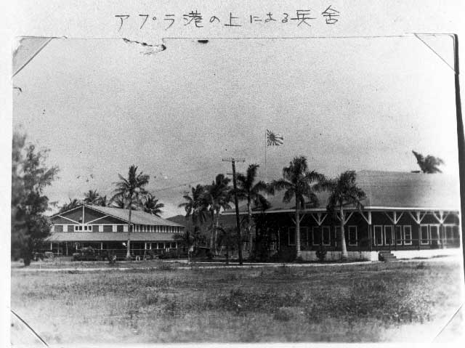
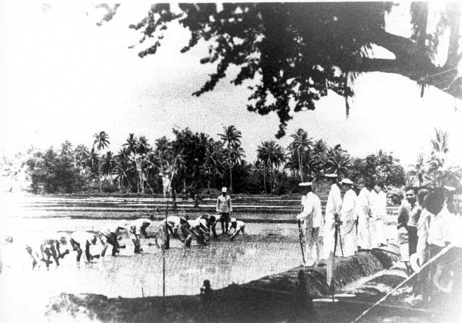
Japanese Occupation of Guam
Notes:
Left Photo: Marine Barracks, Sumay, Guam (WAP-036)

Slide 2
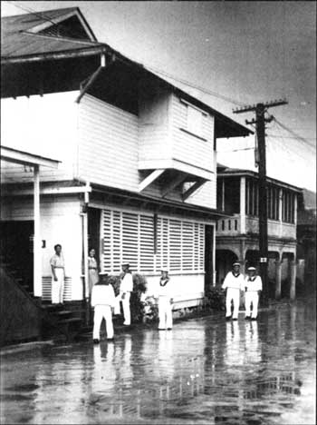
Guam remained in Japanese hands for two and a half years and Chamorros were forced to endure hardships of the military occupation in a war not of their own making.
Early in the occupation era, men of the Japanese naval militia charged with the island's administration stroll in Agana.
Notes:
Photo Description: Early in the occupation era, men of the Japanese naval militia charged with the island's administration stroll in Agana.

Slide 3
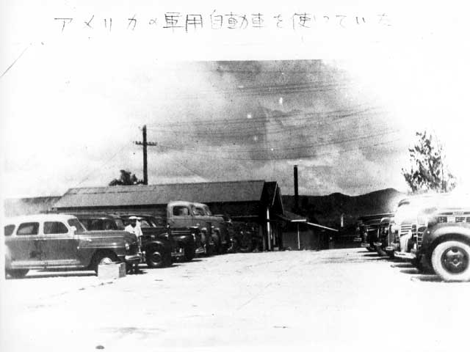
For the first four months the island was controlled by army troops, who were housed in schools and government buildings in Hagatña.
Japanese personnel near row of vehicles
Notes:
Photo: Japanese personnel near row of vehicles (WAP-041)

Slide 4
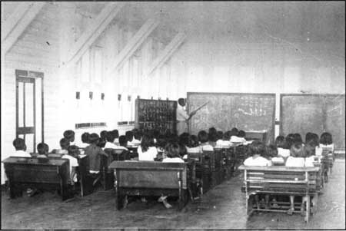
The island was renamed Omiya Jima (Great Shrine Island) and Chamorros were required to learn the Japanese custom of bowing, Japanese yen became the island’s currency, and civilian affairs were handled by a branch of the army called the Minseisho.
Chamorro children learn Katakana, one of the three Japanese alphabets used in writing.
Children's attendance was mandatory, but of 5,000 children attending pre-war schools, only 600 took part in schools opened by the Japanese.
Notes:
Photo Description: Guam children learn Katakana, one of the three Japanese alphabets used in writing. Children's attendance was mandatory at occupation era schools, but of 5,000 children attending pre-war schools, only 600 took part in schools opened by the Japanese.

Slide 5
Cars, radios, and cameras were confiscated and food was rationed until supplies became exhausted.
Japanese personnel in formation along road
Notes:
Photo: Japanese personnel in formation along road (WAP-039)

Slide 6
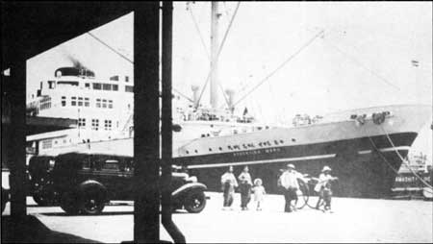
Chamorros suspected of hiding family members wanted by Japanese, or aiding the few Americans that did not surrender, were harassed, beaten, or tortured, and, in some instances, executed by order of the authorities.
On Jan. 10, 1942, on Guam, more than 400 American military and civilian personnel, and others are taken aboard the vessel Argentina Maru. The people are taken to Japan and put in prisoner-of-war camps near the city of Kobe.
Notes:
Photo Description: On Jan. 10, 1942, on Guam, more than 400 American military and civilian personnel, and others are taken aboard the vessel Argentina Maru. The people are taken to Japan and put in prisoner-of-war camps near the city of Kobe.

Slide 7
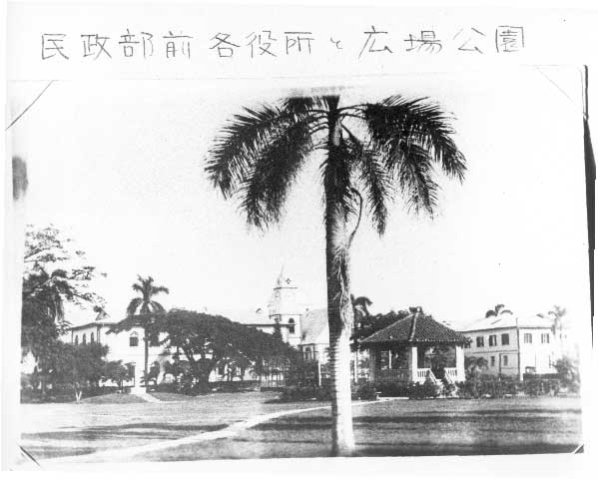
Control of the island came under the Imperial Japanese Navy in March 1942. The Keibitai, as it was known, governed the populace for about 19 months.
Agana, Plaza de España
Notes:
Photo: Agana, Plaza de Espana (WAP-037)

Slide 8
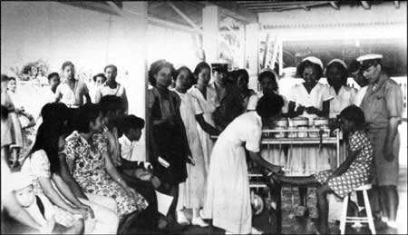
Chamorros were allowed to remain on their farms and trade for products they needed. Social activities including parties, Japanese movies, and sports competitions. Mass meetings were held in Hagatña to reinforce the Nippon Seishen (spirit of Japan).
In the occupation, Japanese authorities, facing a shortage of medical personnel, instituted a program to train students to become nurses. The program faltered because of language differences.
Notes:
Photo Description: In the occupation, Japanese authorities, facing a shortage of medical personnel, instituted a program to train students to become nurses. The program faltered because of language differences.

Slide 9
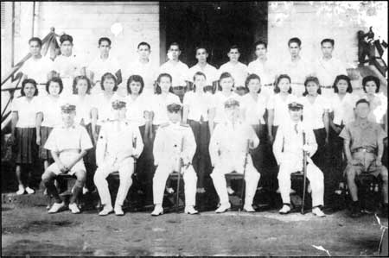
Schools were reopened and Chamorros were required to learn the Japanese language and customs. English was forbidden. Adults and children were taught reading, writing, math, and Japanese games and songs.
Japanese Governor Homura, third from left on bottom row, and other officials pose with students graduating from a teacher-training program. The eight month-long training was held in Agana, with students staying in a dormitory,
Notes:
Photo Description: Japanese Governor Homura, third from left on bottom row, and other officials pose with students graduating from a teacher-training program. The eight month-long training was held in Agana, with students staying in a dormitory, said Francisca Quintanilla Franquez, fourth from left, second row, and Dinang Atoigue Manibusan, to her left. Teachers were strict, but fair and very good, they said. Second row, left to right, are Ana S.N. Ofeciar, Maria Sablan Perez, Maria Garrido Taitano, Franquez, Manibusan, Teresita Perez Salas, Agnes Carbullido Tabor, Lois Charfauros Muna, Lourdes L.G. Toves, Maria Castro Ada, Maria Perez San Nicolas. Top, left to right, Edward Camacho, Antonio Charfauros, Alejo Quinata, Jose Rosario, Tomas Mendiola, Sabino Flores, Juan Tenorio, Jose Mafnas, Vicente Diaz, and Jesus Torres.

Slide 10
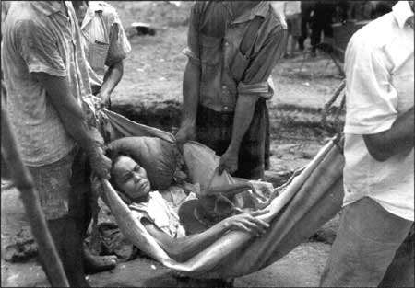
In early 1944, with the war going badly for Japan and an American invasion threatening, the Japanese Army returned to Guam, bringing with it a new stricter form of government: the Kaikontai.
With U.S. forces poised to recapture Guam, Japanese acted to prevent any efforts by Chamorros to aid the coming invasion. On July 10, 1944, people were ordered to march to camps far from probable battle lines. Many people weakened from malnutrition, injury or illness, were only able to reach the camps with the help of others.
Notes:
Photo Description: With U.S. forces poised to recapture Guam, Japanese acted to prevent any efforts by Chamorros to aid the coming invasion. On July 10, 1944, people were ordered to march to camps far from probable battle lines. Many people weakened from malnutrition, injury or illness, were only able to reach the camps with the help of others.

Slide 11
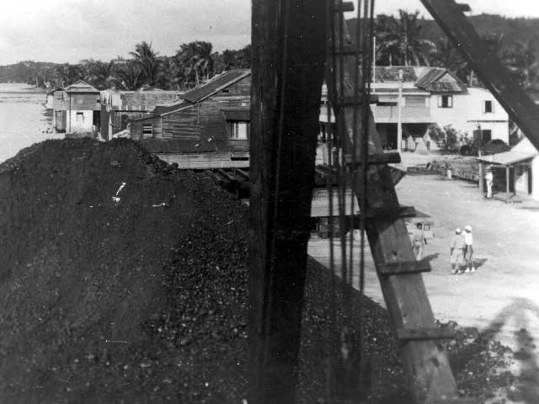
Social activities were terminated, schools were closed, and Chamorro men, women, and children over the age of 12 were forced to work long hours in the fields, repair or build airstrips and defense installations, and dig hundreds of Japanese cave shelters.
Piti Navy Yard
Notes:
Photo Description: A huge mound of coal sits in the Piti Navy Yard, a facility utilized during the occupation by the Japanese naval garrison charged with the administration of Guam. Piti Navy Yard during occupation of Guam (WAP- 042)

Slide 12
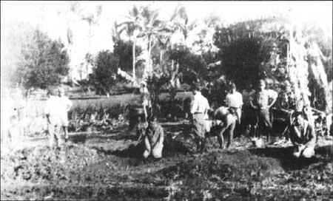
Chamorros, laboring at bayonet point, were mistreated and, in some cases, executed after completing defense installations.
Taken in late June or early July 1944 and captured by the American military, Japanese military officers prepare to execute three Chamorro men.
Notes:
Photo Description: As U.S. forces approached Guam in 1944, the Japanese military began exercising their power over life and death, and their brutality to the Chamorro people turned evil. In this photo, which was taken in late June or early July 1944 and captured by the American military, Japanese military officers prepare to execute three Chamorro men. At left, barely discernible behind the fading in the photograph is Miguel Terlaje. At center is Jesus (Kiadas) Salas, and at right is Juan (Dondo) Perez, his hands clasped together as if he were praying. Jesus Salas and Perez were apparently executed because they had been members of the Insular Force Guard, a naval militia formed just months before the Japanese invaded Guam in December 1941. Miguel Terlaje was apparently executed for disobedience.

Slide 13
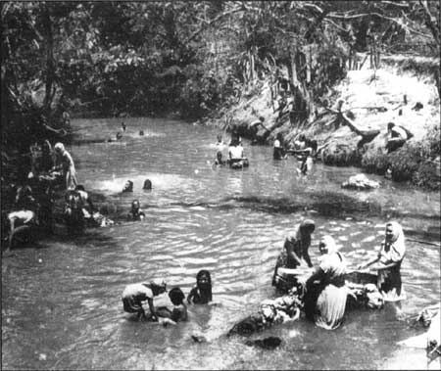
Without warning, 10,000-15,000 Chamorros, young, and old, were forced to march with only the belongings they could carry to concentration camps in Guam’s central and southern jungles. With inadequate shelter, little food, and no sanitary facilities, life in these camps was miserable.
People forced to camp in Manengon used the Ylig River for a water source. In the photo, women are washing clothes as children play in the river's waters. People from throughout Guam camped at Manengon under Japanese order.
Notes:
Photo Description: People forced to camp in Manengon used the Ylig River for a water source. In the photo, women are washing clothes as children play in the river's waters. People from throughout Guam camped at Manengon under Japanese order.

Slide 14
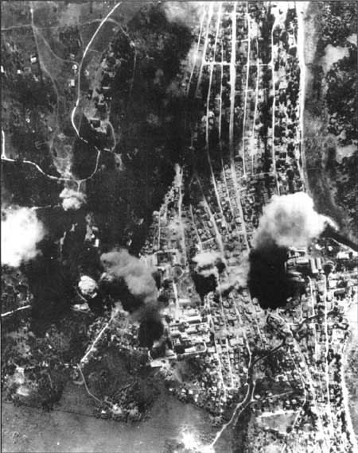
Despite hardships, however, incarceration proved to be a blessing in disguise. Had they not been moved, many Chamorros would have been killed by the American pre-invasion bombardment and Japanese crossfire.
This aerial photo shows Agana in ruins, the result of naval bombardment and strikes from carrier aircraft.

Slide 15
Analyzing Photographs & Prints
1) Observe
2) Reflect
Identify and note details.
Ask yourself the following questions:
What did I notice first?
What people and objects are shown?
How are they arranged?
What is the physical setting?
What, if any, words do I see?
What other details can I see?
Generate and test hypotheses about the image.
Why do you think this image was made?
What’s happening in the image?
When do you think it was made?
Who do you think was the audience for this image?
What tools were used to create this?
What can you learn from examining this image?
What’s missing from this image?
If someone made this today, what would be different? What would be the same?

Slide 16
Now Let’s Analyze!
Write a caption for each of the following images that you see.
OR
Predict what will happen one minute after the scene shown in the following images.

Slide 17
Japanese Marine Barracks in Sumay, Guam
Notes:
Photo: Marine Barracks - Sumay, Guam (WAP-038)

Slide 18
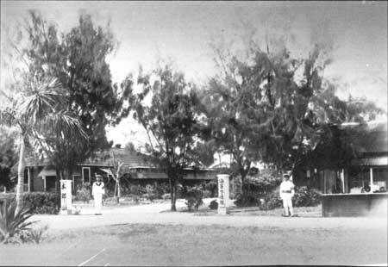
Japanese Personnel near a row of vehicles
Notes:
Photo Description: Japanese sentries stand guard. In occupied Guam, many families were evicted from their homes as military officials desired the residences for their own. Japanese at attention during occupation of Guam (WAP-040)

Slide 19
3) Further Investigation
Analyzing Photographs & Prints
Ask questions to lead to more observations and reflections about these photos.
What do you wonder about…
Who?
What?
When?
Where?
Why?
How?
How would you expand or alter your textbook explanations of history based on these primary sources you just looked at?
Consider how these photos support or challenge information and understanding of World War II. How would you refine or revise the way history could be taught in schools?

Slide 20
Bibliography
War in the Pacific National Historical Park. Occupation. nps.gov. National Park Service, n.d. Web. March 2011.

