Slide 1
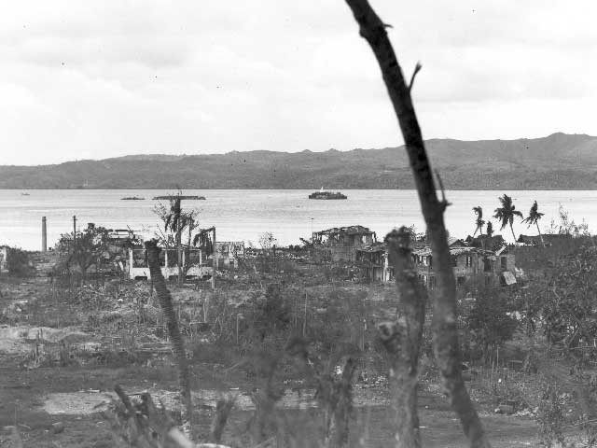
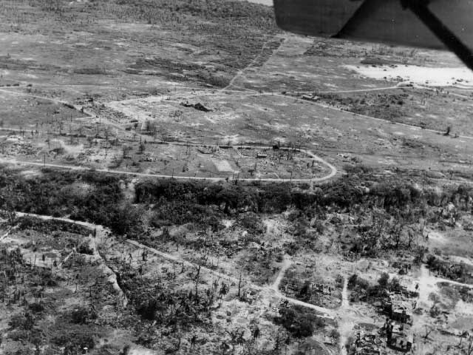
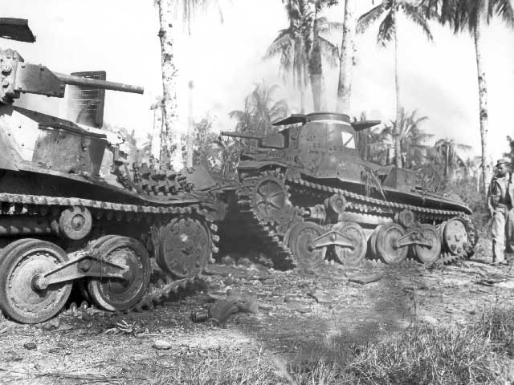
Impact of War: Sumay Village Ruins
Notes:
Left Photo: Aerial view of the ruins of the town of Sumay on the Orote Peninsula. The end of the runway at the Japanese airfield is in the upper right. August 8, 1944. (National Archives 80-G-239718).

Slide 2
Sumay was originally a small prehistoric Chamorro village located on the southern edge of Apra harbor.
Ruins of a Japanese Marine Barracks. July 31, 1944.
Notes:
Photo: This aerial photo shows the ruins of the Japanese Marine Barracks (bottom), and the town of Sumay on Orote Peninsula, Guam, which were recaptured by Marines. In the background is Cabras Island (left), and the Piti Navy Yard (right), between struts of plane's wing. July 31, 1944. (USMC photo # 88,133).

Slide 3
The harbor was a natural deep water port long before the building of the Glass Breakwater, and as such attracted ships from Asia, England, France, Germany, Holland, Russia, Spain, and the United States for many hundreds of years.
During the 17th, 18th, and 19th centuries Spanish ships regularly came to Sumay. In the 1820’s, whalers pulled into Sumay to replenish their supplies, and to take a break from the sea for a few days. The port of Sumay is found on the earliest maps of the island of Guam.
Aerial view of Sumay on Orote peninsula and Cabras Island in the background. August 7, 1944
Notes:
Photo: Aerial view of town of Sumay on the Orote peninsula. Left-in the background is Cabras Island and right, is Piti Navy Yard. August 7, 1944. (National Archives 80-G-239720).

Slide 4
In 1904, the Transpacific Telephone Cable was laid from Hawaii to Guam, and on to Manila, Hong Kong, Shanghai, and Yap island. The Cable station, which brought the first telephone service to Guam, was located in Sumay.
Then in 1921, the U.S. Marine Aviation Squadron and Marine Barracks were established in Sumay.
Pan American Airways located their Air Operations Building in Sumay in 1935, and it was there that the China Clipper landed on the way from California to Manila, and points east.
Orote Peninsula. August 8, 1944.
Notes:
Photo: Aerial view of Orote Peninsula and the pre-war airfield that was enlarged and used by the Japanese. August 8, 1944. (National Archives 80-G-242192).

Slide 5
Two thousand people lived in Sumay in 1941.
Ruins of Sumay. Apra Harbor. August 1, 1944.
Due to the strategic location of the village of Sumay, that was the first site of Japanese bombing on the island of Guam, December 8th, 1941.
Notes:
Photo: Ruins of the town of Sumay on the Orote Peninsula. Looking north across Apra Harbor. August 1, 1944. (National Archives 80-G- 248031).

Slide 6
Analyzing Photographs & Prints
1) Observe
2) Reflect
Identify and note details.
Ask yourself the following questions:
What did I notice first?
What people and objects are shown?
How are they arranged?
What is the physical setting?
What, if any, words do I see?
What other details can I see?
Generate and test hypotheses about the image.
Why do you think this image was made?
What’s happening in the image?
When do you think it was made?
Who do you think was the audience for this image?
What tools were used to create this?
What can you learn from examining this image?
What’s missing from this image?
If someone made this today, what would be different? What would be the same?

Slide 7
Now Let’s Analyze!
Write a caption for each of the following images that you see.
OR
Predict what will happen one minute after the scene shown in the following images.

Slide 8
Japanese Tanks found on the road to Sumay. July 1944.
Notes:
Photo: Japanese tanks 300 yards from Orote Peninsula on the road to Sumay and the old Marine Barracks. July 1944. (USMC photo #93,459).

Slide 9
Wreckage of Sumay. August 7, 1944.
Notes:
Photo: Marines found this wreckage in the town of Sumay, showing signs of the fierce fighting which took place in the battle for the island of Guam. The Marine Corps former barracks in nearby. Cabras island is in the background. August 7, 1944. (USMC photo# 88,198).

Slide 10
Sumay is converted by the U.S. military to an unloading depot for marine aviation supplies. August 1944.
Notes:
Photo: The rubbled village of Sumay is converted into an unloading depot for marine aviation supplies shortly after the recapture of the island. Japanese snipers hid in the cave pocked cliff in the background, Orote Peninsula. August 1944. (National Archives 127-N- 95243).

Slide 11
3) Further Investigation
Analyzing Photographs & Prints
Ask questions to lead to more observations and reflections about these photos.
What do you wonder about…
Who?
What?
When?
Where?
Why?
How?
How would you expand or alter your textbook explanations of history based on these primary sources you just looked at?
Consider how these photos support or challenge information and understanding of World War II. How would you refine or revise the way history could be taught in schools?

Slide 12
Bibliography
War in the Pacific National Historical Park. Sumay Village. nps.gov. National Park Service, n.d. Web. March 2011.
Notes:
Photo:

