Slide 1

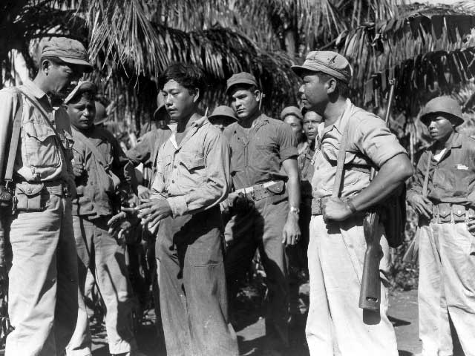
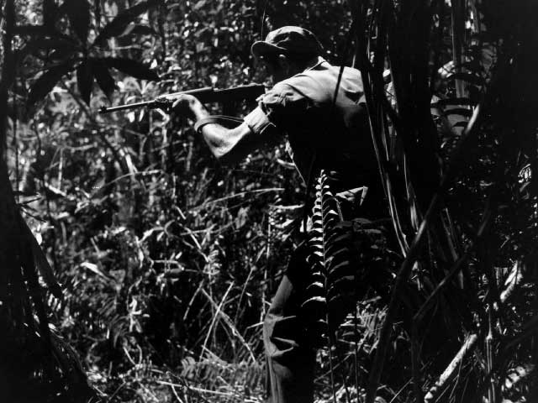
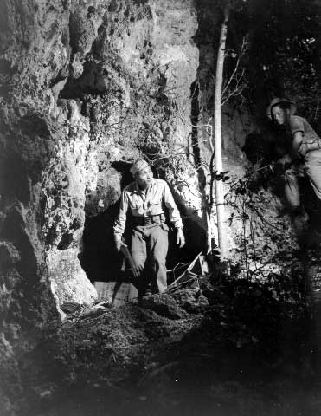

Chamorro Guam Combat Patrol
Notes:
Right Photo: Spotting a Japanese straggler, Cpl. Felix Wusstig fires a shot. (National Archives 80- G - 329470).

Slide 2
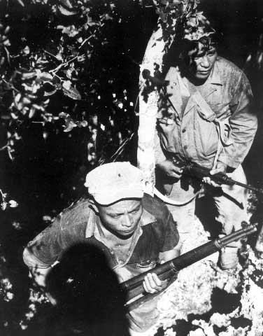
In July 1944, U.S. armed forces stormed ashore to recapture Guam from the Japanese.
Here Chamorro Military Patrol members Joaquin Aguon and Pedro San Nicholas are protecting the rear flank
Dense vegetation made reconnaissance planes ineffective.
Notes:
Photo: Coming into the clear after making their way through nearly impossible brush, patrol members Joaquin Aguon, (left) and Pedro San Nicholas, (right) protect the rear flank. (National Archives 80-G-329465). (Nat Arch 80-G-329465)

Slide 3
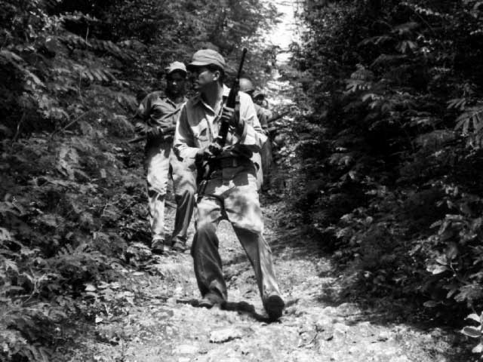
The only practical way to ferret out Japanese locations was to scour the area on foot and rely on intelligence from local Chamorro scouts.
Led by Sgt. Juan Aguon, patrol scouts are in a single file line using tracking methods to find Japanese stragglers. July 1945.
Notes:
Photo: The patrol scouts in a single file, picking up traces of Japanese through tracking methods. Leading this group is Sgt. Juan Aguon in foreground. July 1945. (National Archives 80-G-329464).

Slide 4
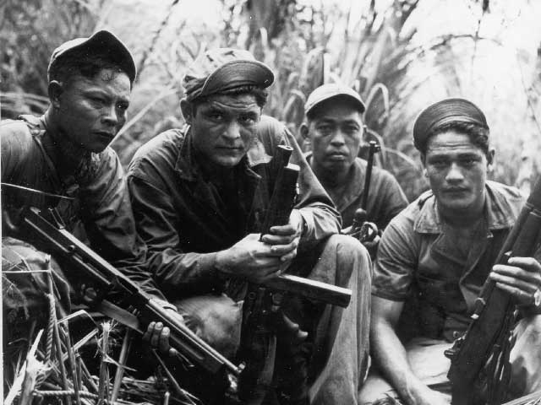
The island was declared secure on August 10, 1944, but thousands of Japanese remained in the jungles at that time. For these men, and the men whose job it was to hunt them down, the war was far from over.
The Chamorro Combat Patrol on the island of Guam. August 14, 1945
Notes:
Photo: The Chamorro Combat Patrol on the island of Guam - August 14, 1945. (National Archives 80-G-490304).

Slide 5
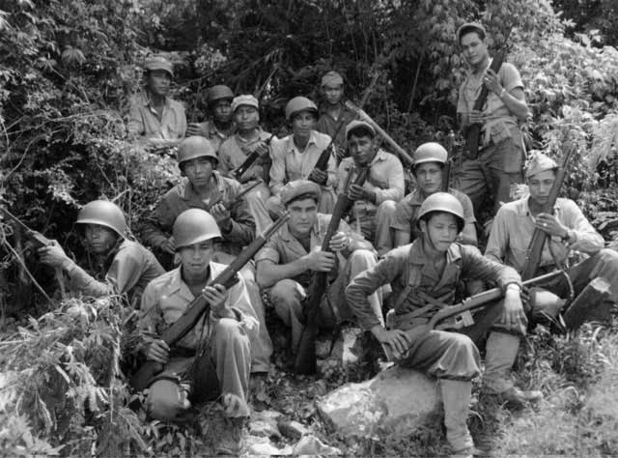
According to Major O.R. Lodge, USMC, “The native guides who accompanied many of the Marine and Army patrols during the campaign proper and the mop up period performed invaluable service in ferreting out Japanese troops and equipment.”
A photo of the Guam Combat Patrol
Notes:
Photo: Ramon N. Ignacio, Francisco J. Cruz, George G. Flores, Pedro A. Perez, Pedro R. San Nicolas, Felix C. Wusstig, Fred Taitano, Jose S. Bukikosa, Ignacio R. Rivera, Jose P. Sales, Juan U. Aguon, Antonio Manibusan, Agapito S. Perez, Vicente L. Borja (not shown are original members Joaquin S. Aguon and Jose Tenorio)

Slide 6
Analyzing Photographs & Prints
1) Observe
2) Reflect
Identify and note details.
Ask yourself the following questions:
  What did I notice first?
  What people and objects are shown?
  How are they arranged?
  What is the physical setting?
  What, if any, words do I see?
  What other details can I see?
Generate and test hypotheses about the image.
  Why do you think this image was made?
  What’s happening in the image?
  When do you think it was made?
  Who do you think was the audience for this image?
  What tools were used to create this?
  What can you learn from examining this image?
  What’s missing from this image?
  If someone made this today, what would be different? What would be the same?

Slide 7
Now Let’s Analyze!
Write a caption for each of the following images that you see.
OR
Predict what will happen one minute after the scene shown in the following images.

Slide 8
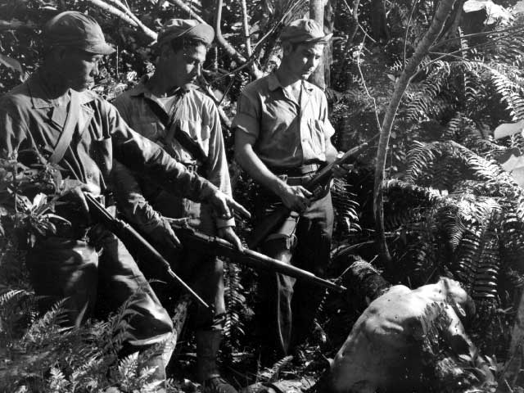
Chamorro Combat Patrol. July 1945.
Notes:
Photo: Chamorro Combat Patrol. July 1945. (National Archives 80-G-329460).

Slide 9
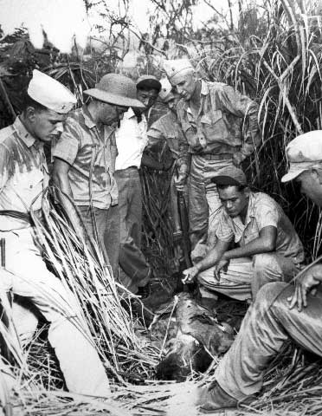
Chamorro Combat Patrol & U.S. military personnel crouching over two Japanese bodies. August 14, 1945.
Notes:
Photo: Chamorro Police Patrol crouches over the bodies of two Japanese. Left to Right Joachim (sic)Aguon, Pfc. Felix Wusstig, a civilian who guided the patrol and Cpt. George Flores. August 14, 1945. (National Archives 80-G-490304).

Slide 10
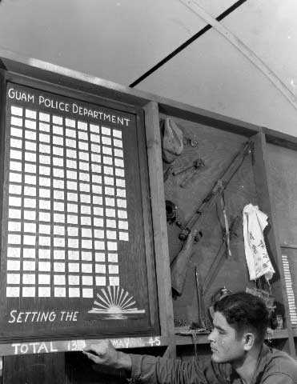
Located in the office of the Chief of Police, Corporeal Felix Wusstig is recording another dead Japanese soldier. July 1945.
Notes:
Photo: Cpl. Felix Wusstig of the Chamorro Military Government Patrol prepares to record another dead Japanese soldier onto the scoreboard in the Office of the Chief of Police, Guam, Marianas. Besides the scoreboard in the office are Japanese weapons, flags, hats, and a canteen. July 1945. (National Archives 80-G-329466).

Slide 11
A Chamorro farmer explains to the Chamorro Military Patrol that items from his farm are missing from the night before. He suspects Japanese stragglers have been stealing from him. July 1945.
Notes:
Photo: The day's hunting starts as members of the Chamorro Military Patrol hear a native explain that during a previous night chickens, eggs, and produce had been taken by Japanese from his farm on the edge of the jungle. L-R Sgt. Juan Aguon, patrol leader, Pedro San Nicholas, Jesus Yoshida, the farmer, Felix Wusstig, Ignacio Riverin, and Antonio Manibusan, members of the patrol. July 1945.(National Archives 80-G- 329467).

Slide 12
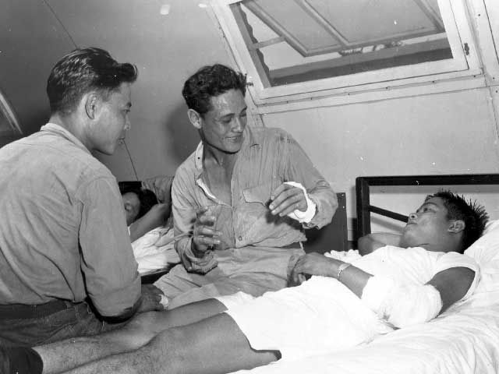
Boza Vicente lies in bed wounded from an attack by seven Japanese with grenades on a patrol in the hills of Guam.
Notes:
Photo: L-R, Joaquin Aguon, George Flores, and Boza Vincente, discuss an attack by seven Japanese with grenades on a patrol in the hills of Guam. In the skirmish Aguon, Flores, and Vincente were wounded. They have been recommended for the Purple Heart Award (National Archives 80-G- 329471).

Slide 13
Francisco Cruz comes out cautiously out of a cave after an inspection while a fellow patrol member, Jose Tenorio, protects him from attacks. July 1945.
Notes:
Photo: Francisco Cruz comes cautiously out of the cave after an inspection while Jose Tenorio protects the patrol from attacks above. July 1945. (National Archives 80-G- 329483).

Slide 14
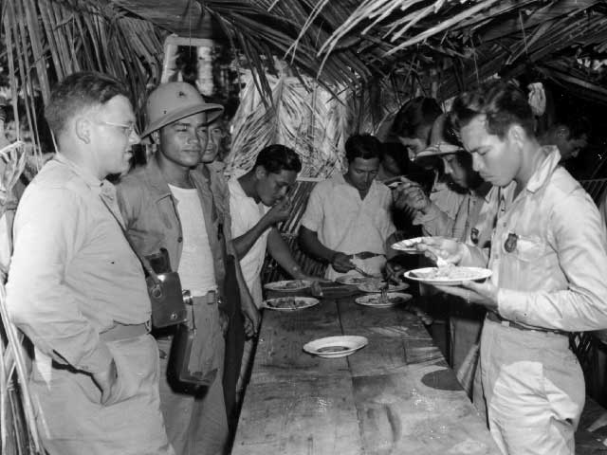
Eating at a local ranch for a meal. On the left is a Navy photographer, Arthur Rickerbe. July 1945.
Notes:
Photo: The Chamorros stop for a meal at a local ranch. Eating, L-R are Navy photographer Lt. (jg) Arthur B. Rickerbe, New York, who accompanied the patrol, Pedro Rosario, George Flores, Sus Camacho, Felix Wusstig, and Revera Juan. July 1945. (National Archives 80-G- 329484).

Slide 15
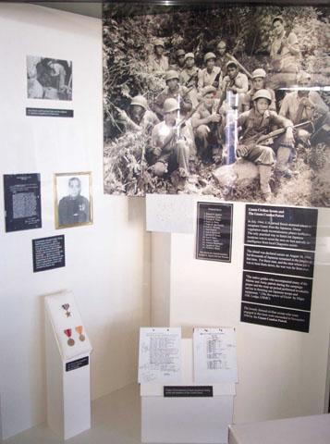
The loosely formed civilian scouts who were engaged in this hunt were succeeded in November 1944 by the Guam Combat Patrol.
An exhibit honoring the Guam Combat Patrol.
Notes:
Photo: An exhibit honoring the Guam Combat Patrols in the old War In The Pacific museum.

Slide 16
3) Further Investigation
Analyzing Photographs & Prints
Ask questions to lead to more observations and reflections about these photos.
What do you wonder about…
  Who?
  What?
  When?
  Where?
  Why?
  How?
How would you expand or alter your textbook explanations of history based on these primary sources you just looked at?
Consider how these photos support or challenge information and understanding of World War II. How would you refine or revise the way history could be taught in schools?

Slide 17
Bibliography
War in the Pacific National Historical Park. Combat Patrol. nps.gov. National Park Service, n.d. Web. 2 March 2011.
Notes:
Photo:

