Slide 1

The Battle on the Washita
Washita Battlefield Traveling trunk Lesson

Slide 2
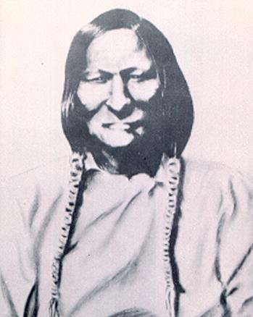
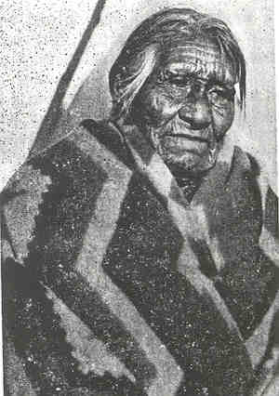
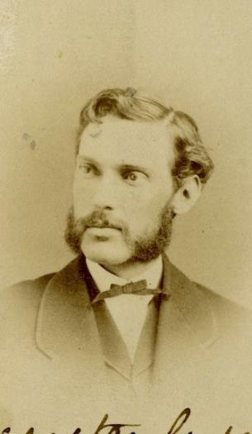
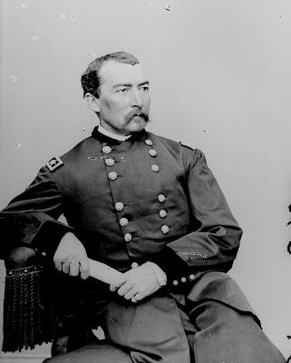
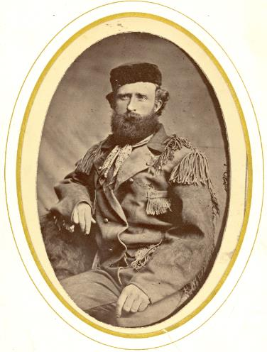
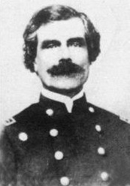
Who was involved?
Lt. Col. George Custer
Chief Black Kettle
Moving Behind (was a child at the battle)
Gen. Phillip Sheridan
Maj. Joel Elliott
Capt. William Thompson

Slide 3
The year is 1868. The United States and Plains Indians have been at odds over settlers moving into land the tribes have been living on for centuries. The settlers believe in manifest destiny and continue to move west to create homesteads and settlements. The Plains Tribes start to raid white businesses, farms, and ranches along settler’s trails. They destroy and steal property, capture women and children, and kill men.
After several failed attempts to attack the tribes during the summer in retaliation, General Sheridan decides to have a winter campaign to attack the Plains Tribes when they are most vulnerable. Many tribes settle in the Washita River Valley where there are resources available to survive the winter. Gen. Sheridan sends out the 7th Cavalry to find them.

Slide 4
A Cavalry Story
You and the 7th Cavalry have made it well into Indian Territory. On the 16th of November you rode and walked 25 miles and reached Beaver River (the North Canadian). You and the other men are exhausted, but your spirits lift two days later, when your column of soldiers passes over a fresh trail of a war party headed north, probably Cheyenne, on their way to attack other Indian villages.
Lt. Col. Custer and Lt. Col. Sully argue about whether you should follow the trail back to their village where the warriors came from and attack or keeping heading south. Lt. Col. Sully believes that the camp would be on alert and the troops would be ambushed. Since Sully is in charge, you and the men continuing riding past the Indian trail and Custer tells you that he thinks it was a “fine opportunity neglected.”

Slide 5
Later that same afternoon, the troops stop and begin work on building Camp Supply, your temporary home while in the field. The weather is turning bad quickly and the days are cold and snowy. On the night of November 22, you get word that reveille will be at 3 a.m. the next morning and that you will leave out of Camp Supply at 6 a.m. to find and strike the Indians, with enough supplies in the wagons to last a month.
The next day, after a very early morning, you and the other men spend hours trying to get the supply wagons across the fast running Canadian River, covered with ice chunks and slush. As Custer readies the troops to march south, a courier comes riding up with news from scouts who went ahead. Two large Indian trails, one used by as many as 150 warriors, has been discovered moving southeast and there is an abandoned Indian camp nearby. Thinking about what happened with Lt. Col. Sully, Custer turns to you for advice. Should he:

Slide 6
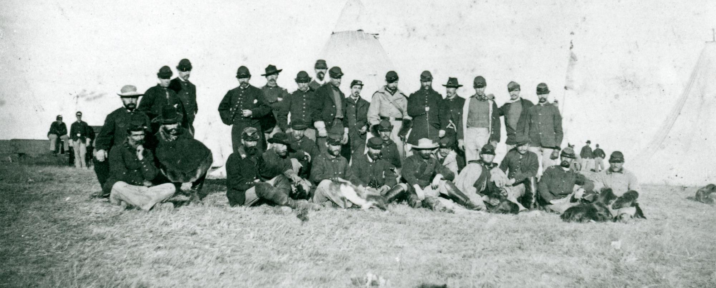
A. Stay put and wait for the 19th Kansas Volunteer Cavalry to arrive. They were supposed to have arrived at Camp Supply before you left but got lost in Indian Territory. Maybe they’ll be able to catch up before you follow the trail to fight the warriors.
B. Send a message back to the scouts to stay on the trail and notify him if the trail changes. If the main command with Custer doesn’t arrive by 8:00 p.m. the scouts are to halt and wait for them.

Slide 7
The true story
A. The 19th Kansas Volunteer Cavalry become so disoriented in the bad weather and with a scout who leads them too far west they arrive at Camp Supply on December 1st. A full week after you’ve found the trail and Camp Supply is another 60 miles north. You and the other men will have either frozen to death or been attacked by Cheyenne while waiting.
B. Good advice! This decision keeps the men’s spirit up as they continue to move towards their objective of finding and destroying an Indian village. Not to mention, marching keeps them warm. The scouts have picked up a good trail. This is the actual decision Custer made that day and the trails do lead to Black Kettle’s village.

Slide 8
A Cheyenne Story
November 20th 1868. Chief Black Kettle and other chiefs ride 80 miles south of their camps along the Washita into Fort Cobb. When they arrive, they see two other tribes receiving food from the military fort and will be camping there for protection.
Chief Black Kettle wants to speak with Colonel William Hazen, General Sherman’s man to oversee Indian affairs. Black Kettle tells Hazen, “But we all want peace, and I would be glad to move my people down this way; I could them keep them all quietly near camp. My camp is now the Washita 40 miles east of Antelope Hills, and I have there about 180 lodges. I speak only for my own people. I cannot speak for nor control the Cheyennes north of the Arkansas [River].”
However, Hazen tells them he could not make peace with them and they cannot come to Fort Cobb because it might be dangerous for the tribes already there. Black Kettle finds out that north of the Arkansas River is General Sheridan, the Great War Chief, and controls the soldiers who are fighting the Cheyennes and Arapahoes. He is told that if the Great Father approves them as friendly Indians, then Hazen will call for them to come to Fort Cobb. Until then, they must return to their camps.
The leaders leave Fort Cobb just a blizzard is beginning. They return to the village late on November 26th. You sit down to eat a supper of buffalo meat, crackers and coffee in the chief’s lodge. As the leaders discuss what should be done, Chief Black Kettle turns to you to ask for advice. What do you tell him?

Slide 9
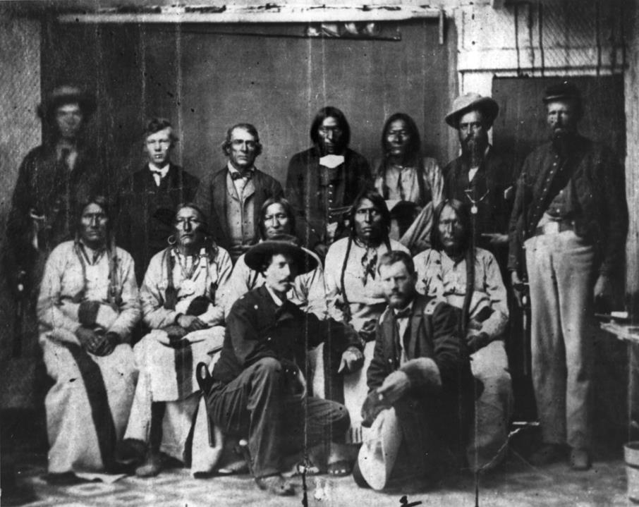
A. Once the snow clears up, send a delegation to look for the soldiers and try to explain who they are, that they met with Hazen and that they believe that you are allowed to be south of the Arkansas River.
B. Move Black Kettle’s camp to a more secure location closer to the downstream villages.

Slide 10
The true story
The weather is too bad and Chief Black Kettle and the other leaders are too tired to leave tonight. You tell him to rest and that as soon as the weather clears your people will once again try to make peace with the white man, this time when they are already looking to attack. This is the actual decision that Black Kettle made that night.
You and the rest of the camp begin to pack up your belongings. The tipis will stay for now and some people will return when the weather is better to get the rest of the items. As you and your family begin to move east the snow worsens. It will not be possible to move to the other camps tonight. You must stay in place and hope that the soldiers do not reach the village before dawn. Your people are now tired and cold, leaving them even more vulnerable to an attack.

Slide 11
A Cavalry Story
Finally, you mount your horse in the darkness and continue on the trail of the war party. Before you can begin moving, you must tie down all your equipment, so it does not make noise. Your buddies try to talk to you, but you remind them you can only whisper. The Osage Scouts smell smoke and see a dying wood fire. This is the fire of herders watching ponies! We are close to a village!
A ripple of excitement and fear runs through the troops and you too. Lt. Col. Custer’s plan is to use the hours between now and daylight to surround the village. As soon as it is barely light enough to see, you will attack the village from all sides. You are one of 800 men being divided into four attachments. Whose command will you go with?

Slide 12
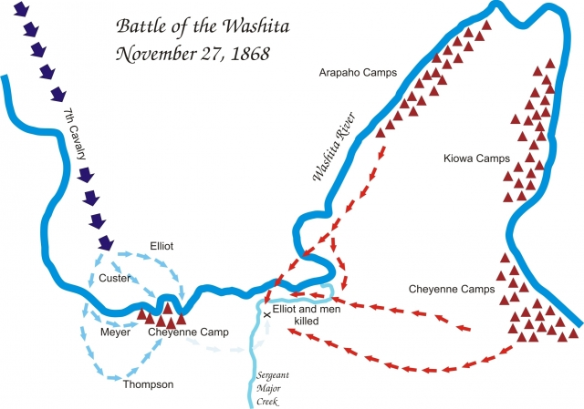
Go with Captain Thompson. His command will move west and south of the village. You will have to cross the icy Washita, but you will be well hidden behind the hills. Your position will be exactly opposite of Custer. You will wait for the bugle to sound “Charge!” to attack.
Go with Major Elliot. His command will move east of the main force, keeping behind the rocky hills in front you as protection and cover. You will settle into a tree line near a stream for the night before you attack. Elliot was part of the scouting party that found the trail into the village so he must know where he is going, right?
Go with Lt. Col. Custer. Custer was a brave leader and always led a column of men into battle. With Custer would be two officers, sharpshooters and the Osage scouts. You will have to cross the icy Washita River as you make your way into the Cheyenne village directly from the north.

Slide 13
The true story
A. Indian Territory is a land that has not been travelled by anyone in Custer’s troops except for the scouts. Capt. Thompson becomes lost in the hills south of the village and arrives late for the battle. His late arrival leaves a wide gap where many of the Cheyenne are able to escape.
B. Major Elliot tells you to start moving east at about 2 a.m., following hills and ridges well away from the village to avoid detection. You are told not to smoke, to only talk in whispers and to carry your tin cup in your haversack to keep it from clanking against your saddle. At one point you see Major Elliot climb a bluff and decide that you are moving too close to the camp and that the noise of the horses stepping in the crusted snow could alarm the village.
C. You stay put with Custer. You spend the next four hours while waiting until dawn, so cold you can’t feel any part of your body. Fires are not allowed and when you start to stamp your feet and pace, the sergeant stops you. The noise of the crunching snow may reach the silent camp below. You spend the rest of the time standing with your horse and holding the reins, chewing on hardtack and listening the dogs barking in the valley below. You are wet, cold and mad!

Slide 14
A Cheyenne Story
The air is full of smoke from gunfire and it is almost impossible to run anywhere because bullets are flying all around you. Many of your people run towards the ice-covered stream where the water runs red from the blood, from those whose legs are cut from the ice and from those who have been killed. You and your aunt Cornstalk Woman have found a good hiding place in some tall grass on a hillside southwest of the village. You lay still and quiet in the grass, but your heart is beating fast and you can hardly catch your breath from running. The sun is out now, and the day is bright. You can hear the sounds of your people struggling in the village. Since you are south of the main village, soldiers are passing through this area more slowly, looking for any women or children who have escaped. You shift in the grass to catch a glimpse of the soldiers and you make eye contact with one of them! He rides towards you both. What do you do?

Slide 15
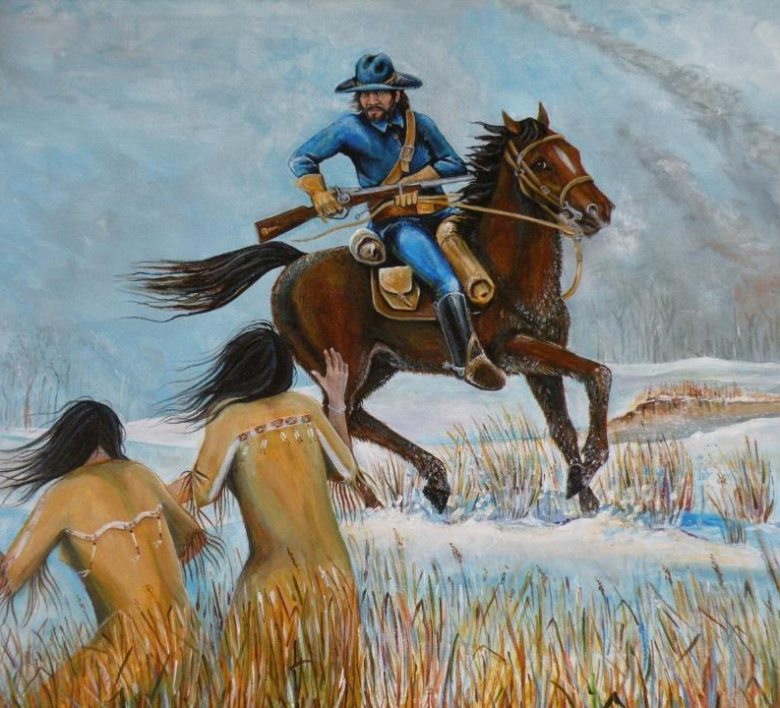
Jump up from your hiding spot and try to outrun the soldier on horseback.
Don’t move. If you remain still and quiet, he might believe he made a mistake.

Slide 16
The true story
If you leave your hiding spot you will surely be discovered by the soldier. No matter what direction you run there will be soldiers on horseback. You cannot outrun the horses. You jump up and begin to run and are immediately captured. You are not killed but now you and your aunt are captives and must make the long and cold march back to Camp Supply.
This actually happened on November 27, 1868 to a young woman named Moving Behind and her aunt Cornstalk Woman. The women stayed still and quiet in the grass and the soldier, for reasons we will never know, decided to show them mercy and rode away. Moving Behind and Cornstalk Woman survived the Battle on the Washita and were not captured. They eventually joined family in the other camps down river.

Slide 17
A Cavalry Story
Suddenly, the trouble Captain Thompson’s command becoming lost in the red hills south of the camp becomes obvious to you. There is a gap between where Major Elliot’s command rode in and where Capt. Thompson should have been! Cheyenne are running quickly through the gap and escaping downstream. You remember the pony trail north of the river heading in the same direction that all the fleeing women and children are running now. What could they possibly be running towards? Major Elliot and Sergeant Major Kennedy ride on top of hill and look through their field glasses. They see men and boys hiding in the woods below you. Maj. Elliot calls for volunteers to join him in the fight. He yells, “Here goes for a brevet or a coffin!” Do you volunteer to join him?

Slide 18
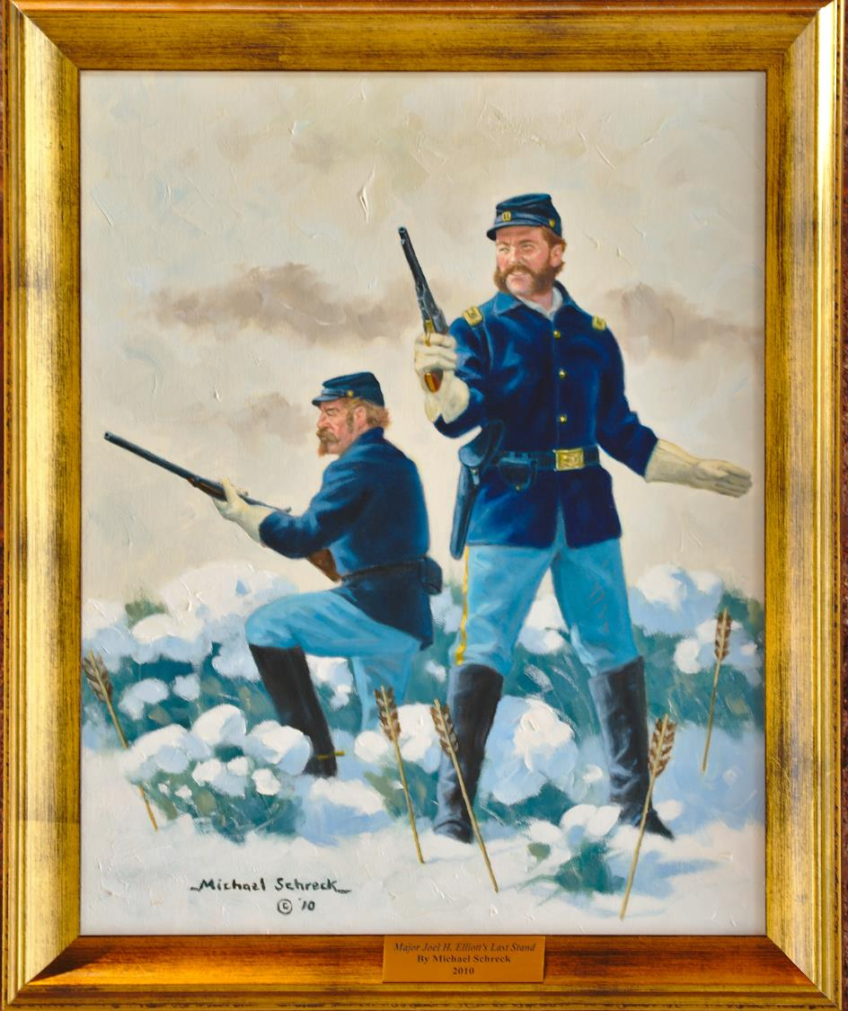
No. You are so cold and so tired from fighting even though it is only 9:00 in the morning. You decide to go back towards the main village.
Yes! This is your chance to show your bravery, impress your superiors and earn a high rank. You step up and tell Major Elliot that you will go and chase these Indians downstream, no matter the cost.

Slide 19
The true story
A. The fighting is beginning to wind down as you head towards to village and you are put in charge of burning the village to the ground. However, you have survived the Battle on the Washita.
B. You follow Elliot and his 16 other volunteers. About two miles away from the main camp you encounter 20 warriors! Where did they come from? Maybe there is a bigger camp downstream? You dismount your horse as you are told but you can tell it is too late. The Cheyenne and Arapaho surround you and you are killed.

Slide 20
A Cheyenne Story
The battle is over, you see a wagon arrive and it is full of bullets to supply the soldiers’ guns. How many more of your people are they going to kill? Suddenly, you realize they are gathering up the ponies and mules near a high bluff south of the village. The animals are difficult to corral and recoil at the soldiers’ presence. The horses are like a member of your family and you cannot bear to think what the soldiers might do next. They are asking you to help to round up the ponies. What do you do?

Slide 21
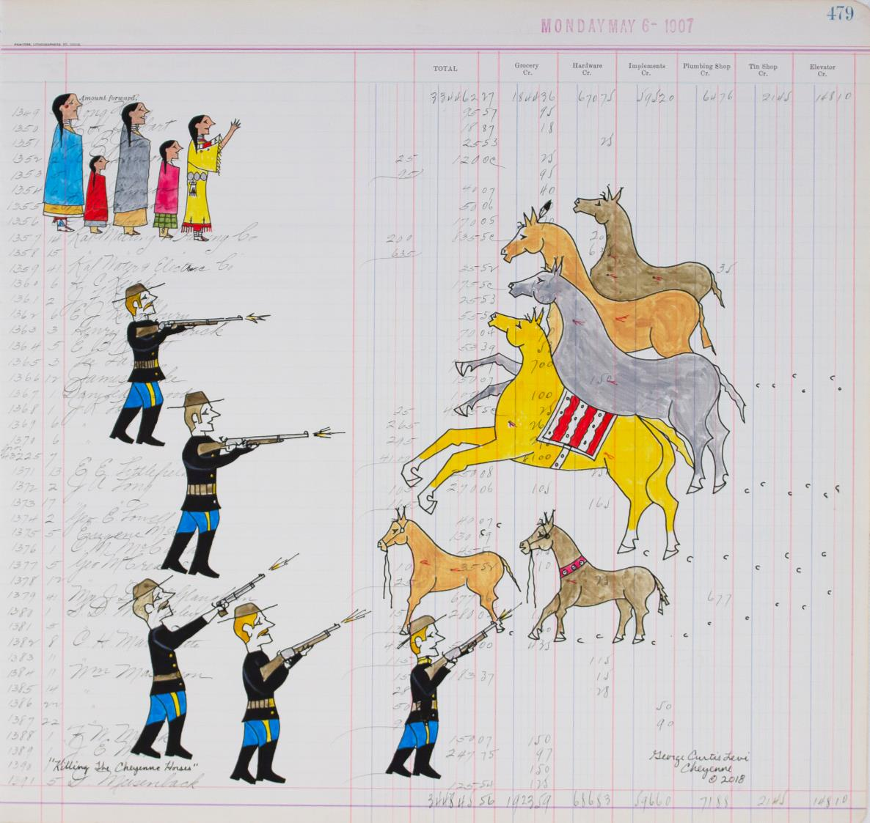
You no longer have your weapons, you are tired, cold and scared. Even though it is very painful to watch the ponies get killed, you are afraid you will be shot and killed on the spot if you do not help.
Refuse to help round up the ponies despite the consequences.

Slide 22
The true story
Though it is very difficult, you work with your aunt to help round up the ponies and lead them to their death. This decision keeps you safe for now, but the sounds of horses crying, like the sound of humans, and running away injured, leaving a trail of blood in the snow, will stay with you forever.
Custer and his men are under strict orders to not kill the women and children. Even though you are being disrespectful and difficult, the soldiers will not shoot you if you do not help with the rounding up of the ponies and mules. They send you back to camp to wait until it is time to take all the captives away.

Slide 23
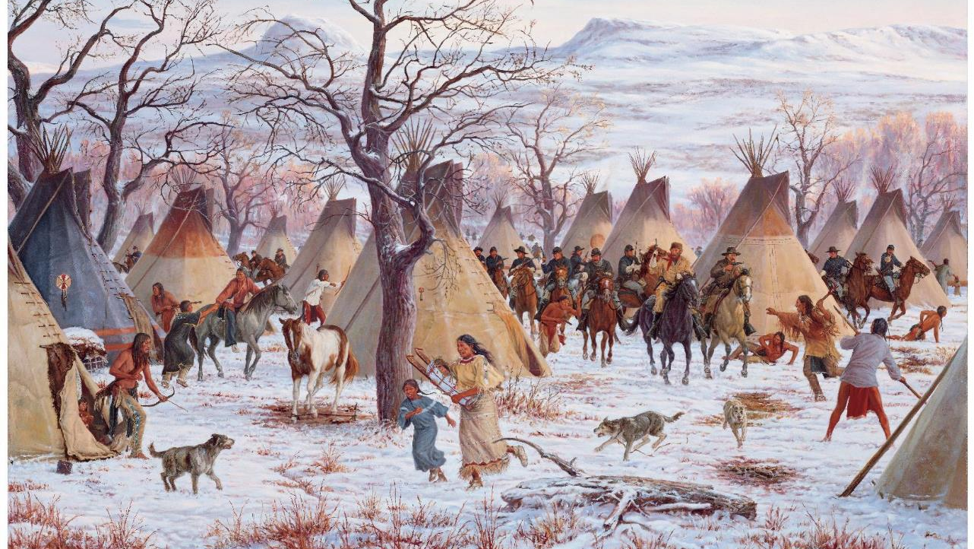

Slide 24
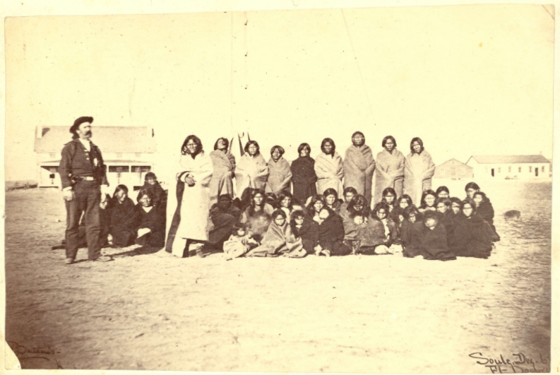
What happened afterwards?
Black Kettle’s village:
The 7th Cavalry destroyed the village, burning or destroying all the supplies that could be used.
Cheyenne total of people killed: 60
53 women and children were taken captive. They were taken to Camp Supply, then to Fort Hays, where they stayed until July of 1969.
When they were released, they returned to their families.
It is estimated that between 192 – 262 people survived the fight.
In 1874, after being defeated in other battles, the Cheyenne moved onto reservations.

Slide 25

What happened afterwards?
US 7th Cavalry:
Custer never took an official tally of casualties in the village. He asked the other officers to determine how many were killed at the battle. He totaled: 103 killed. He later changed it to 140.
Cavalry soldiers killed at the battle: 22
The 7th Cavalry returned to the battlefield a few weeks later with Gen. Sheridan to find the bodies of Maj. Elliott and his volunteers.
In 1876, Custer attacked a village in Montana of Sioux and Cheyenne. This would later be known as the Battle of Little Bighorn. Custer and most of his 7th Cavalry did not survive.

