Slide 1

Indian Treaties
Washita Battlefield Traveling trunk Lesson

Slide 2
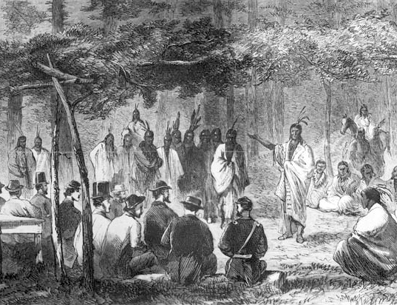
What is a treaty?
A treaty is a written agreement between two or more parties that consists international law. The parties may be countries or other important groups. They can be written about any subject.

Slide 3
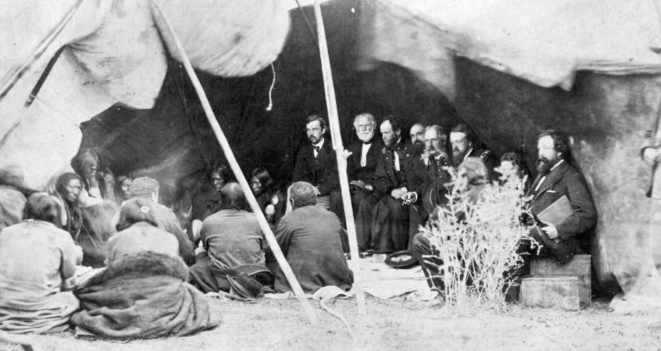
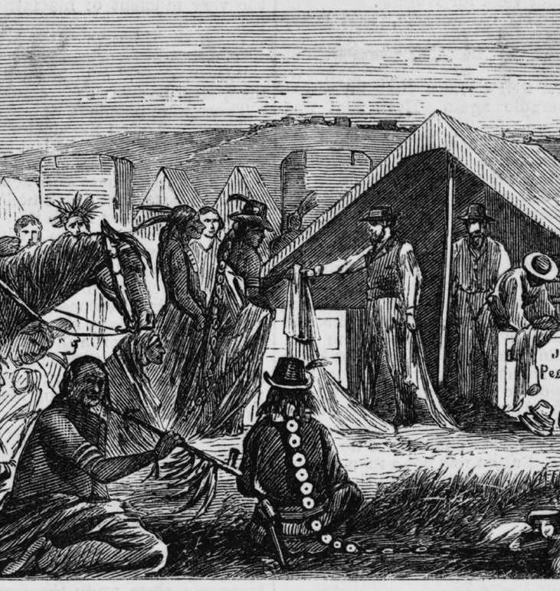
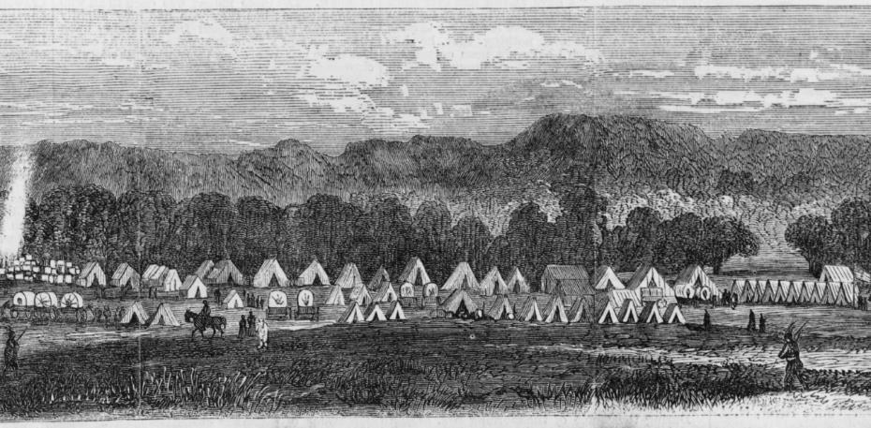

Slide 4
370
The US government signed _____________________ treaties with numerous Indigenous nations from 1778 to 1871.

Slide 5
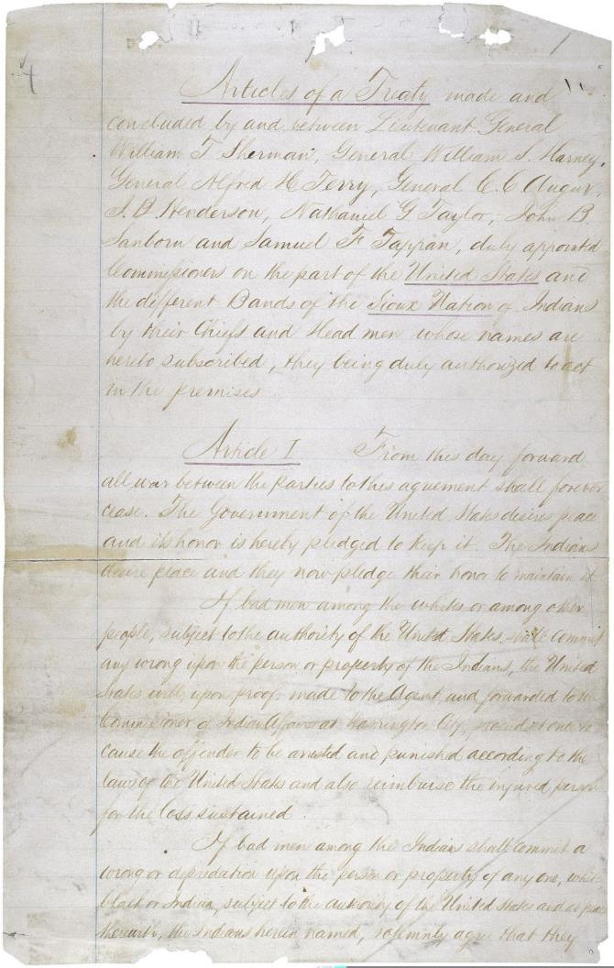
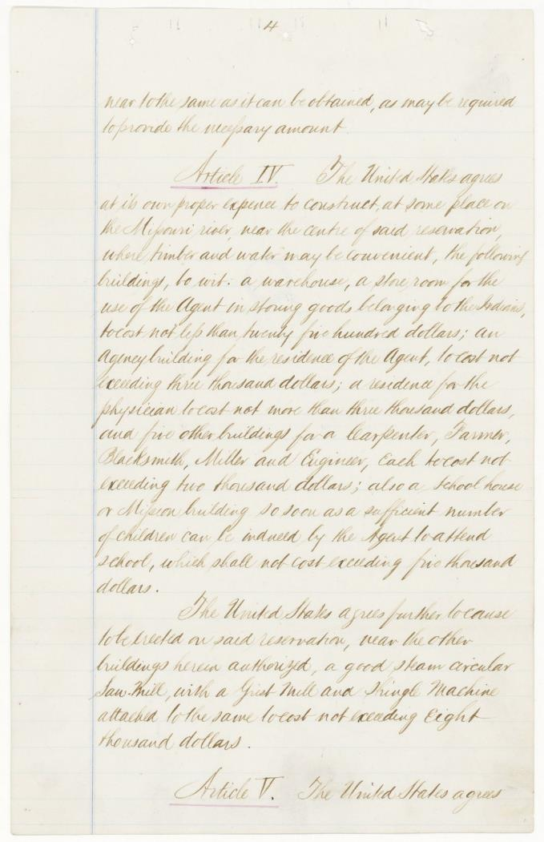
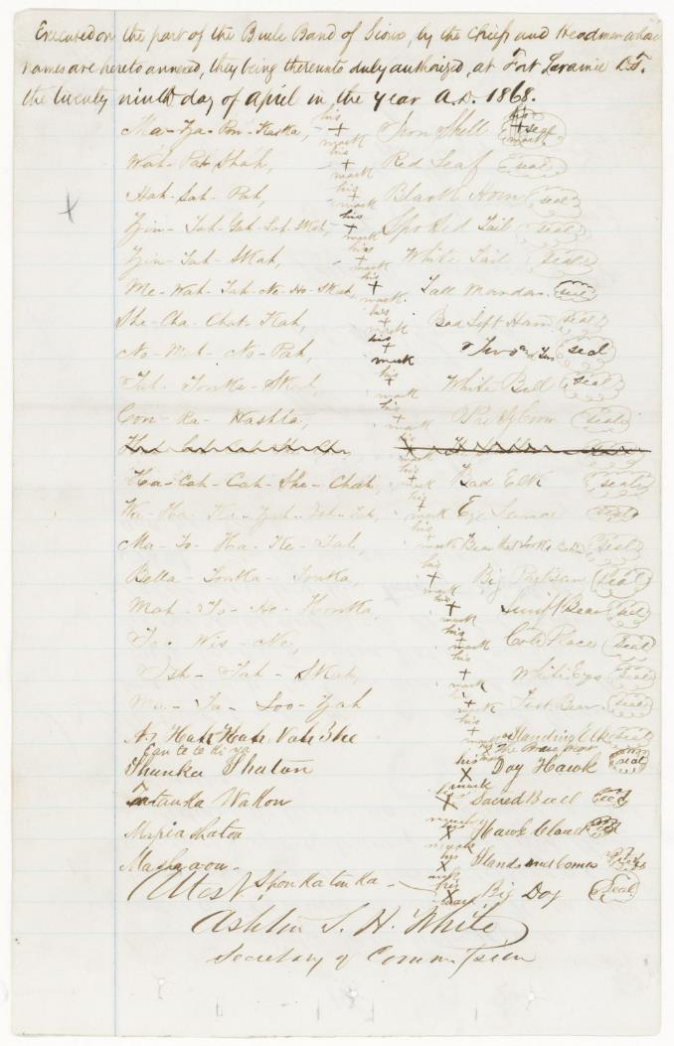
Pages from Treaty of Fort Laramie 1868

Slide 6
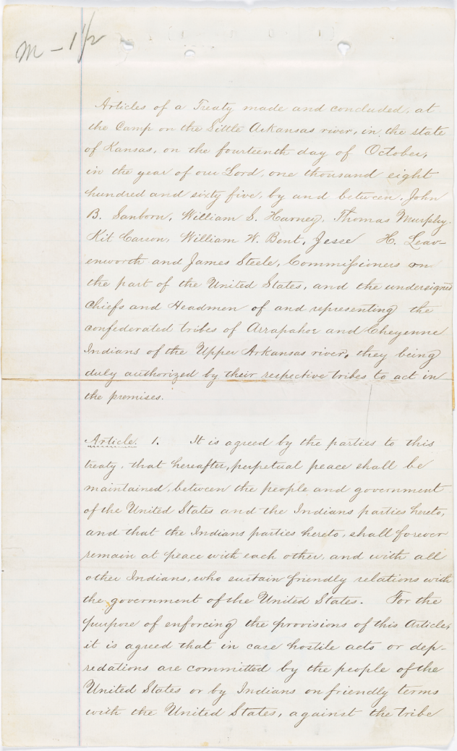
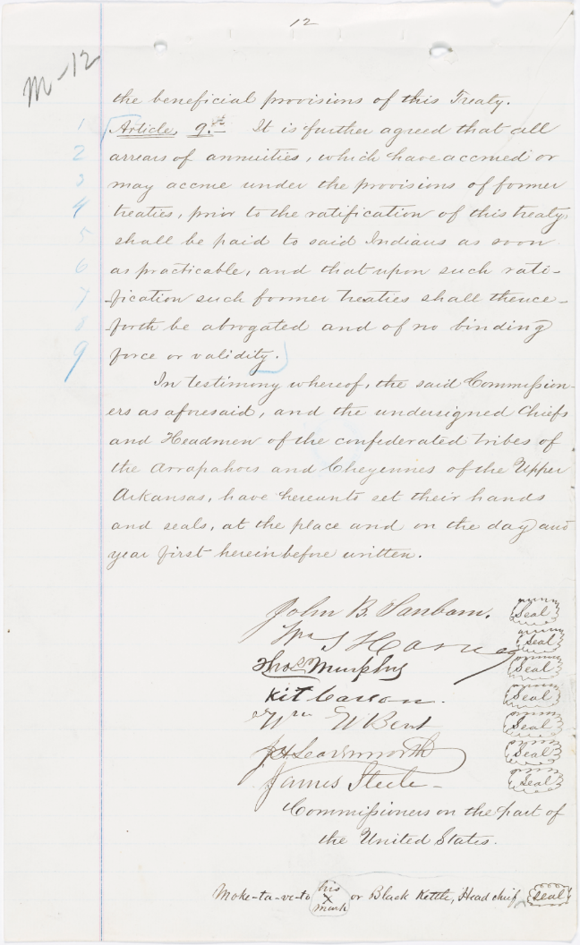
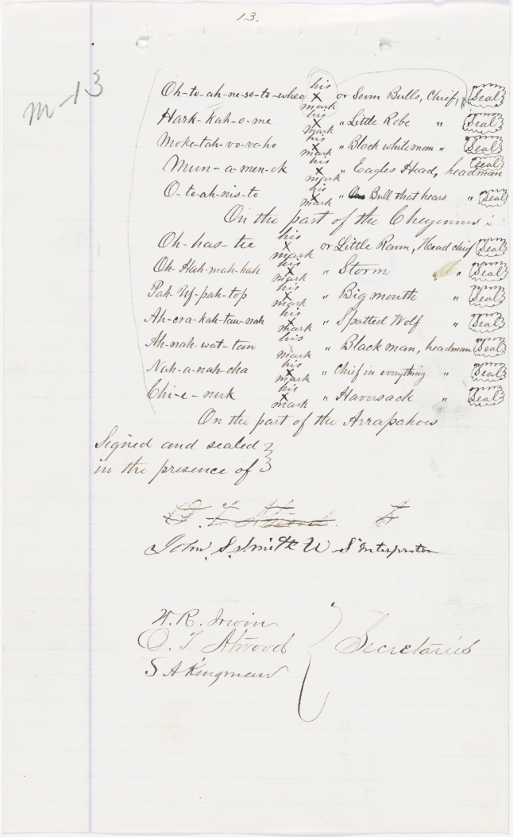
Pages from the Treaty of Little Arkansas

Slide 7
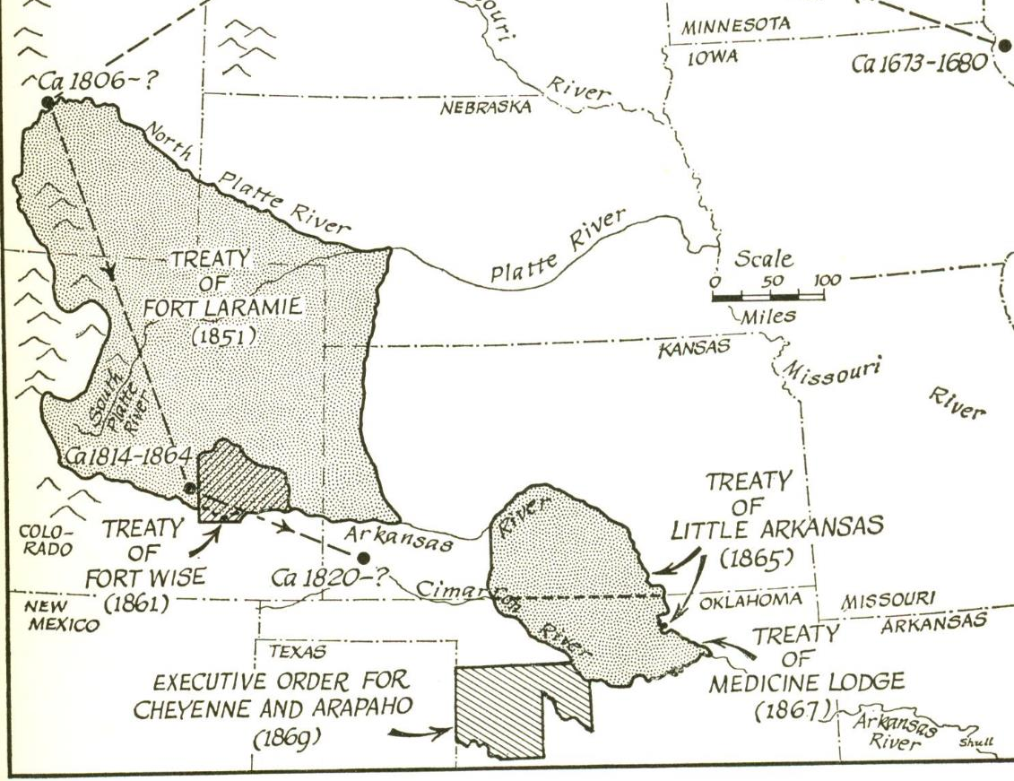
Peace Treaties
Peace Chief Black Kettle signed 3 peace treaties with the US Government:
Treaty of Fort Wise (1861)
Treaty of Little Arkansas (1865)
Treaty of Medicine Lodge (1867)

Slide 8
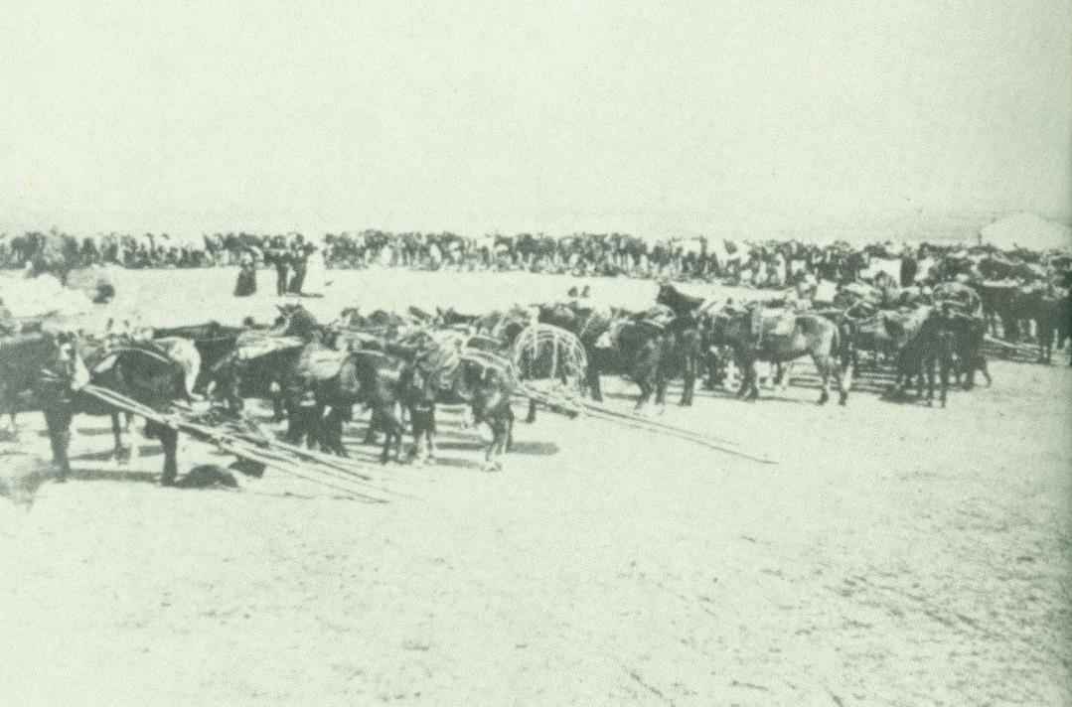
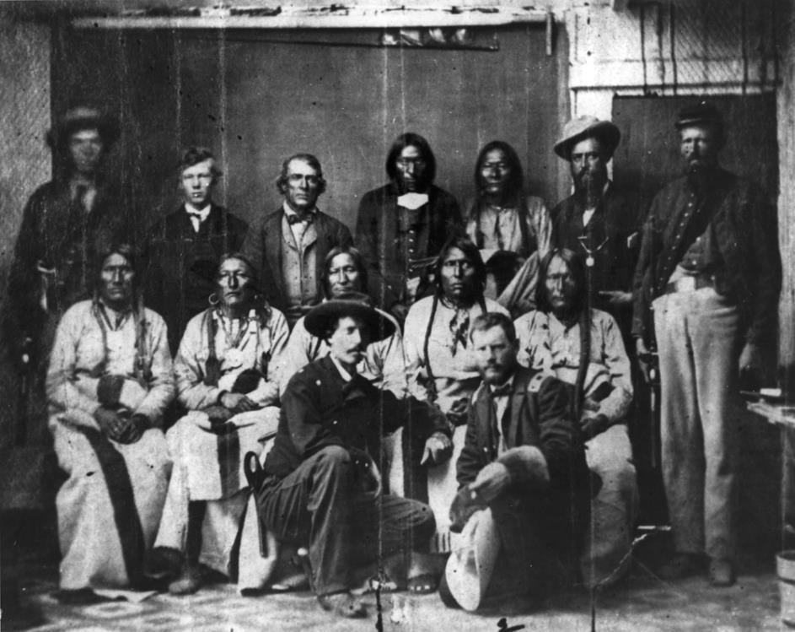
Chief Black Kettle

Slide 9
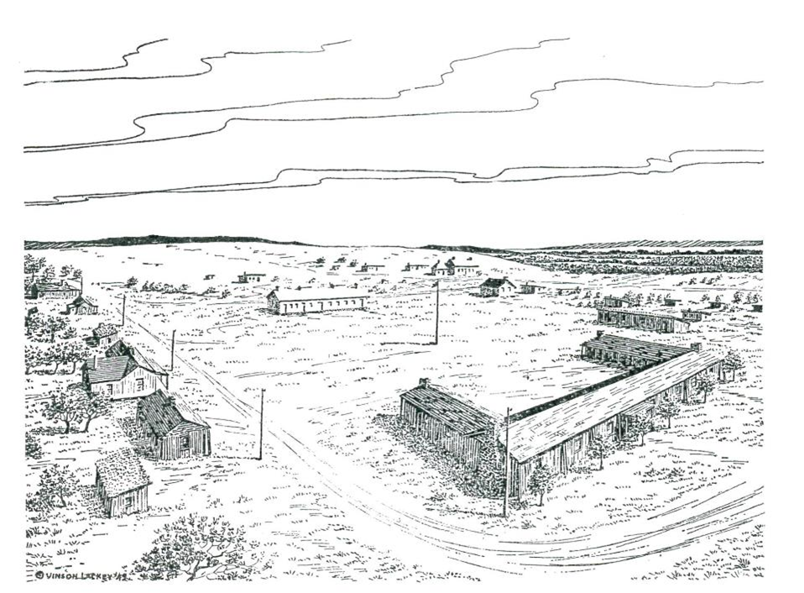
Indian Peace Treaties
Peace Treaties with Plains tribes often included ceding large areas of land for smaller well-defined zones that would be free from white interference.
These well-defined areas of land became reservations.

Slide 10
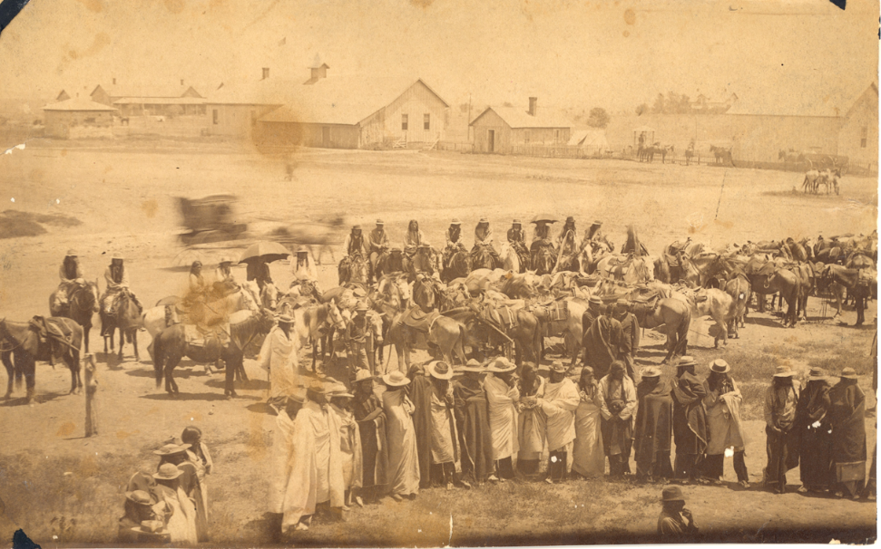
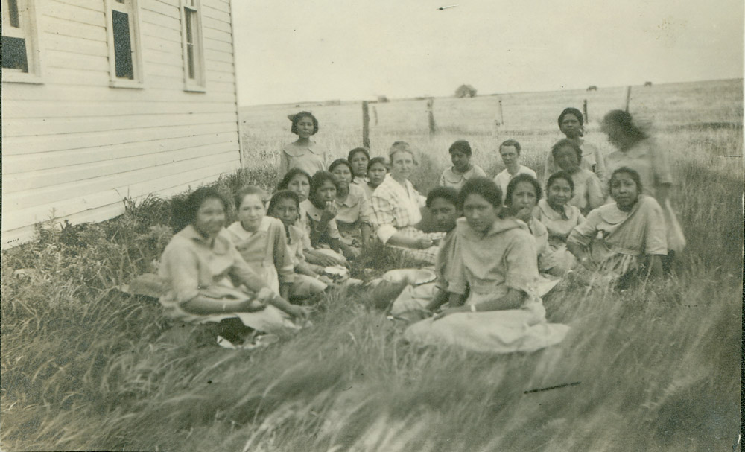
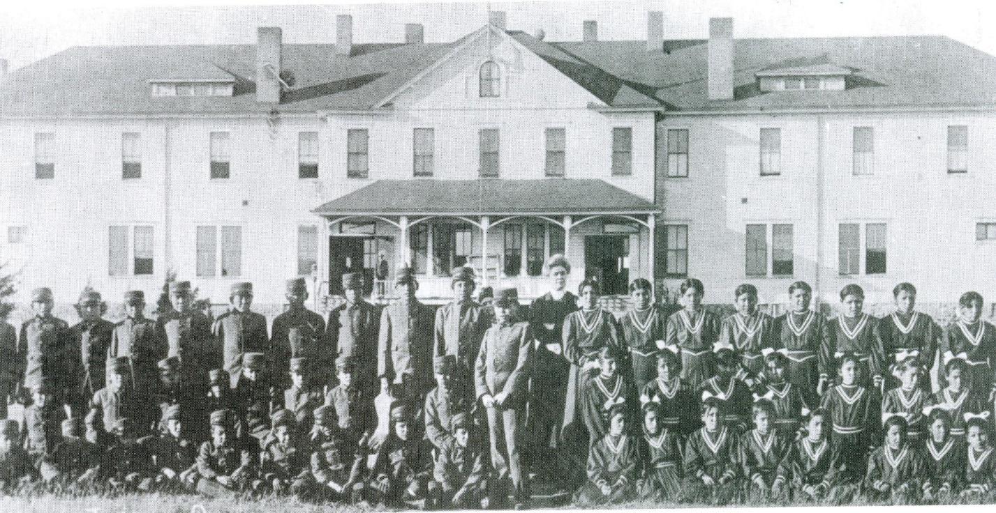
Life on the Reservation

