Slide 1
The Government is forcing everyone within 10 miles of your school to move. In return, you are promised payment. What would you do?
Take the money and move.
1
Resist using the courts and non-violent protests.
2
Stay and hope the government decides to change its mind.
3
Resist using an armed militia.
4

Slide 2
Clash of Cultures on the Plains
Washita Battlefield Traveling trunk Lesson

Slide 3
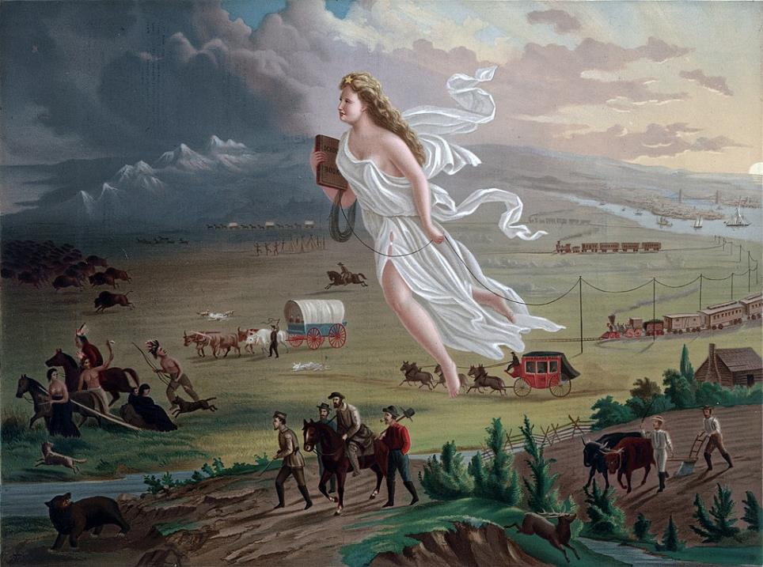
American Progress

Slide 4
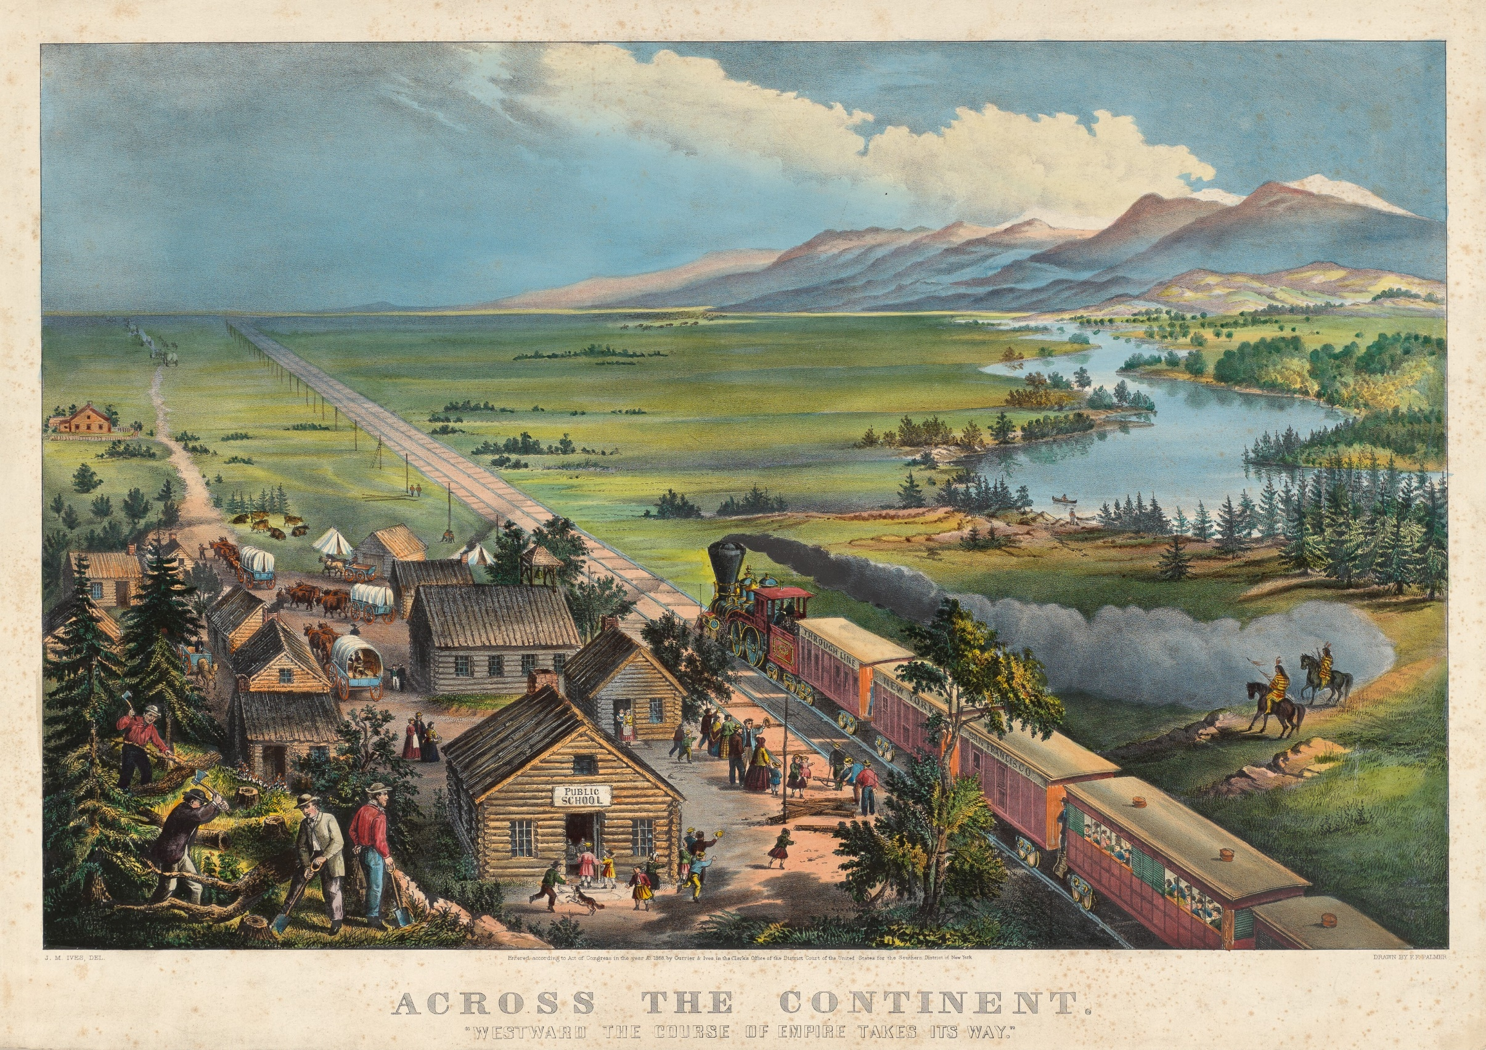

Slide 5
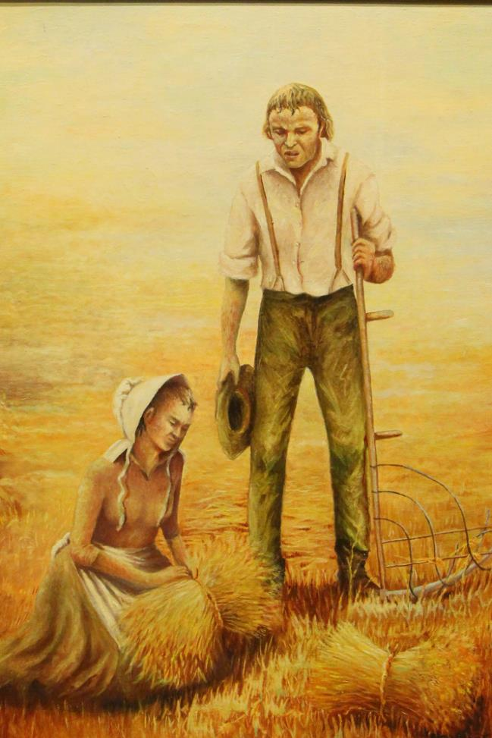
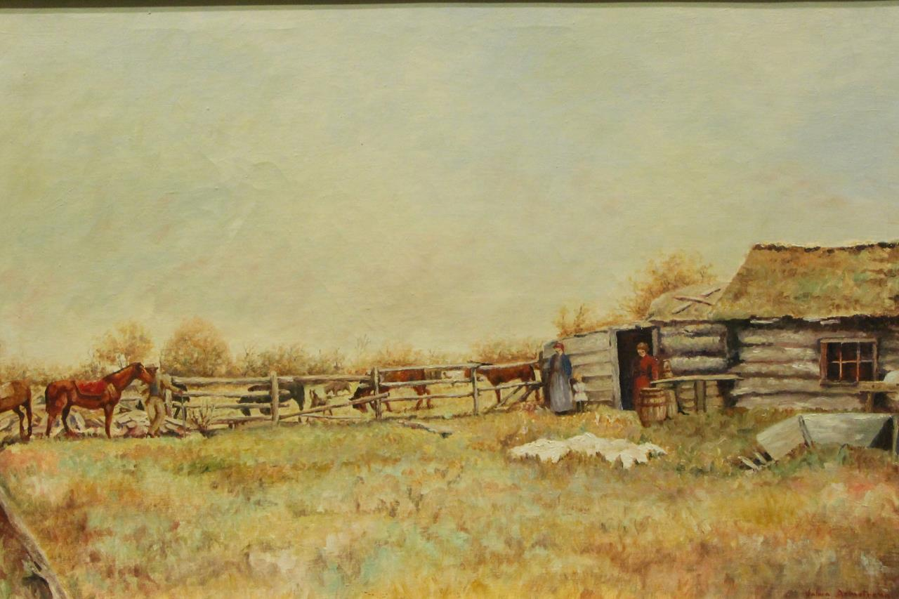

Slide 6
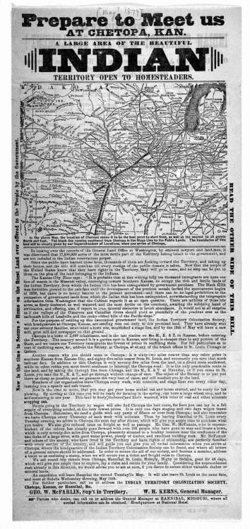
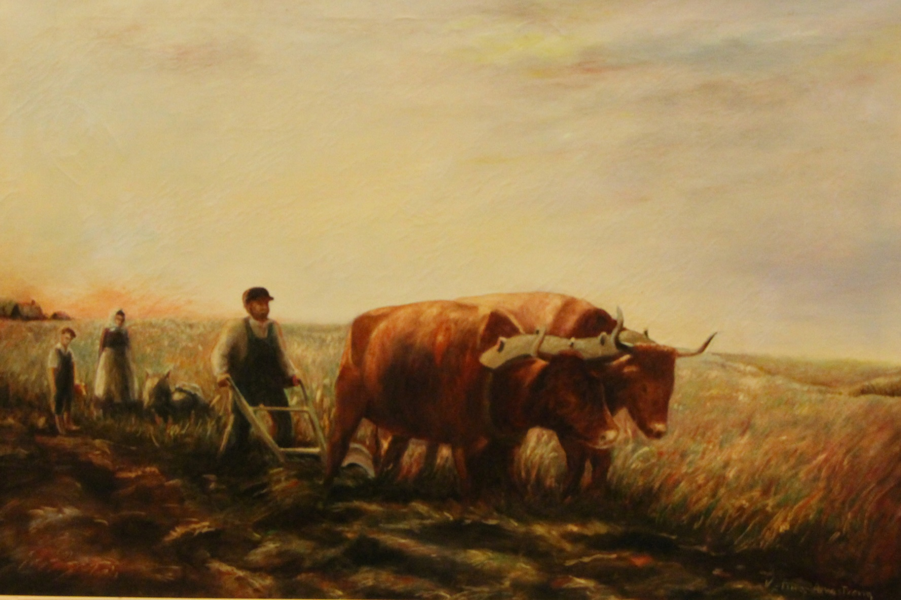

Slide 7
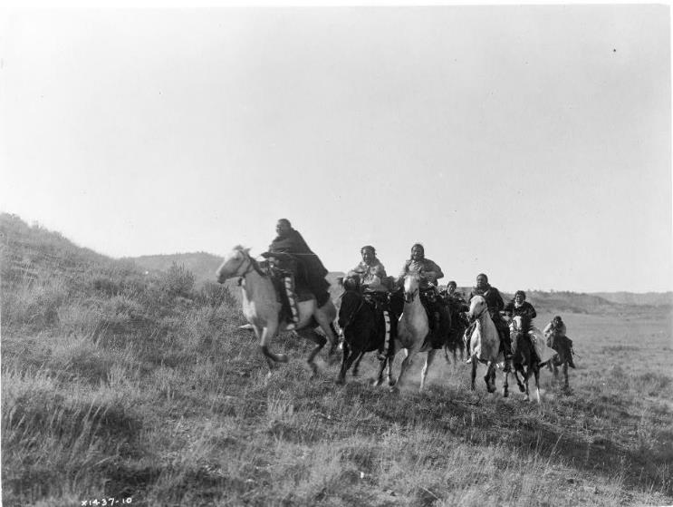

Slide 8
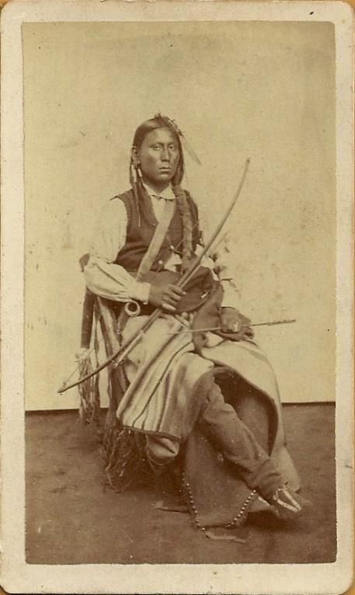
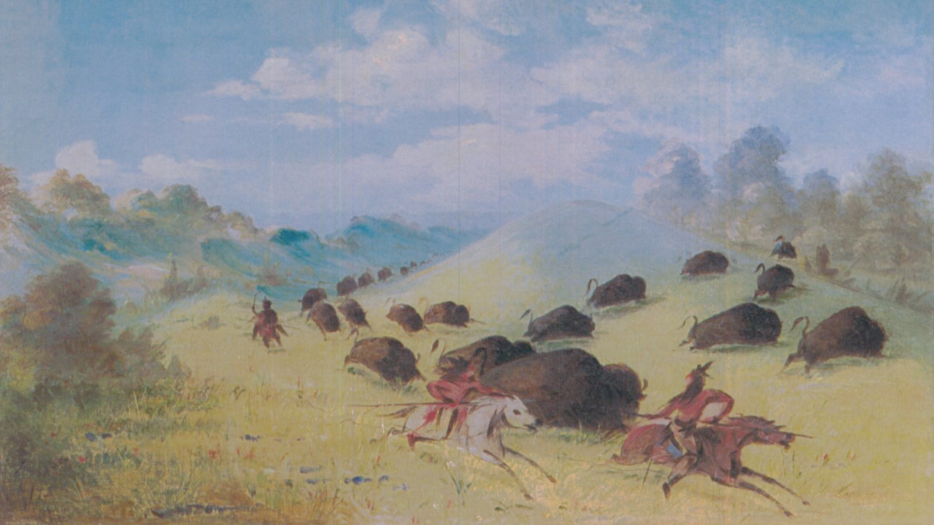

Slide 9
