Slide 1
The U.S. Cavalry
Washita Battlefield Traveling trunk Lesson

Slide 2
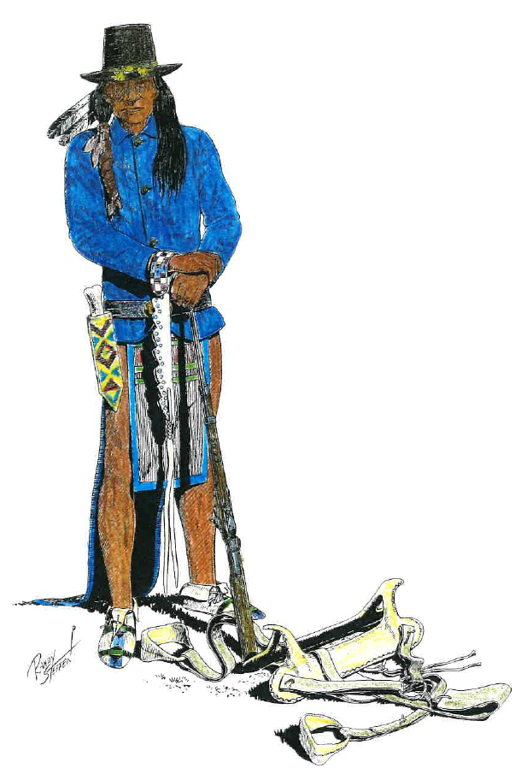
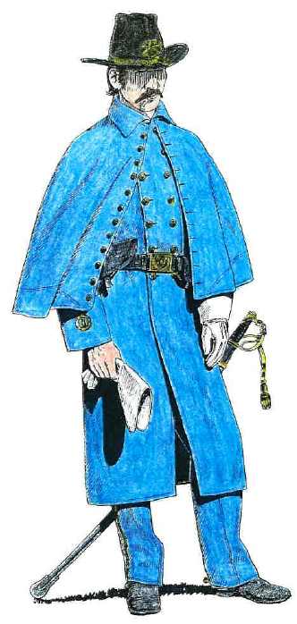
Cavalry Greatcoat
Sack Coat
Cavalry saber
Beaded knife sheath
McClellan saddle
Spencer Carbine Rifle
Bone &
Rawhide saddle
Notes:
Dress coat is in traveling trunk.
Sack coat and Greatcoat would have been worn in the field. Dress coat would have been worn at the fort.

Slide 3
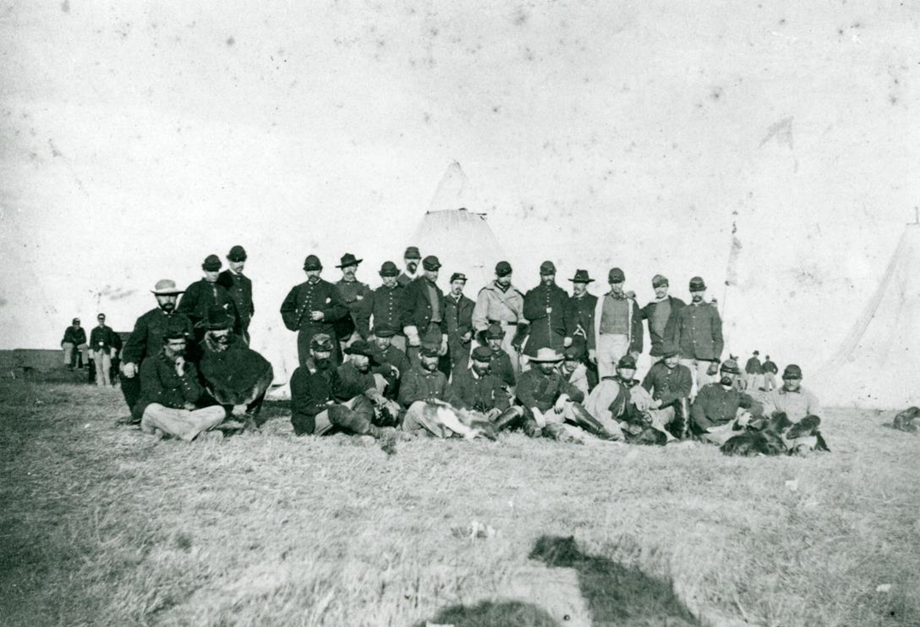
7th Cavalry Officers

Slide 4
Osage Indian Scouts

Slide 5
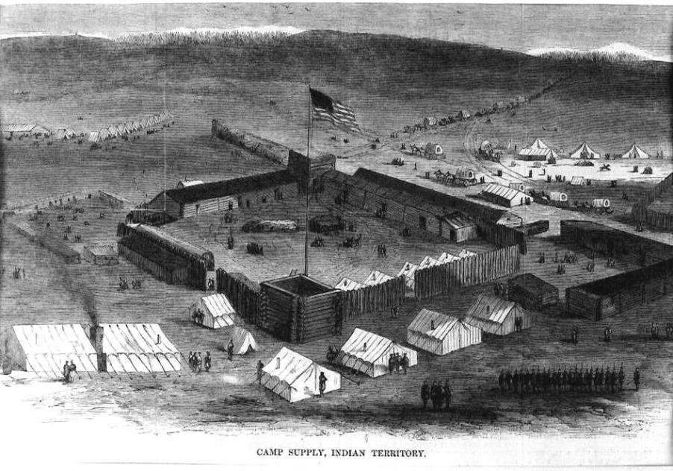
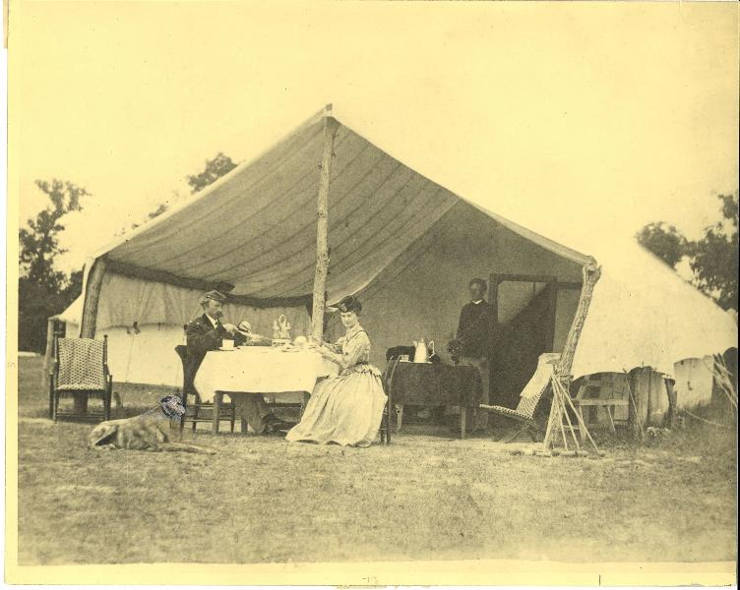
Camp Supply, Indian Territory
Fort Hays, Kansas

Slide 6
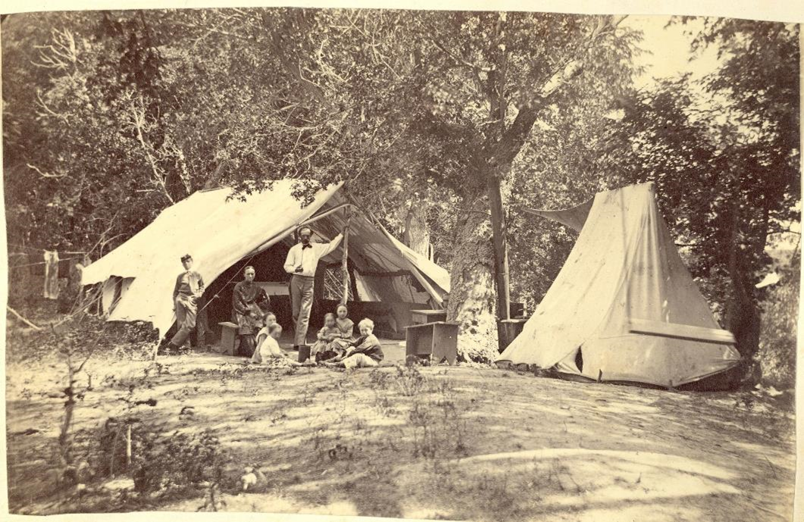
Fort Hays, Kansas

Slide 7
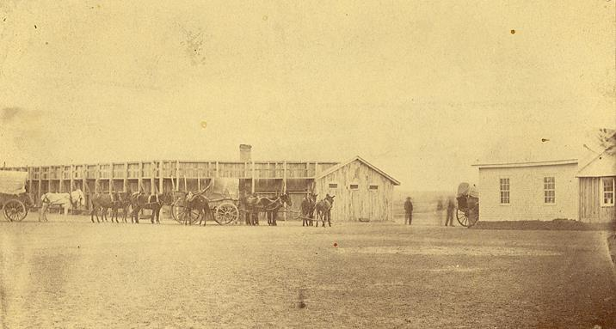
Officers’ Quarters & Parade Grounds Fort Reno, Oklahoma
Stockade
Fort Hays, Kansas

Slide 8
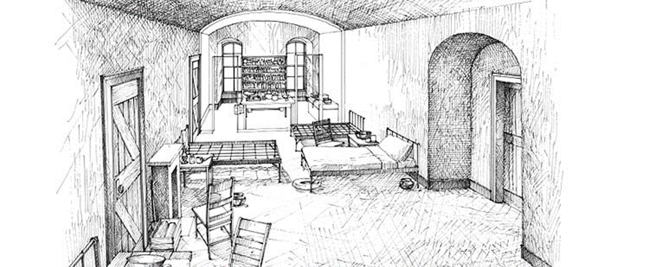
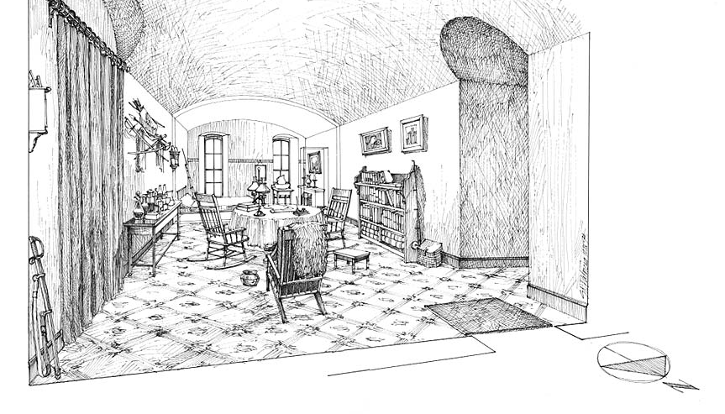
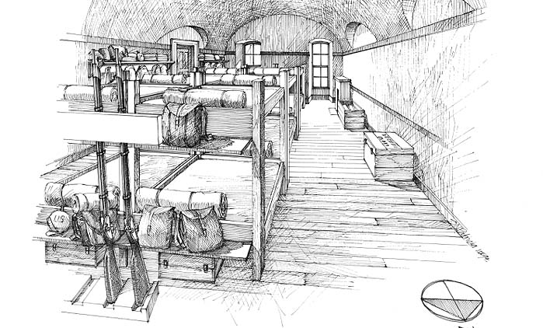
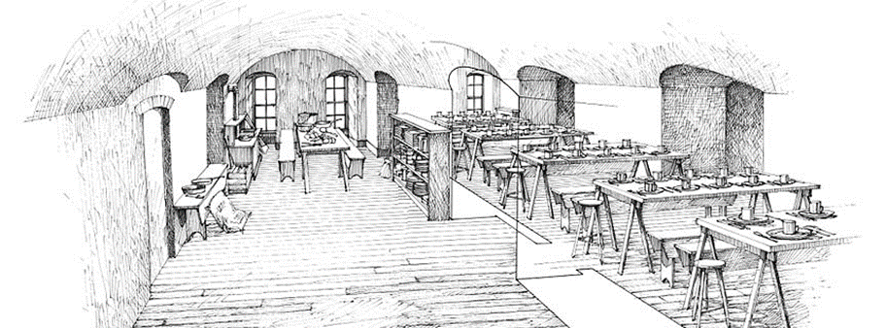
Officers’ Quarters
Hospital & Dispensary
Mess Hall
Enlisted Quarters

Slide 9
Mapping Fort Hayes
Can you find?
How far is it?
A. Hospital- color it blue
B. Commanding Officer’s Quarters- color it yellow
C. Cavalry Stables- color it green
D. “Soapsuds Row” – color them orange
E. Company Barracks- color them red
How far did the Commanding Officer have to walk to get to:
A. The Stables?
B. The hospital?
C. The flagpole?
Key:
1 inch = 100 feet

