Slide 1
Lesson #1
Washita Battlefield Traveling trunk Lesson

Slide 2
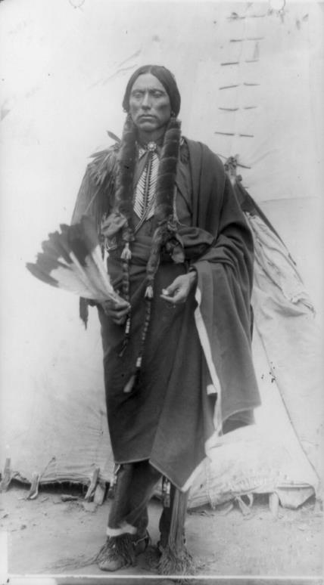
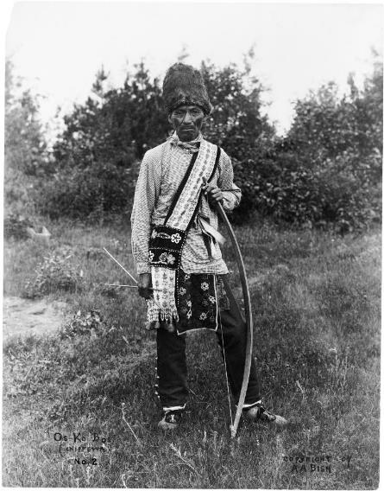
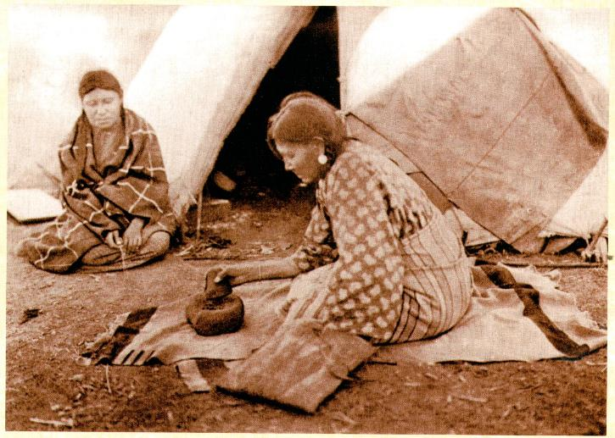
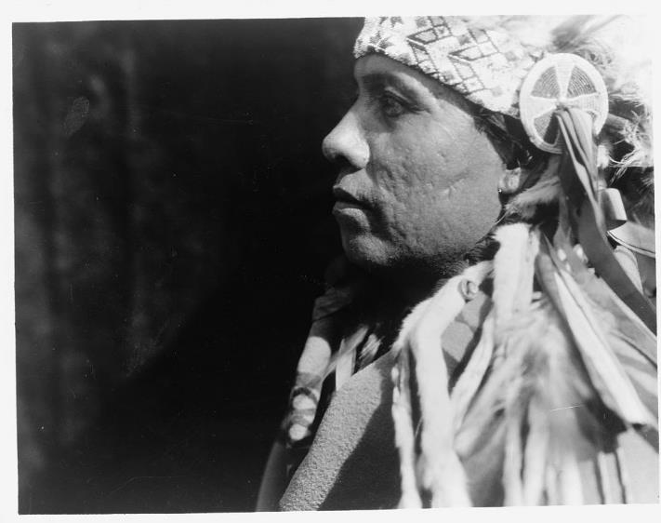
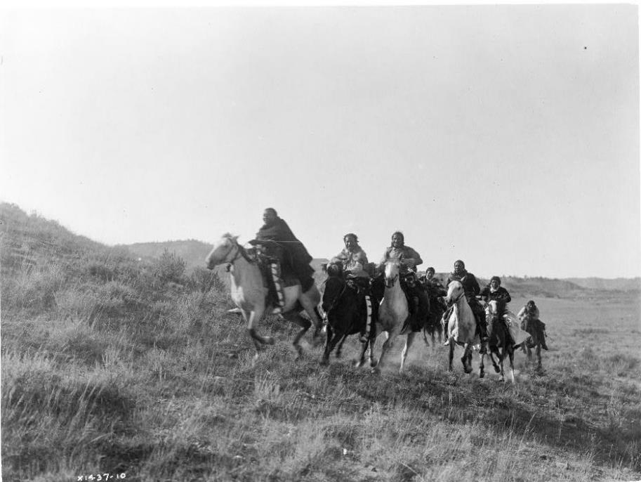
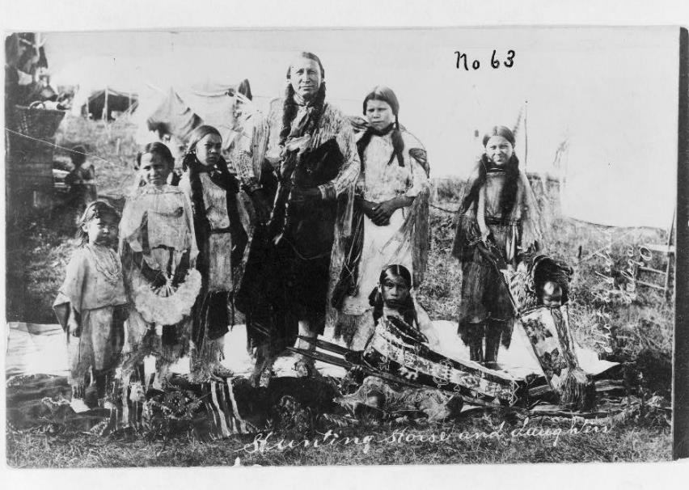
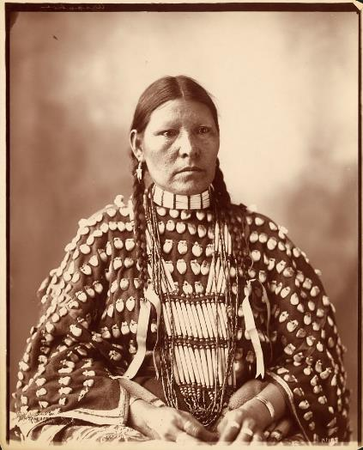

Slide 3
Organs
Made into cooking bags, water containers, & food
Used because they were waterproof
Horns
Made into cups, utensils, powder horns, fire carriers
Tanned hide
Made into bags, belts, blankets, clothing, tipi cover, pouches, moccasins, & machinery belts
Major trade item

Slide 4
Tail
Teeth
Hooves
Used as flyswatters, whips, & ceremonial rattles
Used for decorations on clothing & items
Used for rattles, glue, containers & spoons

Slide 5
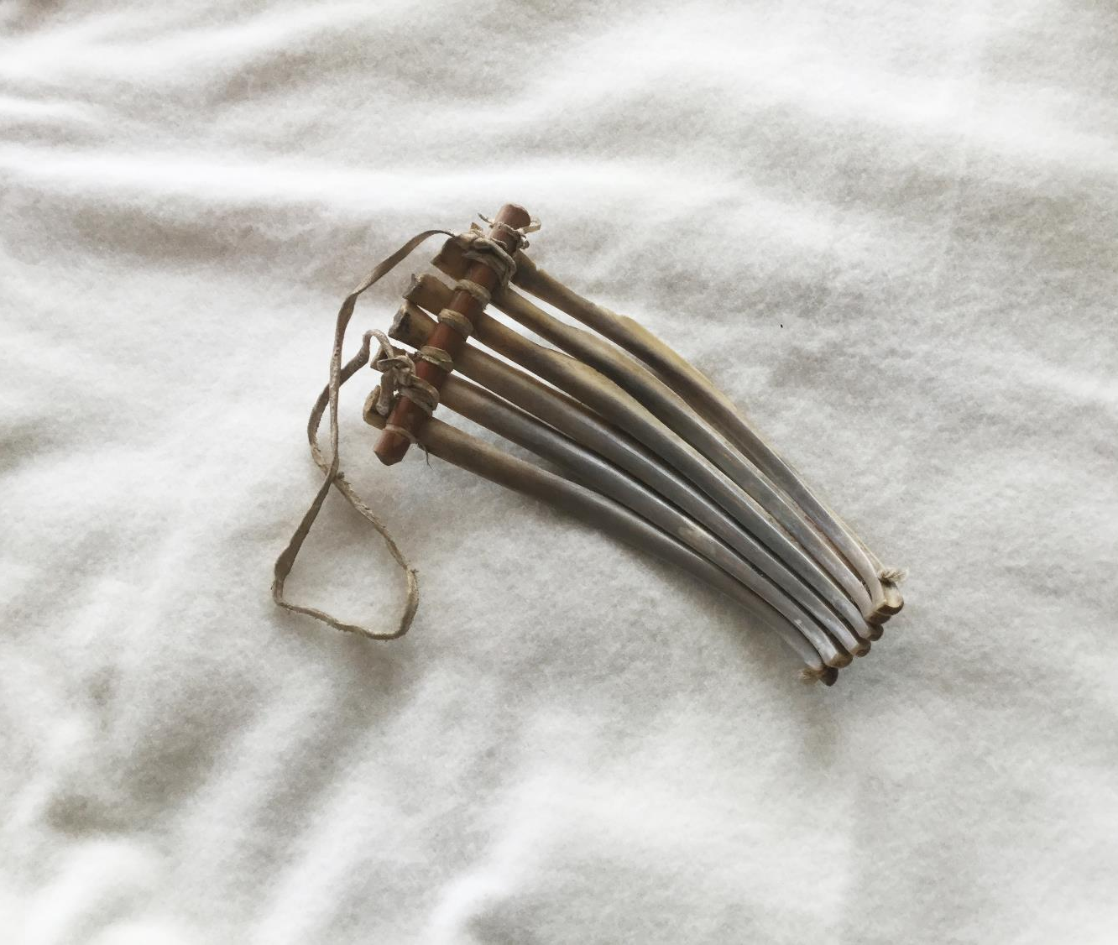
Bones
Used to make arrowheads, awls, game dice, toys, shovels, scrapers, & pipes
Meat
Used for immediate use, jerky, & pemmican
Brains
Used as food & for hide preparation

Slide 6
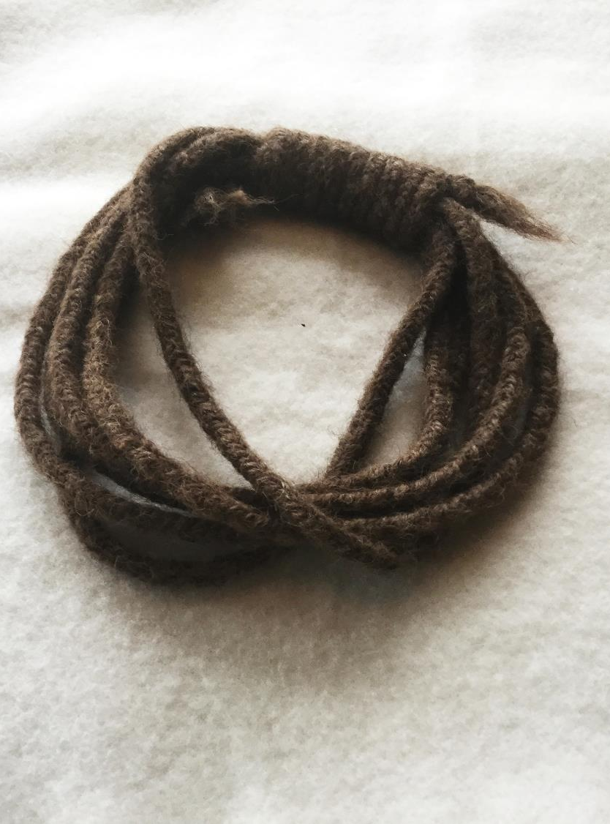
Hair
Used to make rope, stuffing for pillows & other household goods, & lining for winter shoes
Braiding rope was a wintertime activity for women
Rawhide
Used to make parfletches, moccasin soles, shields, ropes, rattles, drums, & saddles
Tendons & Muscles
Made into bowstrings, cinches, & sinew

Slide 7
Were bison only used by Plains Tribes?

Slide 8
