Slide 1
Calabasas, Arizona
June 30, 1908
Subject to the acceptance thereof by the Secretary of the Interior, under the terms of the provisions of the Act of Congress, approved June 8, 1906 (34 Stat., 235), entitled An Act for the Protection of American Antiquities, and for the purposes specified in said act, I hereby relinquish to the United States The E ½ of the NW ¼ of the SW ¼ of the SE ¼ and the W ½ of the NE ¼ of the SW ¼ of the SE ¼ of Section 30 , in the Township 21 South, Range 13 East, Gila and Salt River Meridian, Arizona containing 10 acres, the same being embraced within my homestead entry No. 3035.
Carmen Mendez¹
Witnesses:
C.H. Williams
Frank J. Duffy
1. His X mark used in place of signature.
Quit Claim Deed
Notes:
This is quoted text from a primary source document credited to Carmen Mendez. He is referencing here an area of land with a larger parcel of his own property. His property lies along the Santa Cruz River, in The United States less than 25 miles from our international border with Mexico. In formal language, with this text, Carmen Mendez on June 30, 1908 returned the land described here without compensation back to The United States government. Believe or not land management professionals, as well as your average North American landowners, located and laid claim to land property using this language. In fact this system can found in use still today. It is also leading us to the fourth type of map we will have identified over recent class periods, Quadrangle Maps.

Slide 2
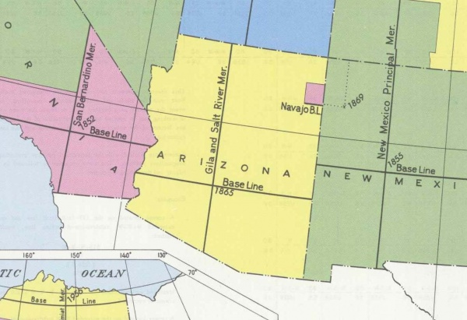
Salt and Gila River Meridian
Source: http://www.clui.org/section/gila-and-salt-river-meridian
Notes:
First I want us to identify the basis for Quadrangle Mapping. This is the Gila and Salt Meridian. Two Perpendicular Lines that serve as the foundation of Quadrangle Land Location in Arizona. Notice how it is not a particularly centered crosshair. Each states has its own, or multiple meridians, most are not centered geographically.

Slide 3
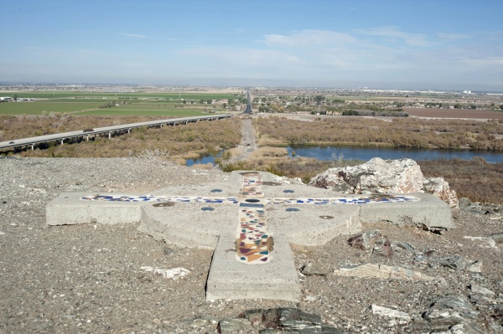
Salt and Gila River Meridian
Looking north over the confluence of the Gila and Salt Rivers, the meridian extends to the horizon as 115th Avenue.
Source: http://www.clui.org/section/gila-and-salt-river-meridian
Notes:
The Initial Point for the survey of Arizona lies atop a 150-foot tall hill west of Phoenix called Monument Hill. This site was selected as it has a good view and is visible from around the area, and because it lies next to a major regional geographic feature, the confluence of the Gila River and the larger Salt River.
Source: http://www.clui.org/section/gila-and-salt-river-meridian

Slide 4
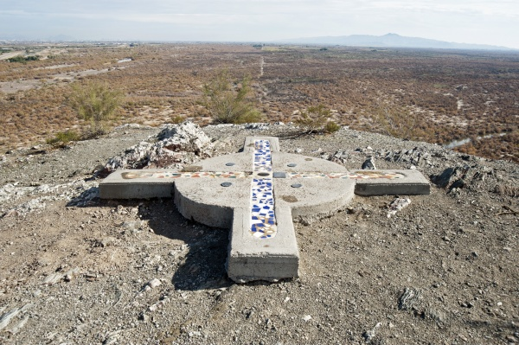
Salt and Gila River Meridian
Looking east into the Gila River Indian Reservation, the baseline is visible on the ground as it becomes Baseline Road. Downtown Phoenix is in the distance on the left.
Source: http://www.clui.org/section/gila-and-salt-river-meridian
Notes:
The site was originally surveyed and marked with an eight-foot tall rock monument in 1851, as part of the U.S./Mexico boundary survey. So when the field work for the territorial survey was started in 1865, this made a solid, already-established point to base it from.
Source: http://www.clui.org/section/gila-and-salt-river-meridian

Slide 5
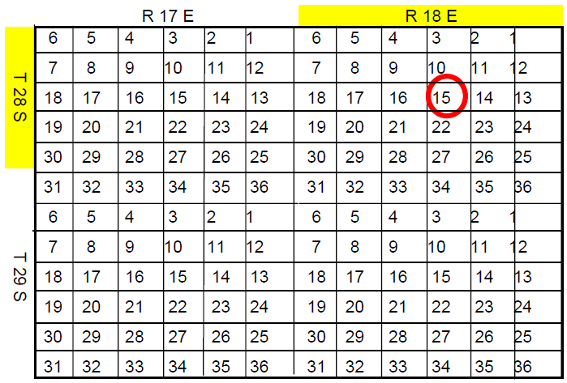
Understanding the Section, Township, Range in Quadrangle Location
A township and range combination is a grid box with 36 total sections arranged six by six.
Example: The Section, Township and Range here is 15-28-18.
Notes:
The Gila and Salt River Meridian divides Arizona into Quadrants or four parts albeit unequal quantifiably. Within Meridian quadrants land is further divided by Section, Township and Range. This example is an adequate representation of these smaller divisions. However, as seen in this slide, the words Section, Township and Range are always listed textually in this order, but the procedure to locate a parcel should follow their listing “backwards.”

Slide 6
Quadrangle Location Procedure
Label the four Cardinal Directions at the appropriate extremes of your graph paper.
Divide your graph paper horizontally, in thirds with lightly drawn lines.
Make a dark line by drawing over the baseline at the northernmost horizontal third of your graph paper.
Label this horizontal line 20S on its north side.

Slide 7
Quadrangle Location Procedure
5. Divide your graph paper again, this time vertically into quarters, with lightly drawn lines.
Make a dark line by drawing over the edge-line along at the westernmost vertical quarter of the of your graph paper.
Label this vertical line 13E on its eastside.

Slide 8
Quadrangle Location Procedure
Note that points immediately south of 20 S. lie in Township 21 and those immediately east of 12 E. lie in Range 13.

Slide 9
N
12 e
20 s
W
E
30
S
31
Notes:
This image is generalized, but after following the previous instructions your map on graph paper should look something like this.
Click on slide again (#9) .
Section 30 falls here as Mendes lists in his Quit Claim Deed. Section 31 is also highlighted here to reflect the full contents of the Mendez original homestead which lies in parts of both Section 30 and 31.

Slide 10
30
Sections 30 and 31
31
Notes:
With this slide I am going provide an abridged representation of the Mendez homestead’s history.
Click on slide again (#10)
Originally the homestead contained about 1/8 of section 30 and 31.

Slide 11
Location Procedure
Begin with a second piece of graph paper.
Create two adjacent 8x8 regions, representing Sections 30 and 31 as Mendez describes in Township 21 South, Range 13 East .
Divide Section 30 into four equal parts, drawing a light border around the SE quadrant.
Then divide that region in four equal parts again, drawing a light border around the SW quadrant.
Then divide that region in four equal parts again, drawing a light border around the NE quadrant.
Then divide that region in two equal parts, drawing a light border around the Western half.
Fill in that Western portion.
30
31
Notes:
In his Quit Claim Deed, Carmen Mendez states, “I hereby relinquish to the United States The E ½ of the NW ¼ of the SW ¼ of the SE ¼ and the W ½ of the NE ¼ of the SW ¼ of the SE ¼ of Section 30 , in the Township 21 South, Range 13 East, Gila and Salt River Meridian, Arizona containing 10 acres, the same being embraced within my homestead entry No. 3035.” We can take this statement and turn it into a “turn by turn” procedure by working with the text in reverse.
Click slide after bulleted point 3.
Click slide after bulleted point 4.

Slide 12
Location Procedure
8. Keep reference lines for borders of Section 30 and 31, but Erase all lines made except the borders of the western portion you just you just filled. Do not erase that filled portion.
Divide Section 30 into four equal parts, drawing a light border around the SE quadrant.
Then divide that region in four equal parts again, drawing a light border around the SW quadrant.
Then divide that region in four equal parts again, drawing a light border around the NE quadrant.
Then divide that region in two equal parts, drawing a light border around the Western half.
Fill in that western portion.
30
31
Notes:
After reading Step 8 apply a series of three clicks on this slide.

Slide 13
Location Procedure
9. With this step we have to reset our map partially to account for the “and” in the Mendez text.
30
States The E ½ of the NW ¼ of the SW ¼ of the SE ¼ and the W ½ of the NE ¼ of the SW ¼ of the SE ¼ of Section 30
31
Notes:
After reading Step 8 apply a series of three clicks on this slide.

Slide 14
Location Procedure
Divide Section 30 into four equal parts, drawing a light border around the SE quadrant.
Then divide that region in four equal parts again, drawing a light border around the SW quadrant.
Then divide that region in four equal parts again, drawing a light border around the NW quadrant.
13. Then divide that region in two equal parts, drawing a light border around the Eastern half.
14. Fill in that Eastern portion.
30
31
Notes:
Before Step 10 read aloud the following: We have to work backwards again in terms of how we would read the Mendez directions. Furthermore most of the steps are identical to the first set in this procedure.
After reading Step 10 click this slide once.
After reading Step 11 click this slide again.
After reading Step 12 click this slide again.
After reading Step 13 click this slide again.
After reading Step 14 click this slide again.

