Slide 1
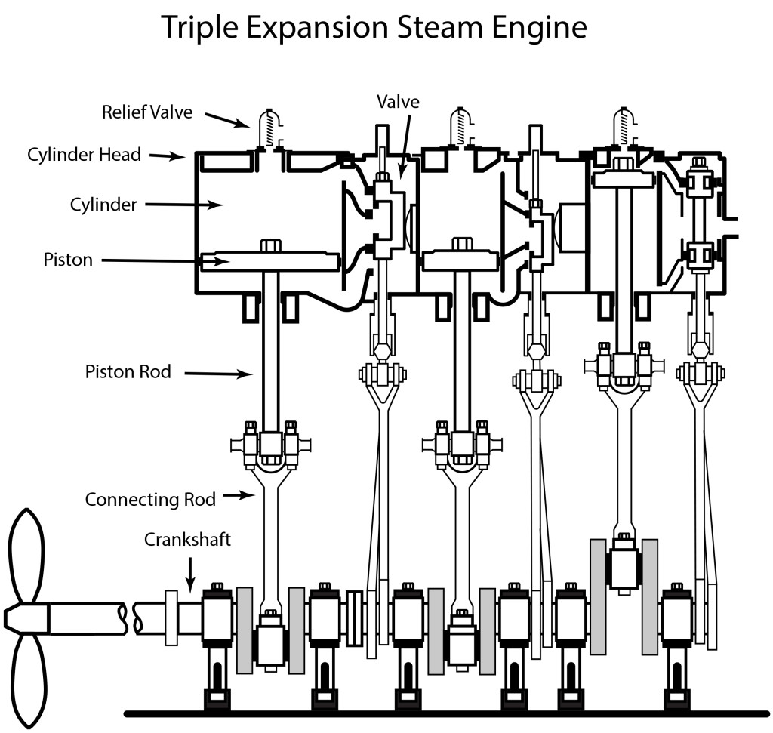
The Engine Room
Name: _____________________
Steam molecules have _______________
energy.
How is energy transferred in the engine room?
________________________________________________________________________________________________________
________________________________________________________________________________________________________
____________________________________________________
The valve has _______________ energy.
Pistons have _______________ energy.
The propeller has _______________ energy.

Slide 2
Answers
Name: _____________________
Steam molecules have mechanical energy.
How is energy transferred in the engine room?
Steam molecules have mechanical energy. They move into the valve. As more steam molecules enter the small space, they push the valve down. The steam molecules move into the piston. As more steam molecules enter the small space, they push the pistons down. When the pistons move, they rotate the crankshaft, and then the propeller.
The valve has mechanical energy.
Fire has _______________ energy.
Pistons have mechanical energy.
The propeller has mechanical energy.
Notes:
Answer key

