Slide 1
Cemetery Preservation Intensive Course for Puerto Rico

Slide 2
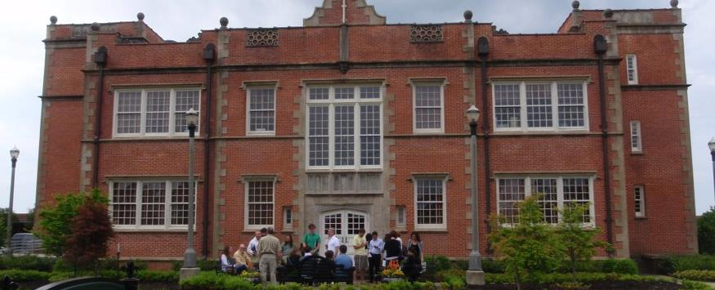
What is NCPTT?
National Center for Preservation Technology and Training
An Office of the National Park Service
A Research and Development Center for Preservation Technology
Better Tools, Better Materials, Better Approaches
Works through Partnerships, Grants, and Internal Projects

Slide 3
What do I need?
Computer with camera and microphone
Internet
Printer for handouts and homework
Access to a cemetery
Digital camera to document your work

Slide 4
How do I use the technology?
Zoom
Chat
Annotate
Share Screen
Mute
Turn off Video
Google Docs
Need a Google Account
Download Documents
Upload Images and homework
Notes:
Let’s briefly walk through the features of Zoom.

Slide 5
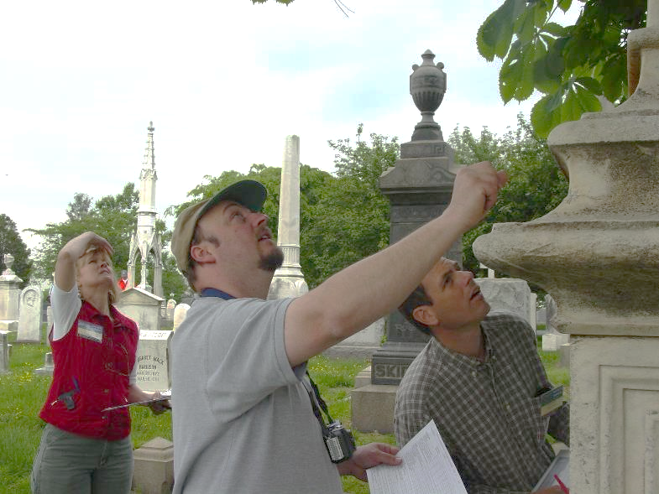
How this course works …
Week 1
Observe
Look at site from a preservation viewpoint
Document features
Work safely on site
Notes:
Look at site from a preservation viewpoint
Document features
Work safely on site

Slide 6
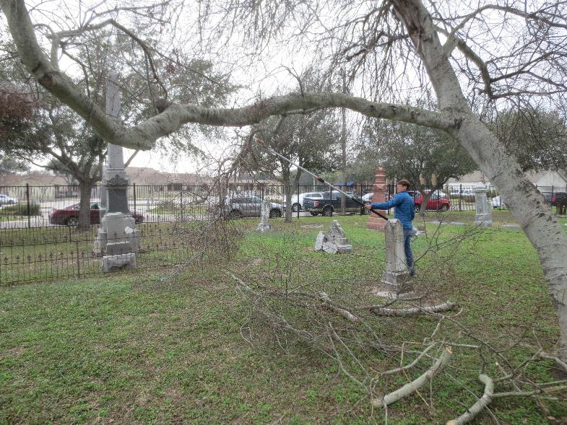
How this course works …
Week 2
Think
Stabilize Features
Establish Priorities
Understand Materials and Cleaning

Slide 7
How this course works …
Week 3
Create
Think strategically
Prepare a proposal
Develop a repair plan

Slide 8
How this course works …
Lecture
Homework
Group Meeting
Review Session
Lectures and presentations: 2-3 hours: Tuesdays
Homework Assignments : 1 to 2 hours
Group meeting at cemetery: 1 hour Wednesdays
Review and Discussion: 1-1:30 hours: Fridays

Slide 9
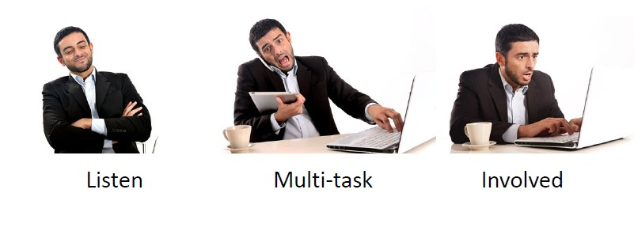
How do I get the most out of this course?
Which one would likely get the best returns from your attendance? Use the draw tool and encircle your choice.

Slide 10
How do I get the most out of this course?
We learn from each other.
Share insights, compliments, challenges and questions.
Join in the video, audio and chat.

Slide 11
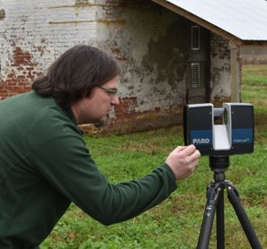
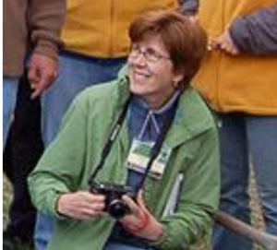
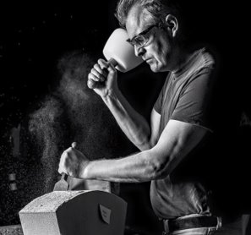
Meet the Instructors
Jason
Church
Technical Services
Debbie
Smith
Historic Landscapes​
Mary
Striegel
Materials Conservation
Simeon
Warren
Architecture and Engineering

Slide 12
How this course works …
Objective
The learner will be able describe the course and complete work assigned to them in a timely manner.

Slide 13
How this course works …
References
Course Schedule
Course Objectives
List of Resources
Where to find documents

Slide 14
How this course works …
Simple Rules
Show up on time
Participate in class
Do your homework
Commit to complete the class

Slide 15
Overview of Cemetery Preservation
Notes:
Good morning. Today, I will present on the current national view of cemetery preservation. My name is Mary Striegel and I am the Chief of Materials Conservation at the National Center for Preservation Technology and Training, known by it’s acronym of NCPTT. The National Center is an office of National Park Service, located in Natchitoches (Nak-a-tich), Louisiana. This workshop was made possible by a Preservation Technology and Training grant to The Montana History Foundation.

Slide 16
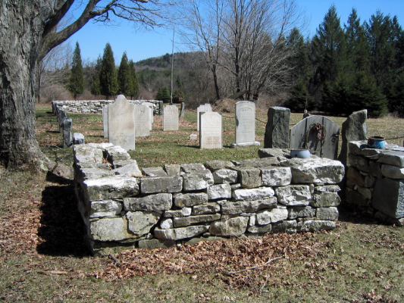
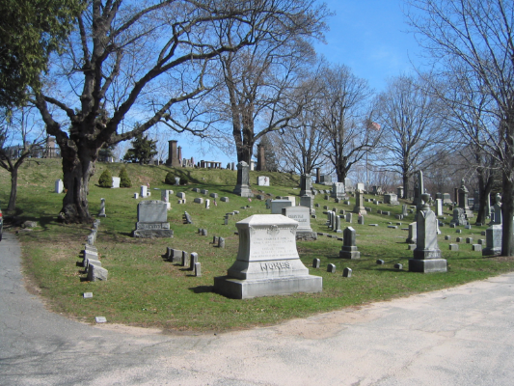
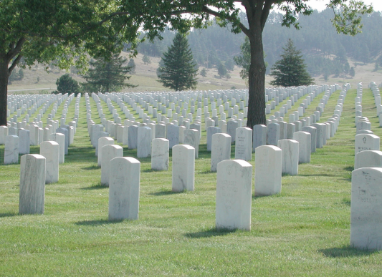
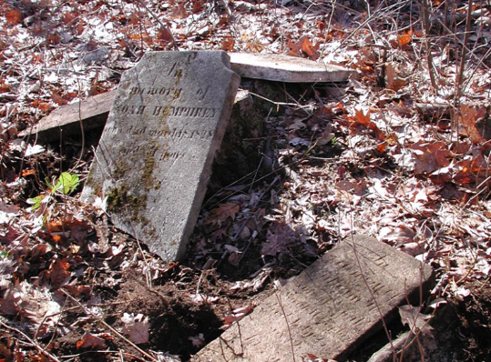
Approximately 10,500 cemeteries in the United States
Notes:
Death care industry experts estimate that there are about 10,500 cemeteries in the United States. The vast majority of those are run by small, private companies or non-profit organizations such as cemetery associations, local governments or churches. Cemeteries can have few graves or many graves. They may be well-maintained or may have fallen into a state of disrepair.

Slide 17
NCPTT National Cemetery Preservation Initiative
Notes:
The National Cemetery Preservation Initiative grew out of the NCPTT materials research program and early discussions between myself (left) and Fran Gale (right), former training director at NCPTT that took place in 1997. We were looking for new training initiatives that had a high degree of relevance to the preservation community. We noted at the time that cemeteries were microcosms of preservation issues including landscapes, the built environment, materials issues, and archeological issues. We worked with the Arkansas State Historic Preservation Office to hold a cemetery preservation workshop at Mount Holly Cemetery in Little Rock.
Architectural conservators like Norman Weiss at Columbia University and Frank Matero at the University of Pennsylvania were turning a spotlight on cemetery preservation. Groups like the Chicora Foundation and the Savannah College of Art and Design were active in educating the public about cemetery preservation. NCPTT launched it’s second cemetery preservation workshop in 2003. Since then, the National Center has become a recognized leader in cemetery preservation across the United States.

Slide 18
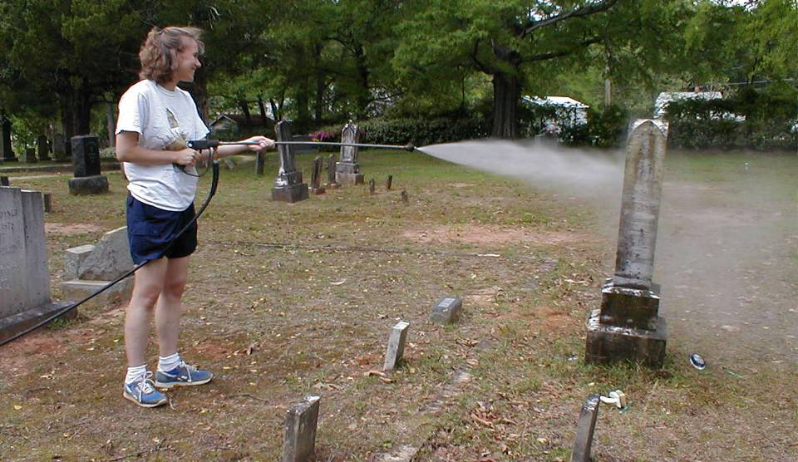
Challenge: Many grave markers in historic cemeteries are lost every day due to poor maintenance, disasters, destruction, or decay.
Notes:
The challenge we face today is that many grave markers in historic cemeteries are lost every day due to poor maintenance, disasters, destruction, or decay. Sometimes well-meaning efforts shorten the lifetime of the grave markers. Here we see an enthusiastic volunteer pressure washing a grave marker. The method is far too harsh for the weathered marble and will result in marring and surface loss.

Slide 19
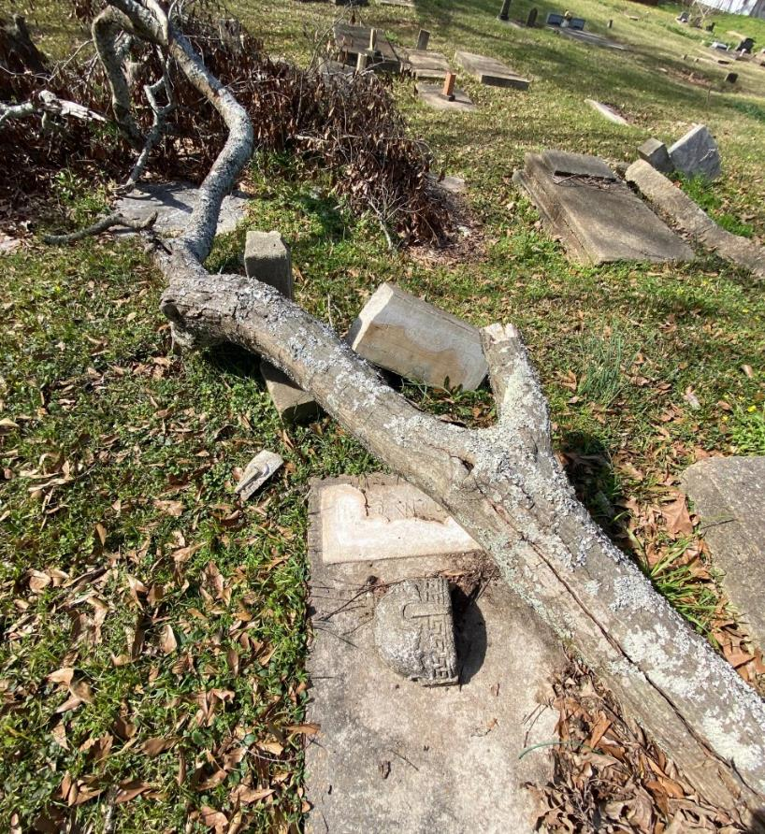
Grave markers can also be damage by falling limbs from unmaintained trees.
Notes:
Be aware of landscape features and potential dangers.

Slide 20
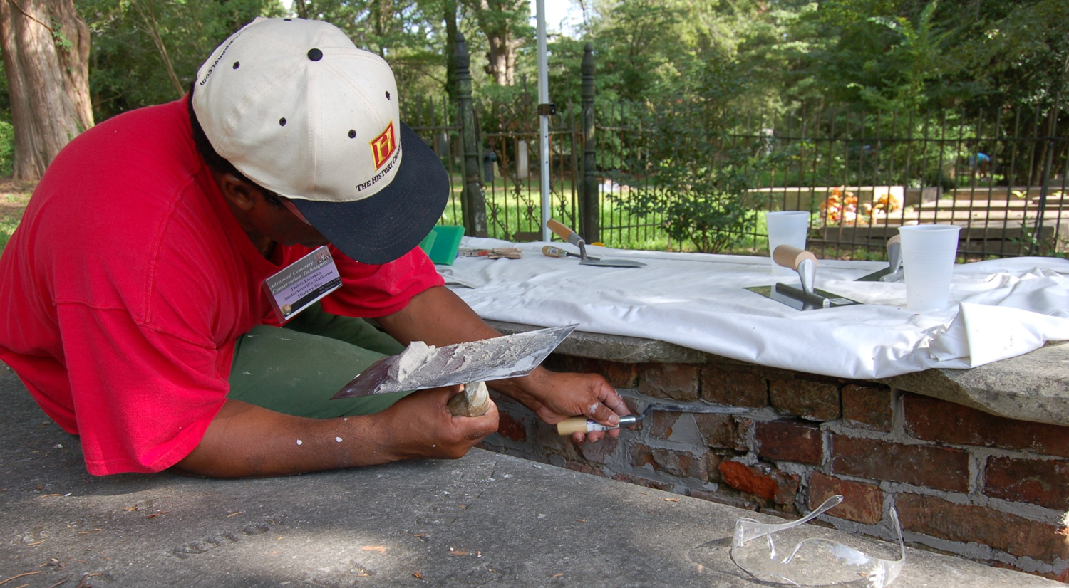
Sound cemetery preservation decisions are based on observation, knowledge, skills, & ethics.
Notes:
We believe that the best efforts to save or cemeteries are based on attentive observations, a sound knowledge base, strong hands-on skills, and solid ethics. There are not enough conservators trained in conservation schools to address the nation’s needs. Thus, a educated grass roots effort is needed.

Slide 21
Goal: Provide the public with better tools, better materials, and better approaches to preserving historic cemeteries.
Notes:
Our national goal is to Provide the public with better tools, better materials, and better approaches to preserving historic cemeteries. This means trusting that the public can discern when they can do the work themselves and when they need professional assistance.
Here we see an NPS employee measuring the color of the Arsenal Monument in Congressional Cemetery, Washington DC. The measurement is important in determining changes before and after cleaning.

Slide 22
Observation
Notes:
We will explore the basic foundations of cemetery preservation beginning with Observations and moving through to Ethics in this presentation.
Often people want to rush in and do something when they see a cemetery deteriorating. There is this urge to fix it. The better approach is sit back, observe the landscape, and build a plan. Cultural landscapes are landscapes that have been affected, influenced, or shaped by human involvement. Cultural landscape architects talk about the preservation of a site holistically. A cemetery landscape is made up of features: the roads and pathways, the grave markers, the trees, shrubs, and plants are all part of the cemetery.
Advances taking place nationally include the development of condition assessments tools, advances in documentation technology, and a focus on creating master plans. Some professionals would advise that if money is limited, skip the assessments and master plan and do some work! We believe that much can be accomplished with volunteers to observe and document a cemetery.

Slide 23
Condition Assessment
Systematic Approach
Site as a landscape
Notes:
Undertaking a condition assessment involves looking at the features of the cemetery and documenting them in a systematic approach. This is more easily accomplished with a small cemetery than a large cemetery. There are new methods for large cemeteries that use statistical methods. Alternately, a cross sectional approach can be taken.
Condition assessments can be made using a paper form or an electronic database. The usually document the materials, conditions, and appearance of the grave marker and other features of the cemetery.
Take photographs and keep them with the written records.
Here we see a photographer documenting a grave marker in American Cemetery, Natchitoches, LA. Note that she has a informational board beside the grave marker to keep information with the photo.

Slide 24
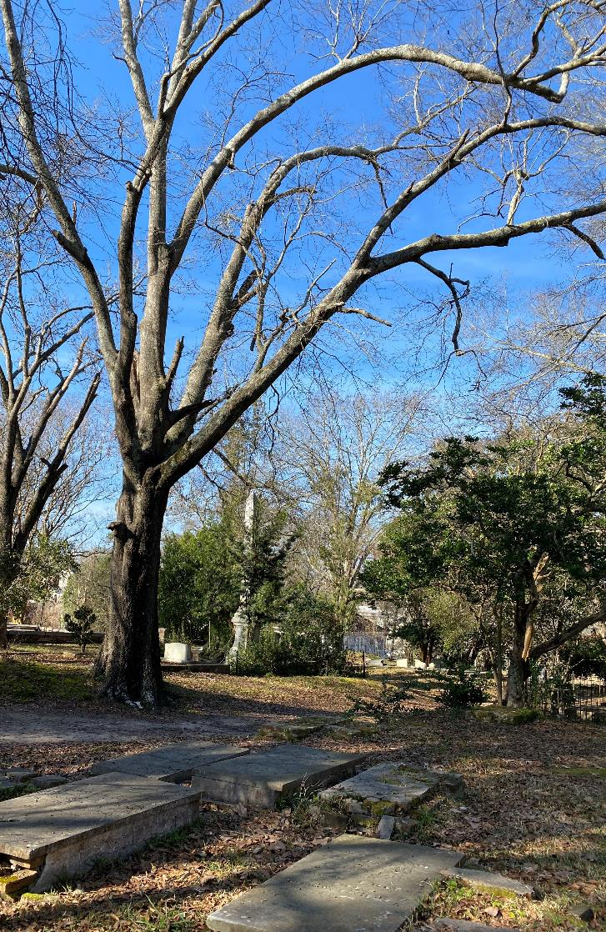
Look Up
Dead branches
Widowmakers

Slide 25
Documentation Technology
Geographic Information Systems
Geo Prospection
Rapid Documentation
Notes:
There are newer technologies that can help with documentation.
A geographic information system can be built which maps every feature in the cemetery using Global Positioning coordinates. The GIS can be used the sort features and plan treatments.
In the photograph we see a conservator using a backpack Global Positioning System to help collect data.
Sometimes graves are not marked within the cemetery. Archeologists have a host of geo prospection tools that can be used to find graves depending on the soil type and other factors in the region. Ground penetrating radar and electrical resistivity are two techniques that can be used to find unmarked graves.
NCPTT continues to work on rapid documentation systems that can be operated on an iPad or iPhone. These systems are useful when documenting a cemetery or evaluating damage after a disaster.

Slide 26
Master Plans
Keep It Simple
Build Over Time
Road Map for Work
Maintenance Plan
Emergency Plan
Notes:
The next step in cemetery preservation is to create a master plan, once you have observed the conditions in your cemetery and created documentation on some or all of the features.
Master plans may consist of several parts, including maintenance plans and schedules, work plans, and disaster plans.
It is best to keep the master plan simple at first and build on it over time. Remember, any plan that collects dust on the shelf is not useful. The Master plan should be like a useful field guide that is referenced frequently.
Here we see a weed trimmer in Congressional Cemetery. Weed trimers account for a tremendous amount of damage in cemeteries if they are used incorrectly. It is best to used the smallest diameter trim line and angle the trimmer towards the ground around markers.

Slide 27
Knowledge
Notes:
The best cemetery preservation efforts are dependent on the knowledge and skill level that the individual has to do the work. It all starts with the individual seeking out the knowledge needed to do a good job.
What is the source of your information? The internet has a plethora of information, but some sources can be suspect.
What are the circumstances that have created the need for a preservation intervention?
What are the materials you see? Can you identify them? What is the material nature of the problem? Is it a stain or soiling? If so, is it causing harm?
Are there new tools or ways to find out more information?

Slide 28
Information
Check your sources
Use Peer Reviewed Literature
Find Preservation Briefs
Notes:
Always keep in mind that anyone can post information on social media, but what is the quality of that information?
Reliable information can be found from trusted sources.
Sometimes the info can be found the old fashioned way in library books and journals.
The National Park Service has a series of preservation briefs that are a good place to start.

Slide 29
Circumstances
Manmade problems
Deterioration Mechanisms
Environment
Notes:
What are the conditions that you find in your cemetery? From observations and photographs you will begin to see patterns.
There are manmade problems including air pollution. In the photograph seen here, the scaling and flaking of the stone is caused by an interaction between the stone and acid rain. The sulfur dioxide found in the air interacts with water to produce an acidic solution. It can dissolve calcium carbonate found in limestone, marble, and some sandstones.
We refer to causes for decay as deterioration mechanisms. Often water is at the root of problems. Water can lead to erosion of grounds around grave markers, it can provide create damp surfaces which collect dirt and soiling, or be a source of microbes.
Other deterioration mechanisms may be caused by the environment. Cyclic rain , freeze thaw cycles, temperature extremes can all cause mechanical deterioration of features.

Slide 30
Materials
What is it?
How do I find out?
How does it behave?
Notes:
Additional knowledge is needed before treatments can begin. It is important to identify the materials that make up a feature. You may rely on visual appearance and simple tests. Alternately, you may need to seek experts or analytical instrumentation to identify the materials.
Here we see conservators using a portable X-ray Fluorescence analyzer to identify the elements that make up this iron fence and the possible paint pigments that remain.
Most importantly, knowing the materials that make up the feature gives you power to choose the right treatment.
For example, people will call me and ask how to remove a stain from their grave marker. My first questions are:
What is the stone?
Where is it located?
Have you determined the cause of the stain? Is it from metal? Is if from air pollution? Is if from biological growth?

Slide 31
Skills
Notes:
At the end of the day, cemetery preservation comes down to the skills you have to do the work. Those skills are going to depend on your experience, your ethical foundation, the training you have received, and the complexity of the treatment you are undertaking.

Slide 32
Ethics
Do No Harm
Be Authentic
Understand Treatments
Notes:
A sound ethic is the basis of good treatments.
The mantra of any good conservator or preservationist should be
DO NO HARM!
It is better to do nothing than to undertake a misguided effort, or to work beyond your knowledge and skill set.
In this image we see a grave marker poorly pieced back together with some mysterious adhesive. Again, the person who undertook the treatment was well meaning, but they had neither the skill or knowledge to do this work.
Understand your treatments. Use reversible treatments when possible. Don’t manufacture elements that are inconsistent with the feature. BE Authentic.

Slide 33
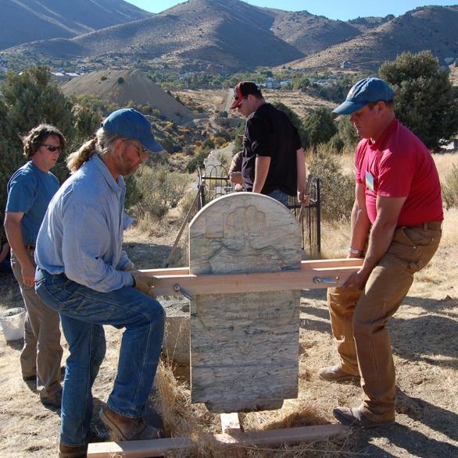
Training
Targeted Levels of Expertise
Workshops
Videos
Webinars
Tel-Broadcasts
Notes:
There are a wide variety of workshops offered around the country, including those from
NCPTT
Jonathan Appell
Chicora Foundation
National Preservation Institute
Association for Gravestone Studies
International Preservation Studies Center
NCPTT’s workshops are geared to an individual’s expertise. We offer workshops for cemetery enthusiasts, maintenance staff, and professional conservators.
In addition to workshops, you can find webinars and short videos on our website.
As with literature, you need to research the workshop and the expertise of those who teach.

Slide 34
Treatments
Traditional Methods
New Materials
Cleaning
Notes:
Undertake treatments armed with your observations, the knowledge you’ve developed, and the skills you’ve honed.
There are a wide range of treatments applied in the field.
First an foremost start with safety issues in the cemetery. Are there damaged trees with “widow-maker” dangling limbs? Are there loose grave markers that could easily topple? Is the landscape overgrown and home to venomous creatures?
Treatments range from traditional methods that are 100s of years old, like limewash, to new chemicals to consolidate stone. Know your treatments!
Try the simplest, gentlest treatments first.
For example, cleaning a grave marker might be as simple as rinsing it regularly with water or gently scrubbing it with a vegetable brush and water. Always test your treatments in a small unobtrusive spot before applying it to a feature.
Word of caution, what you do the grounds can affect your markers! Example Round-up can cause damage to stone.

Slide 35
Current & Future Challenges
Lack of trained cemetery specialists
Plethora of cemeteries in need
Information vs Misinformation
Minimal or non-existent funding
Notes:
To sum up, our challenges for today and the future include:
Lack of trained cemetery specialists
Plethora of cemeteries in in need
Information vs Misinformation
Minimal or non-existent funding
In the photograph we see a respected maintenance worker grinding the surface of a grave marker. Would you be willing to stop him?

Slide 36
Without observation, knowledge, skills and ethics, cemeteries will continue to fade from memory.
Notes:
Remember that good observations, sound knowledge, developed skills, and an ethical foundation leads to good cemetery preservation. Without it, our cemeteries will fade from memory.

Slide 37
Be a part of a larger movement
for better cemetery preservation!
Notes:
You can apply the lessons learned here this week and be a part of a larger movement towards better cemetery preservation.

