Slide 1
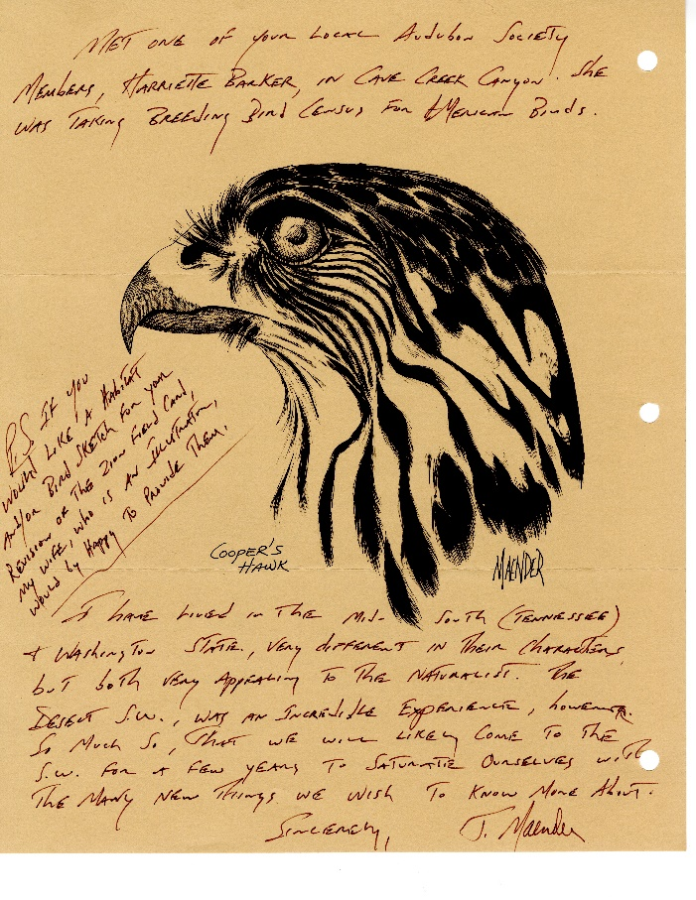
Lesson 2 Introductory Slide
Lesson 2: Research Methods using Field Study and Museum and Archival Collections Lesson Guide
NPS Photo
NPS Photo
NPS Photo
Notes:
During Lesson 2 you will learn about and practice the skills of observation in field study, study a field observation document from the park museum collection, and prepare a formal account of observations made of a bird in its natural environment. You will use these skills to carry out your own field study of birds in an outdoor space near your home.

Slide 2
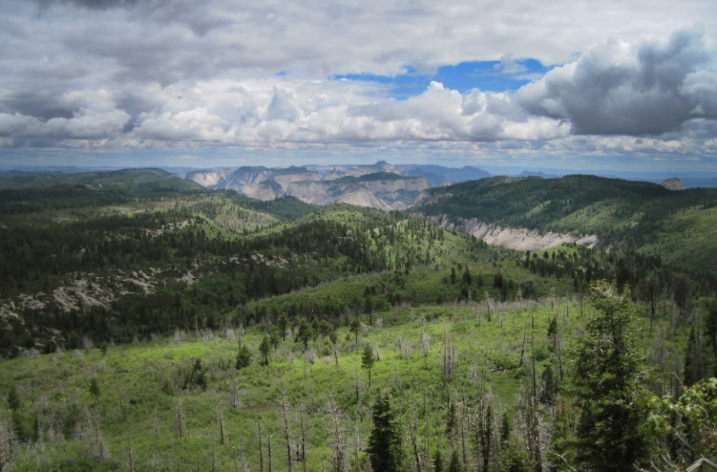
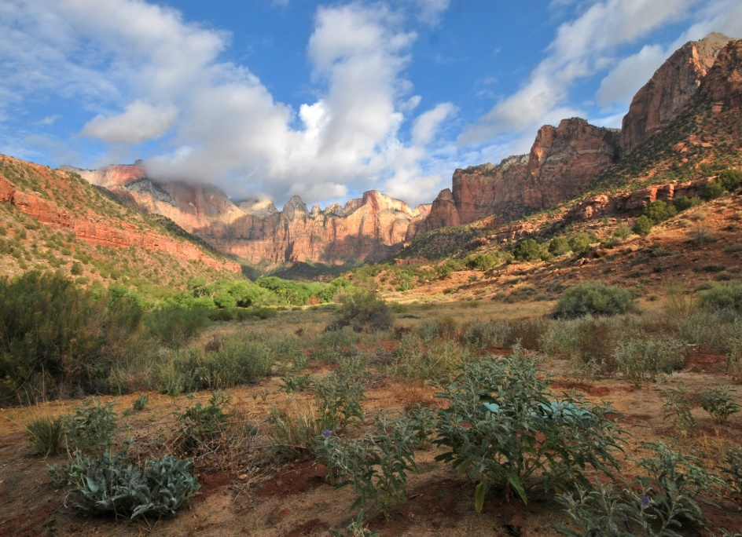
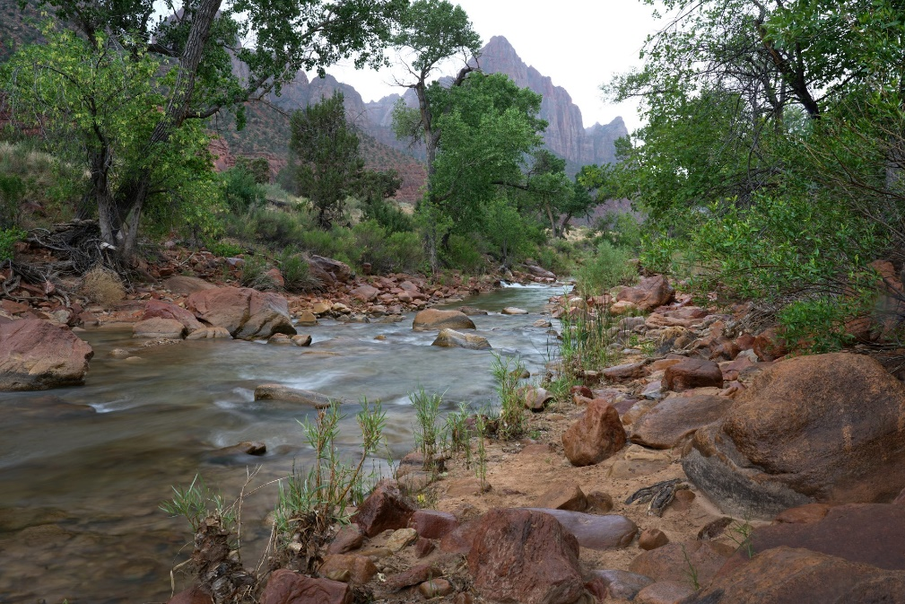
The Four Major Ecosystems of Zion
Ecosystems of Zion National Park
Notes:
(3 minutes) Zion National Park is a vast, beautiful landscape featuring dramatic sandstone cliffs and canyons. The park was founded in 1909 as a national monument. Since then millions of people have visited to experience this high desert ecosystem and witness the biodiversity of the area’s plants and animals. Take note of the four distinctive landscapes shown here that provides habitat for the plants and animals living here. These include High Plateau Forest, Riparian and Water Areas, Pinyon-Juniper Forest, and Desert Grassland. (See ZION virtual exhibit Habitat Feature for descriptions of each)
There are over 400 national park sites in America- National Parks, like Zion, are living laboratories where scientists ask questions. They observe and experiment to learn from interactions of plants and animals in their natural environment…during this unit you will discover how observations of living now while studying collected specimens and data of the past gives us a more full understanding of our future. Natural history museums and collections like that of Zion National Park play a key role in this endeavor of monitoring and projecting changes faced.

Slide 3
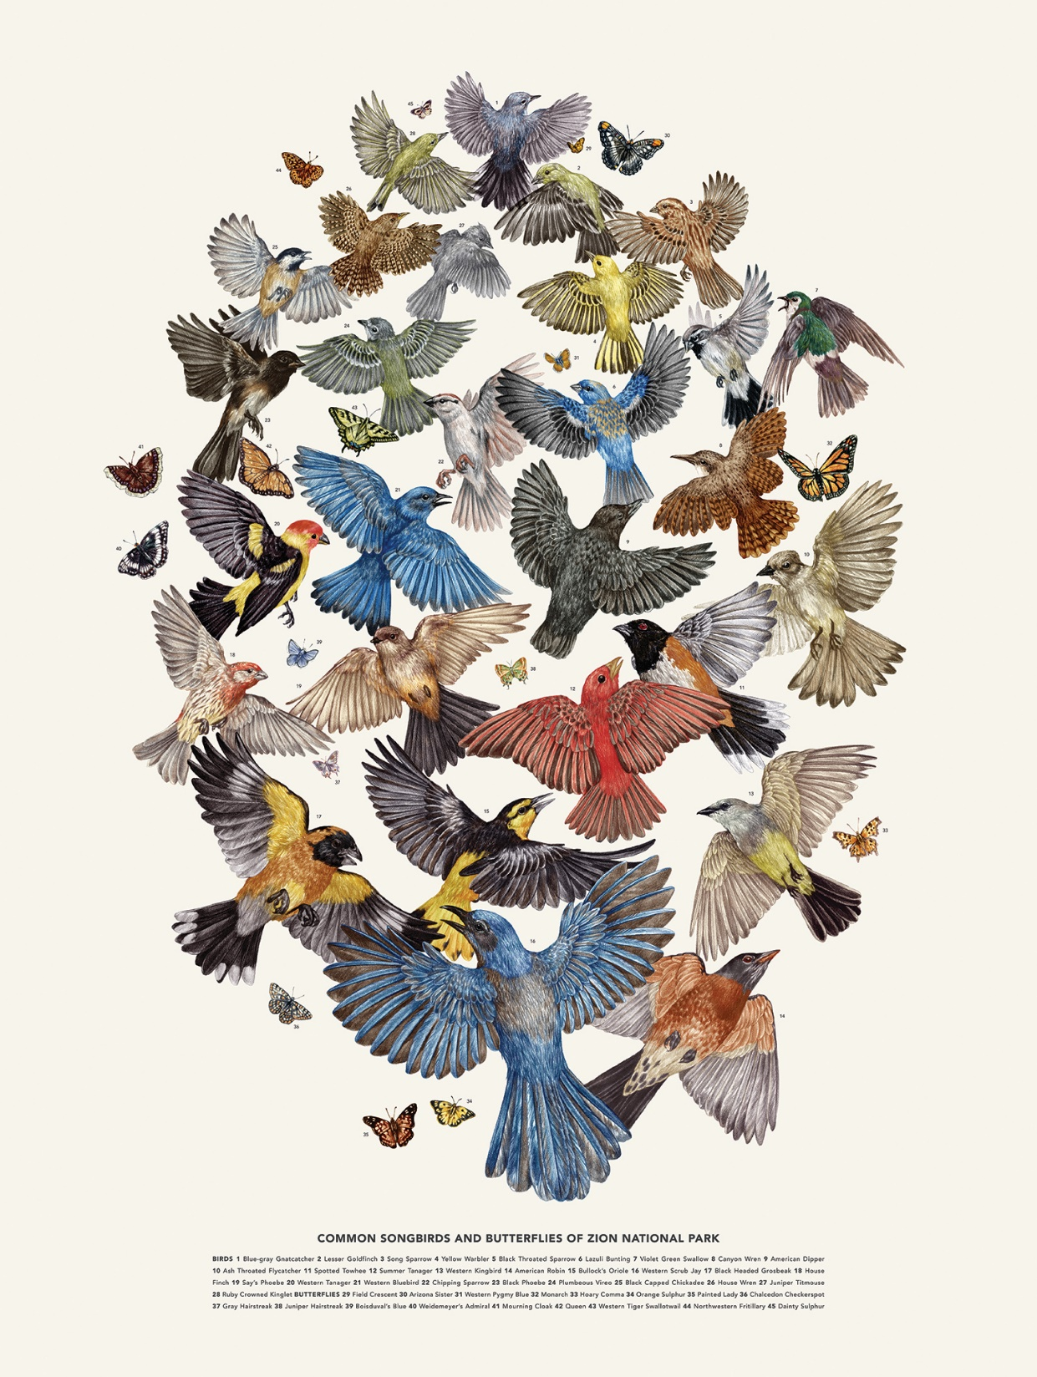
Biodiversity in Zion
What is biodiversity?
Why is biodiversity important?
How do scientists document and record diversity of birds?
How and why should I be a birder?
Common Songbirds of Zion Artwork by Zoe Keller
Notes:
(2 minutes) This unit will focus on learning about nature in both Zion and your neighborhood by taking closer looks at birds. Birds are super interesting and are a great way to explore how organisms use physical features and behaviors to survive in their neighborhood. How do we know what we know about birds past and present? A major contributor to our knowledge is through field study and observations made by scientists and naturalists past and present. You can be a bird observer and contribute to bird knowledge as well…Plus, being a birder is a great way to enjoy nature. Birding is a hobby millions of people young and old do just for fun. You and your classmates are going to observe and record your observations for class soon.
The following video showcases how citizen birdwatchers and scientists conducting field studies can and do join forces to understand bird behavior past and present.

Slide 4
Cooperative Field Study- Birders and Scientists
Notes:
(5:33 minutes) Watch video to 5 minutes 33 seconds. Closed captioning available in settings. Video highlights the basics of backyard birding, what to look for, and how to identify birds.
Link if embedded video is not working: https://www.youtube.com/watch?v=NpdwyFBJakg
Important Note: Let students know that binoculars are not needed to bird watch. If they have access to them, use them. If not, they can still make observations.

Slide 5
Field Study Observation and Data Sheet
Notes:
(5 minutes) Now it is time for us to do a practice field study using video of birds interacting with their habitat.
This observation sheet will help guide you in recording important information about each bird’s appearance and behavior. Rather than counting birds like the previous video, you will be recording the behavior and physical traits of birds.
At this point in becoming a birder it is not important to identify exactly what bird we see, but to learn what to look for and how to record your field data. We will learn about using an online bird identification tool tomorrow.
Each student should have a copy of worksheet and prepare to participate in field study exercise.
Briefly go through the observation sheet and prepare students for recording data. A detailed sketch of the bird is not needed- the basic silhouette or outline is most helpful to birders. Learning to notice things is most important at first. After the first day encourage students to notice more details and begin to use an app or field guide to narrow down or identify species.
If you are short on time, feel free to eliminate one of the next three video observations. Observing all three will give students a better sense of the diversity of species however. All 3 of these birds live in and around Zion National Park.
*Inform students they will use this same form for making bird observations for the next week (or however long the teacher decides) at home in an outdoor space. Details will be given at end of lesson today.

Slide 6
Field Study 1: Spotted Towhee
Video by Clive Bramham
Notes:
(1 minute)
Embedded video from YouTube
Video link https://youtu.be/NuL885n0z8Y
Closed captioning not provided. No speaking parts in the video.
Permission to embed and use received from videographer Clive Bramham.

Slide 7
Field Study 2: Cinnamon Teal
Cornell Lab of Ornithology
Notes:
(1 minute)
Embedded video Cornell Lab of Ornithology via YouTube
Video link https://youtu.be/Ak8YmIAYlVI
No closed captioning. No speaking parts in the video.
Permission to share granted via educational policy

Slide 8
Field Study 3: Golden Eagle
Cornell Lab of Ornithology
Notes:
(1 minute)
Cornell Lab or Ornithology video via YouTube
Video link https://youtu.be/PxhSA-4bcr0
No closed captioning. No speaking parts in the video.
Permission to share by Cornell educational share policy

Slide 9
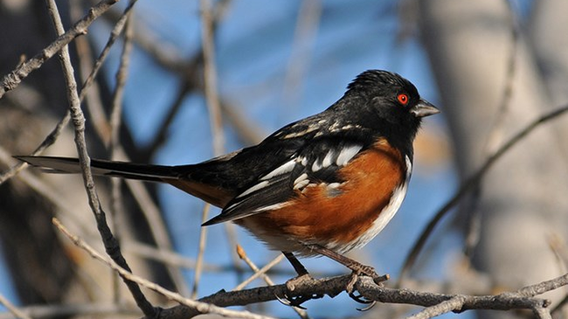
Small Group Discussion: Field Study Observations
Share your sketch of the Spotted Towhee. How would you describe the shape of its body?
What was the Spotted Towhee doing? Why do you think it was behaving this way?
Compare and contrast the three birds observed in the videos. How are the similar? How are they different?
Why do you think there is such physical and behavioral diversity in birds?
Photo Sally King, NPS
Notes:
Photographer Sally King, National Park Service
(3-4 minutes) Small group or class discussion

Slide 10
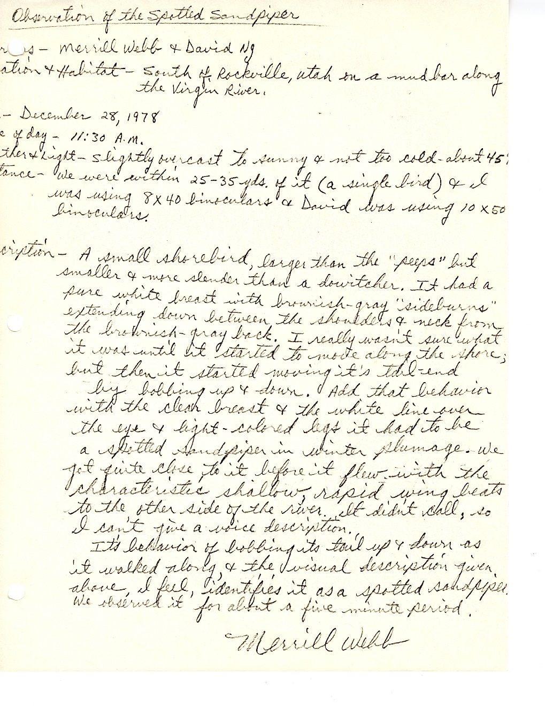
Archived Historical Document
Observation of the Spotted Sandpiper
Observers: Merrill Webb & David Ng
Location & Habitat: South of Rockville, Utah on a mud bar along the Virgin River
Date: December 28, 1978
Time: 11:30 A.M.
Light & Weather: slightly overcast to sunny and not too cold- temperature about 45 degrees
Distance: We were within 25-35 yards. I was using 8X40 binoculars and David was using 10x50 binoculars.
Description:
A small shorebird, larger than the “peeps” but smaller and more slender than a dowatcher. It had a pure white breast with brownish-gray “sideburns” extending down between the shoulders and neck from the brownish-gray back. I really wasn’t sure what it was until it started moving its tail-end by bobbing up and down. Add that behavior with the clear breast and the white line over the eye & bright colored legs it had to be a spotted sandpiper in winter plumage. We got quite close to it before it flew with the characteristic shallow, rapid wing beats to the other side of the river. It didn’t call so I can’t give a sound description.
Its behavior of bobbing its tail up and down as it walked along & the universal description given alone, I feel identifies it as a spotted sandpiper. We observed it for about a five minute period.
Merrill Webb
Notes:
(5-8 minutes) Students may read this observation account silently to themselves or read aloud as a class. Then proceed with a class discussion in general fashion as you wish or use this guide:
**This is a historical observation document that is kept in Zion National Park’s museum archives. Natural history museums keep items like this because they contain important information.
Can you read the original document on the right?
Do you think this was written by a scientist, ranger, or a hobby birder? Why do you think that?
What do you think the author’s purpose was for writing this account?
What behaviors did the observers document?
What physical traits did they document?
Why do you think archiving past field studies and observations is important?
How might rangers and scientists use this information today?

Slide 11
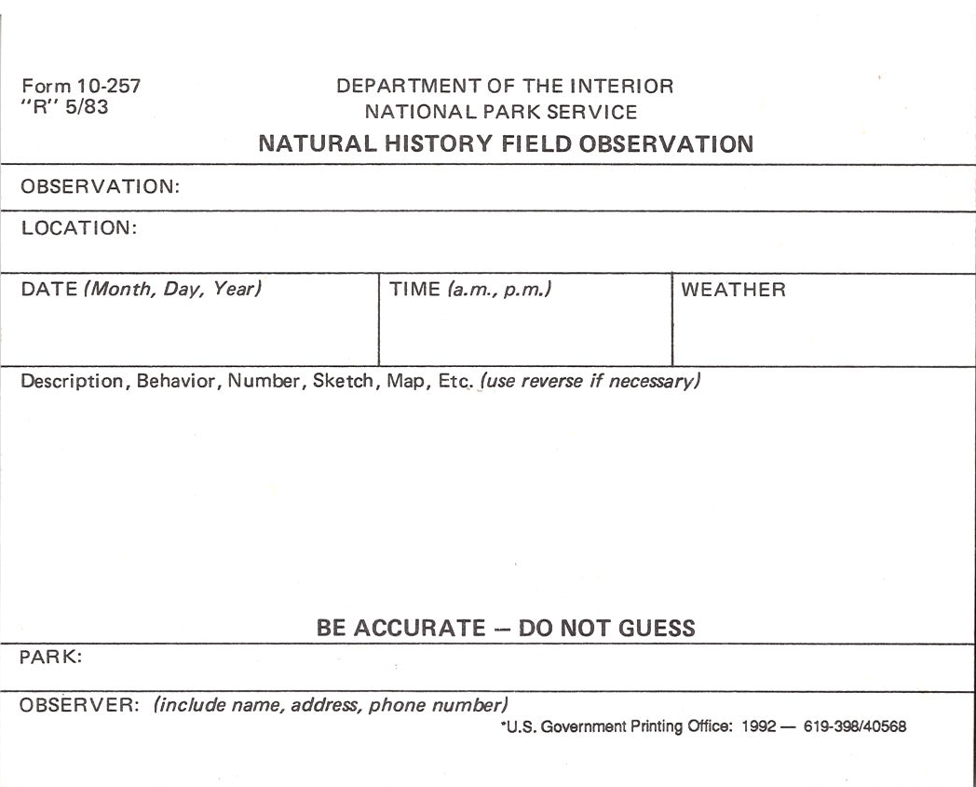
NPS Official Field Observation Form
Official National Park Service Natural History Field Observation
Notes:
(15-20 minutes including video observation and writing) After reading and learning from the historical observation account of the Spotted Sandpiper, it’s time to practice sharing data and observations in a formal, descriptive writing style in a fictional but realistic scenario. The field observation form you see here is used in national parks like Zion. Park rangers, scientists, and visitors use this form to report official observations and encounters they have with animals, plants, fossils, or other natural objects.
Scenario: You are visiting Zion National Park and see this bird. After watching the bird they ask a ranger what they think it was and he responds it sounds like a Northern Flicker. The ranger asks you to please document your observations by completing the form. He will share it with the park biologist as she is currently studying why the Northern Flicker population is going down in the park. Watch this 1 minute video as if it is happening to you now as a visitor to Zion National Park. Reflect upon the historical account just read on the previous slide. Things to consider including are: the weather and general conditions; location (Zion, in a forest area for example); date and time of day; and detailed description of both the physical appearance and behaviors of the Flicker. Remember that this is an official field observation document that will be used by scientists and remain in park records forever.
Teacher may print a copy for each student or have students create their own template on paper. The observation form is found in the Teacher Guide. The video is on the next slide and may be played several times.

Slide 12
Northern Flicker Field Video
Field Study 4: Northern Flicker
Video by Georgi Abbott
Notes:
https://youtu.be/33B2NbjMq0s
Video by Georgi Abbott
No closed captioning. No speaking parts in the video.

Slide 13
Home Field Study Assignment
At Home Birding Observations
Notes:
As a part of this unit you will all practice doing a field study by observing birds living in your neighborhood. For the next week spend at least 15 minutes in an outdoor space making observations of birds you see. Use this field observation form we used today to record your observations. This is a fun activity to do with an adult or sibling. Identifying the bird isn’t necessary, but you may if you can. Bring your sheet back to class each day as we will take time to share with the class. You will also use these notes as a part of your final project. (You may wish to make multiple copies for students, double-sided. At the beginning of each lesson there will be time to share a few student observations) Look and listen while doing this activity. Add as much detail as you can. *Encourage students to use bird feeders to draw birds to their outdoor spaces.
This is the end of the lesson unless you will be doing the Lesson 2 Extension Activity that follows on the next slides.

Slide 14
Extension Activity Video: Day in the Life of a Field Researcher
Notes:
(15+ minutes) Extension Activity- Watch the video about a day in the life of a field researcher in Kenya. Closed captions available in video settings. Permission to share granted via Cornell educational use policy.
Video link https://www.youtube.com/watch?v=Xa6Tipb7sYo
Assignment: A billionaire donor has granted you money, equipment, and staff for a one month field study of any animal you are interested in. Choose your species to study and then create a research plan and budget to give the donor. You must convince her that you have a strong plan and that your research will be useful. A blank research proposal template form is provided on the next slide.

Slide 15
Research Proposal Form
Research Proposal
Notes:
You may use this form for student research proposals or use your own guidelines.

