Slide 1
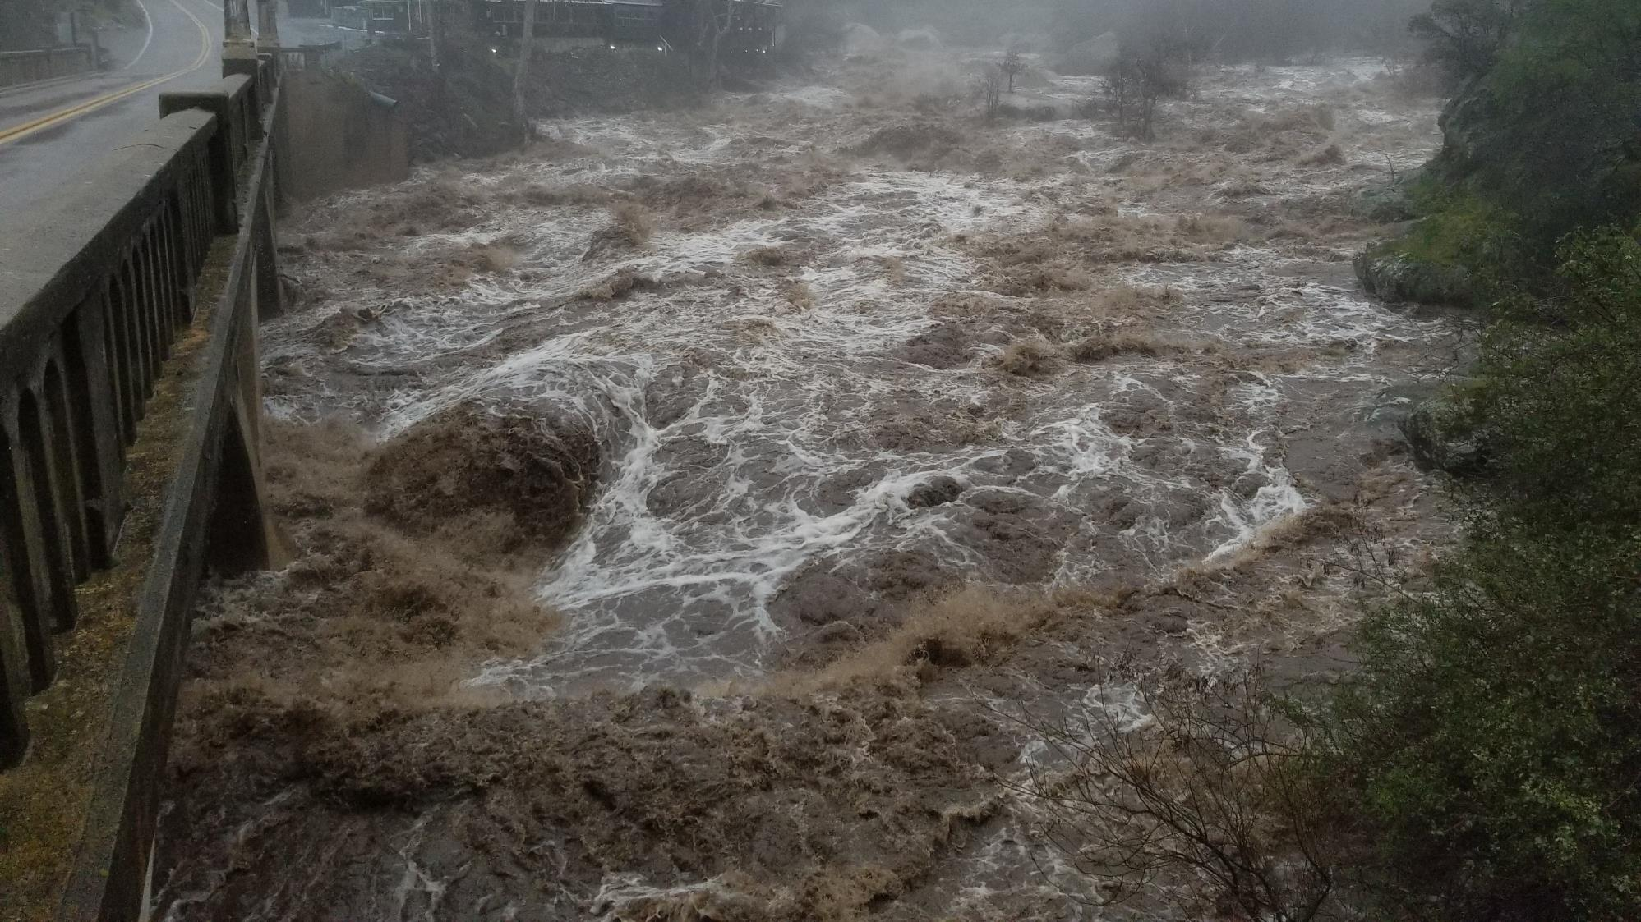
March Winter Storm Damage Report
Caltrans
Tulare County
Sequoia and Kings Canyon National Parks

Slide 2
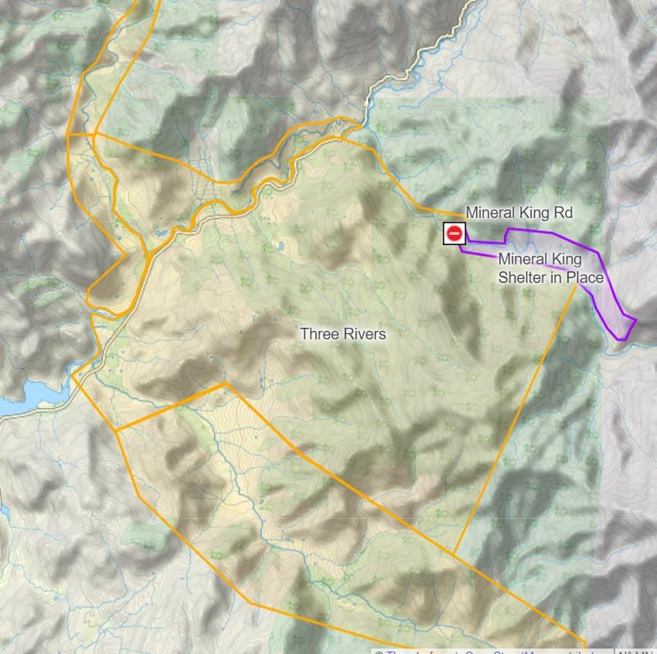
Tulare County Report

Slide 3
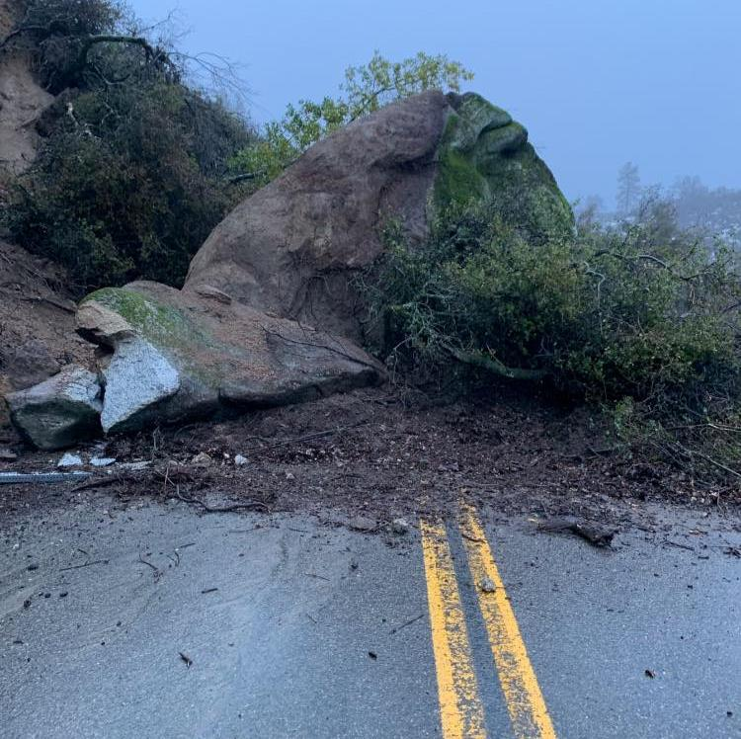
Caltrans Report

Slide 4
Sequoia and Kings Canyon

Slide 5
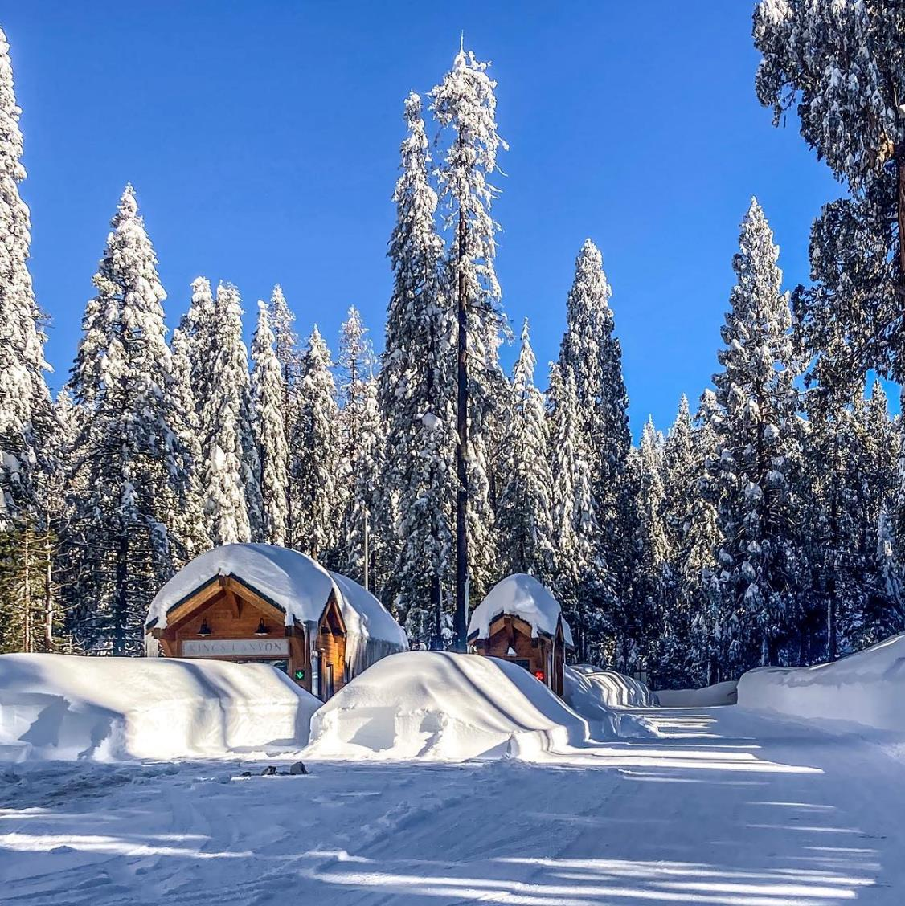
Current Conditions
Sequoia National Park
Public Access Closed at Entrance Station
No Resident or Public Access to Mineral King
South Fork Campground and Trailheads Closed
No Access to North Fork Trailhead (County Section)
Kings Canyon National Park
No Public Access from Highway 180

Slide 6
Damage Report

Slide 7
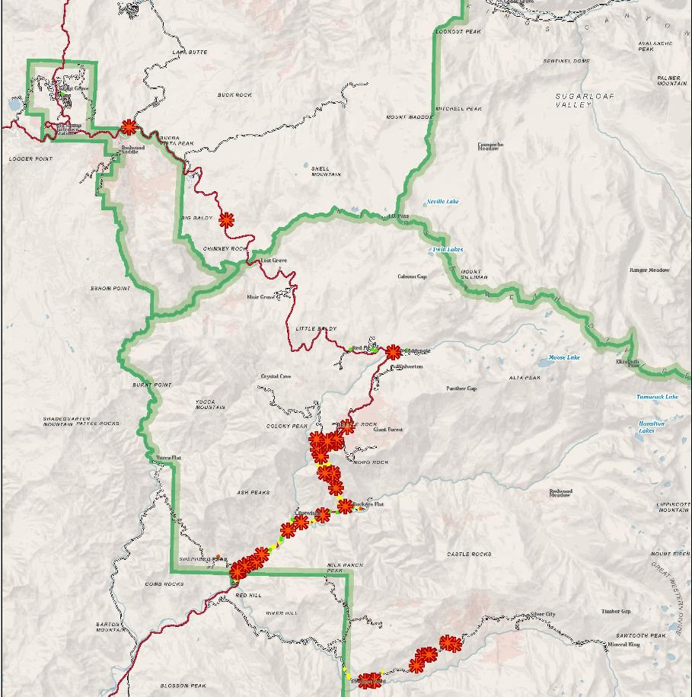
Map of Road Issues

Slide 8
Generals Highway Ash Mountain Entrance to Hospital Rock

Slide 9
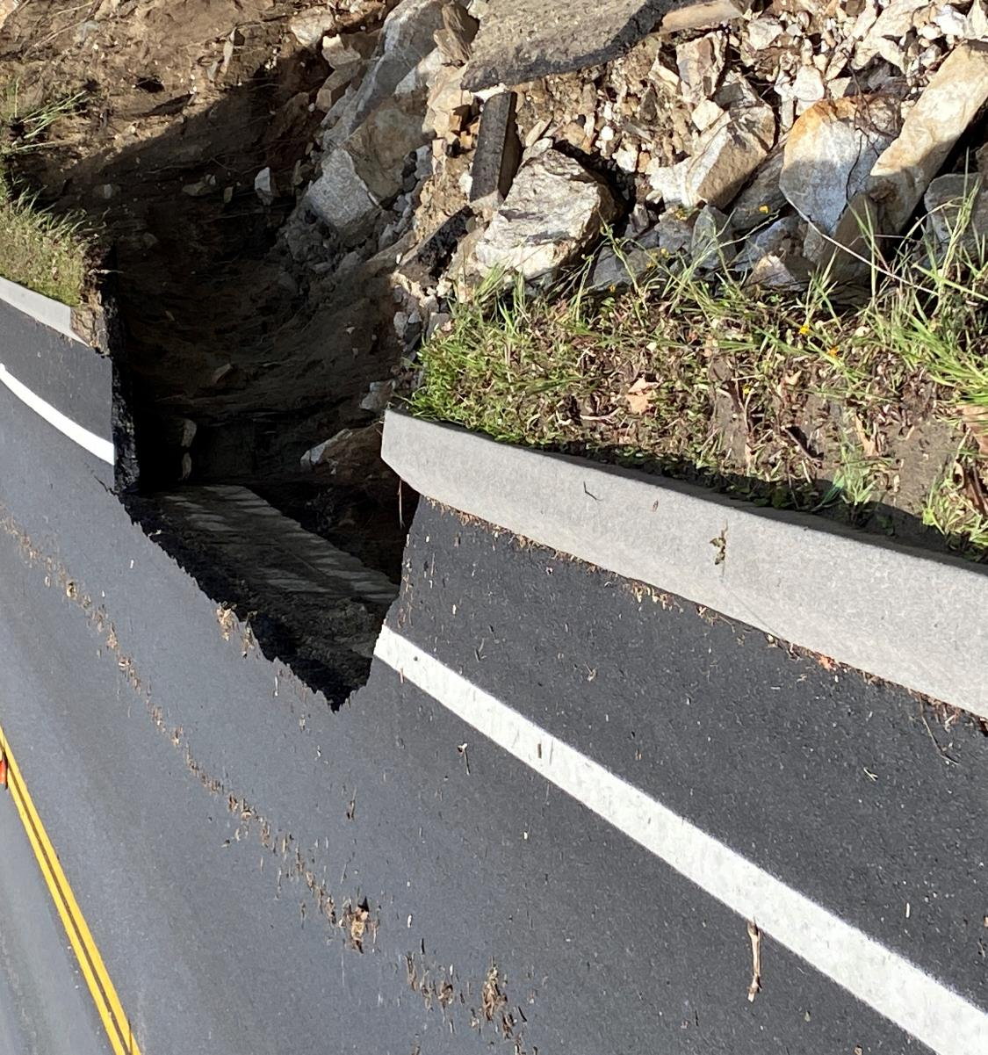
Sequoia Foothills- Sycamore

Slide 10
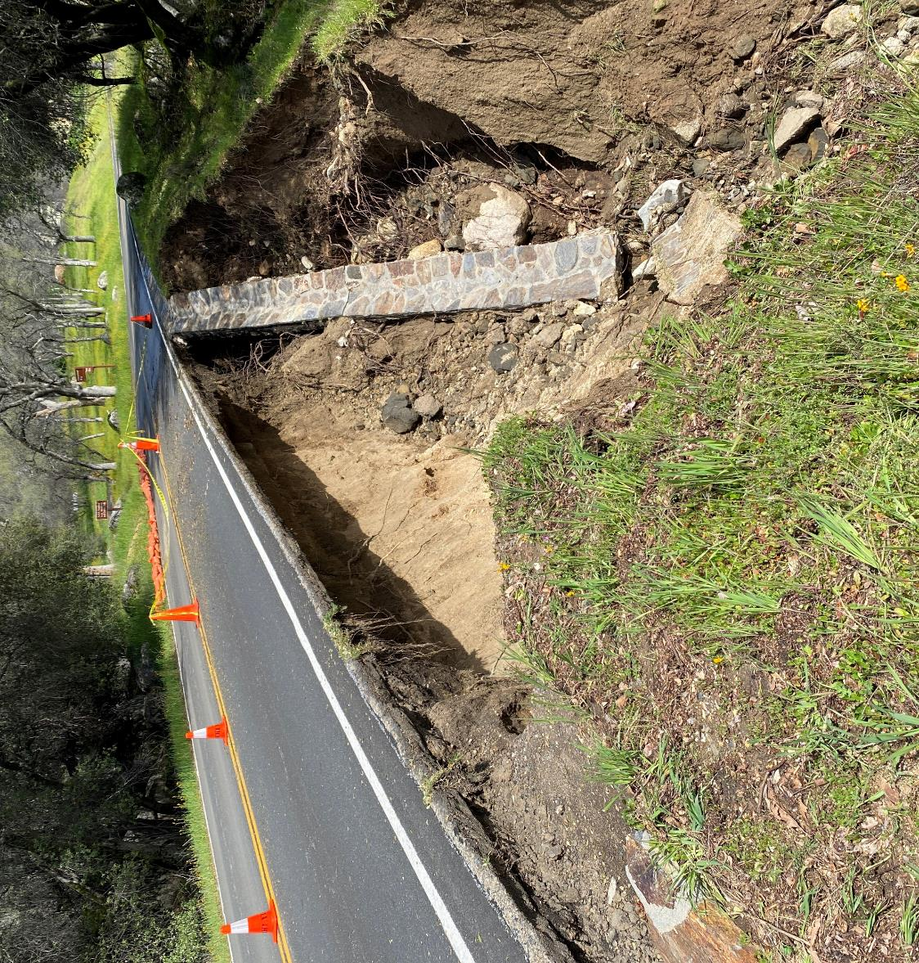
Sequoia Foothills- Cammerer Way

Slide 11
Sequoia Foothills- Alder Creek

Slide 12
Sequoia Foothills- Potwisha 1

Slide 13
Sequoia Foothills- Potwisha 2

Slide 14
Sequoia Foothills- Potwisha 3

Slide 15
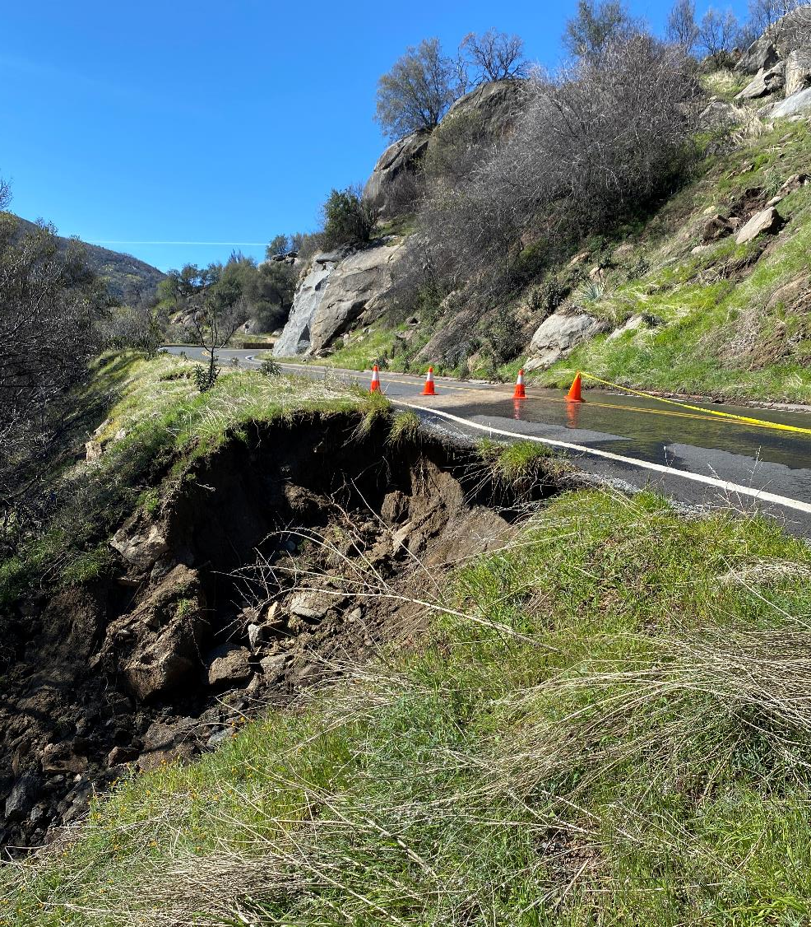
Sequoia Foothills- Hospital Rock 1

Slide 16
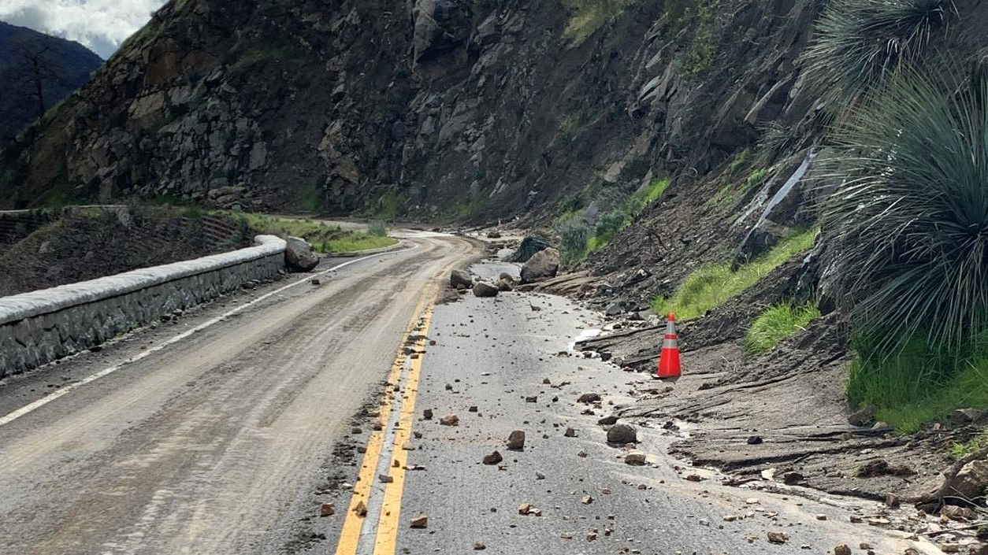
Landslides and Debris

Slide 17
Generals Highway Hospital Rock to Giant Forest

Slide 18
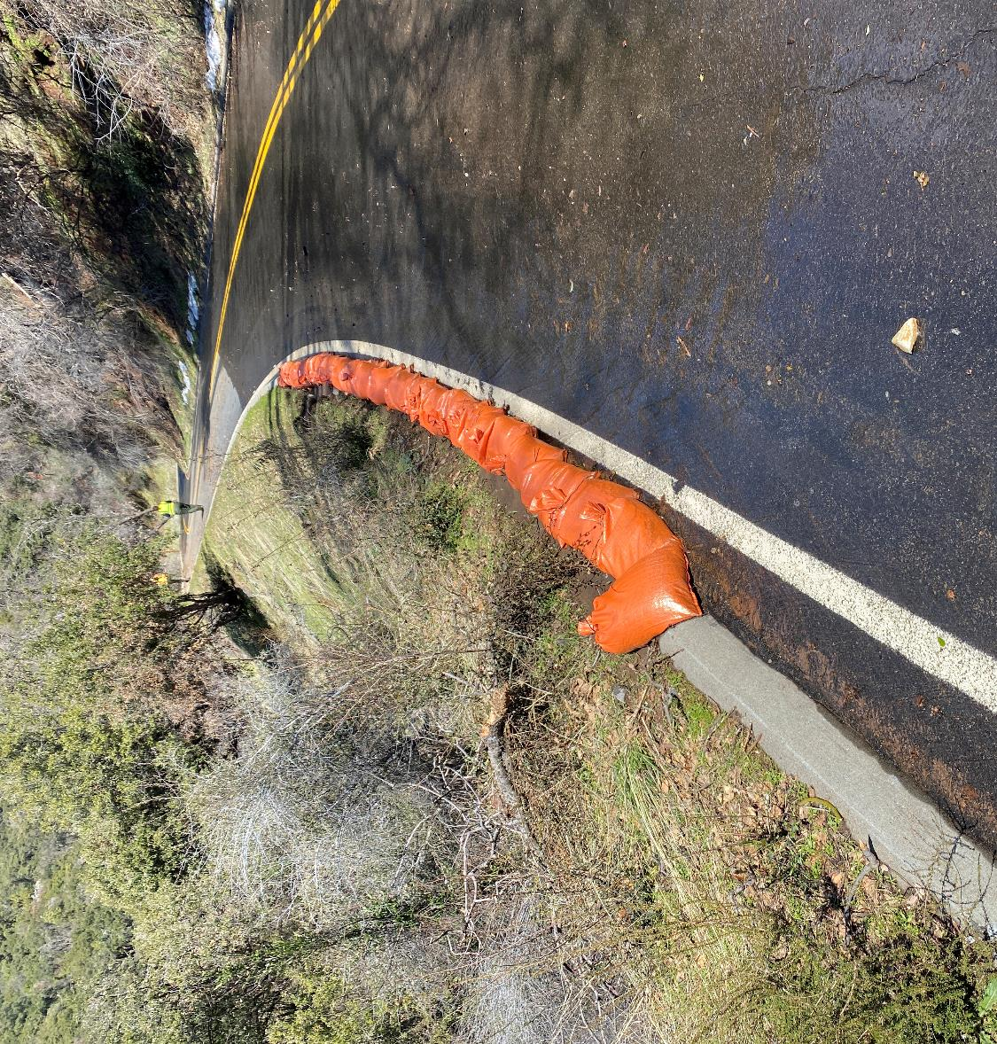
Big Fern Springs 1

Slide 19
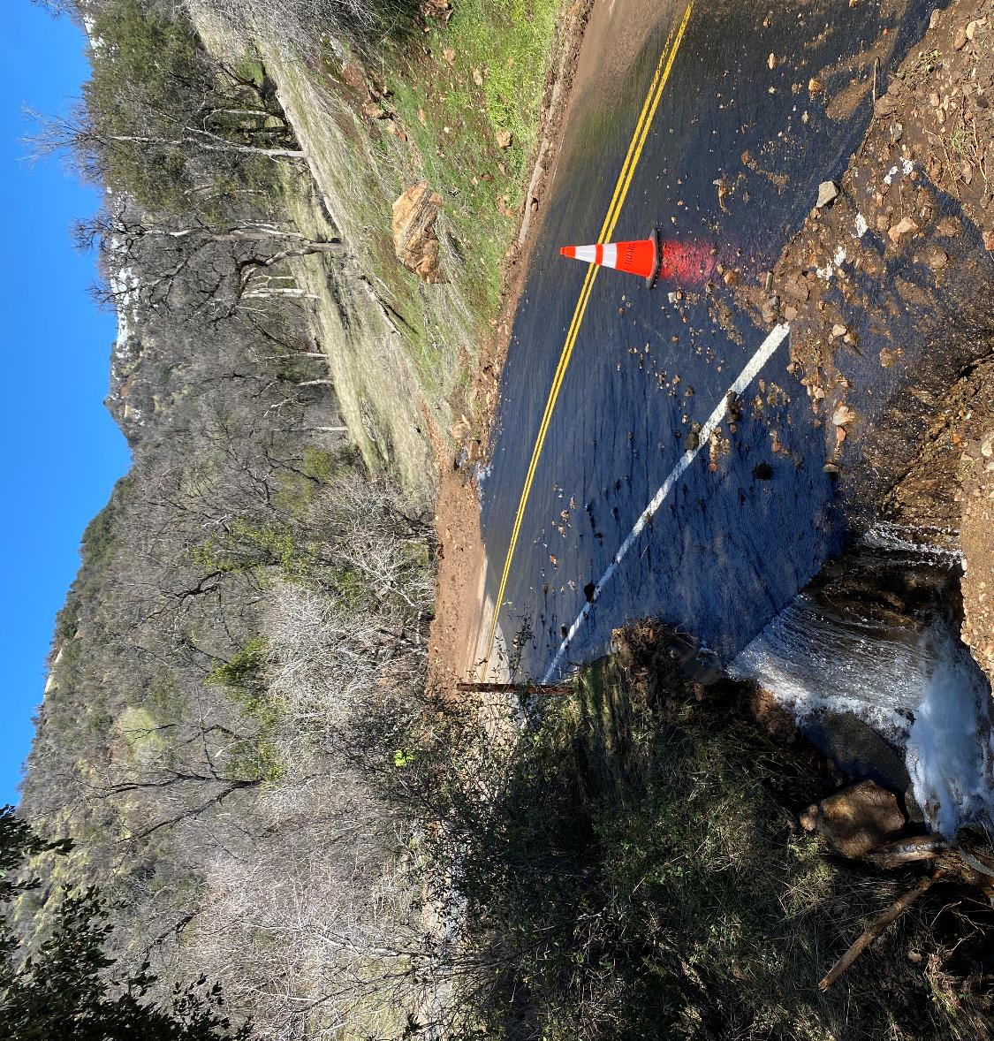
Sequoia Foothills- Hospital Rock 2

Slide 20
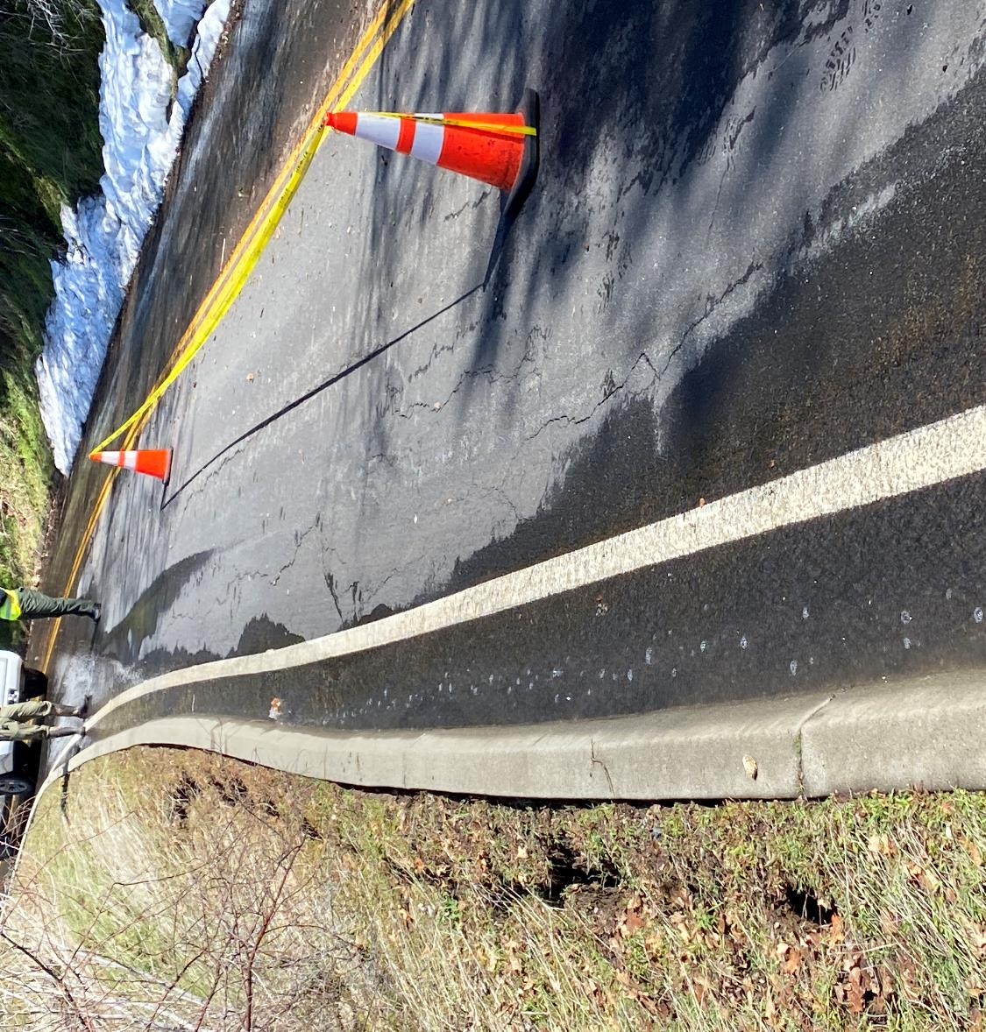
Big Fern Springs 2

Slide 21
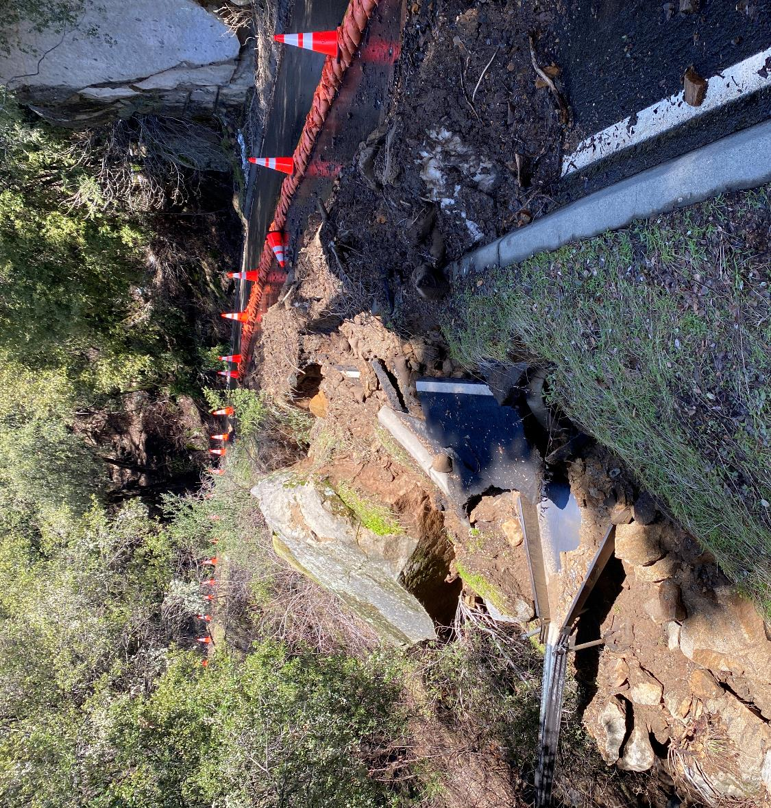
One Shot Rock

Slide 22
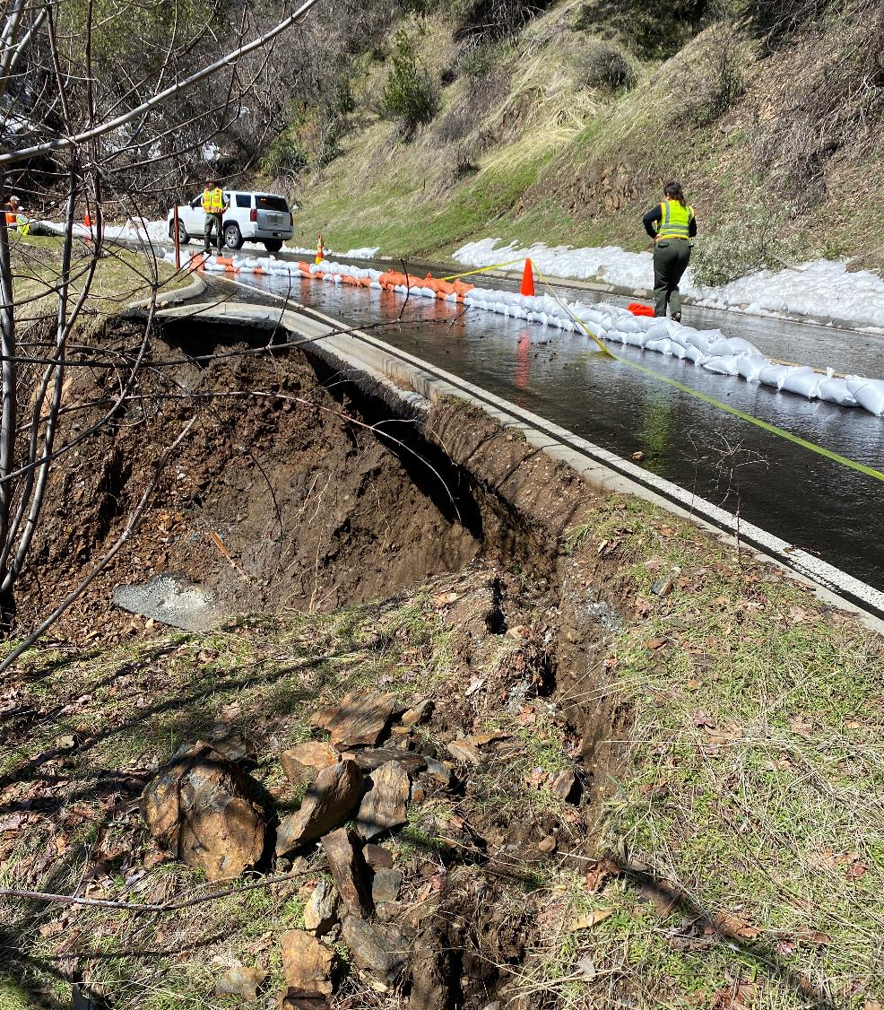
Amphitheater Point

Slide 23
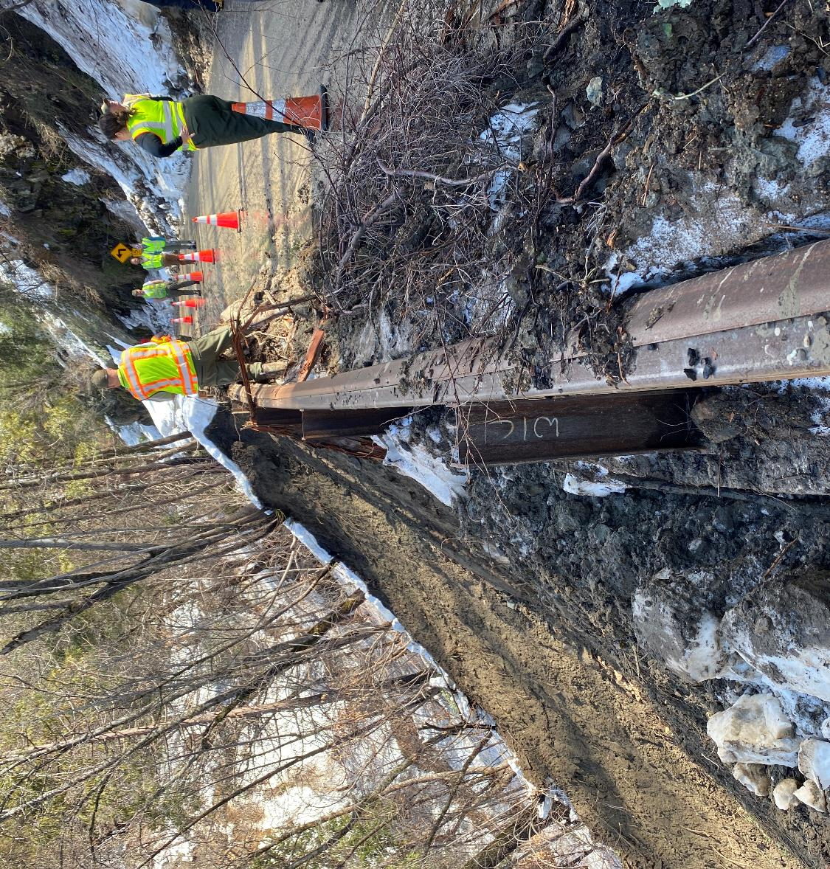
Deer Ridge

Slide 24
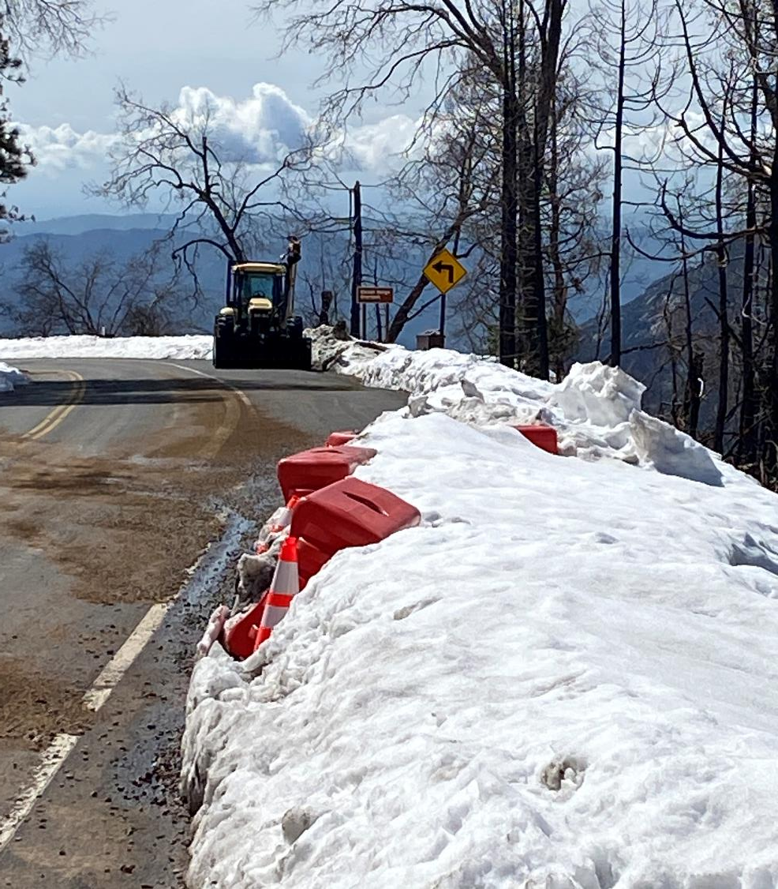
Eleven Range

Slide 25
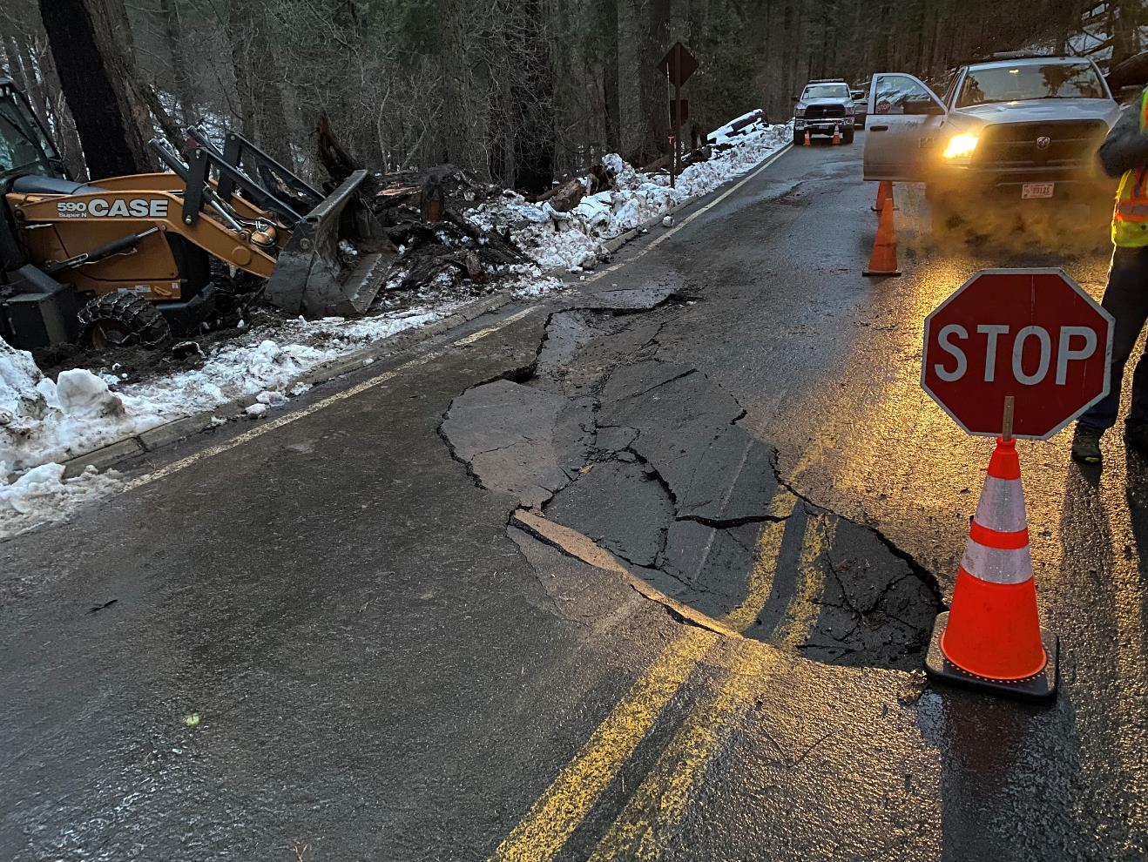
Four Guardsmen

Slide 26
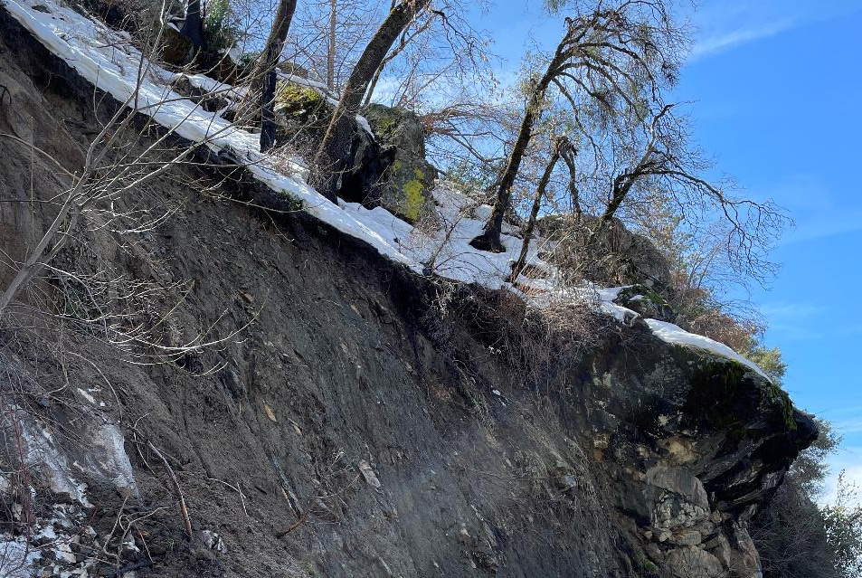
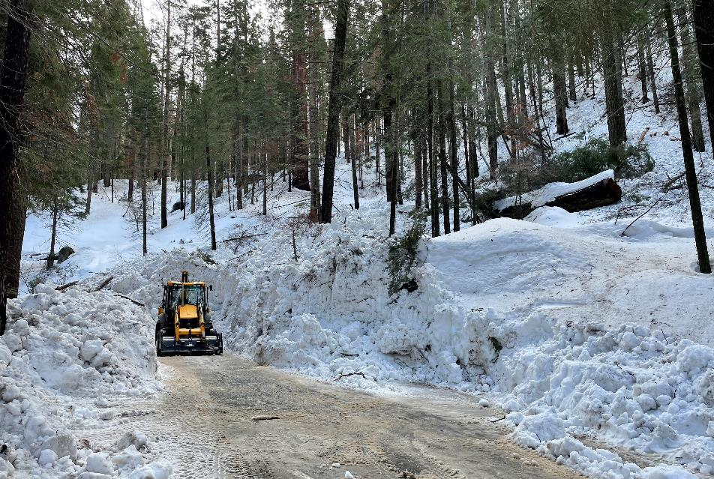
Avalanche Zone and Landslides

Slide 27
Generals Highway Giant Forest to Wuksachi

Slide 28
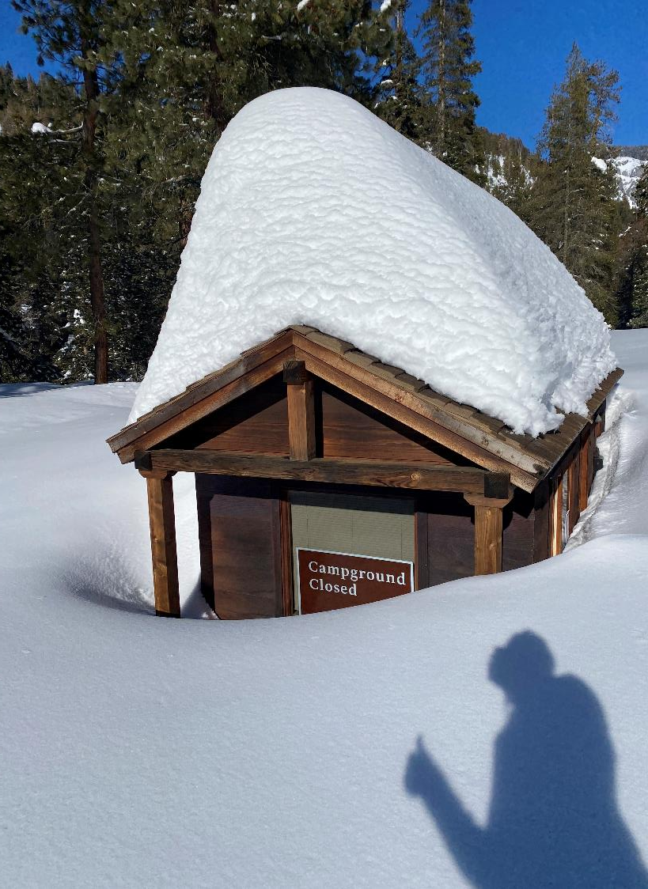
Record Breaking Snowpack

Slide 29
Generals Highway Wuksachi to Hwy 180

Slide 30
Map of Road Issues – Grant Grove

Slide 31
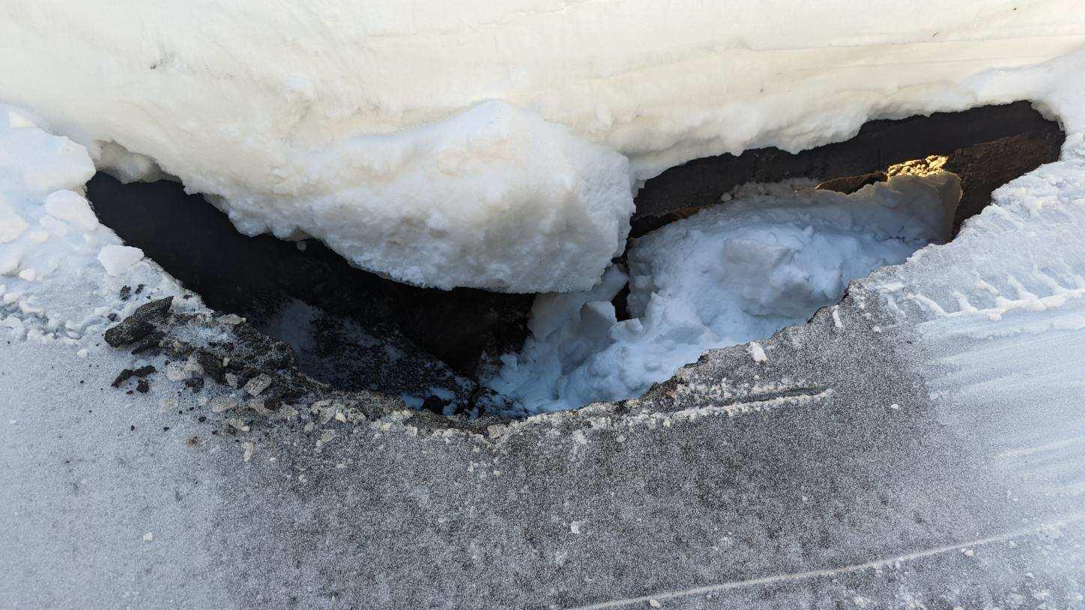
Pythian Camp

Slide 32
Map of Road Issues – Grant Grove

Slide 33
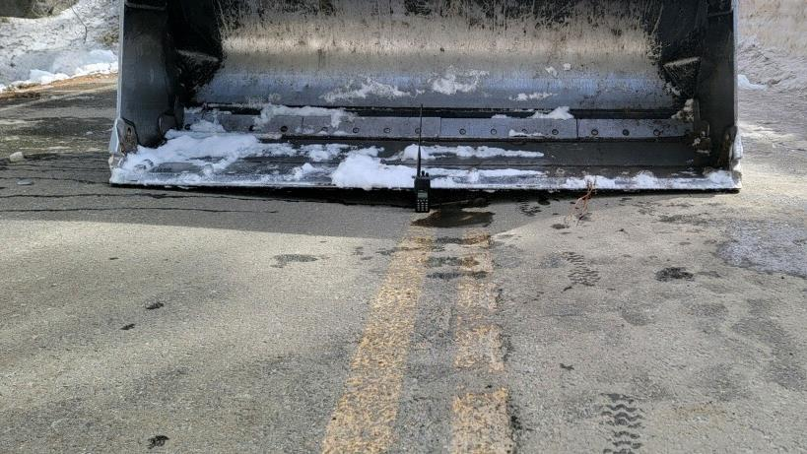
Quail Flat

Slide 34
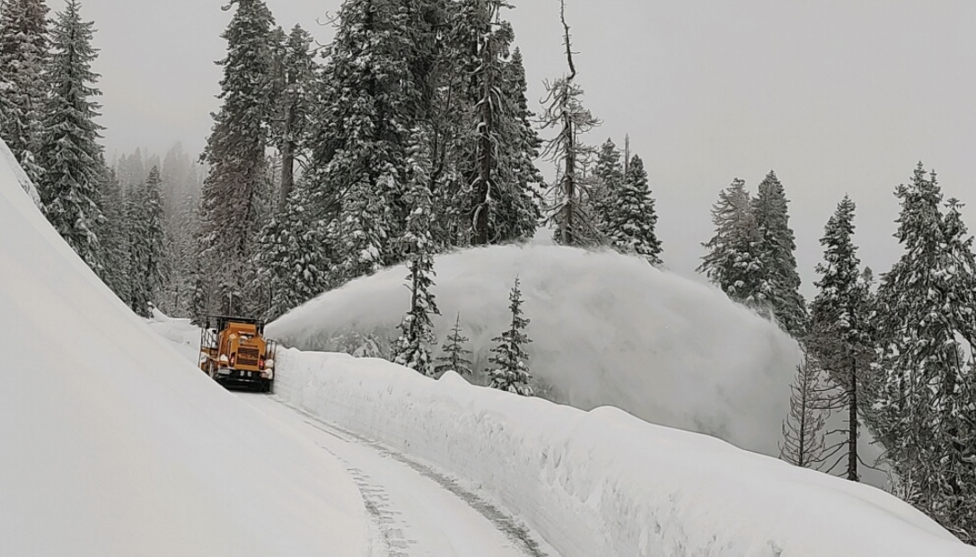
Snow Removal

Slide 35
Mineral King

Slide 36
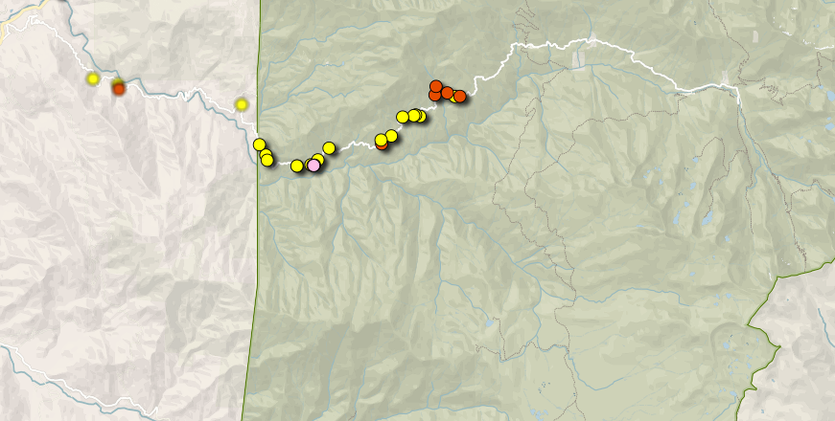
Map of Road Issues – Mineral King

Slide 37
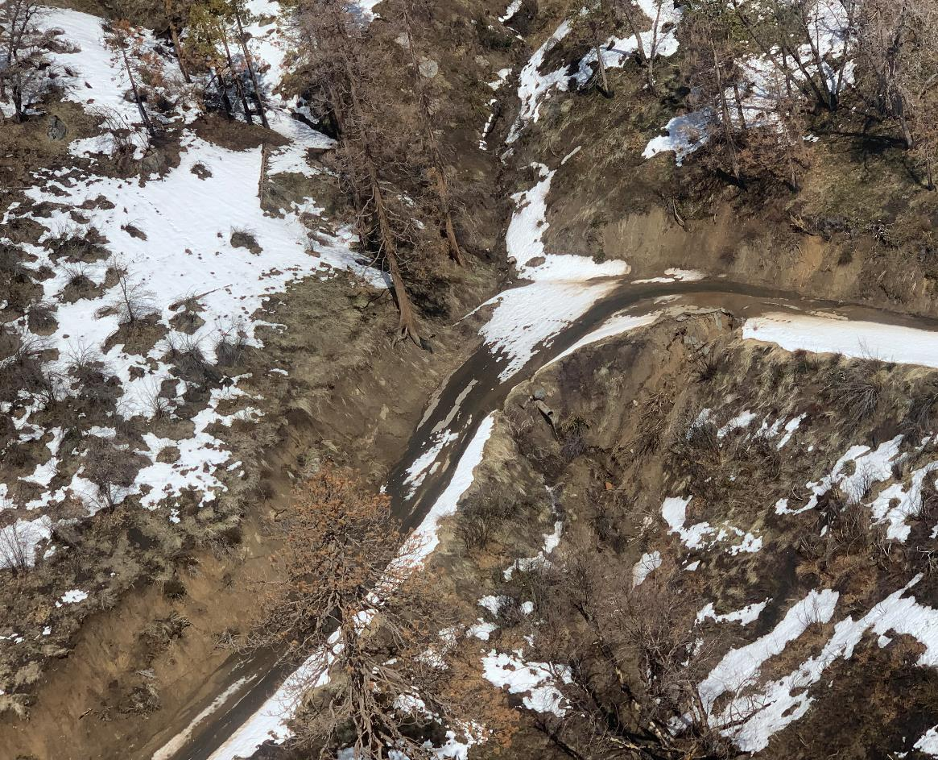
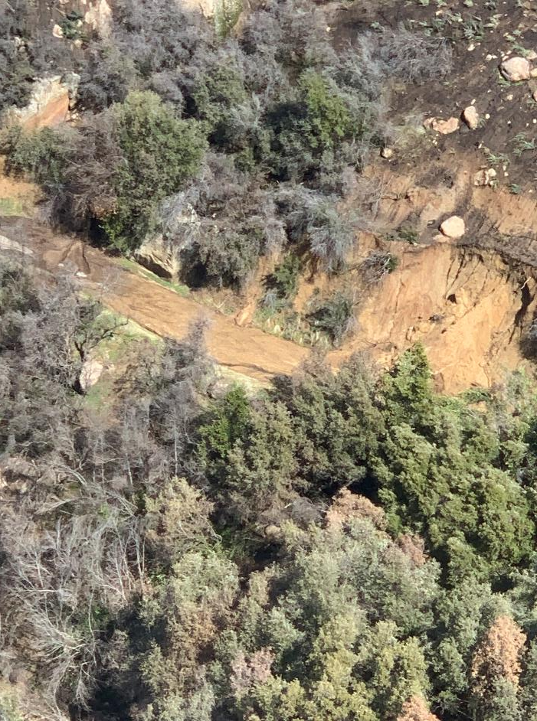
Aerial Views of Mineral King Road

Slide 38
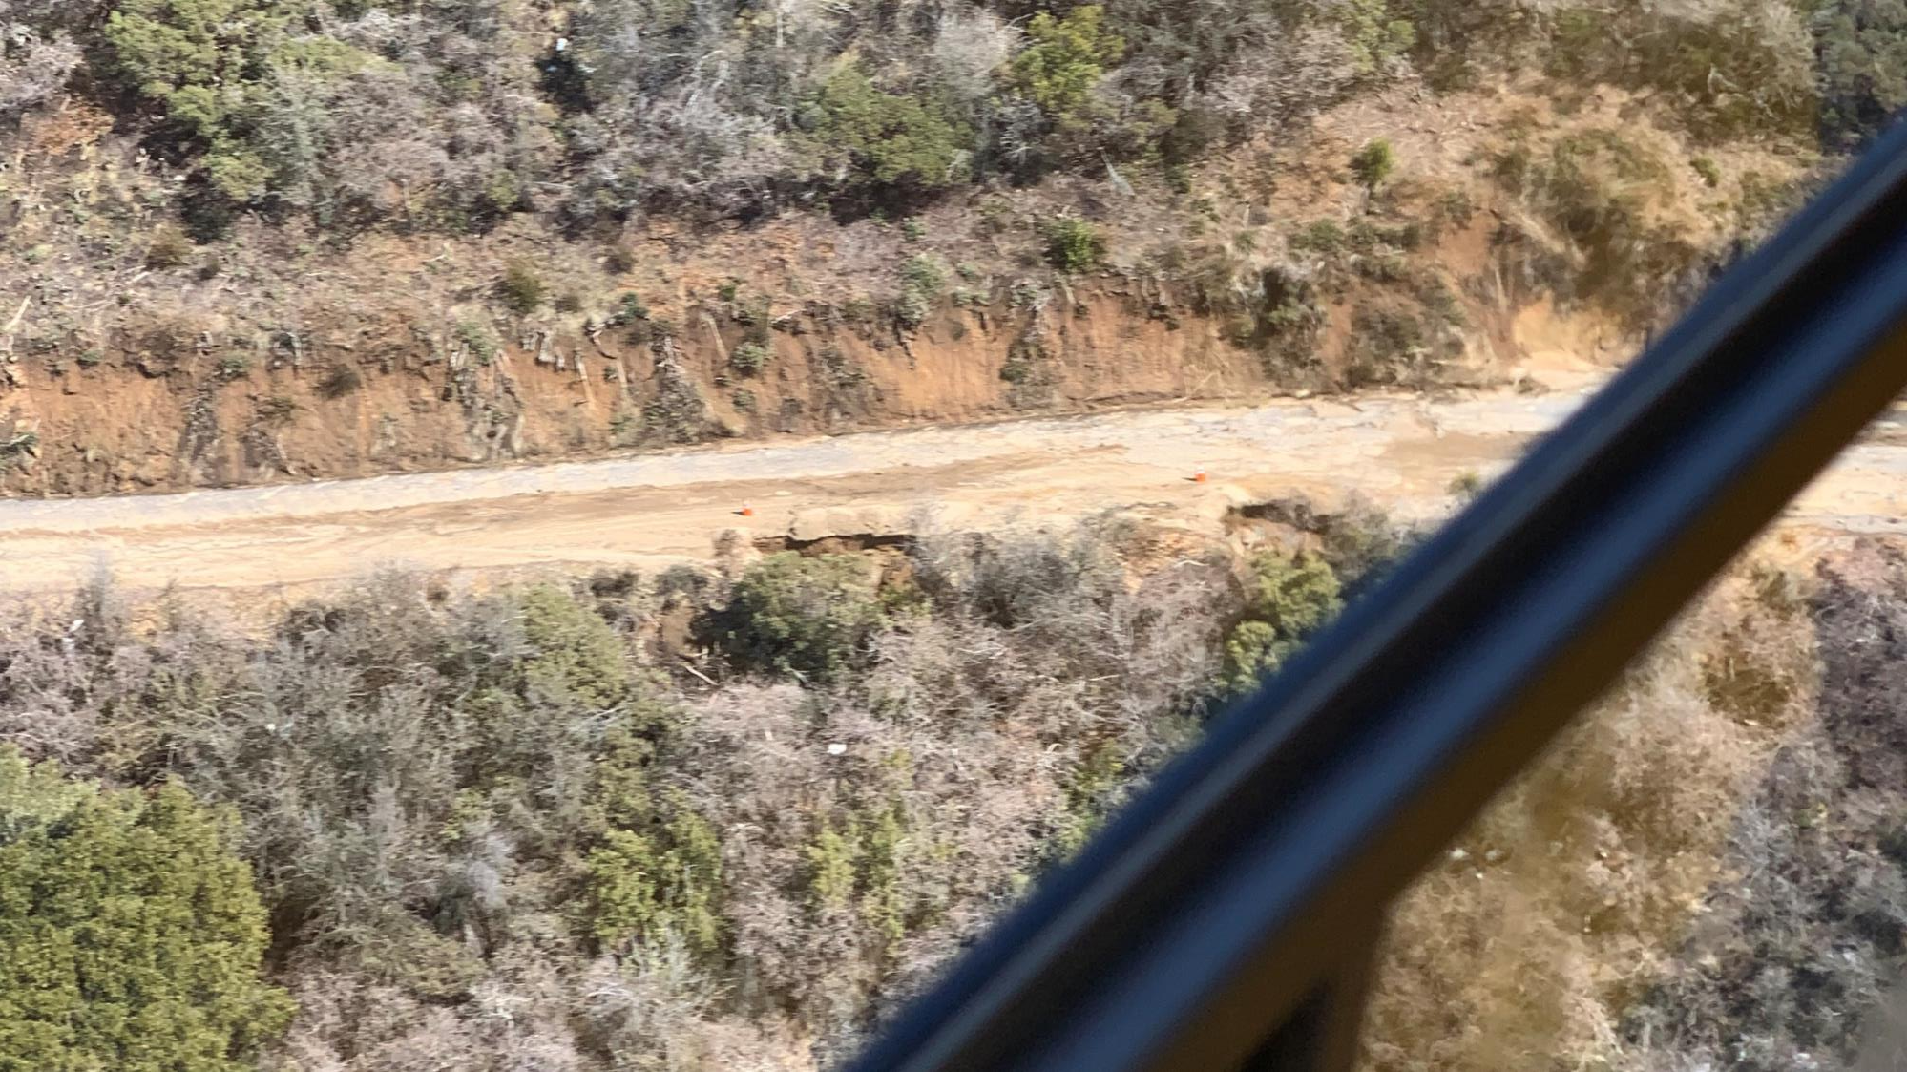
Aerial View of Mineral King Road

Slide 39
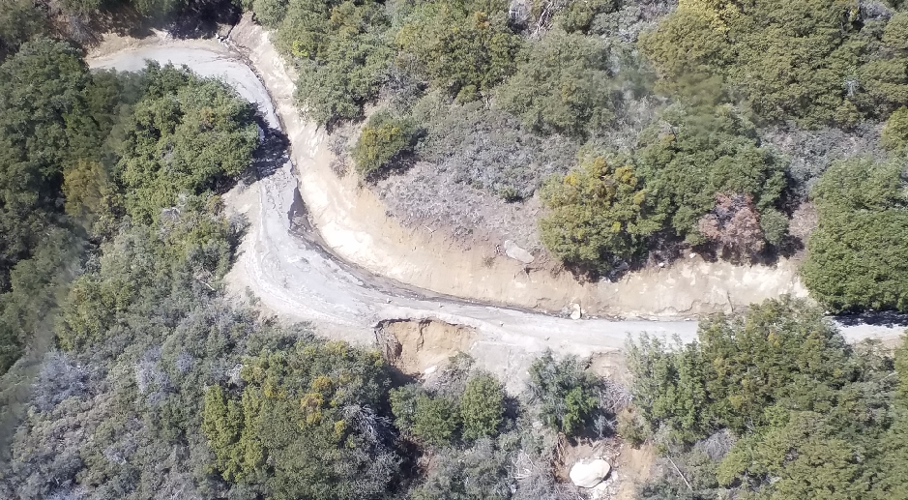
Aerial View of Mineral King Road

Slide 40
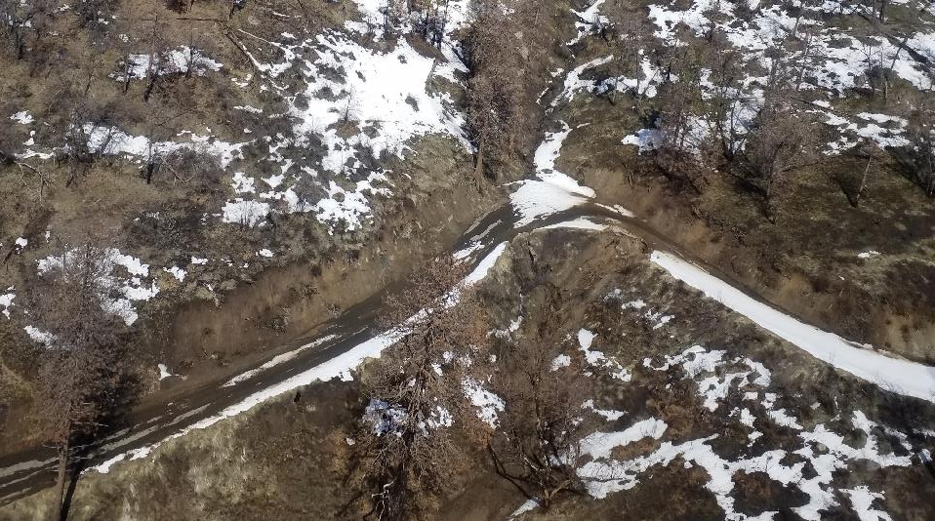
Aerial View of Mineral King Road

Slide 41
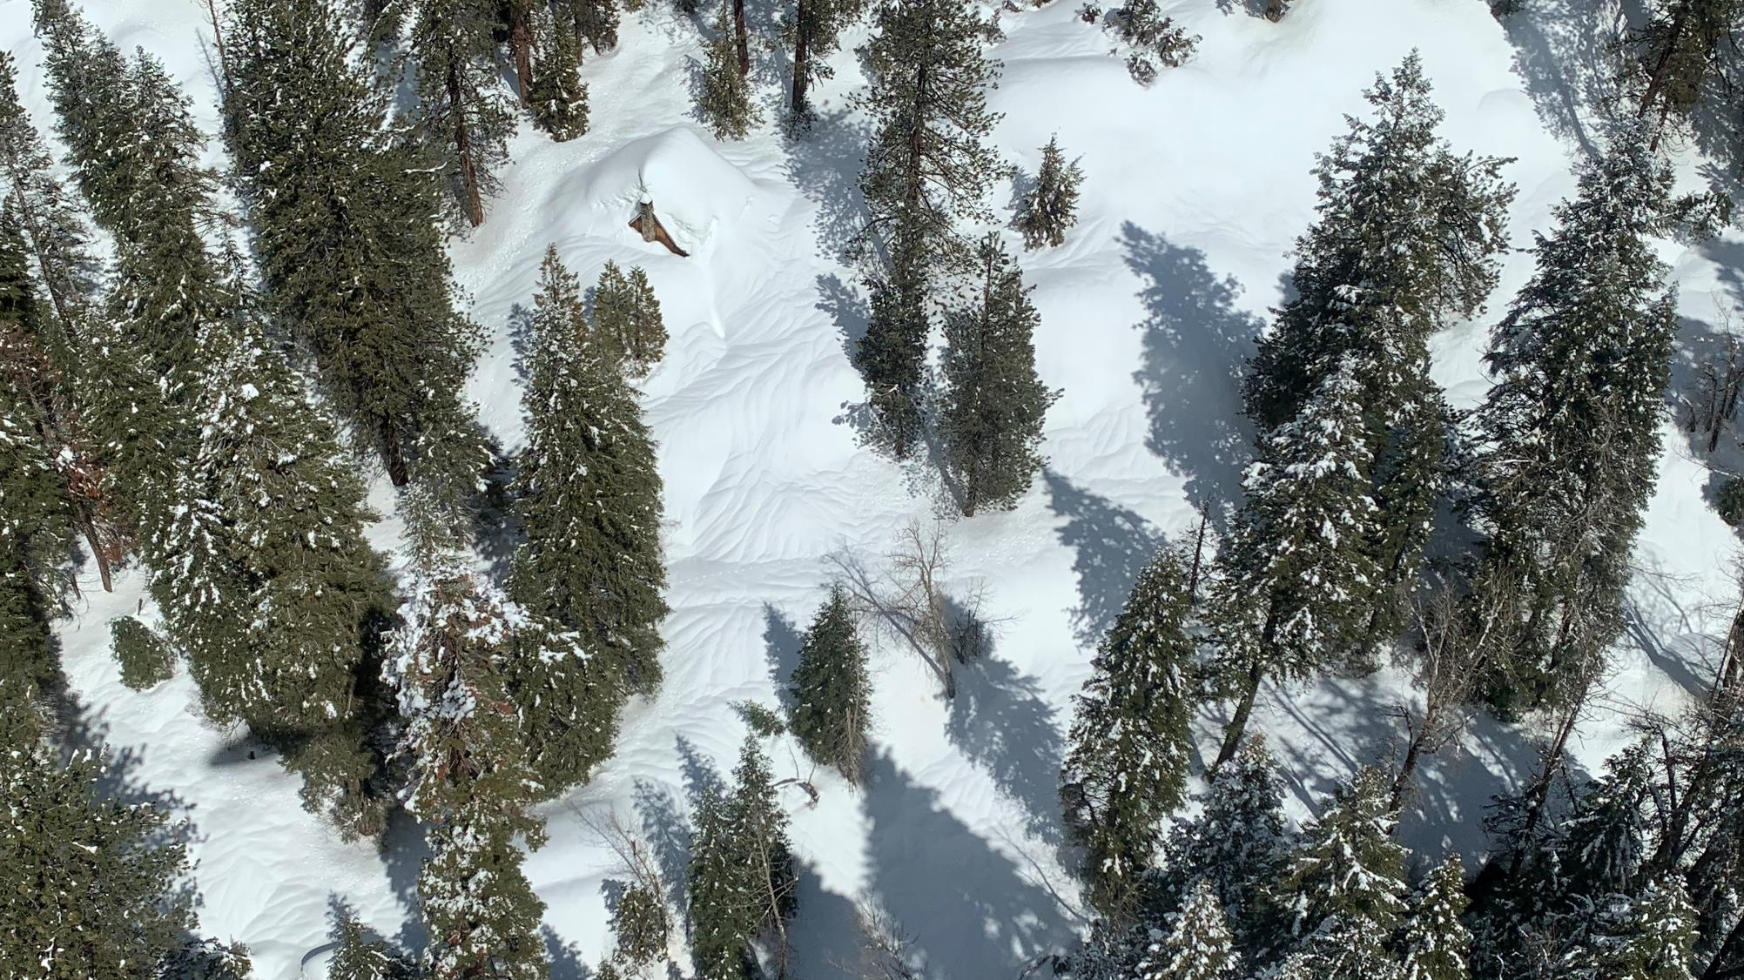
Mineral King Cabin

Slide 42
Cedar Grove

Slide 43
Highway 180

Slide 44
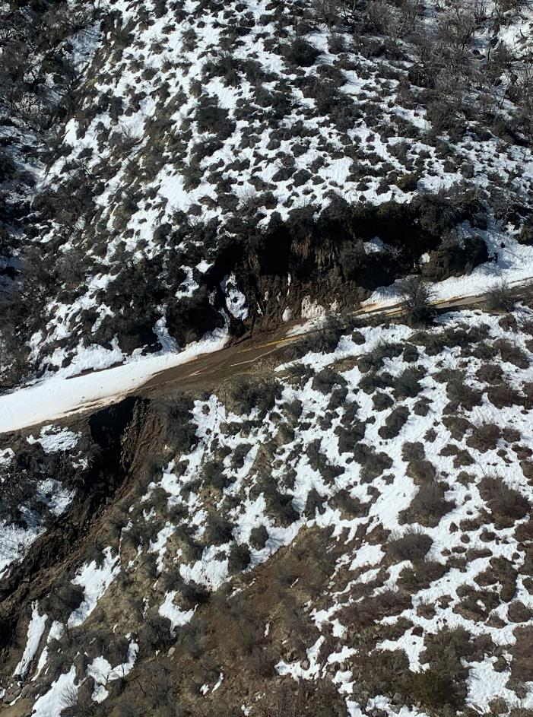
Aerial Views of Highway 180

Slide 45
Public Reopening Estimates As of 3/24/23

Slide 46
Kings Canyon National Park

Slide 47
Grant Grove
Current Status: Closed
Current Estimated Date of Public Reopening: April 7 to April 14
NPS road crews are working to reopen the Grant Grove area upon the completion of Caltran’s repair of Hwy 180 below the park.
Residents within or north of the park currently have limited access.

Slide 48
Cedar Grove
Current Status: Closed
Current Estimated Date of Public Reopening: Not available
The NPS will attempt to reopen the Cedar Grove facilities as soon as practical upon the completion Caltran’s repair of the multiple road washouts on Hwy 180 between Grant Grove and Cedar Grove.
The discovery of additional damage once NPS crews can access Cedar Grove on the ground may further delay public opening.

Slide 49
Sequoia National Park

Slide 50
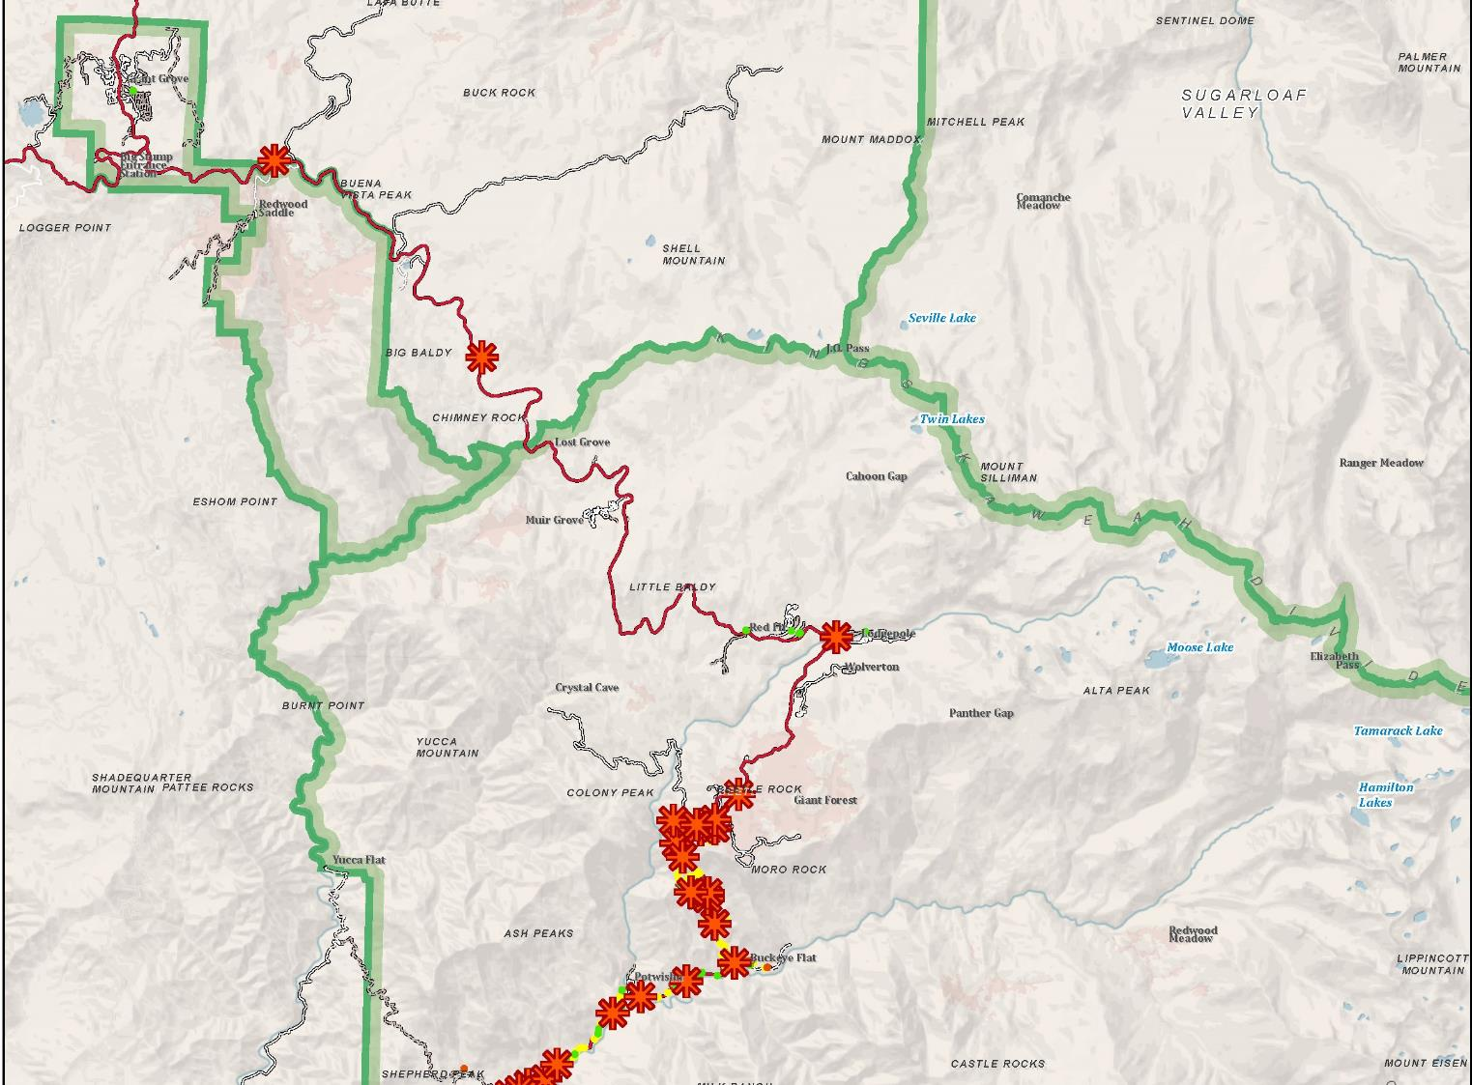
Map of Road Issues

Slide 51
Access to Giant Forest Via Hwy 180 (Grant Grove)
Current Status: Closed
Current Estimated Date of Public Reopening: May 26 to June 16

Slide 52
Access to Giant Forest Via Hwy 198 (Three Rivers)
Current Status: Closed
Current Estimated Date of Public Reopening: Not Available
No sooner than 1-2 weeks following opening from Hwy 180
Access from Hospital Rock to Giant Forest may initially be via one-way traffic flow while one-lane storm and fire recovery repairs continue.

Slide 53
Foothills- Ash Mountain to Hospital Rock
Current Status: Closed
Current Estimated Date of Public Reopening: April 7 to April 14

Slide 54
Crystal Cave
Current Status: Closed
Current Estimated Date of Public Reopening: Not Available
Initial access may be via Hwy 180
Crystal Cave and Crystal Cave Road will operate on a limited schedule during the season to accommodate fire recovery projects.

Slide 55
Mineral King
Current Status: Closed
Current Estimated Date of Public Reopening: Not Available
Note repair work within Sequoia National Park must be sequenced to follow Tulare County’s repair of the Mineral King Road washout at MM 4.5 (outside the park).
Limited administrative access by property owners may be possible in advance of public reopening.

Slide 56
South Fork
Campground is closed indefinitely.
Road access, trailhead parking, and trails were severely damaged.
No estimate repair dates.

Slide 57
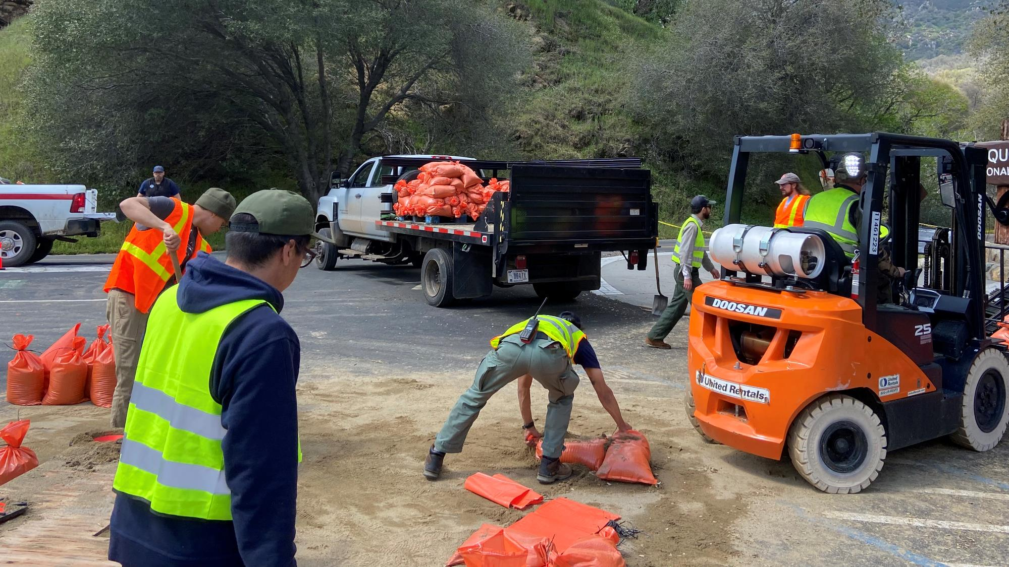
Questions

