Slide 1
Vida en el Aire…/Life in The Sky

Slide 2
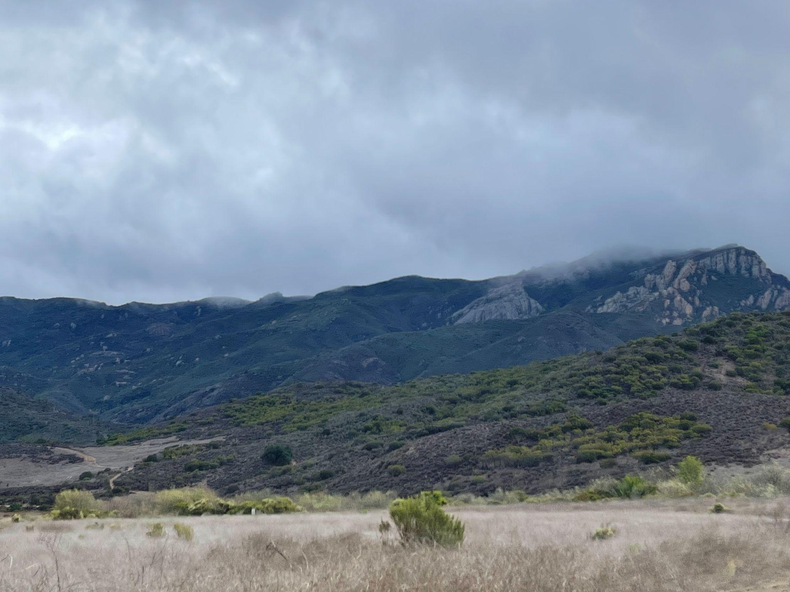
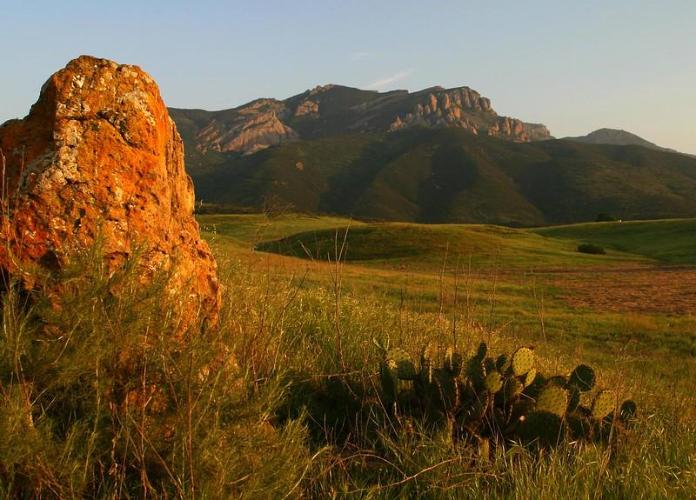
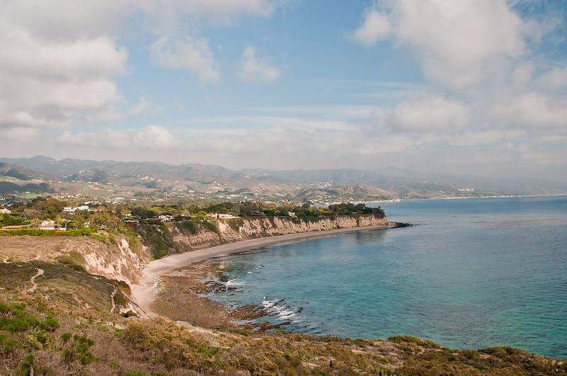
Mediterranean Eco-System
Cold & wet winters

Slide 3
Santa Monica Mountains National Recreation Area
Is home of
400 Birds
Thousands
migratory birds!
Pacific Highway = Flyway
Birds use V formation to maximize their power
Each wings movement helps the other bids to move
Notes:
“From oak woodlands to grassland savannas to the coastal shore, the many diverse habitats of the Santa Monica Mountains support a wide variety of resident and migrating birds. More than 380 species can be seen year-round including shorebirds, songbirds, woodpeckers, and raptors. Of all the species found in the recreation area, about one-third reside and breed here.”
Open space that is full of native vegetation, quiet, and dark is important for migrating birds. Sites like the Santa Monica Mountains provide a place to land and feed migrating and stationary birds alike.

Slide 4
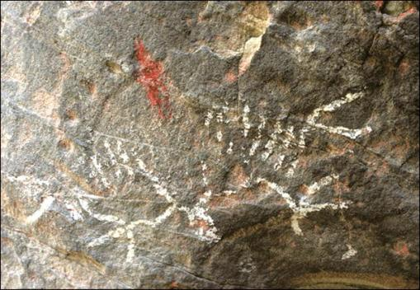
Tongva Connections to Birds
The Tongva admire their winged relatives and still hold that connection to this day:
Birds of prey - yongaavet
Hawk - pakiishar
Raven - 'aalwot

Slide 5
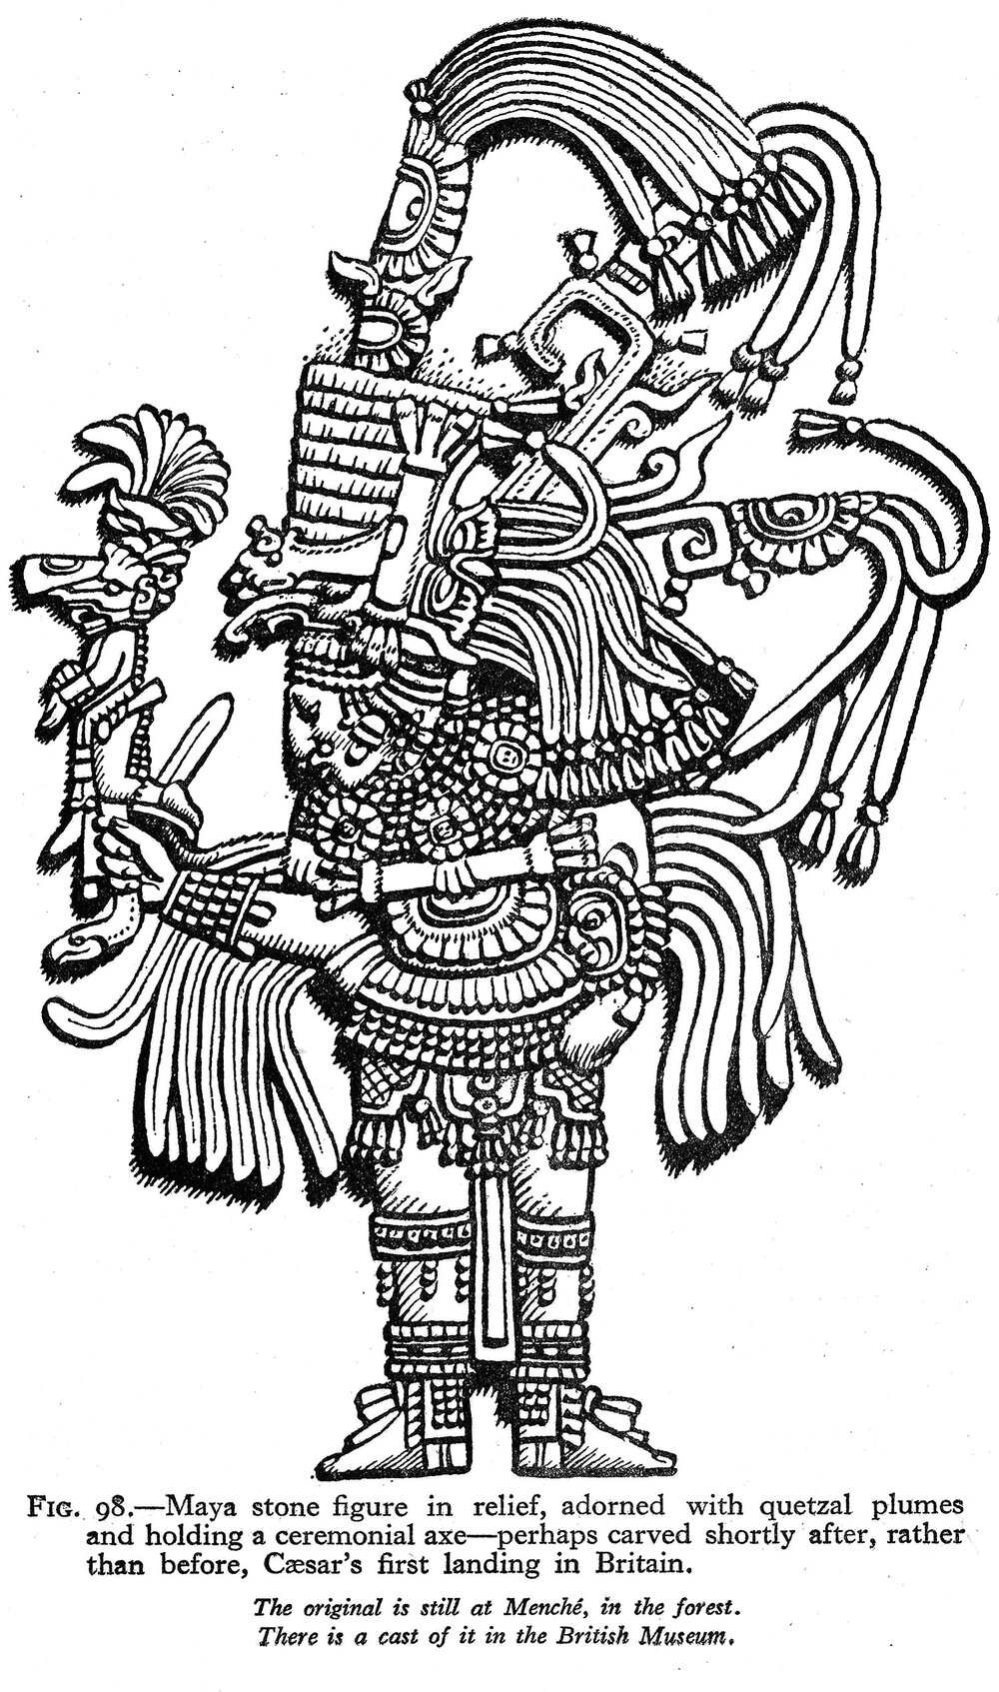
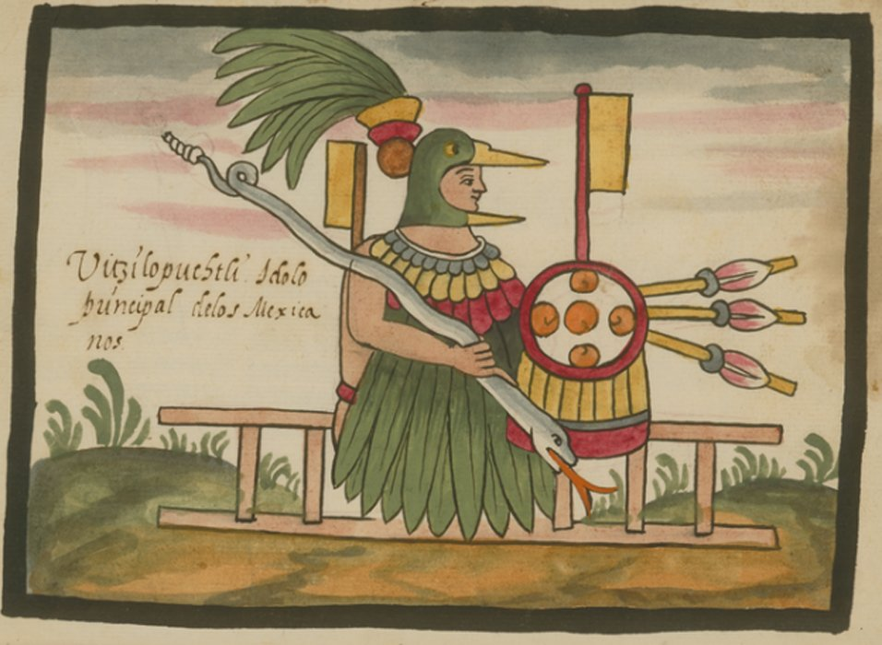
Notes:
This slide may need to be updated

Slide 6
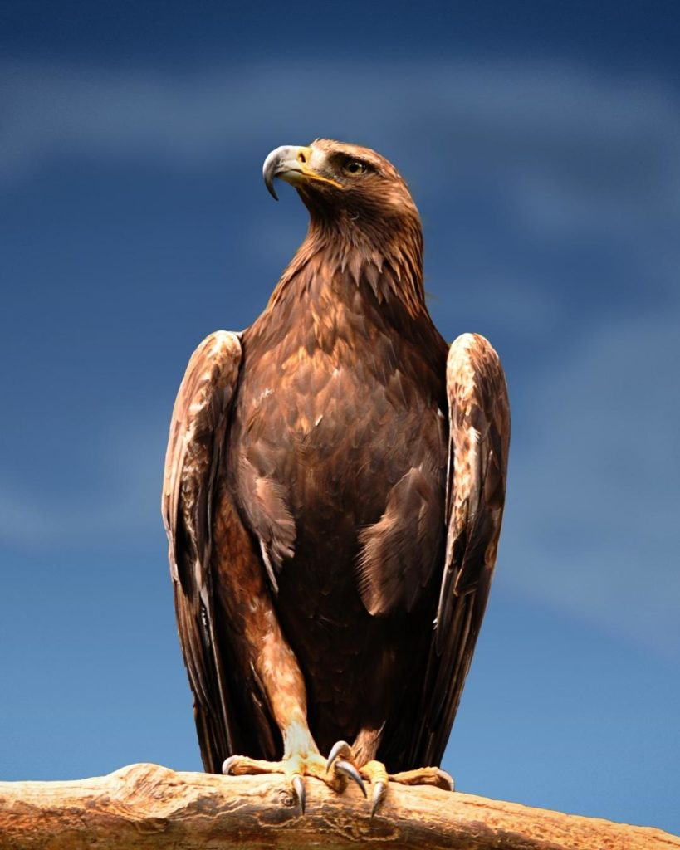
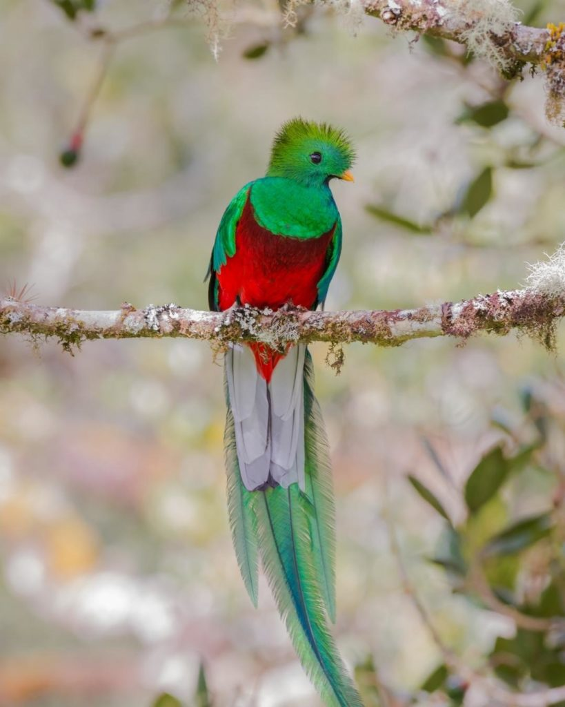
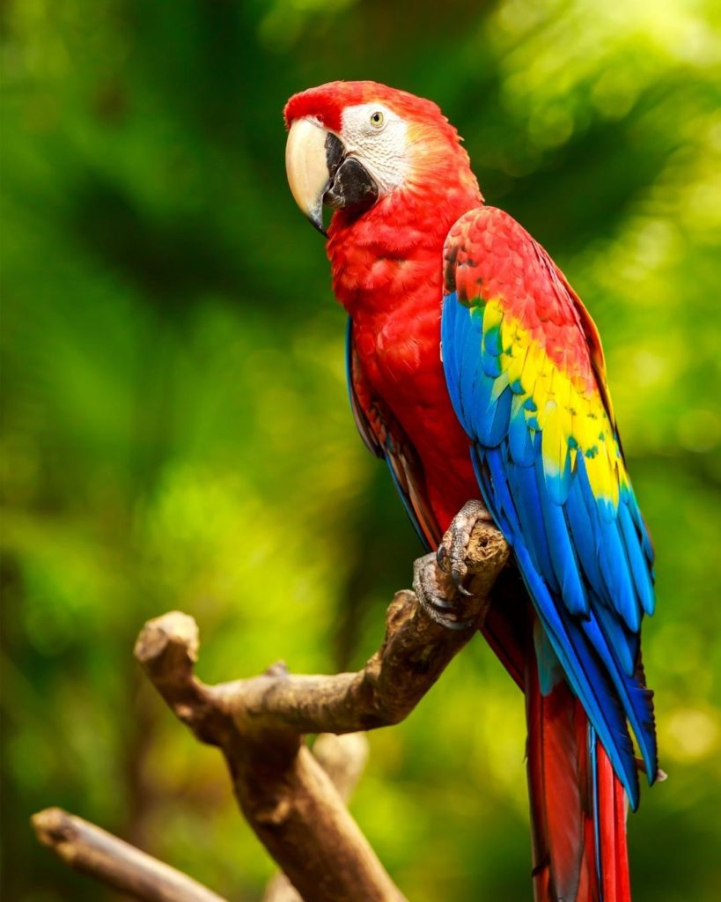
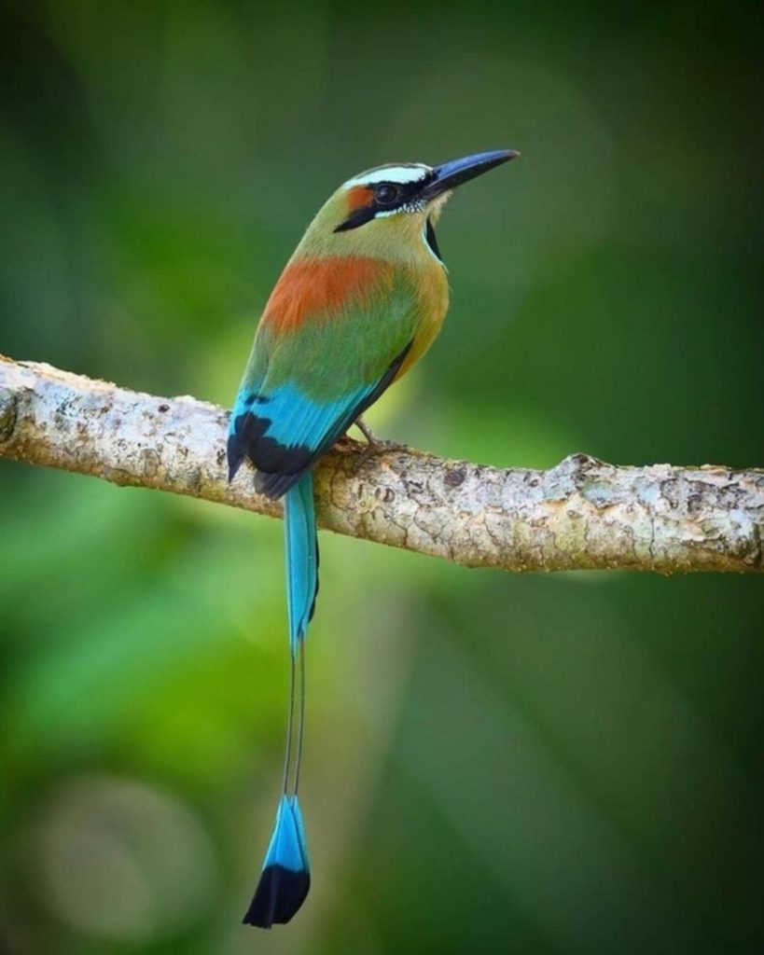
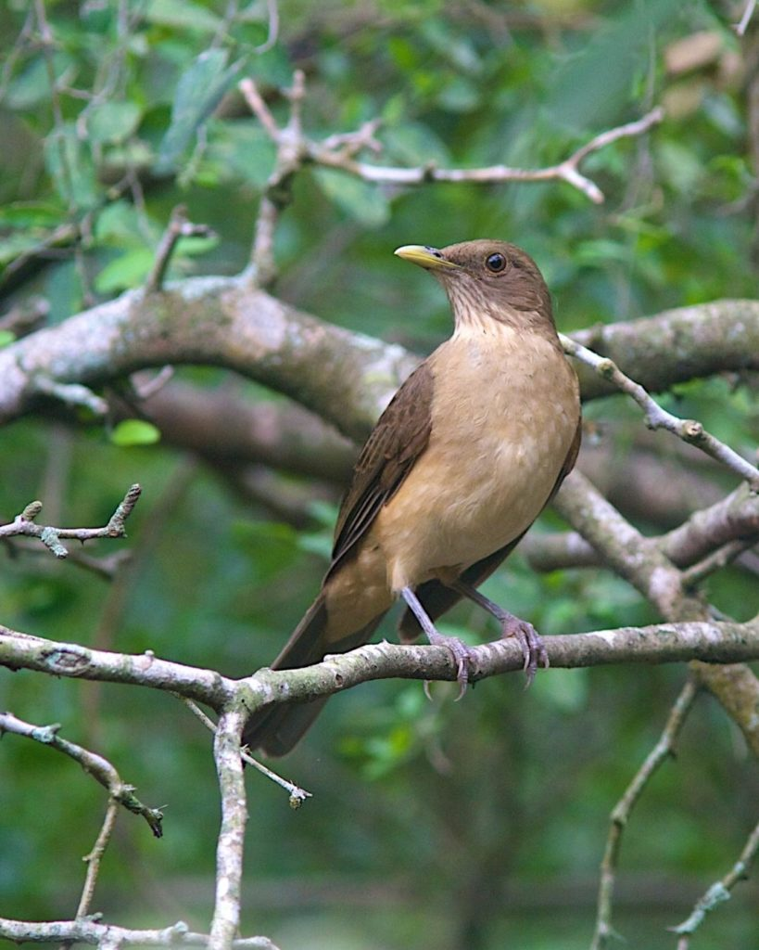
Birds From Latin America
Notes:
1st bird what is it?

Slide 7
Huitzilopochtli’s high priest, the Quetzalcóatl Totec Tlamacazqui (“Feathered Serpent, Priest of Our Lord”), was, with the god Tlaloc’s high priest, one of the two heads of the Aztec clergy. The 15th month of the ceremonial year Panquetzaliztli (“Feast of the Flags of Precious Feathers”) was dedicated to Huitzilopochtli and to his lieutenant Paynal (“He Who Hastens,” so named because the priest who impersonated him ran while leading a procession around the city). During the month, warriors and auianime (courtesans) danced night after night on the plaza in front of the god’s temple
Huitzilopochtli’s Nahuatl name words huitzilin, “hummingbird,” and opochtli, “left.”
Aztecs believed that dead warriors were reincarnated as hummingbirds and considered the south to be the left side of the world; thus, his name meant the “resuscitated warrior of the south.”
His other names included Xiuhpilli (“Turquoise Prince”) and Totec (“Our Lord”).
His nagual, or animal disguise, was the eagle.

Slide 8
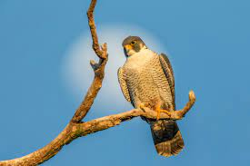
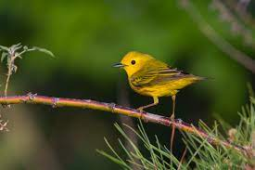
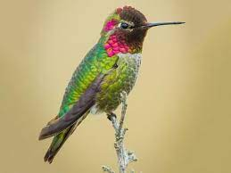
Migratory birds that can be found in Southern California

Slide 9
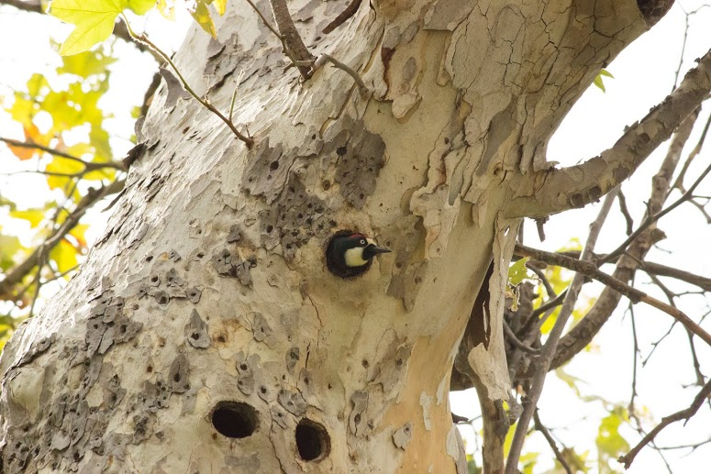
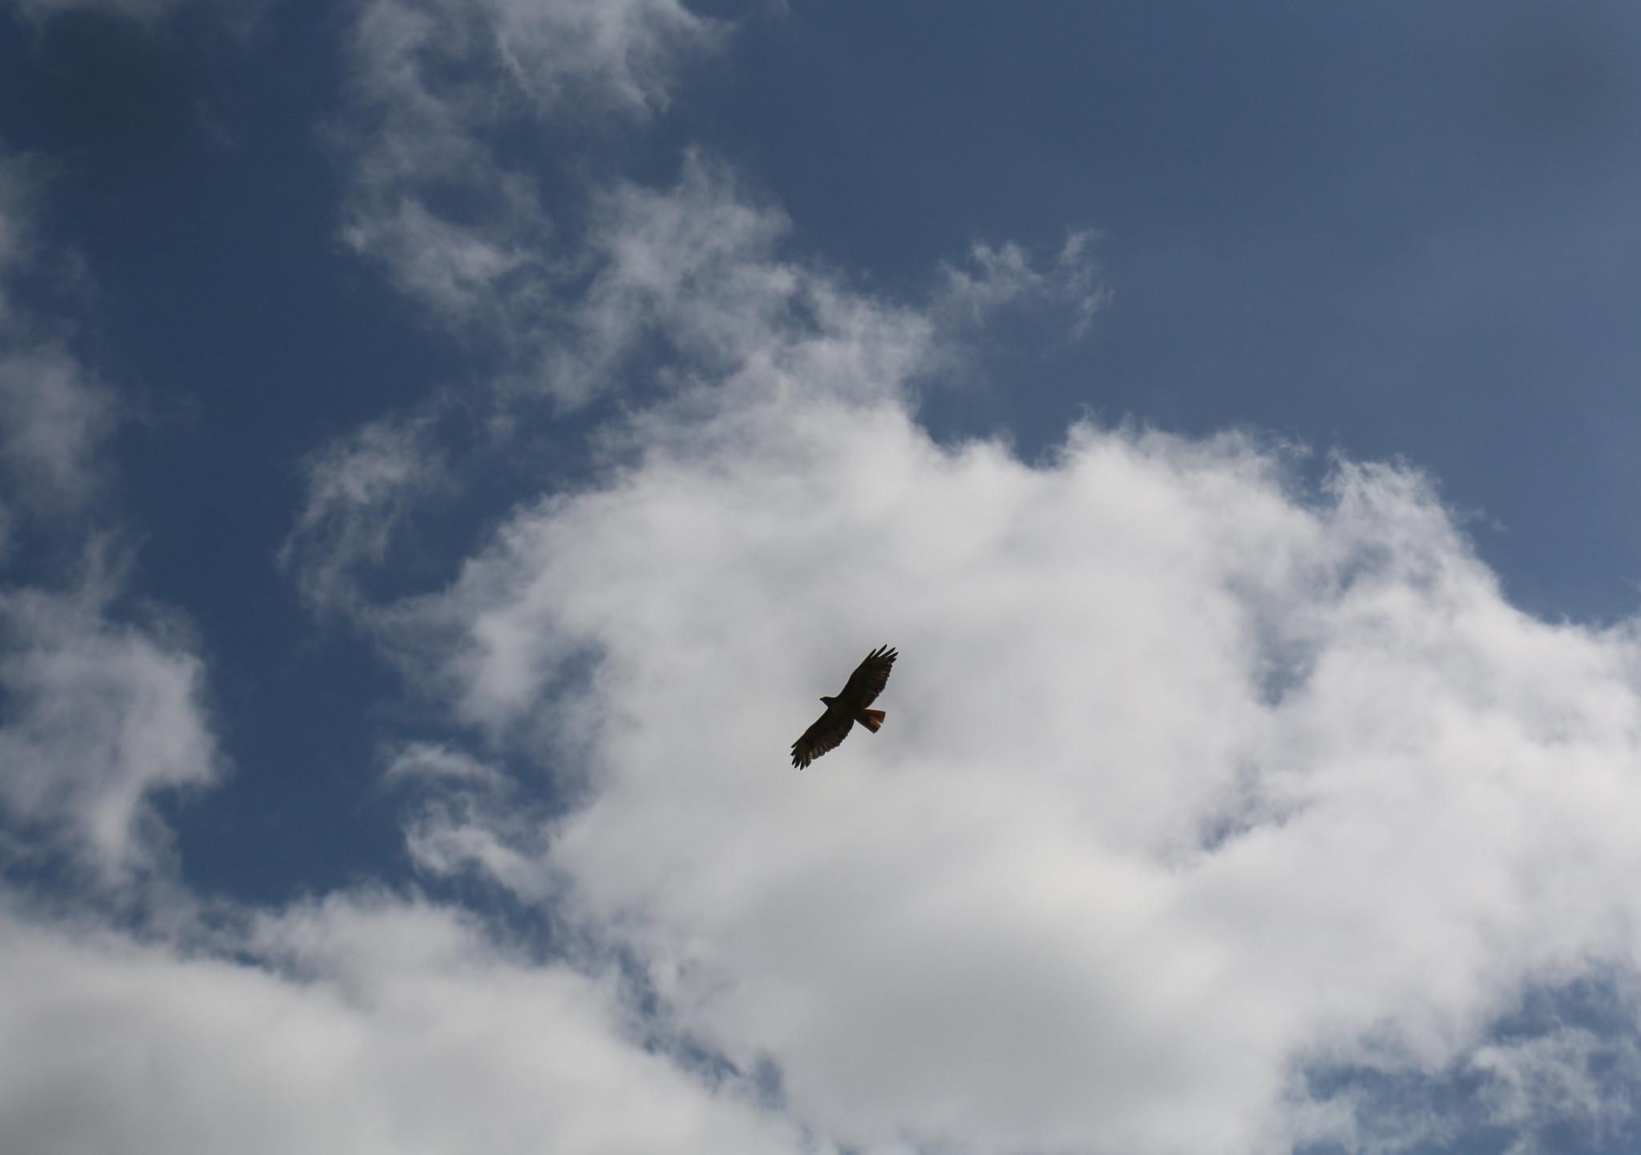
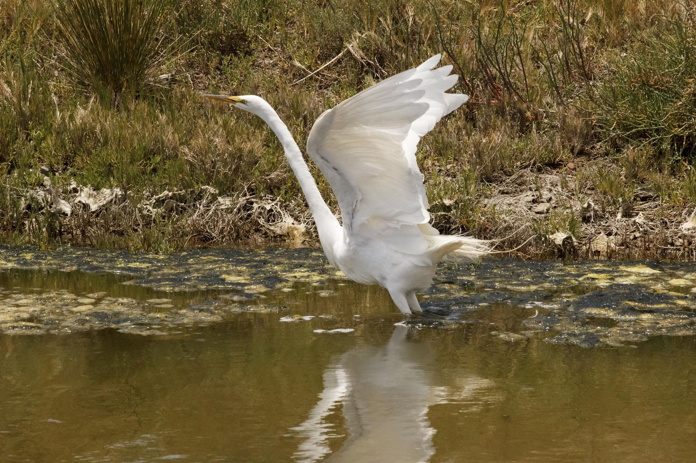
Birding 101
Observing what a bird is doing and where it is can help you identify the bird’s species.
Notes:
Avian species are one of the most common wildlife that we may come across during the day and potentially at night.
-Facts (number of species found throughout the world)
-There are over 5,000 bird species across the American Continent alone. With over 10,000 species found around the world.
-Make connection between local species, species in Latinoamerica, and those that migrate (or connect the two).
If it’s swimming, there’s a good chance it’s a member of the duck family, but no chance it’s a dove.
• If it’s clinging to the side of a tree, it could be a woodpecker, but not likely to be a duck.

Slide 10
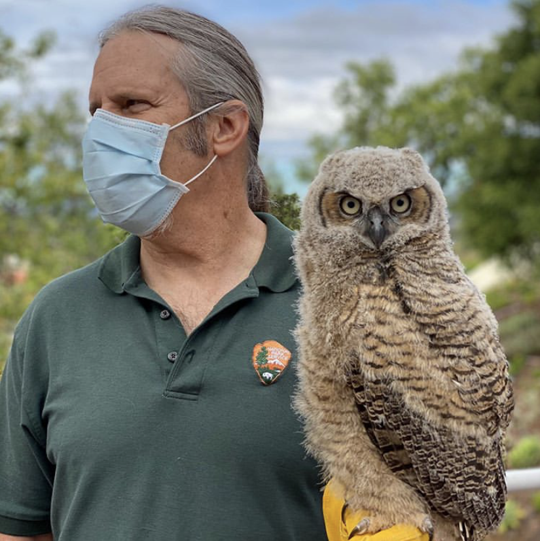
Observation
Listen for Calls and Songs
You can often hear a bird before you see it, and sometimes you will hear it but not see it at all. The time of day may also bring out new species.If you become familiar with the kinds of birds likely to be in your area, you can begin to match up sounds with species.

Slide 11
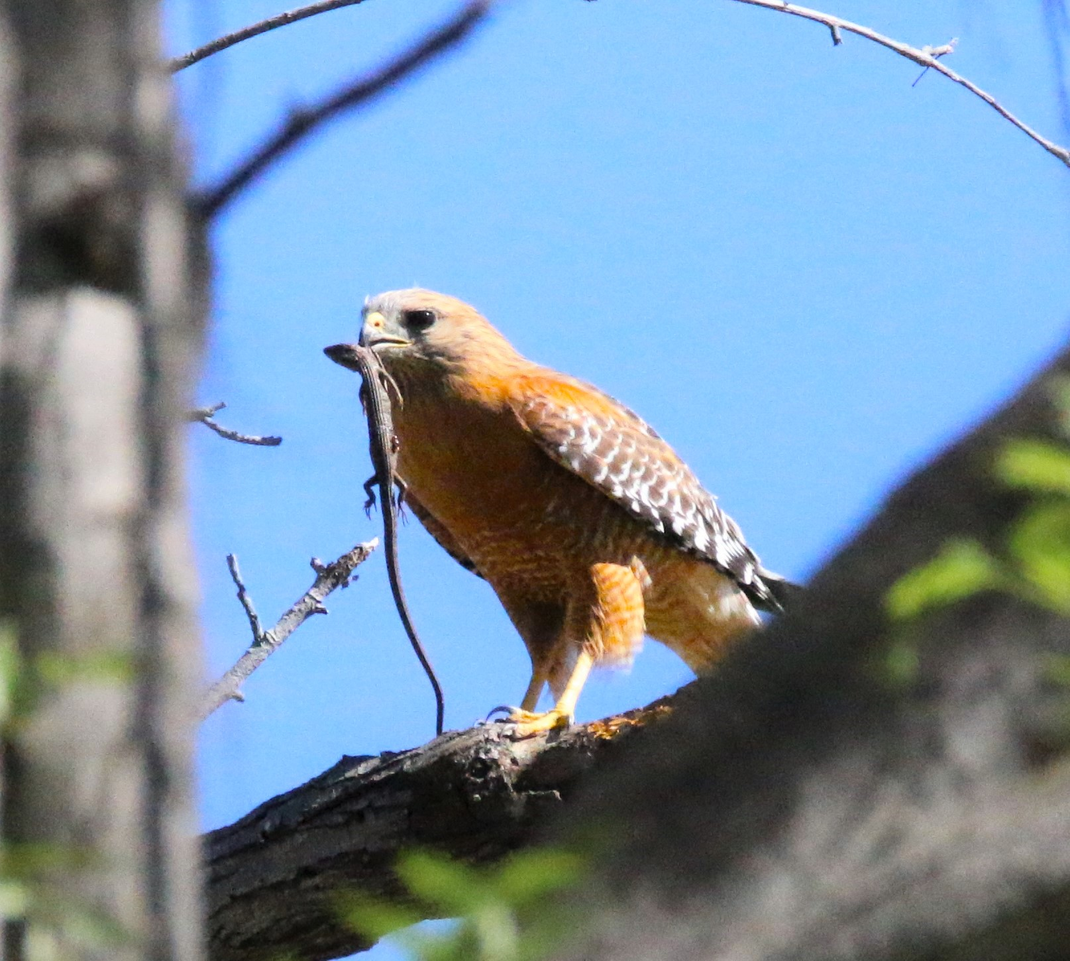
Bird ID Tips
There are many identifiers that can narrow down the species of bird you come across!
Notes:
Every Bird is a different species. Things to look for are field marks or the physical characteristics of a bird—its color, markings, size, and shape
Start with the basic color or colors.
Think about its shape. Does it have a crest—feathers that stand up on top of its head? Is its tail long or short?
What does the beak look like? Is it long or short, thick or thin, straight or curved?
How big is it? Does it seem small, medium-size, or big? Compare its size and shape to something you know, like your fist or a football, or a bird you’re familiar with, like a crow or robin.

Slide 12
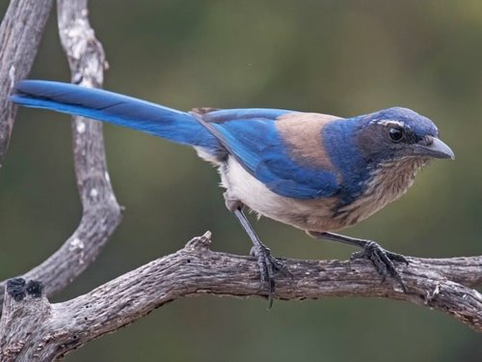
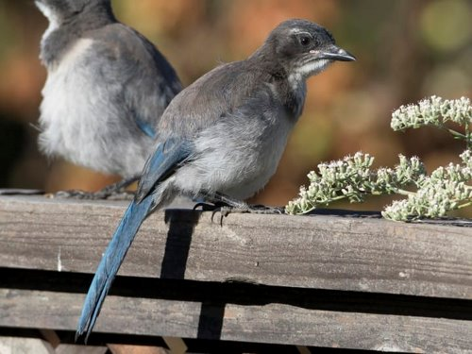
Adults and Juveniles
Notes:
Western Scrub Jay

Slide 13
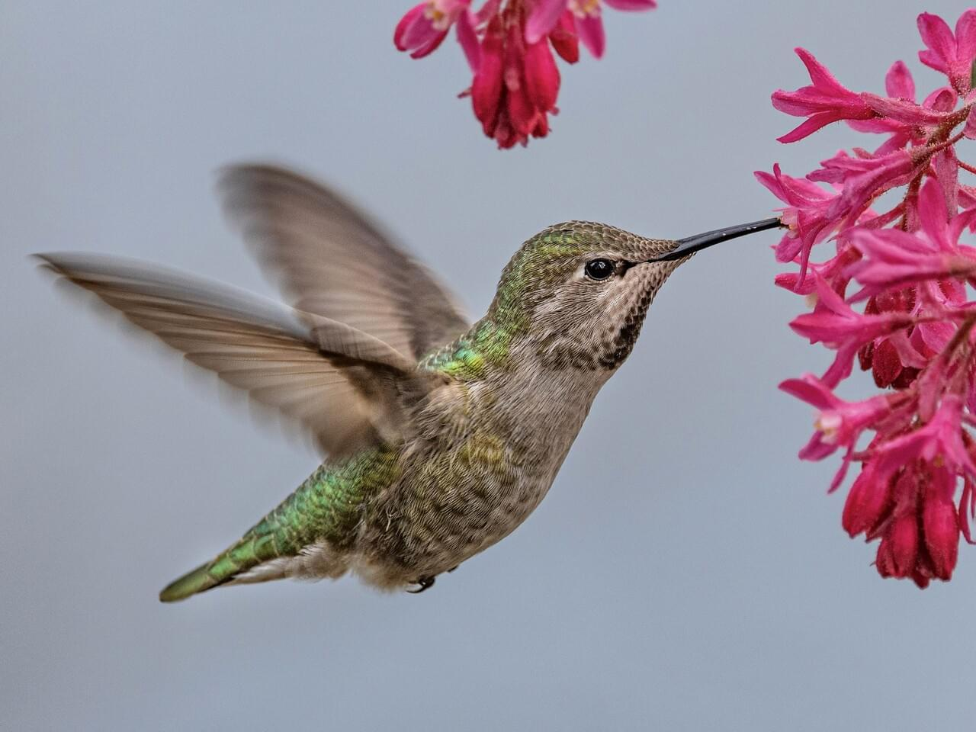
Male and Female
Notes:
Insert picture of allens hummingbird picture instead (more dramatic) or ignore slide entirely

Slide 14
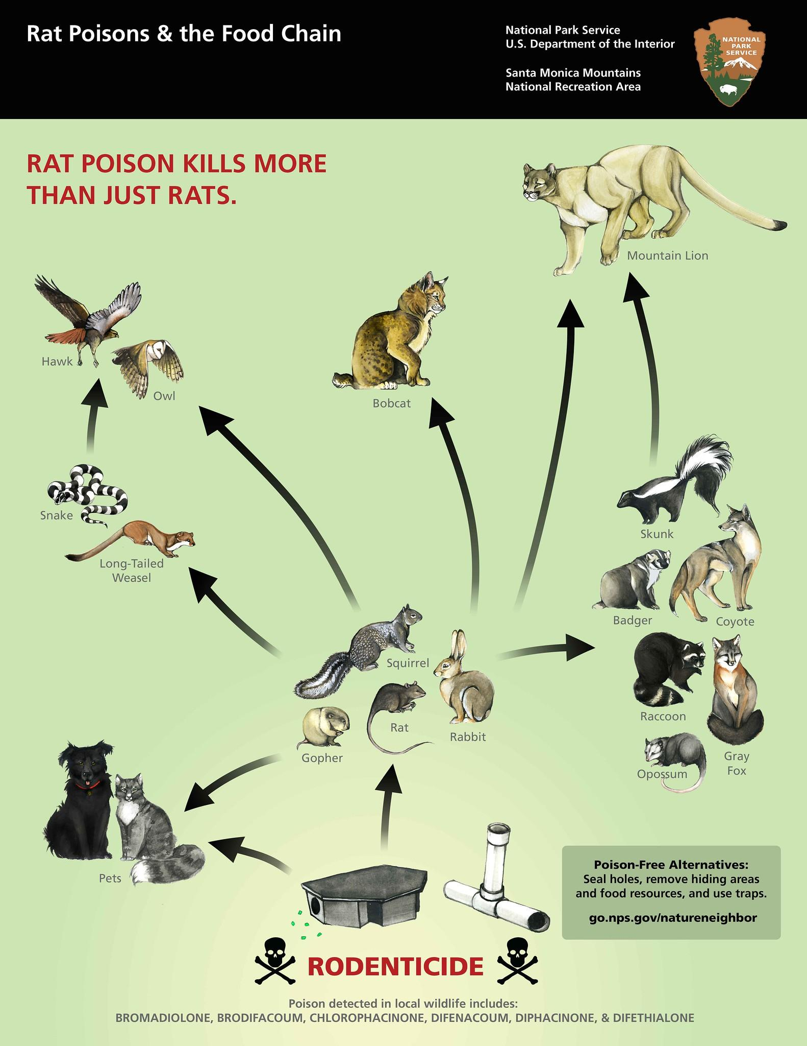
Nature Neighbor Connection
Notes:
Pest control, public health, seed dispersal, ecotourism, pollinators, environmental monitoring—these are some of the ways birds benefit humans.

Slide 15
How Can We Help?
Prevent Window Crashes
Keep an eye on our pets (i.e. household cats)
Plant Native Plants (Food source for Birds)
Leave resources alone (i.e. branches, leaves=nest materials)
Close Blinds or turn off unneeded lights!

Slide 16
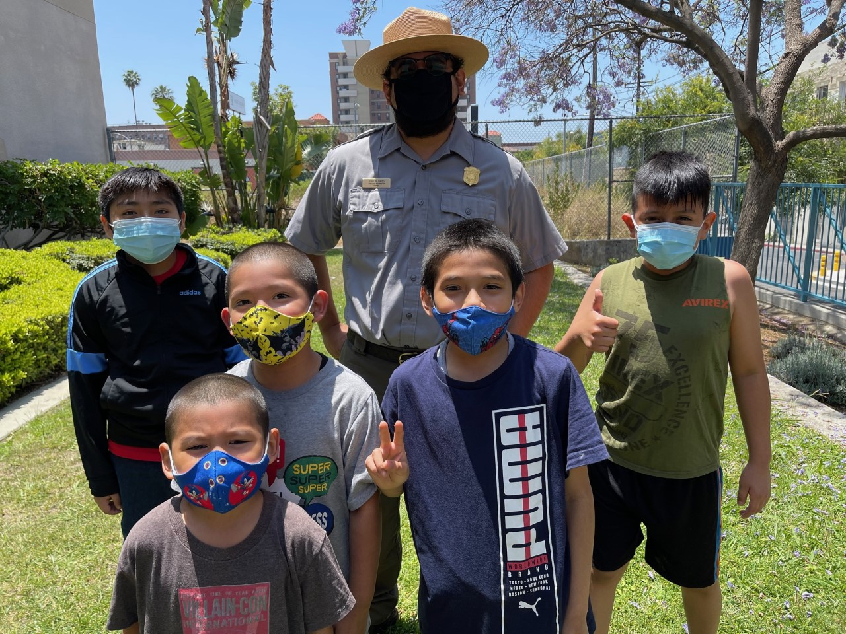
Gracias from our Education Team!

