Slide 1
The Ghost of the Mountains
El Fantasma de las Montañas

Slide 2
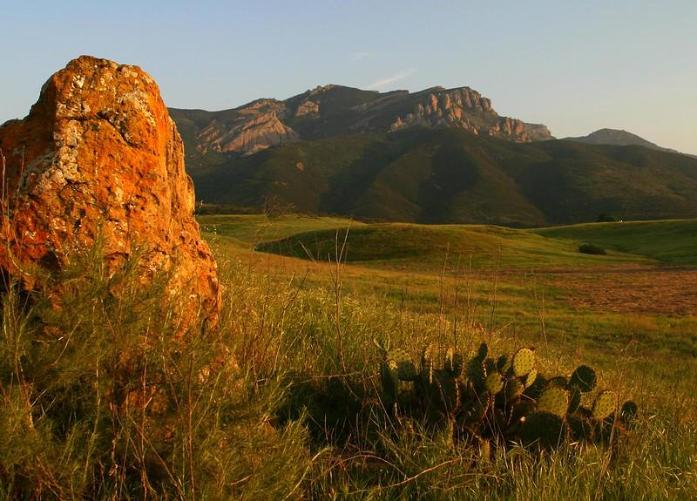
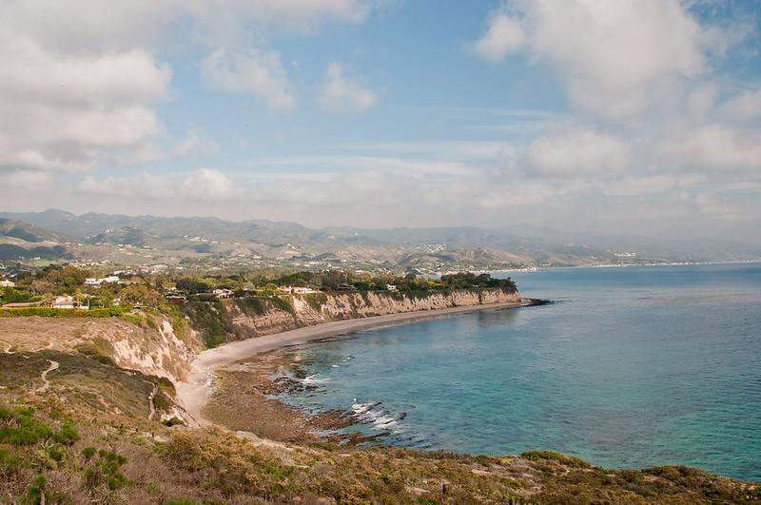
Mediterranean Ecosystem

Slide 3
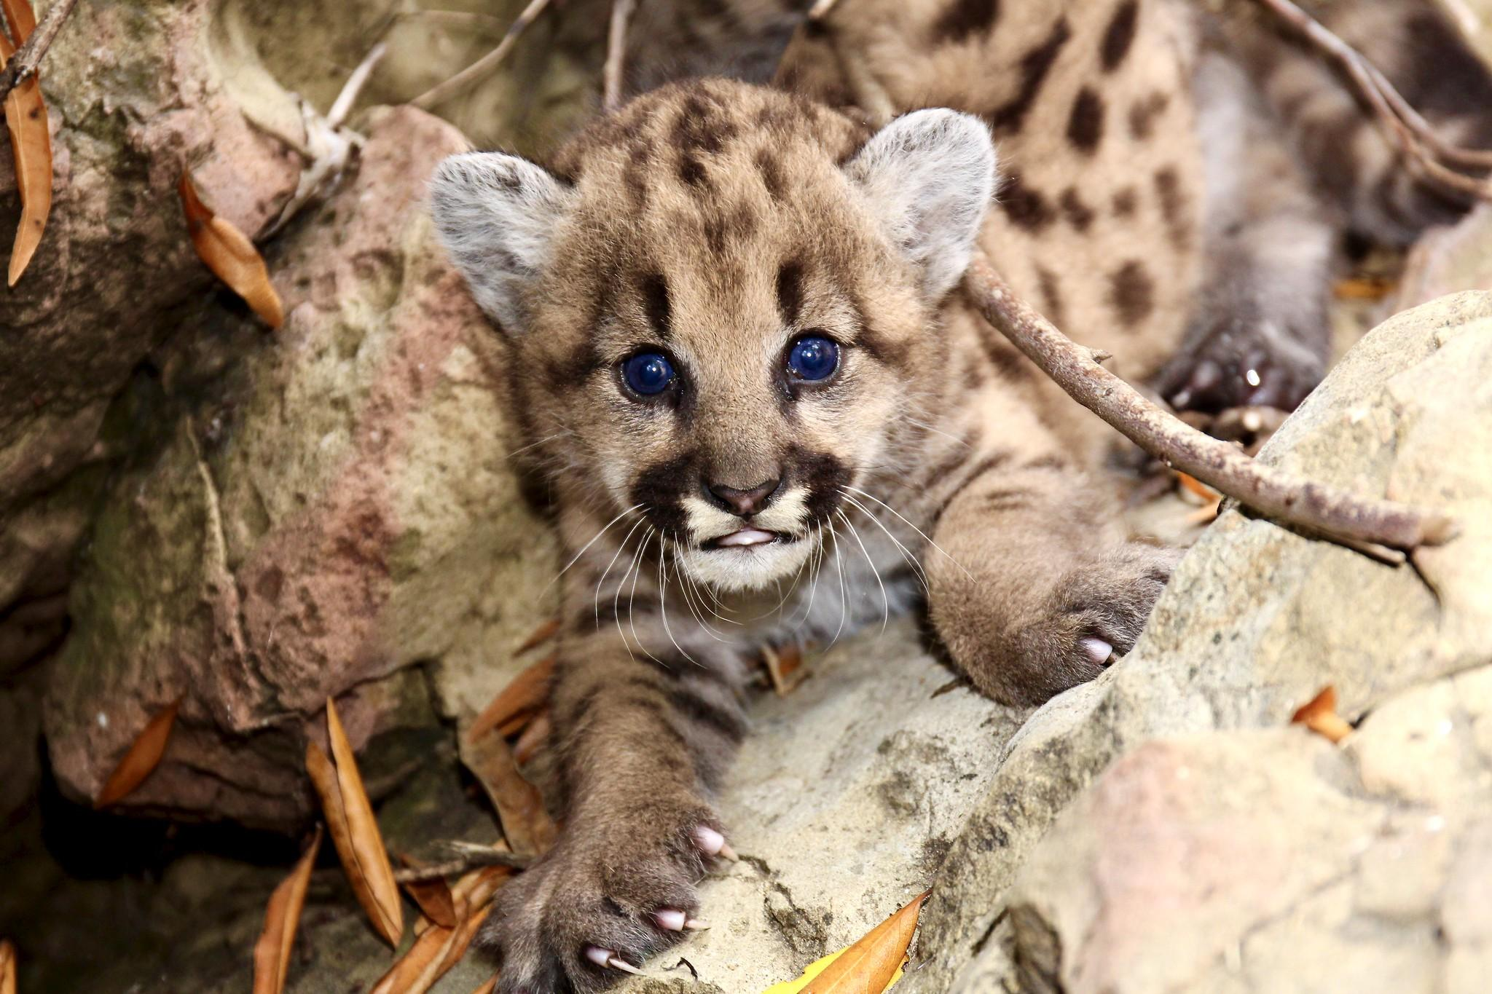
Cultural Connection
The “Ghost Cat” has many names that you may already be familiar with. Some examples are the following:
Puma/Mountain Lion/Panther/Cougar
Tukuurot (Tongva)
Miztli (Mexica)
T’oj (Mayan)

Slide 4
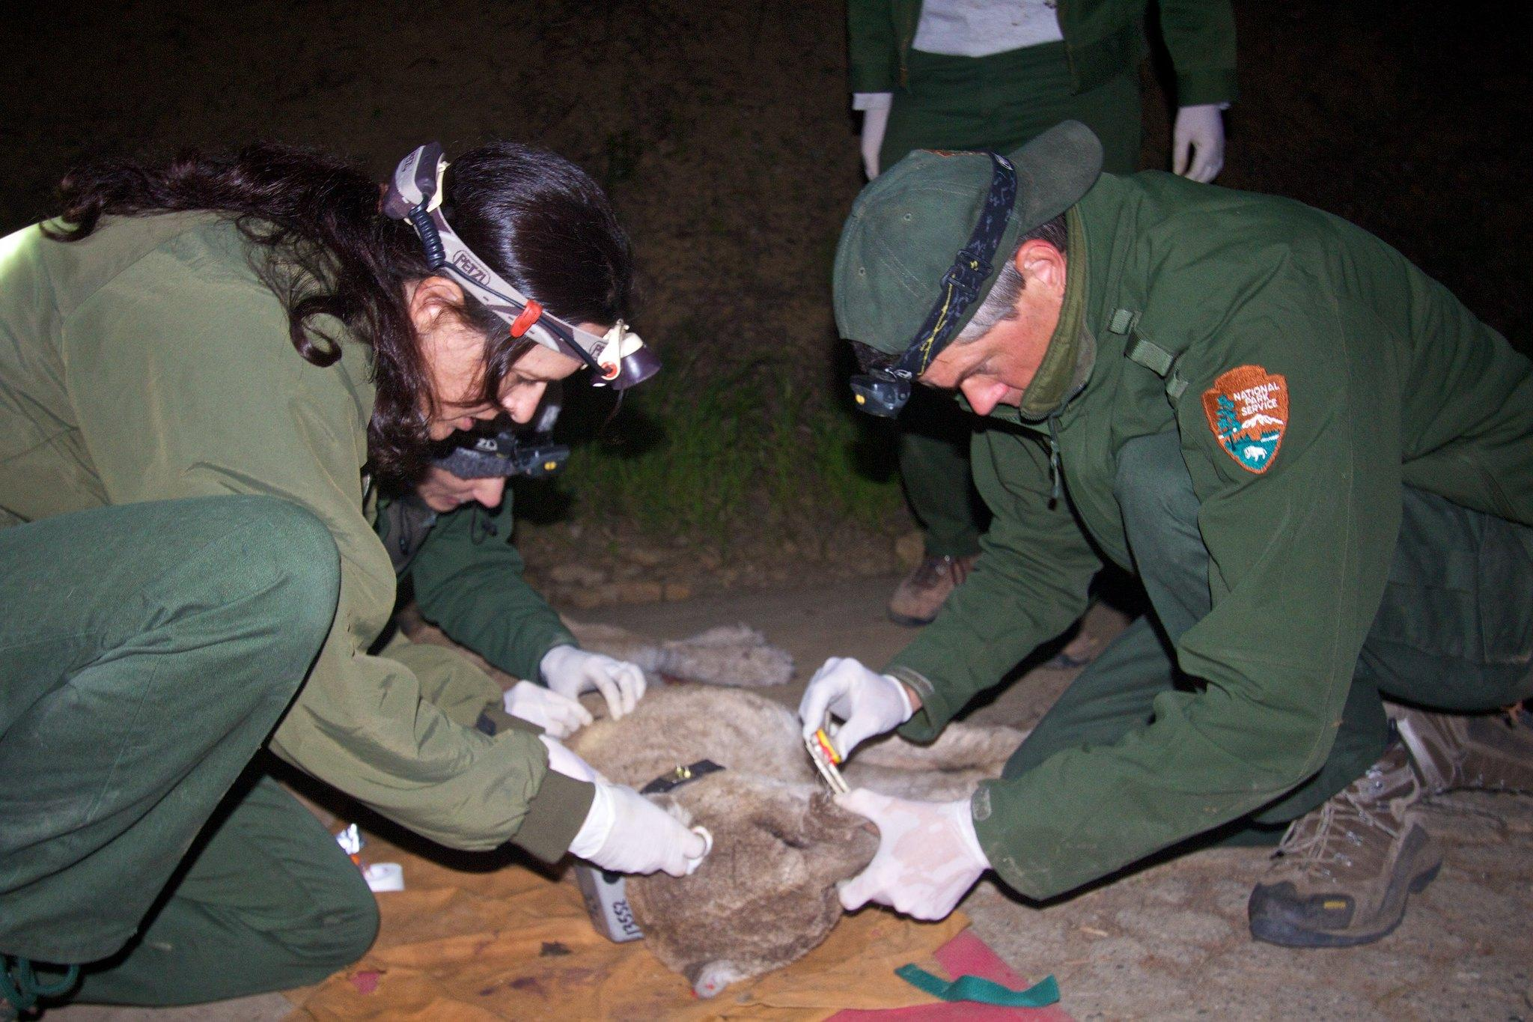
Studying Mountain Lions
Notes:
Size
Weight
Nocturnal or Diurnal?
Diet
How do we study these animals?

Slide 5
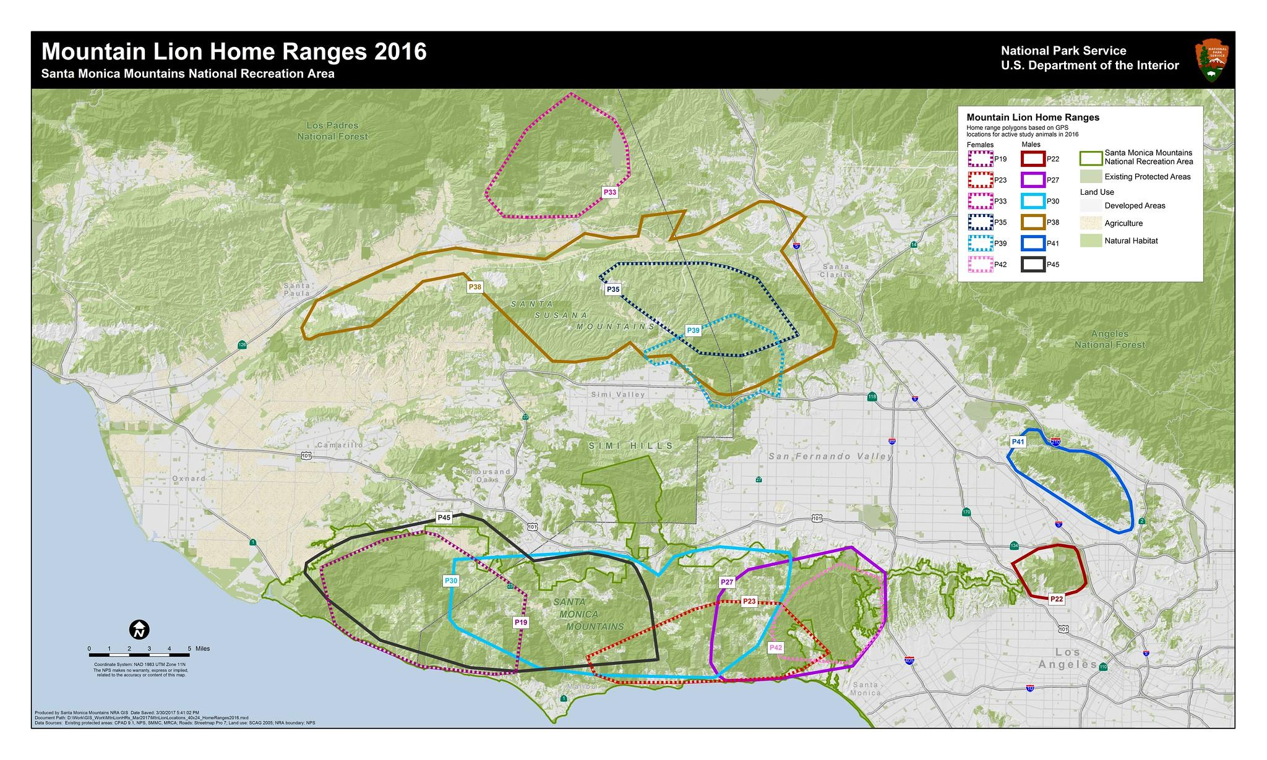

Slide 6
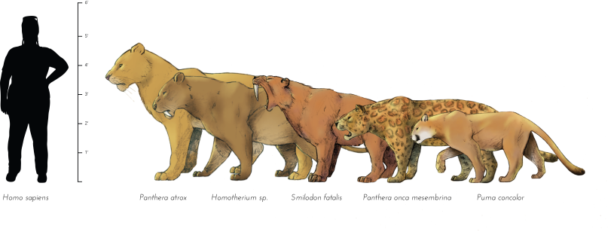
Ancient Connections
Notes:
Image is from the La Brea Tar Pits

Slide 8
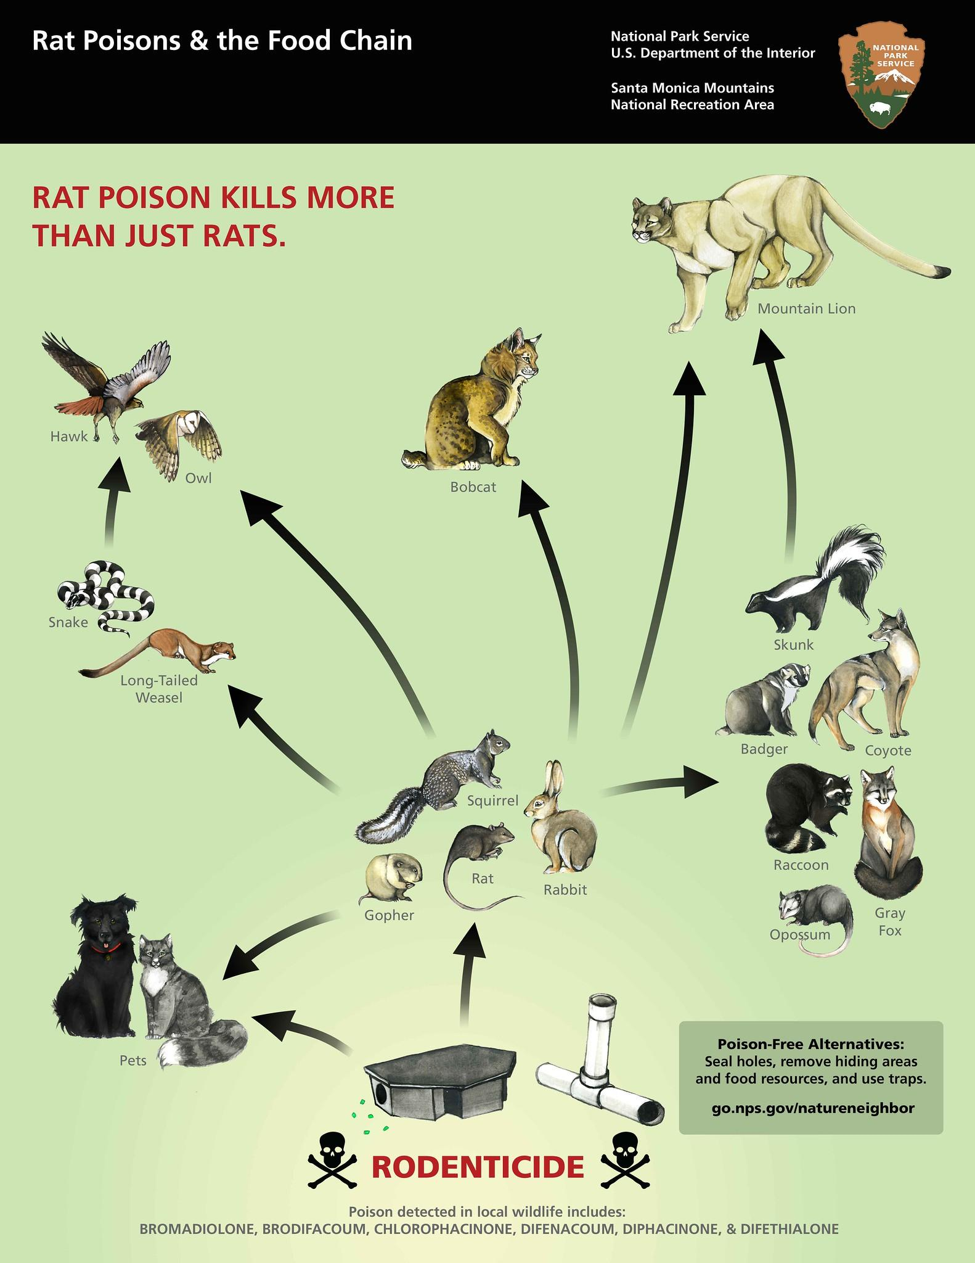
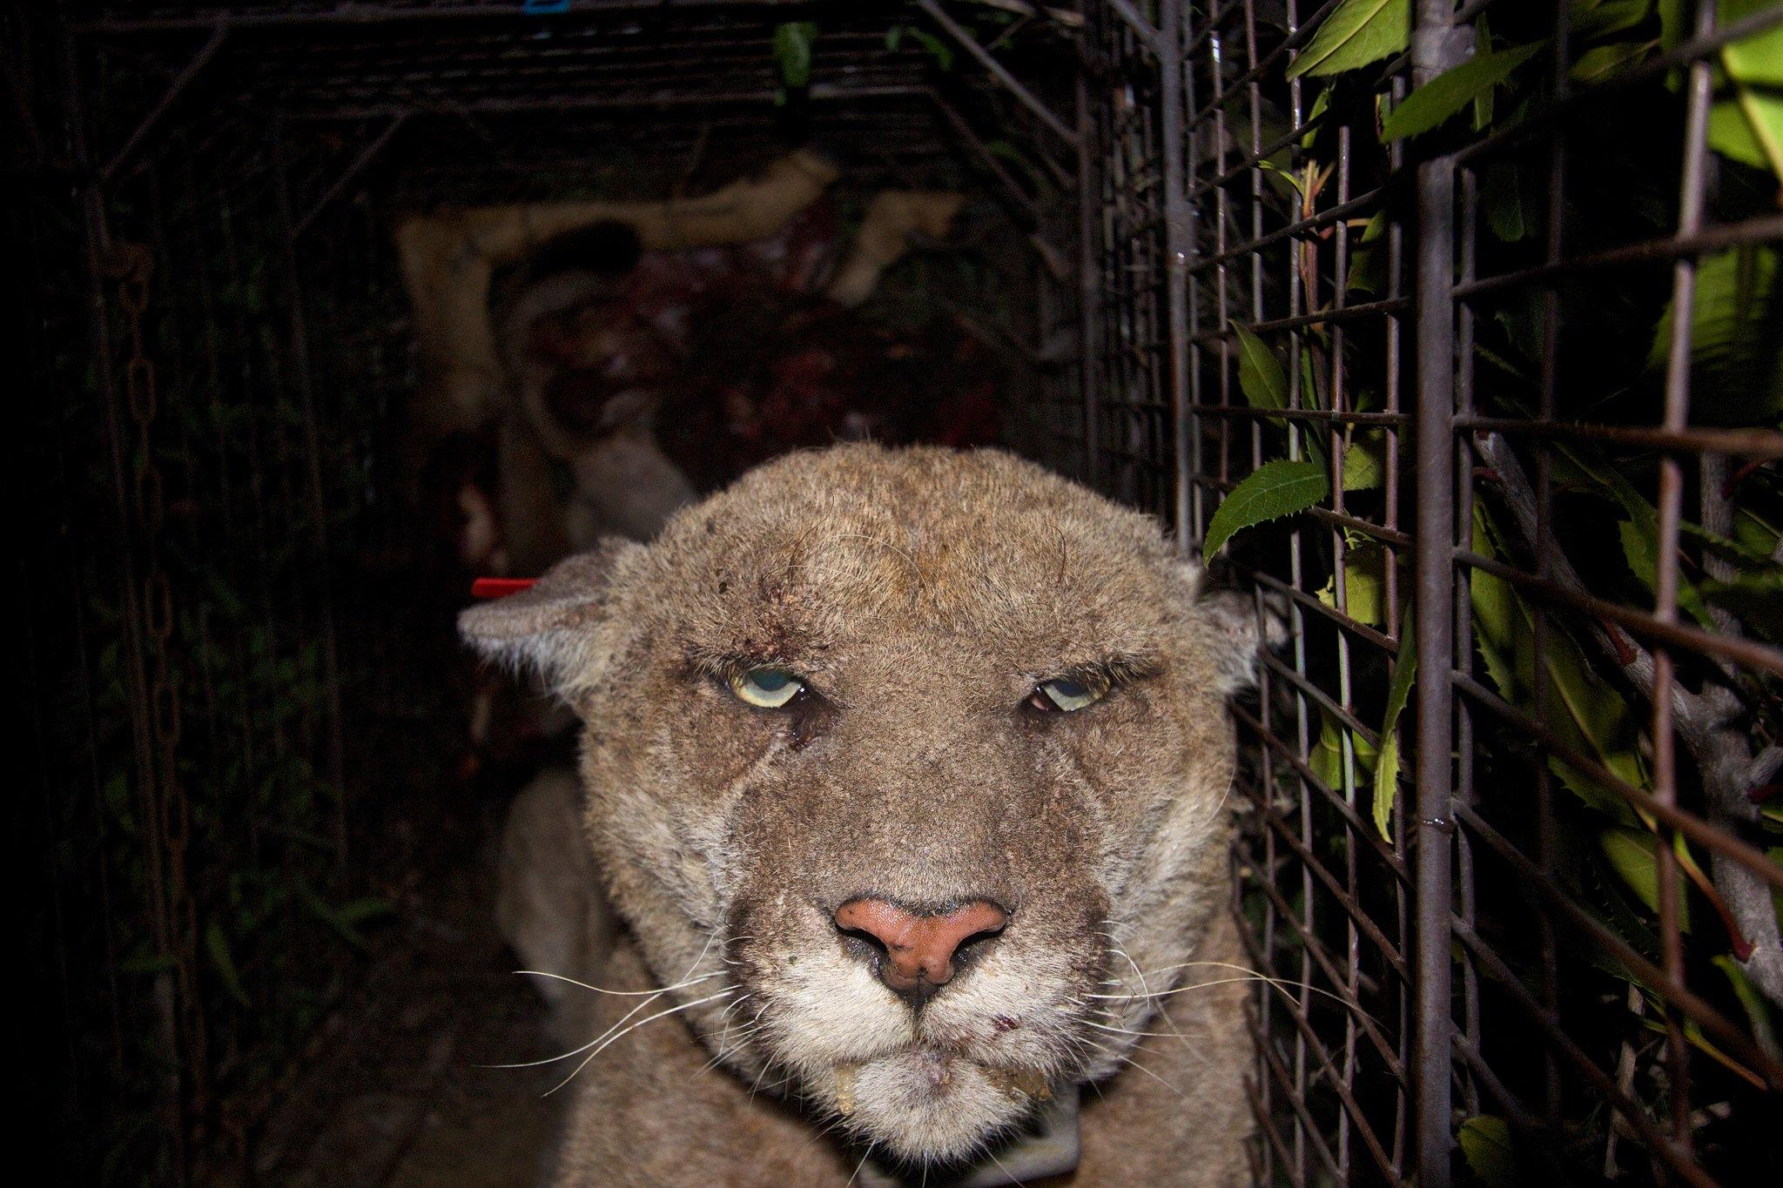
Dangers to our Big Cats!

Slide 9
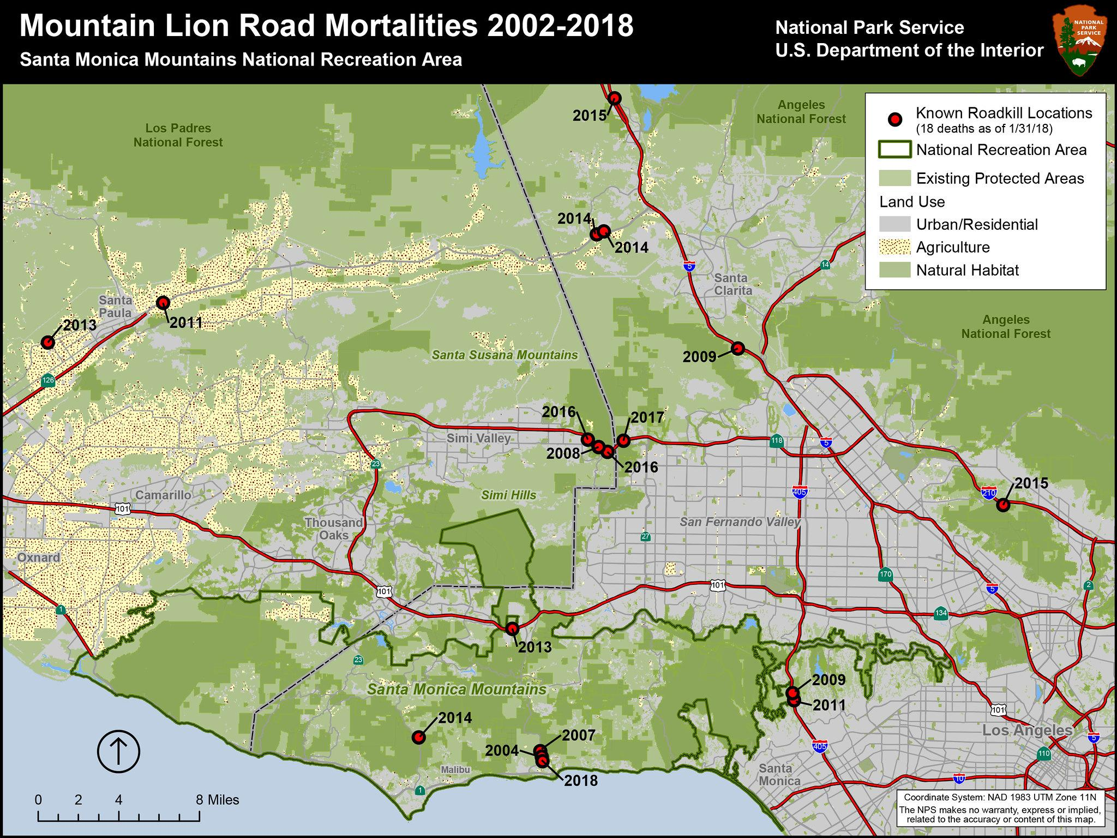

Slide 10
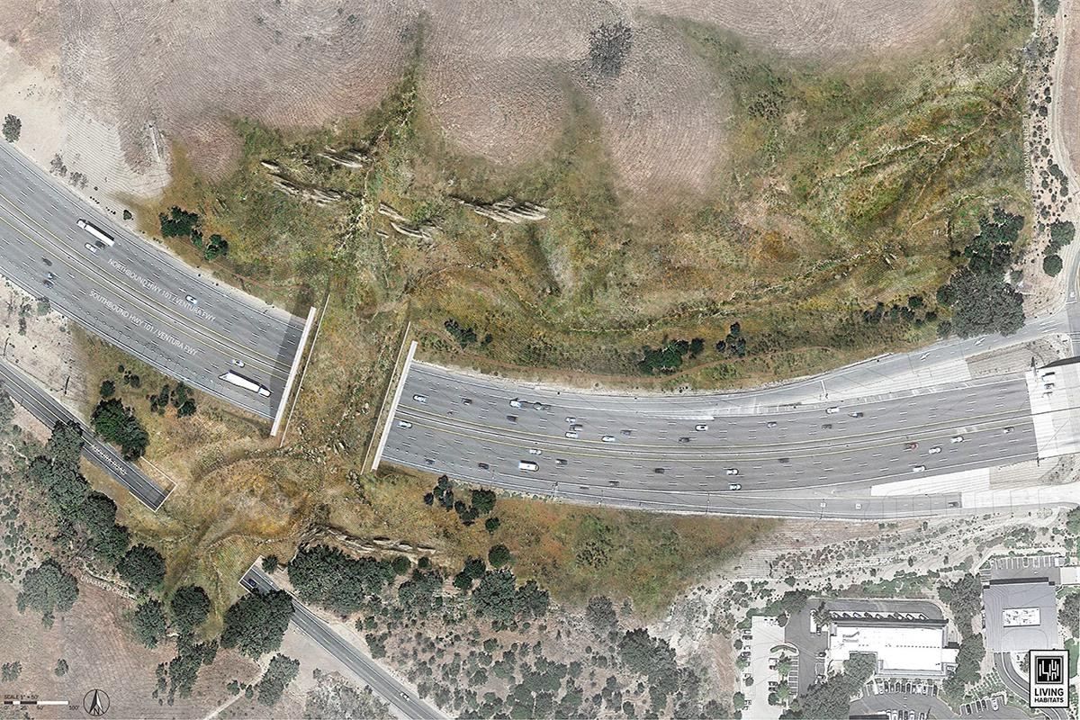
Co-existing with Nature!

