Slide 1




Welcome!
Bienvenidos!
Notes:
3/12 Cohort 3 Agenda

Slide 2
Today we are talking about: mariposas!
What is a Butterfly?
The Monarch Migration
Butterflies in LA
x
x
x

Slide 3
Que es una Mariposa?

Slide 4
What is a butterfly?
Flying insect
Scaly wings
6 jointed legs
2 antennae
compound eyes
exoskeleton

Slide 5
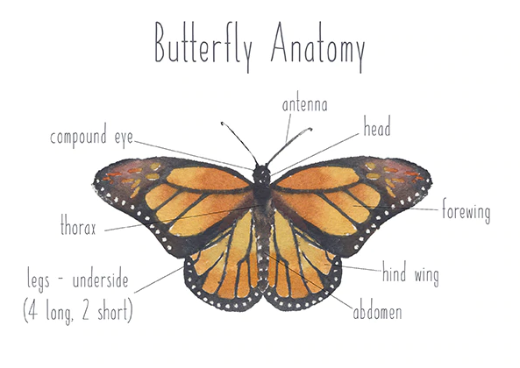

Slide 6
725
Species of butterflies in North America

Slide 7
20,000
Species of butterflies around the world!

Slide 8
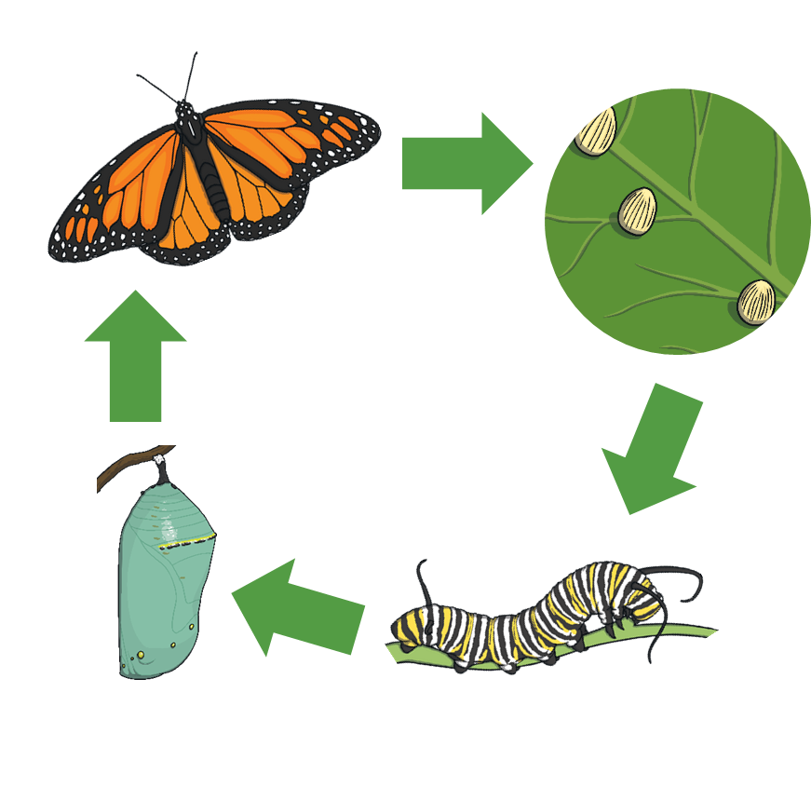

Slide 9
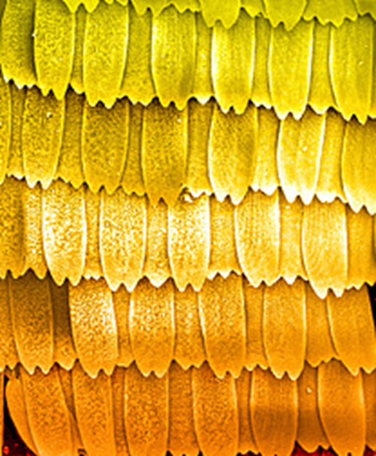
Scales on the Wings
x200

Slide 10
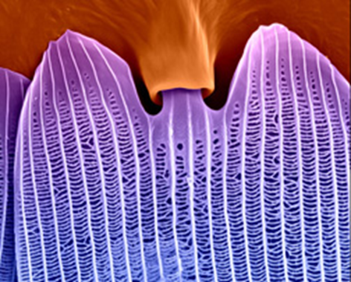
Scales on the Wings
x5,000

Slide 11
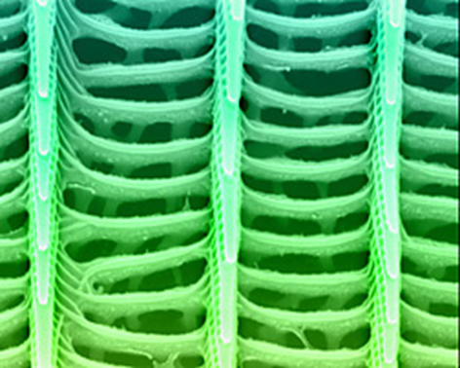
Scales on the Wings
x20,000

Slide 12
Monarch Migration!

Slide 13
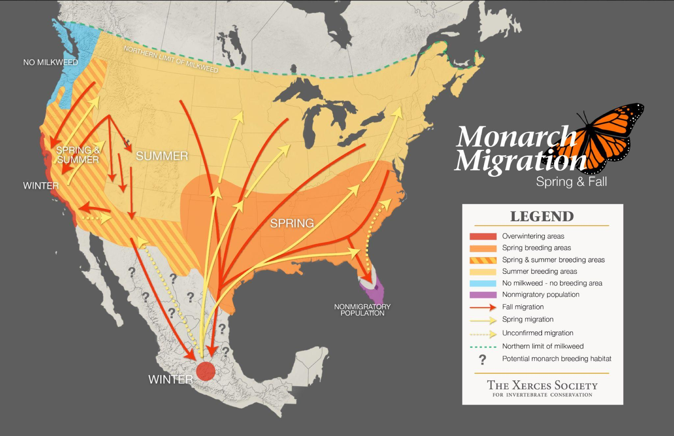
Notes:
Monarch Butterfly Distribution Map

Slide 14
Monarch butterflies migrate 2.000 miles or more in autumn from the United States and Canada to central Mexican forests where they hibernate.

Slide 15
They can travel between 50 and 100 miles a day, and it can take up to two months to complete their journey.

Slide 16
Migrating monarch butterflies are guided by the sun’s orbit as they travel through North America.
Even on cloudy days, they’re able to stay on track thanks to an internal biological compass that functions based on the movement of the sun

Slide 17
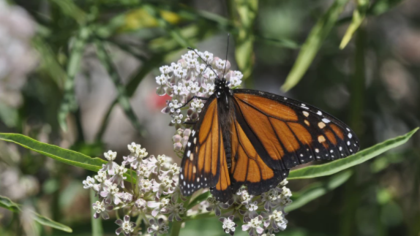
Milkweed is the only plant that monarchs will lay their eggs on,
because it is the only source of food for the emerging baby caterpillars

Slide 18
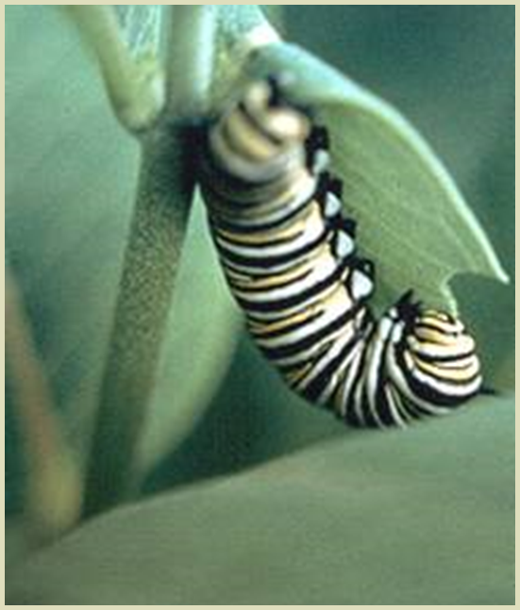
Monarch larvae feed exclusively on milkweed worldwide.
There are approximately 230 different kinds of milkweed worldwide.
Those local around us include the Common Milkweed and Narrow-leaf Milkweed.

Slide 19
Finding Butterflies in LA

Slide 20
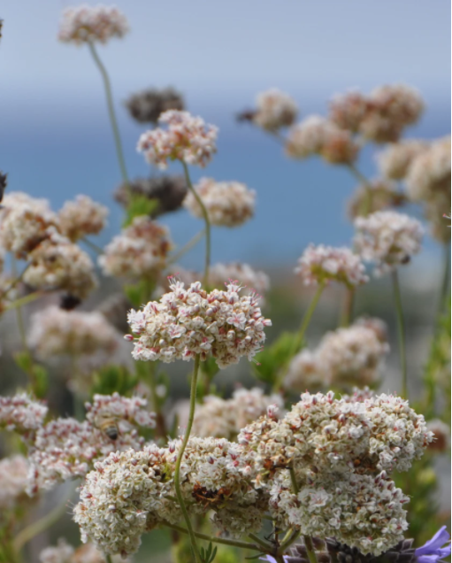
California Buckwheat
Attracts butterflies and bees (native pollinators!)

Slide 21
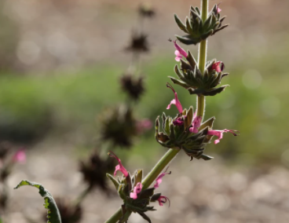
Hummingbird Sage
Blooms in oak woodland!

Slide 22
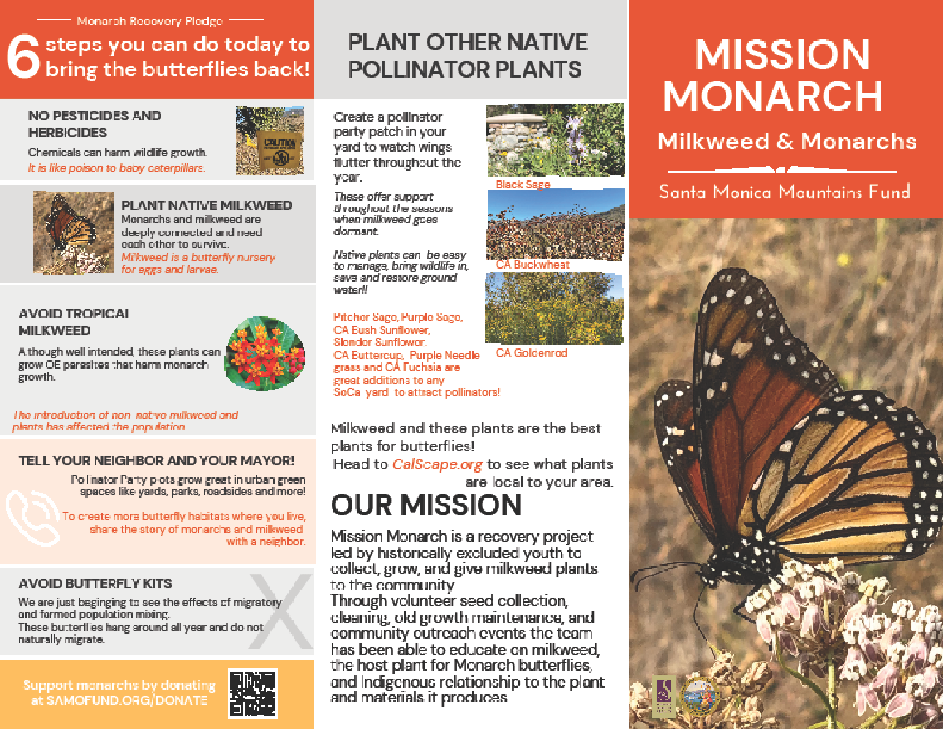

Slide 23
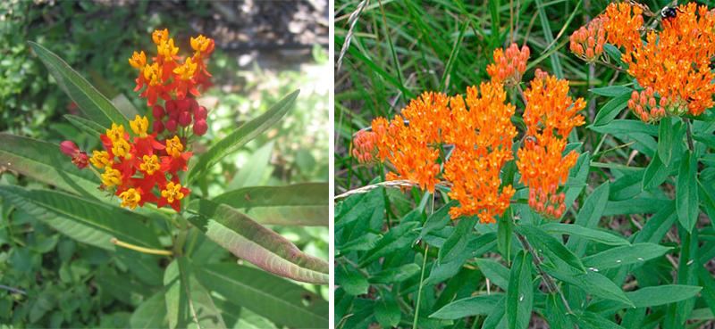
Notes:
Tropical milkweed. These are not good for monarchs!

Slide 24
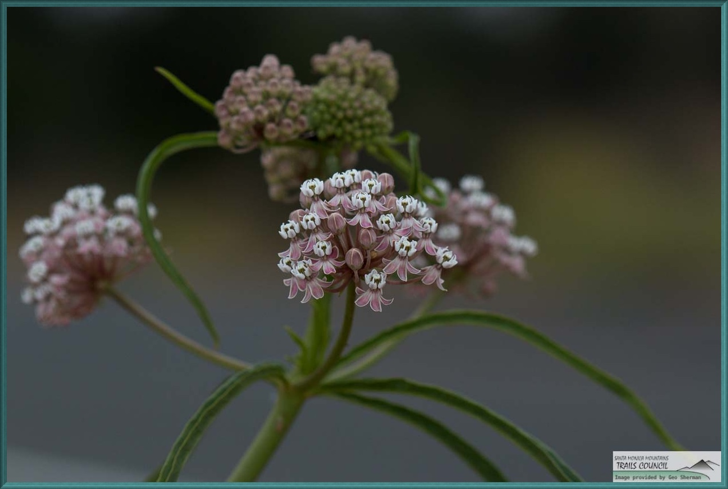

Slide 25

Thank you! Please fill out the survey!!!
Notes:
https://jeopardylabs.com/play/nature-game-time

