Slide 1
Chumash: A Changing People, A Changing Land Language and Name Tag Information
Rancho Sierra Vista/ Satwiwa
Home of the Satwiwa Native American Indian Culture Center

Slide 2
Land Acknowledgment
We, the Santa Monica Mountains National Recreation Area, recognizes the original stewards of the lands as the first people of these places. We are grateful to the Chumash, Gabrielino- Tongva, and Tatavian people for the ability to share stories, cultural heritage, and connection to environment on their ancestral homes.

Slide 3
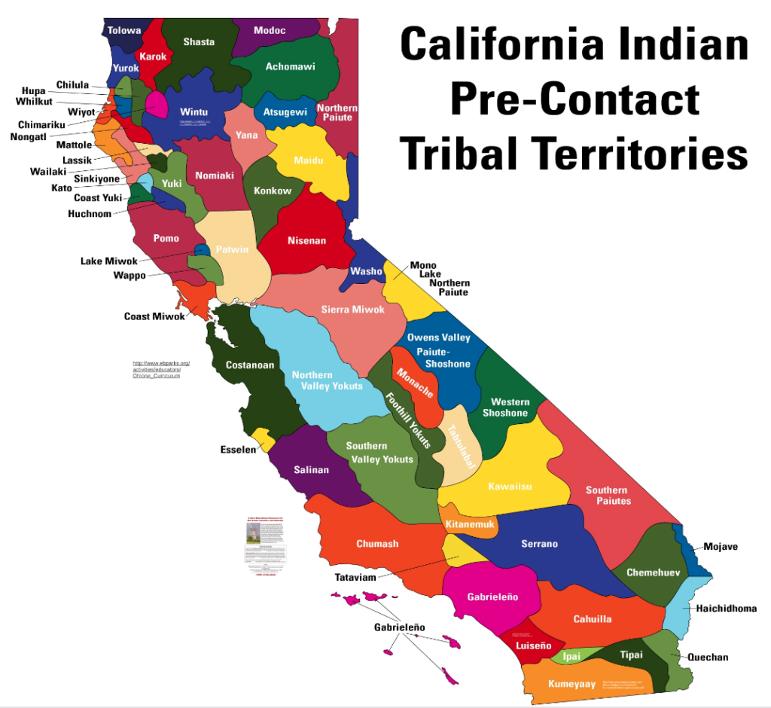
What language did the Chumash Speak?
In California, one way we divide Native people into tribes is by the language they speak. The Chumash speak several varieties or dialects of the Hokan language. Their neighbors to the south, the Gabrielino/Tongva, speak a version of the Shoshone language and the Tataviam, their neighbors to the northeast speak a version of Uto-Aztecan.

Slide 4
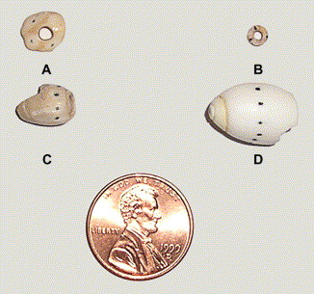
Where does the name ‘Chumash’ come from?
The name Chumash comes from the Hokan word, michumash, meaning "the makers of shell bead money." The michumash were the people of Santa Cruz Island, who made most of the Chumash shell beads from olivella shells (small snails). In 1891, the name was shortened to Chumash by J.W. Powell, who was studying these people.

Slide 5
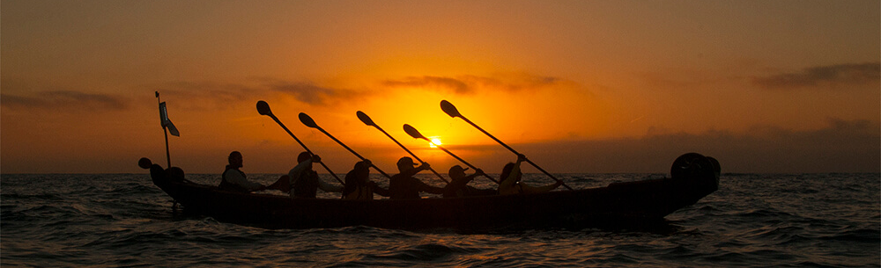
Vowels
Like the Spanish language, Chumash vowels have only one sound each:
a" as in ball
"e" as in bet
"i" as in bee
“o" as in toe
"u" as in boot

Slide 6
Pick one or two of these Chumash words to make your name tag: |  | Nature |  | People and Objects
Animals |  | Nature |  | People and Objects
English | Chumash | English | Chumash | English | Chumash
^{bat} ^{bear} ^{blackbird} ^{coyote} ^{crayfish} ^{eagle} ^{falcon} ^{fish} ^{fox} ^{goose} ^{gopher} ^{hawk} ^{lizard} ^{mountain lion} ^{owl} ^{pelican} ^{rabbit} ^{rattlesnake} ^{raven} ^{swordfis} ^{vulture} ^{weasel} ^{whale} ^{woodpecker} | ^{makal} ^{khus} ^{chok} ^{ashka shniwish} ^{qo/oy} ^{kaslow} ^{helek} ^{lahus} ^{haw} ^{wawa} ^{tapo} ^{woy} ^{pocoyi} ^{yum} ^{muhu} ^{hew} ^{ma} ^{qshap} ^{qaq} ^{elyewun} ^{onoq} ^{monsow} ^{pahat} ^{pu/akak} | ^{canyon} ^{Earth Mother} ^{land} ^{Milky Way} ^{meadow} ^{moon} ^{sky} ^{sun} ^{water} ^{willow} ^{Wind} ^{world} | ^{onomyo} ^{Hutash} ^{shup} ^{Alchupo ash} ^{nakhuwi} ^{auhai} ^{a/apay} ^{alishaw} º ^{kahaw} ^{sahkut} ^{chupu} | ^{child} ^{man} ^{spirit} ^{woman} ^{abalone jewelry} ^{arrow} arrowhead bead money bull roarer ^{demon} ^{fishhook knife} ^{paint} ^{rattle} ^{shell cup} ^{tar} ^{village} | ^{ch-ich-i} ^{uhuy} ^{ahushush} ^{eneq} ^{huqpey} ^{ya} ^{sulupe} ^{a/chum} ^{a/ahtumumu} ^{nunashush} ^{cisha} ^{tiho} ^{ahimonush} ^{ciwis} ^{shtuliwash} ^{pismu} ^{apanus}

Slide 7
7

