Slide 1
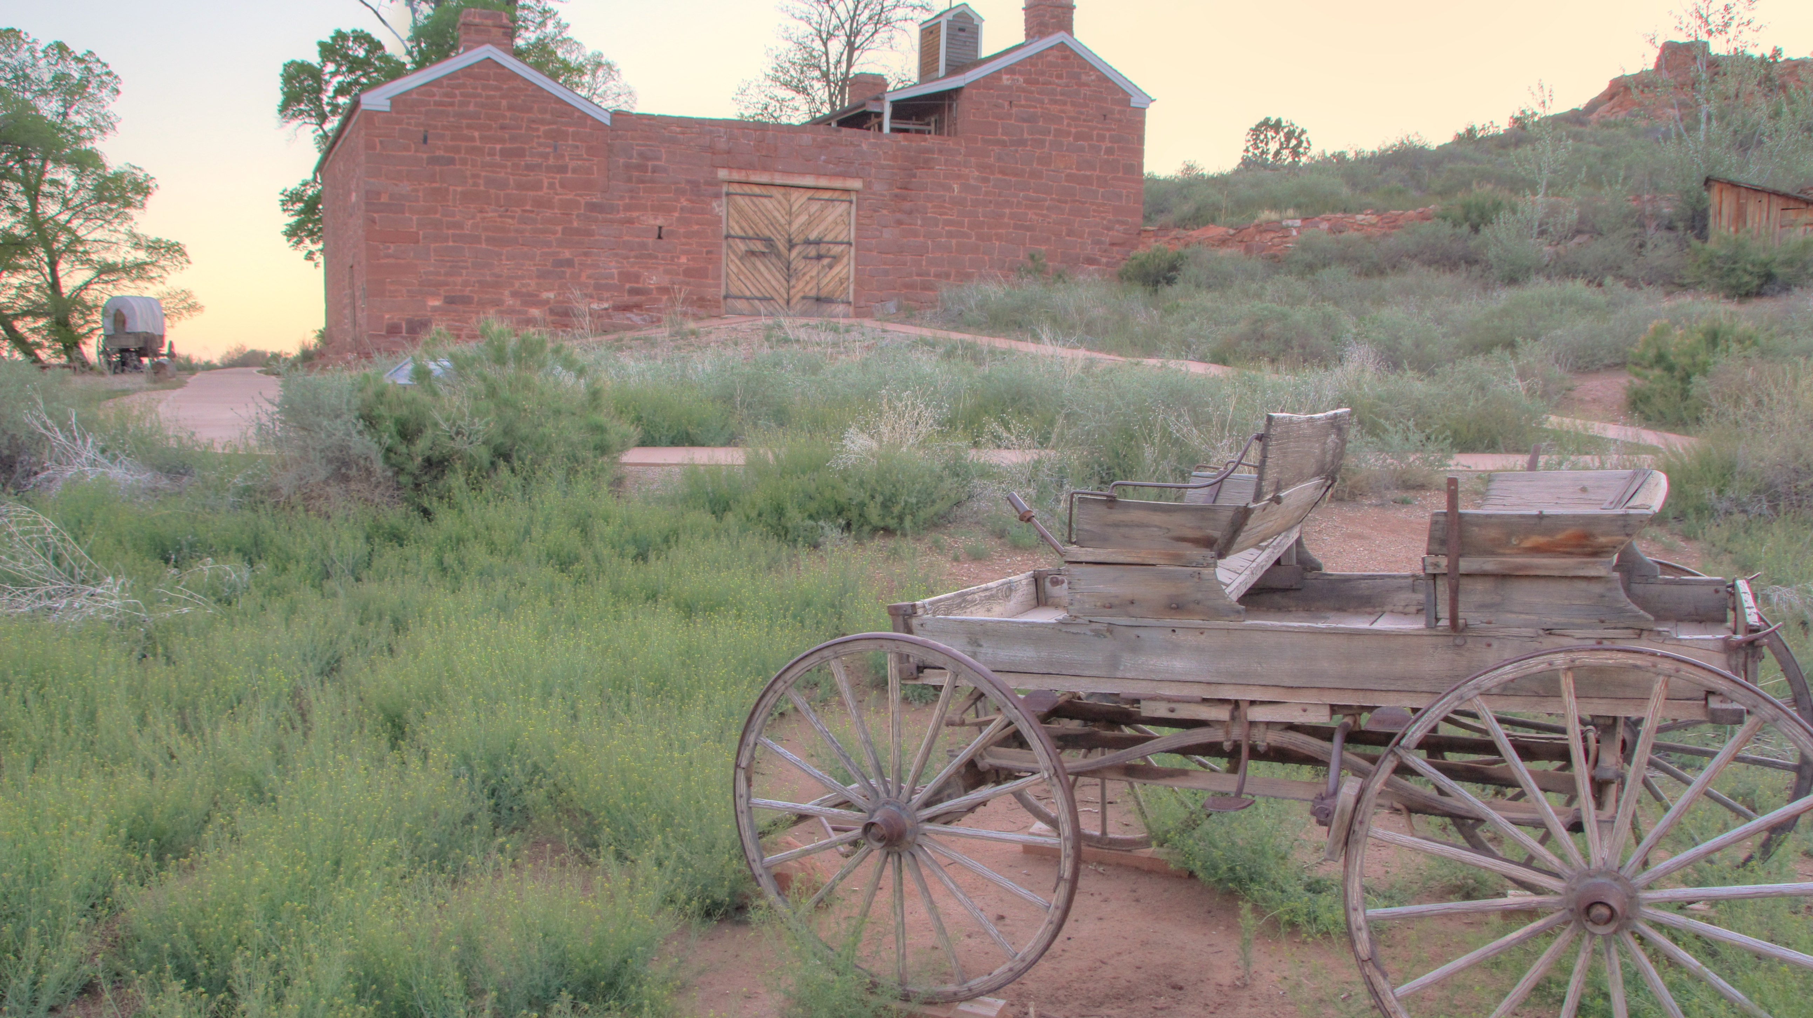
Pipe Spring National Monument Virtual Lesson 1
At home activity for students

Slide 2
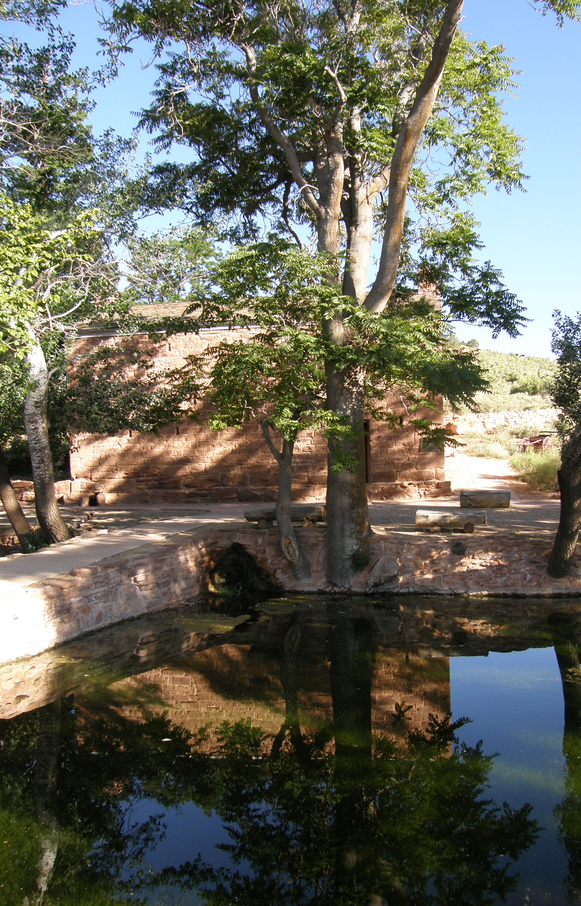
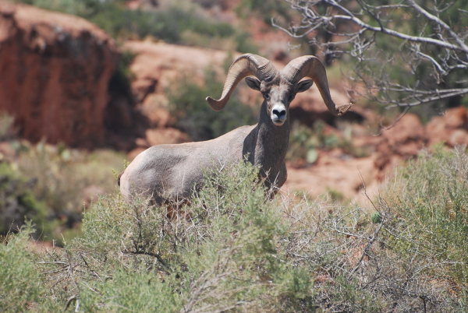
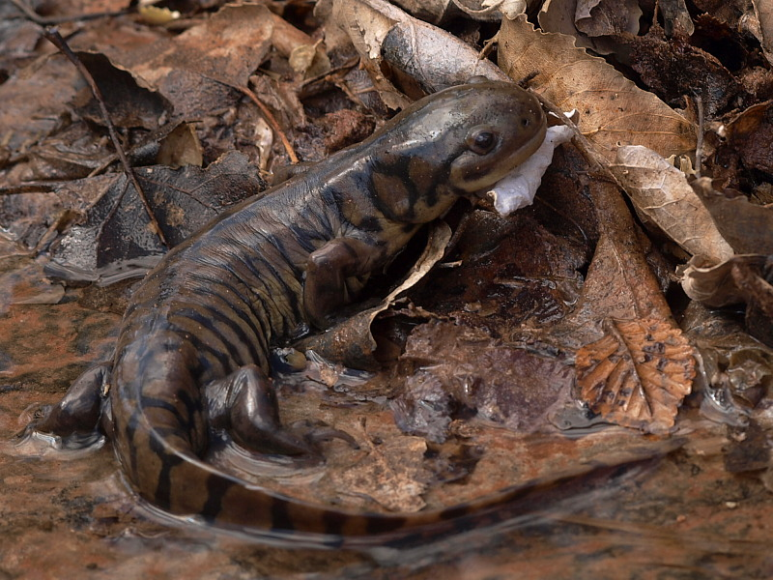
Welcome to Pipe Spring!
Pipe Spring is a small national monument in the middle of the desert near the border of Utah and Arizona.
Why is Pipe Spring significant:
  As one of the few large water springs on the Arizona Strip, we provide water to:
    Wildlife-birds, amphibians, deer, bighorn sheep, coyotes, etc
    And lots of people for thousands of years!!
View of Spring water entering ponds
Desert Bighorn Sheep and Tiger Salamander

Slide 3
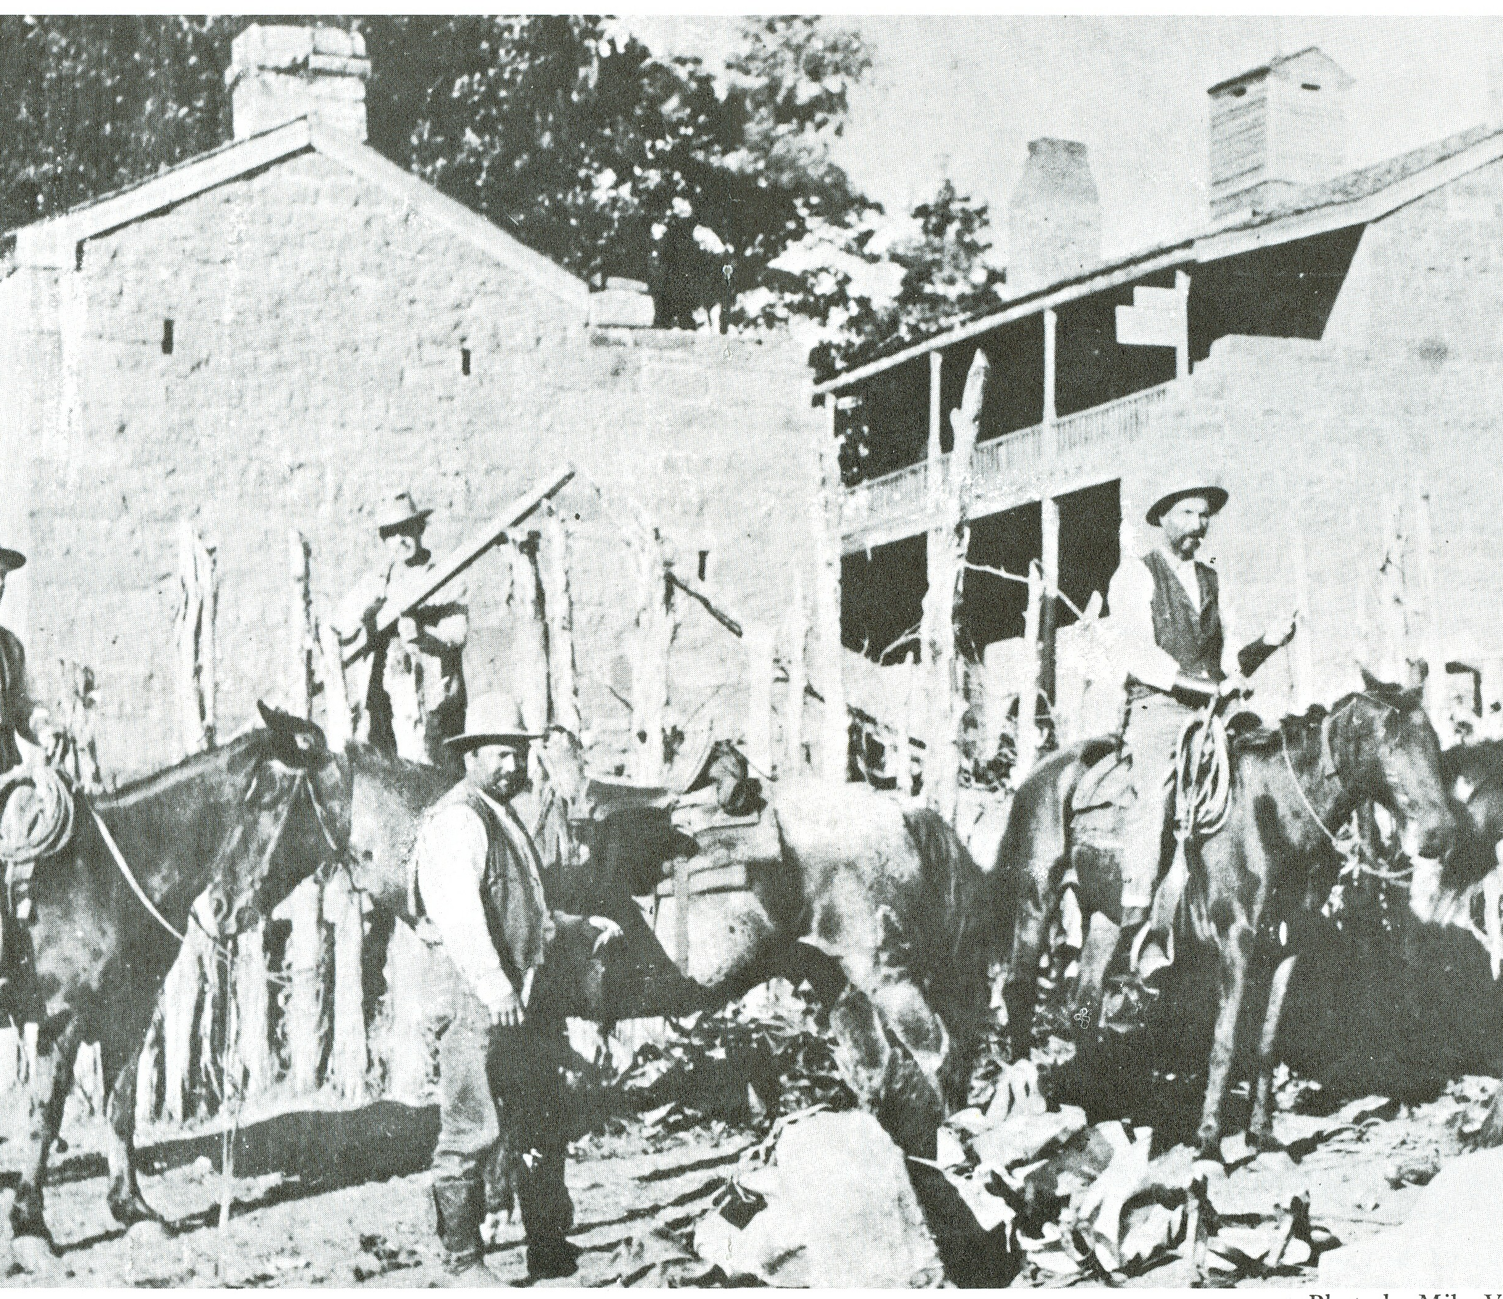
People of Pipe Spring
For thousands of years, Native Americans have used the water of Pipe Spring.
  The Native people who live here today are called the Kaibab Band of Southern Paiutes.
  They used the spring water to farm, gathered wild plants nearby and hunted animals for food. They trace their ancestry in this region back thousands of years!
In the 1860s, members of the Church of Jesus Christ of Latter-Day Saints settled the spring and in the 1870s, the church built a large cattle ranch.
  They made butter and cheese here everyday to send to St. George. Pipe Spring fed the people building the temple there.
  Settlers moving to new places in Arizona also stopped and used the water here. Pipe Spring is a stop on the Old Spanish Trail, the “Mormon Wagon Road,” and the Honeymoon Trail

Slide 4
Children at Pipe Spring in the late 1800s
There were many children at Pipe Spring and many of them had different responsibilities and roles to play to either help their families or run the ranch.
At Pipe Spring at any one time, you may have met a child who was a telegraph operator (usually teenagers), a dairy maid, a ranch-hand, a Paiute gather, or a settler passing through on their way to Arizona.
Let’s look at each of the different children you might have met at Pipe Spring through the objects they would have used or played with.

Slide 5
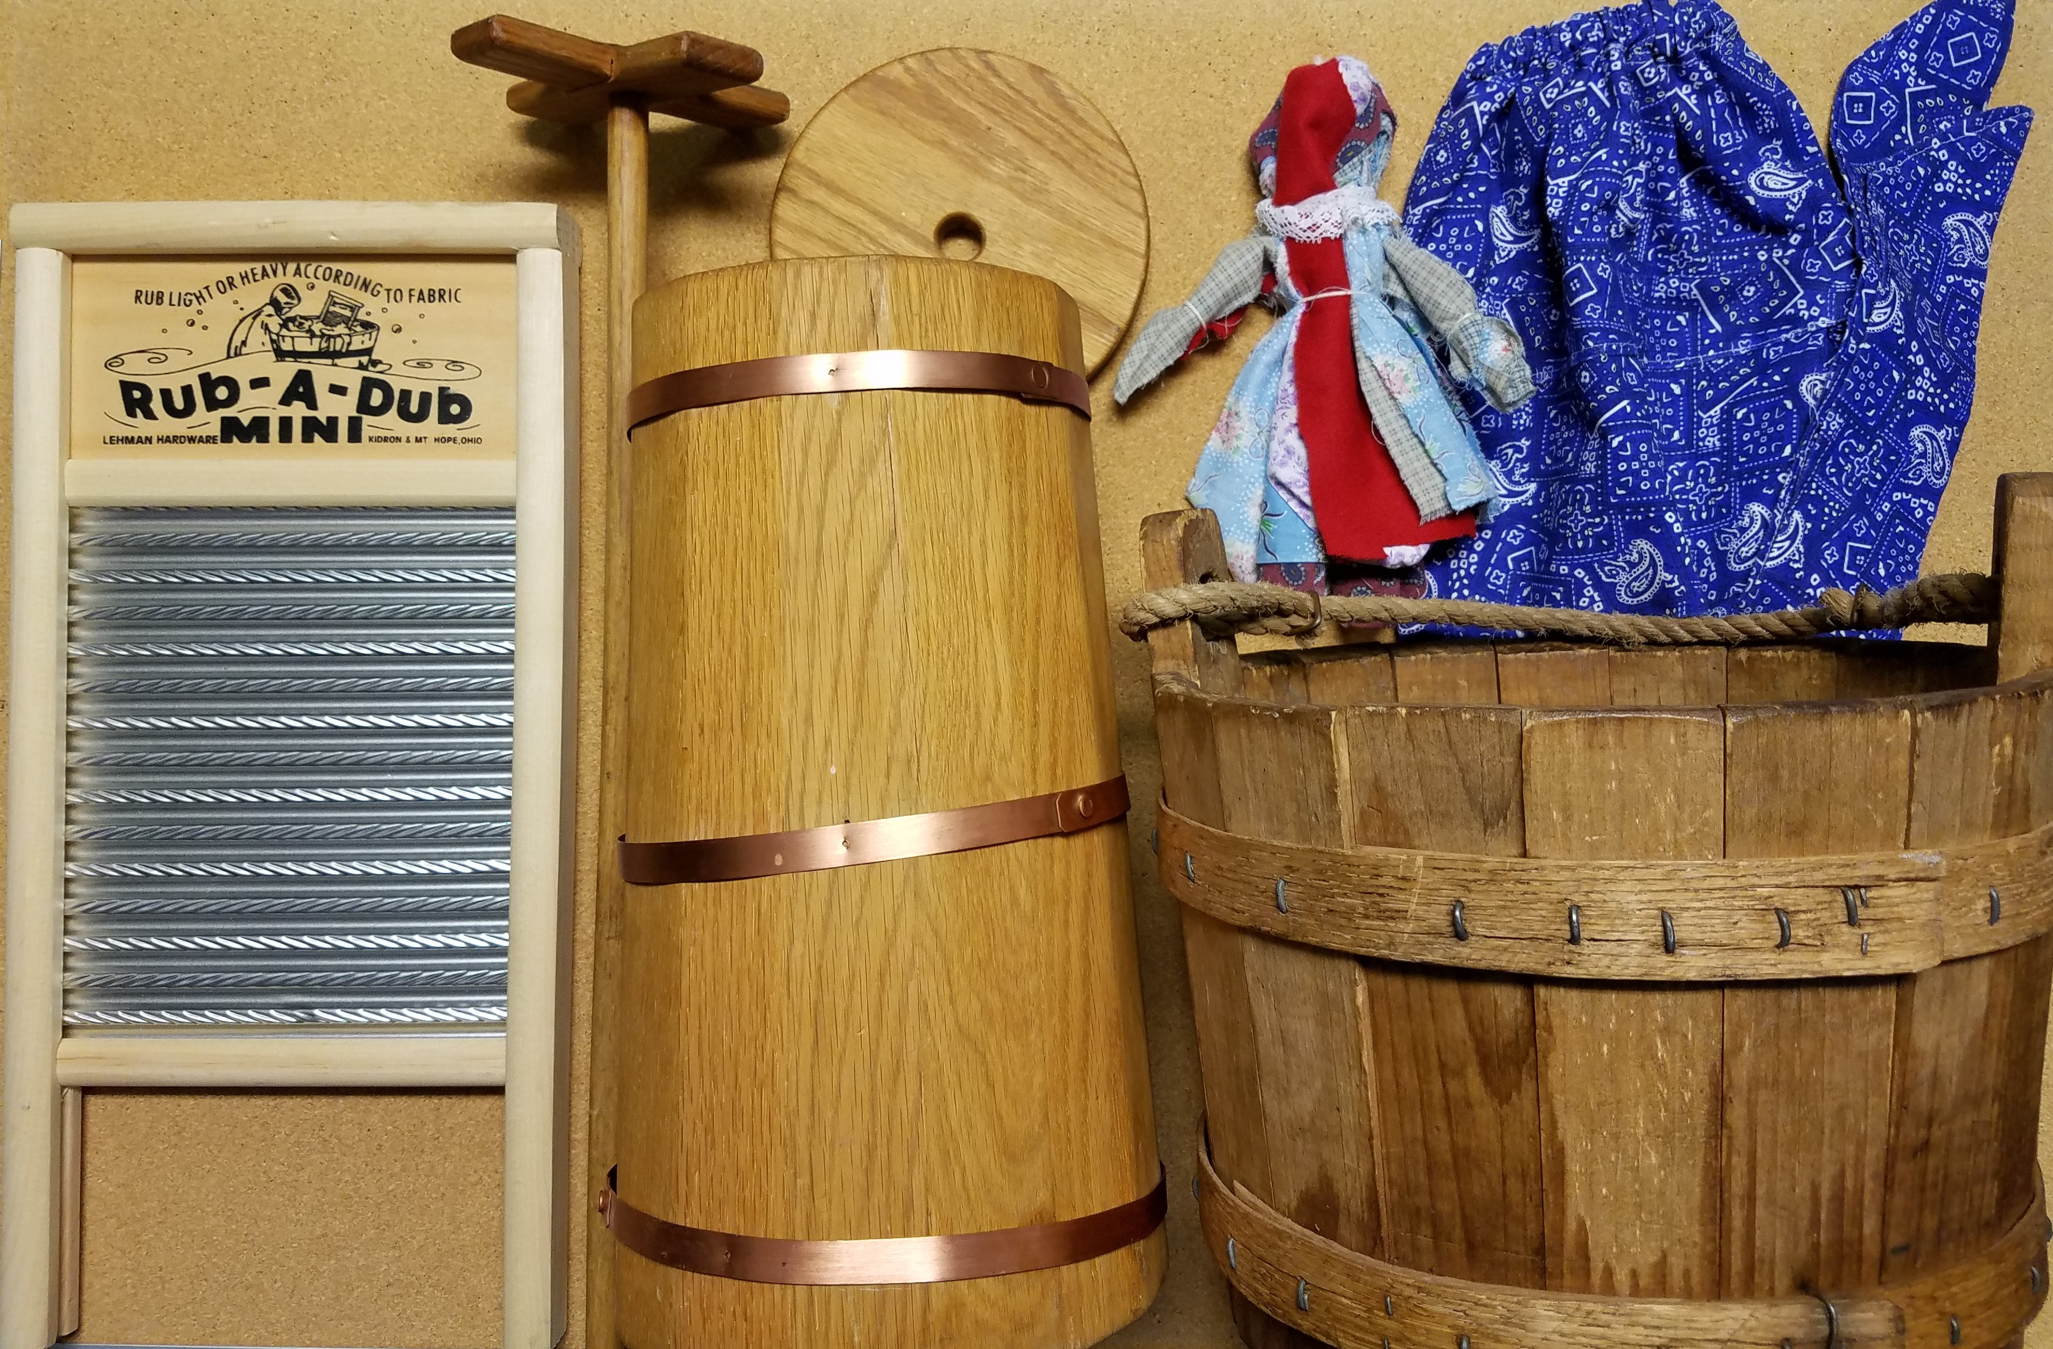
Mystery Person #1
What things do you see in the picture? Who do you think may have used them?

Slide 6
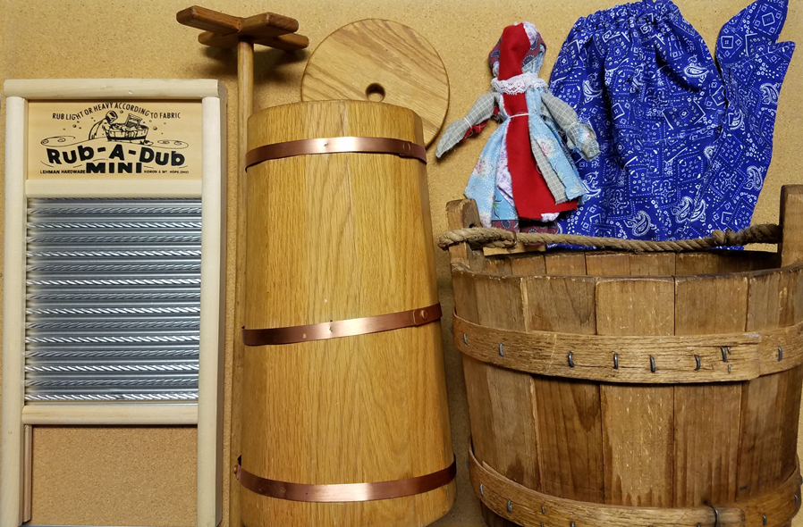
Dairy Maid!
Bonnet for gardening
Rag doll to play with
Making Butter
Dairy Maids had many responsibilities!
Washing Clothes
Bucket to fetch water

Slide 7
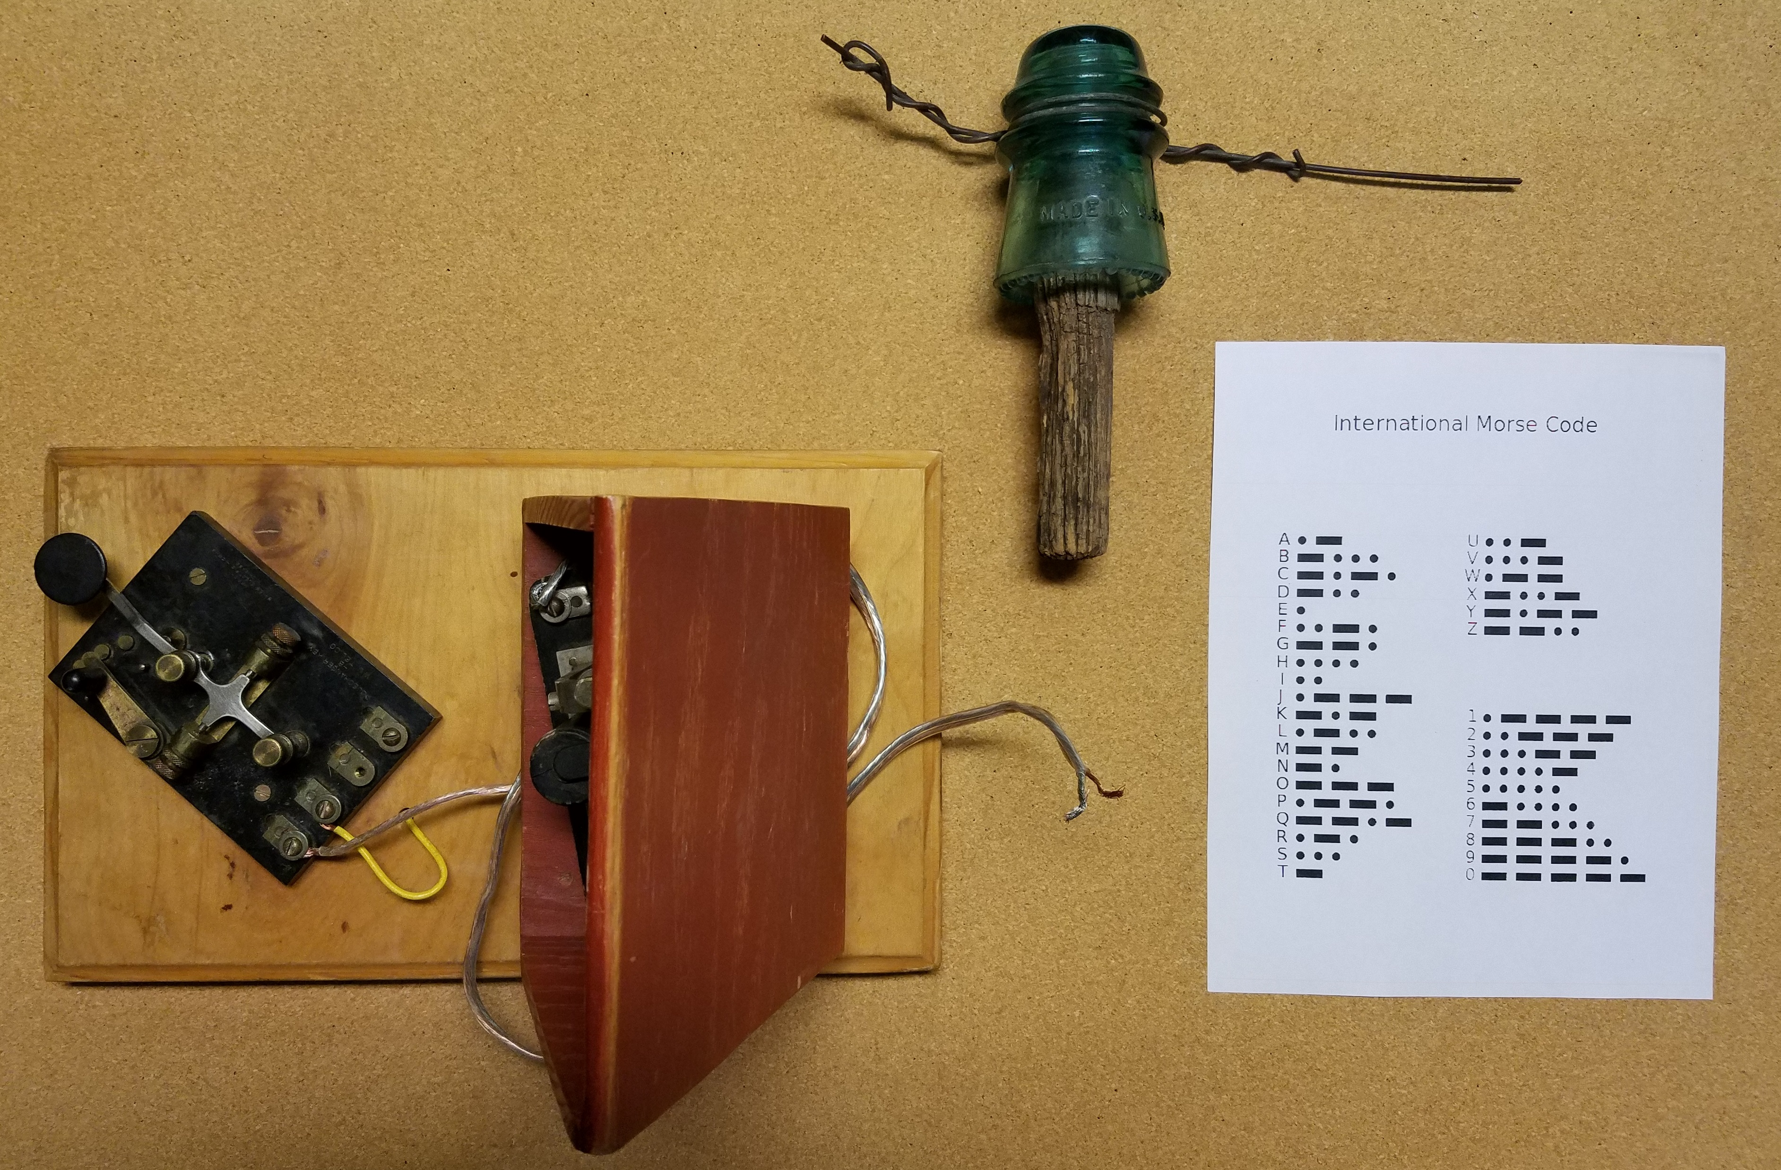
Mystery Person #2
What things do you see in the picture? Who do you think may have used them?

Slide 8
Telegraph Operator!
Telegraph operators sent and received messages. The telegraph is older than the telephone. It made sounded like beeps or clicks that the telegraph operator translated into words.
Electric wire and insulator, messages traveled down the line to telegraph stations
Telegraph key and sounder-to send and receive messages
Morse Code-the code telegraphers learned

Slide 9
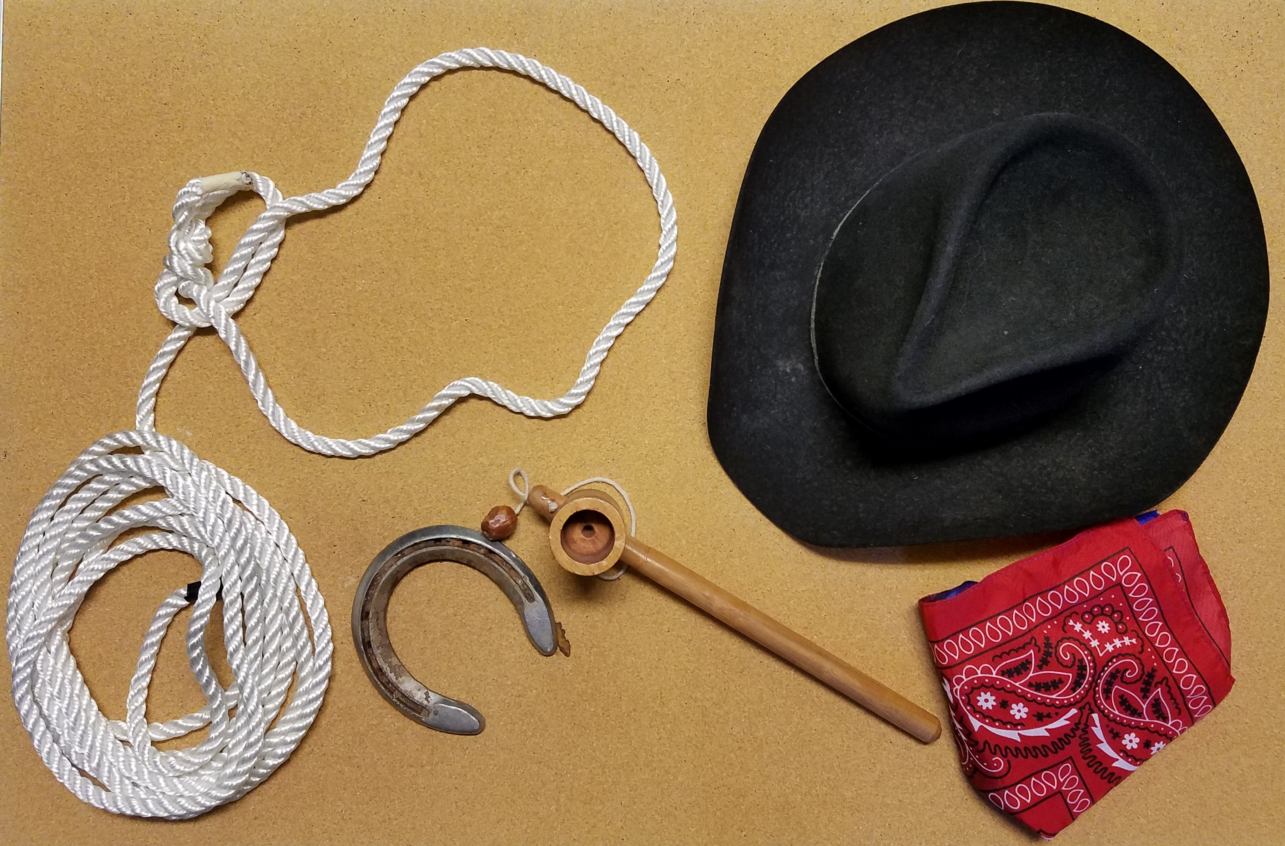
Mystery Person #3
What things do you see in the picture? Who do you think may have used them?

Slide 10
Ranch-hand!
Cowboy hat for sun protection
Ranch-hands helped move the cows from pasture to pasture and drove them to market in St. George.
Rope for lassoing cows
Cup and Ball game for fun
Horseshoe
Bandanna-lots of uses on a cattle drive!

Slide 11
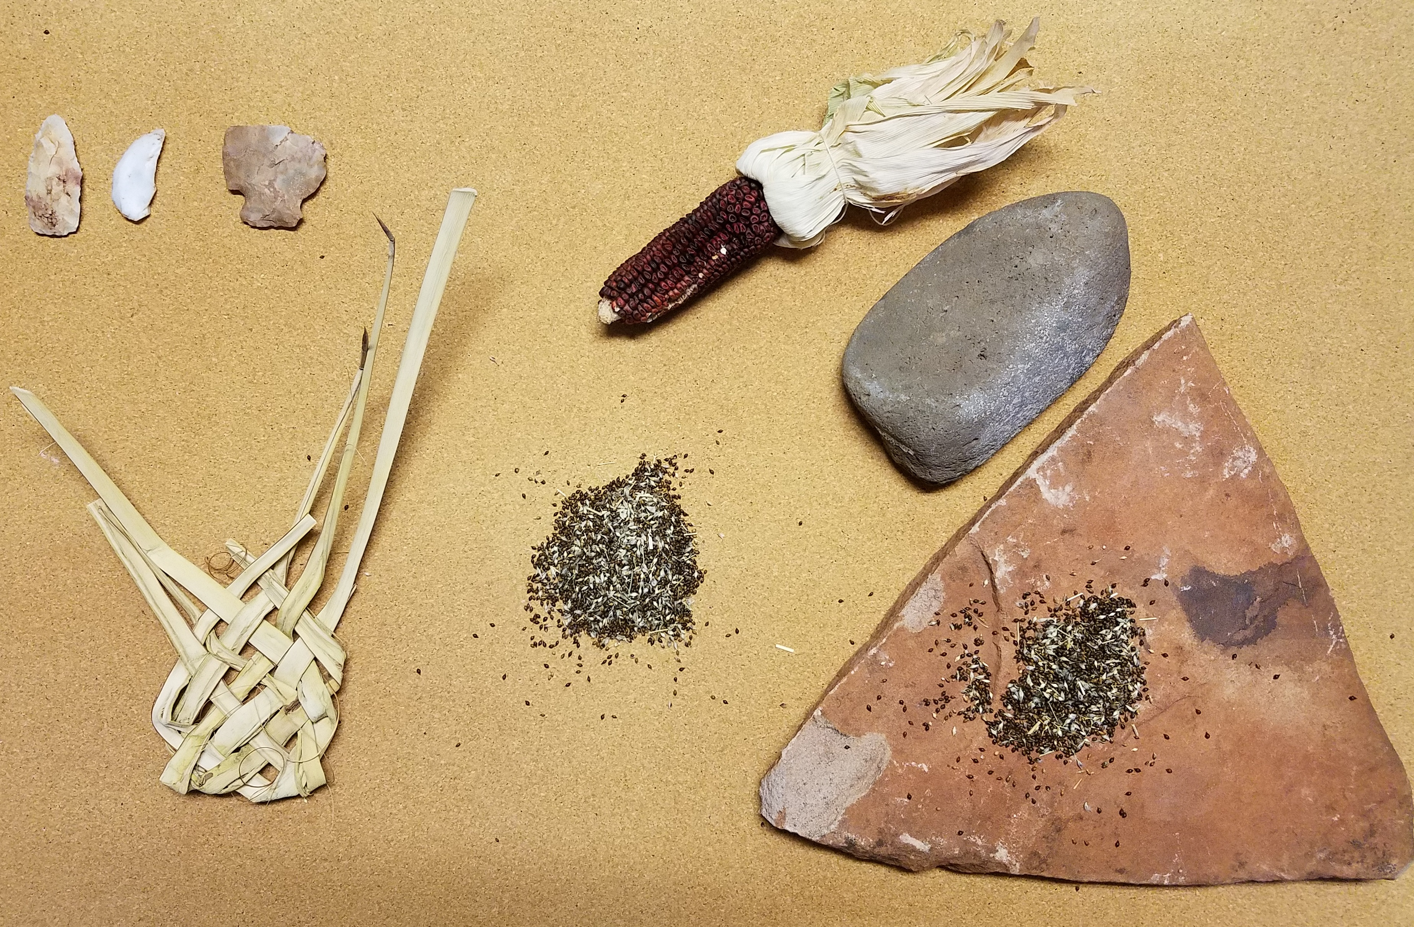
Mystery Person #4
What things do you see in the picture? Who do you think may have used them?

Slide 12
Paiute Gatherer!
Grinding stones for food
Southern Paiutes continued to live at and near Pipe Spring after American settlers moved in.
Arrowheads for hunting
Grew corn and other plants for food
Collected Rice Grass Seed
Wove Yucca leaves into tools and rope

Slide 13
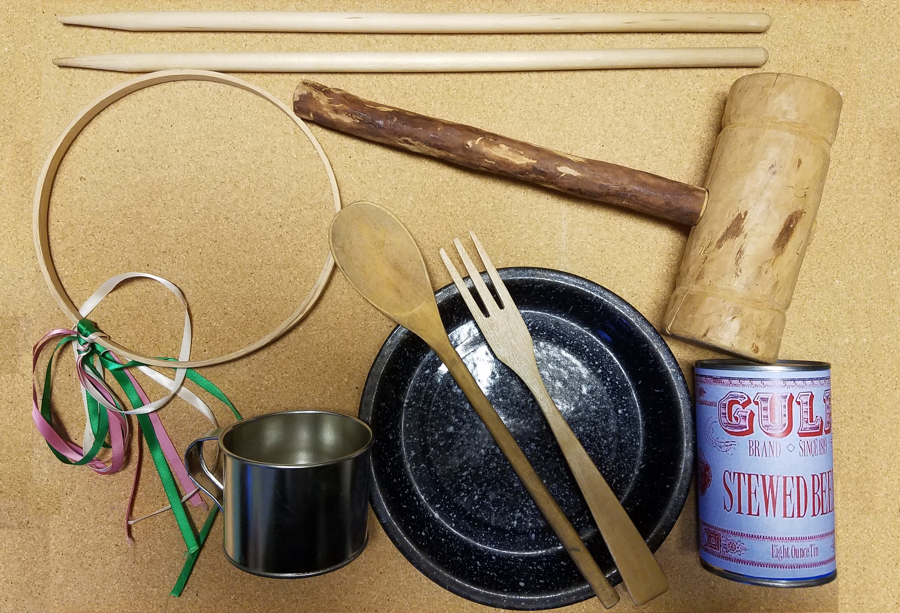
Mystery Person #5
What things do you see in the picture? Who do you think may have used them?

Slide 14
Setter Traveling Through!
Wooden Mallet to fix wagon parts
Pipe Spring was a rest stop on 3 major trails. Everyone needed water, not only for themselves but their animals too.
Graces-a ring toss game played by children
Tin plate, cup and wooden utensils-won’t break while traveling on bumpy roads
Ate canned or dried foods. Food had to last weeks or months

Slide 15
Kids at Pipe Spring were very busy!
To learn more about Pipe Spring and the children who lived there watch the videos sent by your teacher and do the home activities.
Explore Pipe Spring Online:
  On our website, you can take a virtual tour of Winsor Castle, the fortified ranch house at the monument, explore the grounds and ridge trail.
  www.nps.gov/pisp click on “Learn About the Park” and then “Photos and Multimedia” to take a tour!
  Thanks kids and hope to see you at the Parks soon!

