Slide 1
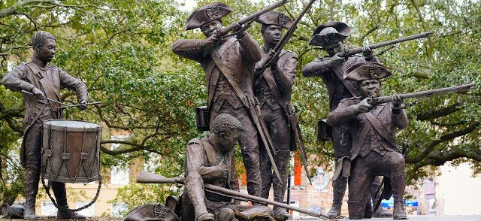

A New Tide: Armed Conflict through the Eyes of Black America
Notes:
Hello and welcome to A New Tide: Armed Conflict through the Eyes of Black America. My name is Philip Bailey, and I am the Historian for the National Park Service’s American Battlefield Protection Program (which I’ll refer to as ABPP moving forward).
Before I begin, I want you to know that this presentation is a starting point - not the conclusion - of an effort to bring the war stories of Black and African Americans to the same level of exposure that Bunker Hill and Gettysburg have to the people of the United States. I’ll explain more about that later, but for right now, I want to take you to a sinking Island in the Chesapeake Bay.
Image: Savannah, Georgia's, Haitian Monument on Franklin Square, which commemorates the contribution of the Chasseurs-Volontaires de Saint-Domingue. The regiment accompanied the Comte d'Estaing as part of the French expeditionary force that laid siege to Savannah, Georgia.

Slide 2
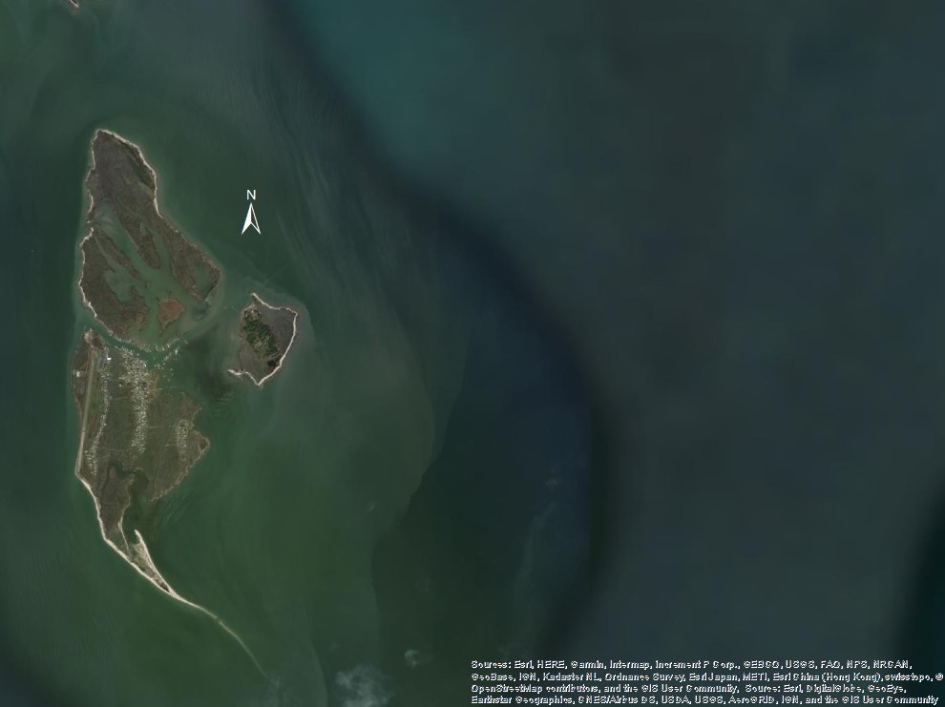
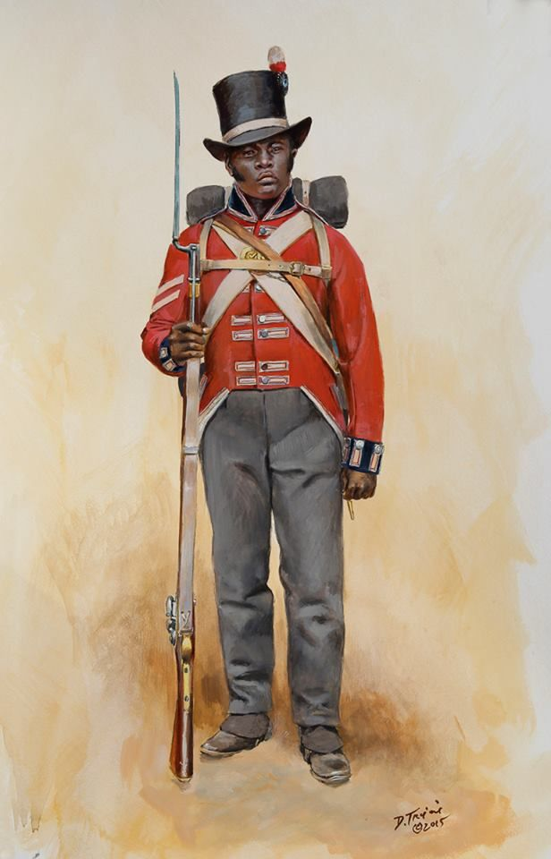
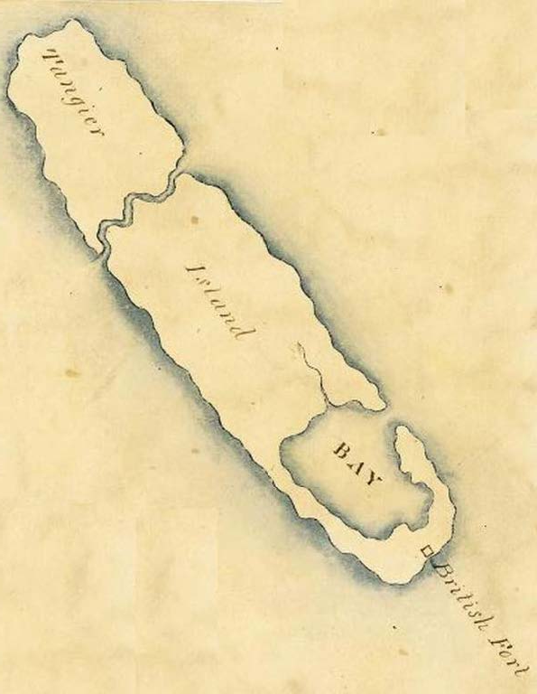
“What are their stories?”
During the War of 1812, the promise of freedom led many African American slaves to side with the British. Some 600 former slaves chose to serve as Colonial Marines and took part in the British attacks on Baltimore and Washington D.C
But they didn’t have to – thousands of other freed blacks would be evacuated to British colonies in Canada and the Caribbean.
So why did hundreds of freed men choose to fight?
  What are their stories?
  How do those stories change our understanding of the history of the United States?
Notes:
Tangier Island, has been slowly consumed by rising sea levels and erosion for over a hundred years. As can been seen on the main image of this slide, the southern portion of the island has been completely lost to the waves. But during the War of 1812, this brackish tide gave a different impression, produced different feelings for thousands of enslaved blacks who chose to risk their lives in pursuit of a better life, and a better tomorrow. For those who had just liberated themselves, this Island was a physical manifestation of the freedom they had gained on their own two feet. The gateway to their personal emancipation.
Tangier Island was the site of British Fort Albion, a military base where any escaped slave could secure their freedom as a part of British war measure to destabilize the American economy. But for hundreds of these freed slaves, it was more than just a means to an end, more than just being an involuntary participant in national politics. They chose to be equipped, trained, and fight alongside the British as part of the Corps of Colonial Marines. They didn’t have to – thousands of others would be evacuated to British colonies in Canada and the Caribbean. But the men who fought in this Corps, represented in the painting by Dan Troiani, they made a decision, they chose to express their freedom on the battlefield. Why? What are their stories? How do those stories change the narrative of the Battle of Bladensburg or the burning of Washington? Some of the many battlefields where the Corps was present.
These are important questions, and questions that ultimately focus on learning about who these people were as individuals.
Image: ArcGIS World Image of Tangier Island, with images of a British Colonial Marine and Historic Map of the Island inset. The approximate location of Fort Albion is identified by a white circle.

Slide 3
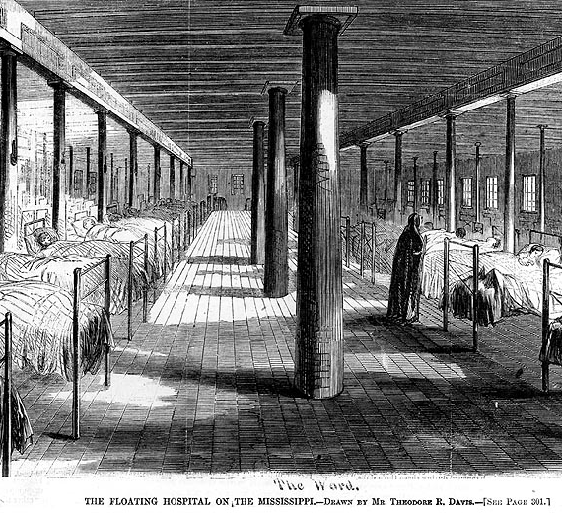
“Who were they as Individuals?”
Ann Stokes was first taken aboard a Union Naval vessel as "contraband" in 1863. She was hired as a nurse and worked under the direction of the Sisters of the Holy Cross.
Ann became the first African American woman to serve on board a U.S. military vessel, the USS Red Rover.
The USS Red Rover was the United States first hospital ship and would treat nearly 3000 patients onboard.
Notes:
Individuals like Ann Stokes. During the American Civil War, Ann was classified as “contraband” and taken aboard a Union Naval vessel in January of 1863. That same month, Ann enlisted as a nurse onboard the United States first hospital ship, the USS Red Rover. Ann was the first African American woman to serve on a U.S. military vessel, and she would soon be joined by four others; Ellen Campbell, Alice Kennedy, Sarah Kinno and Betsy Young.
These five women would serve as part of the Union’s brown water navy in campaigns against Vicksburg, MS and Fort Hindman at Arkansas Post.
Image: USS Red Rover (1862-1865). Line engraving after a drawing by Theodore R. Davis, published in "Harper's Weekly", January-June 1863, page 300

Slide 4
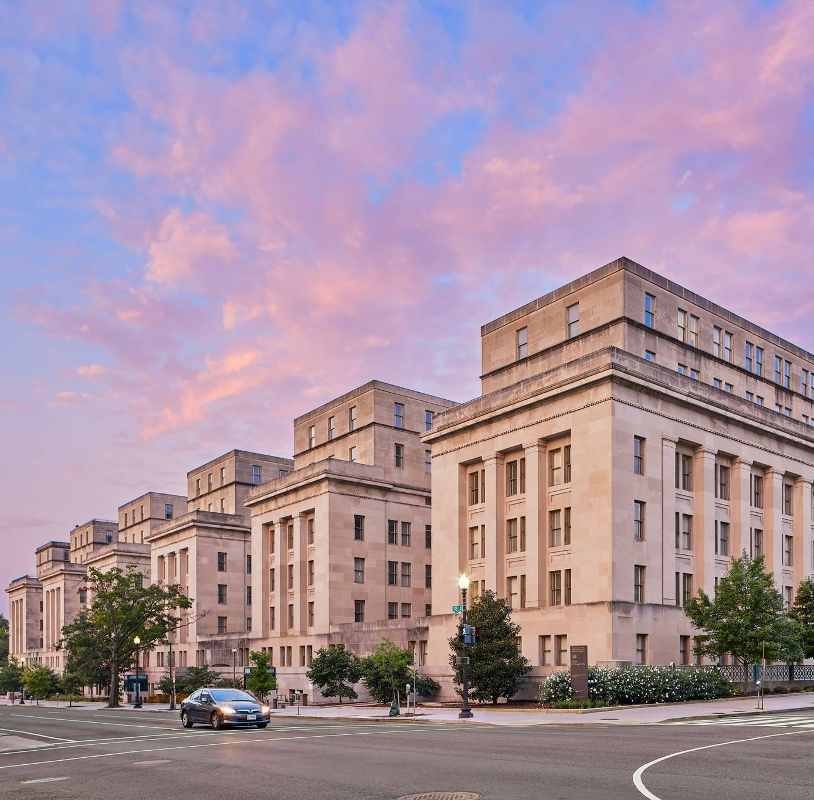
What is the American Battlefield Protection Program?
The National Park Service’s American Battlefield Protection Program (NPS ABPP) assists citizens, public and private institutions, and governments in planning, interpreting, and protecting sites where historic battles were fought on American soil during the armed conflicts that shaped the growth and development of the United States.
Legislative Authority: 54 U.S.C. § 308102
Notes:
These are examples of the type of stories that the ABPP wants to help tell.
ABPP’s mission is “to assist citizens, public and private institutions, and governments at all levels in planning, interpreting, and protecting sites where historic battles were fought on American soil. But that mission can be summarized as helping to tell the stories of peoples experience during the armed conflicts that shaped and changed this country.
ABPP is a national program authorized by Congress to provide grants through a series of smaller unique programs. We currently have seven staff members located in Washington, DC. but we have awarded grants from New York state, all the way to the Marshal Islands in the Pacific.
* * *
So why is ABPP hosting this webinar today? Because ABPP wants to encourage a diverse group of applicants to apply for grants provided under our Battlefield Preservation Planning Grants program. We believe that by providing financial assistance to projects that contain diverse subject matter, grant recipients will convey a more complete understanding of the full diversity of the American experience, and the armed conflicts that shaped the growth and development of the United States.
Today’s presentation is focused on African American History specifically, because ABPP has identified that rich history as an area where we need to grow and increase the number of successful applications and projects. There should be a better understanding of armed conflict through the eyes of black America.
To date, ABPP has only received and awarded one Planning Grant with a focus on black and African American history. I’m going to talk about that project, then explain more about the Planning Grants program.
Image: 4th US Colored Troops, This image is available from the United States Library of Congress's Prints and Photographs division under the digital ID: cwpb 04294 https://hdl.loc.gov/loc.pnp/cwpb.04294

Slide 5
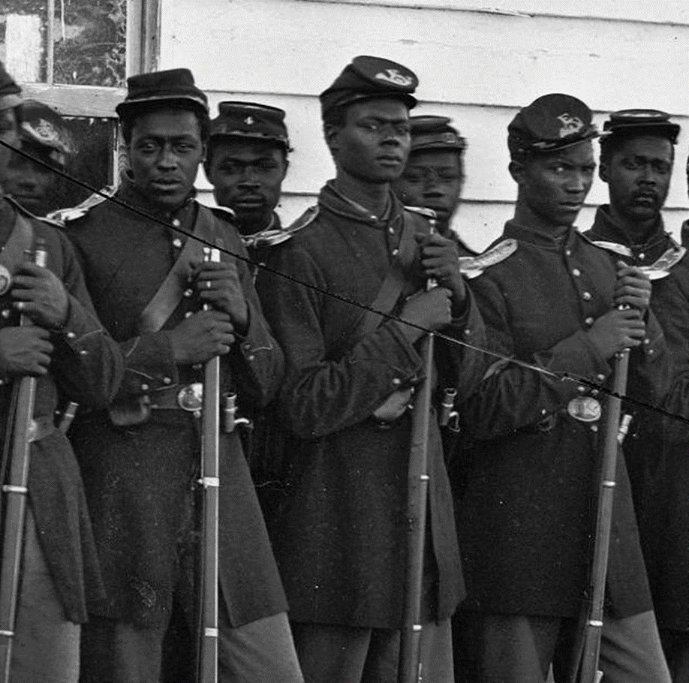
Telling All Americans’ Stories
Preservation Planning Grant (2019): The US Colored Troops and North Carolina’s Civil War Battlefields
Recipient: North Carolina Department of Natural & Cultural Resources
Project Highlights: This project is focused on researching the movement and impacts of the USCT at 20 Civil War battlefields in North Carolina and using that research in future preservation planning and interpretation across the state.
Notes:
In 2019, the State of North Carolina’s Department of Natural & Cultural Resources was awarded a grant to research US Colored Troops and their impact on North Carolina’s Civil War Battlefields. Men like the 4th US colored troops pictured on this slide. The 4th USCT took part in General Sherman's Campaign of 1865 and saw action at Goldsboro and Cox’s Bridge.
Researching and telling their story may lead to new developments in preservation planning, new nominations for the National Register of Historic Places, and most importantly, an interpretation of battlefields that recognizes the contributions of Black soldiers and says to Black visitors and local residents, “you are part of this story.”
Image: 4th US Colored Troops, This image is available from the United States Library of Congress's Prints and Photographs division under the digital ID: cwpb 04294 https://hdl.loc.gov/loc.pnp/cwpb.04294

Slide 6
Battlefield Preservation Grant Programs
Preservation Planning | Land Acquisition | Interpretive Modernization* | Battlefield Restoration*
Annual, competitive | Rolling | Annual, competitive | TBD
No match | 50% match | 50% match | 50% match
All periods of history | Rev War, 1812, Civil War | Rev War, 1812, Civil War | Rev War, 1812, Civil War
Planning, research, and outreach activities excluding bricks-and-mortar preservation or restoration work | Land acquisition by state and local governments | Reimagining battlefield interpretation using technology – planning and implementation level | Restoration of landscapes to day-of-battle conditions, including plans and studies
$1.9 million per year | $10-13 million/year | Up to $1 million/year | Up to $1 million/year
*Authorized but not yet an active funding opportunity
Notes:
As I said previously, North Carolina’s Department of Natural & Cultural Resources was awarded a grant, more specifically a Preservation Planning Grant. This is one of the two grant programs ABPP currently administers with two more on the way.
Here is a quick comparison; Preservation Planning Grants are an annual, competitive grant program that assists in planning, researching, interpreting, and other preservation related tasks. They can cover any time period involving armed conflict on American soil, from the first European contacts with Indigenous cultures to the US bombing of Kiska, Alaska in World War 2. Battlefield Land Acquisition Grants (BLAG), is a rolling grant program that provides a 50% match in funds to assist with fee simple acquisition, or the establishment of a preservation overlay on battlefields, not part of a NPS unit, and listed in one of two Battlefield Reports. These reports cover the American Revolution, War of 1812, and the Civil War.
We will be focusing on Preservation Planning Grants (which I’ll refer too as PPGs moving forward) because they are the only grants that can be applied to any armed conflict on American soil, regardless of whether the United States was in existence at the time, or the US Army was involved in the battle. They also have the widest scope of eligible activities.

Slide 7
Preservation Planning Grant Basics
Battlefield Preservation Planning Grants fund documentation, research, planning, partnership building, interpretation, and outreach
Projects can focus on battlefields and associated sites from any period in American history
Grants are awarded annually through a competitive merit review process
Typical awards range from $30,000-$100,000, and no match is required
Grant projects are typically completed in two years
Notes:
PPGs also don’t require any matching funds on the part of an applicant. They typically range from $30,000 to $100,000 per award, but there is no hard ceiling. Applicants can apply for multiple grants – there is no restriction on the number of awards that can be given to a particular organization, state, or topic – but keep in mind that it is a competitive merit review process. That means that if an applicant applies for multiple grants, they aren’t just competing against other applicants, they could potentially be competing against themselves.
Project assisted under the PPG program typically are completed in two years, with an annual reporting cycle.
Those are the basics, now before I get into more detail, I have one more story to tell.

Slide 8
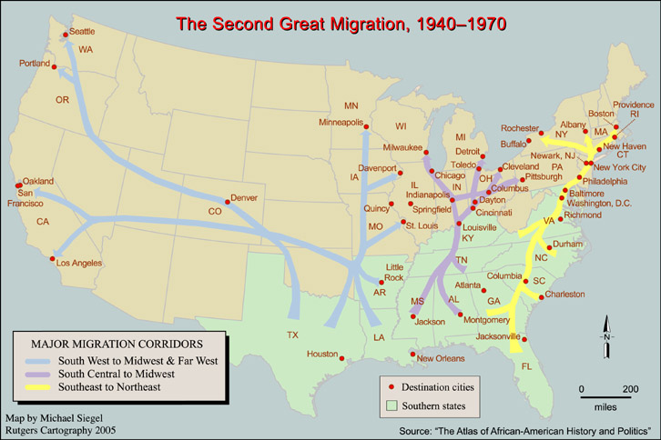
Stories Big and Small
Prior to 1916, over 90% of the black population of the United States lived in the South. But over the following 60 years almost 50% would move north and west into more industrialized, urban environments like the cities of Detroit and San Francisco.
The second wave of this Great Migration took place during World War 2.
Notes:
According to the Census, prior to 1916, over 90% of the black population of the United States lived in the South. But over the following 60 years almost 50% would move north and west into more industrialized, urban environments like the cities of Detroit and San Francisco.
The second wave of this Great Migration took place during World War 2 and had a profound effect on the west coast, where states like California saw their population of African Americans quadruple in only a couple years.
Image: A map of the Second Great Migration of African Americans from the south from 1940-1970, from the Atlas of African American History and Politics, 2005.

Slide 9
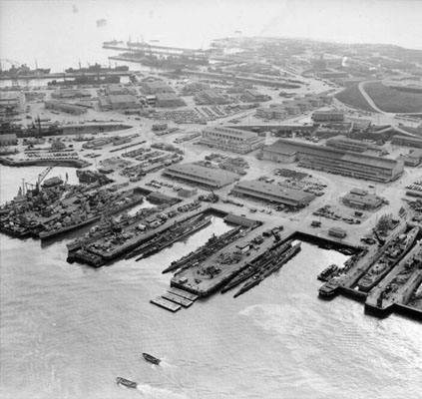
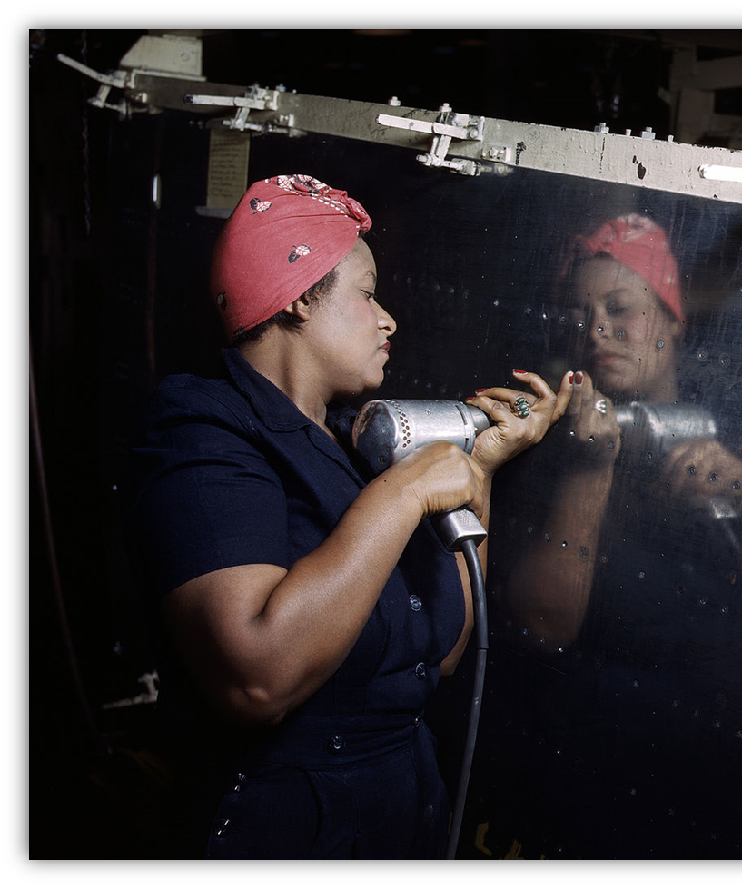
Stories Bound Together: Hunters Point
Hunters Point in San Francisco, California was one of many shipyards that serviced the American Navy during World War 2
7% of the workforce was African American by 1945, and a large portion of that number were black women.
  Black women were often tasked with the most physically demanding and labor-intensive jobs.
  Black women made up a larger portion of the labor force than their white female counterparts.
Notes:
What does this Great Migration have to do with battlefields – you may be asking? Where does this national story tie into more local events? One example is in San Francisco.
Hunters Point in San Francisco, pictured on this slide, was one of the numerous shipyards that serviced the American Navy during World War 2. Prior to the war, African Americans comprised no more than 3% of the workers on the docks, but by 1945 they numbered more than 7%. Of the approximately 50,000 African Americans that worked in the shipyards along the West Coast, a large number were black women. Black women were often concentrated in the most physically demanding and labor-intensive jobs. A Department of Labor study revealed that 63% of black women were engaged as welder's trainees and laborers. In contrast, only 6% of white women worked as laborers, 9% as welder trainees . . . (Lemke-Santangelo, 1996).
It was these women, along with African American men, who helped to repair 27 ships from battle damage at Hunters Point during the war. The most important of these, from a Preservation Planning Grant perspective, is the Aircraft Carrier USS Intrepid. The Intrepid was repaired at Hunters Point after it was involved in combat at the Battle of Kwajalein Atoll (Roi-Namur) in the Marshal Islands. After it received these repairs, the Intrepid went on to fight at the Battle of Peleliu in Palau. Its this ship and these events that thematically tie Hunters Point to two battlefields that have been awarded Preservation Planning Grants in the past.
Image: Image of Hunters Point during World War II, with an inset of an African American "Rosie" from 1943. This image is available from the United States Library of Congress's Prints and Photographs division under the digital ID fsac.1a35371

Slide 10
Definitions
1. Eligible activities must focus on planning, interpreting, and preserving
sites associated with armed conflicts that shaped the growth and
development of the United States.
  Armed conflicts = periods of collective violence, characterized by specific events and bounded in time
2. Projects must contribute to the preservation of battlefields or associated sites that are thematically tied with events that occurred during an armed conflict.
Themes for associated sites:
  Military
  Government, Law, Politics, and Diplomacy
  Intellectual History
  Economics of War
  Society
  Transportation
Notes:
I mention this idea of tying events from one location to another, because PPG Projects don’t have to just focus on sites of Armed Conflict. Projects at sites that are thematically tied to a battlefield are also eligible for funding and are called associated sites. There are six themes that an associated site can fall under:
Military: sites directly associated with military forces on land or sea.
Government, Law, Politics, and Diplomacy: sites associated with decision-making, policy creation, political process, or diplomatic relations during periods of armed conflict
Intellectual History: sites associated with the publication or creation of ideas and values that influenced the social, political, economic, and military actions during periods of armed conflict.
Economics of War: sites associated with economic activities that contributed to a battle, fighting, or war efforts.
Society: sites associated with the home front and civilian conduct during periods of armed conflict.
Transportation: Sites associated with moving people, goods, and information during periods of armed conflict.
I keep saying the word site or sites, because ultimately, any story an applicant wants to tell through using a Preservation Planning Grant must be grounded in the preservation of a physical location; Tangier Island, Fort Hindman, Cox’s Bridge, or Hunters Point. Another way of saying it, is it has to be focused on place-based preservation. Projects can focus on multiple locations, like the NC grant covering 20 battlefields, but they always have to contain a physical component to them, whether its currently extant or not.

Slide 11
Eligible Activities
Consultation and Partnerships
Collections Stewardship
Education
Historical Documentation
Exhibitions, Media, and Signage
Planning
Public Programs and Outreach
Survey and Inventory
Notes:
However, telling and preserving the story of a site doesn’t have to just focus on researching its history. Preservation Planning Grants fund a wide range of eligible activities like:
Consultation and Partnership: PPGs can assist with the costs for meetings, consultation, consensus building, development of MOUs and other agreements related to preserving historic sites associated with an armed conflict.
Collections Stewardship: PPGs can help support artifact processing, conservation, or analysis for research or interpretation of a battlefield.
Education: PPGs can fund the production of print or digital educational materials and media, including curriculum development. Just remember that it has to be tied to armed conflict.
Historical Documentation: PPGs can assist in the development of nominations, updates, and boundary expansions for national and state historic registers. They can also help support recording oral histories.
Exhibitions, Media, and Signage: PPGs can fund the development, fabrication, and installation of exhibits or signage that do not impact historic properties or archeological resources.
Planning: PPGs can aid strategic planning for site management, preservation, stabilization, heritage tourism, or past and future battlefield land acquisition. To be clear, planning for land acquisition, not funding it. To fund that activity an applicant would need to apply for a BLAG grant and follow their rules and procedures.
Public Programs and Outreach: PPGs can help support interpretive program development, including audience-focused studies and evaluation.
Survey and inventory: PPGs can fund projects that contain archeological identification and evaluation following a systematic research design, or Cultural landscape inventories and reports.
Believe it or not, this is not an exhaustive list of all the different types of eligible activities PPGs can fund. A more detailed list is included with each years Notice of Funding Opportunity.
One more note that I want to make here, is that projects on federal land or using federal resources can be funded if they meet the regulatory standards for financial assistance. That means that it can’t involve funding activities that are of a direct benefit to the federal government, there has to be a public purpose outside of the agency’s work to fulfill its mission. Unlike a cooperative agreement, a grant-funded project like those under PPGs can’t be controlled by a federal agency, it has to be driven by the non-federal applicant.

Slide 12
What is Not Eligible?
Lobbying and Fundraising
Land Acquisition
Capital Projects or bricks and mortar preservation work
Battle Reenactments
Activities that could harm a battlefield’s integrity (e.g. large scale archeological data recovery, metal detection without a research design)
Research unrelated to place-based preservation and stewardship
Projects unrelated to battlefields and associated sites
Notes:
So what is out of bounds? Activities like lobbying and fundraising, land acquisition, capital projects and brick and mortar preservation work, battle reenactments, activities that could harm a battlefields integrity, research that is unrelated to a site (place-based) preservation or stewardship, and any project unrelated to battlefields and associated sites.

Slide 13
Eligible Applicants
State and local governments
Public and private institutes of higher education
Nonprofits having a 501(c)(3) status
Federally recognized Native American tribal governments, other Native American tribal organizations, and Native Hawaiian Organizations
Notes:
Who is eligible to apply for a PPG? State and local governments, public and private institutions of higher education (HBCUs), Nonprofits having 501(c)(3) status, and Federally recognized Native American tribal governments, tribal organizations, and Native Hawaiian organizations.

Slide 14
North Carolina Revisited
Preservation Planning Grant (2019): The US Colored Troops and North Carolina’s Civil War Battlefields
Recipient: North Carolina Department of Natural & Cultural Resources
Project Highlights: This project is focused on researching the movement and impacts of the USCT at 20 Civil War battlefields in North Carolina and using that research in future preservation planning and interpretation across the state.
Notes:
That is a lot of details, so let's take another look at the North Carolina grant to review.
The grant was awarded to a department of the North Carolina state government. Project activities will not harm the integrity of any of the battlefields, there were no capital improvements, reenactments, or brick and mortar work included in the proposal; but activities do contain elements of planning and historical documentation. Finally, the 20 battlefields are clearly sites of conflict.
Image: Repeat of black and white photograph of the 4th US Colored Troops

Slide 15
How to Apply
Search on Grants.gov: CFDA #15.926, or program name
Download application package from Grants.gov:
  Notice of Funding Opportunity (NOFO)
  Standard application forms
Complete and submit through Grants.gov Workspace
Notes:
If anyone attending this webinar today is interested in applying for a Preservation Planning Grant, the FY21 application period is currently open. The easiest way to find the PPG Notice of Funding Opportunity on grants.gov is to search by our CFDA#15.926, but the announcement number is P21AS00206. All applications should be submitted through grants.gov workspace, paper applications will only be accepted on a case-by-case basis, per the special considerations outlined in the NOFO.

Slide 16
Application Components
Grants.gov standard forms:
  SF-424 - Application for Financial Assistance
  SF-424A - Budget Information – Non-Construction Programs
  SF-424B - Assurances – Non-Construction Programs
  SF-LLL – Disclosure of Lobbying Activities???
Project Narrative
Budget Narrative
Map
Indirect Cost Rate Agreement, if applicable
Other supporting documents
Notes:
Every responsive application must contain several standard forms, a detailed project narrative, budget narrative, map, an indirect cost rate agreement (if applicable), and other supporting documents.
Information required in the project narrative section is outlined in the NOFO and is essential for the panel of Merit Reviewers to score and rank each application according to specific Merit Review Criteria. These are outlined in Section E of the NOFO.

Slide 17
Merit Review: NOFO Section E
Criteria | Value
1. Preservation Opportunity | 20 points
2. FY2021 Focus Areas | 10 points
3. Objectives & Activities | 20 points
4. Administration & Implementation | 20 points
5. Partnerships & Engagement | 20 points
6. Secretary of the Interior Priorities | 10 points
Highest Possible Total Score | 100 points
Notes:
A key component of this year’s criteria are our FY2021 Focus Areas, which include:
Projects that focus on underrepresented sites and stories that enhance our understanding of the origins of the United States. Stories like the ones we’ve spoken about during todays webinar. Or;
Projects that address the history and legacy of those who experienced the armed conflicts that led to American independence (for example, the “Pueblo Revolt”, the American Revolutionary War, or “Nat Turner’s Rebellion”). This is a very broad construct, but it recognizes that important events in history do not occur in a vacuum, there are catalysts and after-effects.

Slide 18
Review & Award Timeline*
February 12, 2021: Application deadline
February 2021: Internal review for eligibility and completeness
Initiation of Section 106 review
March/April 2021: Competitive merit review
April/May 2021: Risk assessment
Budget & scope negotiation (if needed)
May 2021: Grants awarded
*This timeline may be subject to change
Notes:
PPGs timeline this year is fairly quick. As I said before, our application period for FY21 is currently open – it just started on November 13th. Applications are due through grants.gov by 11:59PM on February 12, 2021.
After that, all responsive applications will proceed through a series of reviews, including checks for eligibility, Section 106, and the Competitive Merit Review process. Notifications of Award are scheduled to be made by the end of May.

Slide 19
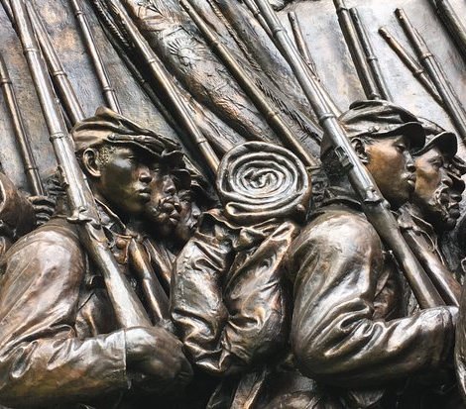
What Stories Do you Want to Tell?
Do those stories include the experience of Black and African Americans?
What can these stories tell us about the development of the United States?
Notes:
Now, before we move on the question-and-answer segment of this presentation, I have a couple questions for you; what stories do you want to tell? Are they stories like those we talked about earlier? Are they stories that give a better understanding of armed conflict through the eyes of black America? Can they teach us more about the development of the United States? If yes, then do you think a Preservation Planning Grant would assist you in your efforts to tell that story?
If you are not sure, or if I am unable to answer any questions you might have today, members of the ABPP staff are available to discuss your ideas in detail by email or by phone during regular business hours 5 days a week. I’ll provide contact information at the end of this webinar, but for now, lets move on to any questions you have for me.

Slide 20
Q&A
  What questions do you have?
Notes:
You can type your questions into the chat or unmute your microphone at this time. I just ask that once you are done asking your question you remute your mic and keep any follow-up questions to a minimum to respect everyone who may also have a question.

Slide 21
Feedback Opportunity
  We want to hear from you!
  Do you have advice on how to make this funding opportunity relevant and feasible for Black and African American organizations and communities?
  What potential barriers do you see in applying for this funding?
  We welcome any other feedback, advice, and suggestions from today’s audience.
Notes:
Before I close this webinar, I also wanted to provide some space for any feedback you may have for ABPP in our efforts to make funding opportunities, like PPGS, relevant and feasible for Black and African American organizations and communities. What don’t we know?

Slide 22
Contact us any time!
abpp@nps.gov
Philip Bailey: (202) 513-7126
Dr. Emily Button Kambic: (202) 354-2035
https://www.nps.gov/abpp
Thank You
Still have Questions?
.
..
Notes:
In conclusion, I just want to say thank you very much for joining me today for this presentation. If you still have questions, please reach out to us at abpp@nps.gov or by phone. Thank you.

