Slide 1
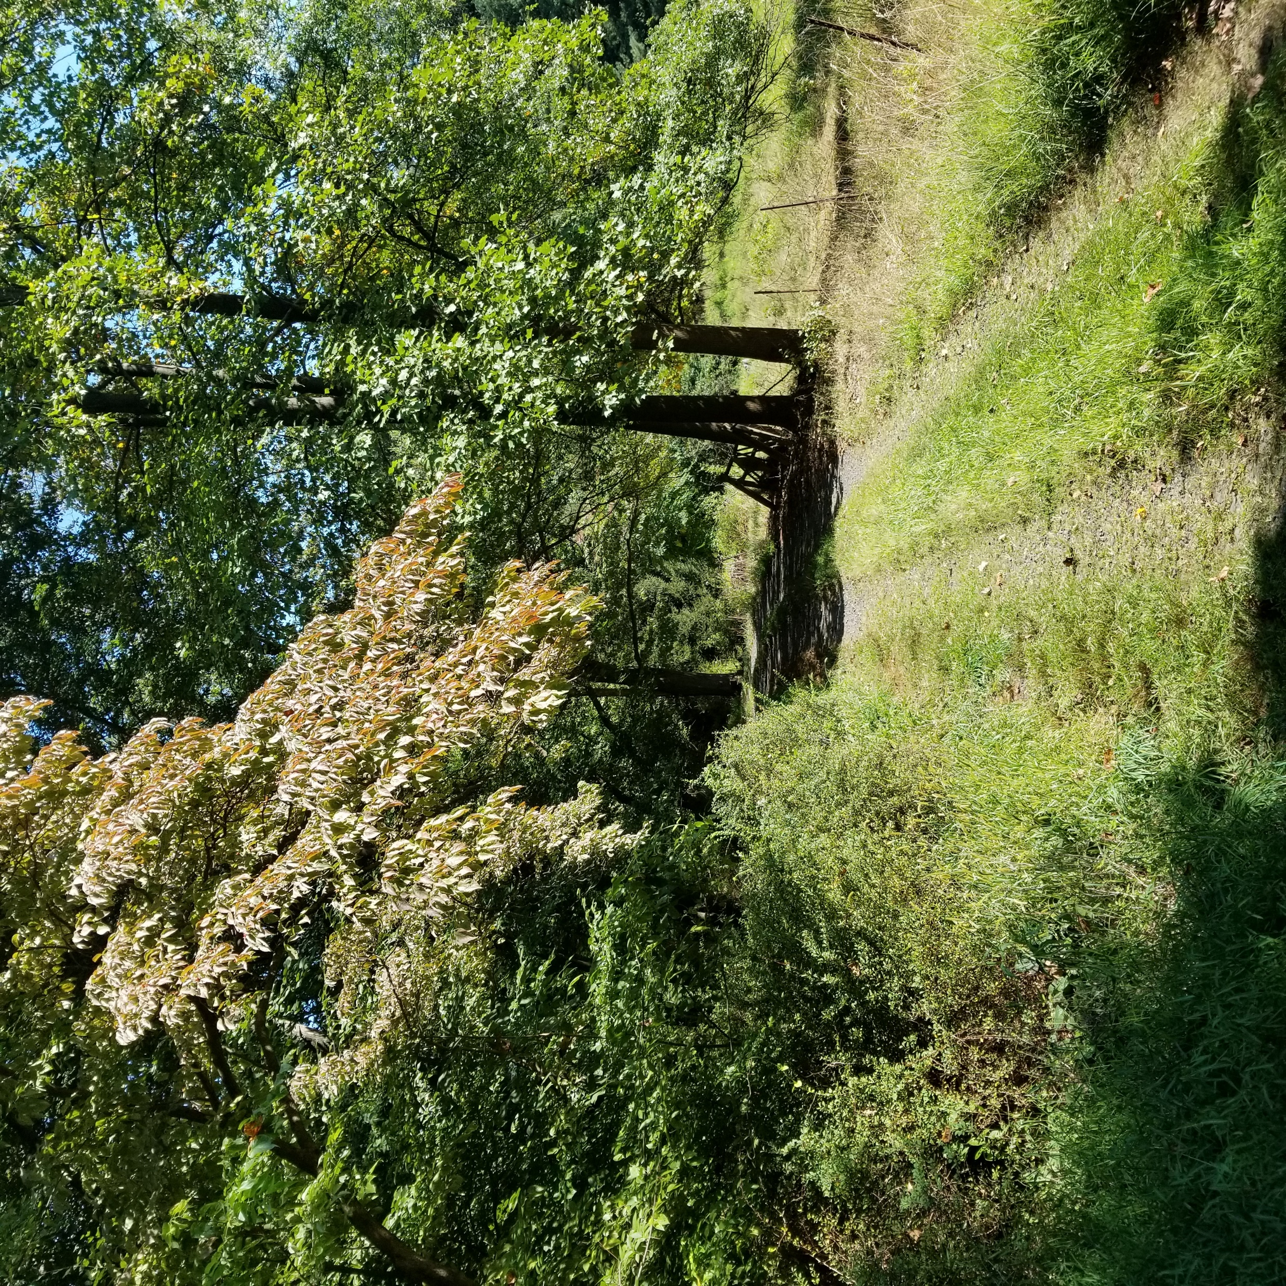
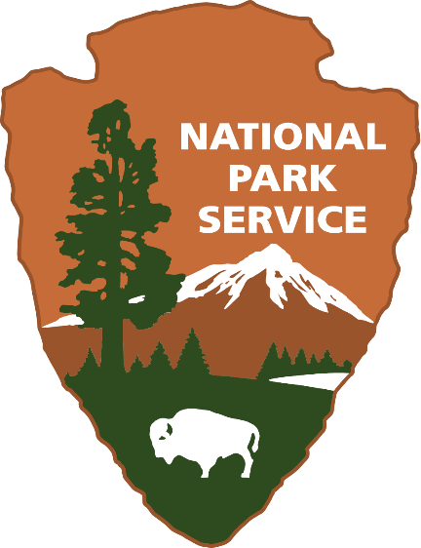
Battlefield Preservation Planning Grants:
2021 Program Overview
November 10, 2020
Notes:
Introductions: speaker intro and what we’re going to cover – grants from the ABPP with a focus on preservation planning grants, expanded eligibility guidance, examples of successful projects, and time for Q&A

Slide 2
Centering Local Knowledge
In 2017-2020, the University of Montana’s highly collaborative grant-funded project aimed to define a battlefield centering Indigenous ways of knowing.
The project brought together non-Native and Apsáalooke (Crow) researchers, elders, and institutions to document a battlefield landscape and history defined by spiritual events and places.
Notes:
One 2017 grant application asked a provocative question: “What have we overlooked?” in the stories that shape battlefield preservation priorities?
The University of Montana used a 2017 grant to complete a study of how spirituality and spiritual landscapes shaped battlefield strategies and histories on the Northern Plains. This collaborative project was led by both Native and non-Native researchers, partnering with the Crow Tribe, elders, Salish Kootenai College, and Little Big Horn College. The project centered Apsáalooke (Crow) perspectives on Ashkoota Binnaxchikua/Where The Camp Was Fortified, also known as the Battle of Arrow Creek, which occurred between Apsalooke and allied Arapaho, Cheyenne, and Sioux forces in 1863-1864 as settler incursions disrupted Native territories and food security. According to Apsaalooke traditions, the history of this battle is interlaced with places, events, and visions that connect battlefield landscapes with spiritual understandings of the past and present. This project recognized that in answering the fundamental question of “where is the battlefield?,” indigenous cultural knowledge is vital for our collective understandings of what happened, where it happened, and why it was important. This project created a case study for an indigenous definition of the battlefield landscape and events that the researchers hope will keep this heritage, which was so carefully preserved for over 150 years, from being overlooked in cultural heritage preservation efforts.
From “What have we overlooked?” this grant’s final report was titled “Where They Fought,” which sums up the success of this project in centering Native voices, and leads us to ask, what stories do YOU want to remember? (Image: University of Montana)

Slide 3
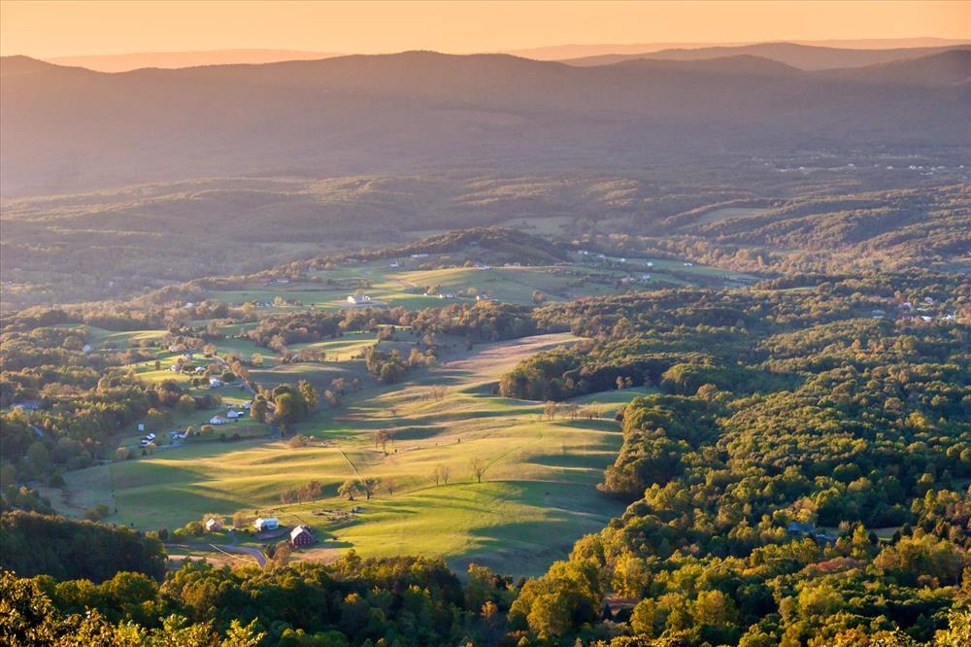
Planning for the Future
Preservation Planning Grant (2016): Shenandoah Valley Conservation Alliance: Building Capacity for the Future
Recipient: Alliance for the Shenandoah Valley
Project Highlights: This grant supported GIS database creation and outreach materials for a new nonprofit created by a merger of 3 nonprofits. The Alliance convenes communities to have a voice in planning for preservation, conservation, farmland protection, and transportation.
Notes:
Communities are dynamic, and battlefields are also people’s homes, which change as our nation changes. These grants also give grassroots organizations the means to ask their communities, “important things happened here – how do you want to shape this land’s future?”
For instance, one grant to the Alliance… funded capacity building activities for a merger of 3 very small local conservation and community advocacy nonprofits, partnering with Shenandoah Valley battlefields Foundation as well. Very expansive view of battlefield preservation as part of heritage tourism and preservation of valued rural community lifestyles. Brings together multiple groups with grassroots origins in the Shenandoah Valley for a larger voice. Grant application clearly distinguished which activities would be funded by PPG, as specifically tied to battlefields, vs other activities with other funding sources, which is important for eligibility on a project with a broader vision like this. This organization received a 2020 grant for community visioning around the future of the Port Republic and Cross Keys battlefields. How could you imagine bringing people together for places that are important to you?

Slide 4
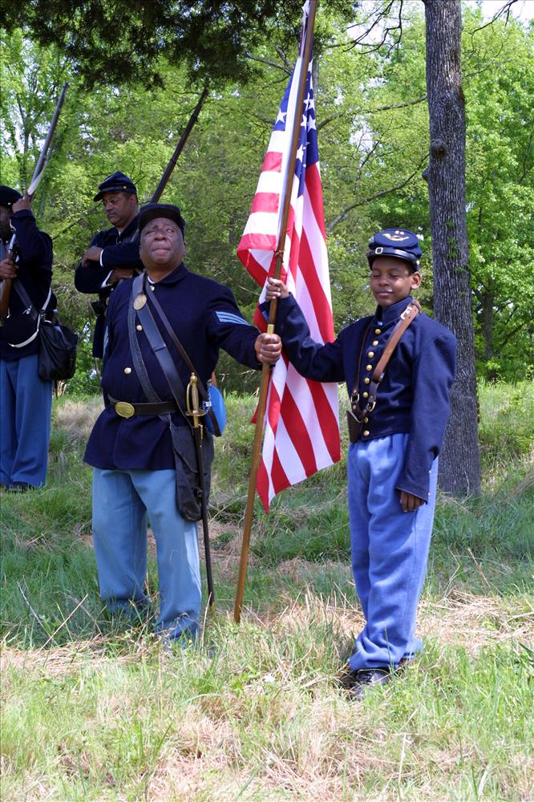
Telling All Americans’ Stories
Preservation Planning Grant (2019): The US Colored Troops and North Carolina’s Civil War Battlefields
Recipient: North Carolina Department of Natural & Cultural Resources
Project Highlights: This project is focused on researching the movements and impacts of the United States Colored Troops at 20 North Carolina Civil War battlefields for use in future preservation planning and interpretation across the state.
Notes:
Have you ever been inspired by a narrative of American history that you felt you were part of? The Preservation Planning Grant program can fund research and interpretive activities to help tell the full story of American history. For example, a recent grant to the state of North Carolina will help the state incorporate the blossoming of recent historical scholarship on African Americans in the Civil War by studying how the US Colored Troops were involved in the state’s 20 Civil War battlefields. This focus may lead to new approaches to preservation planning, new nominations for the National Register of Historic Places, and interpretation of battlefields that recognizes the important contributions of Black soldiers and says to Black residents and visitors, “you are part of the story of this place.”
These are a few examples of what these grants can do, but they are far from comprehensive. I hope you might get some inspiration from these questions – what stories you want to tell, and how you want to shape your land’s future – as you hear more about the details of the planning grant program.

Slide 5
Why Battlefields? Why Grants?
Notes:
I may be preaching to the choir since you’ve joined this webinar, but why should anyone care about battlefields? These can seem like a pretty niche concern within historic preservation. Yet think about how armed conflict is interwoven throughout American history. From Spanish colonial conflicts of the 16th century in the southwest and Florida, to the formative Pequot War and King Philip’s War in 17th century New England, to the American Revolution, to the nineteenth century’s battles across the continent, war shaped the territory and landscapes of todays United States. Many Americans have ancestors who died on these lands. Furthermore, many battlefields are large cultural landscapes. Documenting and preserving the state of these landscapes when battles took place can be a part of larger strategies for conservation and public access to green spaces for communities and stakeholders who may value these lands for purposes in addition to their history. When it comes to both preserving historic sites that are part of American heritage and landscape-level stewardship, we know one really important principle is not ending our efforts at the borders of protected lands. Grants are one of the tools in NPS’s toolbox to extend our stewardship mission by giving control and money to other organizations for projects beyond federal lands, without substantial federal involvement. Let me give you a few examples how.
(Image: map of battlefields?)

Slide 6
American Battlefield Protection Program
The National Park Service’s American Battlefield Protection Program (NPS ABPP) assists citizens, public and private institutions, and governments in planning, interpreting, and protecting sites where historic battles were fought on American soil during the armed conflicts that shaped the growth and development of the United States.
Legislative Authority: 54 U.S.C. § 308102
Notes:
First, I’d like to tell you who we are. The ABPP is a national program authorized by Congress and administered by the NPS for the purpose of… (read) We’re a program with seven staff, located in the Cultural Resource, Partnerships, & Science Directorate within WASO, and our offices are in Washington, DC. You can reach us easily at abpp@nps.gov, and our last slide will share contact information.

Slide 7
Battlefield Preservation Grant Programs
Preservation Planning | Land Acquisition | Interpretive Modernization* | Battlefield Restoration*
Annual, competitive | Rolling | Annual, competitive | TBD
No match | 50% match | 50% match | 50% match
All periods of history | Rev War, 1812, Civil War | Rev War, 1812, Civil War | Rev War, 1812, Civil War
Planning, research, and outreach activities excluding bricks-and-mortar preservation or restoration work | Land acquisition by state and local governments | Reimagining battlefield interpretation using technology – planning and implementation level | Restoration of landscapes to day-of-battle conditions, including plans and studies
$1.9 million per year | $10-13 million/year | Up to $1 million/year | Up to $1 million/year
*Authorized but not yet an active funding opportunity
Notes:
NPS ABPP currently administers two grant programs, and two more were established in the 2019 National Defense Authorization Act. We anticipate that they will be funded and become active in FY2021. Here is a quick comparison.
Since one of our frequent land acquisition grant partners, the American Battlefield Trust, offered a webinar in this series a few months ago, today we’re going to focus on the preservation planning grants. Nevertheless, I’d like to give you a couple of quick examples of land acquisition grants that also exemplify partnerships in conservation.

Slide 8
Grant Basics
Battlefield Preservation Planning Grants fund documentation, research, planning, partnership building, interpretation, and outreach
Projects can focus on battlefields and associated sites from any period in American history
Grants are awarded annually through a competitive merit review process
Typical awards range from $30,000-$100,000, and no match is required
Grant projects should be completed in two years

Slide 9
Eligible Applicants
State and local governments
Public and private institutes of higher education
Nonprofits having a 501(c)(3) status
Federally recognized Native American tribal governments, other Native American tribal organizations, and Native Hawaiian Organizations

Slide 10
Definitions
1. Eligible activities must focus on planning, interpreting, and preserving sites associated with armed conflicts that shaped the growth and development of the United States.
  Armed conflicts = periods of collective violence, characterized by specific events and bounded in time
2. Projects must contribute to the preservation of battlefields or associated sites that are thematically tied with events that occurred during an armed conflict.
Themes for associated sites:
  Military
  Government, Law, Politics, and Diplomacy
  Intellectual History
  Economics of War
  Society
  Transportation
Notes:
Will give a couple of examples of lesser known armed conflicts that we have recently funded, that also exemplify project activities people might not think of as “preservation,” but that we believe contribute to stewardship.
Now, we haven’t given a clear definition of associated sites for these grants previously, so there are fewer funded examples, but I’d like to discuss a few types of potentially eligible sites that aren’t battlefields per se. One type would be the fort, supply depot, or other infrastructure intimately tied with preparation and defense in conflict, even if no battle was fought. Another would be rail lines that provided supply and transport so critical that armies fought to defend them. Also contraband camps, recruitment stations, hospitals, etc. We are open to creative proposals applying this definition in historically grounded ways to projects that will be innovative for our program.

Slide 11
Eligible Activities
Consultation and partnerships
Collections stewardship
Education
Historical documentation
Exhibitions, media, and signage
Planning
Public programs and outreach
Survey and inventory

Slide 12
What is Not Eligible?
Lobbying and fundraising
Land acquisition
Capital projects or bricks and mortar preservation work
Battle reenactments
Activities that could harm a battlefield’s integrity (e.g. large scale archeological data recovery, metal detection without a research design)
Research unrelated to place-based preservation and stewardship
Projects unrelated to battlefields and associated sites
Notes:
Plus anything else that is unallowable under 2 CFR 200

Slide 13
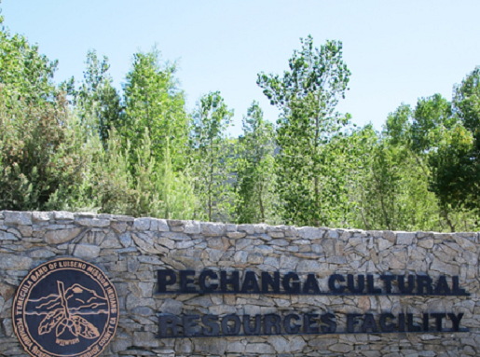
Pechanga Band of Indians Planning Grant
Temecula Massacre Battlefield and Cemetery Documentation
  Armed conflict: Mexican-American War
  Preservation goals: Identification & documentation of massacre site and associated cemetery, commemoration through documentary film
Eligible Activities:
  Site survey and inventory
  Archival research and oral history interviews
  Production of documentary film
Notes:
Application traced Temecula Massacre as a result of Battle of San Pasqual, 1846. Previous eligibility guidelines had said specifically “battlefields” were eligible and a site had to be directly connected to a battlefield, which left one-sided violence like massacres in an ambiguous space. New guidelines say that sites must be connected to an armed conflict, but do not have to fit the definition of a battlefield, which is not applicable for all wars or even all occurrences of collective violence during a given war.
This is a sensitive site to the Pechanga Band, so identifying the resources associated with the massacre is an important step toward preserving them, especially since they are not all on tribal land. Additionally, the grant includes funding for a documentary film about the battle and its resonance for the Tribe, which is an activity that might not immediately occur to everyone as preservation-oriented, so we wanted to highlight this.

Slide 14
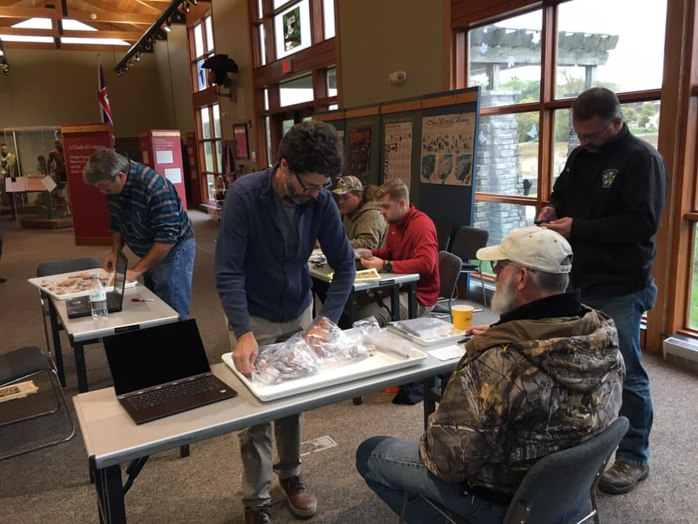
Ball State University Planning Grants
Battle of Peckuwe Site Identification, Documentation, and Public Outreach (2018, 2020)
  Armed conflict: Battle of Peckuwe (1780), Revolutionary War
  Preservation goals: Identification & documentation of battlefield boundaries, interpretation & education
Eligible Activities:
  Archeological and historical survey
  Interpretation and education in partnership with Clark County Parks
  Communication with interested tribes before and throughout project
Notes:
Ball State University’s Archaeology and Applied Anthropology Laboratories has received multiple planning grants for work on battlefields in the Midwest, which I’d like to discuss as an example of best practices for non-Native applicants. Two recent grants in 2018 and 2020 have focused on archeological survey to research the Revolutionary War battle of Peckuwe and the extension of settlers into today’s Ohio. While this project is led by non-Native researchers, they have worked to build relationships with tribes like the Eastern Shawnee and Shawnee Tribe of OK who are part of this history, starting with seeking tribal input prior to applying and continuing to communicate throughout the projects. We know this through letters of support from the tribes.
The NPS ABPP invites tribes to consult on our grantmaking activities under Section 106 of the National Historic Preservation Act, and we see over and over that when non-Native applicants start building these relationships early, and the Section 106 initiation letter is not the first time a tribal leader or THPO hears about a project, this leads to better relationships and a greater chance for indigenous perspectives to shape the project. This is relevant for any conflict, since Native ancestral lands and Native people were involved in the Revolutionary War, Civil War, World War II, and others people might not initially think of. If you would like to propose a project and are not sure how to find tribes with interest in the area, your SHPO can help. Please also be aware that you can apply for a grant just to work on building these relationships prior to starting a larger project. (Image: Ball State University)

Slide 15
Review & Award Timeline*
February 12, 2021: Application deadline
February/March 2021: Internal review for eligibility and completeness
Initiation of Section 106 review
March/April 2021: Competitive merit review
April/May 2021: Risk assessment
Budget & scope negotiation (if needed)
June 2021: Grants awarded
July 2021: Grant agreements signed, projects can begin
*This timeline may be subject to change

Slide 16
How to Apply
Search on Grants.gov: CFDA #15.926, or program name
Download application package from Grants.gov:
  Notice of Funding Opportunity
  Standard application forms
Complete and submit through Grants.gov Workspace

Slide 17
Application Components
Grants.gov standard forms:
  SF-424 - Application for Financial Assistance
  SF-424A - Budget Information – Non-Construction Programs
  SF-424B - Assurances – Non-Construction Programs
  SF-LLL – Disclosure of Lobbying Activities???
Project Narrative
Budget Narrative
Map
Indirect Cost Rate Agreement, if applicable
Other supporting documents

Slide 18
Merit Review: NOFO Section E
Criteria | Value
1. Preservation Opportunity | 20 points
2. FY2021 Focus Areas | 10 points
3. Objectives & Activities | 20 points
4. Administration & Implementation | 20 points
5. Partnerships & Engagement | 20 points
6. Secretary of the Interior Priorities | 10 points
Highest Possible Total Score | 100 points

Slide 19
Outreach Goals
Broaden the pool of new applicants, especially with expanded guidance on eligible armed conflicts and associated sites
Fund projects and organizations telling the full American story from diverse perspectives
Highlight underrepresented program areas: Black history, Indigenous-led projects, associated sites, sites west of the Mississippi
Notes:
Geographic: west of Mississippi
Community-led: especially for explorations of Black and Indigenous history, funding projects for descendant community led organizations or strong partnership projects
Historical: Black history and associated sites
In review, This year’s funding competition will be starting very soon, and application materials will be available at grants.gov. We are excited to fund new projects directed by communities and their needs, representing the histories of all Americans. Next week we will be offering webinars focusing on Native American and African American histories and how they relate to battlefield preservation, so we also invite you and your networks to join us again Tuesday and Wednesday afternoons if you’d like to hear more; you can sign up on our website. We know there are so many more stories to be told and places to be cared for, we are excited to hear your ideas.

Slide 20
Q&A
  Questions for Discussion:
  Do you have any ideas you’d like to talk about?
  What potential barriers for your partners or communities do you see in applying for this funding?
  Do you have advice for NPS ABPP on successful strategies for outreach and help to new potential applicants?

Slide 21
Contact us any time!
abpp@nps.gov
Philip Bailey: (202) 513-7126
Emily Button Kambic: (202) 354-2035
https://www.nps.gov/abpp
Thank You
Questions?
.
..

