Slide 1
Fisheries Collapses
Technology and Food Demands

Slide 2
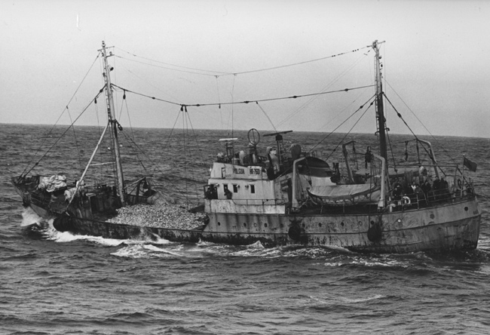
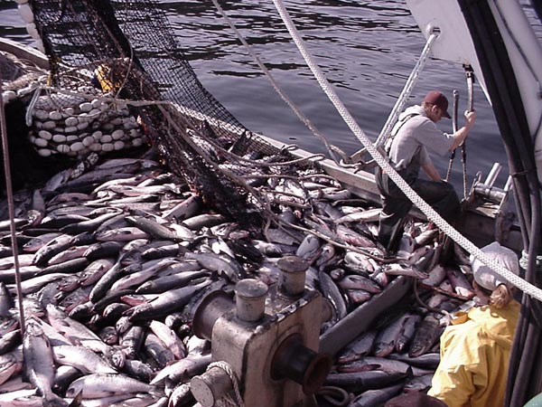
Escapement Rate and Harvests
The biggest threat to recovery is open ocean harvest.
Nearly 70% of salmon harvested are in Canadian waters.
10% are harvested in Alaskan waters, while only
8.5% are harvested commercially in Washington.
Notes:
The biggest threat to salmon once they enter the ocean is commercial fisheries, since between 40-65% of salmon who enter the ocean end up being caught by fishing vessels. Of those harvested, 70% are captured in Canadian waters. So, because of the international entanglements, not much can be done to help salmon once they enter the ocean.

Slide 3
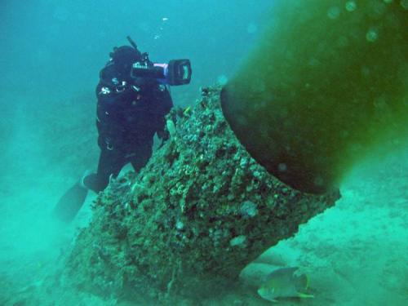
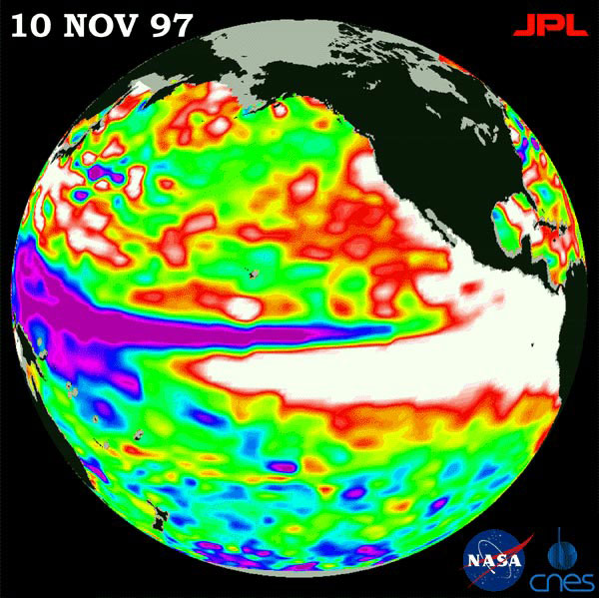
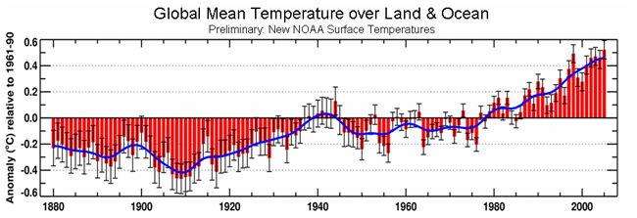
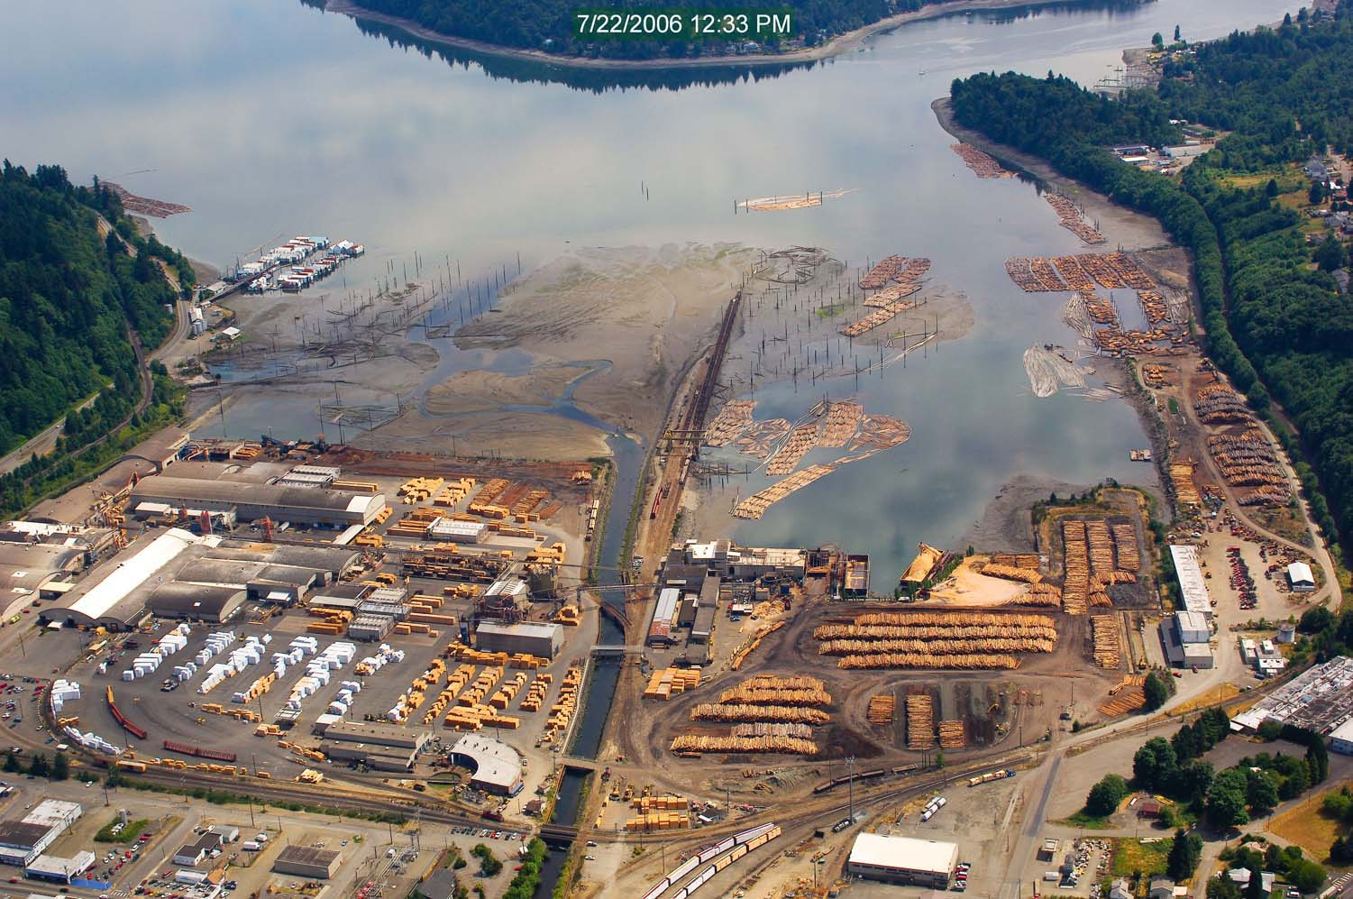
Other Threats in the Ocean
Global Warming
El Nino Events
Pollution
Notes:
Global warming threatens to change ocean current patterns, impact upwelling rates, raise water temperatures, and will cause the oceans to become more acidic as the ocean absorbs more carbon dioxide. All of this is likely to result in less plankton, which impacts forage fish and salmon food availability.
Increasing cyclical El Nino events result in higher ocean temperatures and the loss of nutrient-rich upwelling, which vastly reduces food supply for salmon and causes temporary crashes in fish populations. While El Nino events have been going on a long time, their impact combined with other factors could doom salmon to virtual extinction.
Pollution, sewage, and dangerous chemicals entering the ocean from urban centers along the Pacific coast threaten the entire food chain, as well as, salmon health specifically.

Slide 4
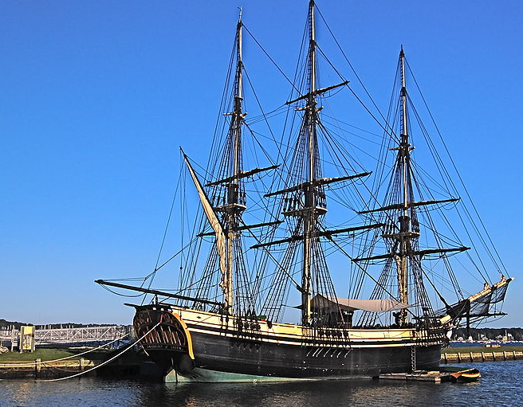
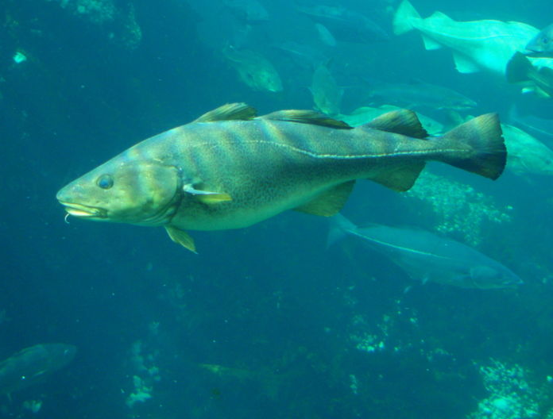
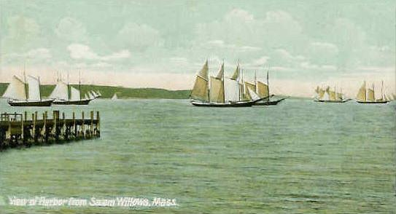
The Advent of Industrial Fishing The Grand Banks Example
Notes:
Fishing has been around for as long as humans have lived near water. But, it was not until the 1500’s that major industrial scale fishing began to take hold. European fishing vessels plied the waters of the Grand Banks off of Newfoundland harvesting cod that were so plentiful, they could virtually drop a net and pull it up full of cod within minutes.
However, despite relentless fishing by hundreds of ships over the centuries, they never even seemed to make a dent in the Atlantic cod populations until the advent of modern commercial fishing vessels and techniques in the 1960’s. For more than one hundred years, commercial fisheries harvested 300,000 tons of cod from the Grand Banks every year. However, in the 1960’s larger fishing vessels with improved technology for finding fish increased the numbers harvested to a peak of 800,000 tons in 1968.
Shortly thereafter, scientists began to see a drop in the number of cod in the sea. By the 1990’s, the cod was gone with a dramatic fishery collapse that has yet to recover.

Slide 5
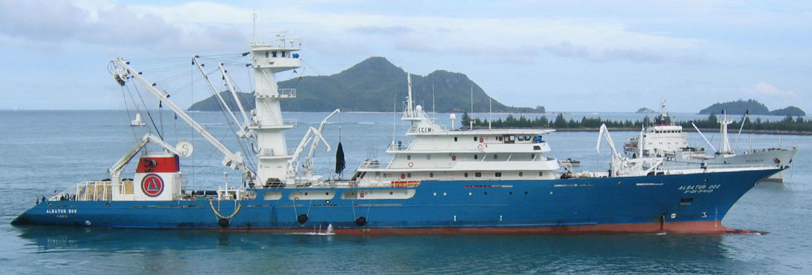
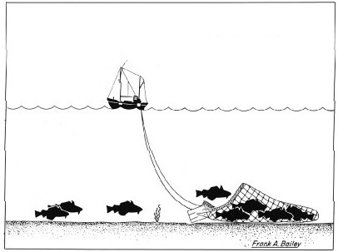
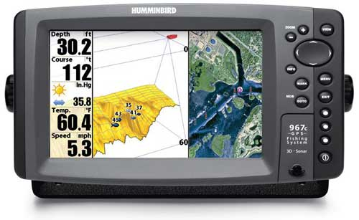
New Technology and Bigger Boats
Notes:
Modern fishing techniques have far out-stripped the ability for fish to reproduce. As the fish get harder to find, commercial fishing fleets have had to use technology to keep up. The use of fishfinder sonar allows ships to find the schools, track them down, and capture the entire group.
Historically, ships with shallow nets and plying the waters blindly would capture groups of fish, but not entire schools. Sure, fishermen with years of experience would know the best locations at the right times of the year to get large catches, but it was never enough to severely impact the population’s ability to reproduce successfully.
But, beginning in the 1960’s, commercial fishing fleets began using larger boats, with larger nets, and mechanized equipment to go further out to sea and deeper into the ocean than ever before on the search for fish. International competition for fish led commercial fishing companies to race to catch more or risk losing out to competitors.
The creation of factory boats allows them to capture and process the fish right at sea, making for a more efficient operation, but also risking the livelihood of small family fishing operations.
With the ability to capture virtually every fish in the water with these new technologies, the target fish species simply could not keep up. There are not enough adults producing enough offspring for the populations that once numbered in the billions or even the trillions to return to those numbers.

Slide 6
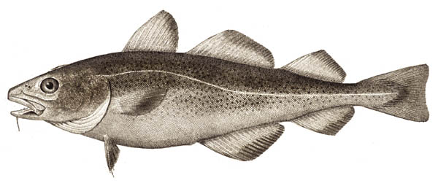
Will the Atlantic Cod Ever Return? Maybe not…
Notes:
When the cod fishery collapsed, most governments called for an moratorium to cod fishing in these areas until the population recovered. It was thought, based on their lifecycles, that fishing could resume in 5-10 years. But, the population has not recovered in the 20 years since the collapse and fishing activities have still not resumed. Why?
Young cod primarily feed on zooplankton like copepods near the surface. But, once they grow older, they settle to the bottom of the ocean floor and begin feeding on larger forage fish like herring and capelin. Atlantic cod can grow to be up to 6 feet long and over 200 pounds. Cod can live for more than 25 years and each female produces millions of eggs each year starting at around age five.
Historically, due to their physical size and their shear numbers, Atlantic cod was at the top of the food web.
But, as large cod disappeared from the ecosystem, other species began to fill in the niche of top predator on forage fish. Species like flounder, hake, haddock, and seals have increased in population and taken on the niche of primary predators of forage fish.
In addition, with large adult cod gone from the ecosystem due to overfishing and only smaller younger cod left, they are now prey for these same predators. Many of the young cod are being eaten before they reproduce. Historically, once a large female adult cod began reproducing, she could produce millions of eggs for up to 20 years. With so many millions of adult cod in the seas, even heavy predation on smaller cod was tolerable because there were so many large adults reproducing.
However, now there are very few large adults, and the young cod are being consumed by the larger numbers of predators that have filled the niche, making recovery of the stock very slow and difficult.

Slide 7
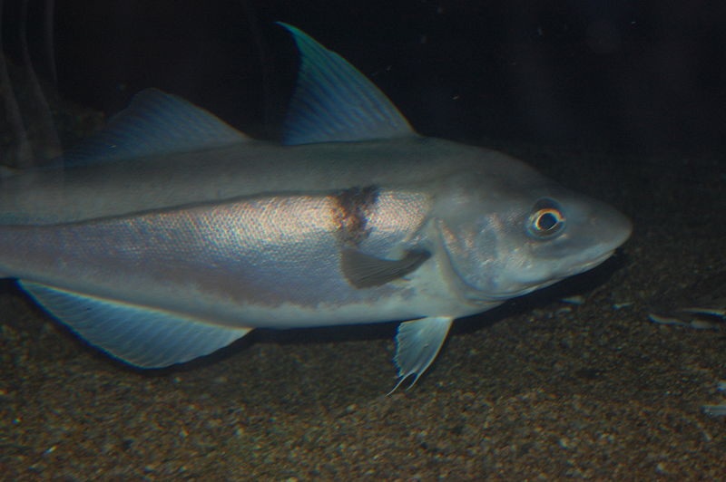
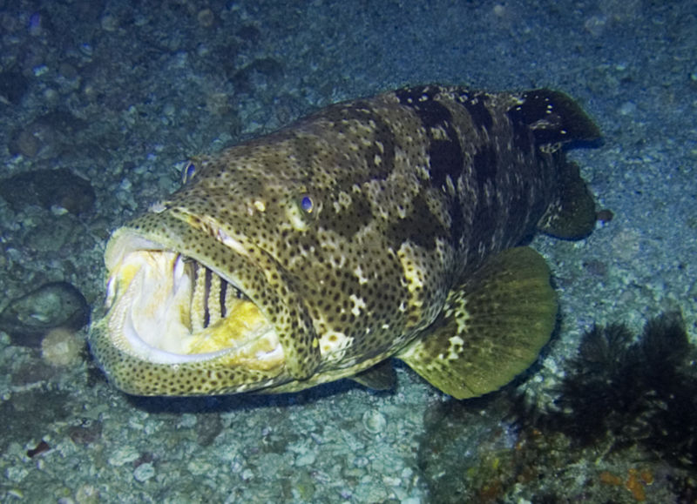
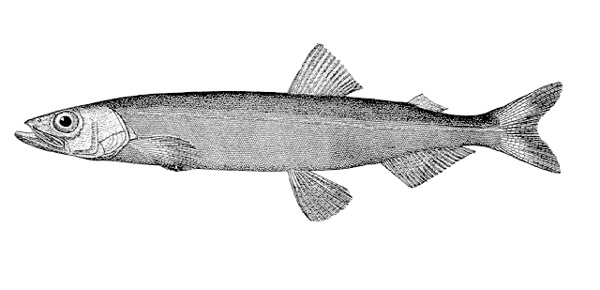
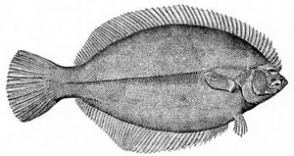
The Competition
Haddock
Grouper
Capelin
Flounder
Notes:
Historically, due to their physical size and their shear numbers, Atlantic cod was at the top of the food web. But, as large cod disappeared from the ecosystem, other species began to fill in the niche of top predator on forage fish. Species like flounder, hake, haddock, and seals have increased in population and taken on the niche of primary predators of forage fish.
With large adult cod gone from the ecosystem due to overfishing, only smaller young cod are left, but they are now prey for these new top-level predators. Many of the young cod are being eaten before they reproduce. Historically, once a large female adult cod began reproducing, she could produce millions of eggs for some 20 years. Historically, millions of adult cod could out-reproduce, the predation on smaller cod, while also feeding on those same predators.
However, now there are very few large adults, and the young cod are being consumed by the larger numbers of predators that have filled the niche, making recovery of the stock very slow and difficult.

Slide 8
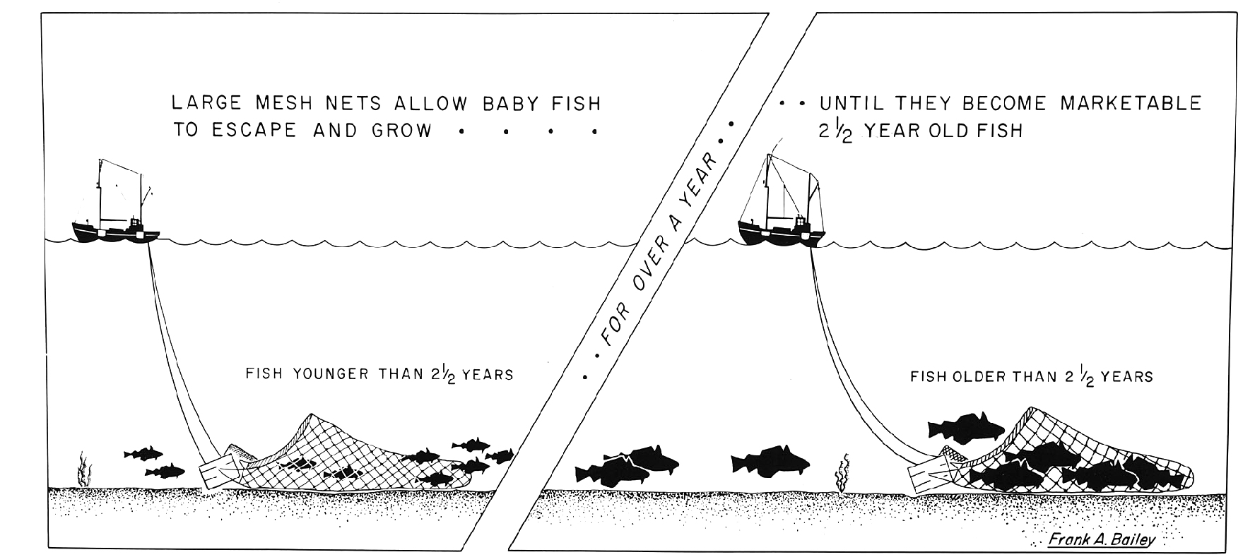
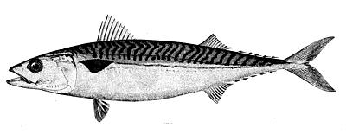
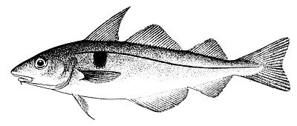
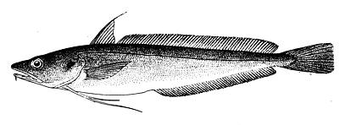
Notes:
Historically, due to their physical size and their shear numbers, Atlantic cod was at the top of the food web. Adult cod feed on forage fish, smaller predatory fish, and even cannibalize juvenile cod.
But, as large cod disappeared from the ecosystem, other species began to fill in the niche of top predator on forage fish. Species like flounder, hake, haddock, and seals have increased in population and taken on the niche of primary predators of forage fish.
Historically, once a large female adult cod began reproducing, she could produce millions of eggs for some 20 years. Historically, millions of adult cod could out-reproduce the predation on smaller cod, while also feeding on those same predators of their juveniles.

Slide 9
Notes:
With large adult cod gone from the ecosystem due to overfishing, only smaller young cod are left, but they are now prey for these new top-level predators. Many of the young cod are being eaten before they reproduce. Historically the sheer number of juveniles allowed enough adults to be produced to sustain their huge populations.
However, now there are very few large adults, and the young cod are being consumed by the larger numbers of predators that have filled the niche, making recovery of the stock very slow and difficult.

Slide 10
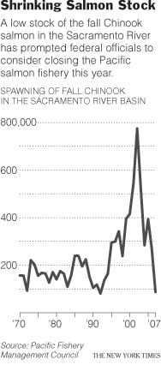
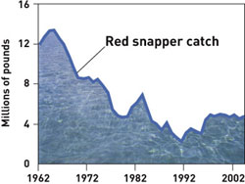
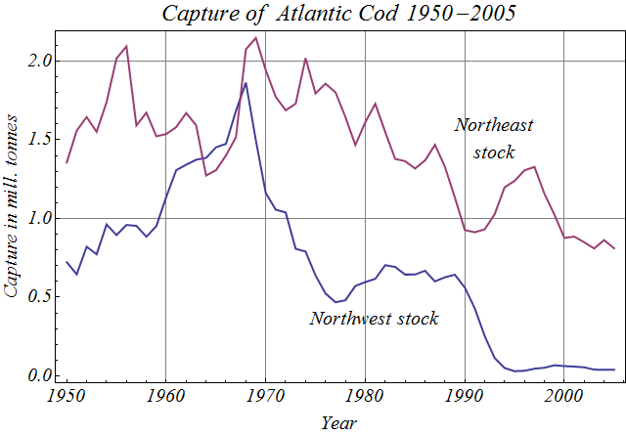
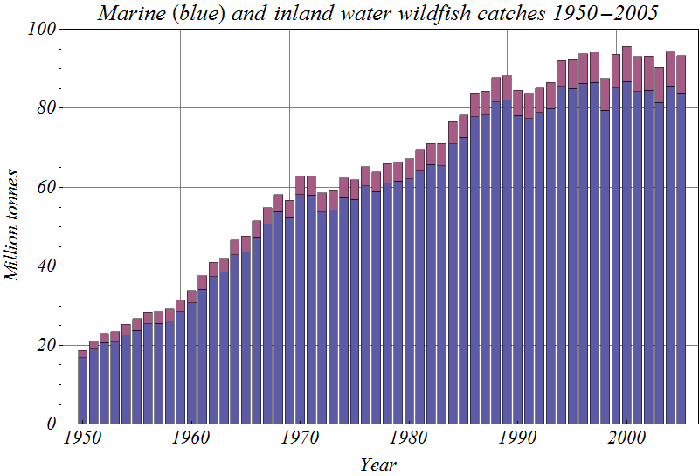
Fisheries Collapses
Notes:
As demands on seafood have risen and the technology of fishing fleets have increased, record numbers of fish are captured in the world’s oceans. From sonar to track and scoop up entire schools of fish in the open waters, to bottom-trawling nets that up every fish on the ocean floor, to drift-nets 25 miles long, it seems almost impossible for fish to escape the net.
Salmon are not alone in seeing their numbers collapse in the last few decades. Atlantic Cod became famous in the 1990’s, when their population collapsed in the Grand Banks. This was the world’s greatest fishery at one point. Virtually every major fish species that is harvested has seen dramatic drops recently. Today, fishermen in Newfoundland and Atlantic coast sit on the shore helplessly with no fish to catch.
Notice the graph in the upper right showing total catch. It shows that the number of fish being caught worldwide increased until the 1970’s and then began to drop. Compare that to the graph in the lower right, which shows world fish consumption continuing to increase. It is not as if they are purposely catching fewer fish or demand has dropped. The numbers of fish captured is decreasing because there simply are fewer fish left to catch.

Slide 11
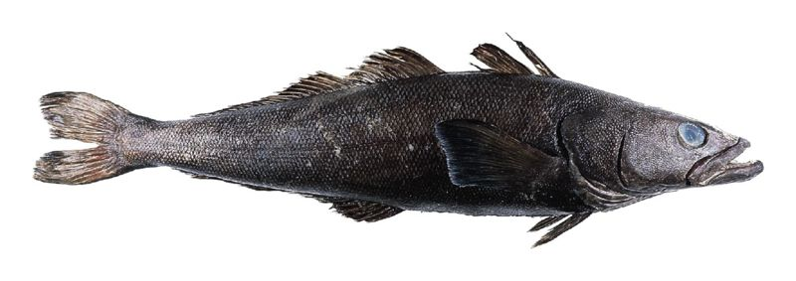
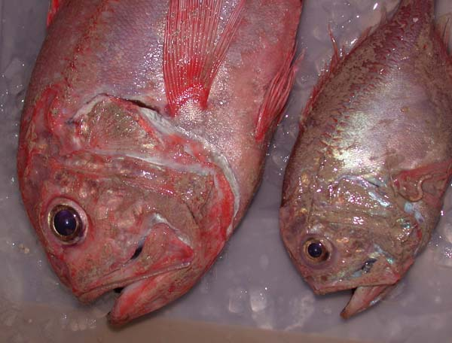
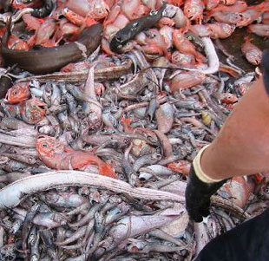
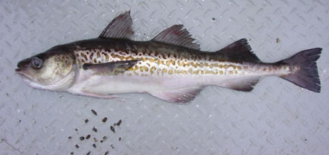
Each Fish Species Collapses
Atlantic cod
???
Chilean Sea Bass/Patagonia Toothfish
Deep sea catch of orange roughy
(Photo by Stephen McGowan courtesy Marine Photobank)
Walleye Pollock
Orange Roughy
Notes:
Over-fishing has put enormous pressures on wild fish. The first major fish stock to collapse was the Atlantic cod. In the 1700’s, it was so plentiful, that farmers used it as fertilizer in their fields and it was traded to sugar cane plantations for valuable rum simply to feed the slaves.
As the fisheries of so many traditional species have collapsed, fishing fleets have been searching for new fish to market. With easy to harvest shallow waters depleted, they have moved to deeper waters and to the open ocean.
In Australia and New Zealand, they discovered a fish species in the very deep oceans, that was incredibly abundant and tasted good, called the orange roughy. They began to harvest and market them worldwide. However, before long the entire fishery suddenly collapsed. Why?
Because, orange roughy do not reproduce until they are 20 years old and do not produce many offspring when they do reproduce. But, this species can live for more than 100 years, so given that long life span, populations could grow quite large. However, once all of the older adults were captured, and reproduction was stopped, there were few young fish to replace them. Recovery of the orange roughly will now take between 20-100 years for the remaining young fish to grow old enough to reproduce again.
Deep sea trawling also has the other problem of by-catch. Up to 50% of the fish they pull up are not marketable, so they throw them back. But, the trauma of being captured, pulled out of water on a boat, and being thrown back in results in very high mortality. Stunned or dead, they become prey for predatory fish or seabirds.
Next commercial fisheries moved onto the Patagonian toothfish. Since that name does not sound appetizing, they renamed it Chilean sea bass (even though it is not related to bass at all). They have fished that species down to very low levels and now it is also approaching collapse.
Today, the world’s most common marketable fish is the Alaska walleye pollock. It is used for fish sticks, fish burgers, and artificial crab meat. They are also using it as a replacement for cod in fish and chips and other meals. Will this species survive or be the next to collapse? Only time will tell…
As each fishery collapses, commercial fishing fleets move onto new fish species. Other species such as grouper, rockfish, red snapper, tuna, and haddock have all seen dramatic collapses in recent years. With these wild fisheries collapses, fish farming seems like a great alternative.

Slide 12
This project was made possible in part by a grant from
Washington’s National Park Fund.

