Slide 1
Fish Hatcheries
Savior or Scourge for Salmon?

Slide 2
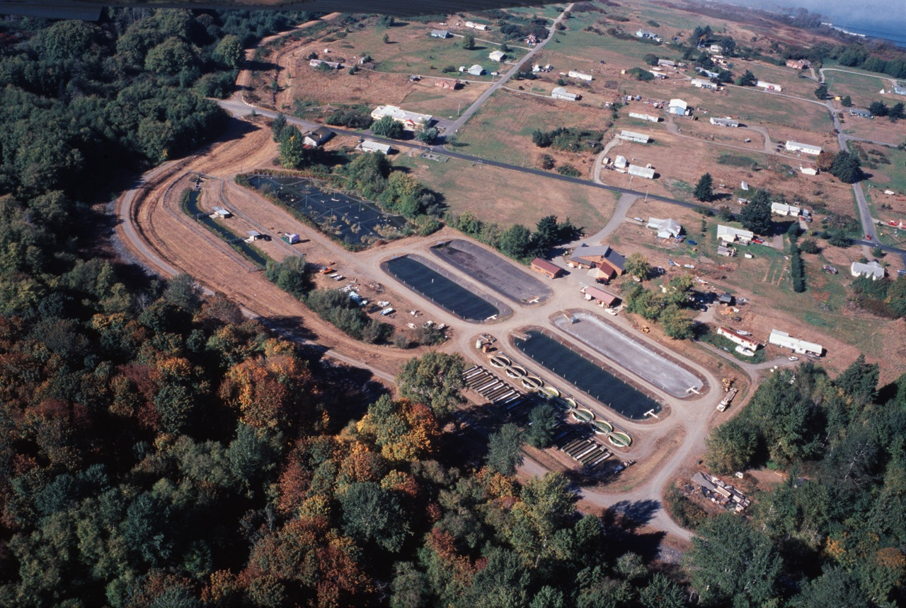
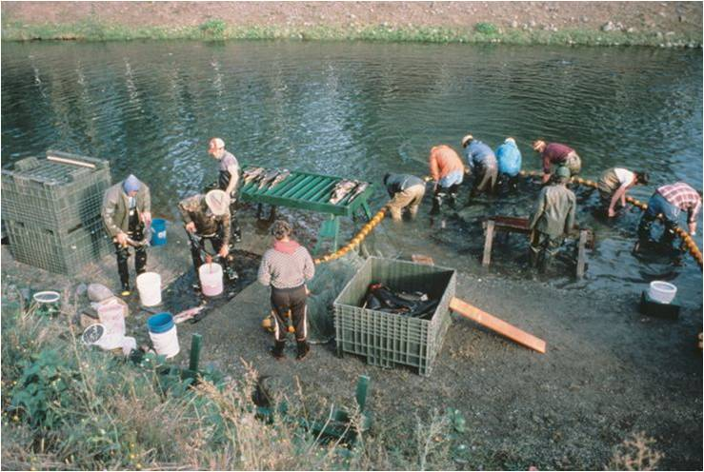
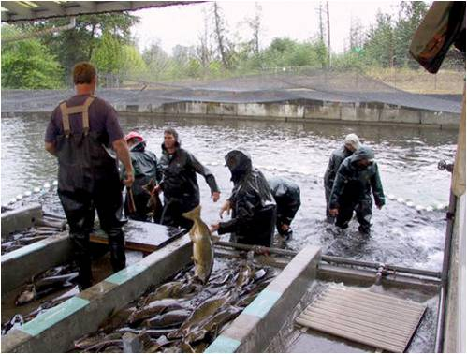
How Hatcheries Work
Notes:
Fish hatcheries serve two primary purposes; raising young fish to be stocked in lakes and rivers for recreational and commercial fishing and to support and supplement the native wild fish populations that have been severely damaged by overfishing and habitat loss.
In the case of the second purpose, to supplement and support native populations in rivers, that can be done in two ways. One is mass producing native fish of the river, but having them essentially be pen-raised to adulthood and then released into the rivers for fishing activities. While the other is using the hatchery to preserve and propagate native wild fish to be used to stock a depleted river and enhance wild populations.
When adult salmon return to the river, they are acquired by hatcheries in one of two ways. Either they will be netted and collected from the river and taken back to the hatchery or they will return to specially designed hatchery channels where they can be collected.
The adult salmon are then killed so that their sperm and eggs can be collected for the next generation.

Slide 3
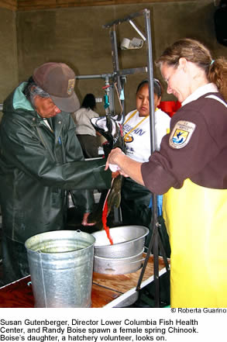
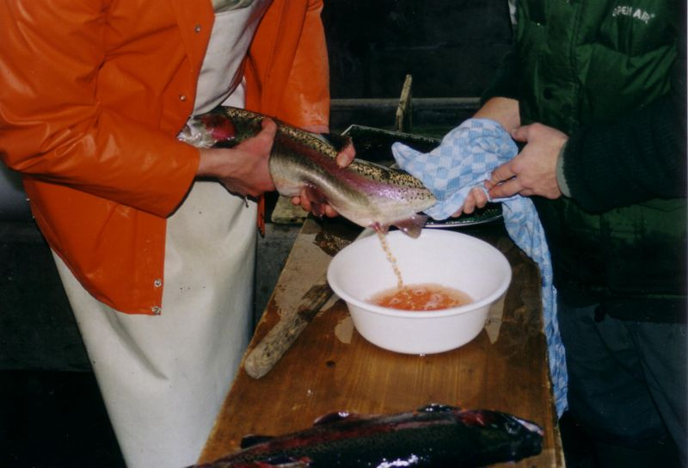
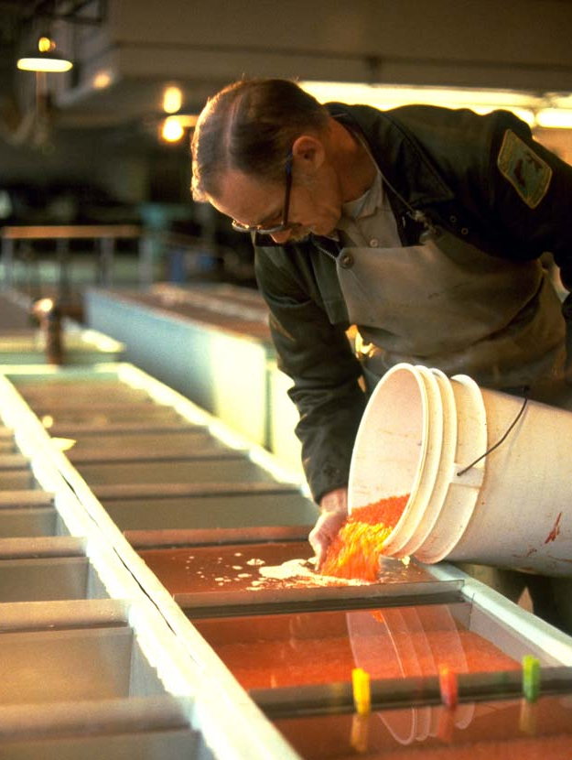
Fertilizing sperm and eggs
Notes:
Eggs are extracted from females and milt (sperm) from the males is then sprayed onto the eggs to fertilize them. The fertilized eggs are then set into incubation tanks where they can held in water with controlled temperature and oxygenation levels until they hatch to become alevin. This controlled method assures a high level of survival in the most sensitive period of a salmon’s lifecycle when mortality is highest.

Slide 4
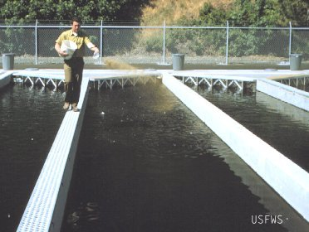
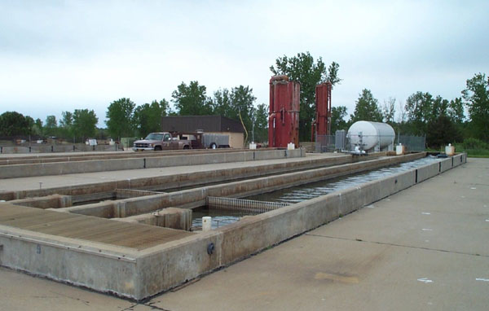
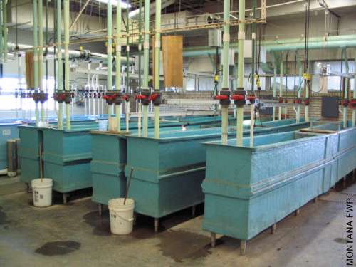
Raising Fry
Notes:
Once the salmon alevin mature to a level where they can swim freely and feed independently as fry, they are transferred to larger tanks. Often the tanks for the smallest of fry are indoors because they are still sensitive to environmental conditions, but they usually get moved outdoors as they get older.
Each tank holds fry of a certain age class to prevent predation by older and larger fish. The fish are often fed fish meal pellets. The salmon tend to learn when feeding time is and congregate in large masses. For sensitive runs, nets are placed above the tanks to prevent predation by herons and other birds.
For the particularly endangered runs, they are often raised in inside tanks to reduce the risk of predators and weather conditions and to more closely control the conditions they rear in.

Slide 5
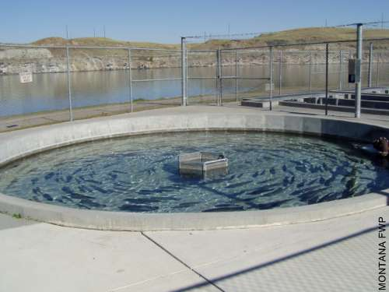
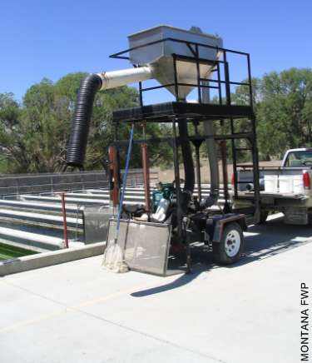
The Larger Life Stages
Notes:
In most hatcheries, anadromous salmon fry are released into the ocean at one or two years of age. This is a time similar to when they would have headed to sea in natural wild runs.
However, in hatcheries whose design is to raise adult fish (kokanee and trout) for lake stocking or for critically endangered runs (such as Redfish Lake sockeye) where adults are needed simply for continued reproduction, the fish are maintained in the hatchery to adult age and then out-planted later.

Slide 6
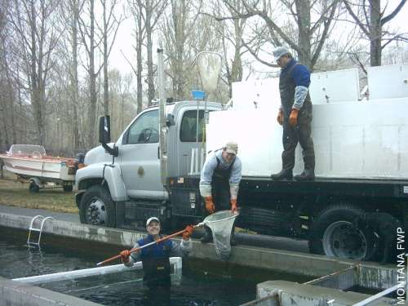
Out-planting to the Wild
Notes:
Here adult fish are being netted to be placed into tank trucks for out-planting in the river or lakes. Fish can also be transferred from one pool to another using these vacuum trucks that suck them up from one tank and deposit them in the next size class location or into the out-planting truck.

Slide 7
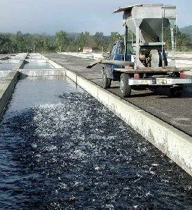
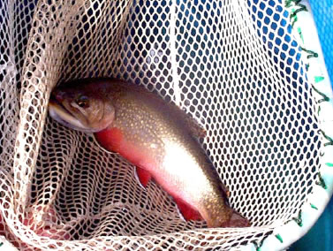
Why Don’t Hatchery Fish Survive Very Well?
Non-competitive behavior
Non-native stocks
Feeding Time
Non-native Eastern Brook Trout are often released into Washington rivers
Notes:
Hatchery fish are fed fish pellets while in the hatchery pens and thus do not learn the normal predatory behavior. While instincts certainly kick in once they enter the wild river or ocean, the lack of training early on may hurt them competitively. Rather than eating a passively falling pellet, wild fish must search for their food and chase moving targets that do not want to be eaten.
Some hatcheries have tried to modify their feeding methods to train juvenile salmon to function in a more “wild” way.
As mentioned previously, many hatchery fish have historically come from stocks that were not native to that stream. The lack of “genetic training” means they are not adapted to the specific temperature, turbidity, chemical, and food level presence of that particular river. This may harm hatchery salmon’s ability to survive in that environment. But, more importantly, if they interbreed with wild salmon stocks, it may harm the wild offspring’s ability to survive in that environment.
Sometimes lakes or rivers are also socked with alien fish species that compete directly with or are predators off native fish. The biggest non-native fish species released in Pacific Northwest waters is the eastern brook trout.

Slide 8
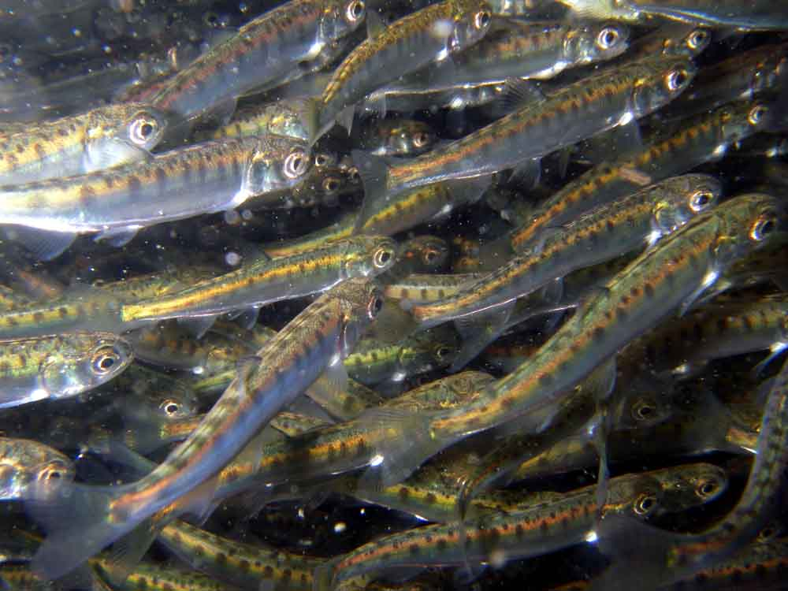
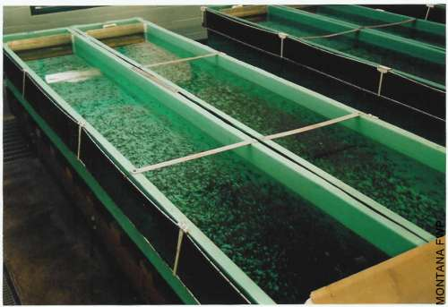
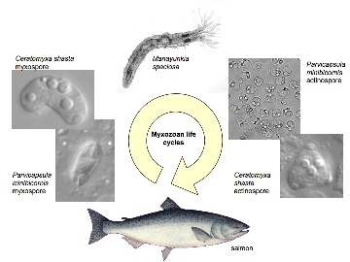
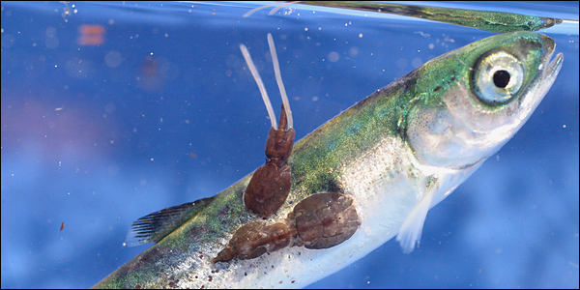
Danger of Hatcheries
Non-native stocks
Swamping and Competition
Disease Transmission
Notes:
Hatcheries have been criticized for several reasons;
Non-native hatchery stock: They have been known in the past to use non-native fish stocks that can disrupt the genetics of the natural wild runs through interbreeding. Rainbow trout stocks from the McCloud River in California were stocked in hatcheries all over the west for decades until recent times. In many cases, those rainbow trout escaped and have interbreed with native steelhead runs. The same has been done with other salmon species. Genetic interference can mean less adaption to environmental conditions particular to that river system, which means less overall survivorship for wild runs, particularly if significant disturbance events such as landslides dumping sediment into the river or major floods occur.
Swamping: Hatcheries release many tens or hundreds of thousands of juvenile salmon into river systems each year. These numbers are often above historic juvenile run sizes and thus can be above the carrying capacity of the river or near shore marine environment. With so many fish competing for food, the small wild salmon populations can end up starving and being outcompeted, lowering their survivorship.
Hatchery raised fish, living in such tight quarters, are more susceptible to disease outbreaks. When those hatchery fish encounter wild runs, there is the risk of transferring those diseases to the wild fish.

Slide 9
The Arguments
Some argue that hatcheries have saved salmon from going extinct.
Some argue the over-use of hatcheries have caused wild salmon stocks to decline faster.
Some argue hatcheries have uses that should be on a case-by-case basis, such as in saving critically endangered runs.
Notes:
Some argue that hatcheries have saved salmon from going extinct by keeping the populations stable. Rather than salmon runs shrinking each year, they assure thousands of fry will enter the ocean regardless of how many adults return. This also keeps a steady supply of fish in the oceans for commercial fisheries. For certain runs, especially the Elwha river runs, this is correct.
Some argue that hatcheries have been dramatically over used and that their enormous releases have been swamping wild salmon runs and reducing overall wild salmon survivorship. This is almost certainly the case in places where small rivers with naturally small runs see their small runs overwhelmed by hundreds of thousands of competitors.
Some argue hatcheries’ best use is in saving critically endangered runs. Simply put, when a salmon run such as the Redfish Lake Sockeye is down to just 1 or 2 adult returns, there simply is no way to keep that run from going extinction without a hatchery. The natural wild environment will simply not allow enough of those eggs to be fertilized and enough fry to reach the ocean. Hatcheries assure that virtually all eggs and fry will be saved to continue the run for another generation.
The hatcheries will be very important for protecting the Elwha salmon runs from sediment moving downstream during dam removal. Once the dams are out, the hatcheries will provide the source populations for recolonizing the river.

Slide 10
This project was made possible in part by a grant from
Washington’s National Park Fund.

