Slide 1
Dams in the Pacific Northwest
Impacts on Anadromous Fish

Slide 2
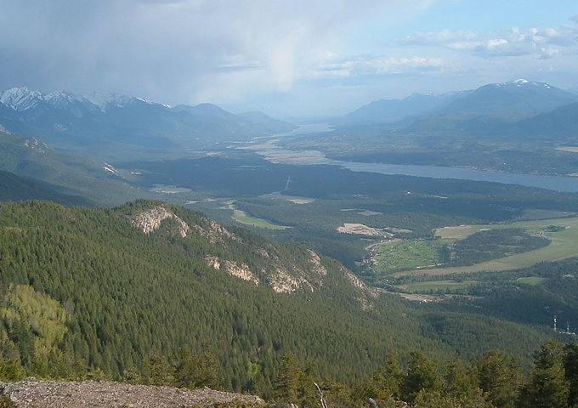
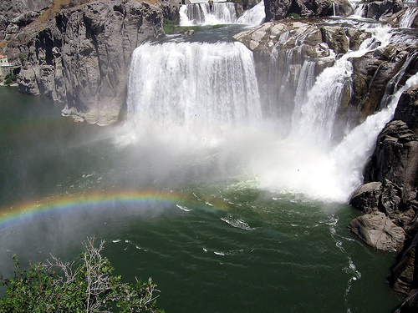
Historic Range of Salmon
Columbia Lake
1,243 miles
1,243 miles
212-ft Shoshone Falls
948 miles
Notes:
Historically, before the building of dams, everything in green on the map was occupied by Salmon runs, from the continental divide of the Northern Rockies to the Pacific coast. Within the Columbia river watershed, salmon could travel as far as 1,243 miles to the headwaters of the Columbia River at Columbia Lake in British Columbia and 948 miles into Idaho along the Snake River to the natural barrier of Shoshone Falls.

Slide 3
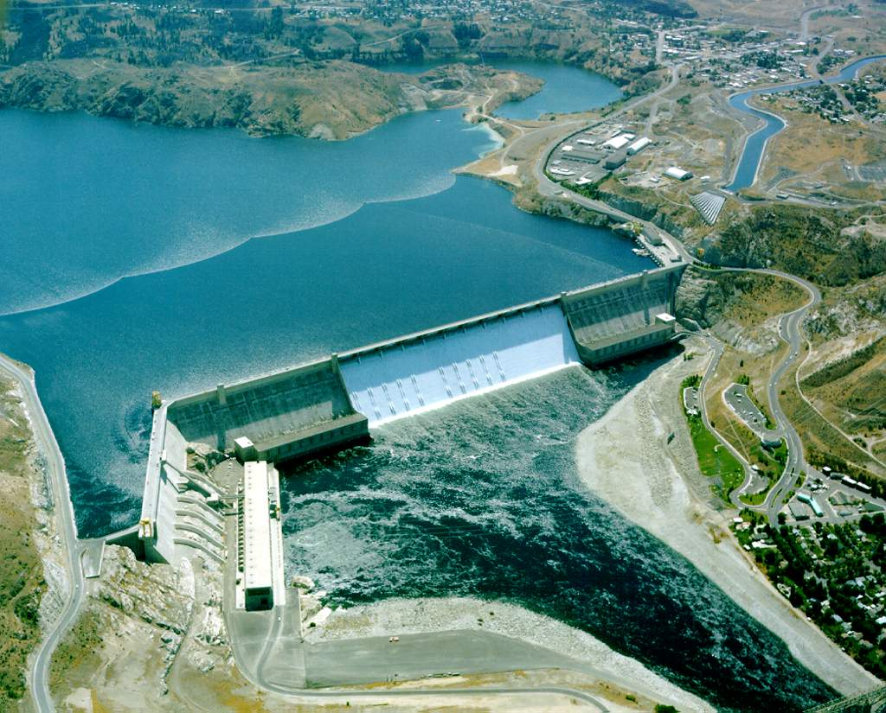
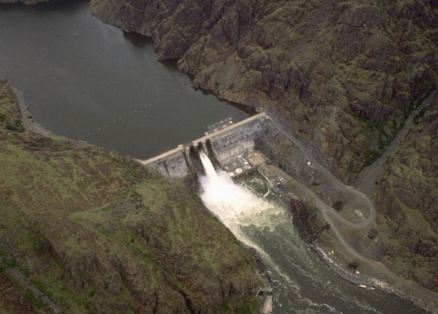
Current Range of Salmon
Grand Coulee Dam
596 miles
Hells Canyon Dam
581 miles
Notes:
Once the dams were built in the 20th century the range of Pacific salmon was greatly reduced. Dams without fish passages ended migration beyond. This is not even discussing the effects of the dams on salmon population health within the area where fish passages do exist. Today, salmon are blocked at the Grand Coulee dam 596 miles from the sea on the Columbia mainstem and at Hell Canyon Dam at 581 miles on the Snake River. The areas in red are areas inaccessible to salmon today due to the presence of dams without fish passages.

Slide 4
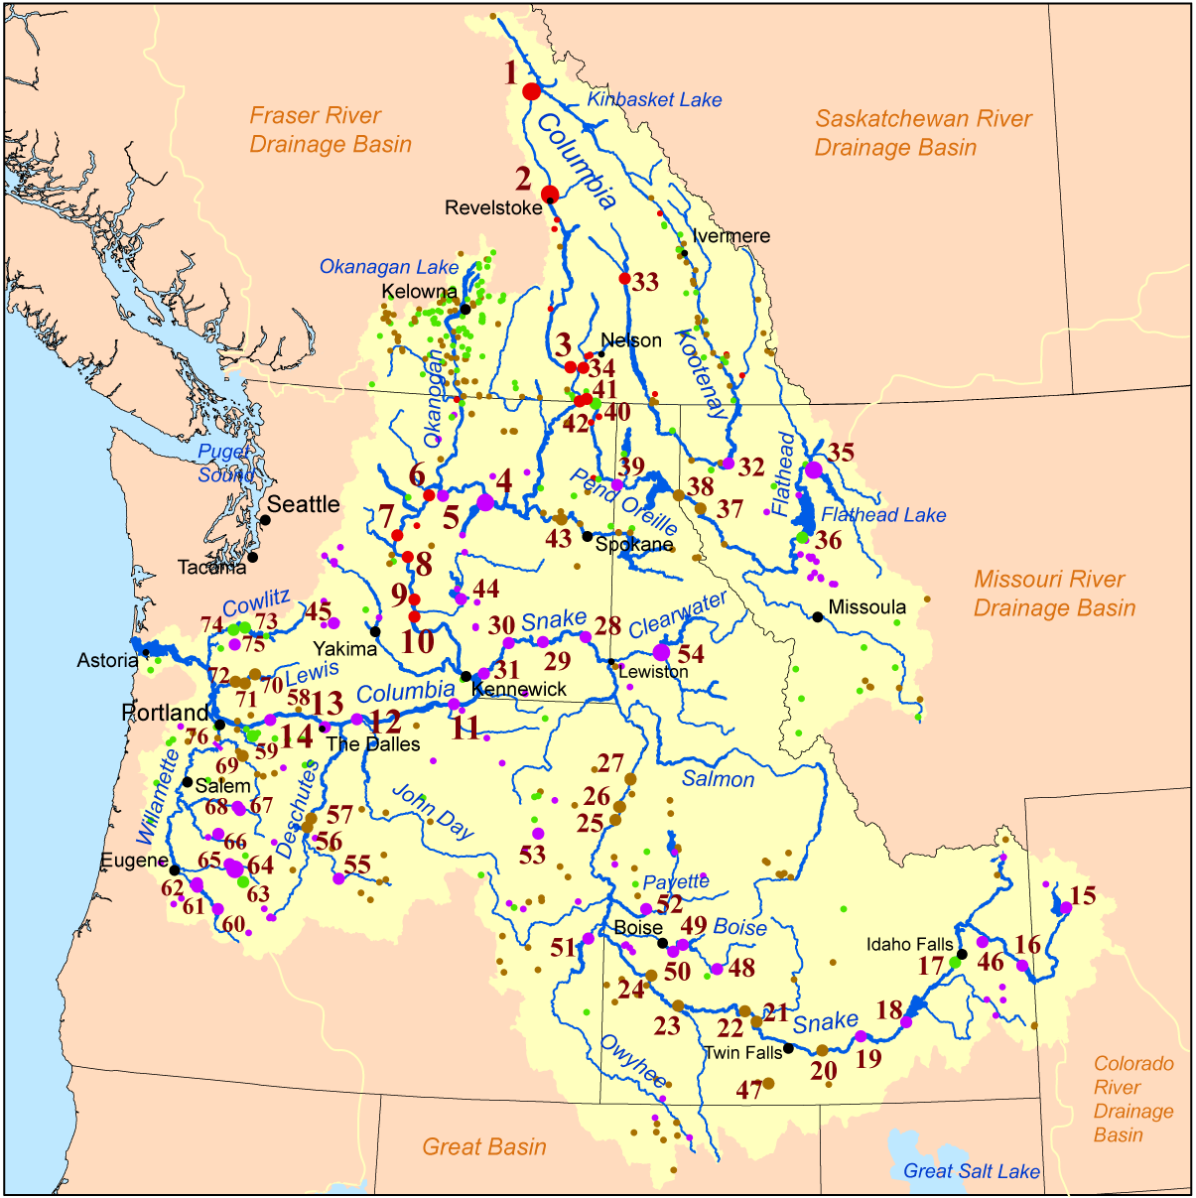
Dams of the Columbia River Watershed
Notes:
There are 76 large dams on the Columbia River and its tributaries. For salmon below the Grand Coulee Dam (a full obstruction), they may have to pass as many as ten dams to reach the sea and get past those same ten dams to return back to their natal streams (not counting any small dams on their tributary streams). There are also an additional four major dams on the Snake river before reaching the Hells Canyon Dam (a full obstruction).

Slide 5
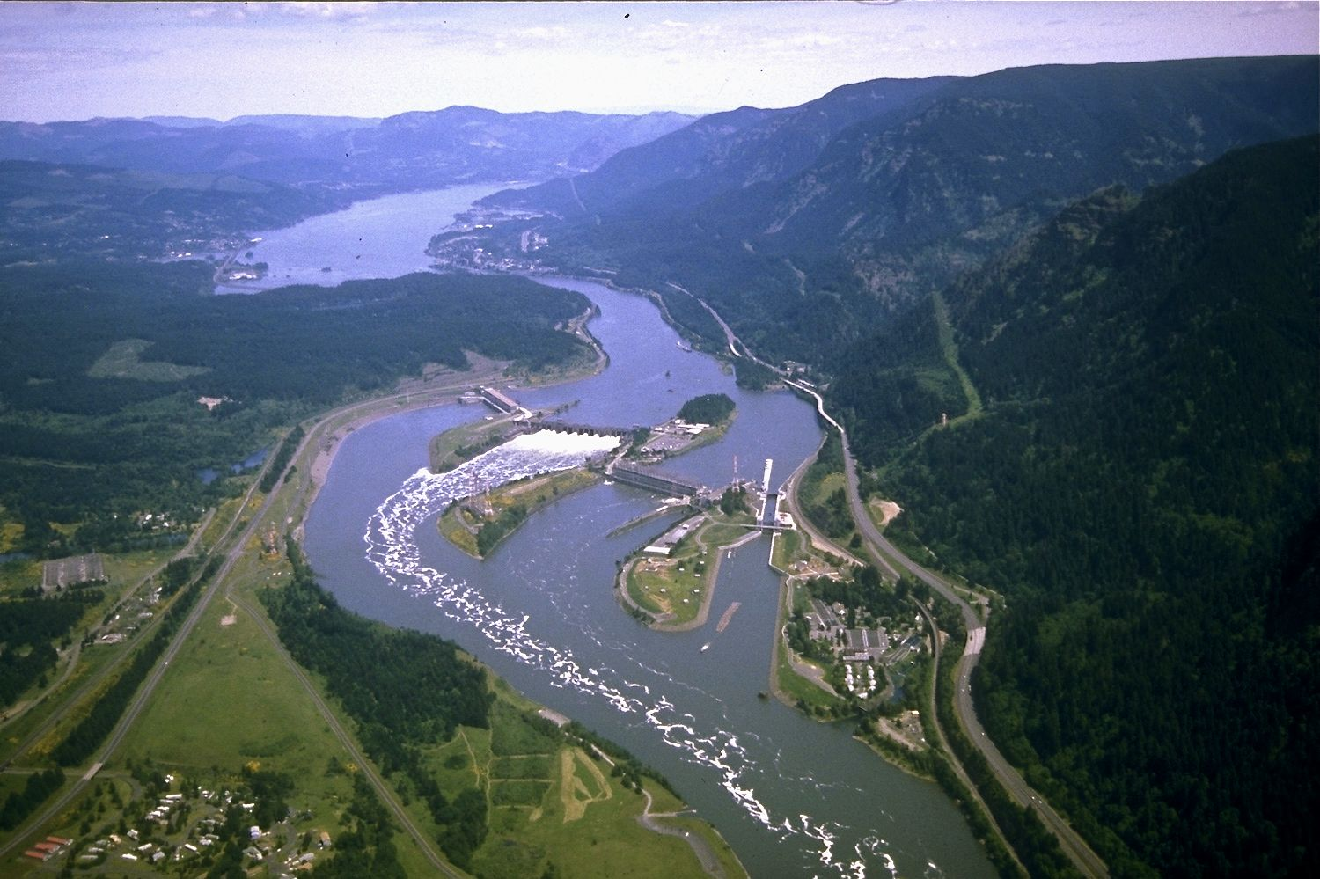
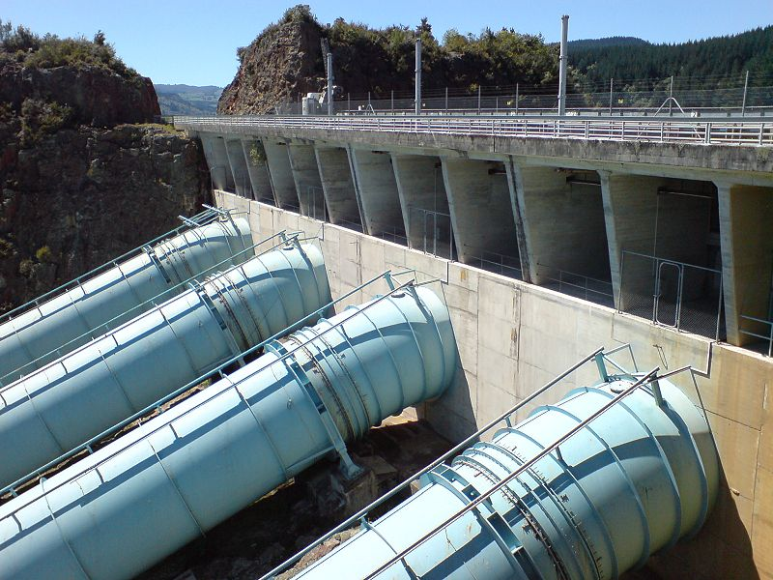
Downstream Passage of Salmon
Notes:
Juvenile salmon do not generally find fish ladders on dams to head downstream. Instead, salmon typically pass through the turbines, over the spillways, or through the navigation locks. Obviously, going through a turbine or dropping off a spillway is a dangerous way to pass through a dam that results in mortality as high as 20%, depending on the dam.
The top-left image shows navigation canals and locks at the Bonneville Dam on the Columbia River. The lower left image shows penstocks that feed water into turbines. The image at right shows water flowing off the spillways at the Glines Canyon dam on the Elwha. If salmon did still exist above Glines Canyon dam, that 200-foot drop would be a killer.

Slide 6
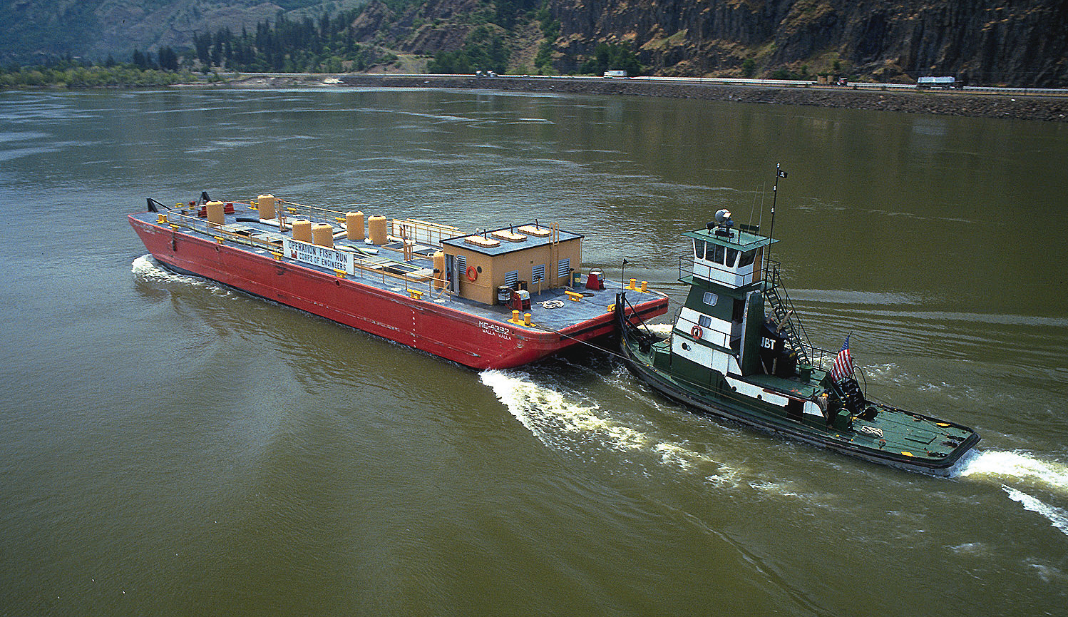
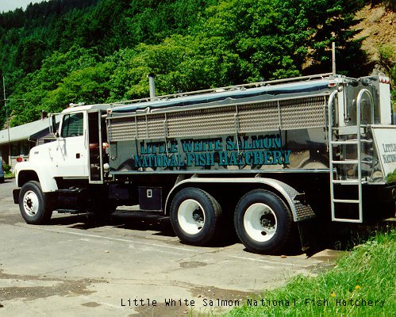
Another Option for Downstream Passage: Barging and Trucking of Salmon
Notes:
To reduce mortality for juvenile salmon heading downstream, scientists have tried capturing tiny salmon, loading them onto barges, and taking them down the river then releasing them below the Bonneville Dam (the last one on the Columbia mainstem). There is debate about the effectiveness of this method, since salmon runs continue to struggle.
On the other hand, some say transporting juvenile salmon prevents the mortality related to dams, gets them down the river faster, removes them from the man-made lakes, and avoids other hazards such as predators. Others argue that it increases mortality by stressing them in cramped quarters where diseases are more likely to spread.
The data is really unclear about whether this process is helping salmon populations in the Columbia basin. This process is also done on other rivers that have either man-made or natural obstructions to salmon migration.

Slide 7
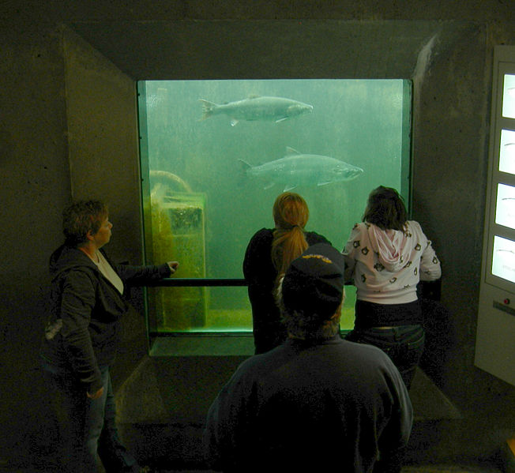
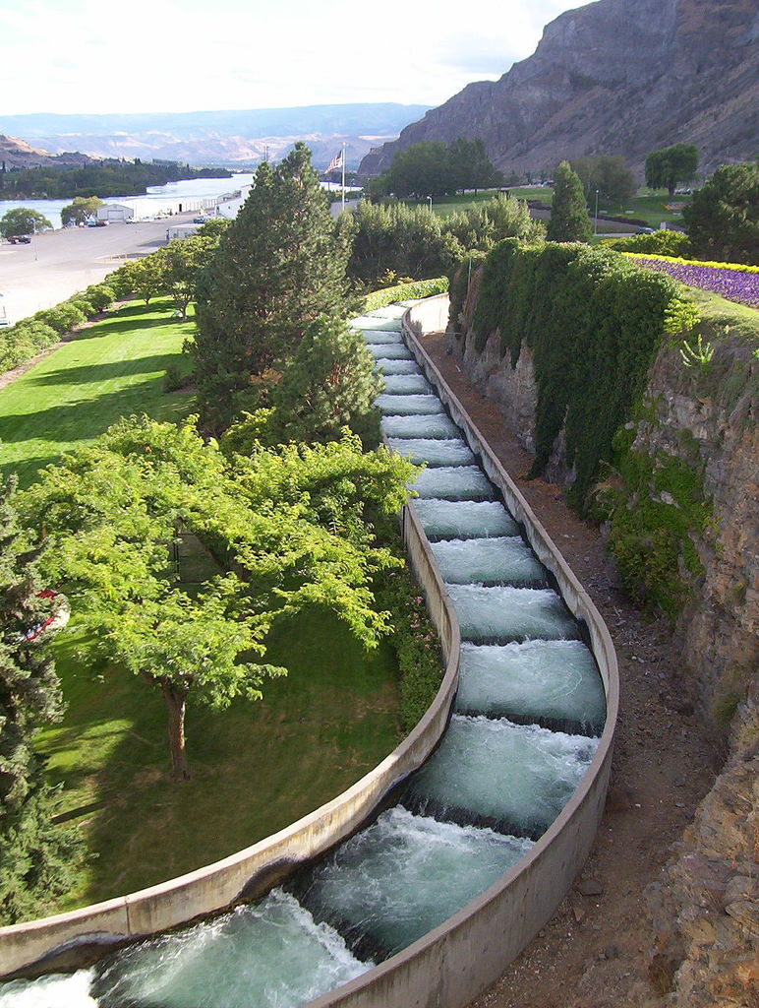
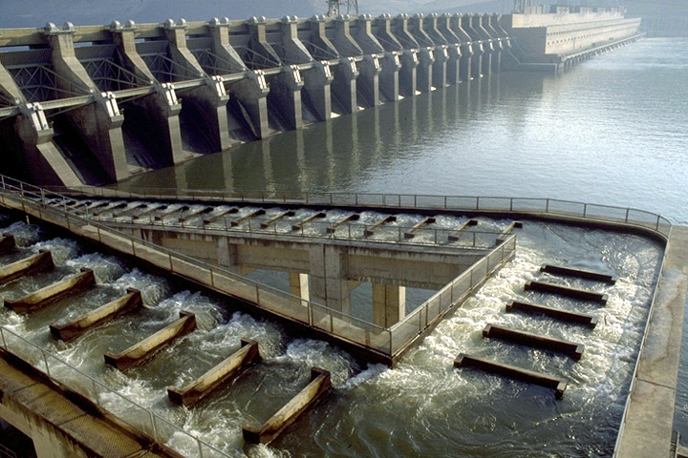
Fish Ladders
Notes:
As early as the building of the Grand Coulee and Bonneville dams in the 1930’s, there was a recognition of the impact these huge structures would have on the anadromous fish of the Columbia River. The Bonneville Dam was built with fish ladders, but that proved technically unfeasible at the Grand Coulee Dam, resulting in it being a full obstruction to the upper 600 miles of the Columbia River for salmon runs.
Fish ladders have evolved over time to become more fish friendly. However, they are not entirely effective. Juvenile salmon do not normally find the fish ladders on the way down river and these ladders have not really been designed with juvenile fish in mind.
On the return, some adult fish have difficulty finding the ladders across the enormous area occupied by the dam. Some of the biggest issues fish have with dams is the inability to find the fish ladders and the disorientation fish have to entering artificially-created lake environments.

Slide 8
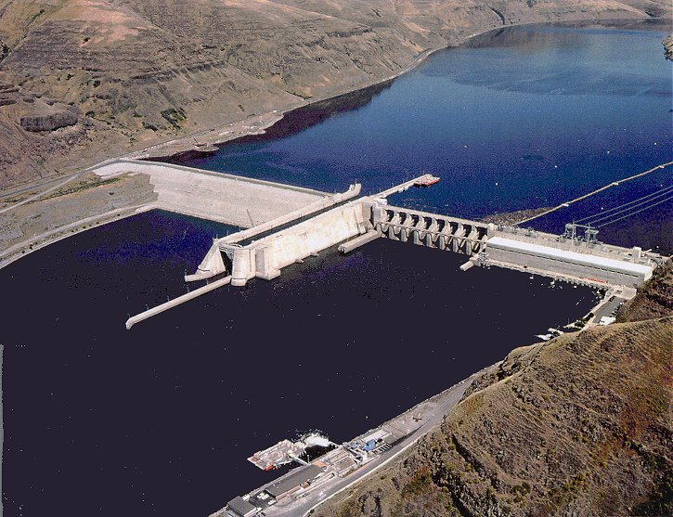
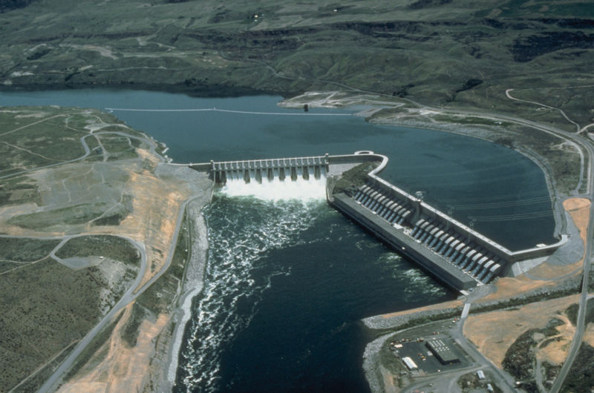
The Effects of Dams on Flow “Artificial Lakes”
Notes:
Naturally, juvenile salmon head to sea in cold water following the strong currents of the river. However, when dams are put in, the river changes in three very significant ways:
First of all, by creating a huge slow-flowing reservoir many miles upstream, it changes the flow patterns of the river. Rather than cruising down the river in days or weeks, it can take juvenile salmon months to get to sea. Juvenile salmon also can become disoriented in these large, deep lakes and have difficulty following the flow of the river. This extra time increases the time juvenile salmon spend without adequate food supplies and increases the risks of predation.
In addition, the increased surface area and slower flow of the reservoir means that the water can absorb more sunlight and the temperature of the lake increases. High temperatures themselves can be lethal to juvenile salmon and can have effects like decreased oxygen supplies and the growth of toxic algae.
These lakes also make it easier for predators to spot and capture salmon. Rather than having rocks and logs for hiding places and being lost in whitewater, they now sit in the wide open for predators. In fact, seals, river otters, and diving birds often make their way to dams for the easy pickings. Some work their way into the reservoirs, while sea lions are famous for sitting at the exits of spillways and canals waiting for the salmon to emerge.
As for returning adults, if they are successful in finding the fish ladders and getting into the reservoir, it can be difficult for them to find their way upstream through the large slow-flowing lake, rather than using their natural inclination to fight the current.

Slide 9
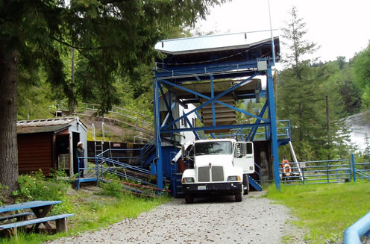
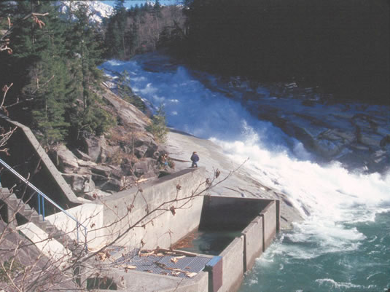
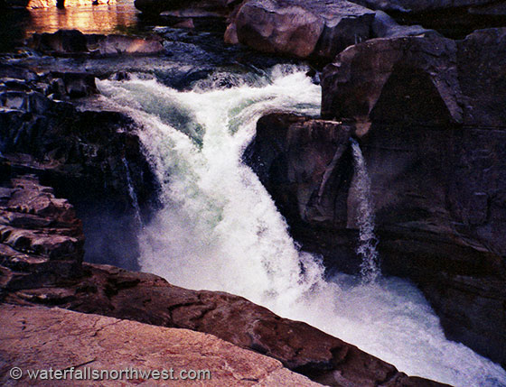
South Fork Skykomish River
Notes:
One location where adults are trucked upstream rather on using fish ladders is on the South Fork Skykomish River. Here, three waterfalls near the confluence of the North and South Forks prevent migration for up to 90 miles of the South Fork. A fish ladder was originally built on the first falls, Sunset Falls. But, it ended up being so expensive they could not afford to built the two others that were needed. So, the WDFW started trucking adult salmon 3.5 miles past all three falls for migration and spawning. The falls are not steep enough to produce significant mortality for juvenile salmon going downstream, so on their way to the ocean they just tumble down the falls.

Slide 10
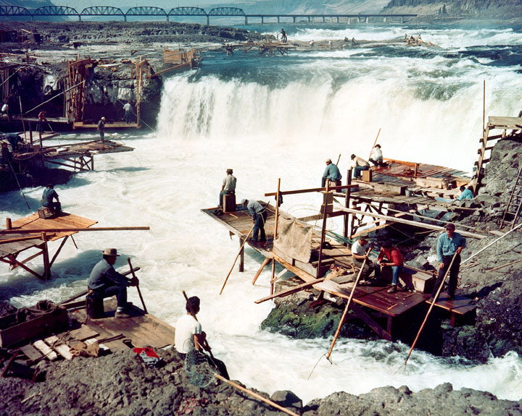
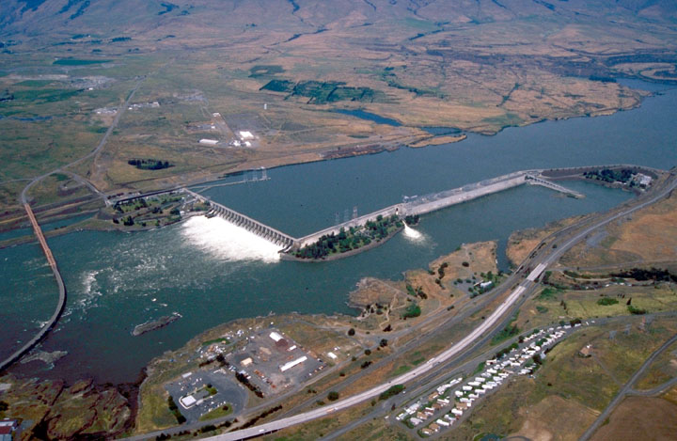
The Silencing of Celilo Falls
Notes:
Celilo Falls, near the The Dalles, Oregon, was a series of massive falls on the Columbia river as it approached the Cascade mountains. It was a famous platform fishing site for Native Americans to capture salmon that were scaling the Cascades on their way up the river. In 1957, the completion of The Dalles Dam, created a reservoir that flooded the falls and made them fall silent. This is an example of the changes in water velocity and environment that salmon have experienced.

Slide 11
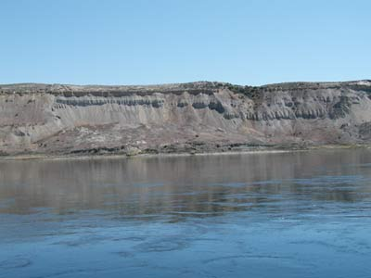
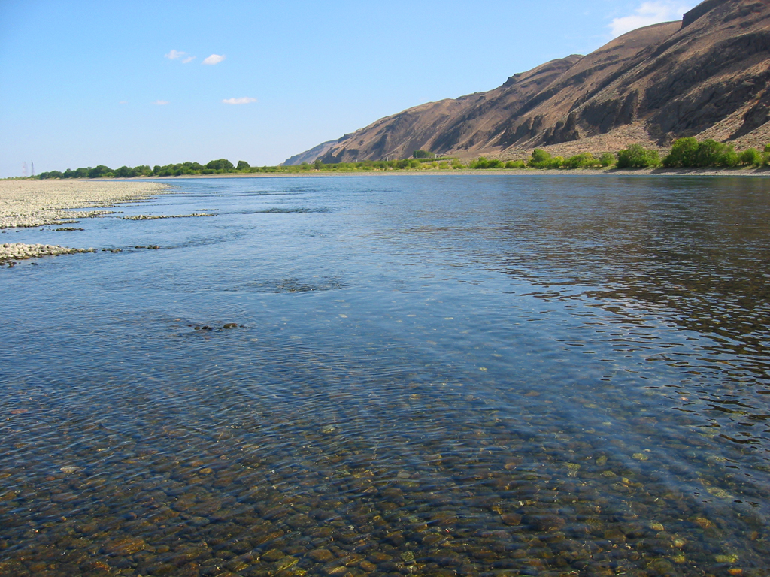
Hanford Reach
The last undammed, free-flowing stretch of the Columbia river left.
Despite it being a low hot desert, this stretch is a very important spawning ground for fall chinook.
Notes:
Located in the lowest and hottest part of the Columbia Basin, the Hanford Reach is the last undammed and free-flowing stretch of the Columbia river left above the Bonneville Dam. Protected from development, due to its location next to the Hanford Nuclear Reservation, the area was finally protected environmentally when named a national monument in the 1990’s. Despite its desert climate, this stretch is a very important spawning area for fall chinook and steelhead.

Slide 12
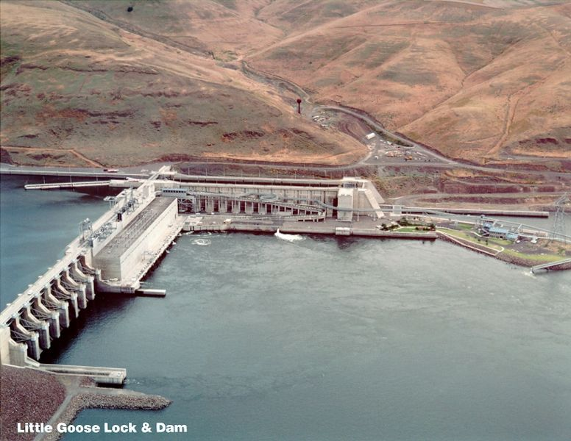
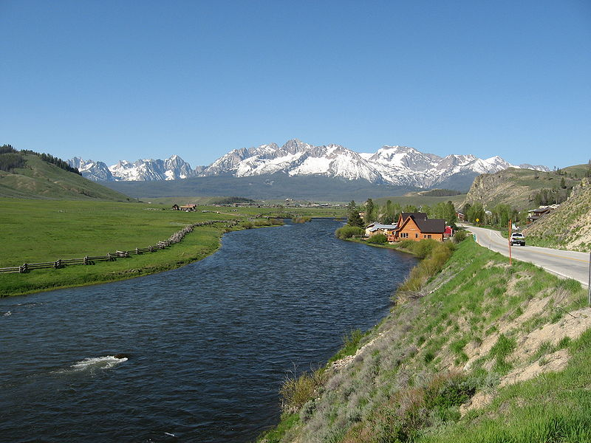
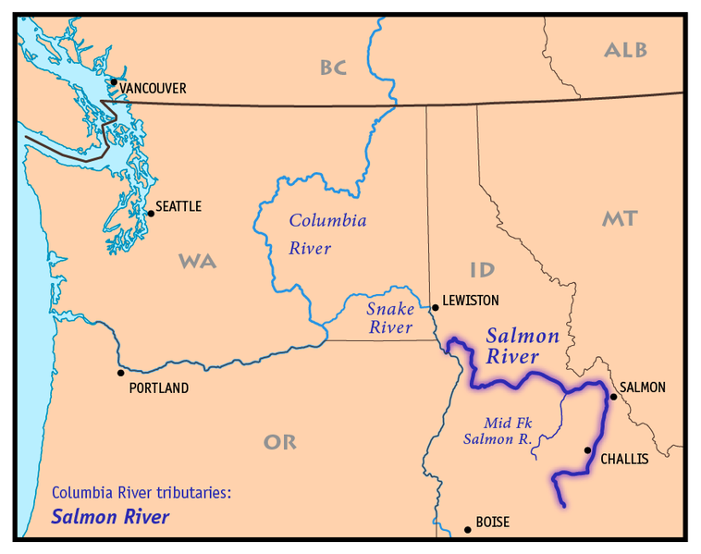
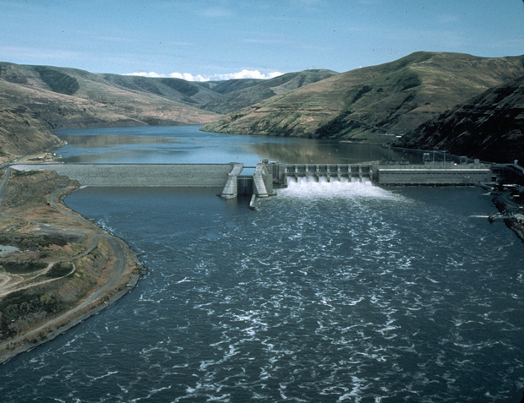
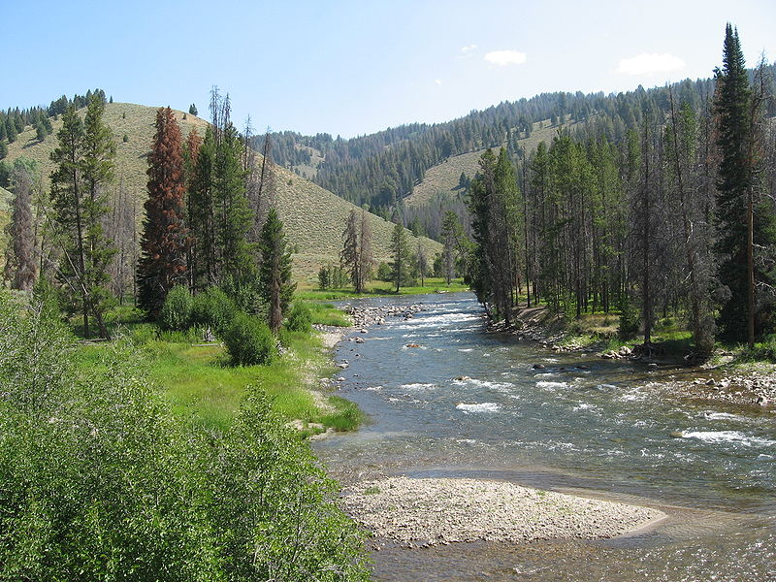
Saving the Salmon River Salmon
Time for dam removal?
Blocked to salmon
Notes:
The Snake River salmon runs that once numbered in the millions have all but gone extinct. They can only reach as far as Hells Canyon Dam, because that dam has no fish ladder. But, below Hells Canyon is a very important tributary of the Snake River that once supported millions of salmon working their way into the Idaho Rockies, the Salmon River.
However, the effects of the four dams on the Lower Snake River (Lower Granite, Lower Monumental, Little Goose, and Ice Harbor) on Snake River salmon have been devastating. The once millions of Idaho salmon have dwindled to the low thousands.
A proposal has been made to remove or greatly modify the four Lower Snake River dams in order to restore salmon runs on the Salmon, Clearwater, and Grande Ronde rivers. However, major opposition related to the dams removal has been that these dams allow barge traffic to reach Lewiston, Idaho plus the loss of hydroelectric and irrigation waters for this region makes their removal unlikely in the foreseeable future.

Slide 13
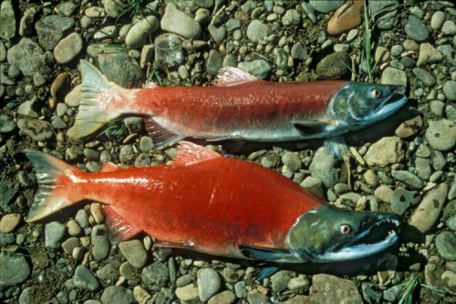
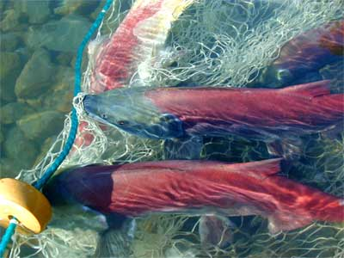
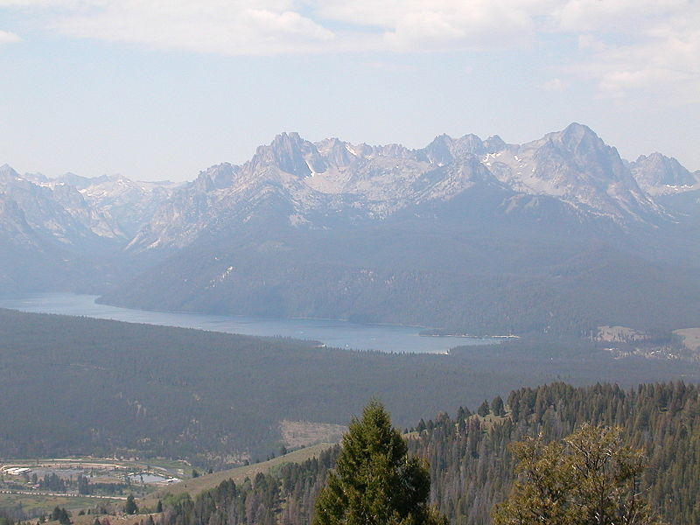
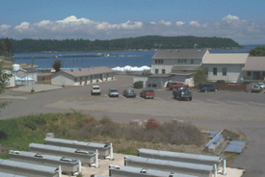
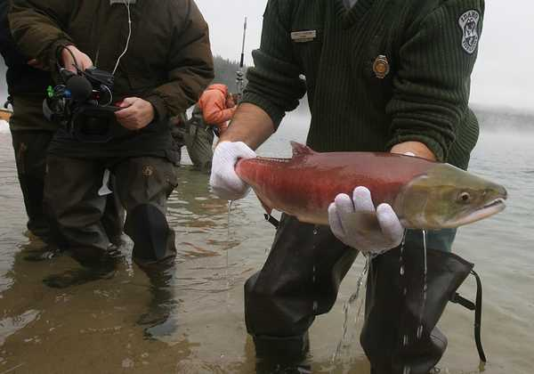
Redfish Lake, Idaho
Notes:
Redfish Lake is located more than 900 miles from the ocean at the headwaters of the Salmon River in Central Idaho. Historically this lake supported runs of 25,000 to 40,000 adult sockeye salmon returning each year. It was named Redfish Lake because of the thousands of bright red sockeye returning to the lake each year.
However, after the construction of four dams on the lower Columbia in the 1930’s to 1960’s, sockeye numbers began to plummet. By the 1950’s the returns numbered only a few thousand salmon. By the 1960’s it was in the hundreds and with the construction of the last of the four lower Snake river dams in the 1970’s, the population virtually disappeared.
In 1990, not a single sockeye returned. In 1992 only one make sockeye returned. Between 1994 and 1998 only three total sockeye returned to the lake. In essence, the Redfish Lake sockeye was functionally extinct.
But, a special captive breeding program was developed in 1991 to try and save the Redfish Lake sockeye. Redfish sockeye eggs and sperm were collected and frozen. The fertilized eggs are reared at a NMFS service facility in Washington and raised for 4 years in tanks until they are adults. The captive adults are then released into the lake to spawn and produce the next generation who can head to sea in an attempt to reestablish wild populations. In addition, many of the reared eggs and salmon fry from the facility are also released into the lake to supplement the population.
The program has had some success, as the returning numbers have risen to the lower hundreds and 2008 was a particularly successful year with 557 adult returns. But, this is a very expensive and intensive effort. The programs has cost millions of dollars already. It seems real progress to naturally occurring runs will not occur unless the four Snake river dams are removed and/or better fish passage facilities are developed.
The top-left image shows a school of returning sockeye similar to what would have been seen historically. By the 1990’s only a few were returning each year, sometimes none. A captive breeding program would capture all adult sockeye and their sperm and eggs were sent to the NMFS Manchester Field Station in Washington for rearing. Adults are released in the lake each year to spawn and produce offspring to begin the journey again.

Slide 14
This project was made possible in part by a grant from
Washington’s National Park Fund.

