Slide 1
Marine-Derived Nutrients
The Aquatic Food Web

Slide 2
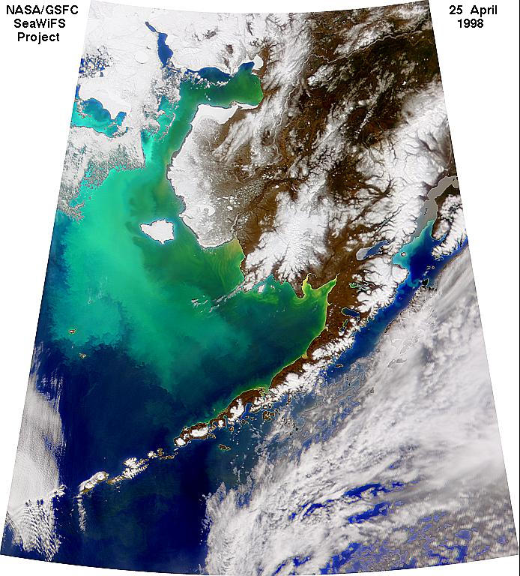
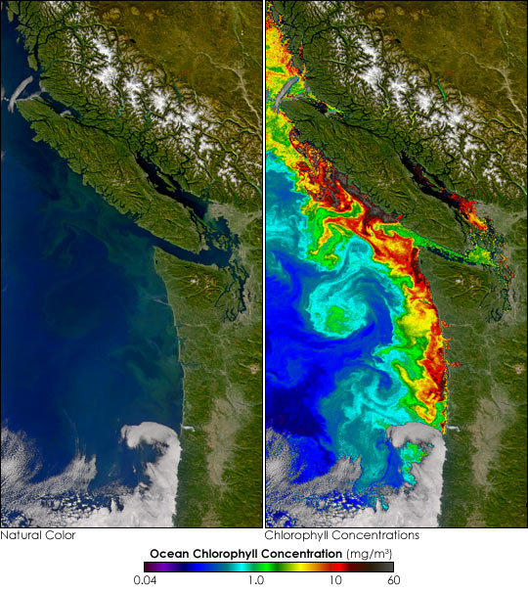
Algal Blooms
The North Pacific Turns Green
Notes:
Algal blooms occur in the cold waters of Alaska and along the Pacific Northwest coast. They occur when long days of summer sunlight combine with cold nutrient-rich waters. These waters are among the most productive environments on Earth.
What is crystal clear water in winter, first turns a milky-light green as the myriad of organisms release their sperm, eggs, and larvae into the water to begin feeding on the developing algal blooms. By mid-summer the waters turn a murky green as the algal bloom reaches its peak.

Slide 3
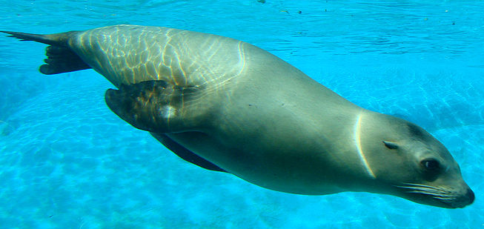
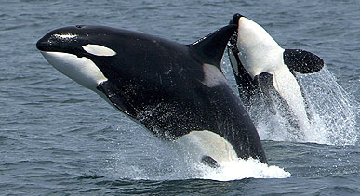
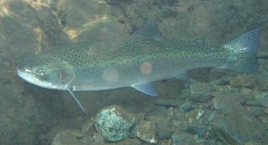
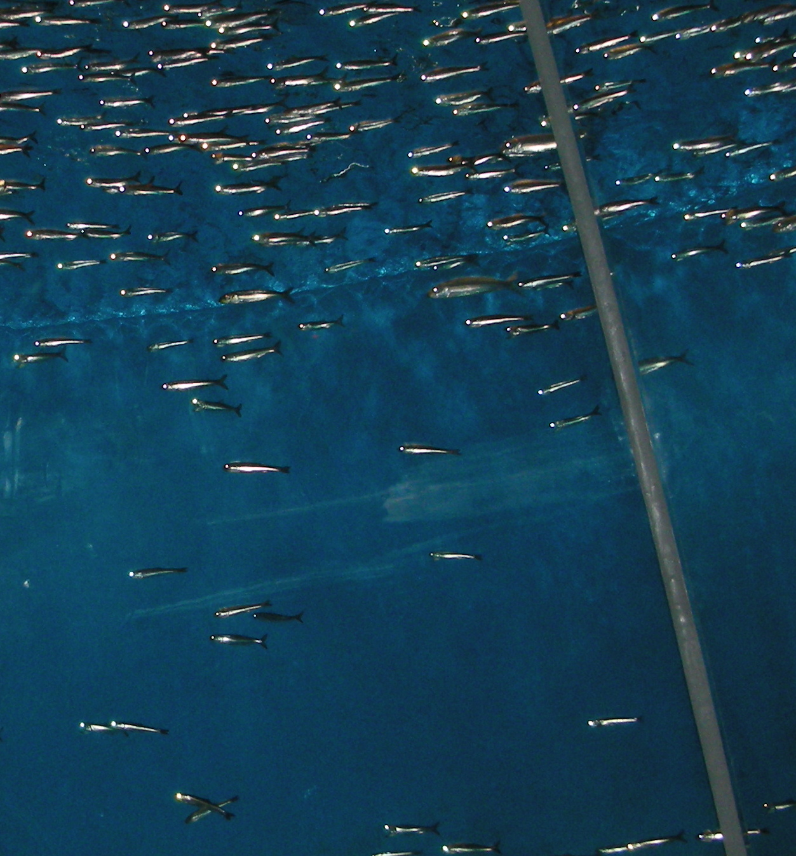

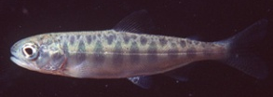


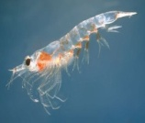
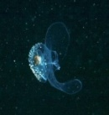
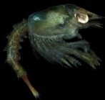
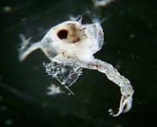
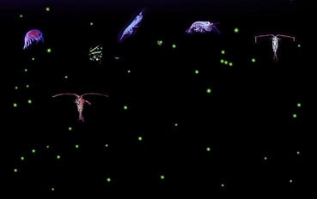
The Marine Food Web
Seals feed on small fish and salmon
Orca feed on salmon and/or seals
Adult Salmon feed on small fish
Anchovies are common schooling fish
Juvenile salmon can be prey for adults
Juvenile salmon feed on plankton
Small forage fish feed on plankton
Zooplankton feed on algae and smaller plankton
Algae produce food from photosynthesis
Notes:
Phytoplankton are single-celled algae and cyanobacteria that drift in the water column and produce their own food through photosynthesis. Kelp are larger colonial algae that anchor themselves to rocks.
Zooplankton consist of two primary groups. Those which are plankton for their entire lifecycle, such as copepods and amphipods, and those which are plankton while in the larval stages but grow much larger as adults, such as crabs, lobster, and jellyfish. Zooplankton can also consist of tiny larval fish before they grow larger. Zooplankton generally feeds on phytoplankton or prey on other zooplankton.
Forage fish refer to small fish that are prey for larger fish and sea birds. These include anchovies, smelt, and a variety of juvenile fish. They feed primarily on plankton. They are often prey for seabirds like cormorants, auklets, herons, and diving ducks.
Predatory fish include larger fish like salmon, tuna, groupers, squid, among others. They feed on forage fish and any number of smaller fish species, juvenile fish, and shellfish.
These predator fish are often prey for larger predators like sharks, seals, and orca.

Slide 4
Trophic Levels
4th level
Consumers
1 energy unit – sharks, eagles, killer whales, marlins, and other large predators
Tertiary
Consumers
10 energy units – large fish and other predators (squid, salmon, seals, tuna, etc)
Secondary
Consumers
100 energy units – small fish and filter-predators like jellyfish
Primary
Consumers
1000 energy units – zooplankton and tiny filter-feeders
10,000 energy units - Phytoplankton
Producers
Notes:
Energy consumed at each trophic level is lost due to heat and metabolic inefficiencies. Thus, the available energy available decreases at each trophic level at approximately 10-fold. So, if there were 10,000 energy units of phytoplankton available in an area, it could only support 1000 energy units of zooplankton. 1000 energy units of zooplankton can only support 100 units of small forage fish. The higher up the trophic level, the fewer individuals an area can support. Thus, by the time you make it to the very large predators, only a few can survive in an area.

Slide 5
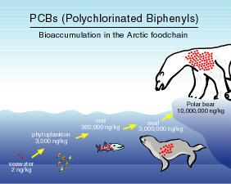
Biomagnification
4th level
Consumers
10,000 chemical units– sharks, eagles, killer whales, marlins, and other large predators
Tertiary
Consumers
1000 chemical units – large fish and other predators (squid, salmon, seals, tuna, etc)
Secondary
Consumers
100 chemical units – small fish and filter-predators like jellyfish
Primary
Consumers
10 chemical units – zooplankton and tiny filter-feeders
Producers
1 unit – Phytoplankton and algae
Notes:
Also associated with trophic levels is the accumulation of nutrients and chemicals up each trophic level. That is because, at each trophic level, more needs to be consumed to allow survival, so more chemicals are being taken into the body. Thus, if each producer has one chemical unit and a zooplankton needs to eat ten of them to survival, the zooplankton will bioaccumulate 10 chemical units. If a small fish needs to eat 10 zooplankton to survive and each has 10 chemical units, the small fish will have 100 chemical units.
This building of chemical units in each trophic level is called biomagnification. This process can be beneficial for certain nutrients, but can be very harmful with the accumulation of dangerous chemicals like PCB’s, DDT, and Mercury. Animals at the top of the food chain often start having serious health effects with these chemicals that does not normally affect lower trophic species. That is why DDT caused the dramatic decline of predatory birds in the 1970’s and PCB’s are hurting orca today.

Slide 6
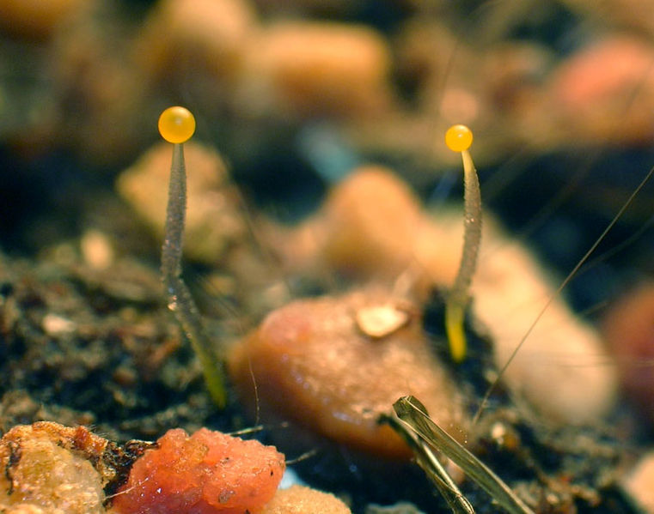
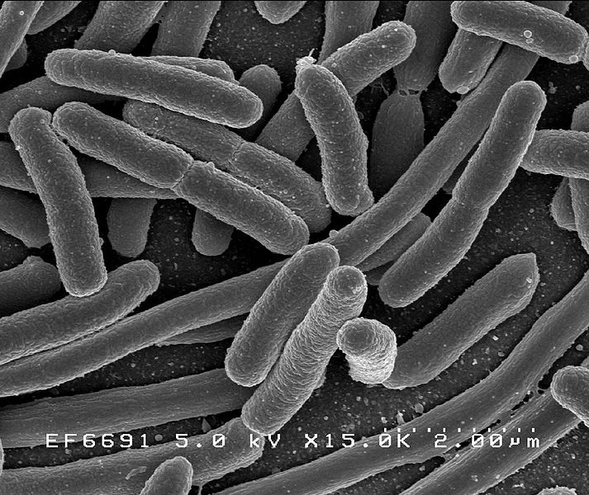
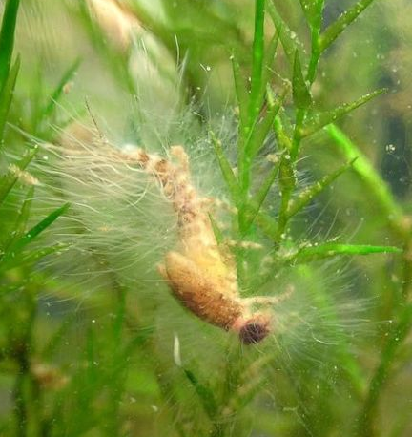
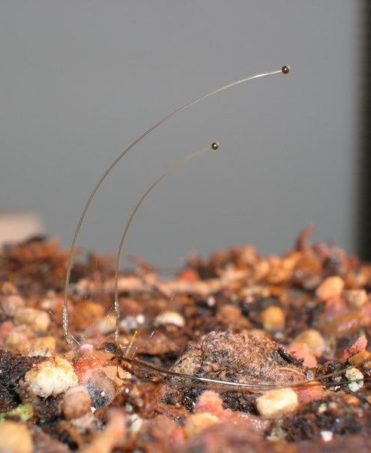
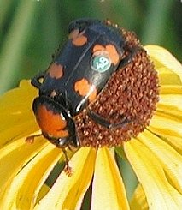
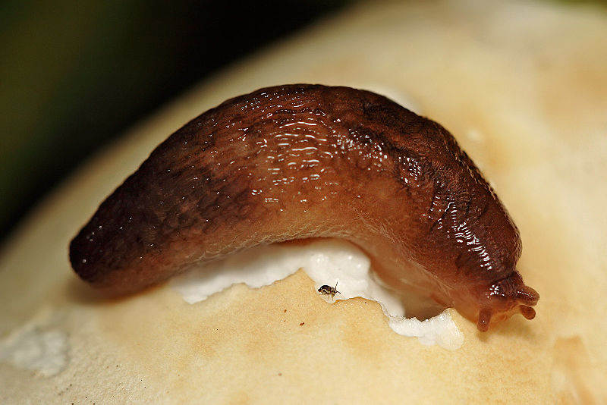
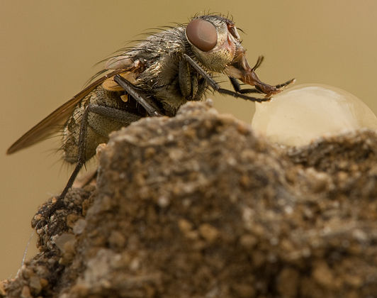
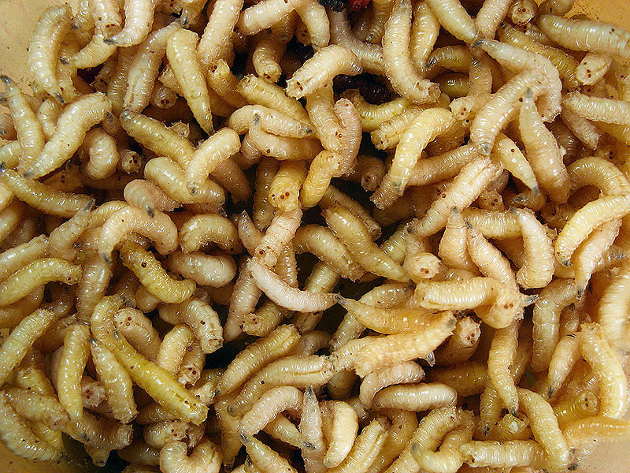
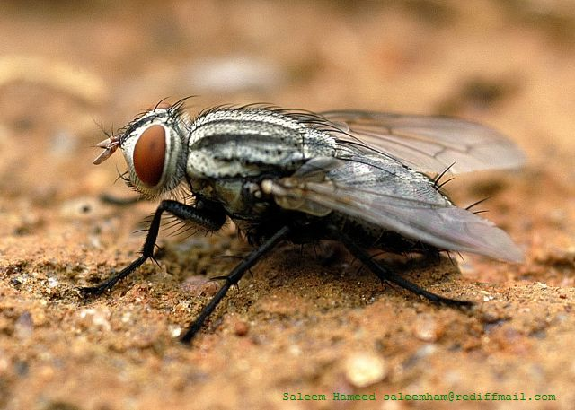
Decomposition of Salmon Carcasses
Notes:
When salmon spawn in the river and die, a myriad of decomposers and saprophytes move in to decompose the salmon carcasses and release the trapped nutrients in their waste, through cellular breakdown, and putrefaction. Bacteria and fungi are the most important organisms in terms of the release of nutrients into the stream and soil. However, scavenging invertebrates such as blow flies and their maggots, carrion beetles, and slugs not only feed on the carcasses, but also open up channels for additional bacteria and fungal invasion deeper into the body.

Slide 7
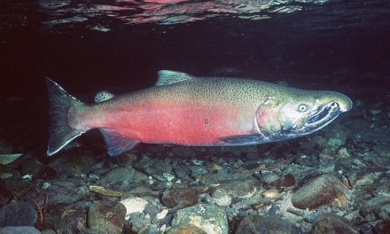
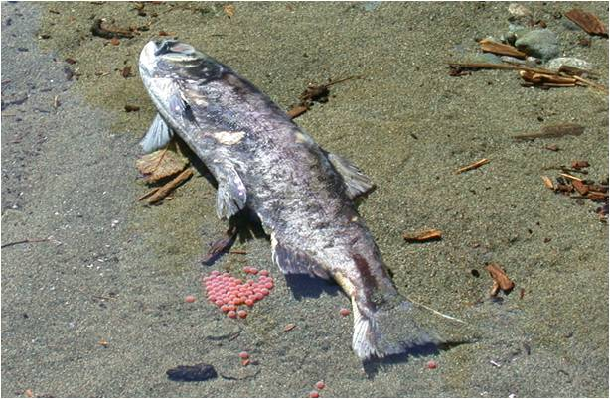
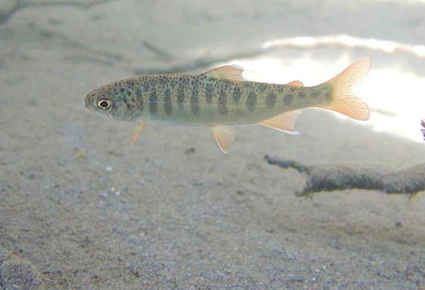
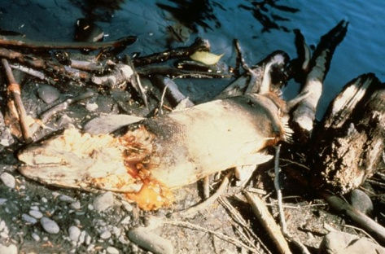
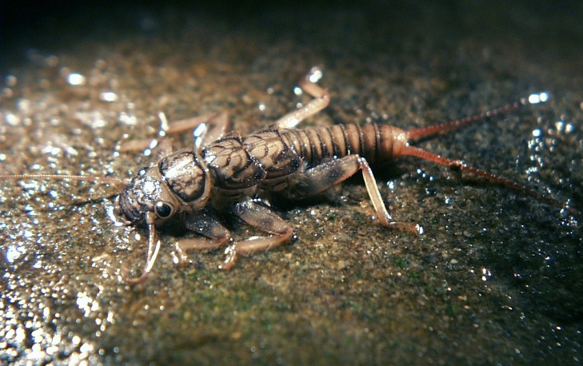
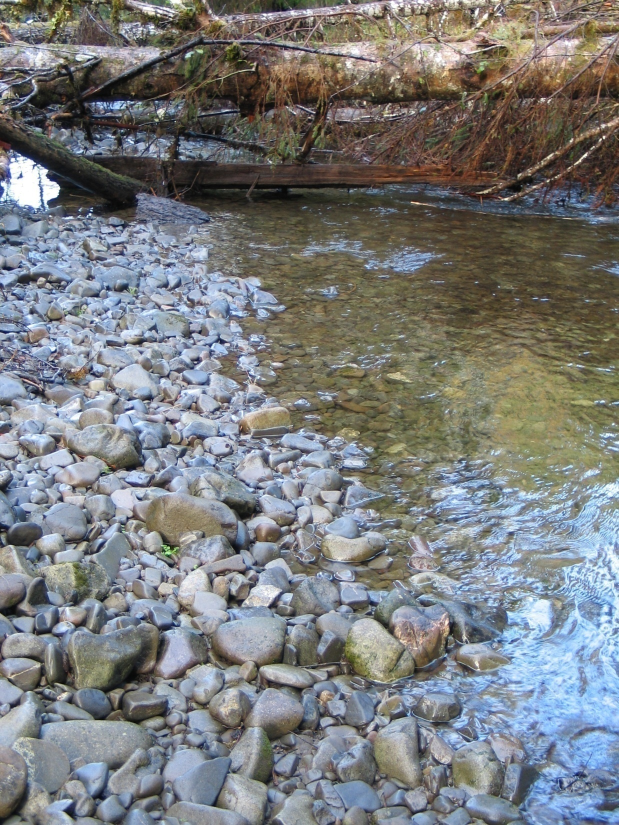
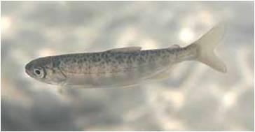
Movement of Marine-Derived Nutrients Across Generations
Adult salmon return from sea
Salmon Carcass
Juvenile salmon head to sea
Nutrients enter water
Juvenile salmon feed on aquatic insects
Nutrients used by algae and bacteria on rocks
Aquatic insects feed on algae and bacteria
It is estimated that up 95% of the food consumed by a salmon fry may have originated from the salmon carcasses of its “parents”.
Notes:
The death of adult salmon after spawning helps to support the growth and survival of their offspring. The decomposition of salmon carcasses results in the marine-derived nutrients entering the river. These nutrients help support the growth of bacteria and algae on the rocks and in the water. This provides food for aquatic insects and snails, which become food for juvenile salmon. Analysis of juvenile salmon tissues show that they have more elevated levels of marine-derived nutrients than fish in non-salmon bearing streams. It is estimated that up to 95% of the food consumed by a salmon fry may have originated from salmon carcass decomposition.
In a way, the adults are helping to feed their own offspring.

Slide 8
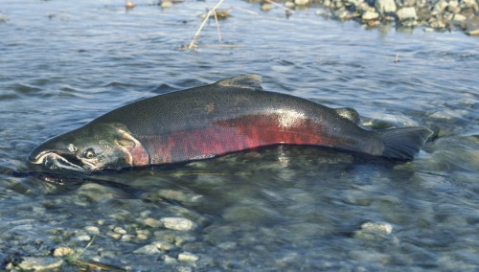
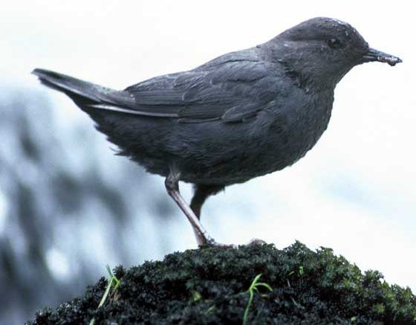
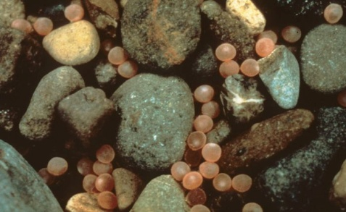
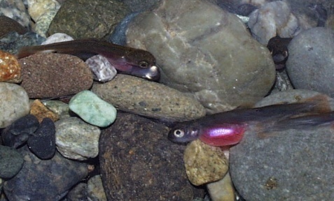
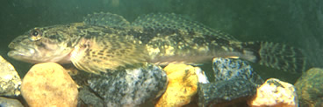
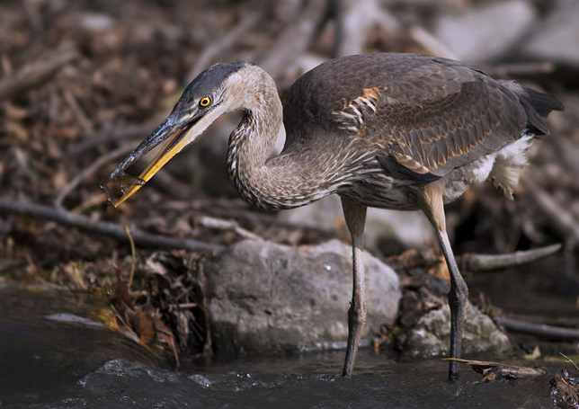

Movement of Marine-Derived Nutrients in the Food Chain
Adult salmon return from sea
Adults deposit eggs in gravel
Eggs eaten by predators
Alevin hatch from eggs
Alevin eaten by predators
Fry feed on aquatic insects
Smolts head to sea
Fry eaten by predators
Notes:
In addition, the marine-derived nutrients find their way into every level of the food chain, as predators feed on the various life stages of salmon. Amphibians, birds, fish, and a variety of animals feed on salmon eggs and alevin which, having originated directly from adult salmon, are mostly entirely made of marine-derived nutrients.
Salmon fry and smolts continue to have high marine-derived nutrient concentrations due to the salmon carcasses fertilizing the water, being taken up by algae and eventually into aquatic insects, which are fed on by juvenile salmon. When these juvenile salmon are fed on by larger predators such as herons, larger fish, otters, and other animals, those marine-derived nutrients enter the predators tissues.

Slide 9

This project was made possible in part by a grant from
Washington’s National Park Fund.

