Slide 1
Habitat Requirements of
Pacific Salmon

Slide 2
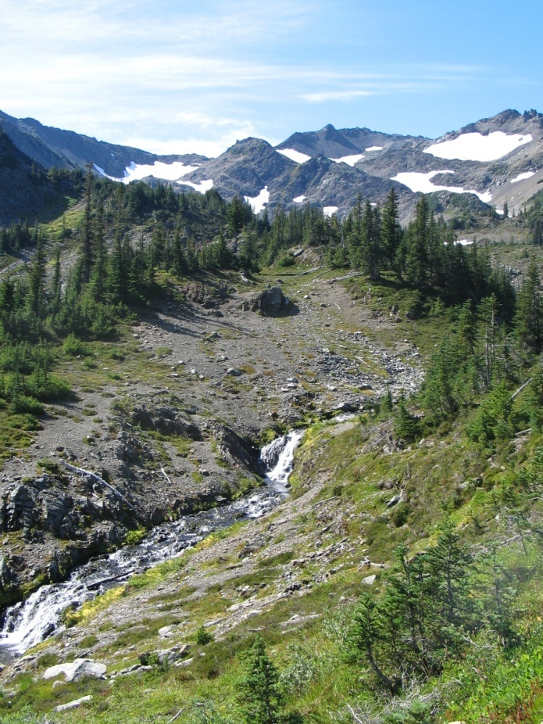
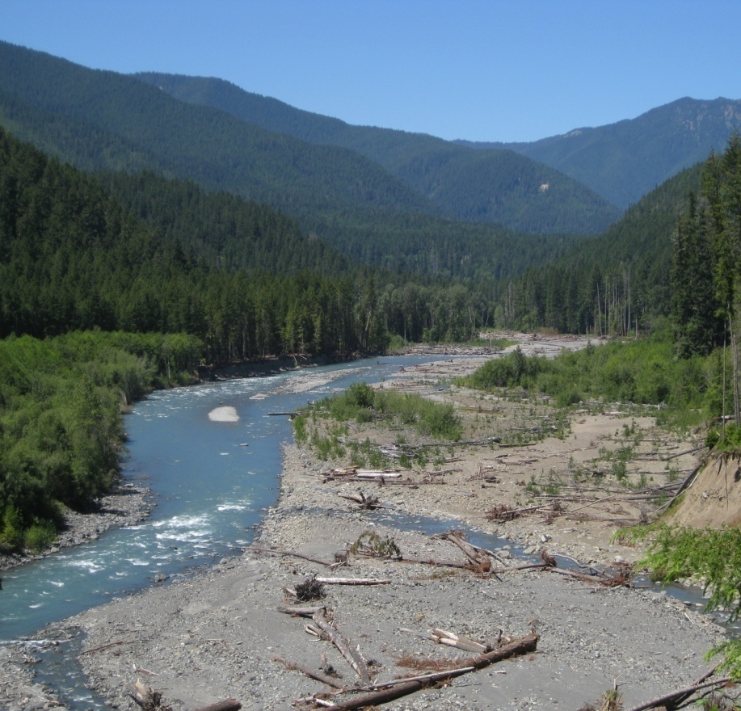
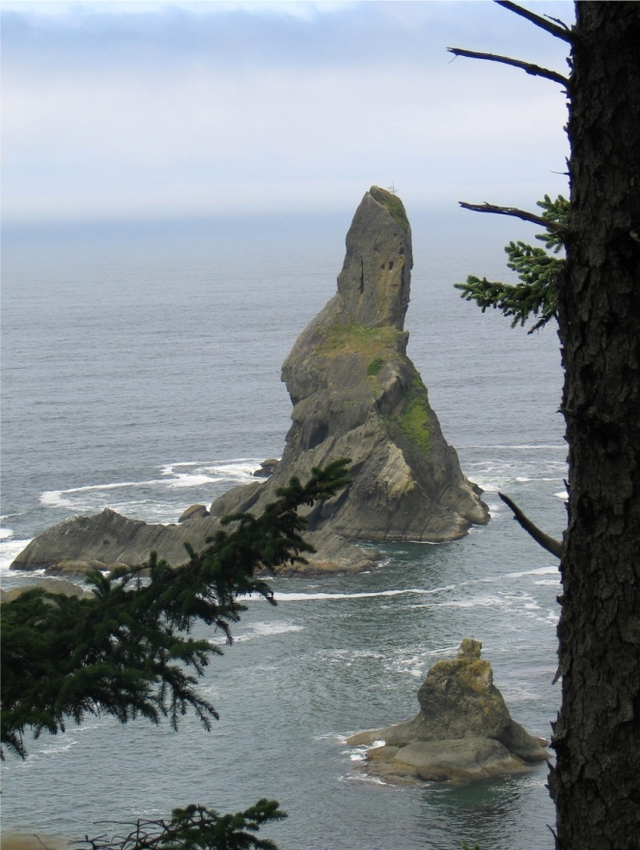
Certain Things All Pacific Salmon
Require for Survival
Cold water in streams
Clear water streams without suspended mud and silt
Cold nutrient-rich ocean waters which support robust plankton blooms and numerous small fish.
Notes:
The requirements listed above limit the range of Pacific Salmon to the north Pacific. As such, they tend to be limited to rivers originating from mountainous areas, with high velocity and large stream sediments, that flow to the ocean. They are also limited primarily to areas in the Pacific Northwest north to Alaska. A few species can live as far south as California, as long as the rivers originate in the mountains and stay cool.
In the ocean, they are also limited to the coldwater of the north Pacific, with a preference for the coastal upwelling zones where nutrients and available food is particularly productive.

Slide 3
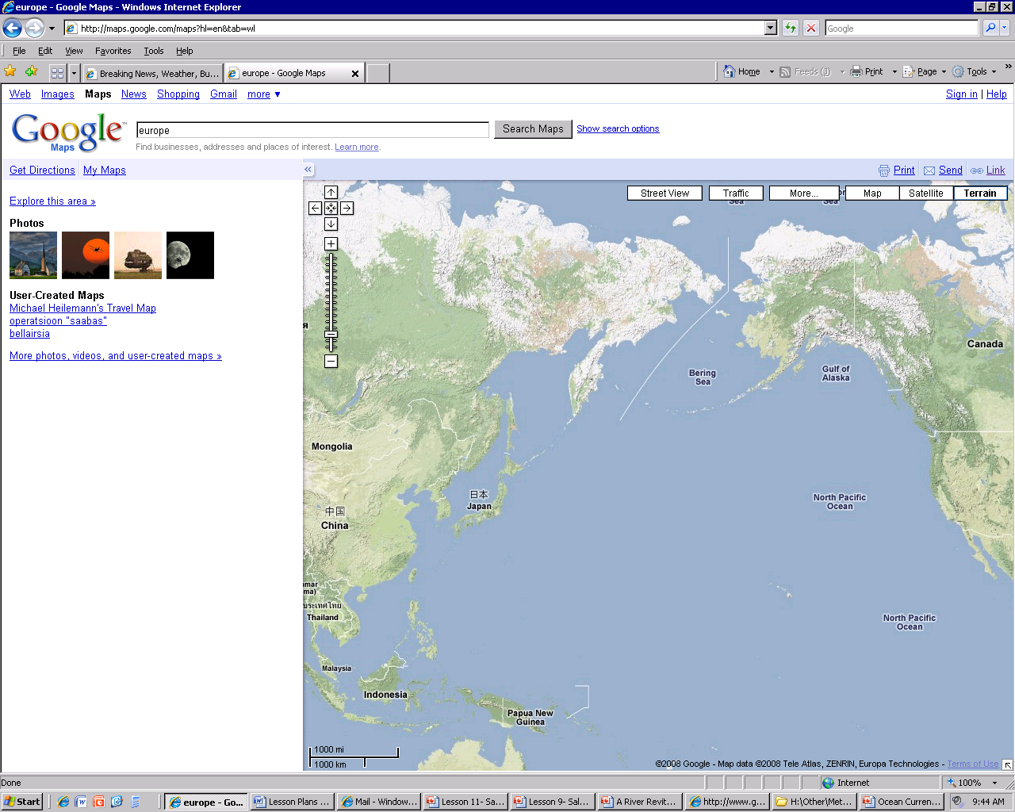
Ocean Currents
Subarctic Current
Oyashio Current
Alaska Current
North Pacific Current
California Current
Kuroshio Current
North Equatorial Current
Equatorial Countercurrent
Notes:
Notice where the cold water from Alaska is being moved. The California current moves it south to Baja, while the Oyashio current moves it south to Northern Japan. Salmon are limited to areas of the ocean with cold water, that are nutrient rich, but that do not freeze over in winter.
There are three generalized regional groups of salmon. The North American salmon migrate in the light-blue shaded areas, the Asian salmon migrate in the light red shaded areas, while the Arctic salmon migrate in the light yellow zones. Unlike the lower latitude salmon, Arctic salmon have to be more flexible in which years they return to spawn due to variations of sea ice cover and frozen rivers in the arctic. Arctic salmon will remain in the Behring Strait until sea ice melts.

Slide 4
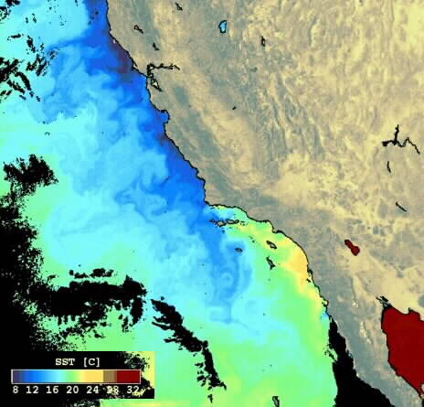
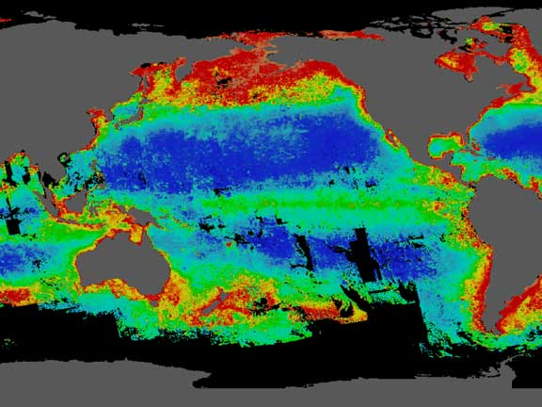
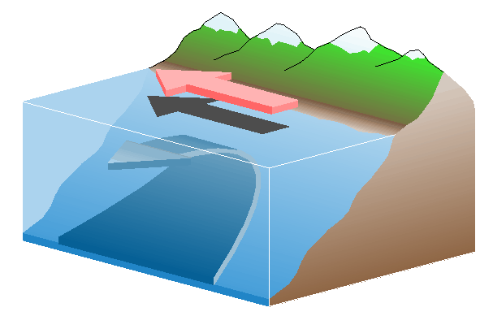
Why is the North Pacific Coast Great for Salmon?
Upwelling!
Phytoplankton Blooms in Summer
Notes:
Cold water holds more oxygen than warm water. More oxygen means more organisms can survive in a given area without depleting the oxygen supply. The California current brings cold water down from Alaska, all the way to Baja.
Wind on the surface moves water on the top, causing deeper water to be pulled up in a process called upwelling.
This upwelling brings nutrients from the bottom to the surface, providing food for algae and plankton. Rich kelp forests grow offshore, while the ocean waters themselves turns green with phytoplankton, the food for zooplankton, which is food for small fish like anchovies, which are then eaten by salmon.
So, as you look at the ranges of the salmon, remember where the cold water currents were located.

Slide 5
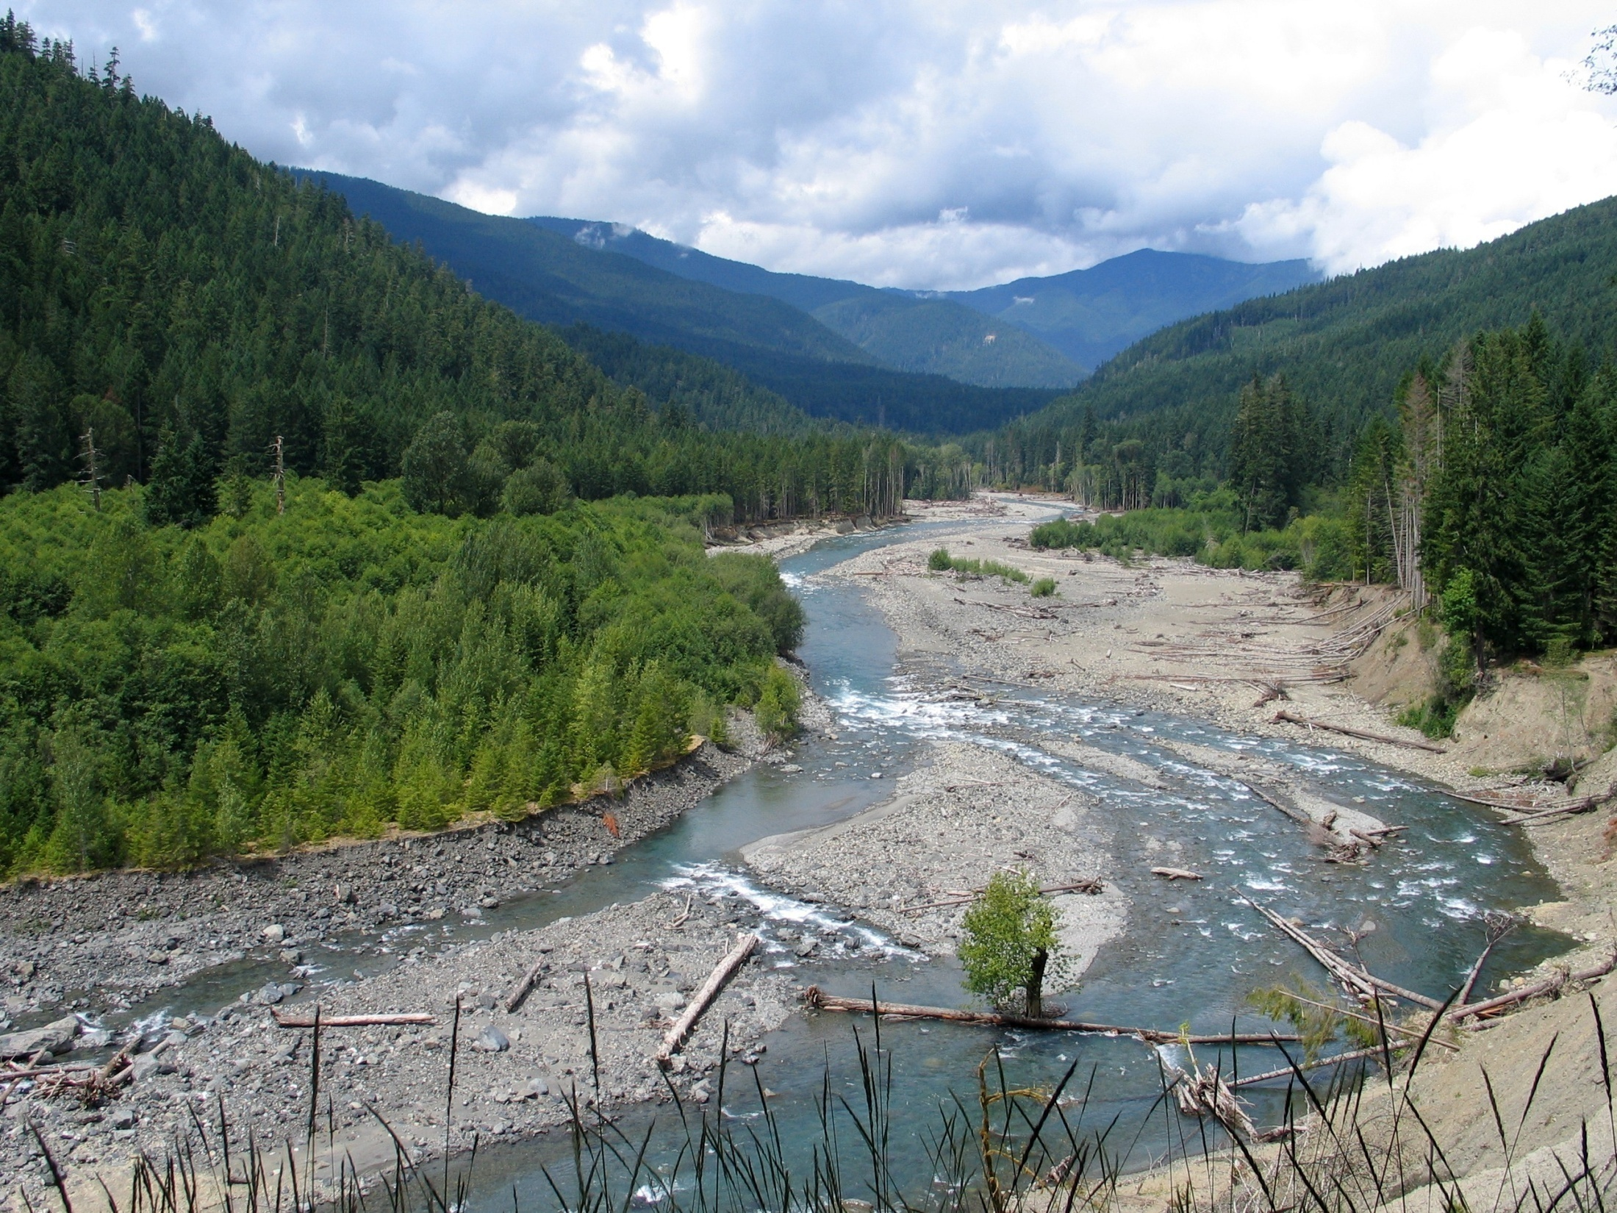
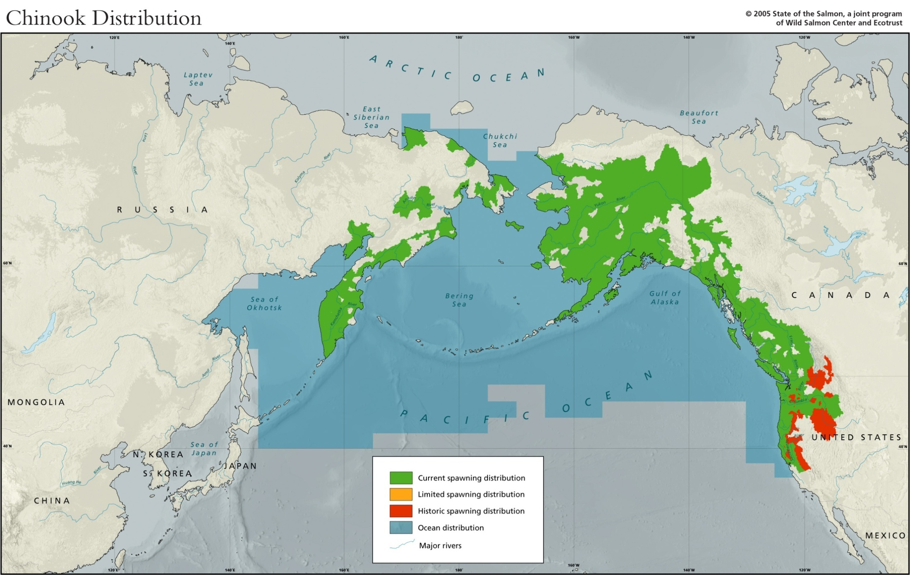
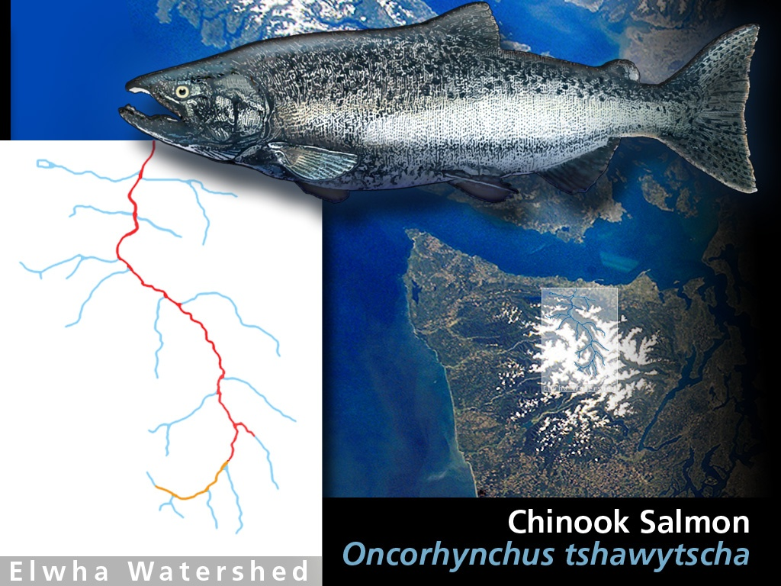
Chinook
Notes:
Chinook are the largest of the salmon species and are mainstem river spawners. They generally spend about 1 year in freshwater before heading to sea for 4-5 years. They have large marine ranges. They have the lowest stray rate of any salmon species.

Slide 6
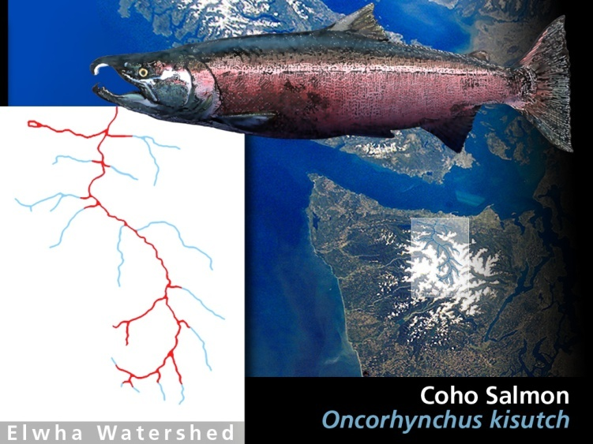
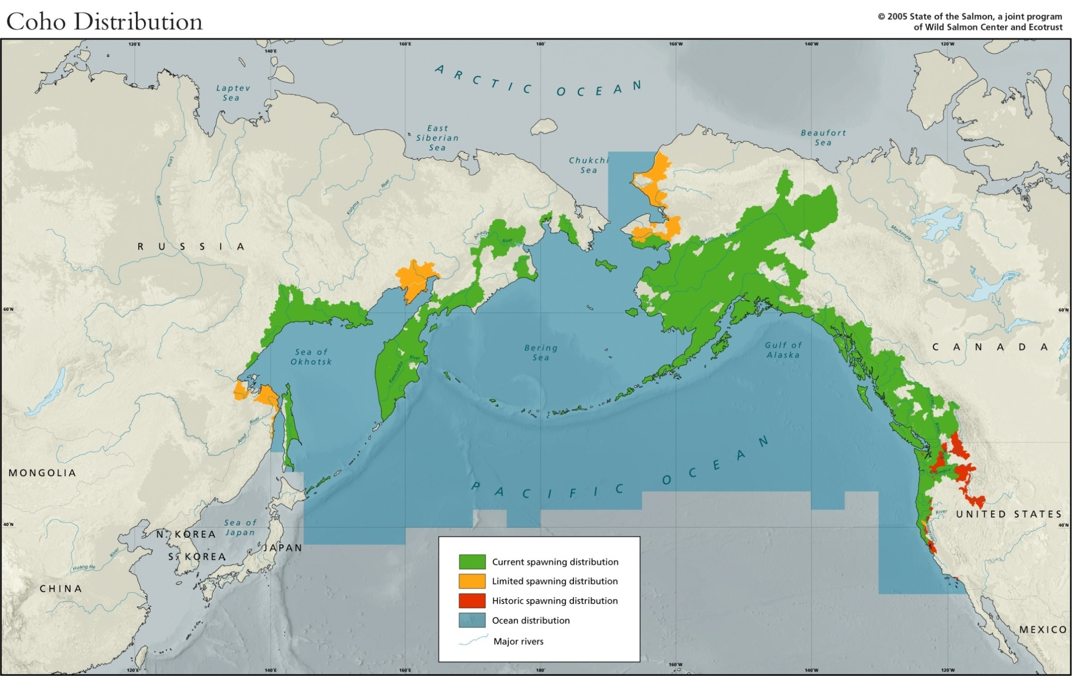
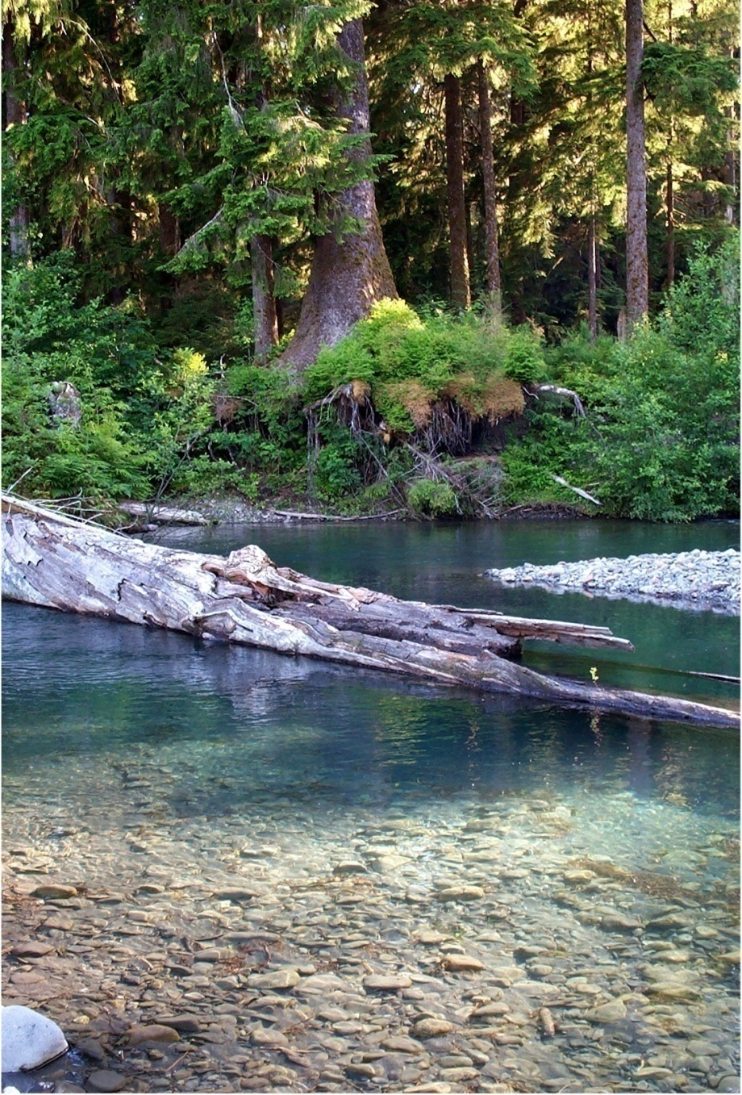
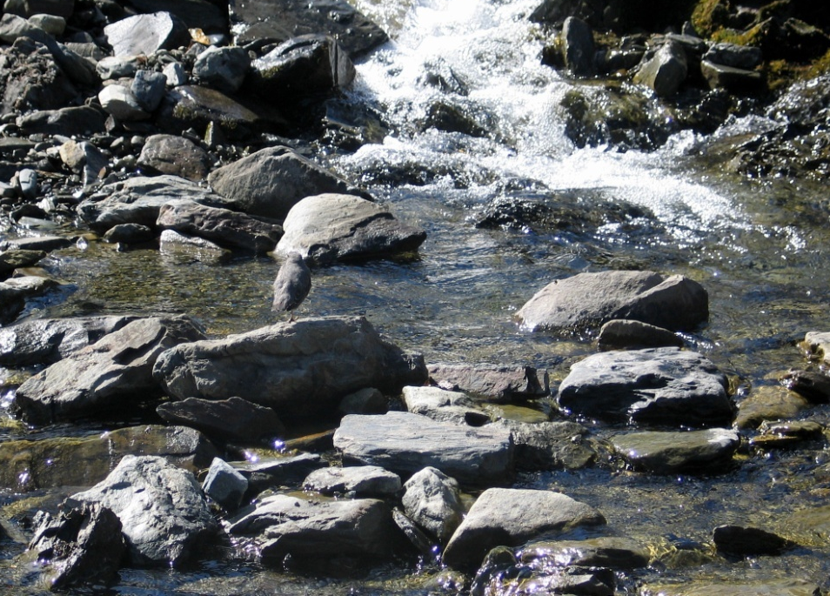
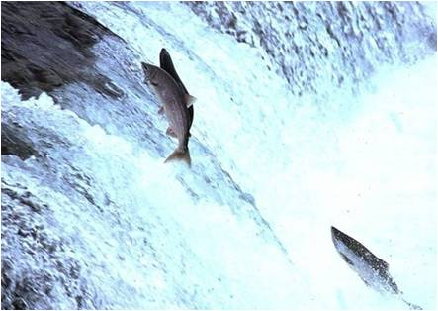
Coho
Notes:
Coho spend one year in freshwater and then live at sea for 1-3 years before returning to spawn. They are among the strongest and longest migrating salmon. They are well known for jumping waterfalls, getting over obstructions that other salmon can not handle, and climbing steep river gradients. They spawn in very shallow streams in side tributaries and all the way up to a river’s headwaters. Thus, in many mountainous areas, they have the largest range of any salmon.

Slide 7
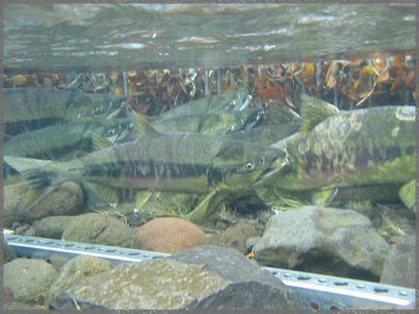
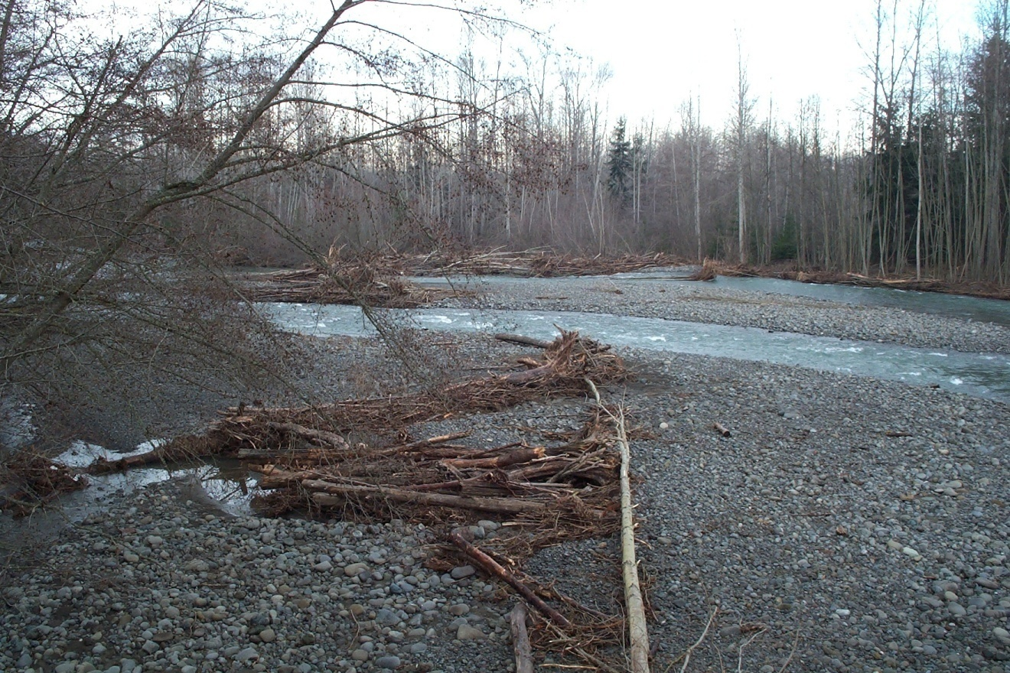
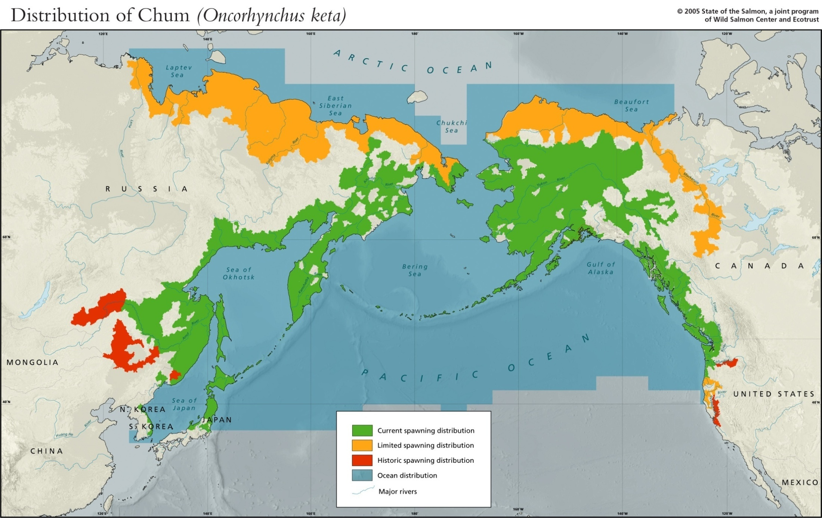
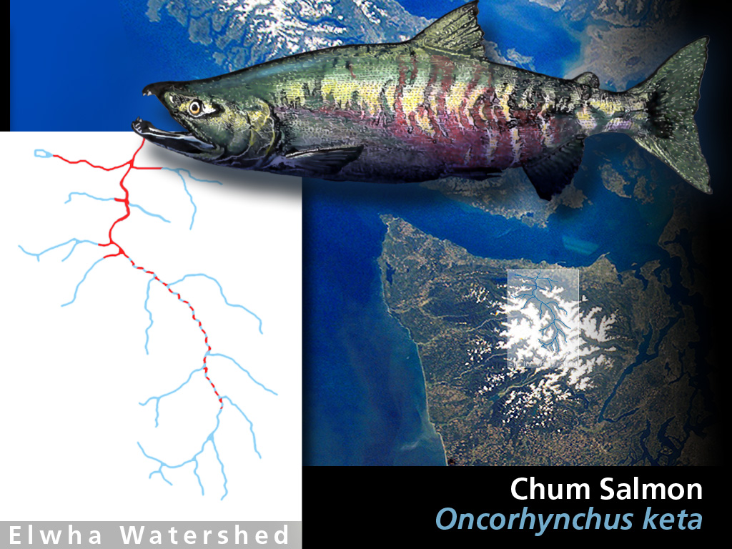
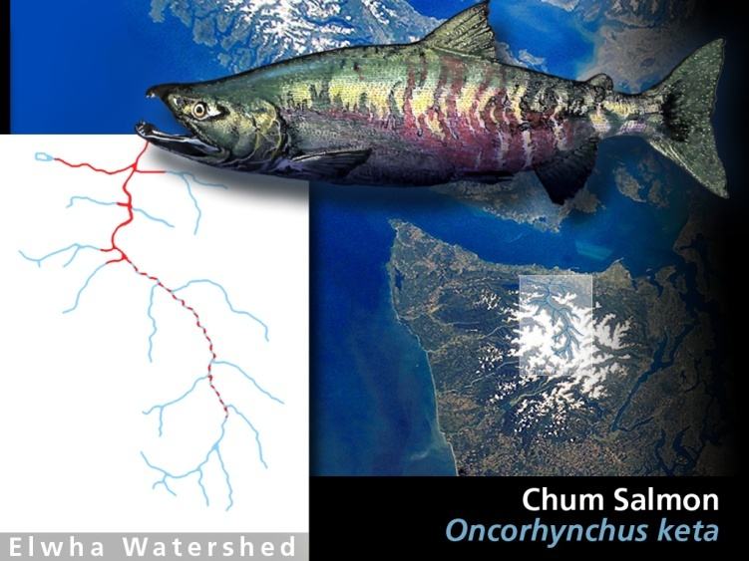
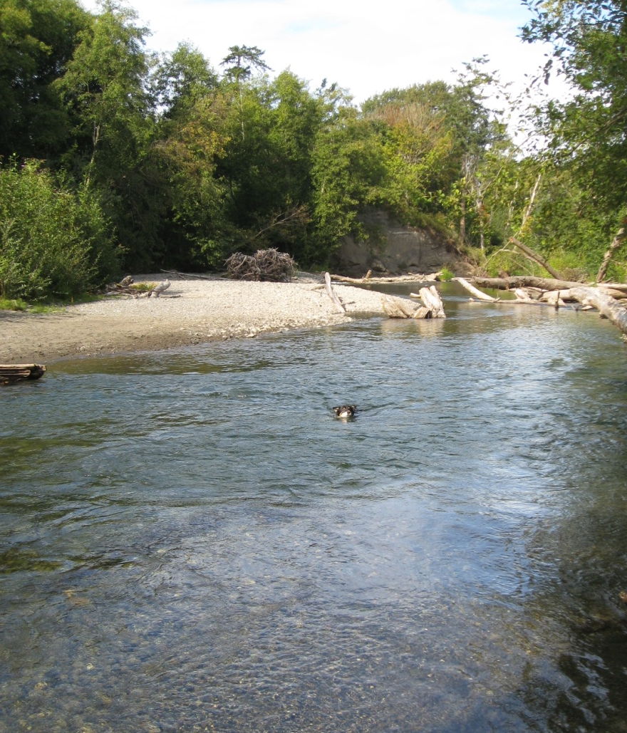
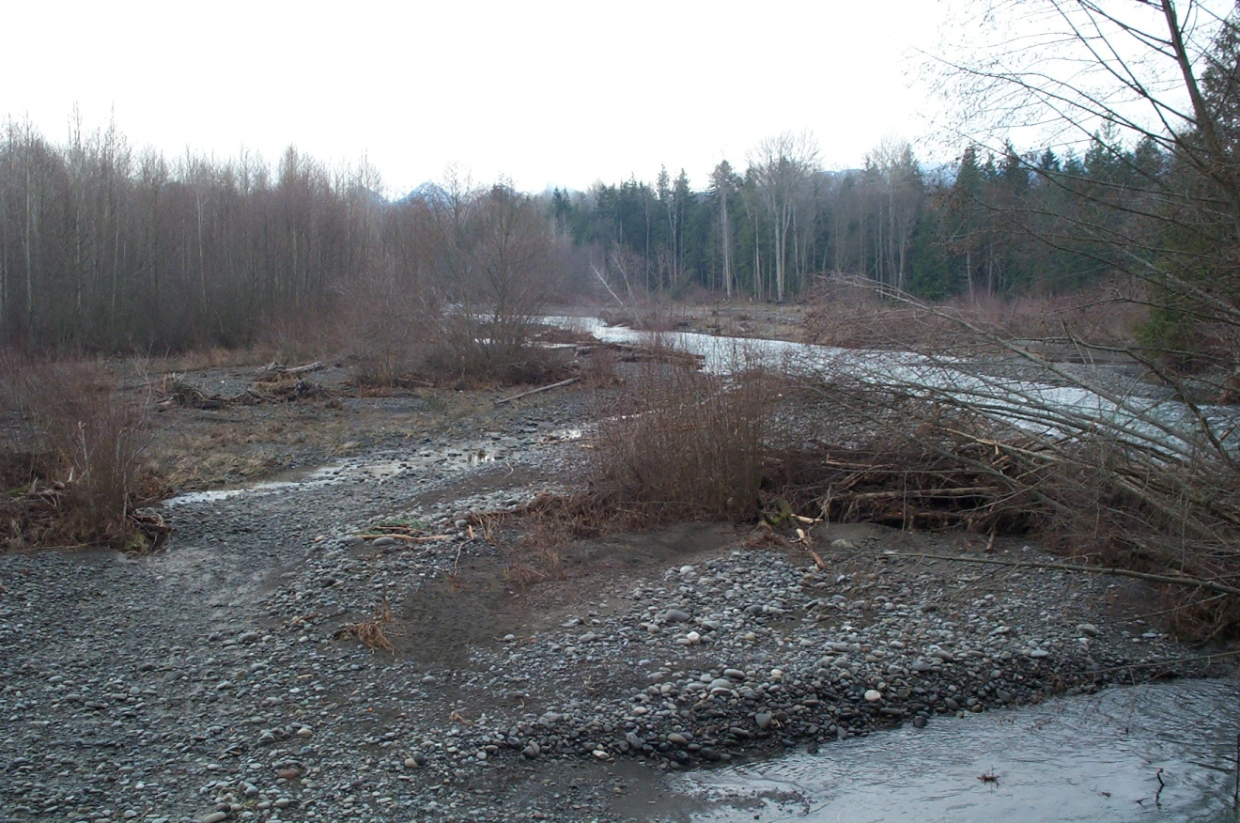
Chum
Notes:
Chum are the second largest salmon species. Juvenile chum immediately head to the estuary after emerging from the redd and spend very little time in freshwater. They spend 3-5 years at sea. Most return to spawn in the lower river and side tributaries. However, some runs are long distance migrants and they have a high stray rate.

Slide 8
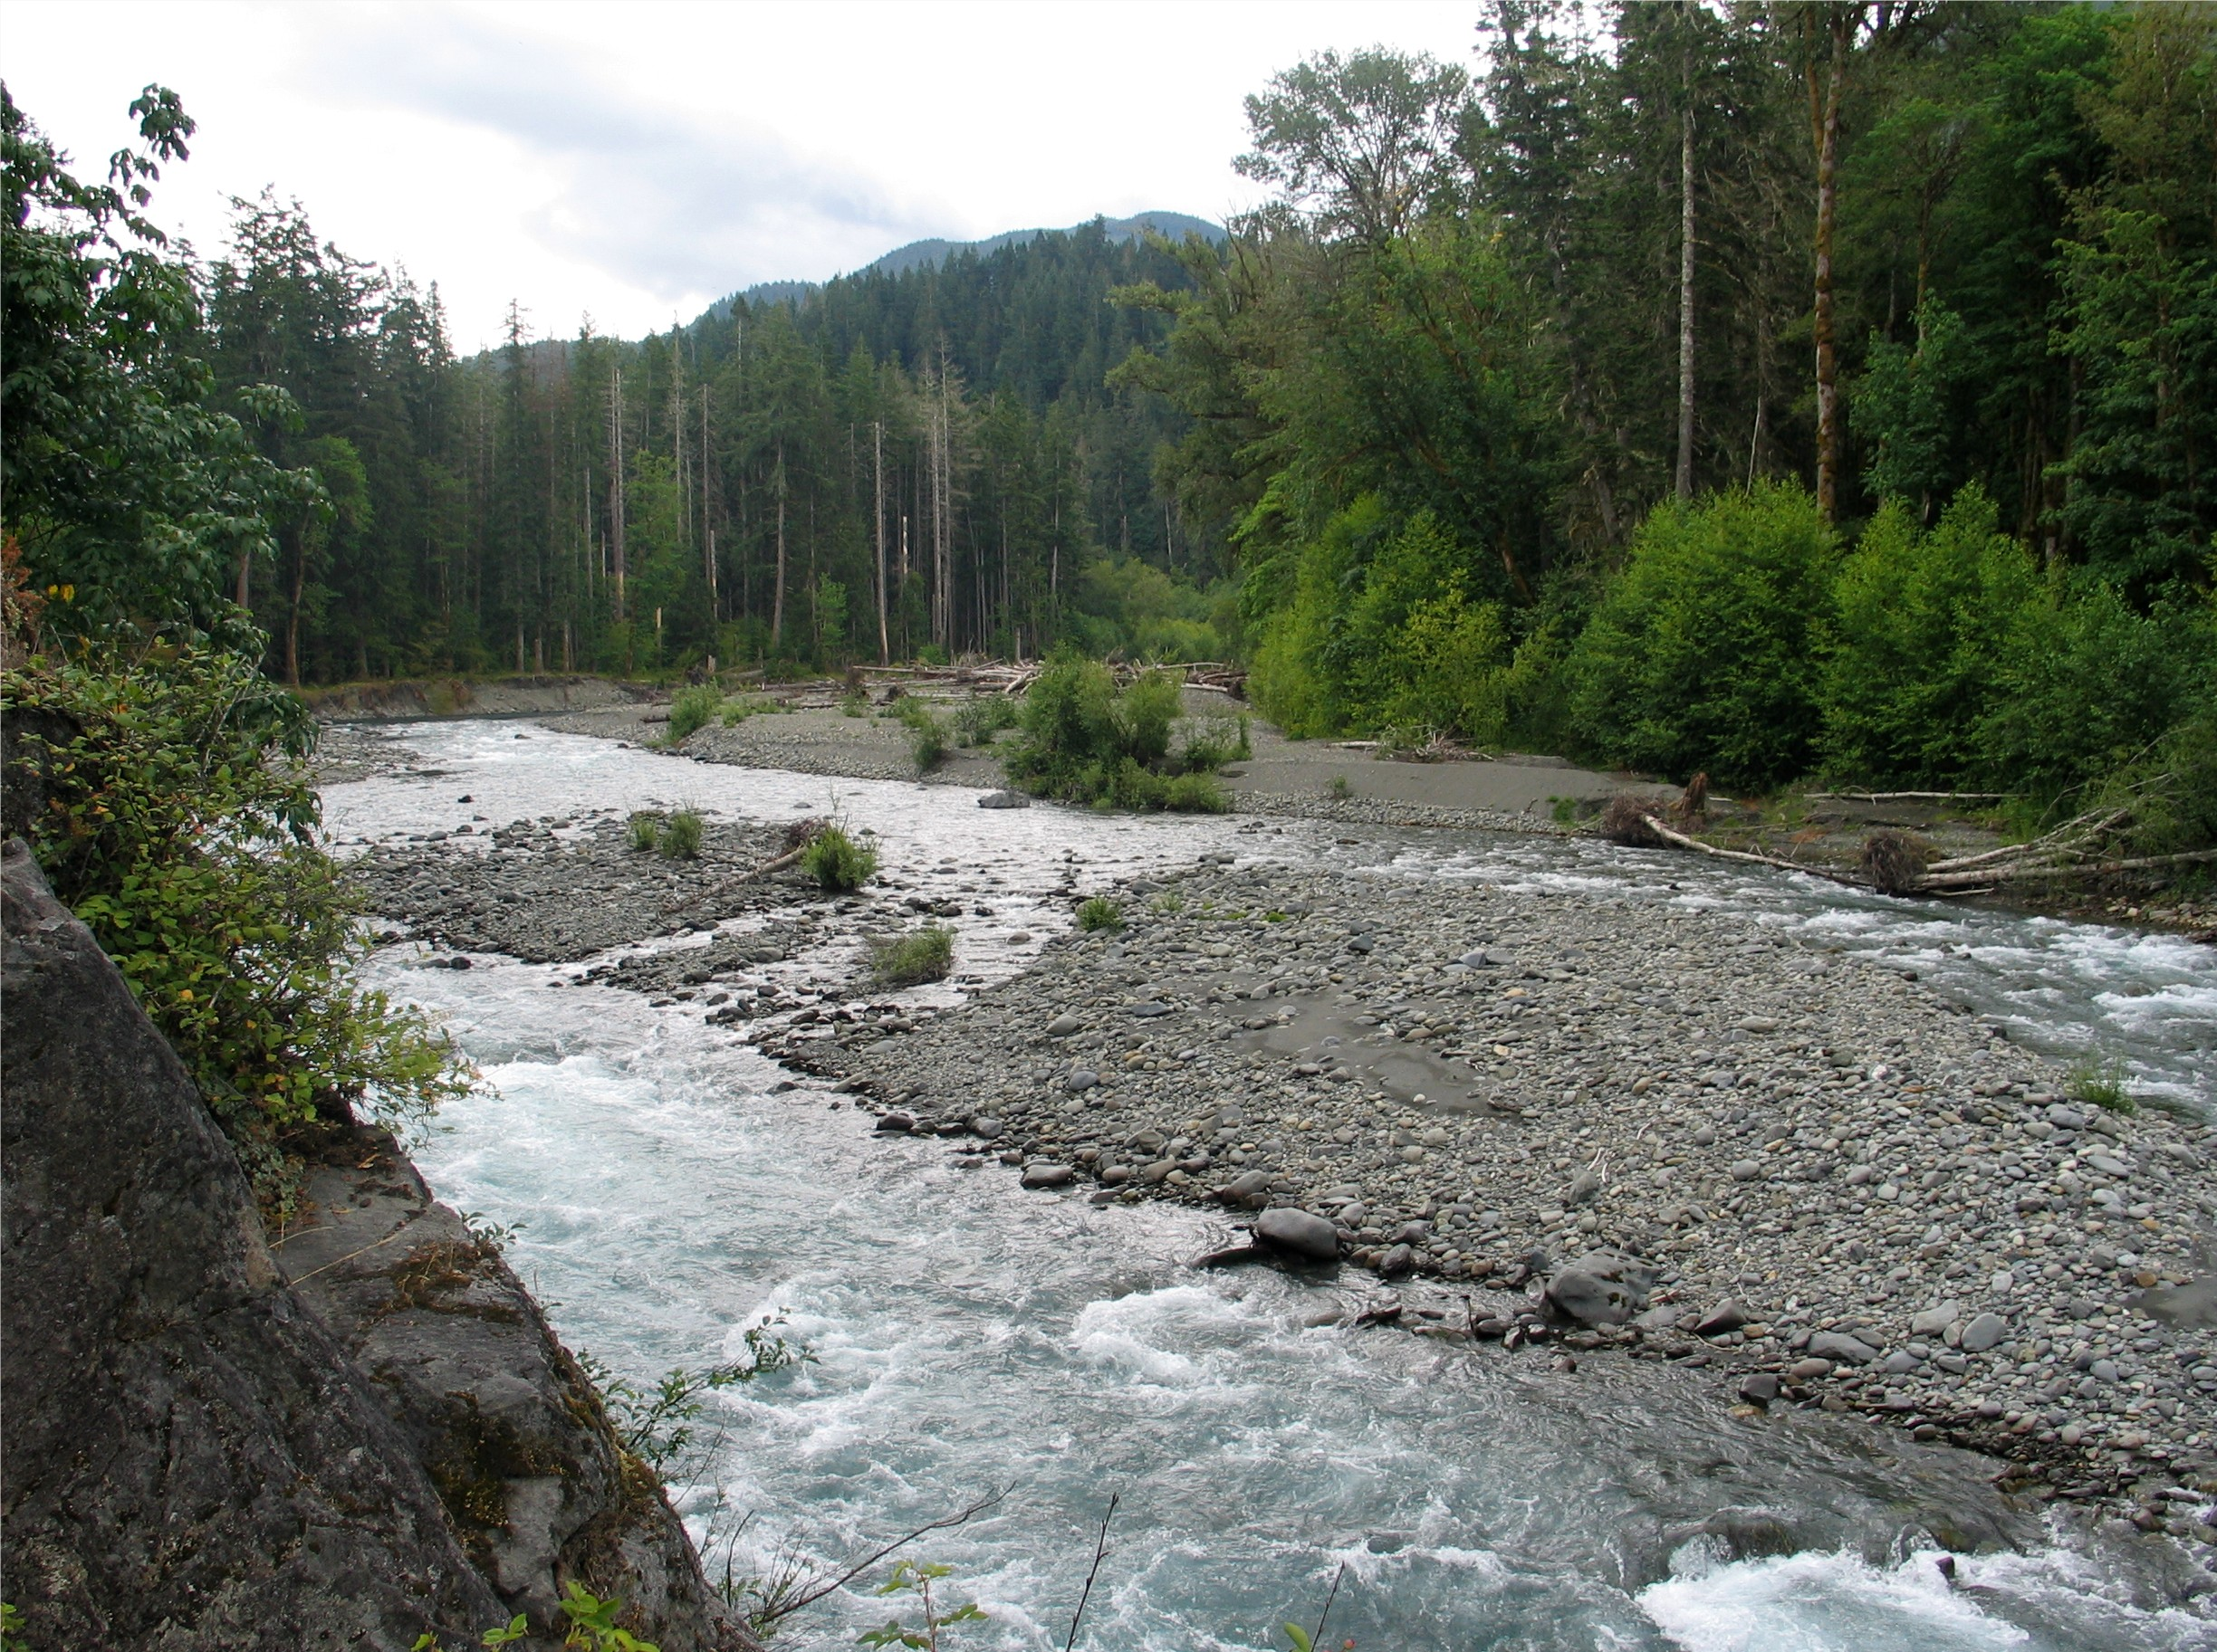
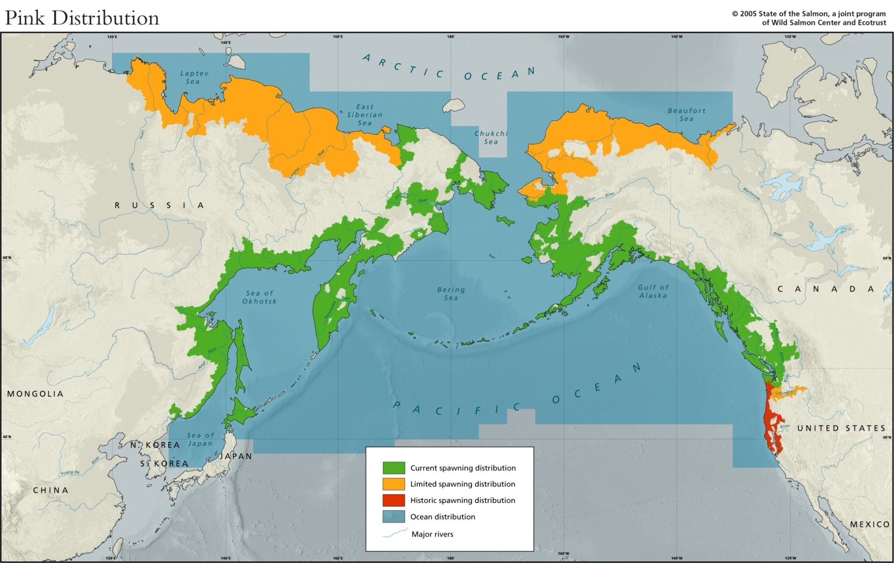
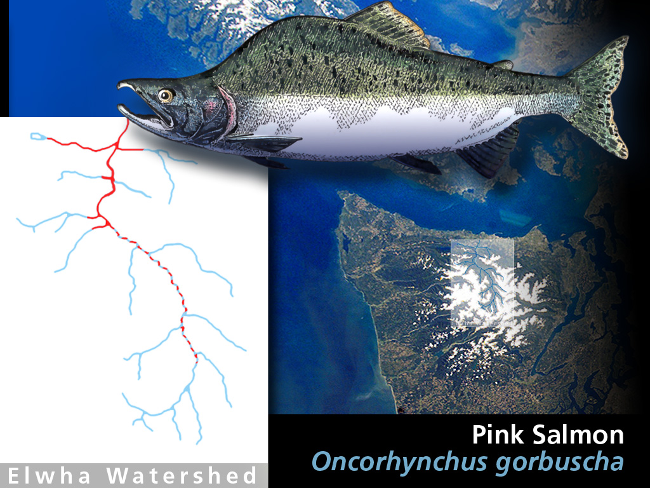

Pink
Notes:
Pink salmon have the simplest life history of any salmon. They spawn in the lower river reaches. They immediately head to sea after emerging from the redd and they spend exactly 2 years in the ocean before returning to spawn. As such, they are genetically isolated into even and odd year runs.
Because of this, scientists can monitor population changes very consistently, because they know exactly when they were born and what the ocean was like while they were out there. Pink salmon are mass spawners, which means thousands of them will arrive in one section of the river at the same time to spawn, as opposed to trickling in a dozen or so at a time and spreading themselves out along the length of the river. In the Elwha river, up to 200,000 pink salmon would return every other year and spawn in the lower sections of the river below the Grand Canyon of the Elwha.

Slide 9
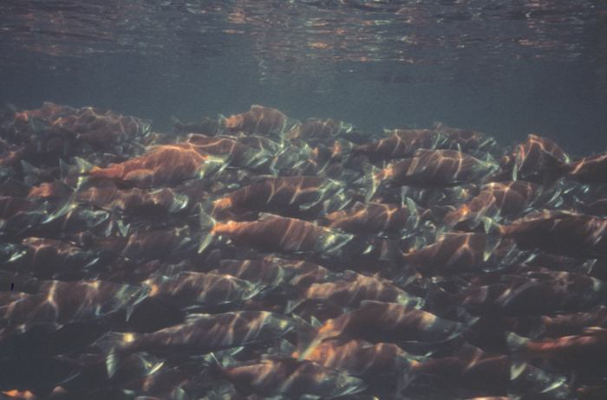
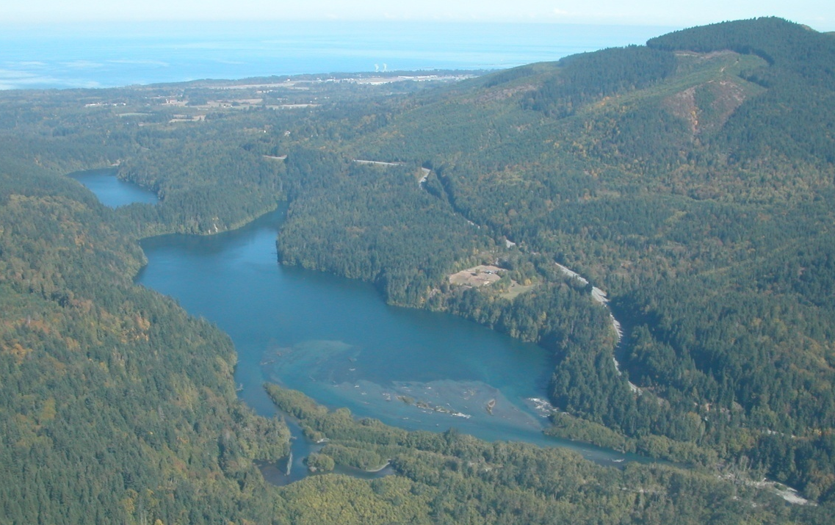
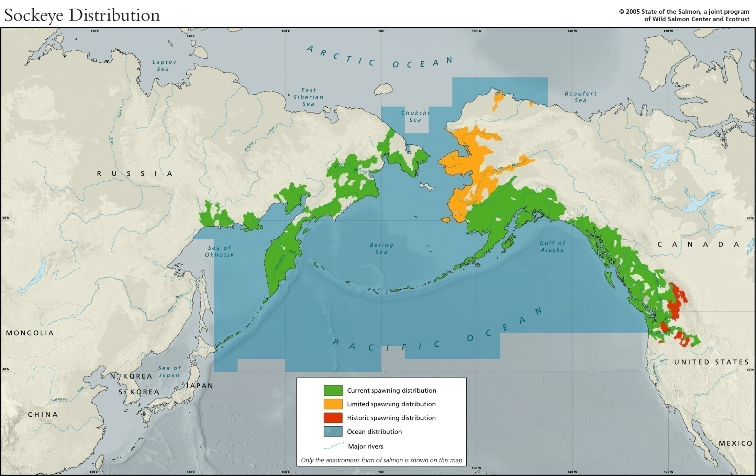
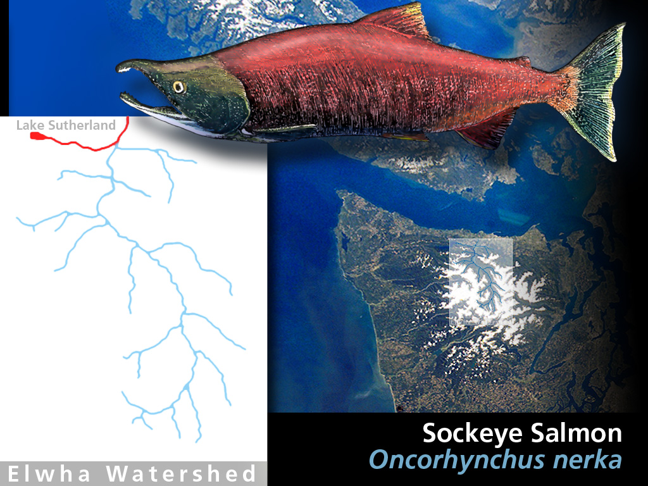
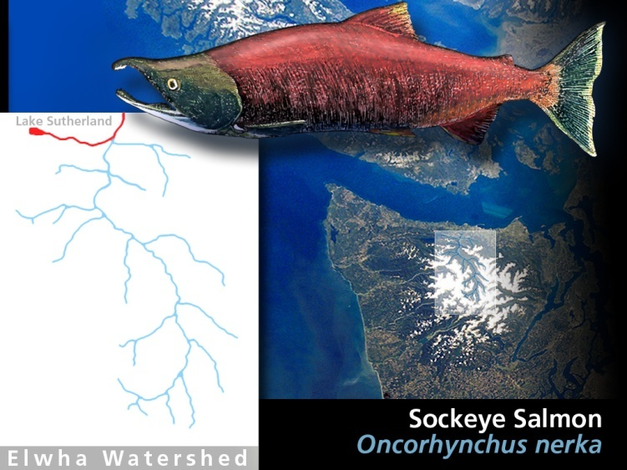
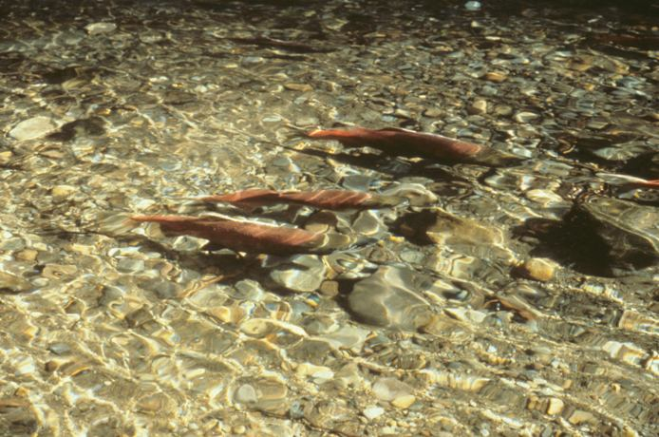
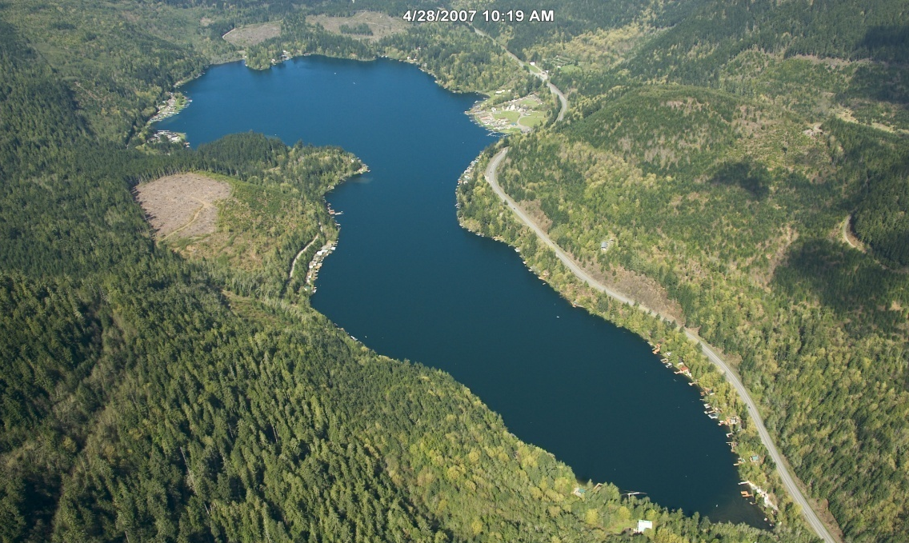
Sockeye
Notes:
Sockeye are unique among salmon, in that they require lakes as part of their developmental cycles. Thus, they tend to be limited to rivers that feed out of lakes. Sockeye can spawn in the mainstem of a river, on the beaches of a lake, or in tributaries that feed into the lake. However, juvenile sockeye will spend between 1-3 years in the lake before heading to the ocean.
Since sockeye are so dependent on lakes, they are able to survive as landlocked forms, called kokanee, when natural events such as landslides block access to the sea or humans build dams and artificial reservoirs. There is a kokanee population in Lake Sutherland above the Elwha dam.

Slide 10
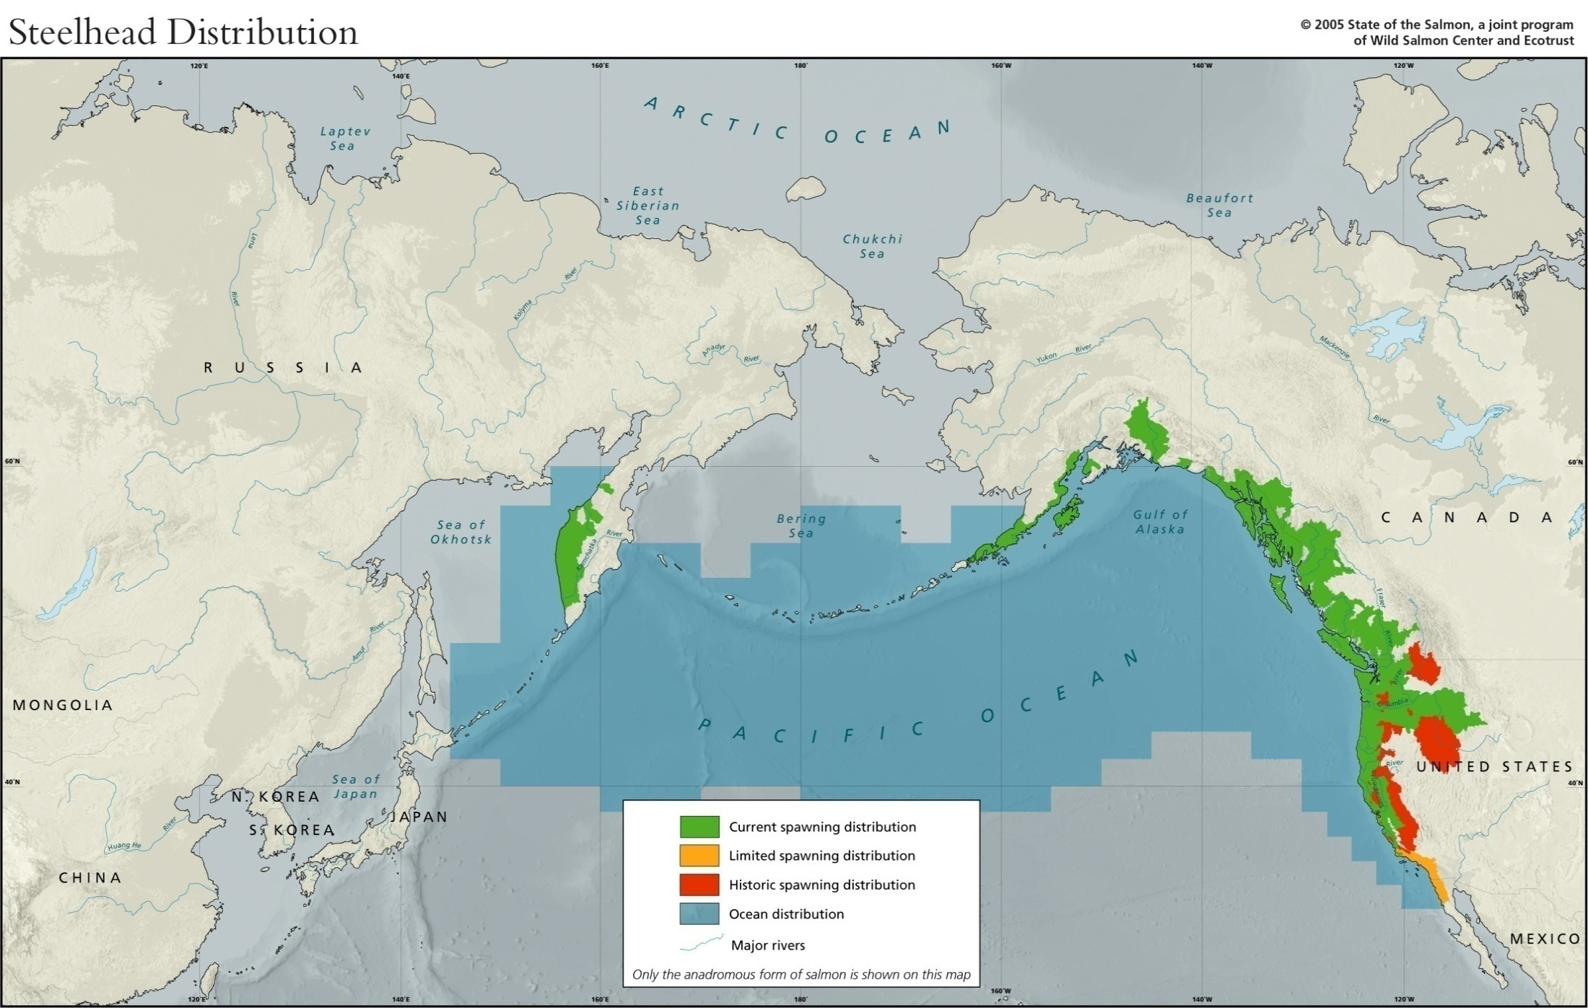
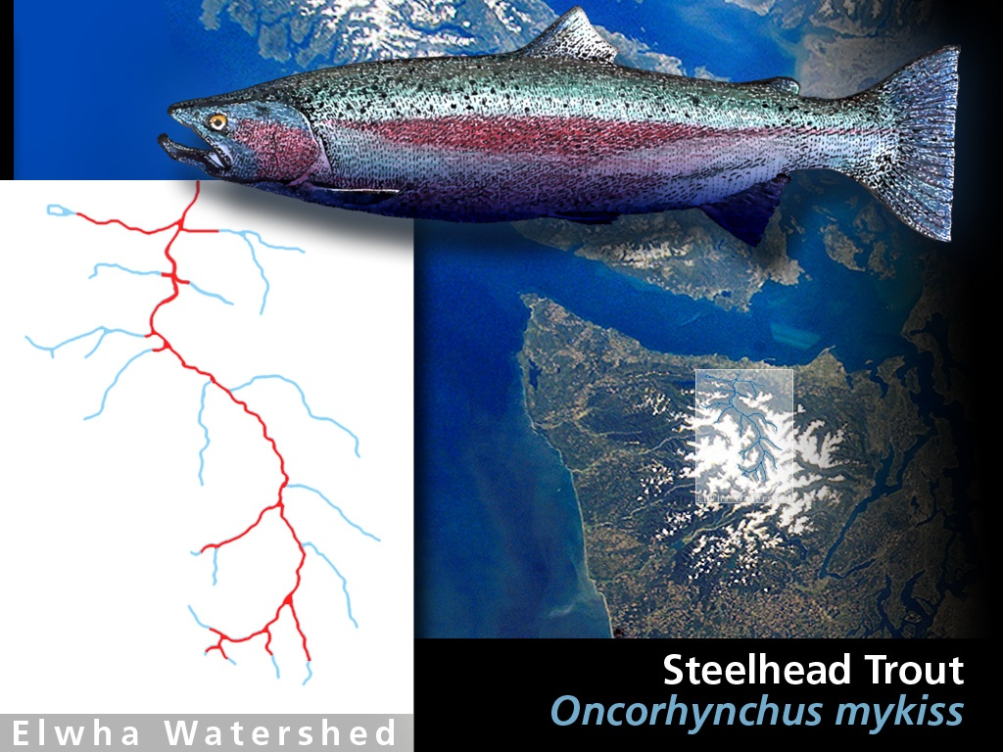


Steelhead/Rainbow Trout
Notes:
Steelhead are anadromous rainbow trout. Rainbow trout are a western North American fish species. However, straying by anadromous steelhead has lead to their colonization of Kamchatka. This probably occurred during the last ice age, when most of the Northwest coast was covered by ice sheets and Kamchatka was not.
There are some unique things about steelhead and rainbow trout. They have the ability to travel far up river drainages and into small tributaries and can jump waterfalls. They can also live in lakes and estuarine environments and they have a higher tolerance for warm water temperatures. This has allowed rainbow trout to proliferate across western North America. During the ice age, with much of their northern rivers covered in ice and cool ocean temperatures extending further south, populations of steelhead colonized rivers as far south as Baja.
Steelhead do not necessarily die after spawning (about 1 in 4 survive), and if they survive will return to the sea. Thus, they can live longer than other salmon, up to 7 years.

Slide 11
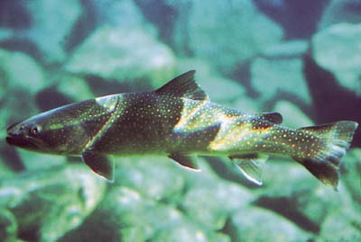
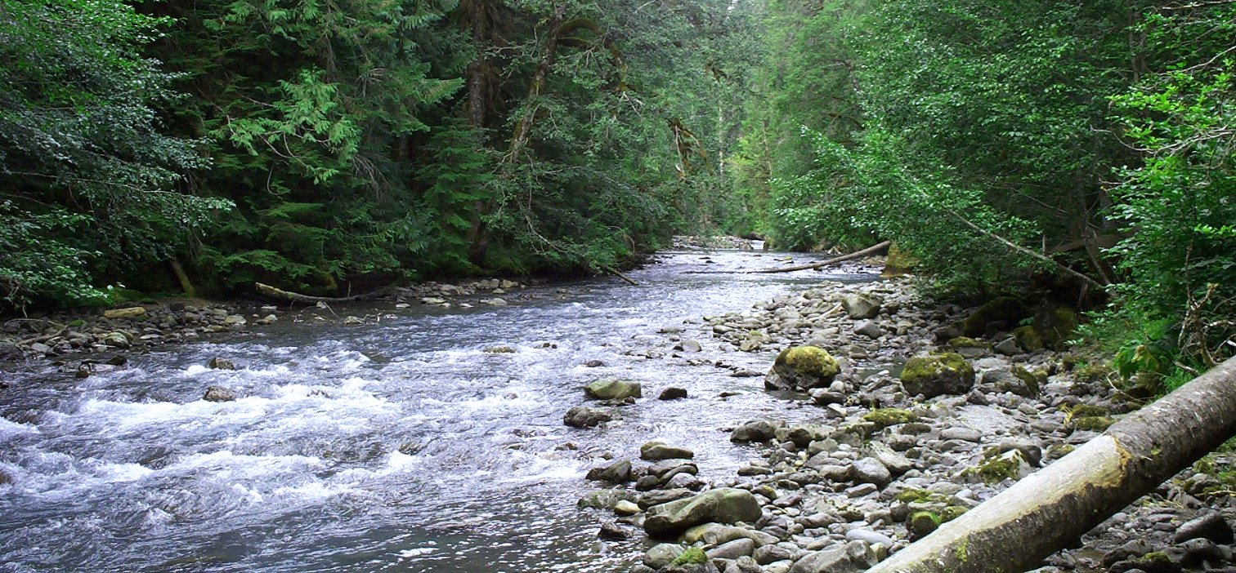
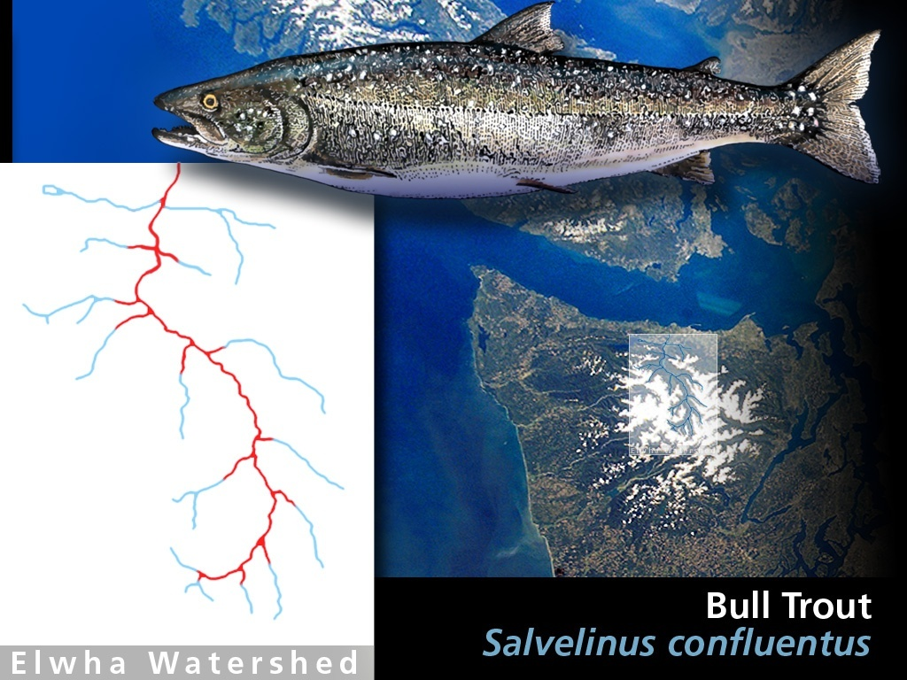
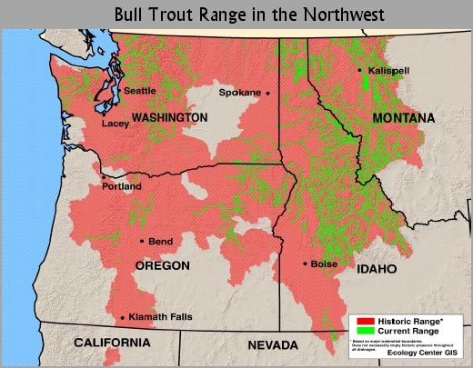
Bull Trout
Notes:
Bull trout are not “salmon” (in that they are not in the genus Onchorhynchus), but rather “char”. Char are a different group of salmonid fish, which include Dolly Varden, arctic char, and eastern brook trout.

Slide 12
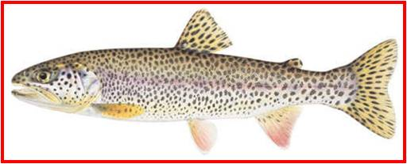
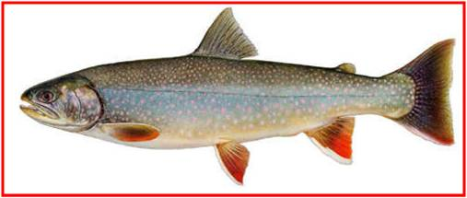
Other Anadromous Trout Species
Coastal cutthroat O. clarki
Dolly Varden Salvelinus malma
Notes:
Coastal cutthroat trout is a species of salmon that has a very flexible lifestyle. It is this evolutionary advantage that allows them to expand and survive in a wide variety of habitats including small isolated streams in desert mountains or migrate into the ocean. Coastal cutthroat trout have survived above the dams, but some will likely return to anadromy when the dams are removed.
Dolly Varden are a char closely related to Bull Trout. They too can be resident or anadromous. They also survive above the dams today.

Slide 13
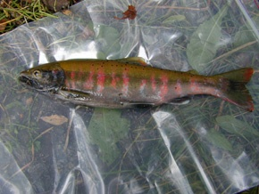
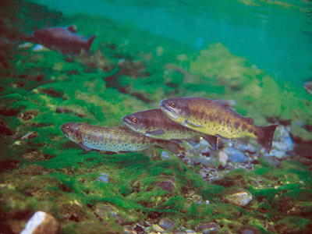
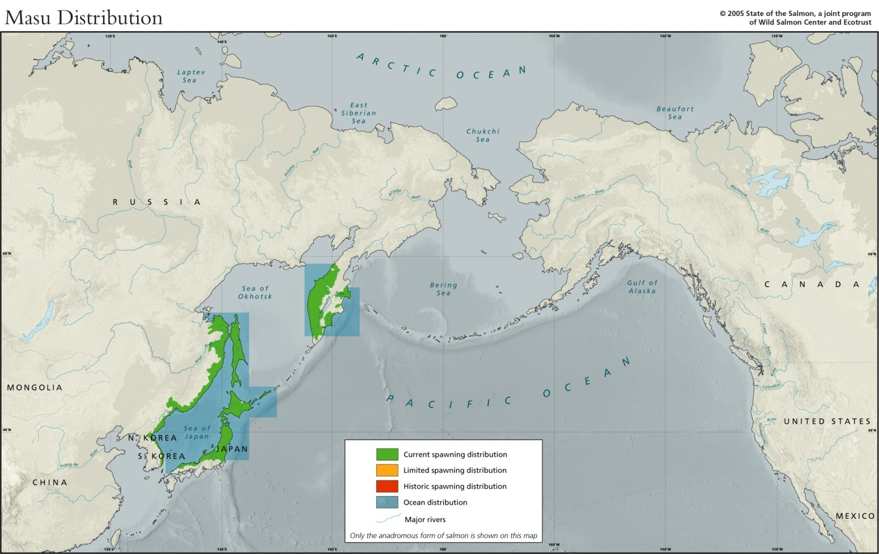
Masu
Salmon
Notes:
There is a sixth species of Pacific salmon. However, it does not occur in the eastern Pacific. It is the Masu salmon, a small salmon that lives primarily in Japan and the Russian far east. One interesting tidbit about the Masu is that there is a landlocked variety isolated in high mountain streams in subtropical Taiwan. Ocean temperatures are far too warm in that region to allow salmon to migrate that far south. It is assumed that during the ice age, changes in ocean currents allowed masu to follow cool waters to Taiwan, but as it warmed they were isolated in the highest and coolest streams. Today there are only about 100 adults left.

Slide 14

This project was made possible in part by a grant from
Washington’s National Park Fund.

