Slide 1
Sediment Deposition At Sea

Slide 2
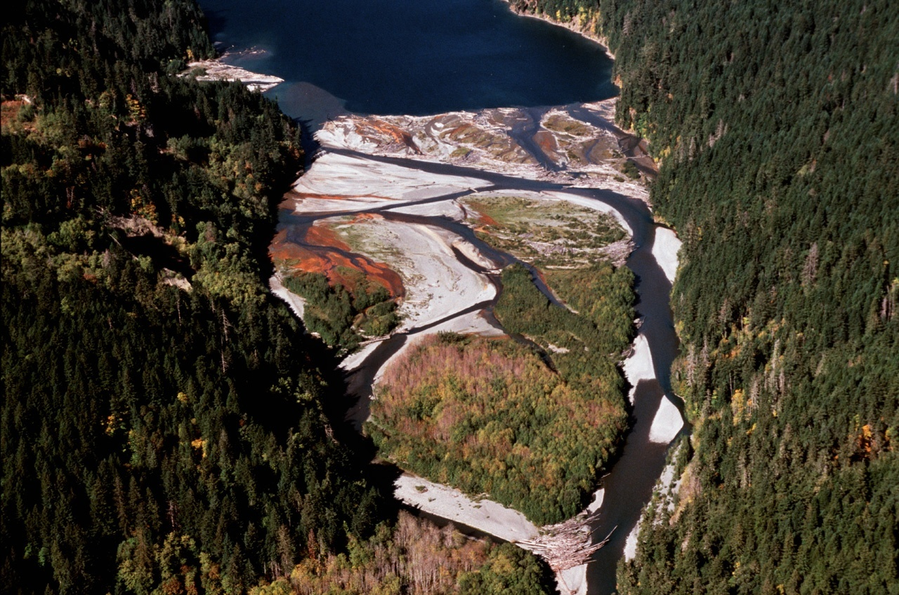
Deltas
Once sediment meets stagnant water on a lake or the ocean, it is deposited in the delta.
Notes:
When a river carrying sediments meets the stagnant water of a lake or the sea, the velocity slows to nearly zero and thus sediment of all sizes will fall out. The accumulation of this sediment forms the delta. Deltas grow outward as more and more sediment accumulates and raises the level of the river bed. Because deltas represent an over-accumulation of sediment, rivers will begin to meander and braid, much like in a wide flat river valley.
As rivers meet the stagnant water of lakes or the ocean, the sediment is deposited. As more sediment is deposited, the river will be deflected by these sediments and will meander widely, often splitting into many channels. Deltas tend to grow outward into the body of water as more sediment accumulates and they grow laterally to the edges of the floodplain as they meander from side to side.
The image here shows the delta at the head of Lake Mills on the Elwha River.

Slide 3
Historic Delta Plains
A river that meanders over a large area over thousands of years can form large delta plains.
Port
Williams
Notes:
A large river depositing sediment over thousands of years can form large deltas. Sections of the delta which have not seen the river flowing over it for many years will compact and stabilize, with vegetation taking over vast stretches. While susceptible to being eroded by the river at a future time, these delta plains can last hundreds of years in this stable state.
Delta plains have often been highly sought after by human communities for farming, due to the generally flat terrain and nutrient-rich fine soils they contain. But, because they run the risk of flood events and river meandering onto their properties, people often build levees to contain the river within its present channel to protect again floods.
The image at left is the Elwha delta plain. The Elwha river is constrained to flow to the west side of the delta due to levees build to protect the Elwha reservation village in the center of the plain.
The image on the right is the Dungeness Valley, an ancient delta plain of the Dungeness River. The river is now constrained by levees to the center of the plain. But, at one time it flowed as far east as Port Williams. With some 25,000 people living in the Dungeness Valley, it is important to keep the river in its current channels.

Slide 4
River-Dominated Delta
Notes:
In places where the sediment load is very high and the wave action at sea is relatively low, the delta will expand out into the body of water in what is called a river-dominated delta. Above is the Mississippi River delta in Louisiana, one of the most distinctive river-dominated deltas in the world.
Notice the sediment levees that have formed on the river banks. This constrains the river, causing it to deposit sediment further out and thus it expanded seaward.
The next image is the Skagit River delta. Notice how it has grown laterally across the floodplain and has deposited sediment under the water level. When the tides recede, channels are carved in the sediment by the flowing river. Then when the tides move in, those channels are submerged, but remain obvious through the shallow clear water. Eventually, with enough sediment, the entire area to Whidbey Island at left will be connected by land.

Slide 5
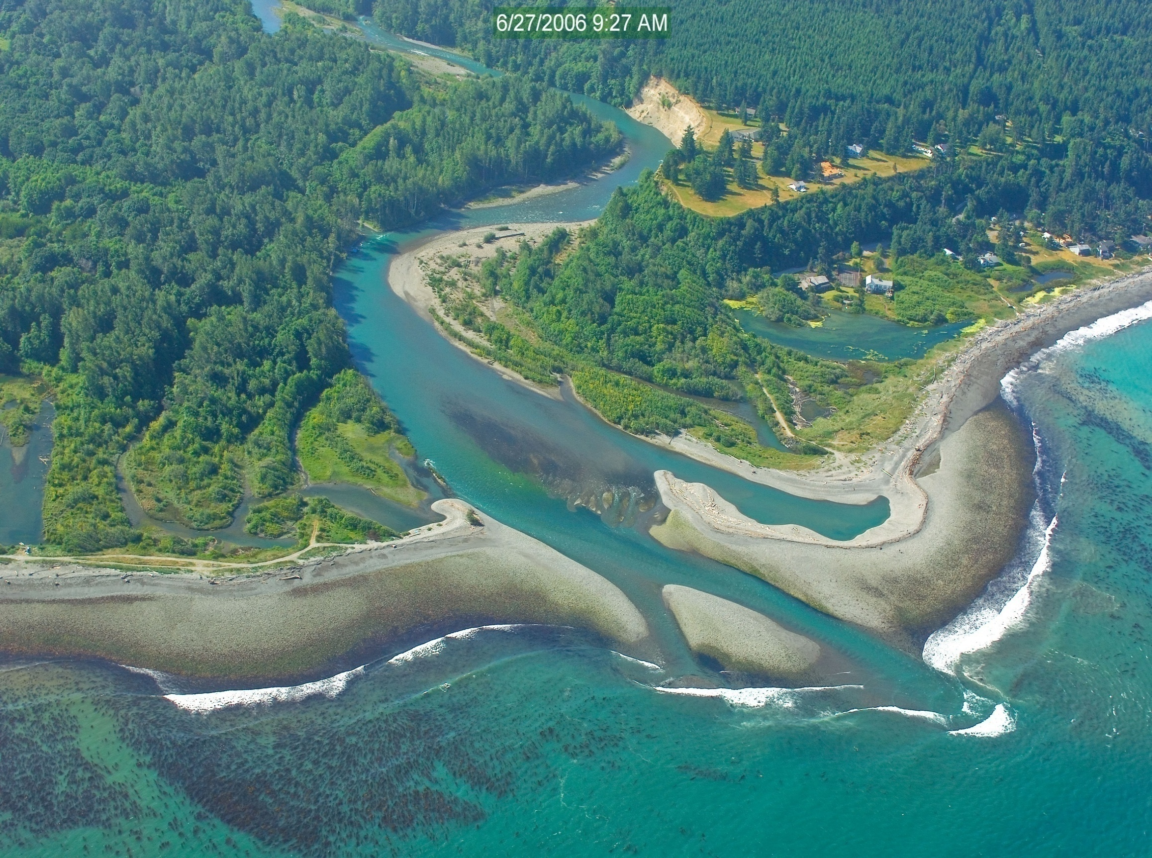
Wave-Dominated Delta
Notes:
A wave-dominated delta is one in which strong wave action and currents erode and transport sediment away from the delta as fast or faster than the river deposits it. In these cases, the deltas often form lateral sandbars across the river with an estuary behind it. The sediment that is transported will often be deposited down current to form long sandy beaches some distance away from the delta.
The image above is at the mouth of the Klamath River in northern California.
The next image shows the Elwha river delta. It used to be a more river-dominated delta, but the dams have blocked sediments from reaching the mouth. Thus, erosion by wave action has been removing fine sediment from the delta, causing it to shrink and turning the area from sandy beaches to rocky shores. This has had an effect offshore as well, as sandy bottoms favorable to eel grass beds have been replaced by seasonal kelp stands on the rocky substrate.

Slide 6
Longshore Drift
The waves arrive on the Dungeness Spit at an angle, which is indicative of the direction of the longshore drift. This wave action picks up sediment and transports it down current.
Notes:
Longshore drift is the acquisition and transport of sediment from river deltas and eroding beaches and its redeposition further down current to form specific ocean sediment depositional features. The direction of the drift is based on the local prevailing winds, tidal movements, and ocean currents. While the current direction and intensity can change from season to season, over a series of years there is a tendency for these currents to have an average effect in one direction. In the Strait of Juan de Fuca, the average direction of the longshore drift is to the east.
The image on the left shows the waves approaching the beach at the Dungeness Spit at an angle slightly to the east. This is the feature most easily seen regarding longshore drift from the ground. These angled waves pick up sand, pull them off shore a few feet, and then redeposit them a little further east each time.
The sediment that comes out of the Columbia River is transported north and is deposited on the Long Beach peninsula. The length of the peninsula gives an indication of how much sediment comes out of the Columbia river and the extent of the longshore drift in the area.

Slide 7
Sand Bars and Estuaries
Sandbar
Estuary
Notes:
When longshore drift deposits sediment in arms that extend out across the mouths of rivers or along the shore, they form sand bars. When this occurs, an area where freshwater and saltwater mixes will form behind the sand bars, forming an estuary. Estuaries are rich in biodiversity and productivity and are important rearing areas for small juvenile fish, because they provide shelter from strong waves, currents, and large predators.
Smaller creeks can be completely enclosed by this moving sand, and their final flow into the sea will occur underground through the sand bar. Larger rivers usually have enough velocity to maintain an active channel through the sand.
This image is of the Klamath River delta and estuary in northern California. The Klamath river has enough velocity to maintain its narrow channel through the sand bars.

Slide 8
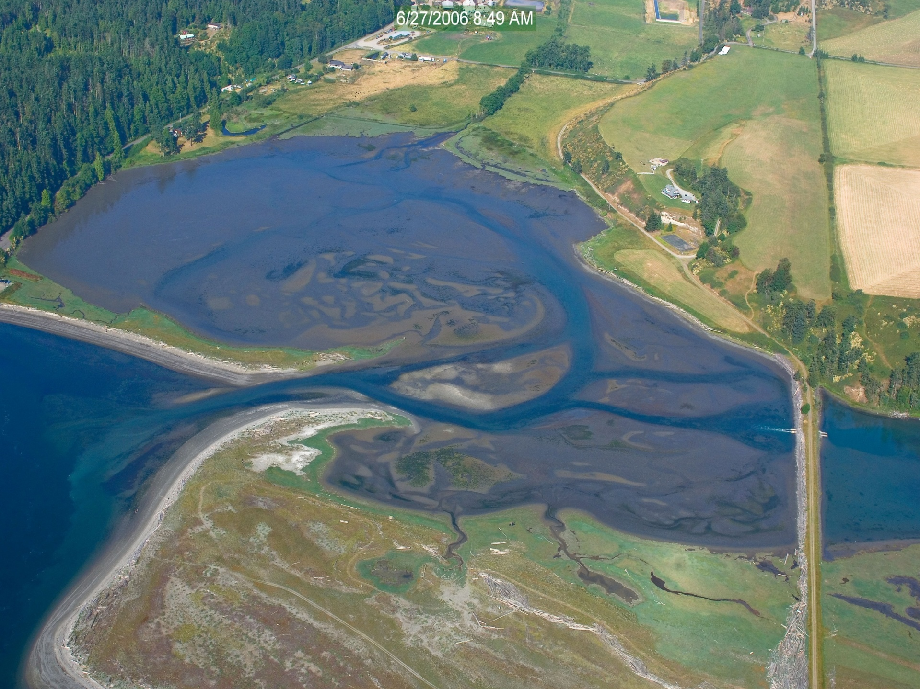
Mudflat Estuaries
Notes:
In areas where significant quantities of sediment have filled basins, the tide may expose this sediment at low tide, but resubmerge them at high tide. These areas are mudflats. Mudflats are full of nutrients and can have extraordinarily high levels of biodiversity and productivity from bacteria to shellfish to juvenile fish and crustaceans to shorebirds.
This image is the mudflat estuary at Port Williams, WA. It was the ancient former outlet of the Dungeness River and as such has a lot of sediments that have accumulated behind the larger sand bar deposits from longshore drift.

Slide 9
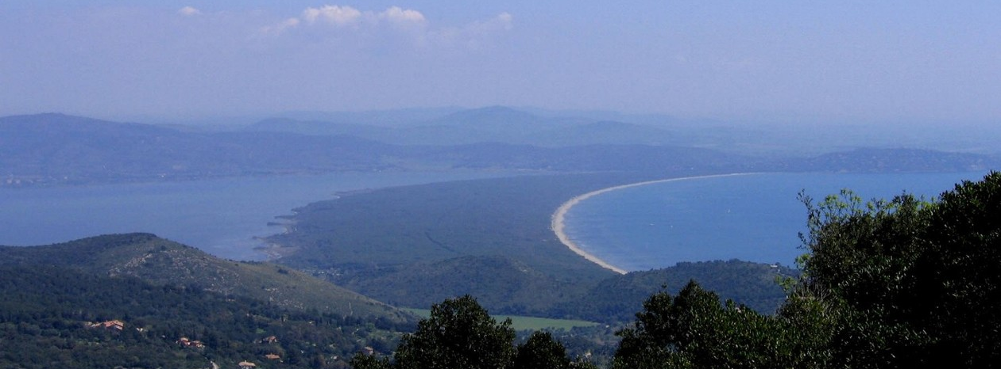
Spits and Tombolos
Notes:
When longshore currents deposit sediment in very long sand bars along the shore, they are called spits. Spits can grow as much as 500 feet a year. A Tombolo is a sandbar or spit that connects from the mainland to an island.
Spits and sand bars are very common on the eastern seaboard of the U.S. because of large quantities of sediments from the ancient eroding Appalachians and weak erosional action from waves due to the prevailing winds blowing off shore.
Spits and tombolos tend to be limited on the west coast to areas of high sediment inputs such as near river deltas and in sheltered areas away from wave action, such as in the Puget Sound.

Slide 10
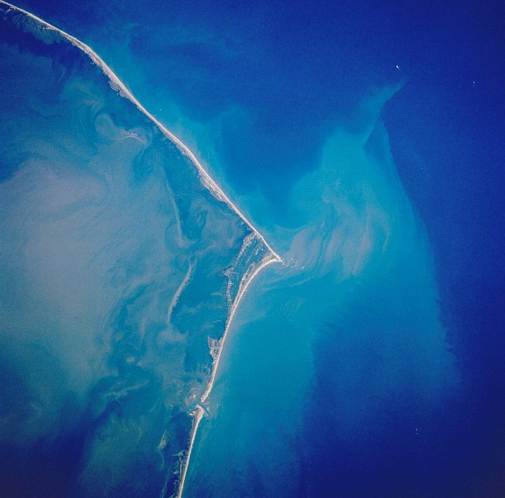
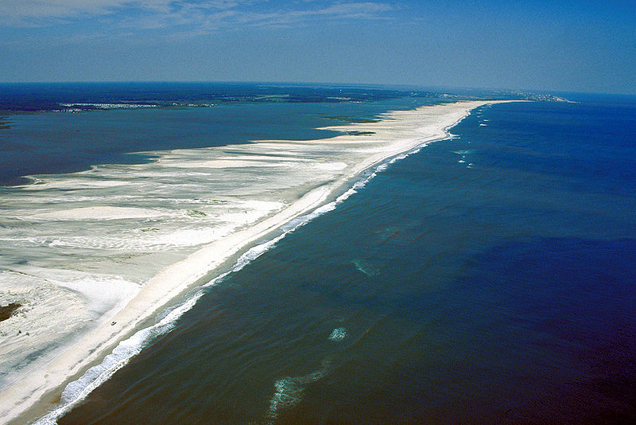
Barrier Islands
Notes:
Barrier Islands are similar to spits and sand bars, except that they are completely disconnected from the shore. Barrier islands are very common on the eastern seaboard of the United States, due to high quantities of sediment from the ancient eroding Appalachian mountains, flat topography along the coast, and prevailing winds that blow off shore, which limits the wave action that could erode these sediment deposits. Barrier islands are virtually non-existent on the west coast because the wave action is too harsh and the substrate is newer and rockier, which means less available sediment to be transported by longshore currents.
Like spits and sandbars, barrier islands tend to have little vegetation, often not much more than grasses and dune plants, because of the sandy soils that drain moisture so rapidly and the susceptibility of the land to erode due to strong winds and wave action.

Slide 11
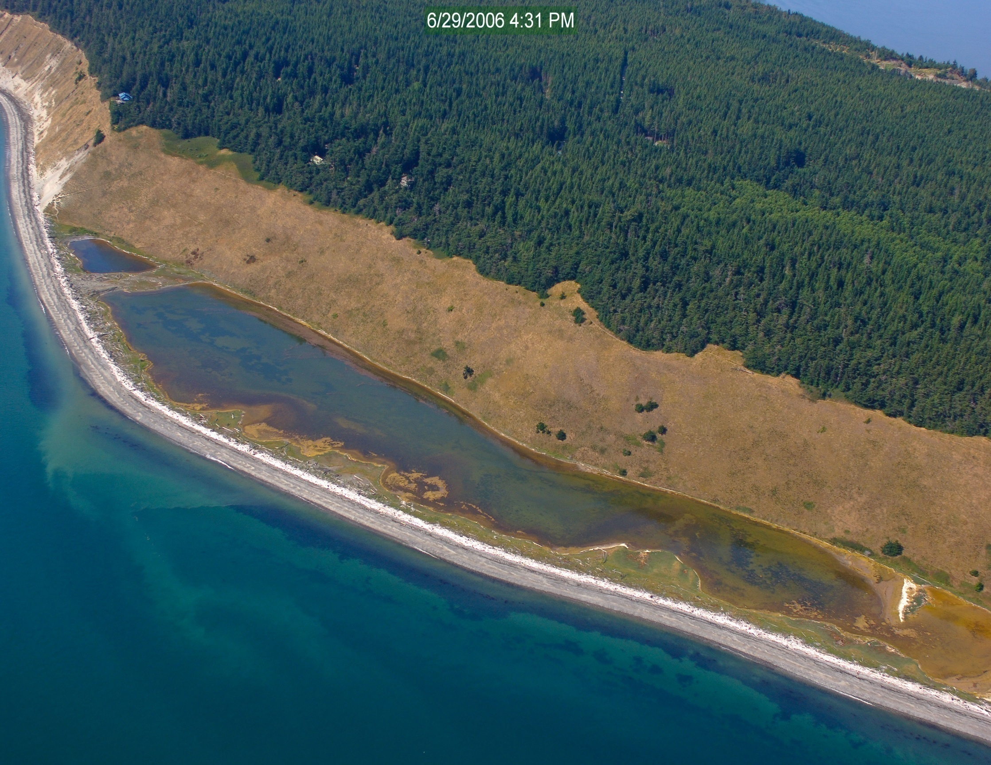
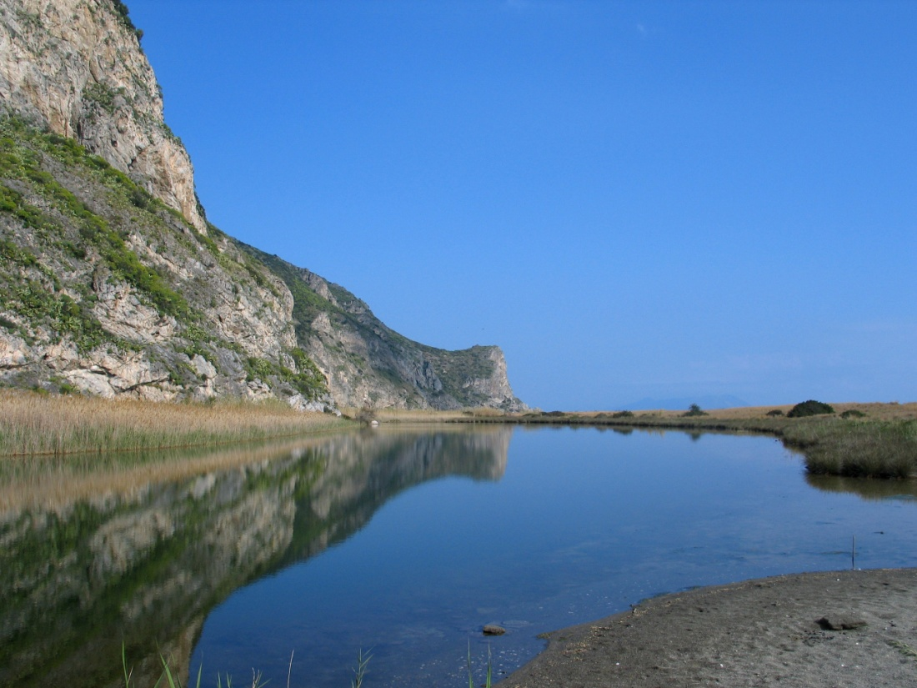
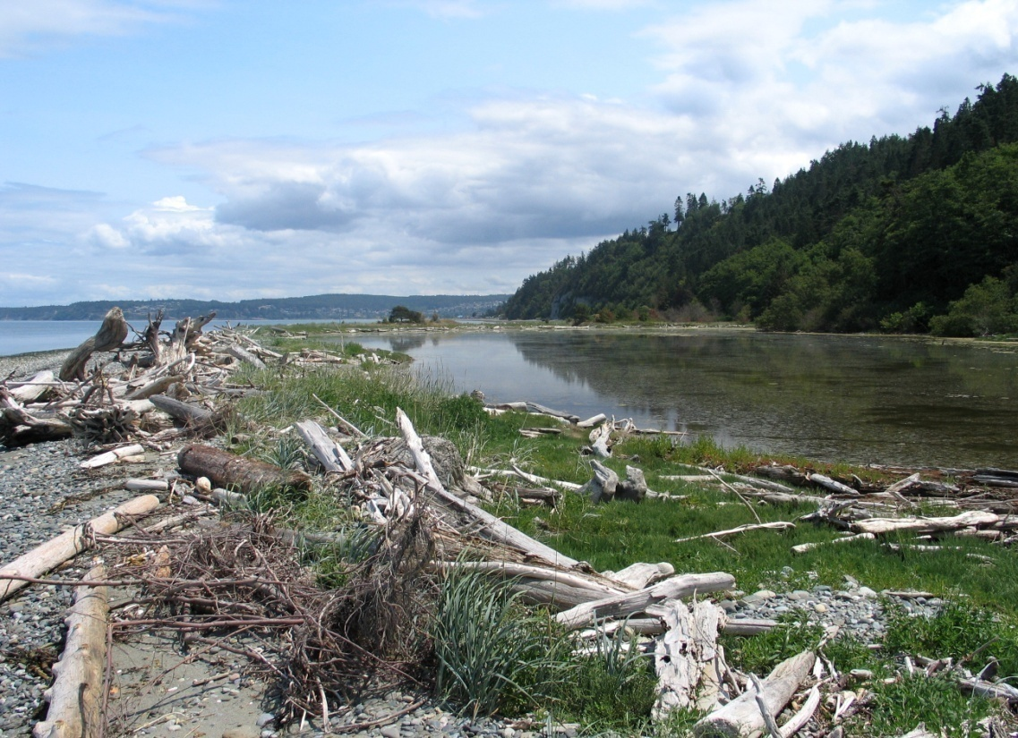
Lagoons
Lagoons are brackish or saltwater pools that are enclosed or semi-enclosed by sand bars, spits, or barrier islands.
Notes:
Lagoons are brackish or saltwater pools that form behind sand deposits. Because they have virtually no currents the water can stagnate, algae growth can explode, and temperatures can get quite warm. All of this results in higher acidities and potentially low oxygen levels.
However, in other cases, especially where there is adequate outlets to the sea to maintain lower temperatures and higher oxygen levels, lagoons can contain high biodiversity and high invertebrate productivity, which become excellent locations for juvenile fish to develop and feeding spots for shorebirds.
The image on the left is the lagoon at Tindori in Sicily. The image on the right is a small lagoon on the Strait of Juan de Fuca formed by a sandbar with driftwood.
The fade in image is a lagoon and coastal bluffs at Whidbey Island, WA

Slide 12
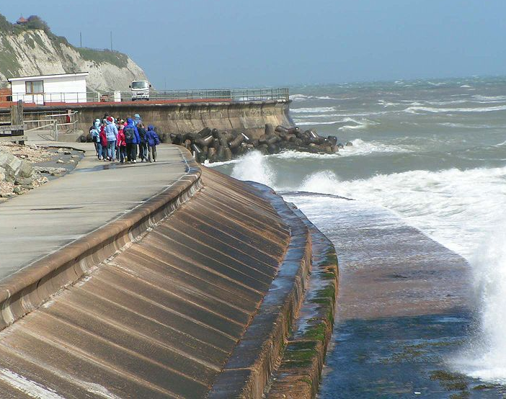
Breakwaters and Sea Walls
Structures used absorb and control the erosive action of waves
Notes:
The first image shows a series of breakwaters in Italy. These are designed to absorb much of the energy of approaching waves, so that the velocity and erosive power on the actual shoreline are significantly less. However, they do let the water through.
The second image shows a seawall in Britain. Seawalls are built up along the shore to absorb the remaining wave energy and to prevent waves from eroding the shore and pushing up onto land. Seawalls and breakwaters tend to be used most often in coastal communities where buildings and roads are right on the shore and are susceptible to wave damage.

Slide 13
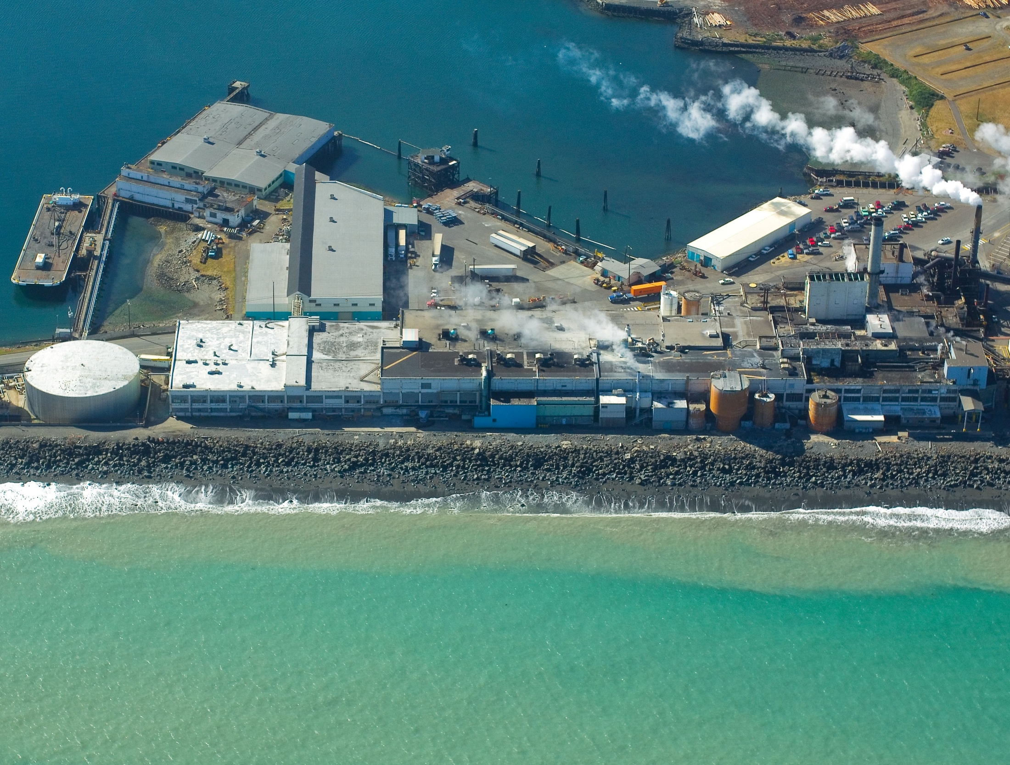
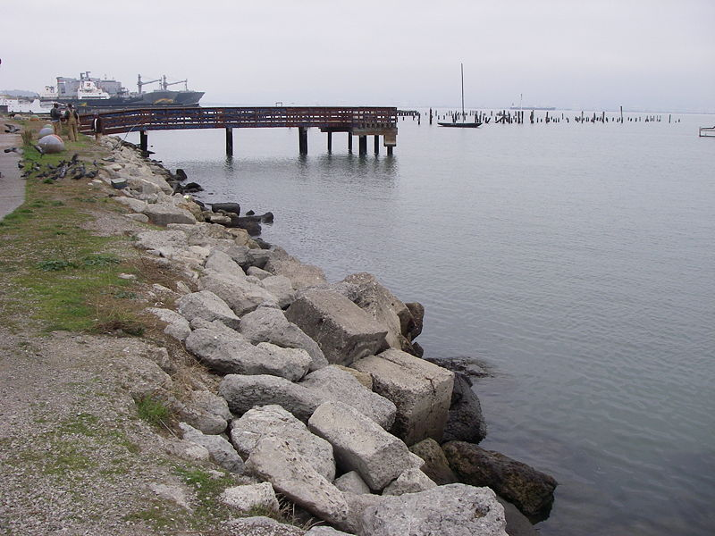
Rip-Rap
Piles of large rocks lined up on shore to prevent wave erosion.
Notes:
The left image is Ediz Hook in Port Angeles, WA. Rip-rap are piles of stone laid out on a beach or shoreline to absorb wave energy and prevent erosion of soil. Ediz Hook was built naturally by longshore drift of sediment from the Elwha River and the nearby bluffs. But, the presence of the Elwha dams and securing the bluffs from erosion resulted in less sediment being deposited and wave erosion removing the sediment that was present. Without the rip-rap absorbing the wave energy and holding the substrate in place, Ediz Hook would disappear.
The fade in image shows the Pulp Mill in Port Angeles being protected by the rip-rap.

Slide 14
Jetty
Notes:
A jetty is a long structure that juts out into a body of water designed to deflect sediment and prevent it from accumulating in shipping channels. These two jetties at the mouth of the Columbia River protect the mouth from wave action and keep Columbia river sediments traveling further out to sea and being deposited in deep water, rather than accumulating at the mouth. The jetties also prevent longshore drift from the south from depositing sediments in the vicinity the mouth of the river. These jetties save the effort of constantly dredging shipping channels near the mouth.
While jetties are useful for protecting local communities from wave action and keeping shipping lanes open, they can have major effects down current. At the mouth of the Arno river in Italy, the jetties have resulted in a lack of sediment being deposited to the north. Thus, the beaches have receded significantly back over the years. In fact, the erosion is so bad, they have put in a series of small jetties along the eroding shore, whose design is to actually capture and store sediment that is being transported north.
Notice that the sediments have piled up on the southern side of each small jetty.

Slide 15
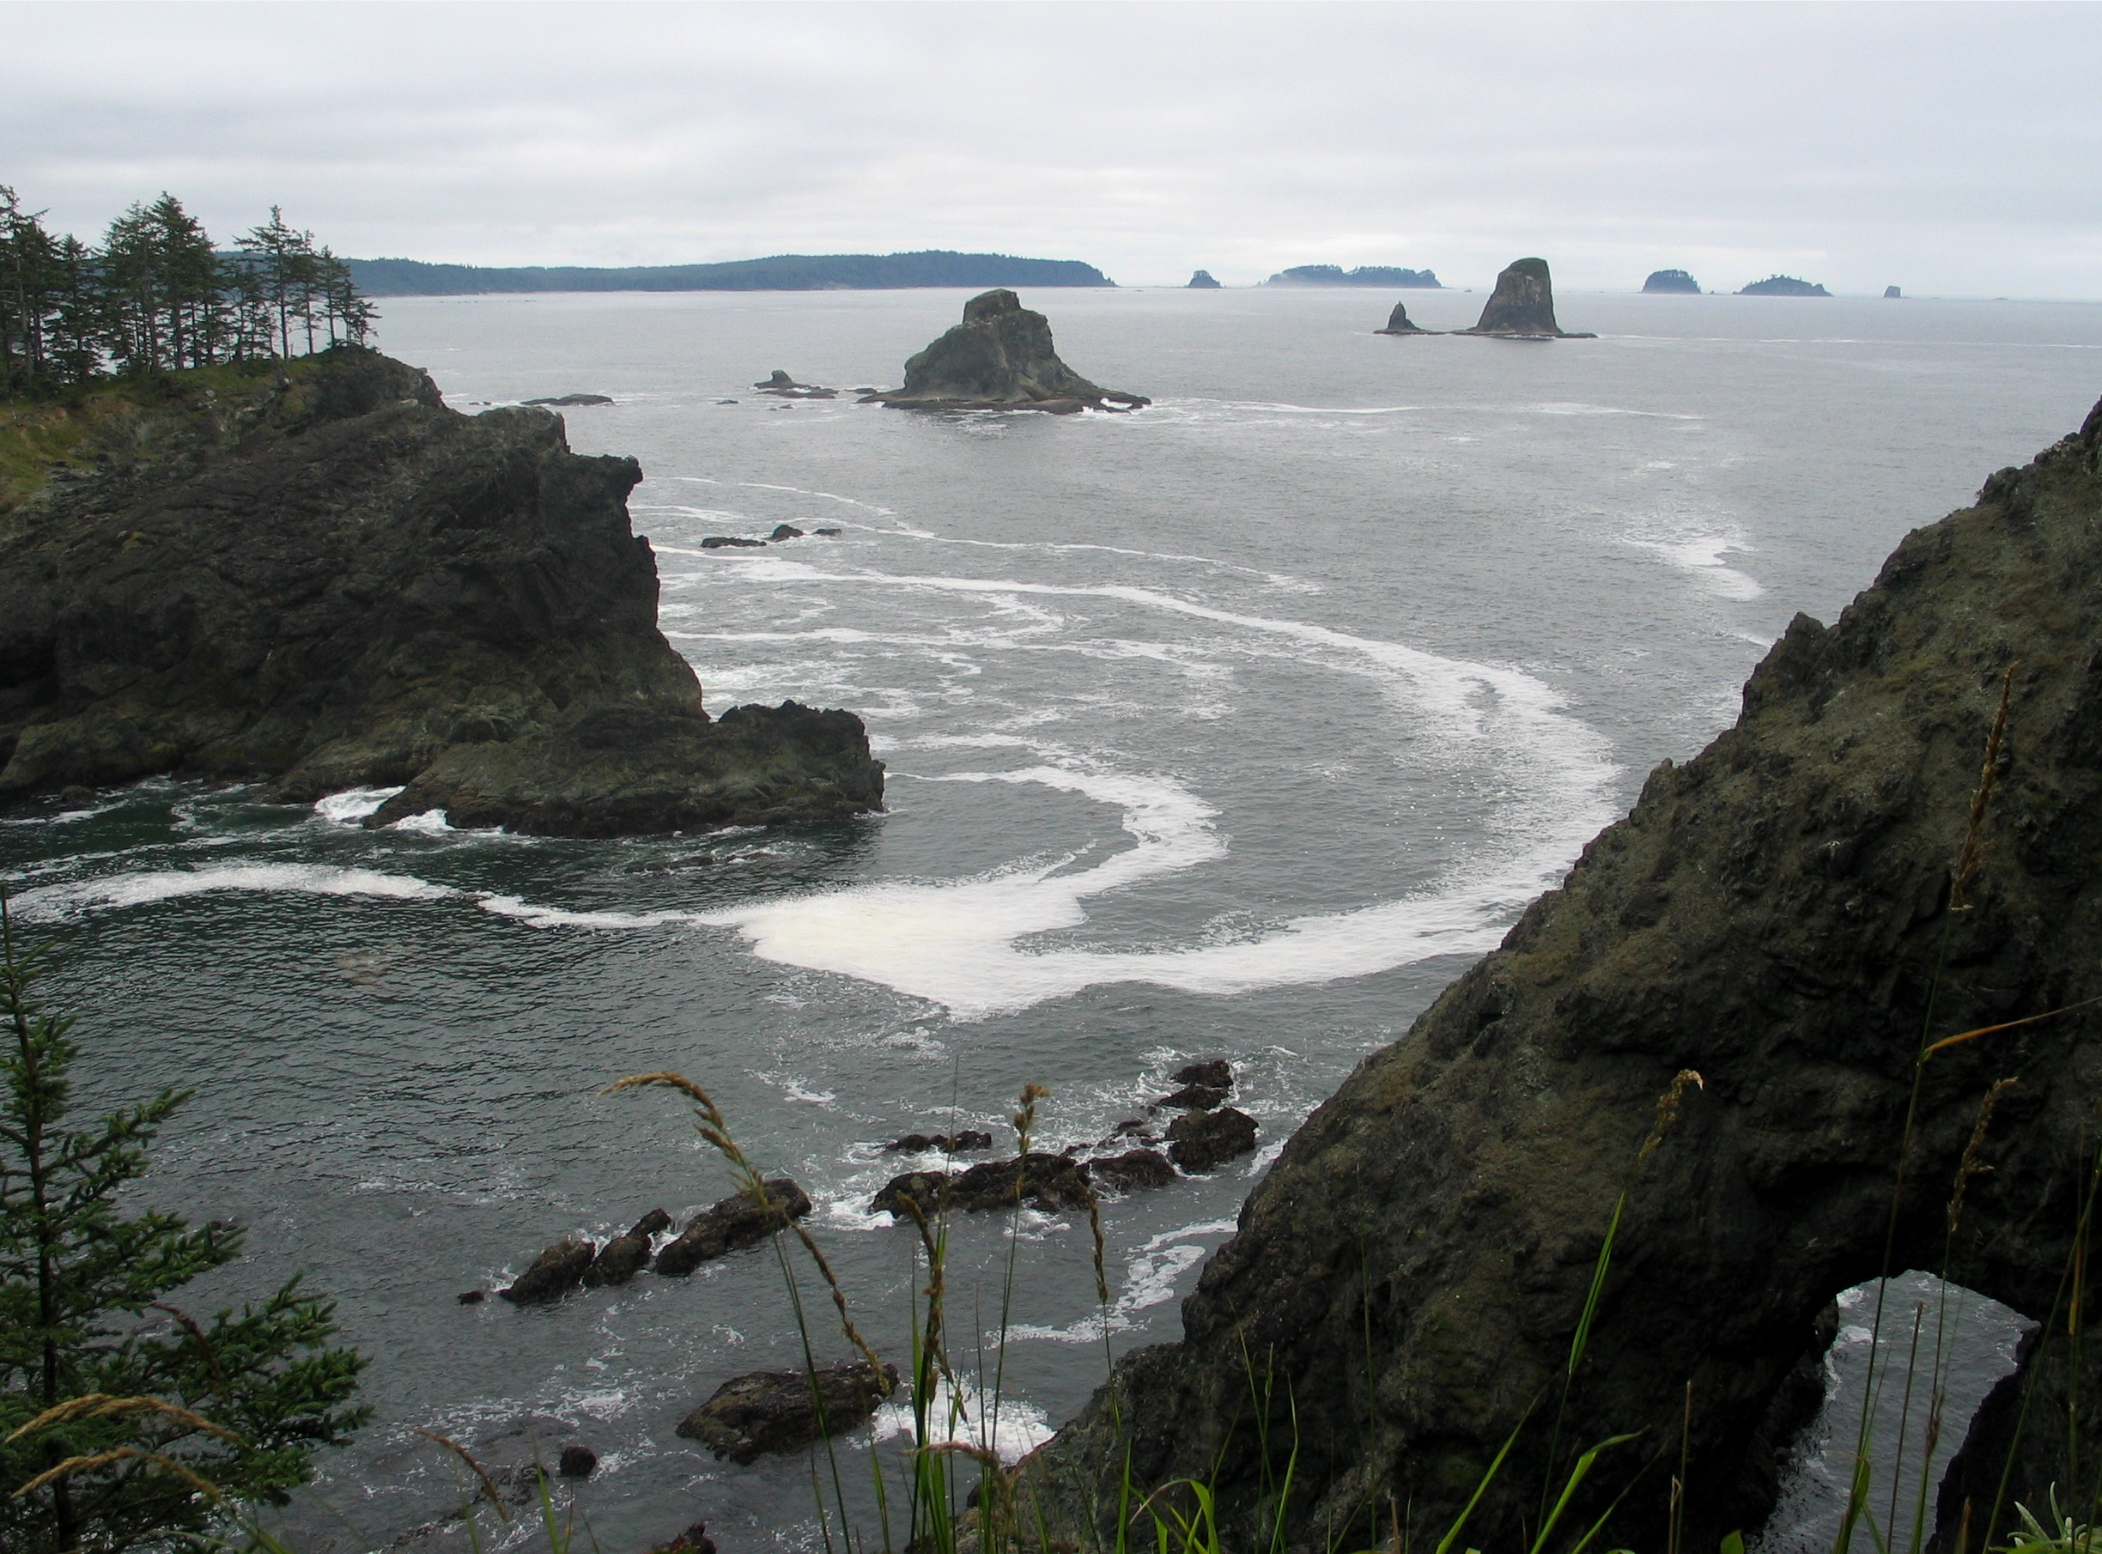
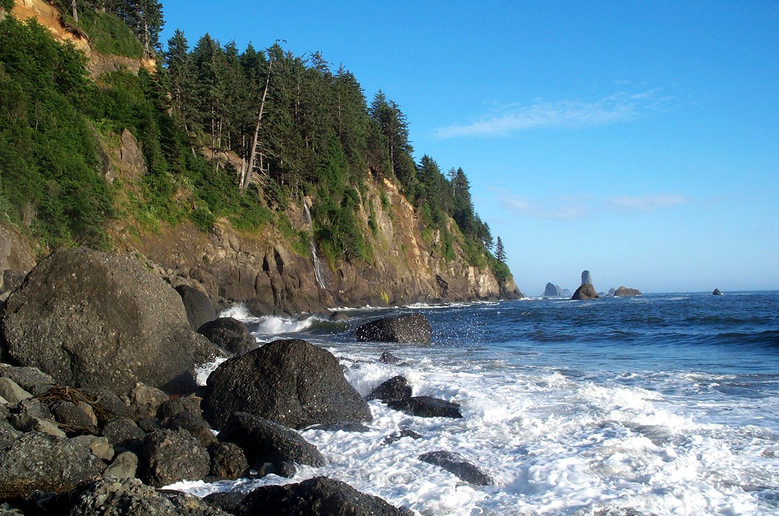
Headlands and Sea Stacks
Notes:
A headland is a rocky promontory that juts out into the sea.
A sea stack is a rocky island that was formerly part of a headland, but ocean wave action have eroded the headland, leaving just small rocky islands behind. Sometimes the sea stacks can be miles off shore, indicating the location of the former seashore.
The first image is a headland and sea stack at 3rd beach near La Push, WA. The second image is Taylor Point headland with a waterfall at 3rd beach. The third image is the view from the top of a headland at Point of Arches looking out at several sea stacks and headlands. Notice the sea arch below caused by the erosion of the headland. Eventually, the arch will collapse, forming a new sea stack.

Slide 16
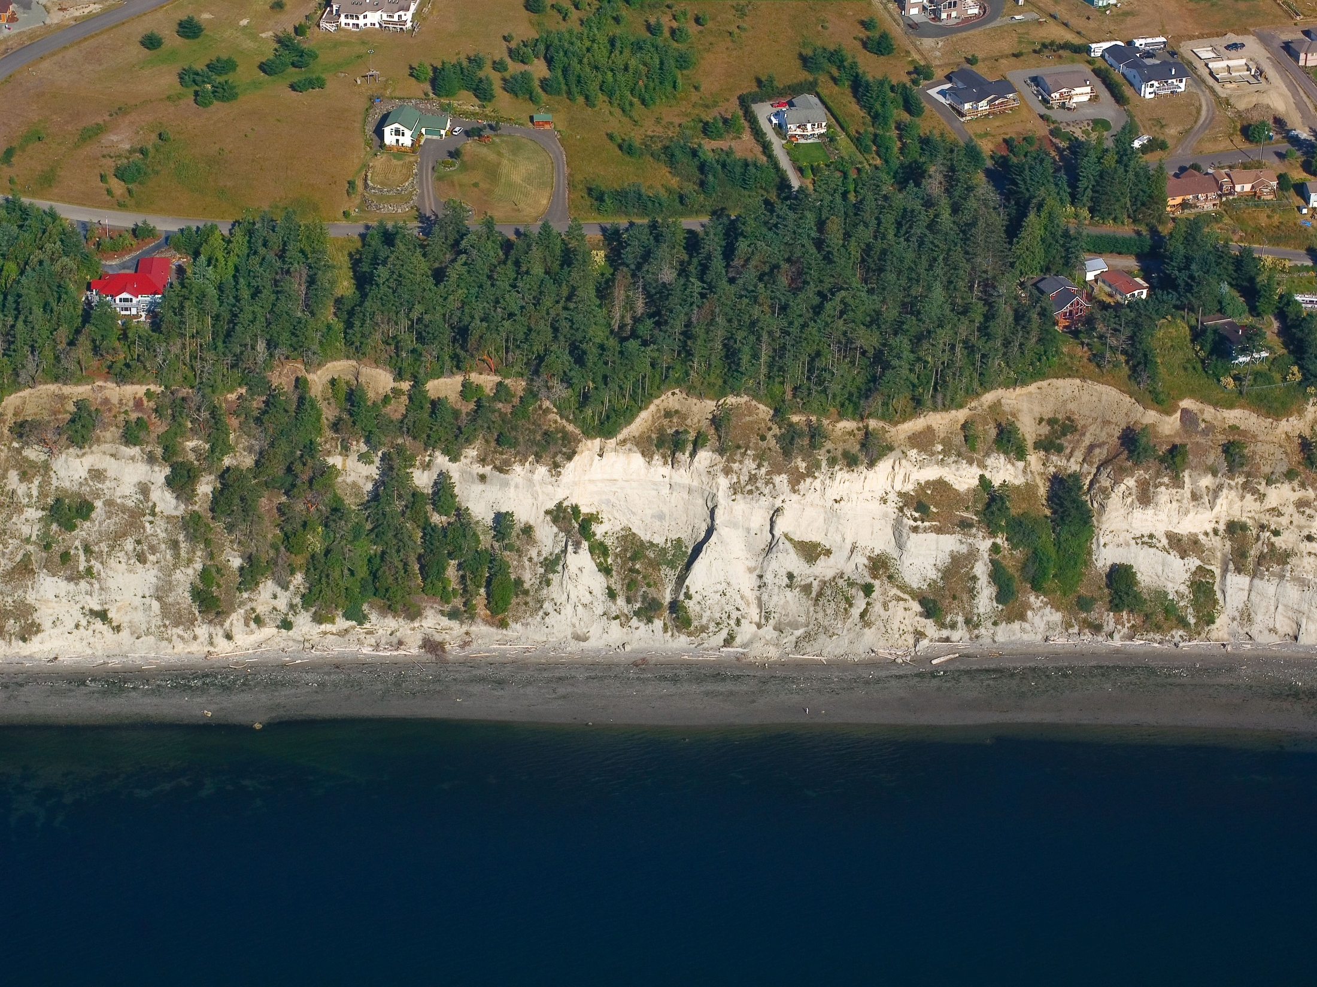
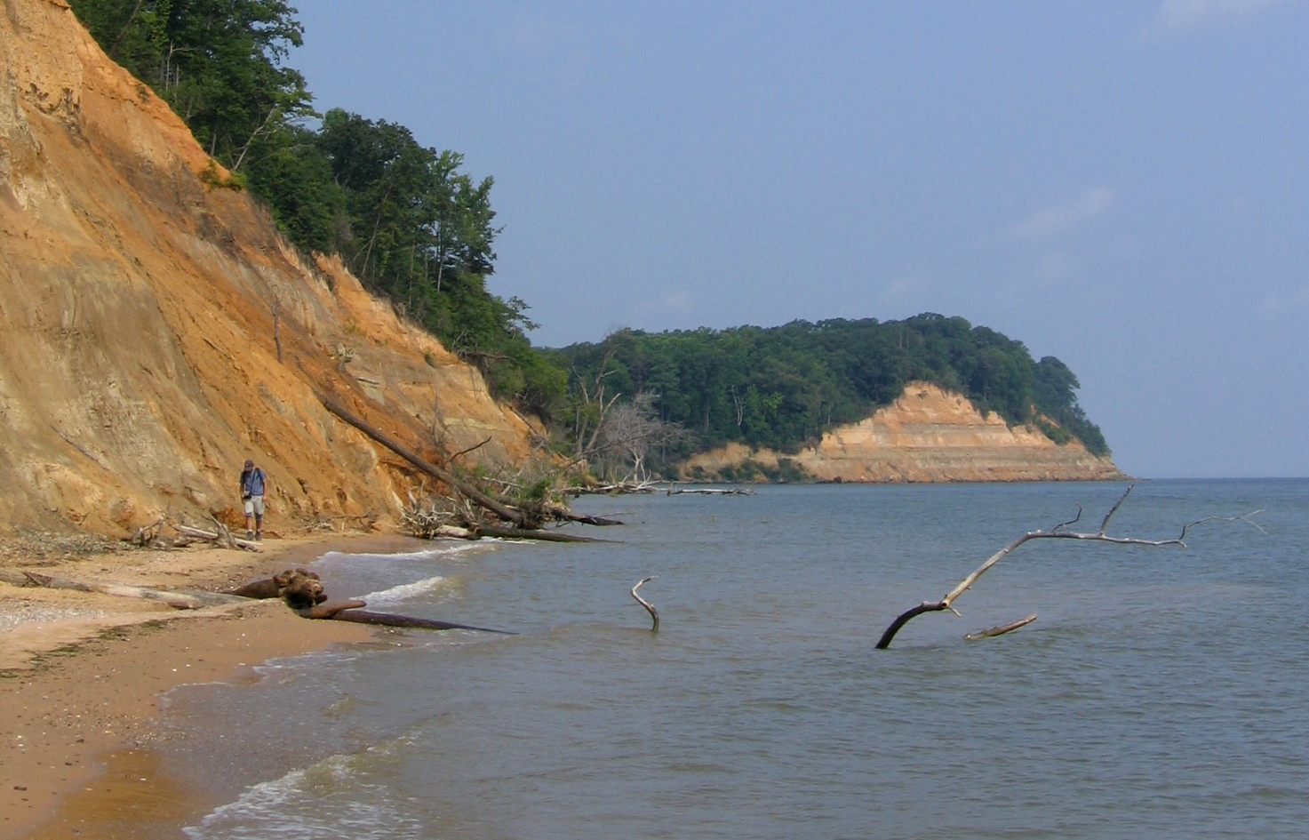
Shore Bluffs
Notes:
If material is not rocky, but rather is made of less consolidated soils and sediment, bluffs can form along the shore. These bluffs are often steep, as ocean waves eat into the base of them and remove sediment. During winter storms, entire sections of the bluffs can collapse into the sea, as waves undercut and over steepen the base. As they collapse, the bluffs are constantly receding. Thus, it is not wise to build homes on the edge of bluffs, as your property will shrink smaller and smaller each year, until your house falls into the sea.
Bluffs represent an important part of the sediment transport system on a coast. Often, erosion along the bluffs can account for more longshore drift sediment than rivers.
These bluffs are located at Calvert Cliffs, Maryland.
This image is located along the Strait of Juan de Fuca in Washington. The entire Puget Sound area is made of bluffs very similar to these. They were formed when glaciers deposited thick layers of sediment during the ice age. As such, they are weakly held together and easy eroded. These homes will see their properties shrink over the years until the house itself will drop into the sea.

Slide 17
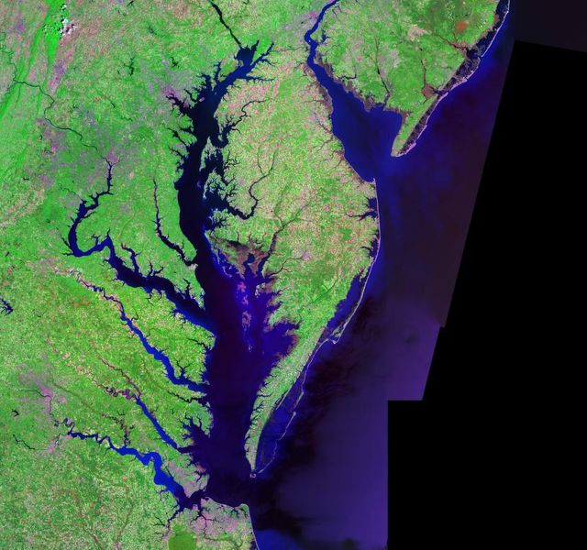
Ria (Flooded River Valleys)
Notes:
During the Ice Age, sea level was some 300 feet lower and many miles further out to sea than it is today. The rivers flowed further and eroded deeper into the substrate than they do today, on their way to the sea. So, when the seas rose again, it flooded into all of those deep river valleys, leaving wide brackish tidal inlets and shallow bays.
The Chesapeake Bay (left) is one of the largest and most famous rias (Delaware bay is another ria to the north). Chesapeake Bay contains hundreds of flooded river valleys branching in all directions.
To the right, Grays Harbor in Washington is a ria of the flooded Chehalis River valley that once flowed violently as it drained the melting ice of the Puget Sound Ice Lobe.

Slide 18
This project was made possible in part by a grant from
Washington’s National Park Fund.

