Slide 1
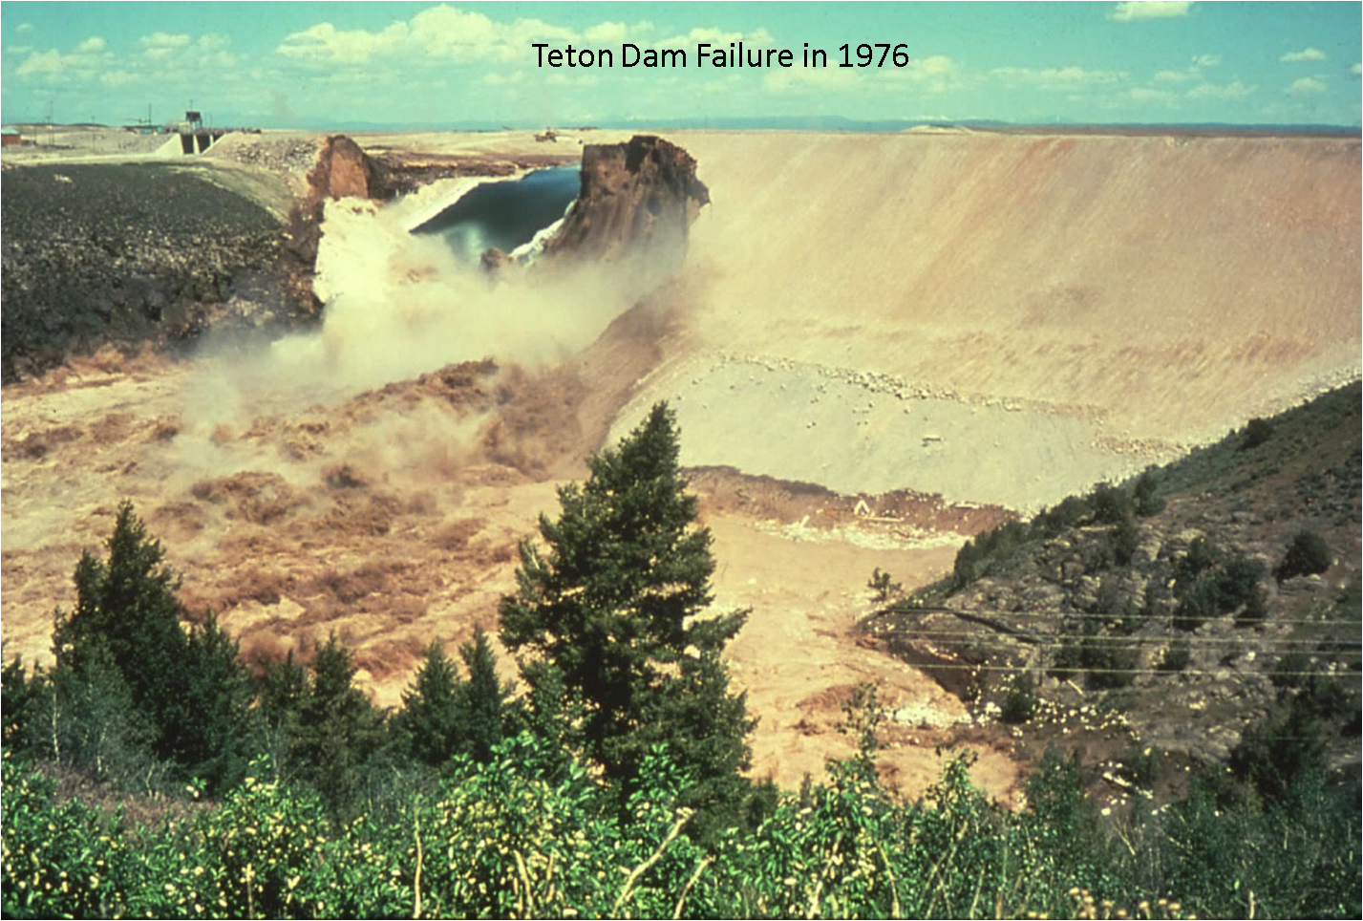
The Breaching of a Dam
The Earthen Dam

Slide 2
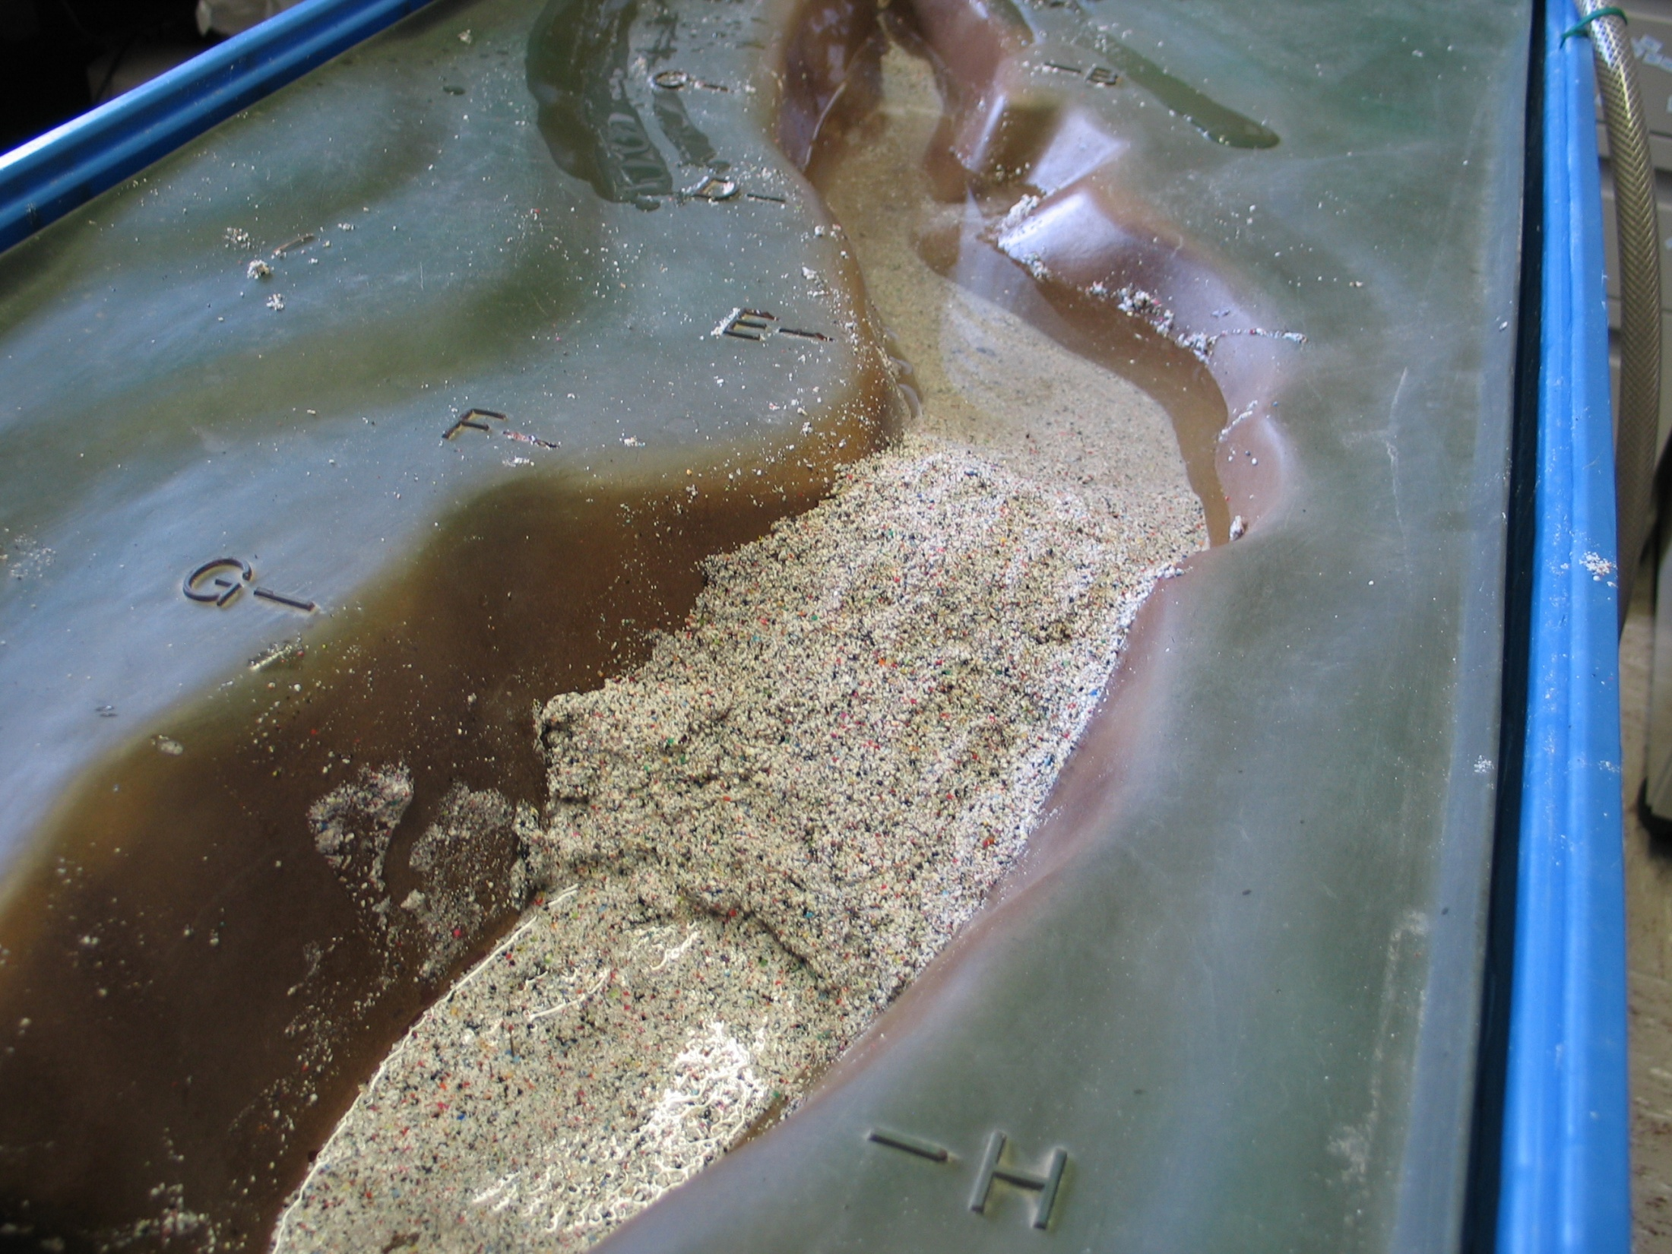
The Earthen Dam is Leaking Water from the Base
All Dams Leak!

Slide 3
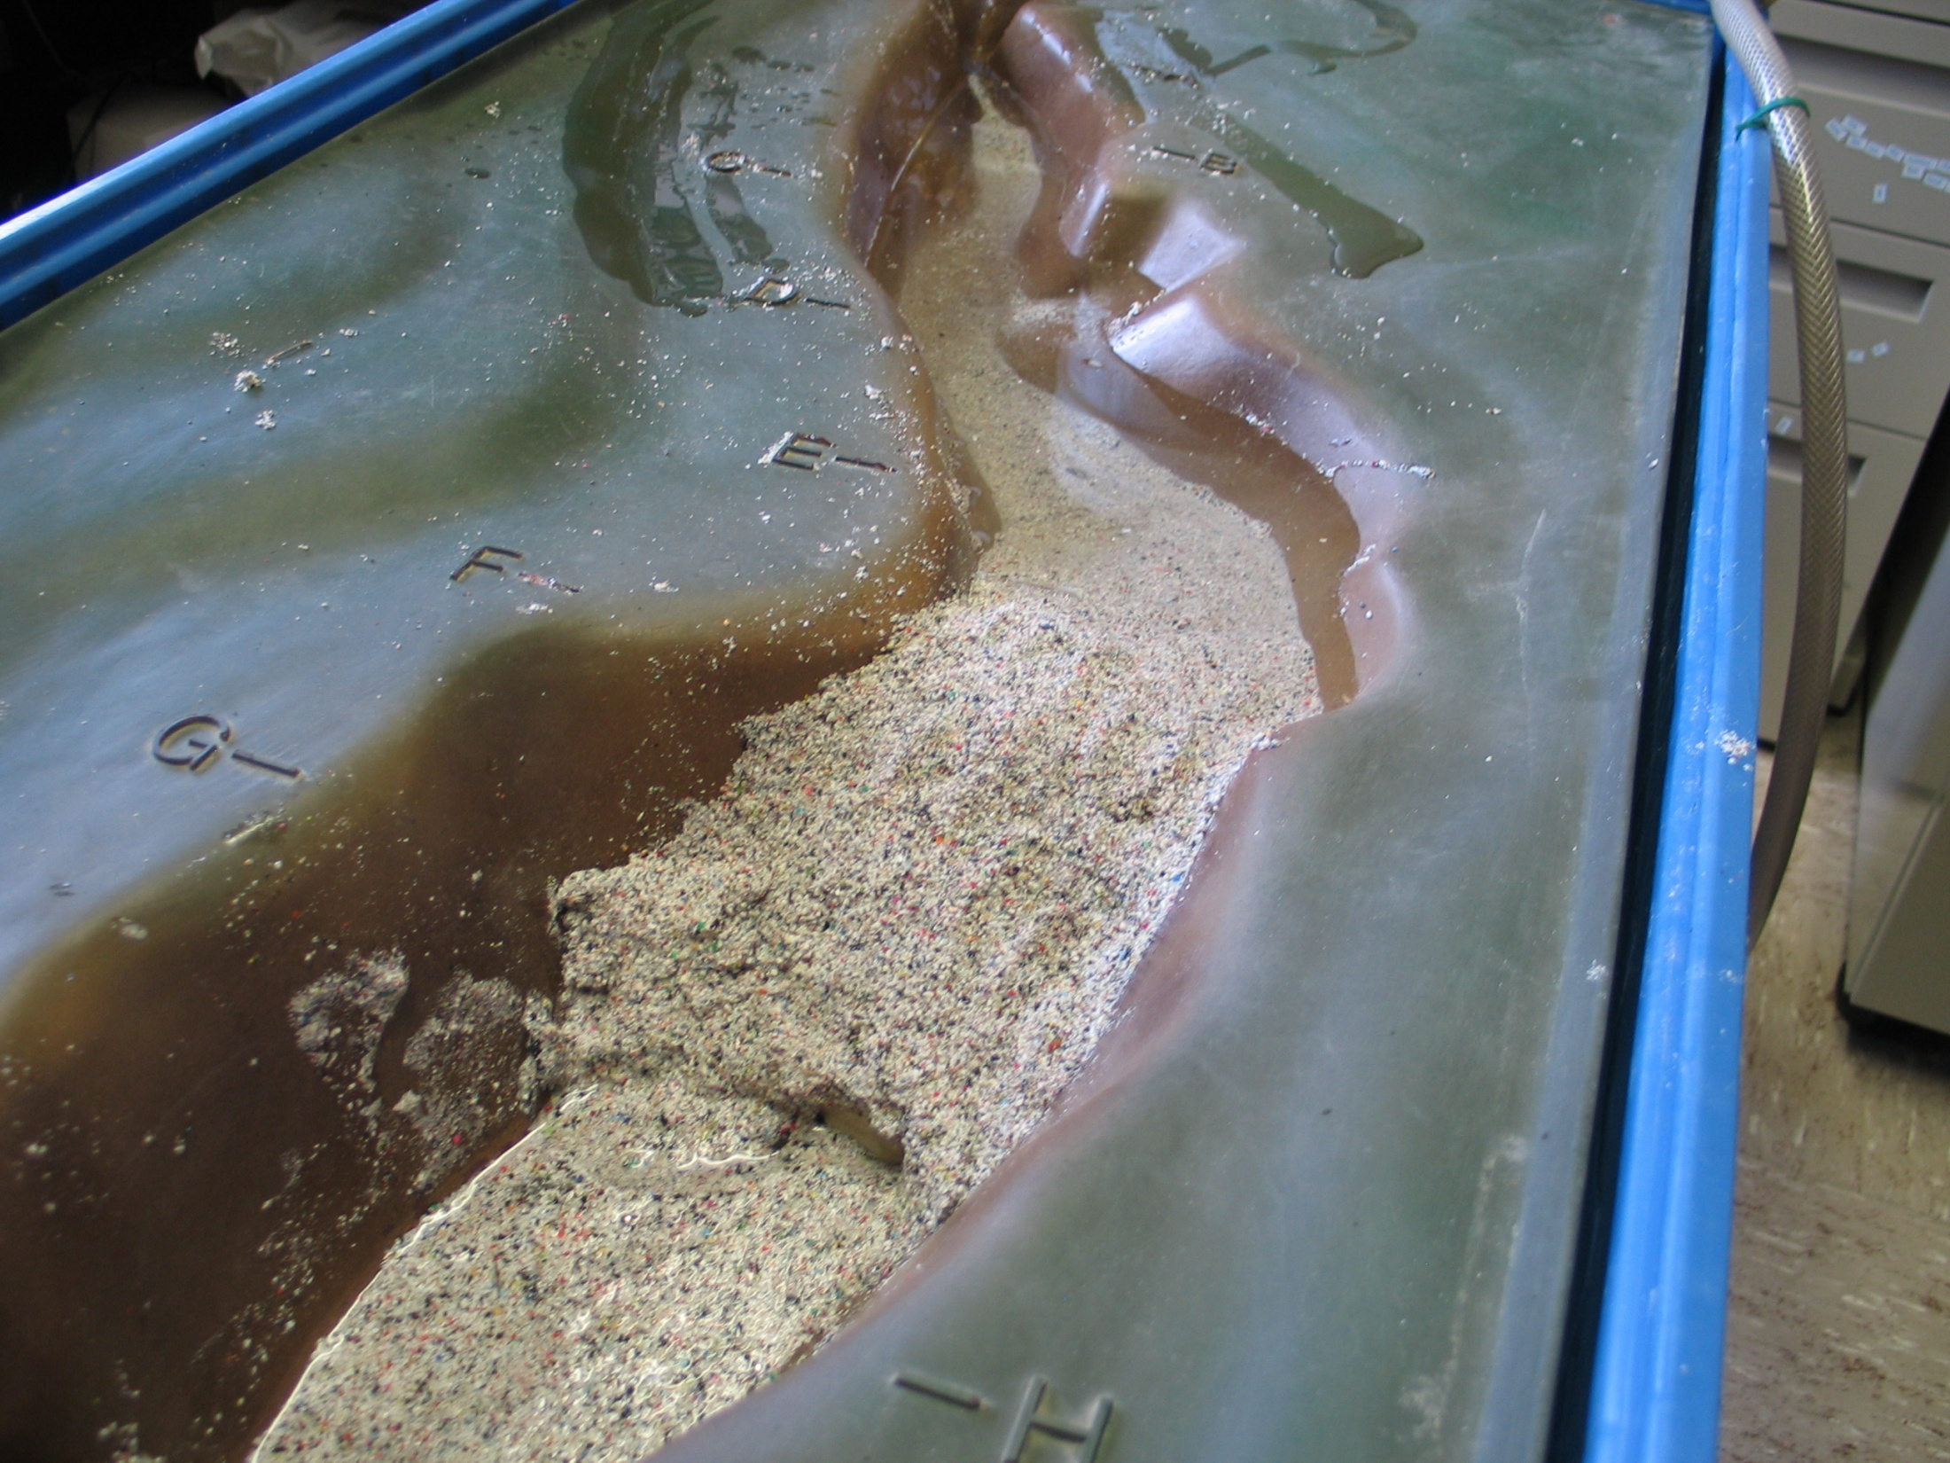
The Pressure of the Lake is Causing the Base to Rupture
Heavy Rains Are Causing the Lake to Top the Dam

Slide 4
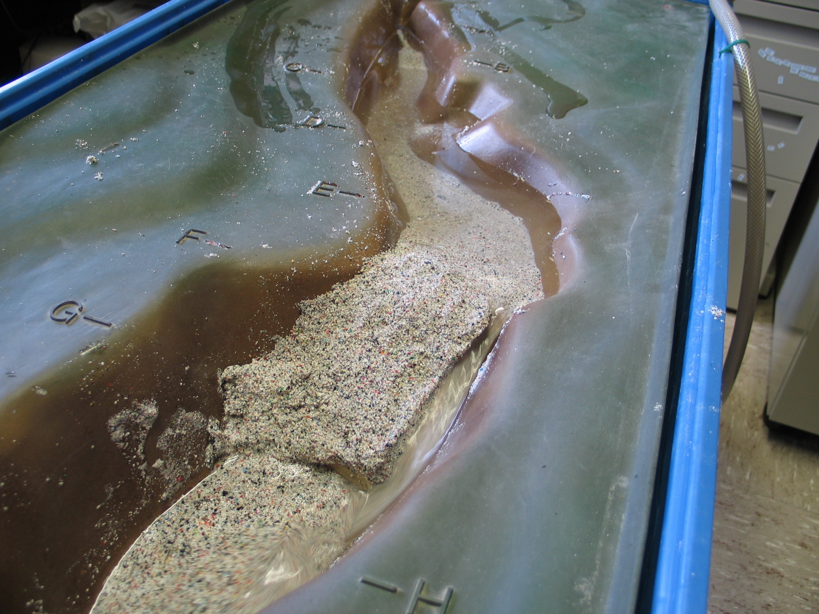
The Lake Has Topped the Dam
Causing it to Erode into it and Releasing a Torrent

Slide 5
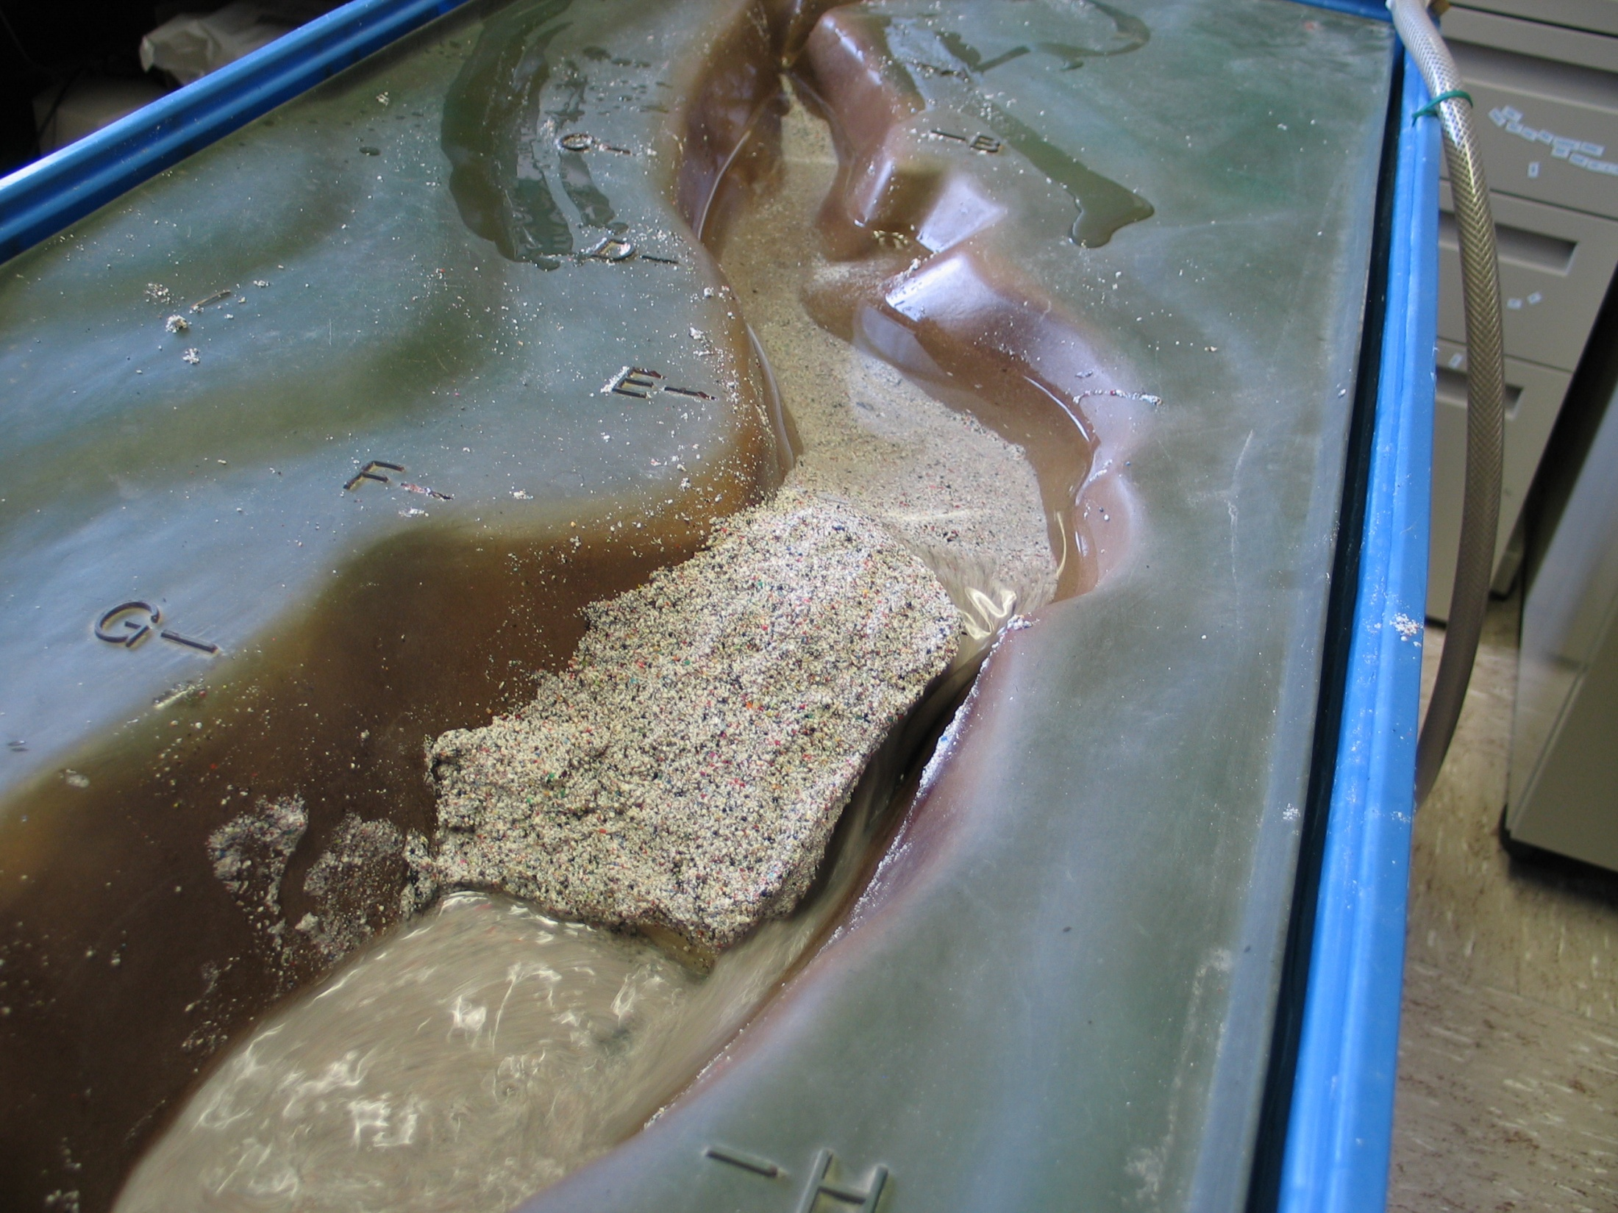
The Erosive Channel is So Deep, the Entire Lake Drains
Devastating Downstream Communities

Slide 6
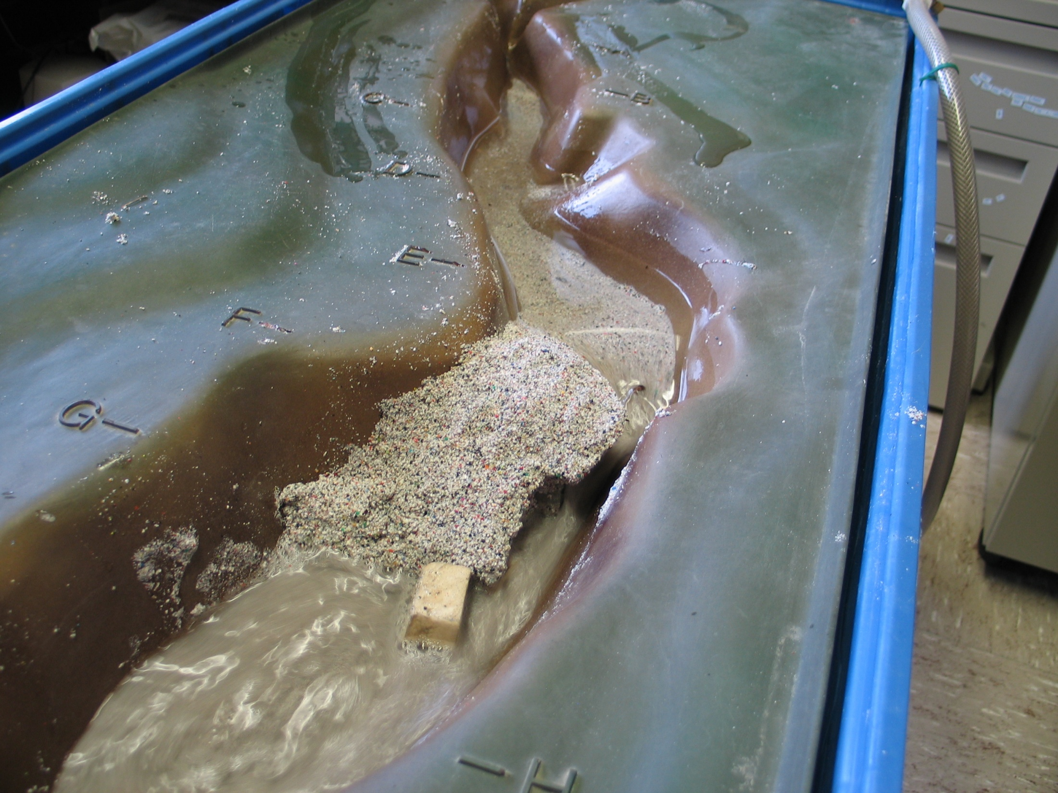
The Torrent is Stripping Pieces of the Foundation Away

Slide 7
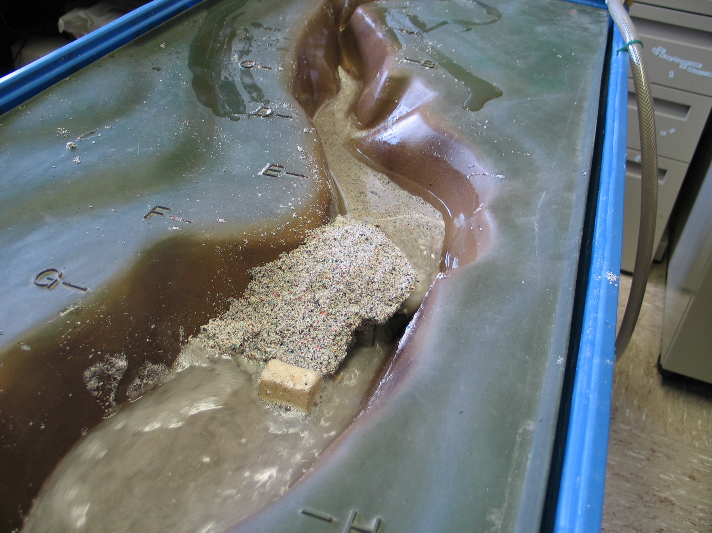
The Dam Structure Remains Mostly Intact

Slide 8
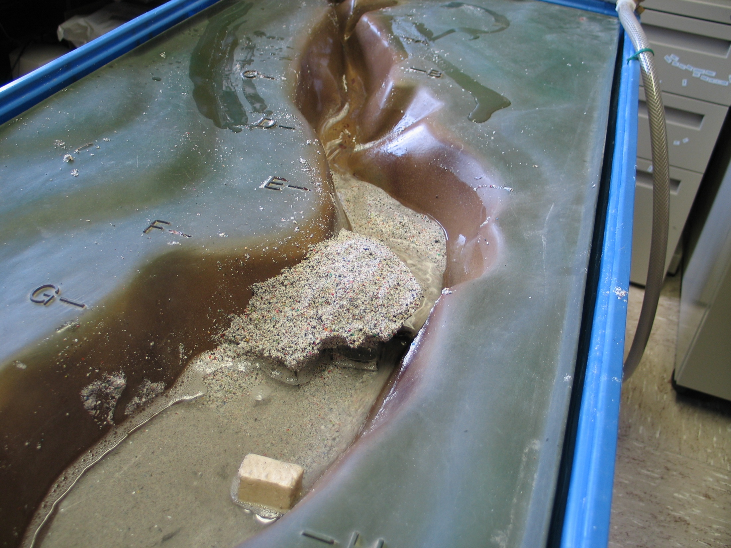
The Lake Has Drained and the Torrent is Over

Slide 9
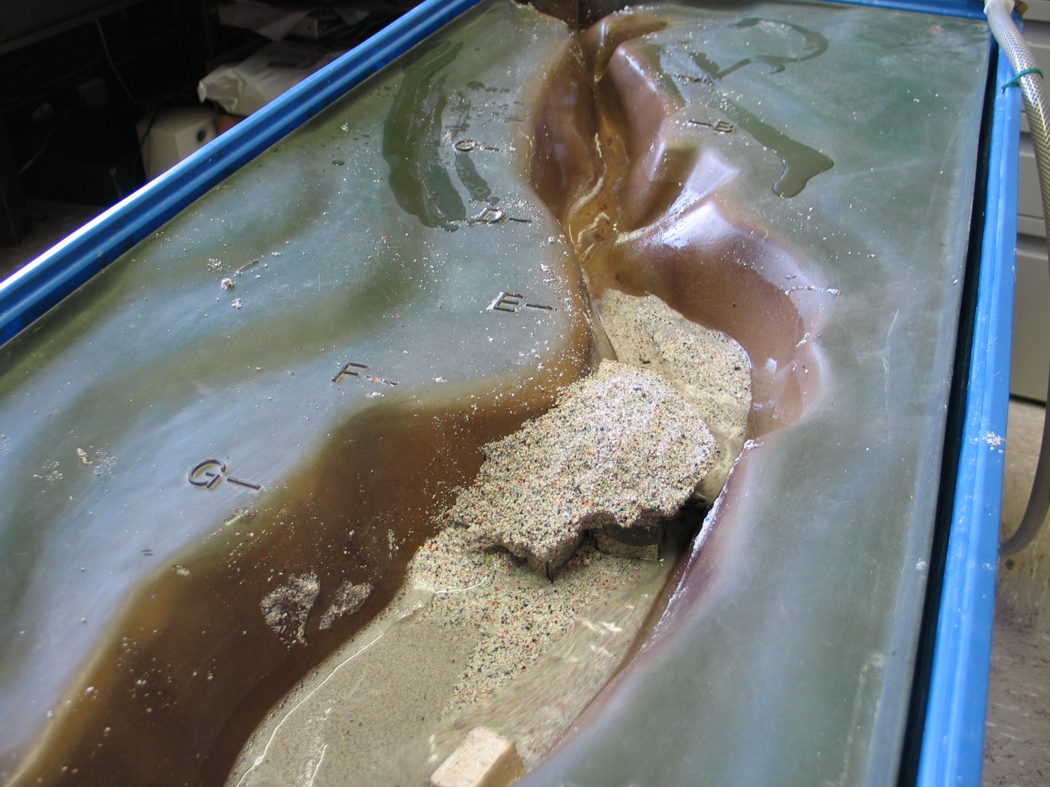
Time to Clean Up From the Flood Waters

Slide 10
This project was made possible in part by a grant from
Washington’s National Park Fund.

