Slide 1
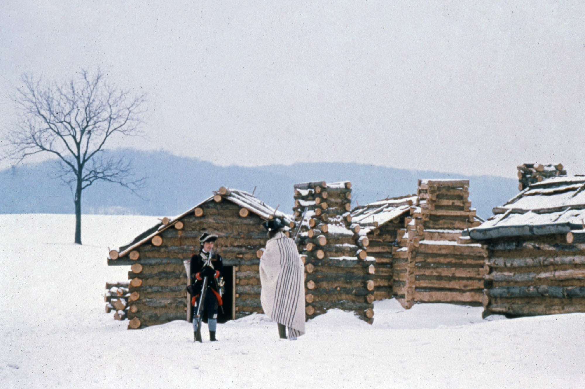
The Winter at Valley Forge
Background Information

Slide 2
Why Valley Forge?
During the last days of 1777, General Washington and the Continental Army were engaging British troops at the Battle of White Marsh, in and around Whitemarsh Township, Pennsylvania, outside of Philadelphia.
As winter set in, the British forces retreated to their headquarters in Philadelphia.
Washington and the Continental Army would spend the winter of 1777-1778 camped at Valley Forge, Pennsylvania, 25 miles northeast of Philadelphia.
  The area was close enough to Philadelphia to maintain pressure on the enemy, yet far enough away to prevent surprise attack.
  From here, the Continental Army secured outlying parts of the state where wary citizens, precious military stores, and the Continental Congress (located in York, PA) all needed protection from the British.

Slide 3
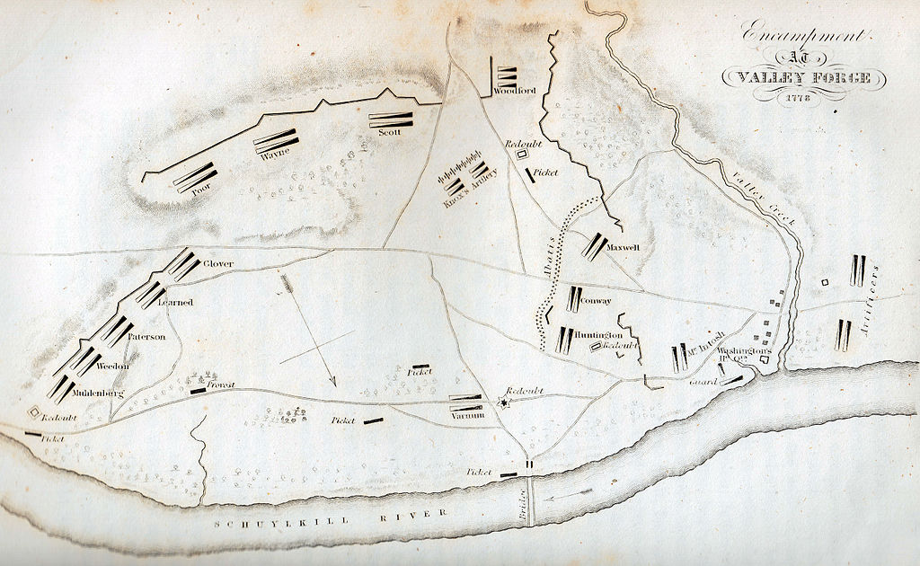
Encampment at Valley Forge, 1778
By, George W. Boynton (1830 engraving)

Slide 4
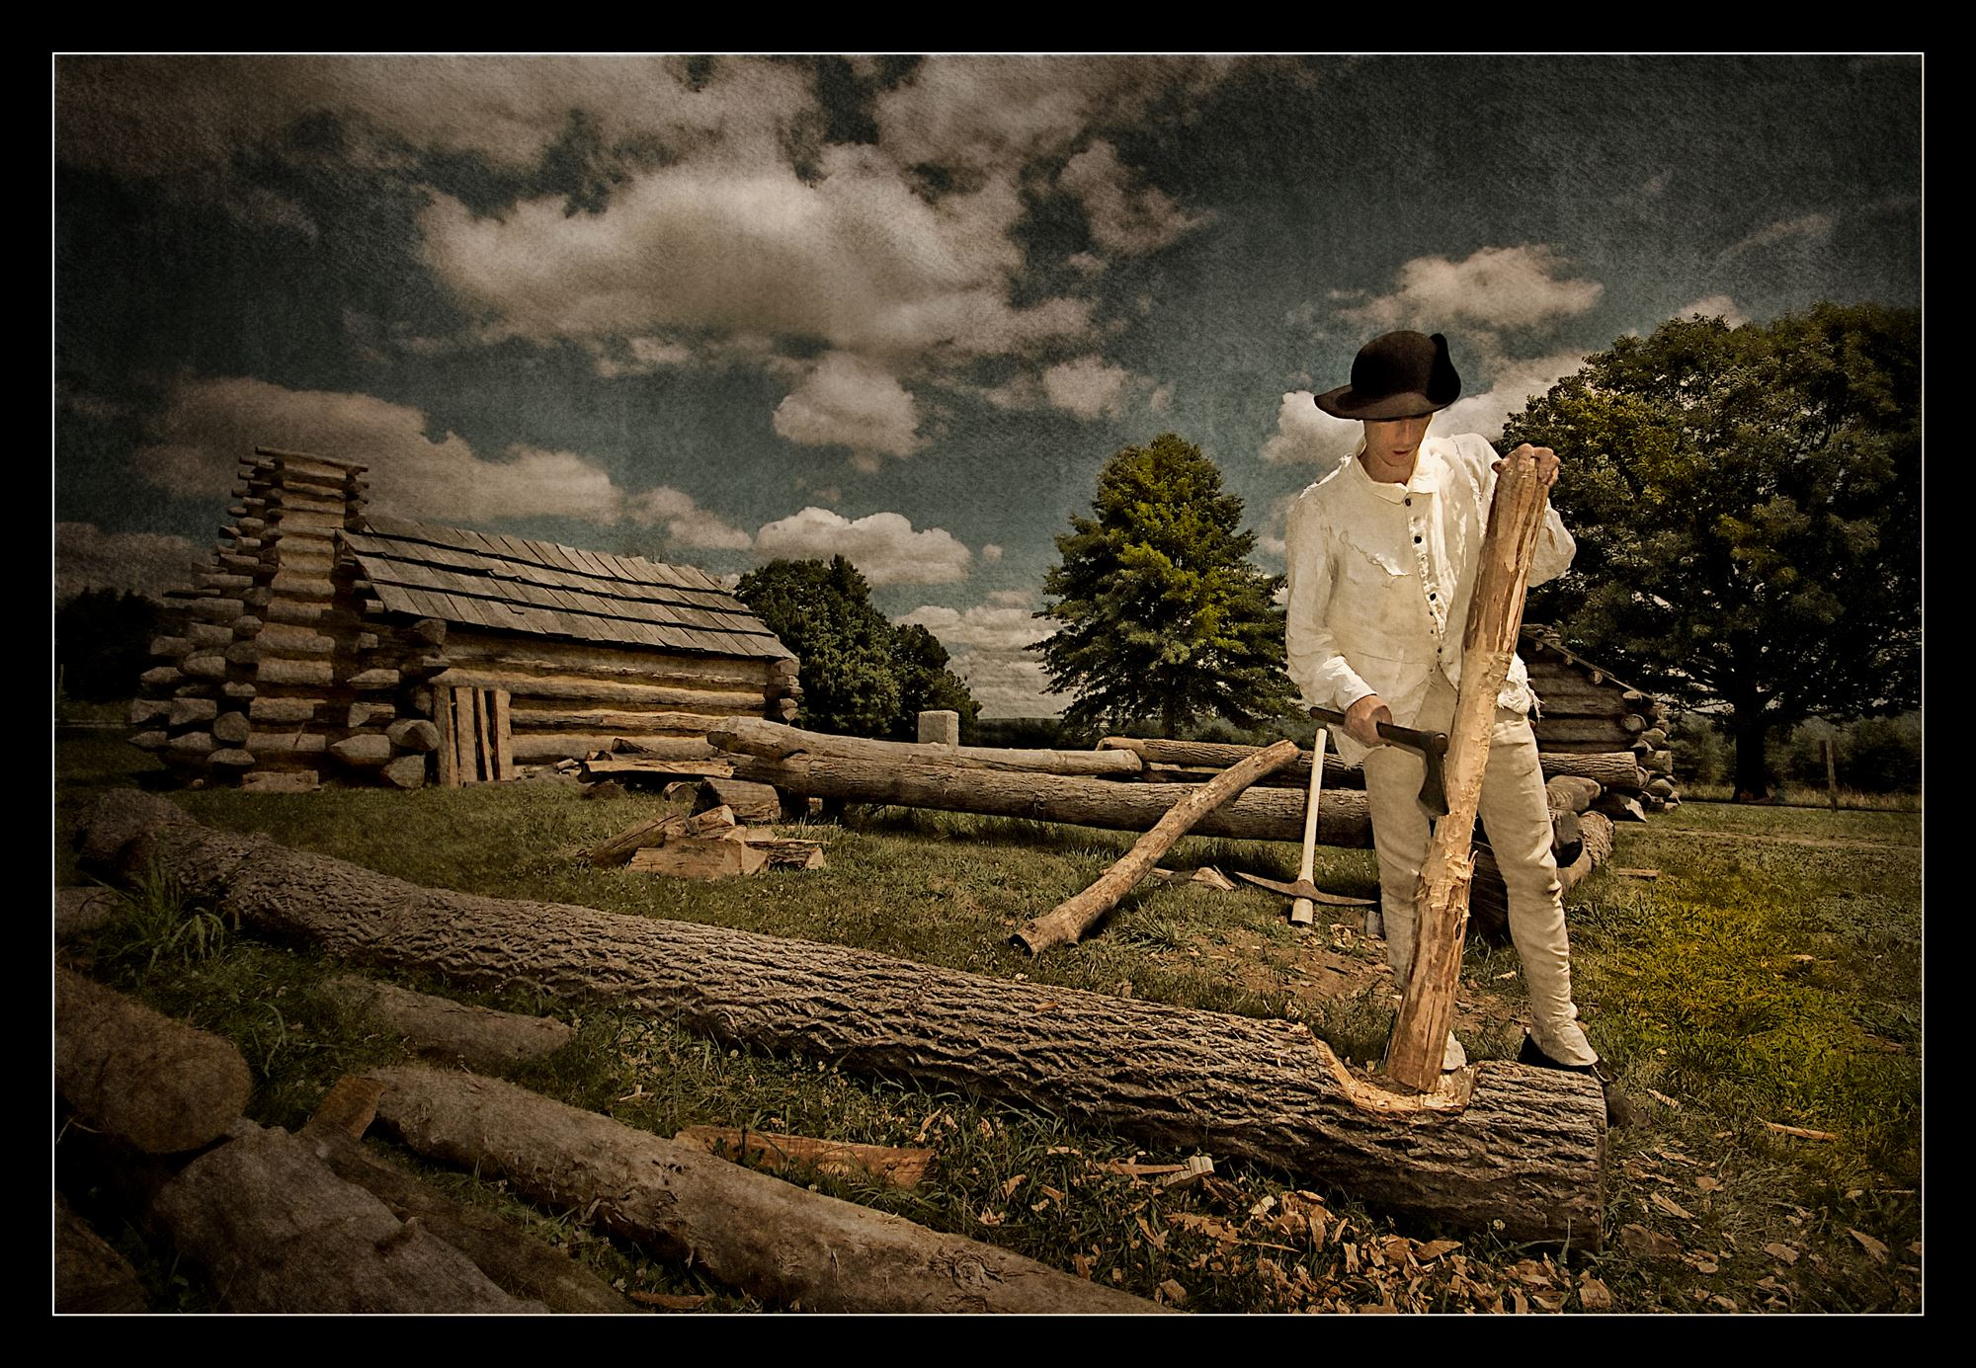
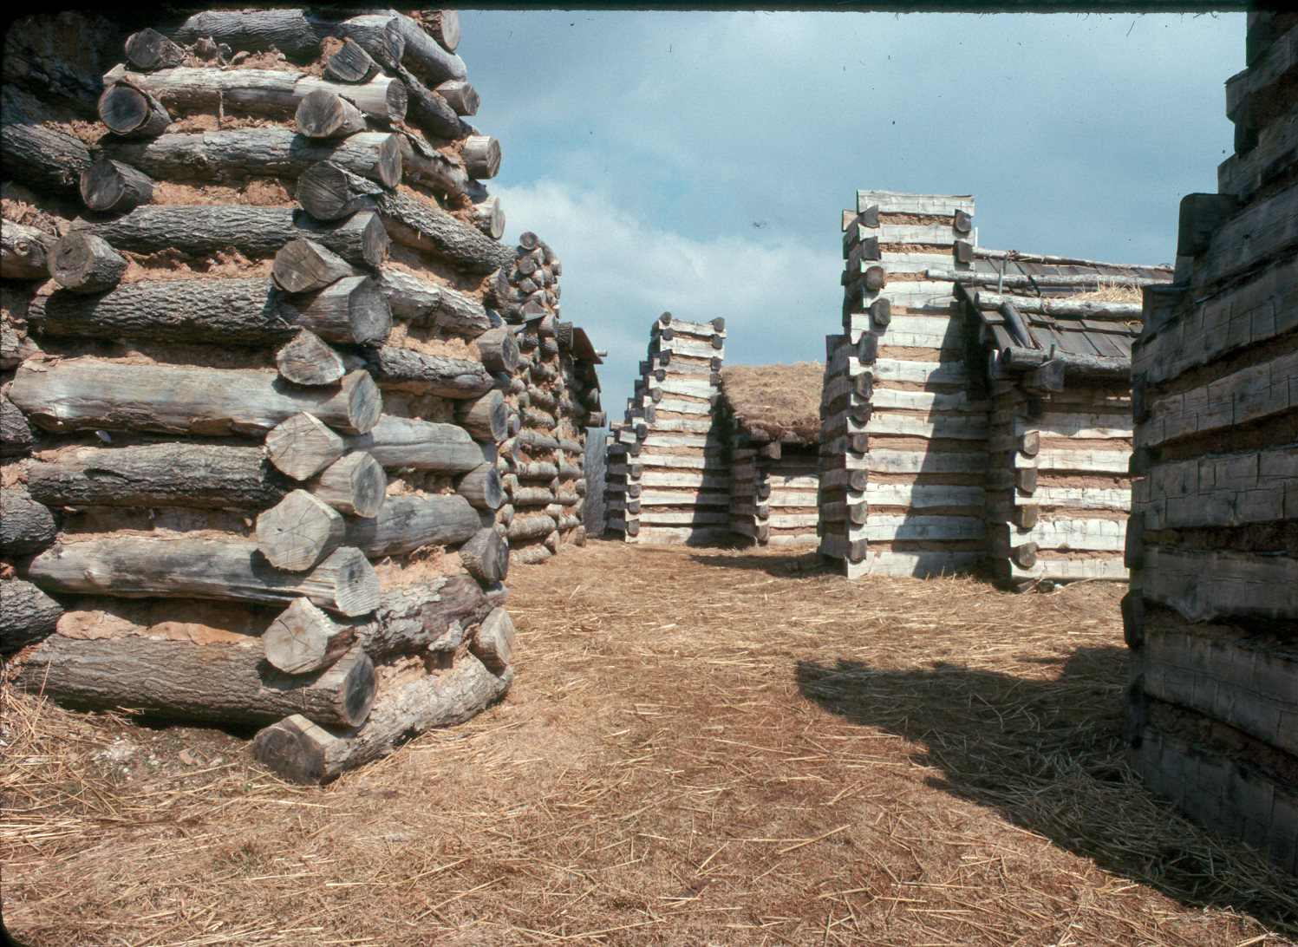
Building the Camp
To maintain the army through the winter, soldiers needed shelter.
Engineers laid out camp huts in parallel lines.
Officers divided the men into squads, provided them with tools, and gave them precise instructions for the construction of the huts.
  Each hut required roughly 80 logs.
  By the end of the encampment nearly 2,000 huts were built.

Slide 5
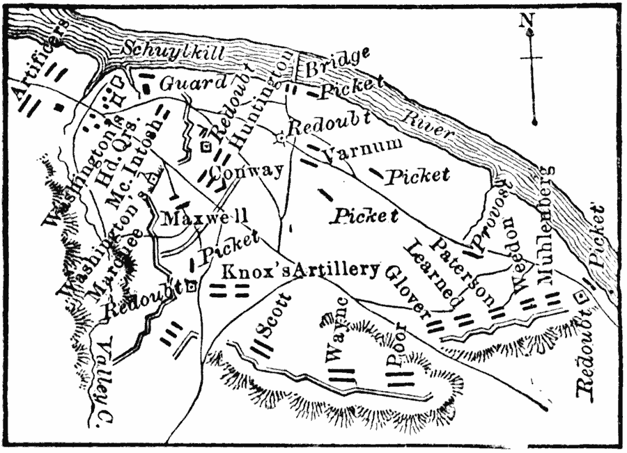

Defending the Camp
Pickets were posted around the perimeter of camp.
Different passwords and countersigns were issued each day.
Inner and outer lines of defensive works provided security.
Four guarded roads led out of camp, and Sullivan's bridge offered an escape route to the north in case the British attacked.

Slide 6
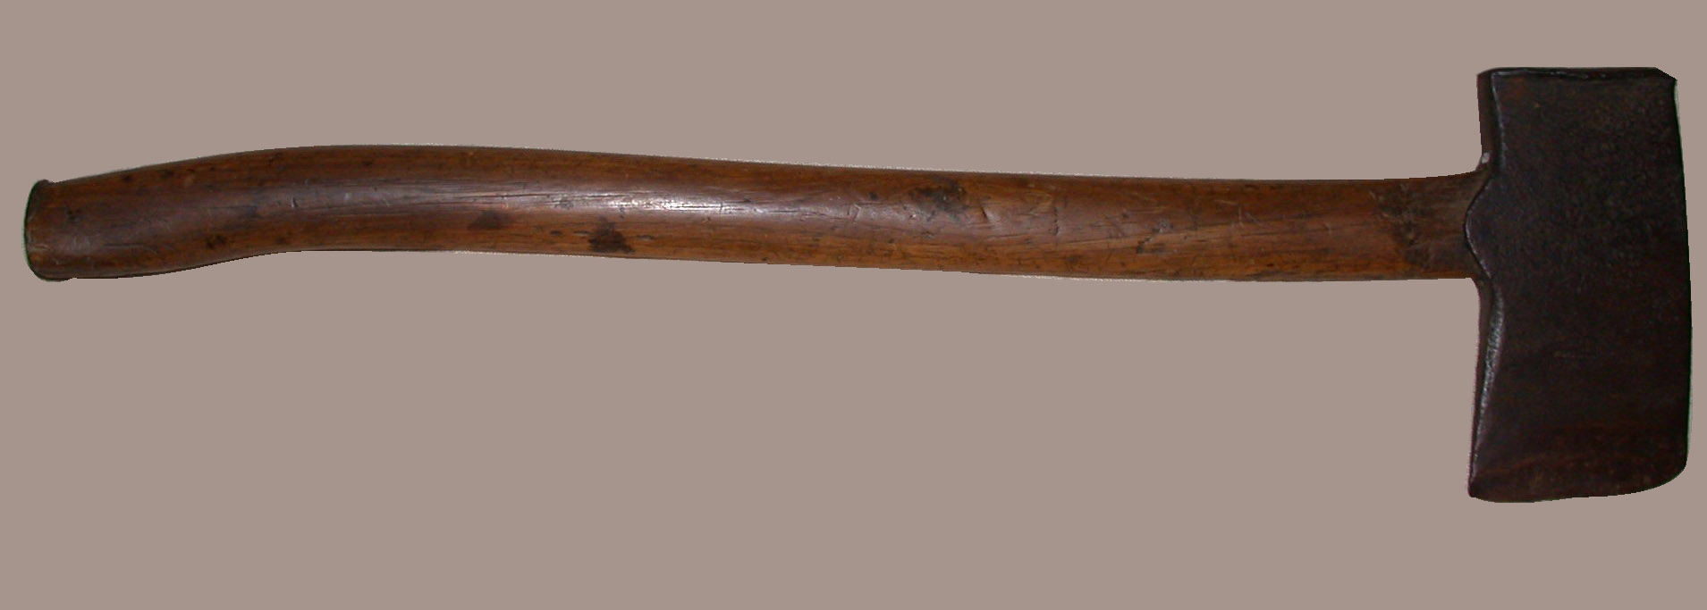
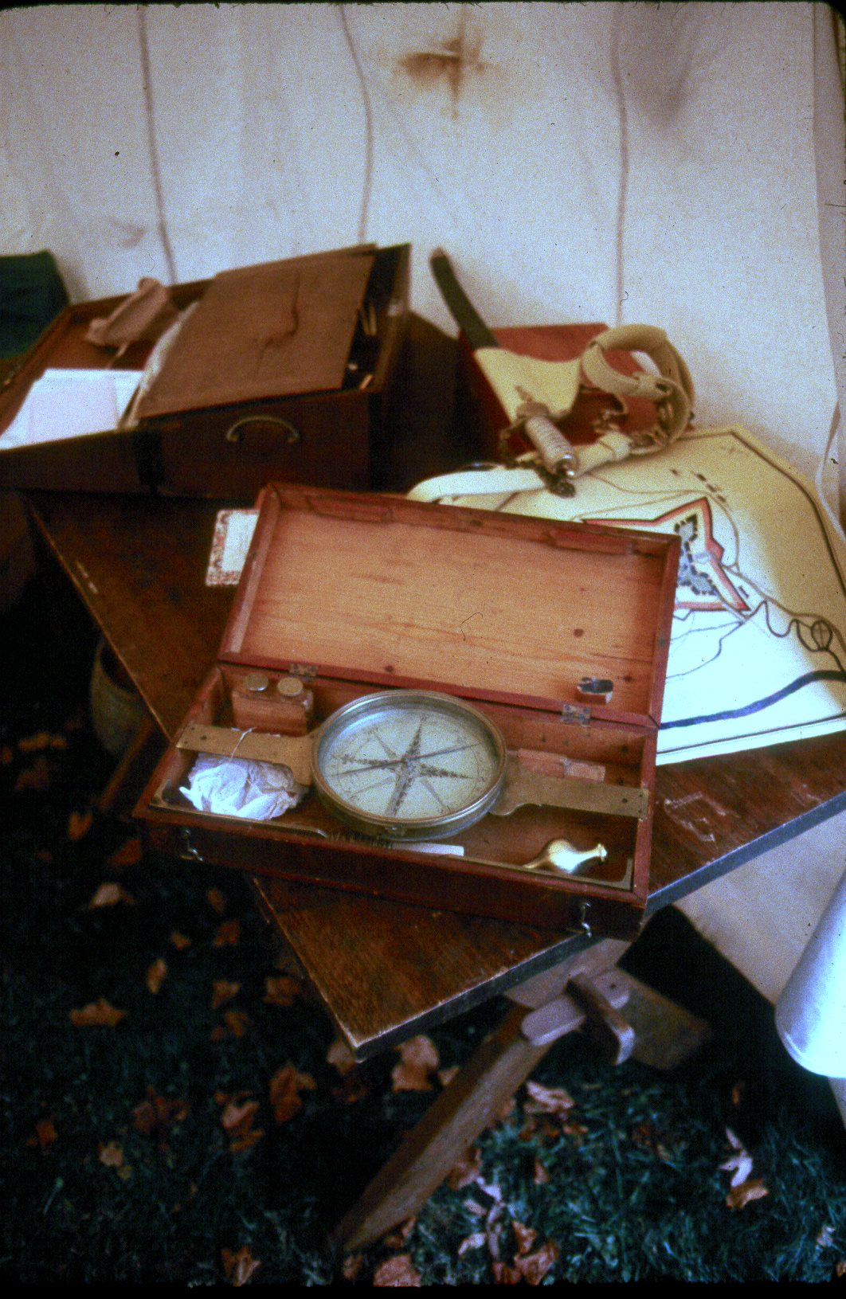
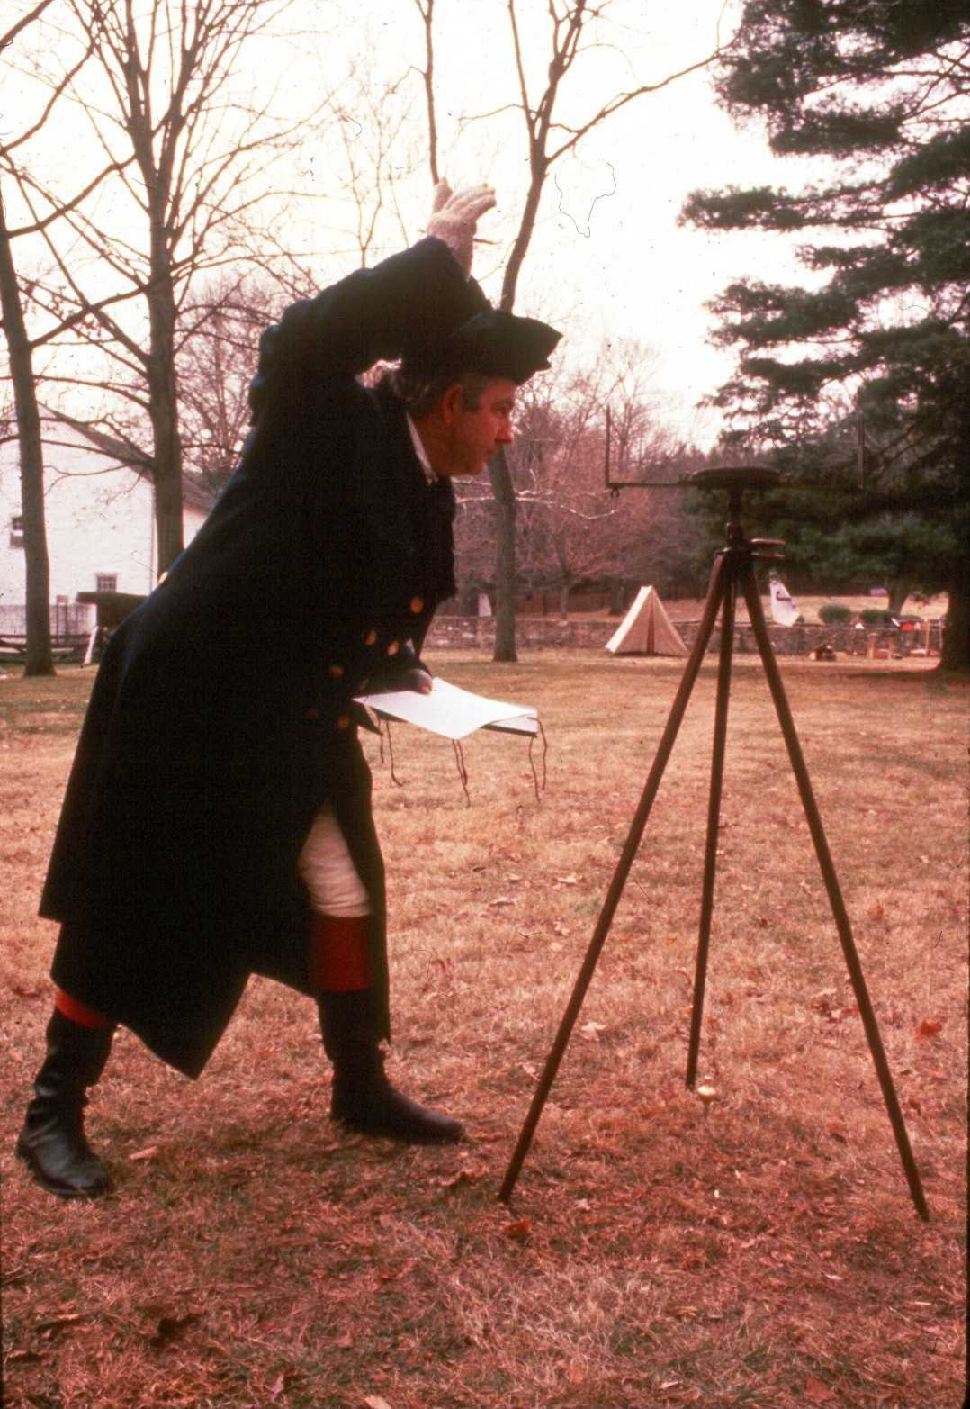
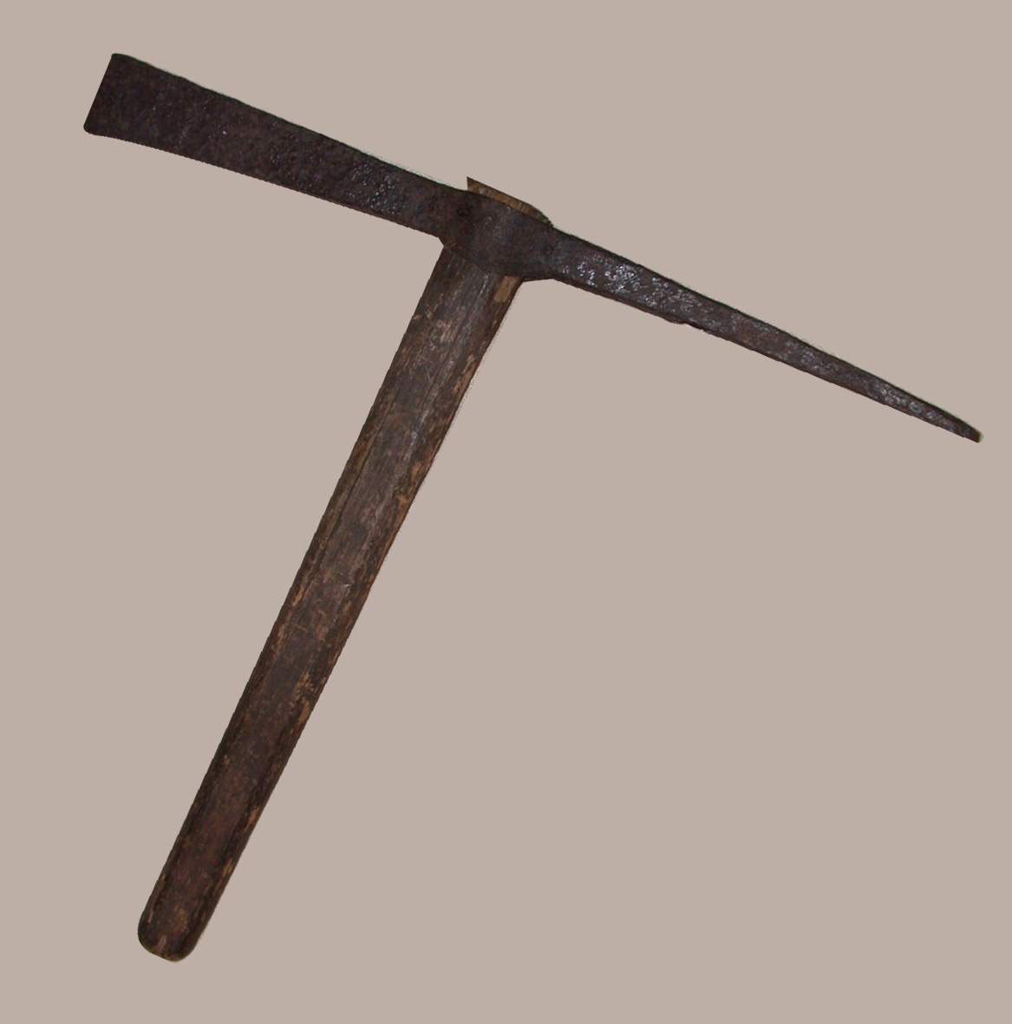
Building the Camp
Camp Ax
Courtesy of Valley Forge Historic Park
VAFO 806
Surveying Equipment
Courtesy of Valley Forge Historic Park
Pick Mattock
Courtesy of Valley Forge Historic Park
VAFO 1571
Surveyor
Courtesy of Valley Forge Historic Park

Slide 7
Early Hardships
By the time the Continental Army reached Valley Forge, many of the soldiers were undersupplied and malnourished.
Of the 12,000 soldiers in camp, only one in four had shoes. Clothing used during the spring and summer were now worn and unfit to protect against the winter elements.
Because of Congress’ difficulty in raising funds to pay and feed the army, soldiers were infrequently paid and received inadequate food rations causing morale to plummet.
The harsh winter, damp conditions, and overcrowded huts caused disease to flourish in camp.
  Many soldiers were rendered unfit to work and nearly 2,000 soldiers would die due to illness.

Slide 8
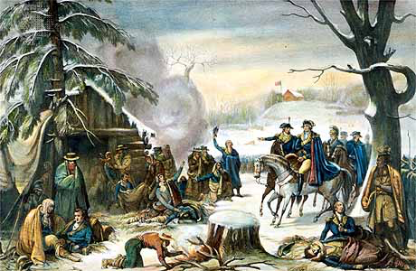
Gen. Washington and Lafayette visiting the suffering part of the army
Painted and drawn by A. Gibert, 1777
Courtesy of the Library of Congress

Slide 9
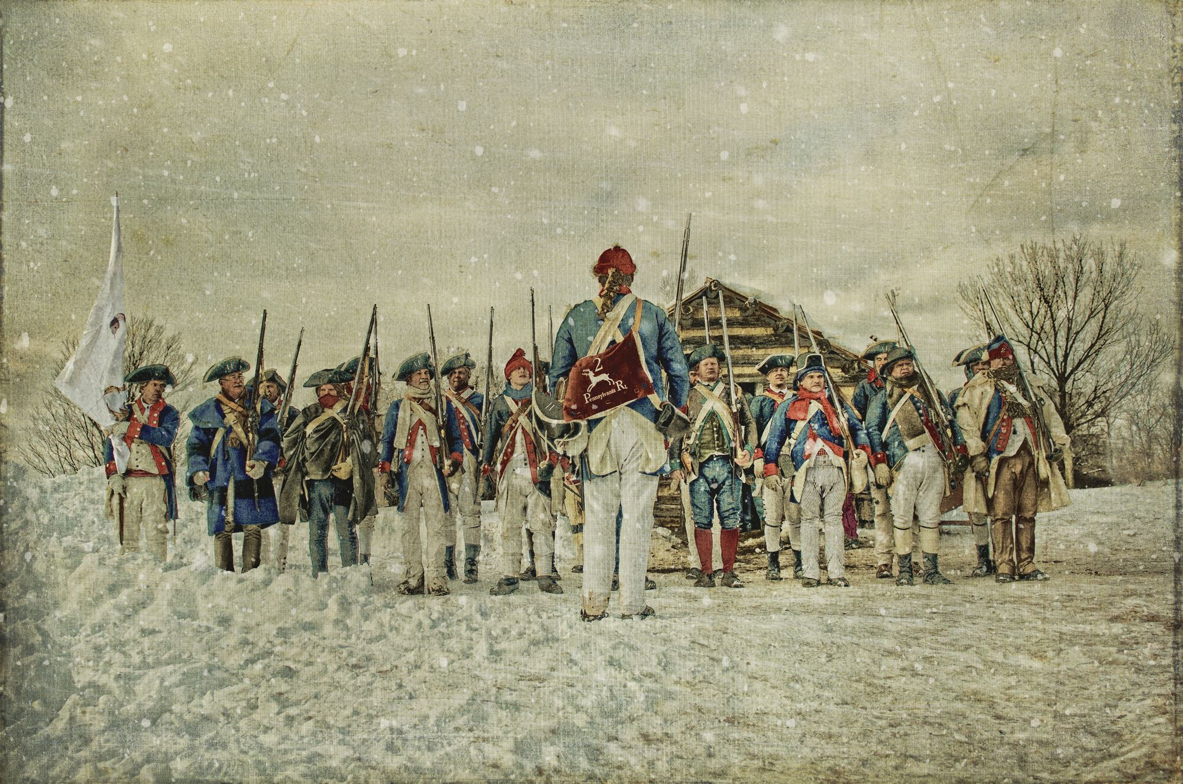
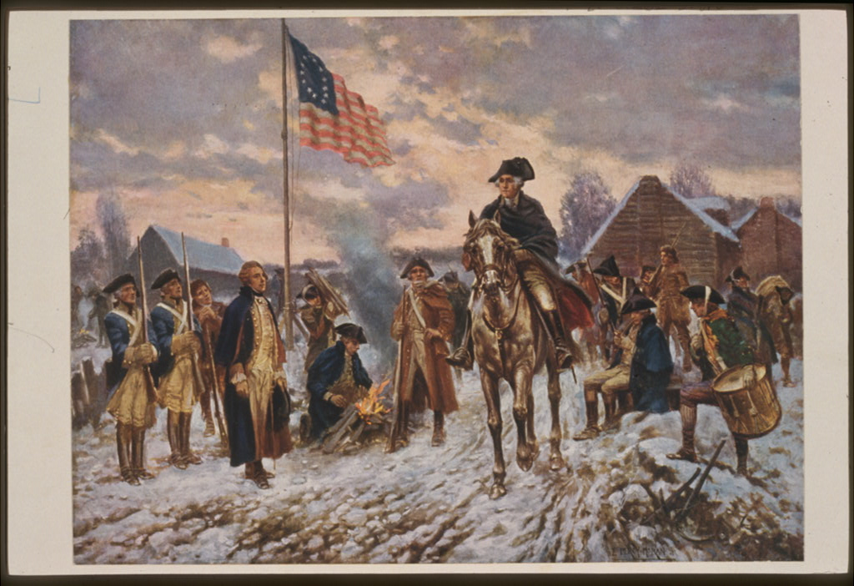
Shoulder Firelock
Courtesy of Valley Forge National Historic Park
Washington on horseback in snow at Valley Forge
By, Percy Morgan, 1911
Courtesy of the Library of Congress

Slide 10
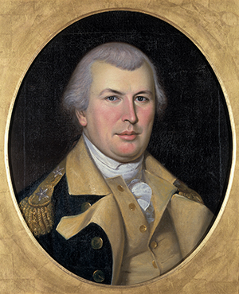
Economy of the Encampment
Valley Forge was the first encampment at which the army suffered severe hardship due to a poorly administered supply system, the depreciation of continental currency, and inflated prices.
The lack of supplies reached crisis proportions. Soldiers resorted to stealing from local farms. Officers and enlisted men openly criticized the states for failing to honor their contract.
In a dramatic letter to the Continental Congress, Washington forced Congress to undertake a complete reorganization of the Quartermaster Department.
Officers recognized the great benefit of establishing regular markets at several locations near camp where soldiers could obtain fresh food and local farmers could trade with the Americans rather than sell to the British in Philadelphia.
  The markets opened by February and continued into spring.
Conditions began to improve with the arrival of spring and the forceful leadership of Nathanael Greene as Quartermaster General.
Quartermaster General Nathaniel Greene
Courtesy of Independence National Historic Park

Slide 11
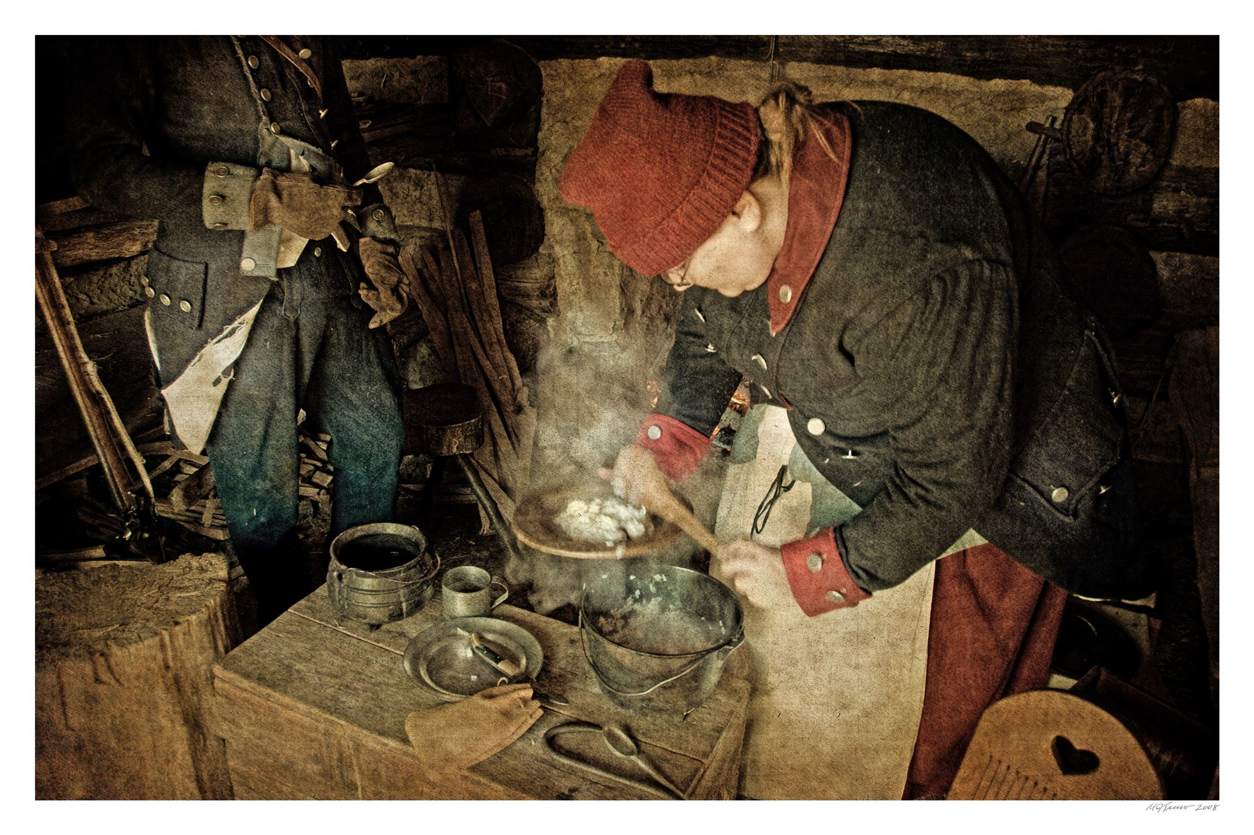
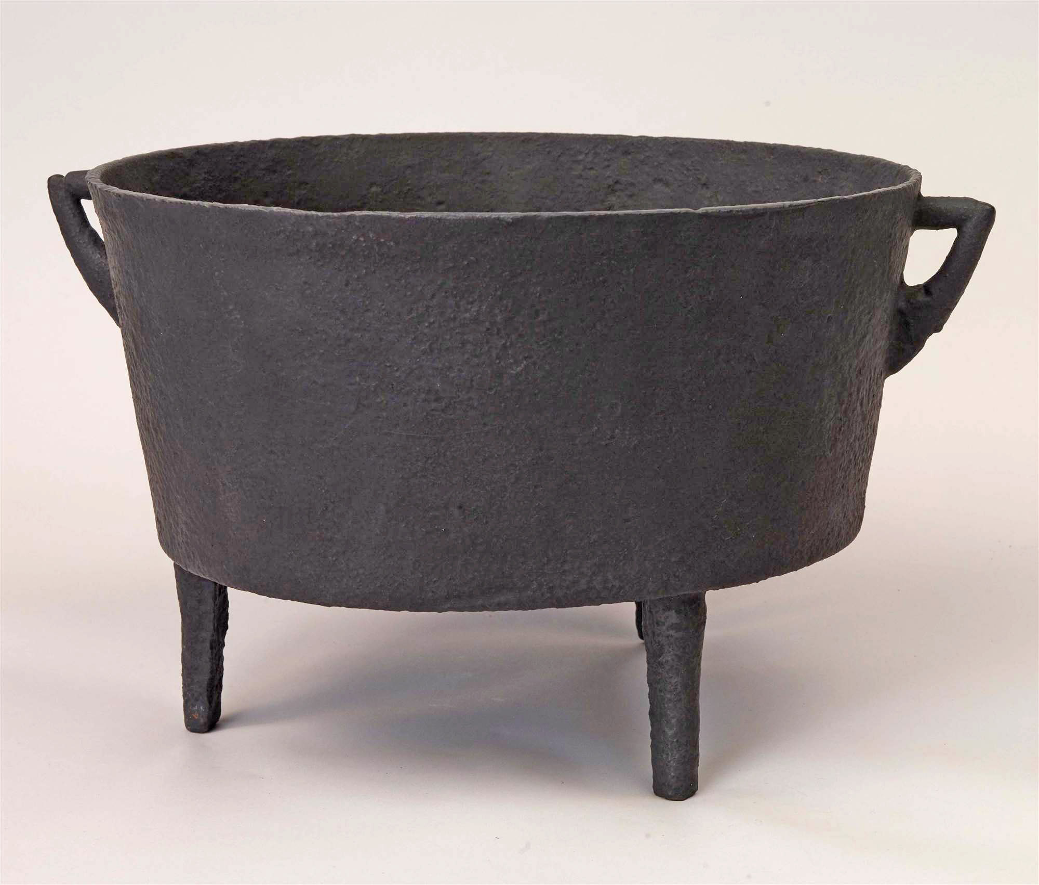
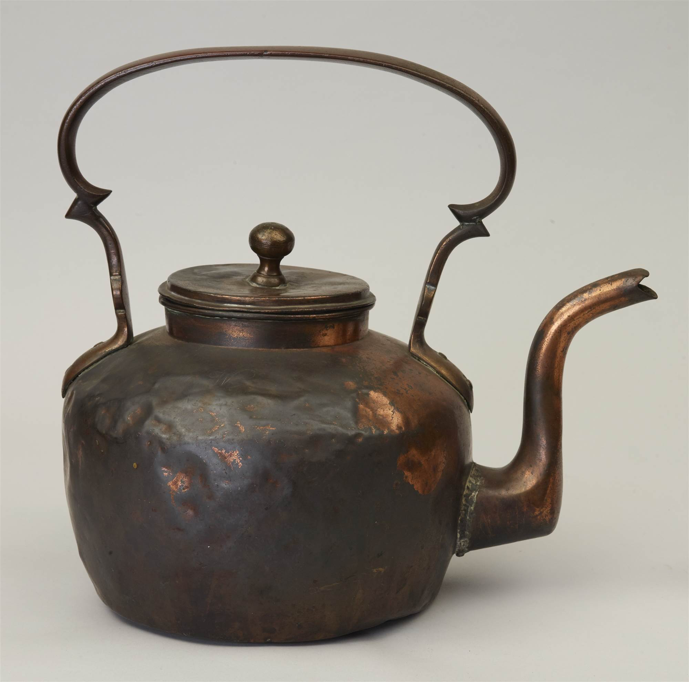
Feeding the Army
General Washington was believed to have estimated that the army needed 100,000 barrels of flour and 20 million pounds of meat to feed 15,000 men for a year.
Local settlers and farmers raised crops and livestock and supplied the military.
Hunting and fishing in the surrounding woods supplemented the diet.
What the army could not supply, it often requisitioned by force.
Soldiers were issued food rations. Army food was usually provided in raw form. Staples consisted of flour, corn meal, or bread, and beef, pork, or fish. Sometimes dry beans or peas were provided.
Lunch Grub
Courtesy of Valley Forge National Historic Park
Kettle
VAFO 3593
Kettle
VAFO 3593

Slide 12
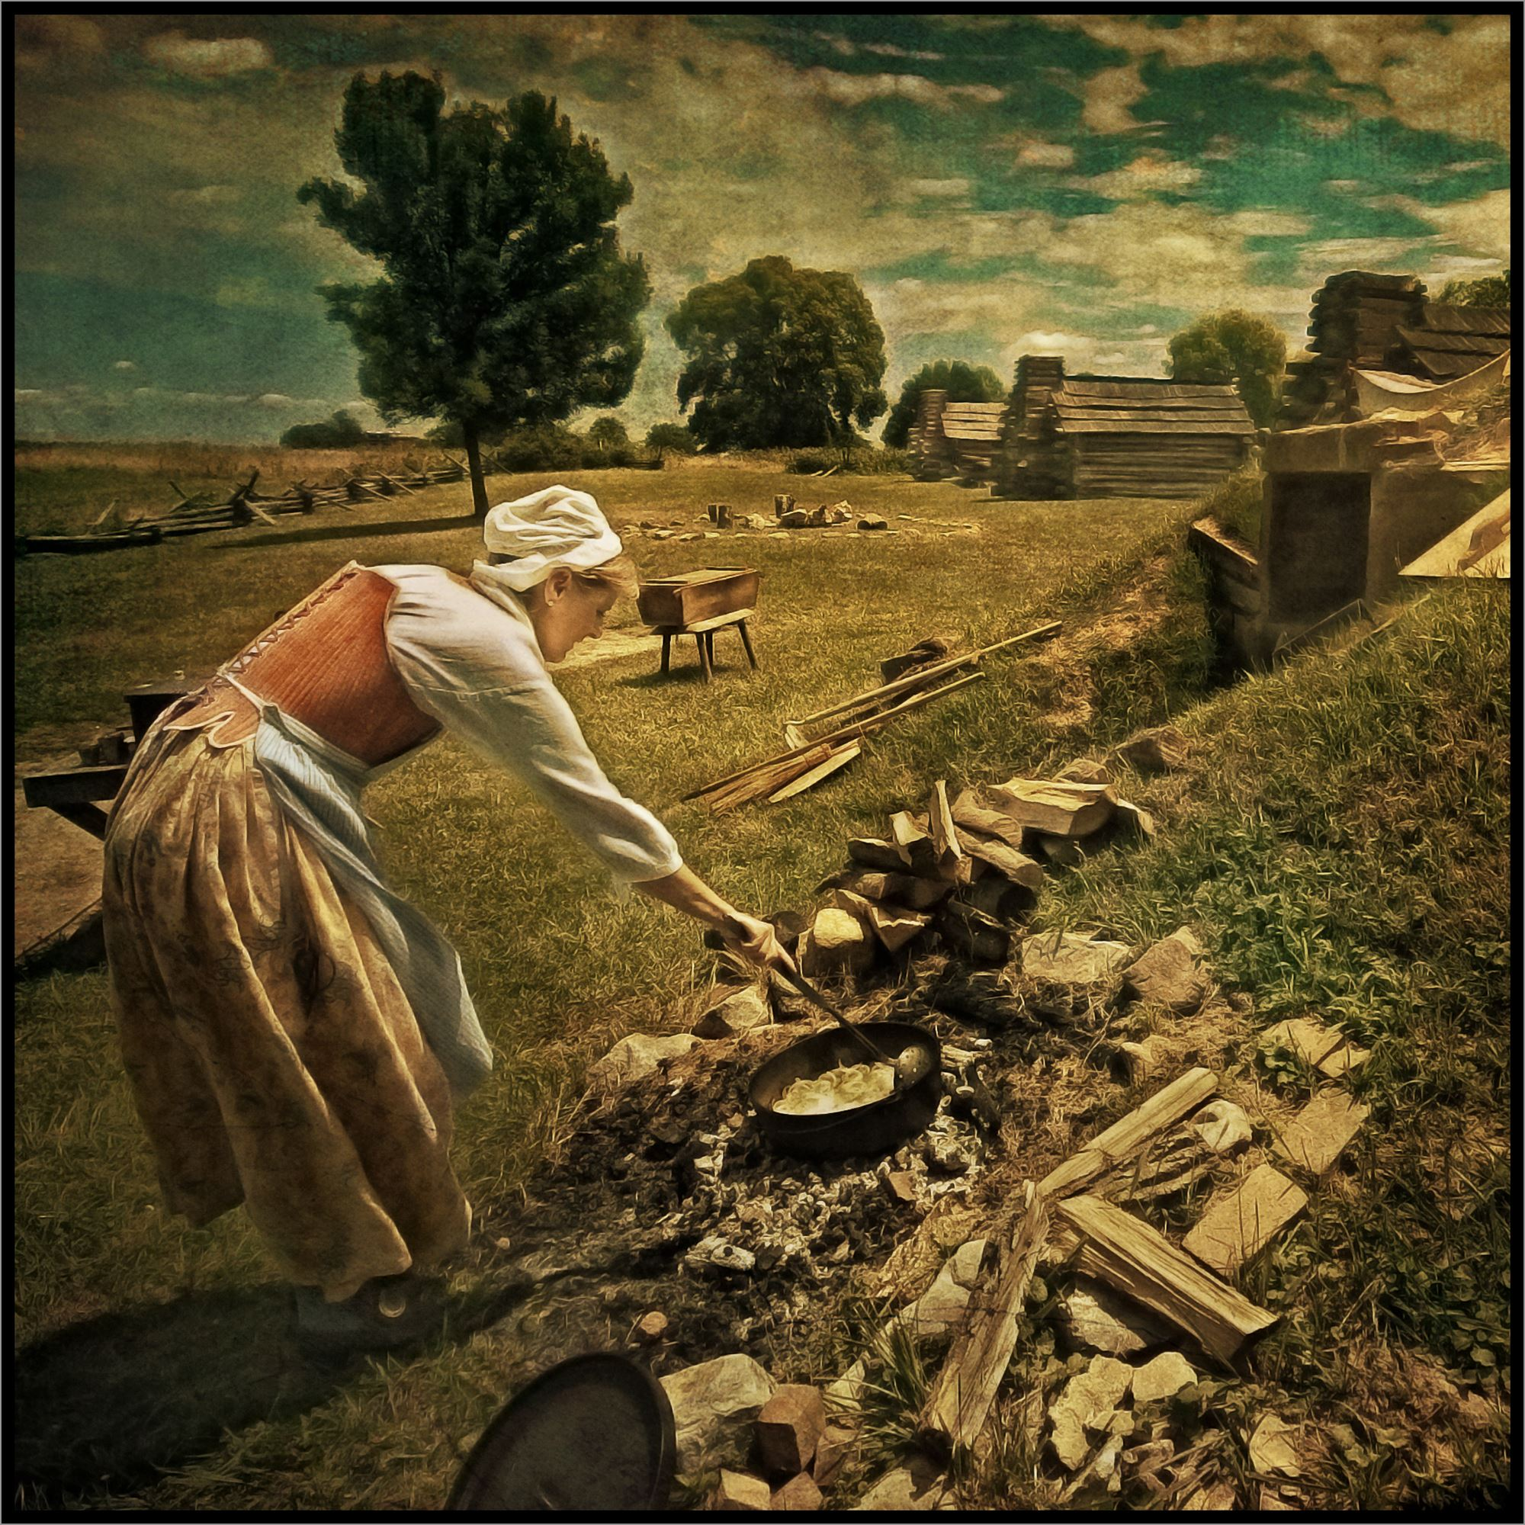
Feeding the Army
Soldiers cooked their own food in pots, kettles, Dutch ovens, grills, and broilers.
Families sometimes accompanied the men into the field. Women assisted with cooking, sewing, washing clothes, and tending the sick. Children carried firewood or water.
Each man supplied his own utensils. These included a spoon, cup, fork, knife, and wood or metal plate. Strong spirits were usually provided.
Stirring the Pot
Courtesy of Valley Forge National Historic Park

Slide 13
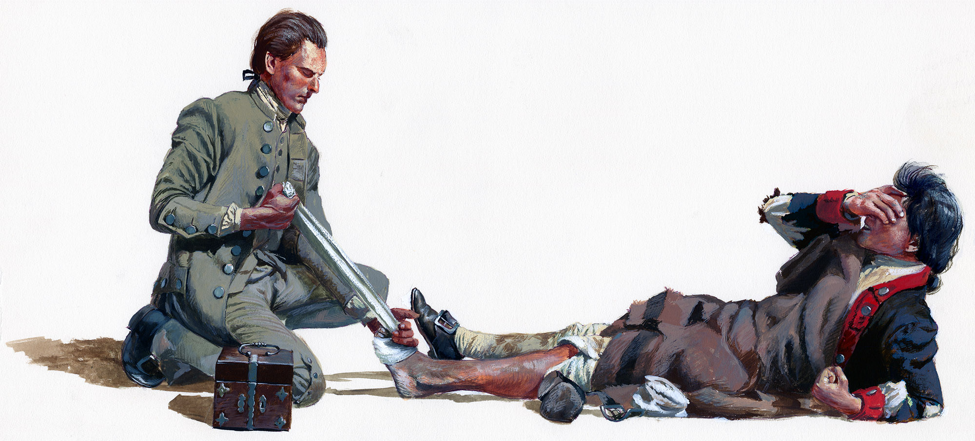
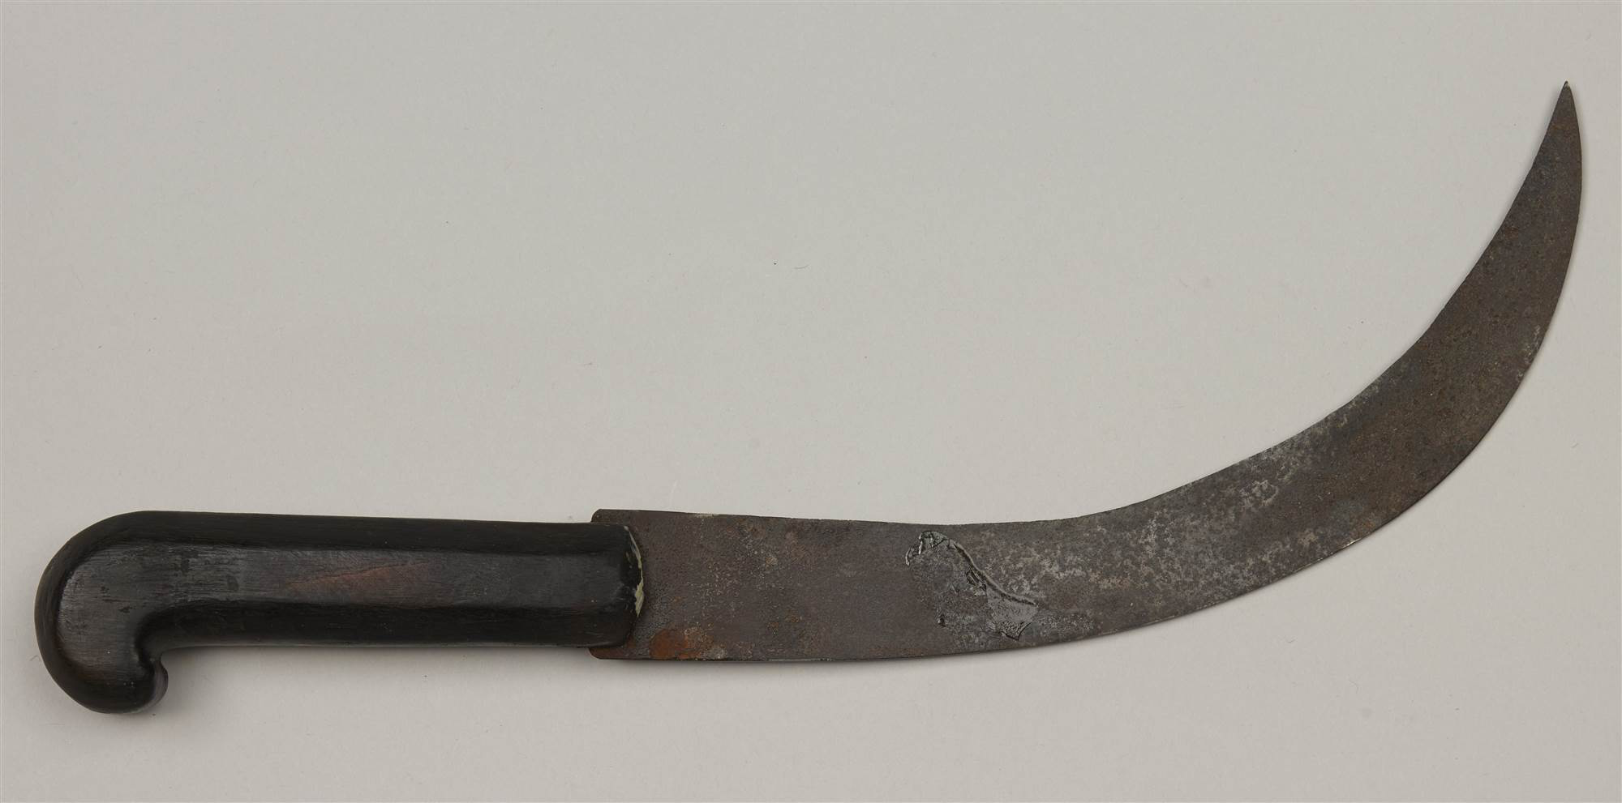
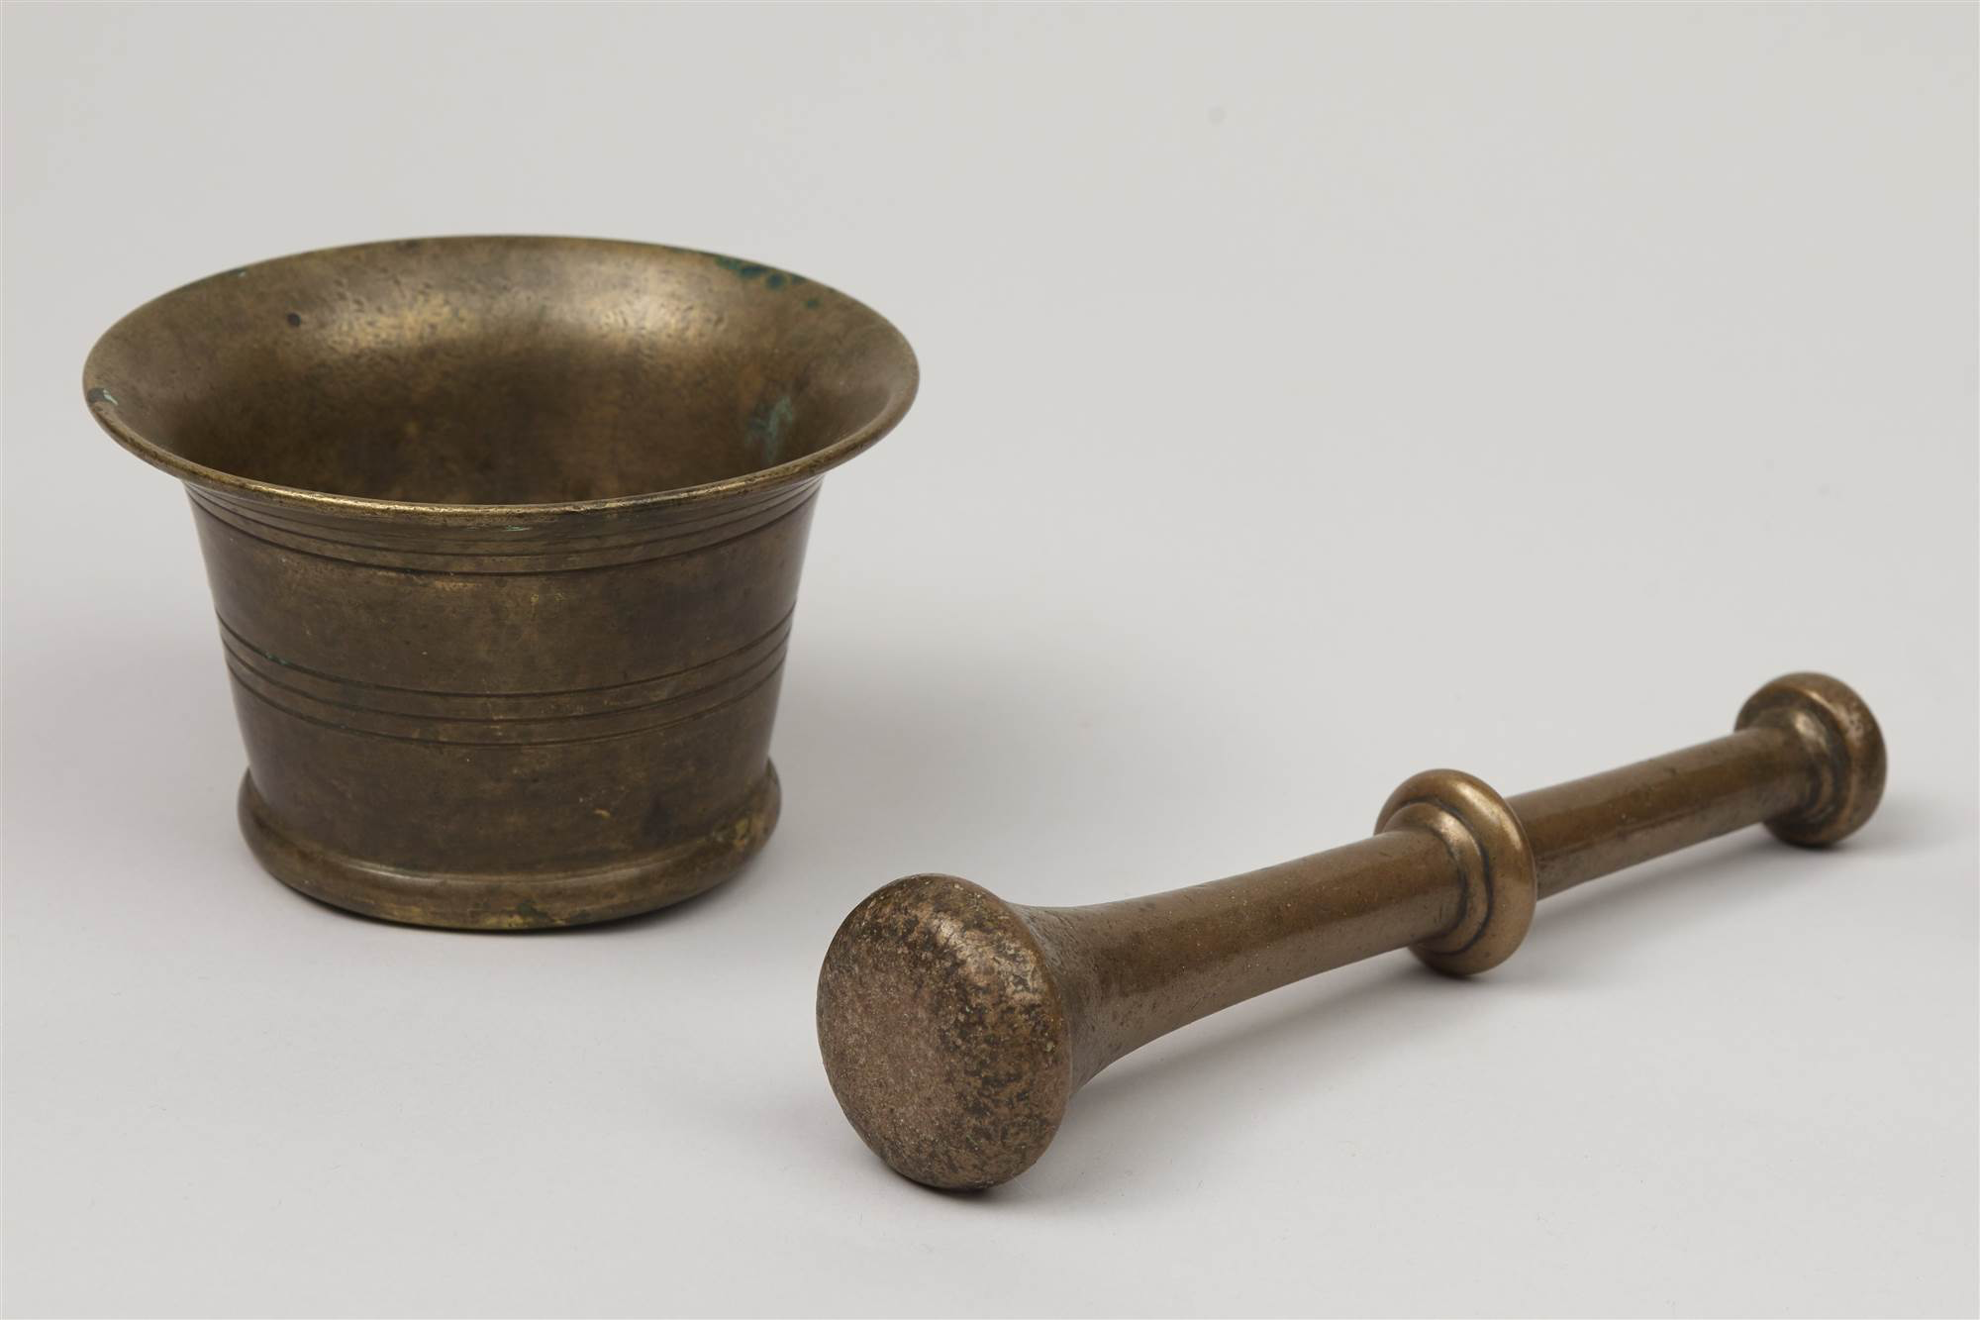
Disease in Camp
Army returns reveal that two thirds of the men who perished died during the warmer months of March, April, and May, when supplies were more abundant.
The most common killers were influenza, typhus, typhoid, and dysentery.
In order to limit outbreaks of disease, General Washington often issued orders to deal with sanitation.
  All garbage was burned
  Use only authorized latrines
  Maintain safe water sources,
  Disinfect drinking water by dosing it with whiskey and vinegar
  Air out cabins in the spring
Army medical services ranged from camp hospital huts to outlying general care and quarantine facilities.
Amputating Knife
VAFO 3552
Mortar and Pestle
VAFO 1356

Slide 14
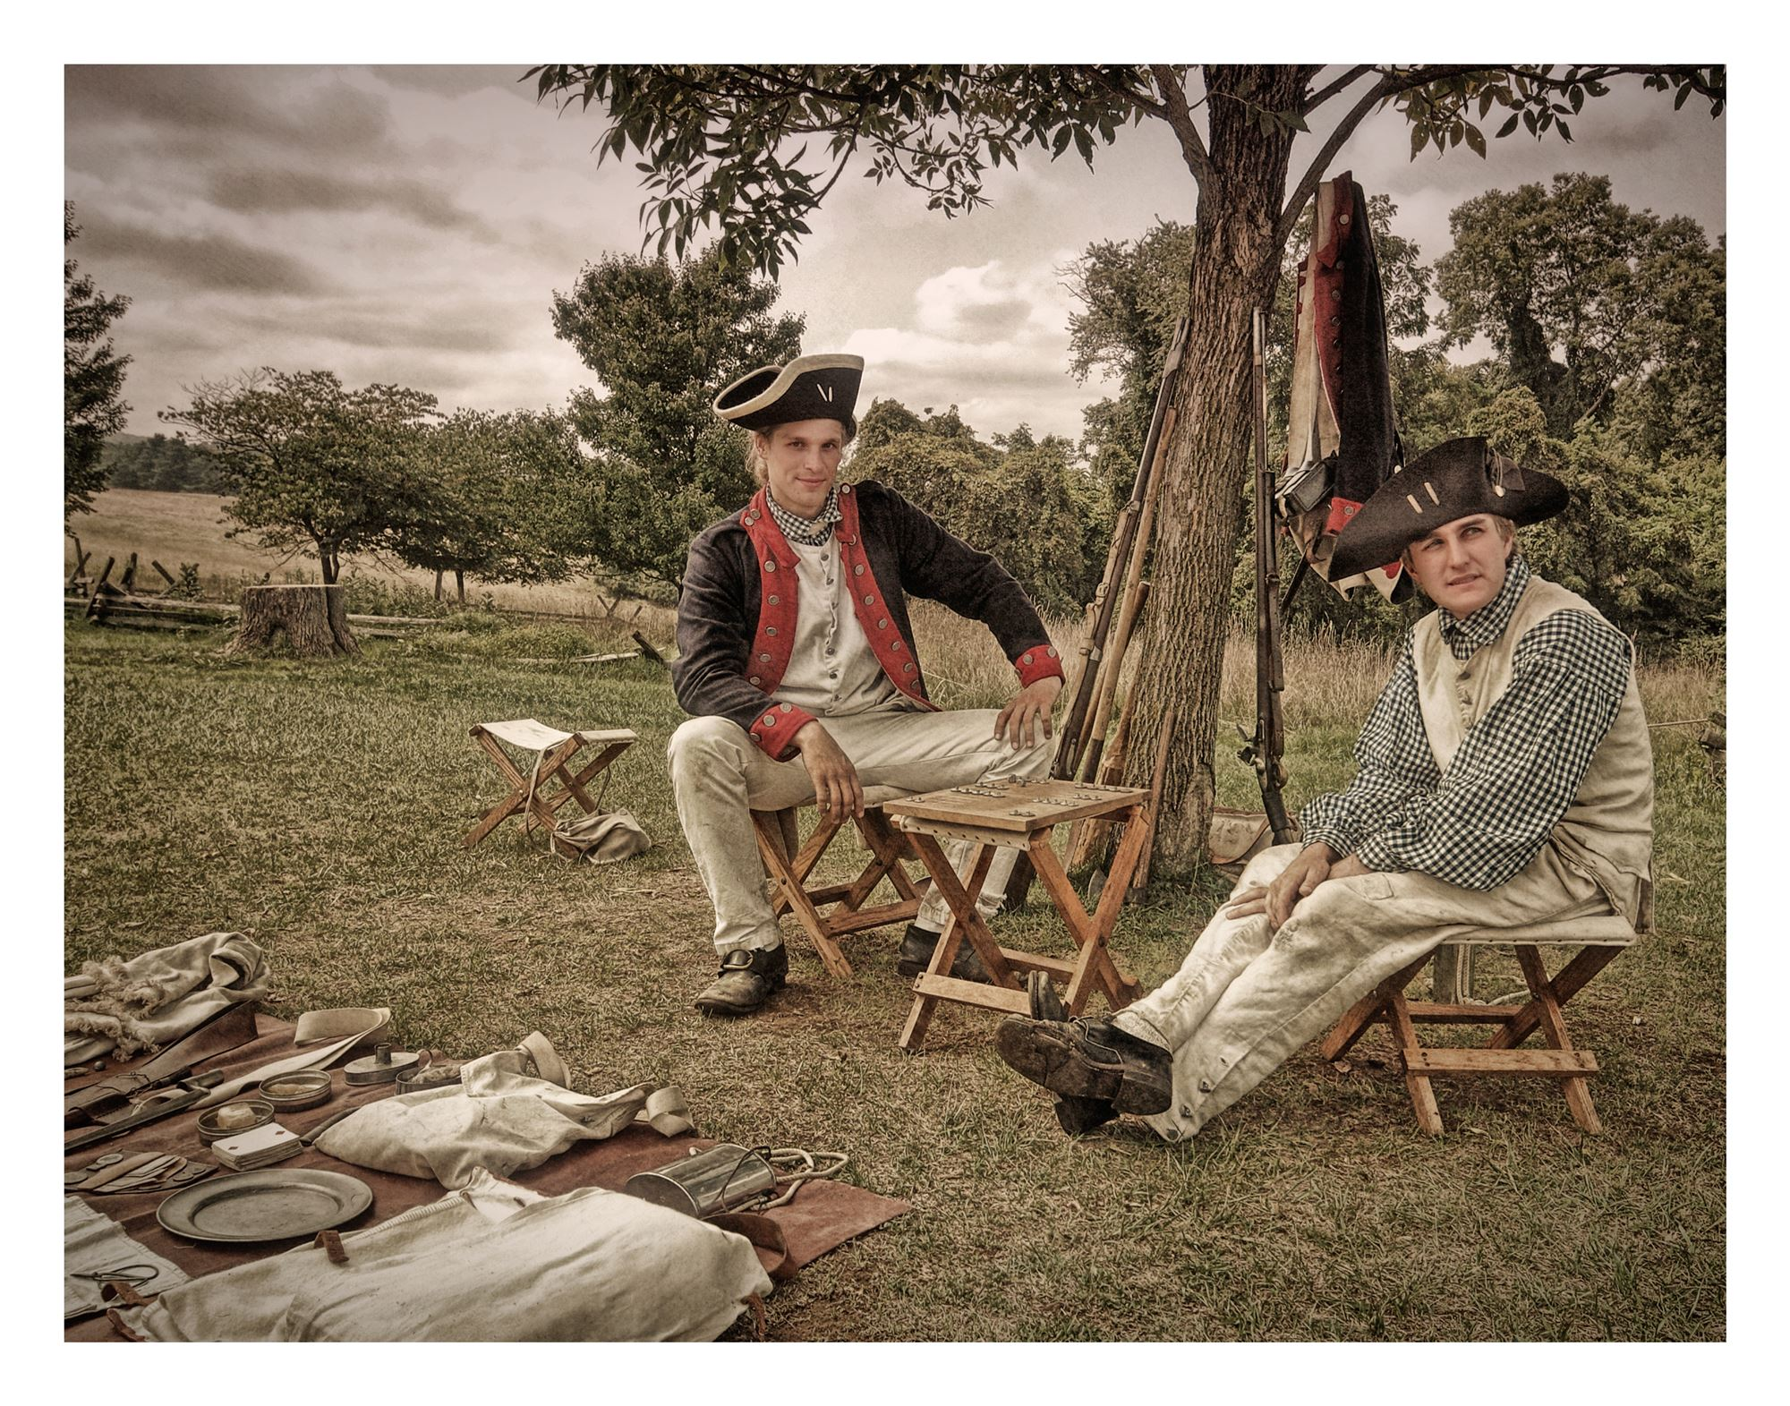
Diversions and Distractions
Soldiers brought to objects to Valley Forge that helped to make life bearable and, in some cases, enjoyable.
Small items carried in haversacks, such as cards, dominos, and dice, were taken out in idle or lonely moments.
Sporting events and theatrical performances lifted morale.
War Games
Courtesy of Valley Forge National Historic Park

Slide 15
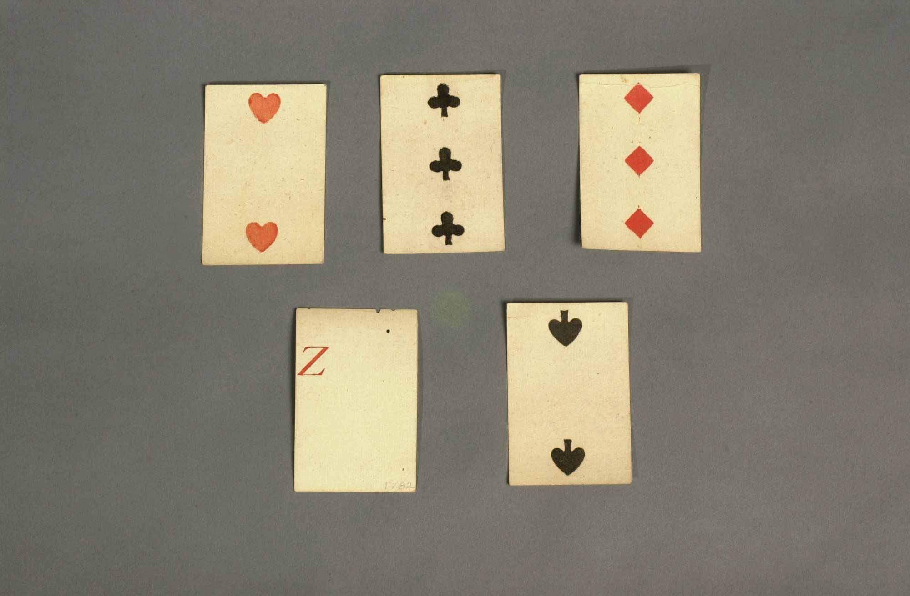
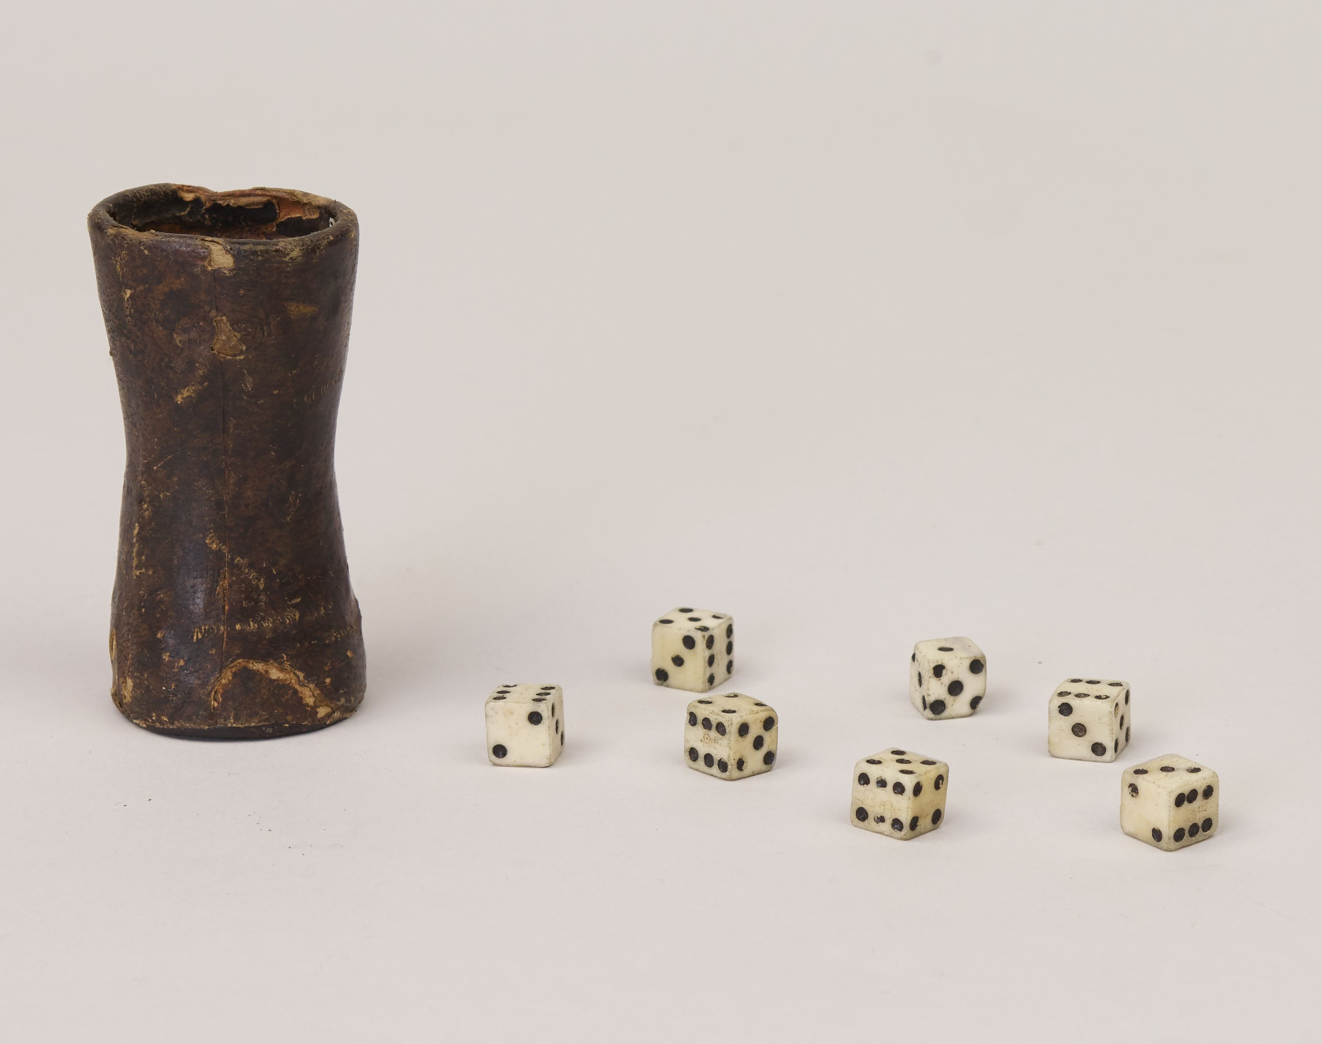
Diversions and Distractions
Simple musical instruments like tin whistles and jaw harps added much-needed melodies to the daily drudgery of building and maintaining a fortified log city.
Soldiers also read to pass the hours, and occasionally played group sports such as wicket and other ball games to build comradery.
Officers in particular enjoyed an active social life. Civilians came to visit. Bachelor officers held dinner parties. Officers joined in theatrical performances with the enlisted men. A few officers' wives, including Martha Washington, gathered to socialize and sew.
Playing Cards
VAFO 1775, 1776, 1777 1778, 1779, 1780
Dice Cup/ Die
VAFO 1222, 1869, 1870, 1871, 1872, 1873, 1874, 1875

Slide 16
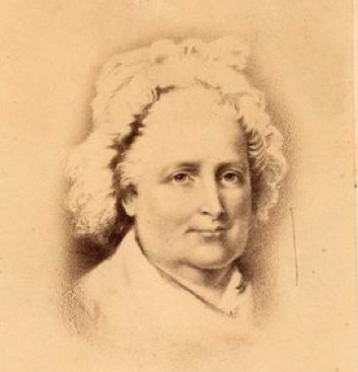
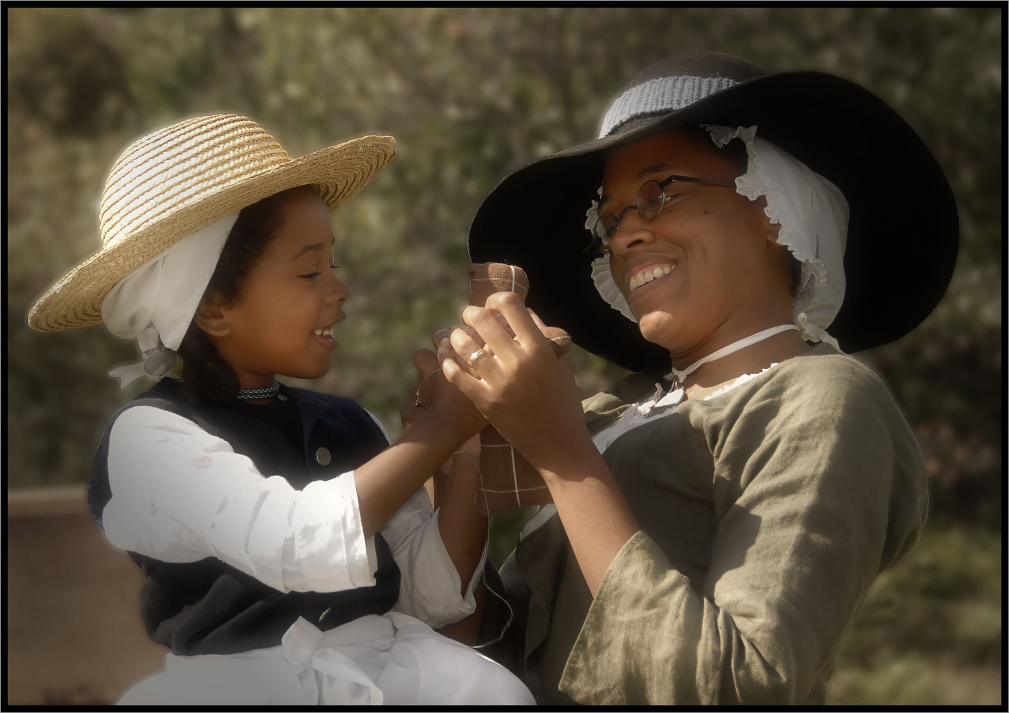
Women in Camp
Women and children were also present at Valley Forge.
Throughout the American Revolution, women traveled with the army to be with their husbands, and they contributed actively to the cause.
The women at Valley Forge included hundreds of enlisted men's wives who followed the army year round, and some general officers' wives on extended visits.
The army compensated full-time women followers for rendering such valuable services as sewing, laundering, and nursing.
Martha Washington
Courtesy of Arlington House, The Robert E. Lee Memorial
Colonial Mother and Daughter
Courtesy of Valley Forge National Historic Park

Slide 17
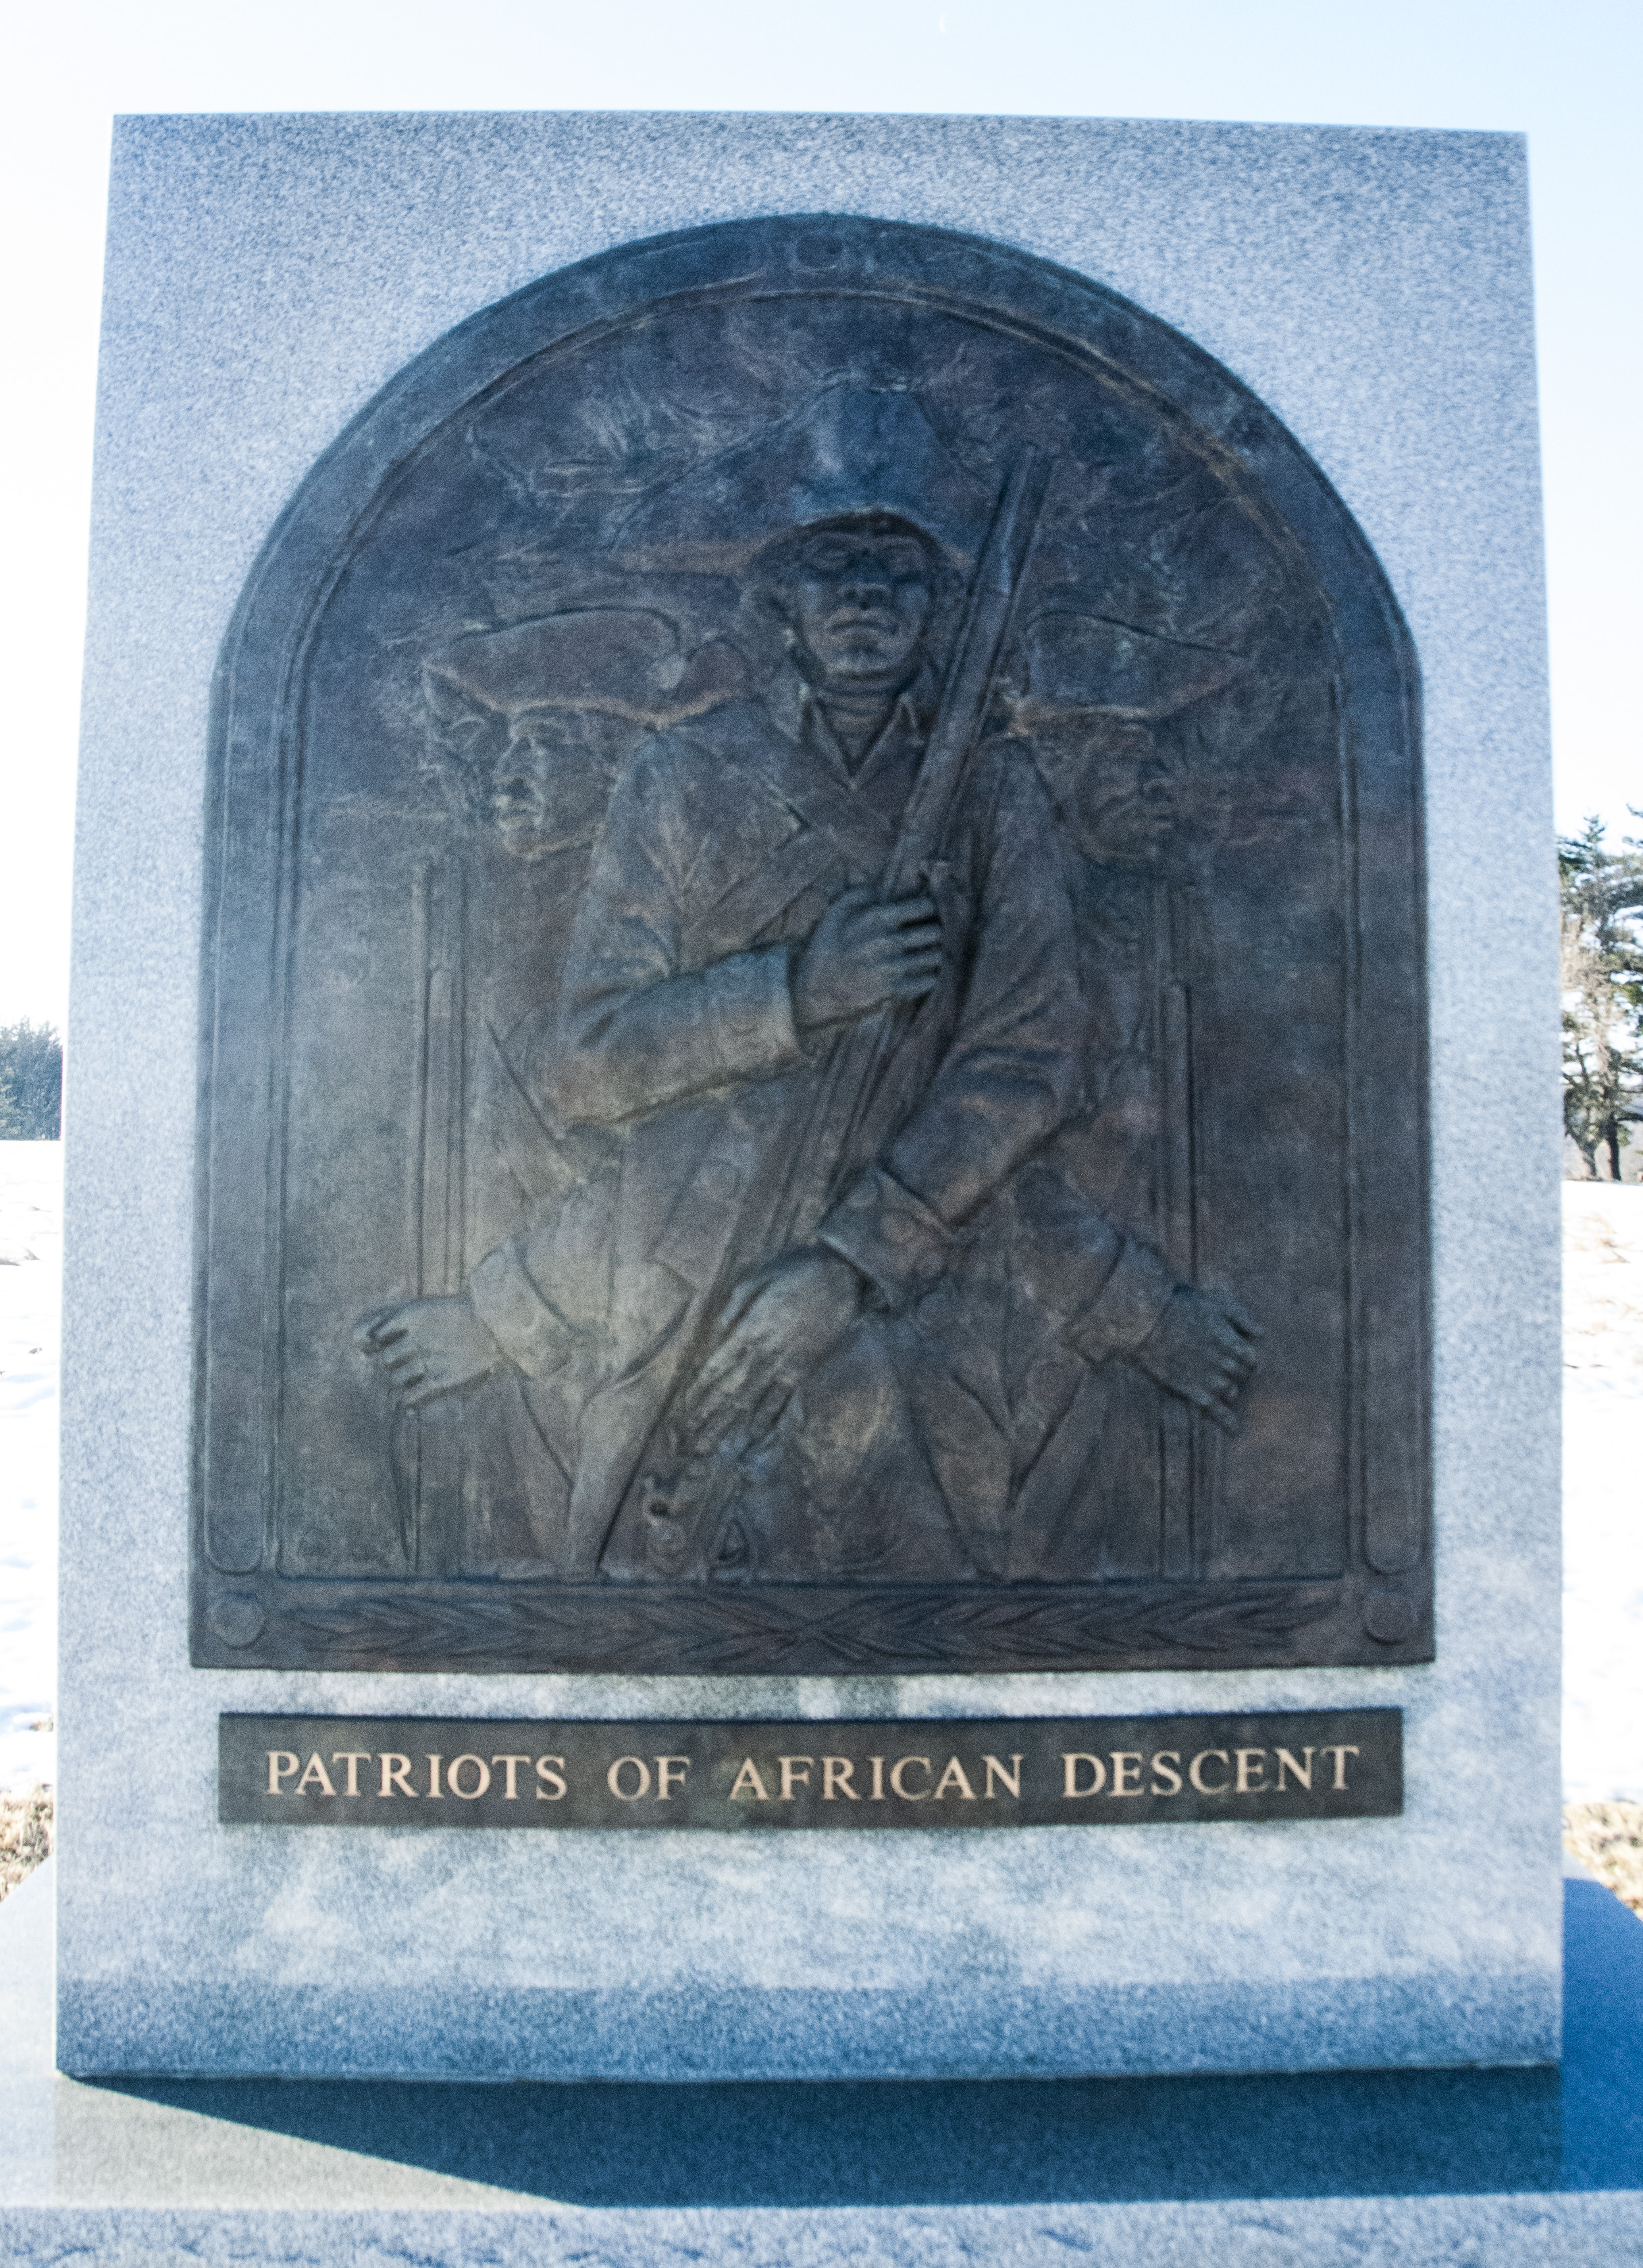
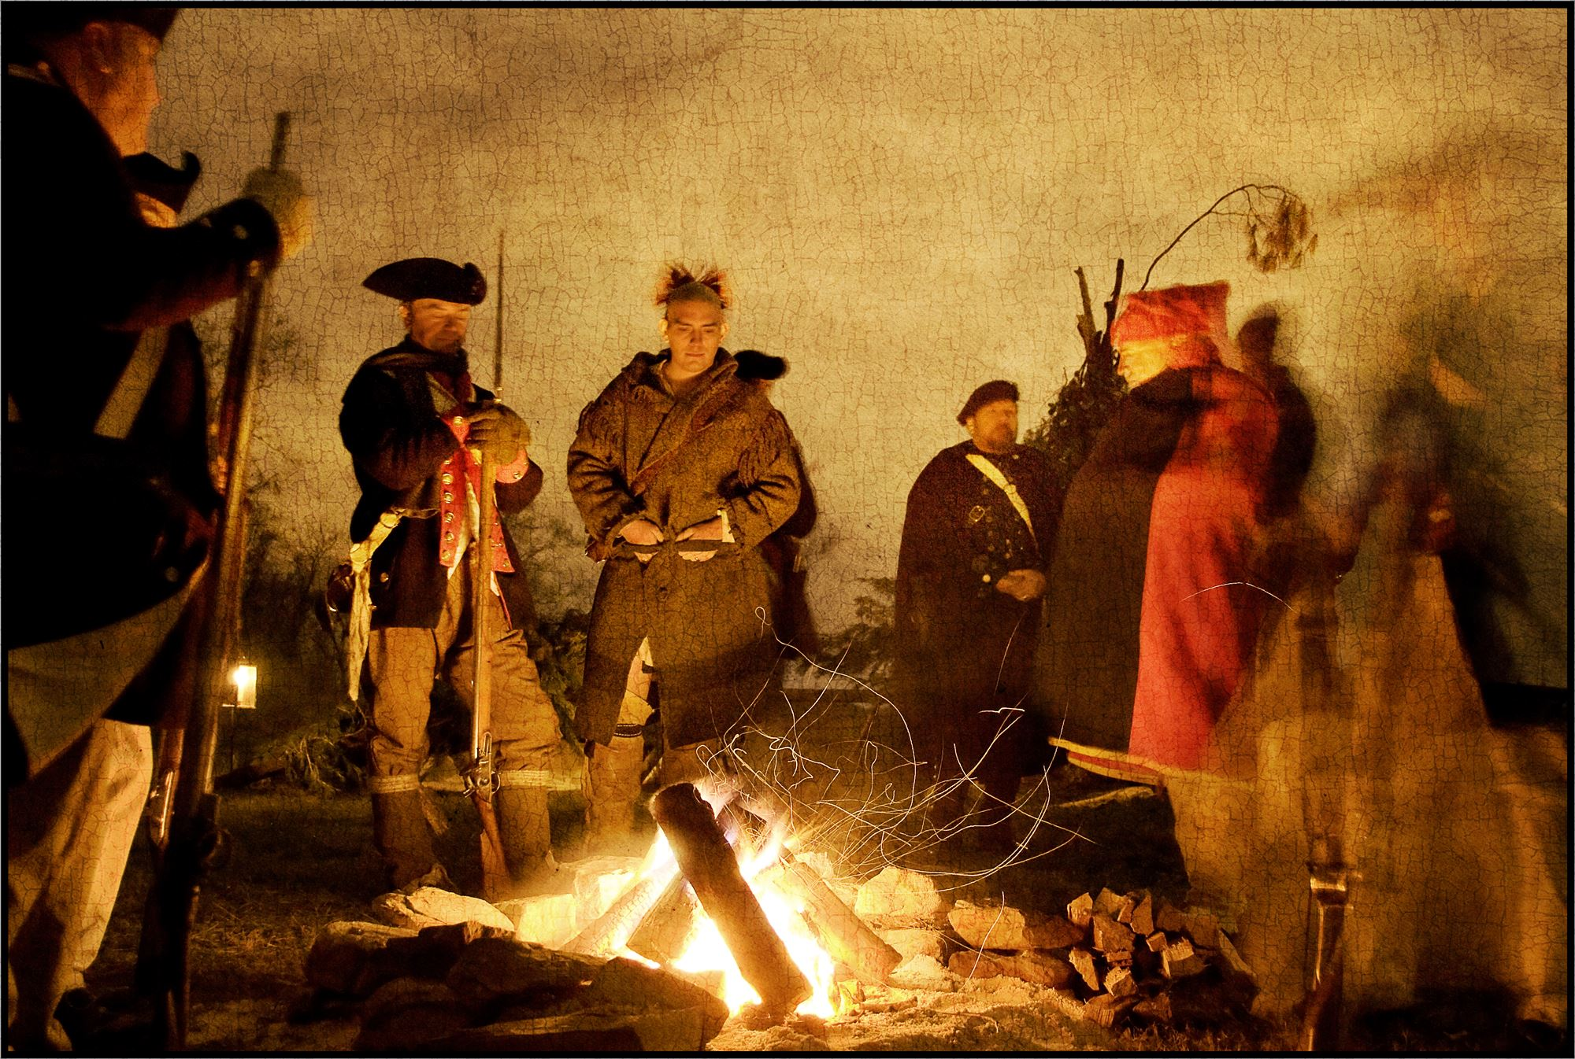
African Americans & Native Americans in Camp
The camp also included enslaved African Americans, who enlisted with both the British and Continental armies in the hopes of earning liberty and wages.
American Indians were also at the camp-- members of the Oneida nation played a significant role at Valley Forge, offering items for trade, aid, and a contingent of warriors.
Patriots of African Descent Memorial, Valley Forge National Historic Park
Arrival at Valley Forge
Courtesy of Valley Forge National Historic Park

Slide 18
Training the Army
Before the Valley Forge encampment, military training had been administered from several different field manuals resulting in an inefficient and undisciplined army.
General Baron FriedrichVon Steuben, a former Prussian military officer) was given the task of training the Continental Army.
  He first trained a company of 120 men who in turn trained other companies, resulting in uniformity of military practice and tactics in the entire army.
In 1779, General Von Steuben would write and publish his own drill manual, Regulations on the Order and Discipline of the Troops of the United States, which was widely circulated throughout the Continental forces.

Slide 19
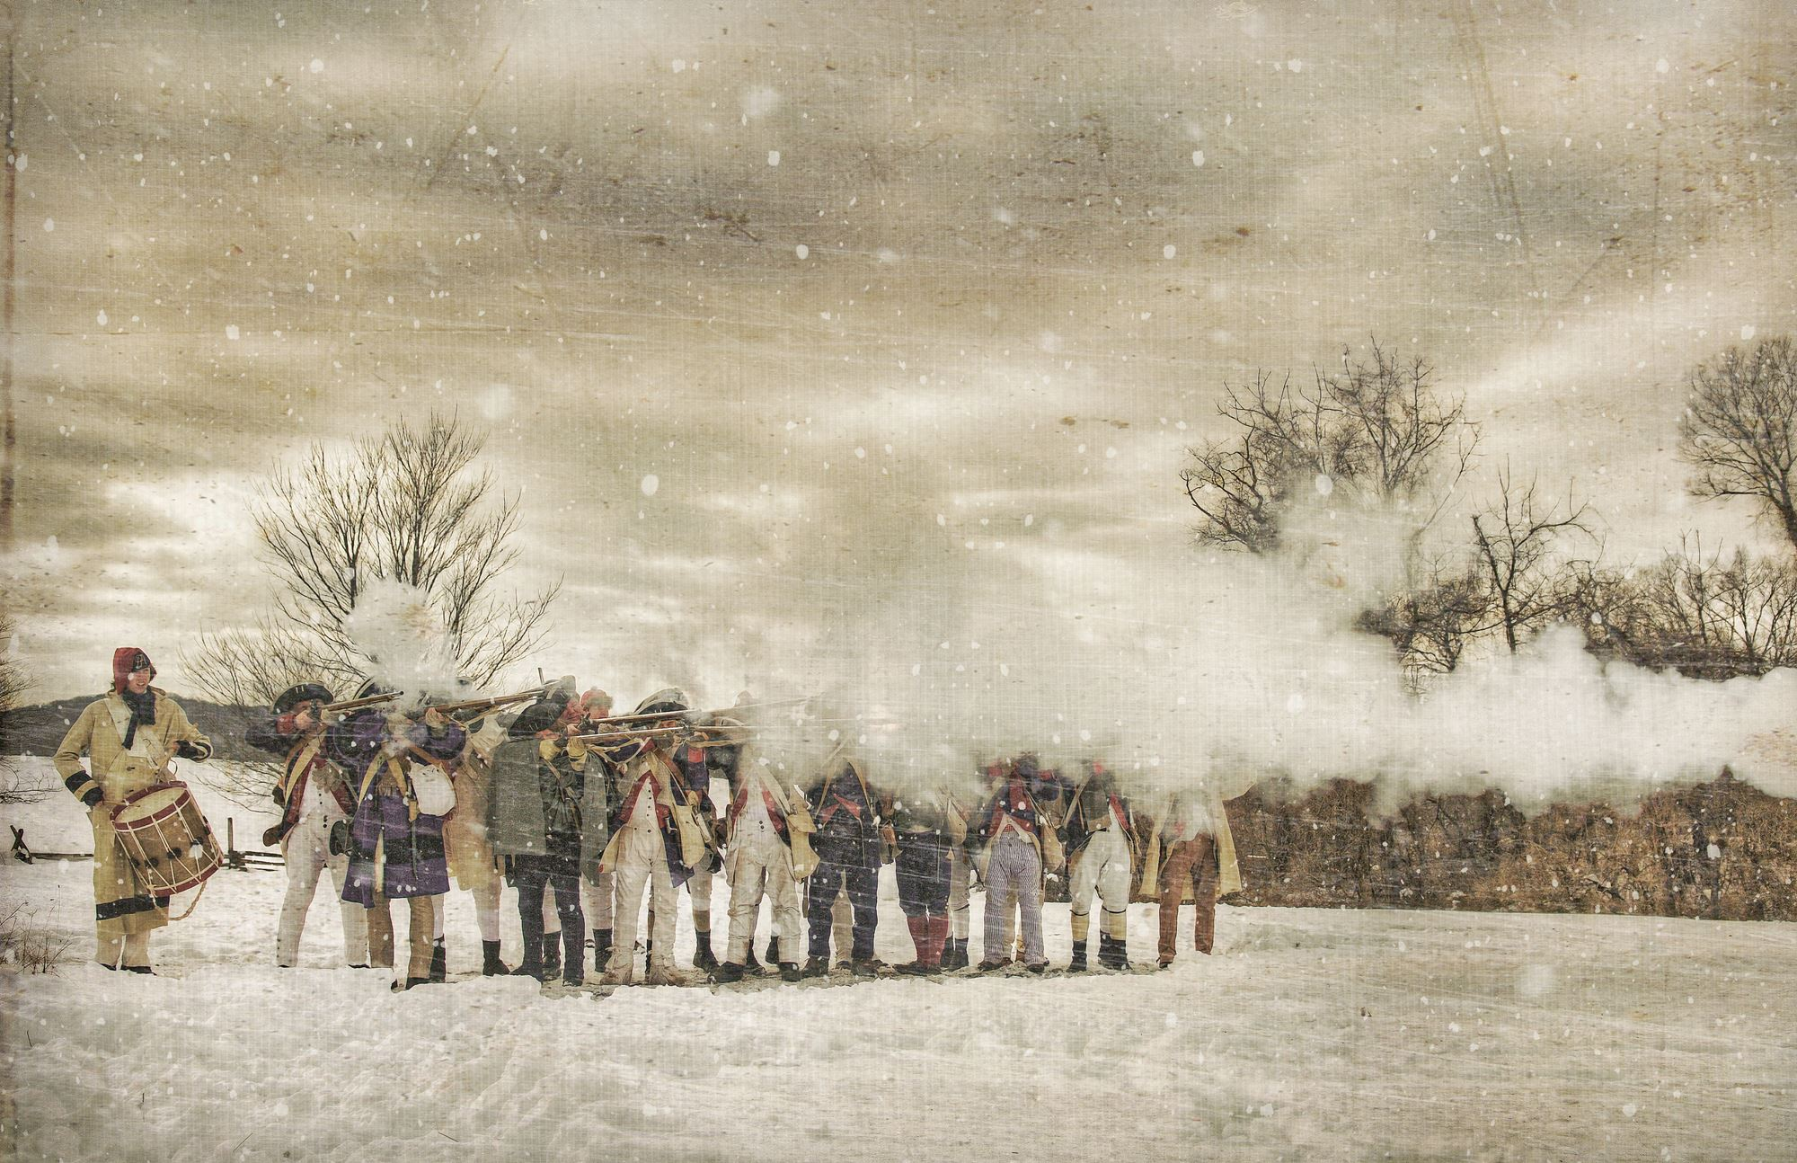
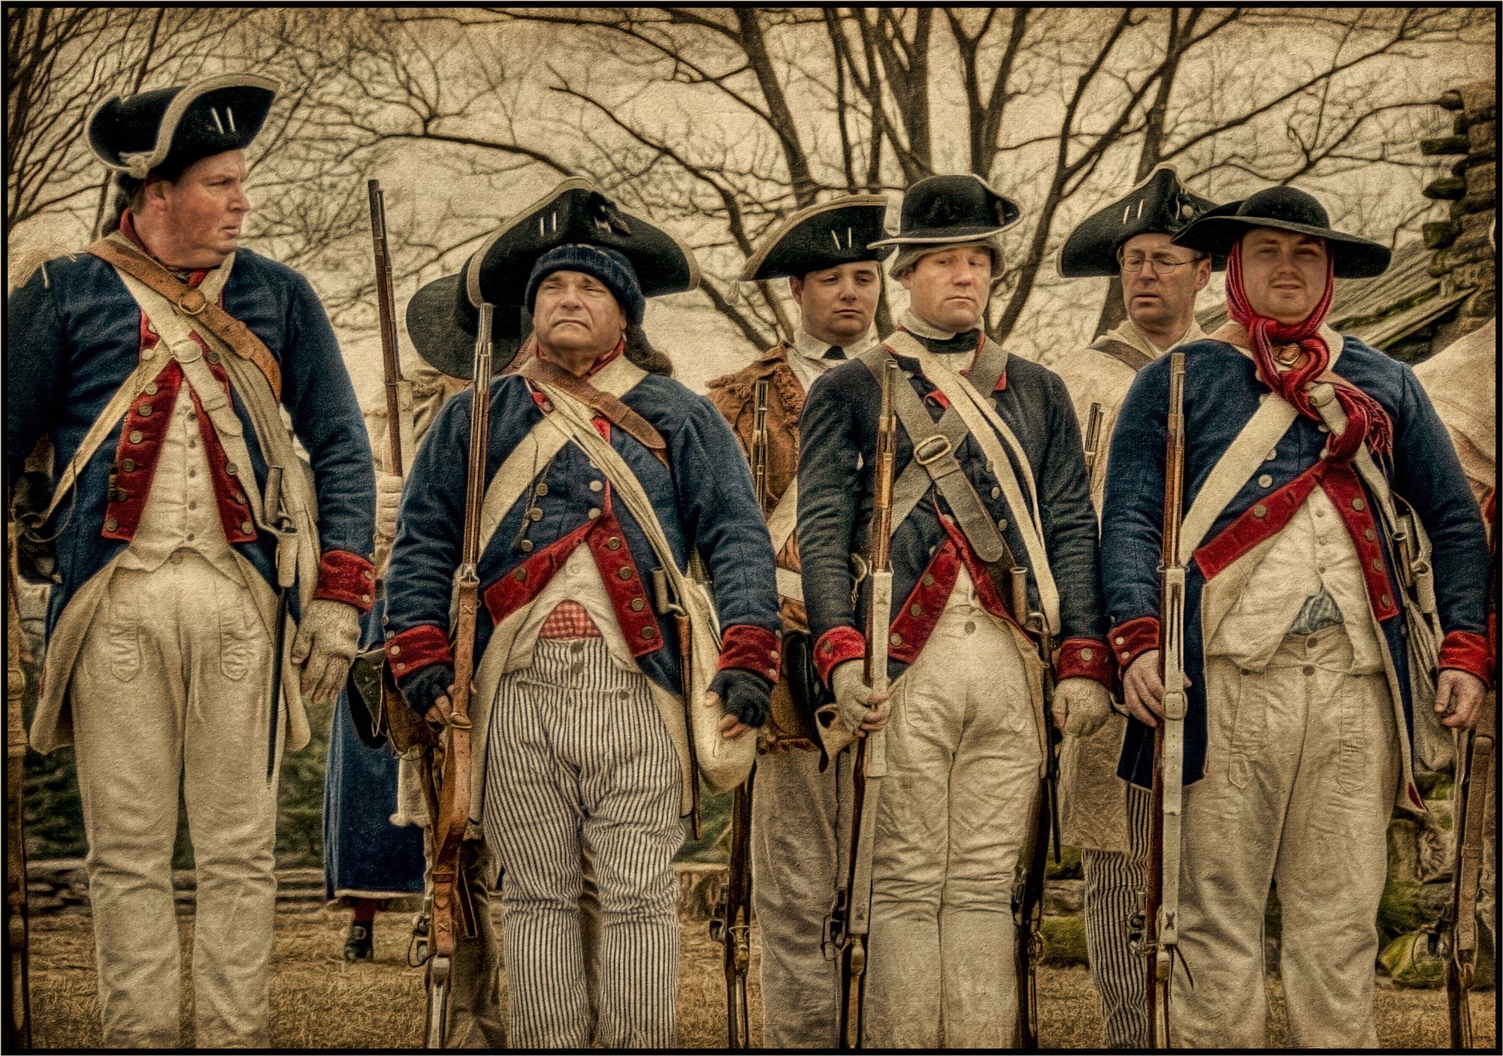
Training the Army
In the Line of Fire
Courtesy of Valley Forge National Historic Park
Silence!
Courtesy of Valley Forge National Historic Park

Slide 20
The Turning Point of the War
After a difficult winter, the army at Valley Forge found out that France had signed a treaty with the Thirteen Colonies and would be sending military and monetary aid.
On June 19, 1778, six months after they had arrived, the Continental Army marched on Philadelphia and reclaimed the city.
The army would pursue the retreating British and engage them at the Battle of Monmouth on June 28th.
  Although the outcome was indecisive, the colonial newspapers heralded it as an American victory.
Because of the training of Von Steuben, the Continental Army had finally shown their ability to stand up to the British military force.

