Slide 1
Making a Scene:
How Landscape Artists Contributed to the Establishment of the National Park System
Background Information

Slide 2
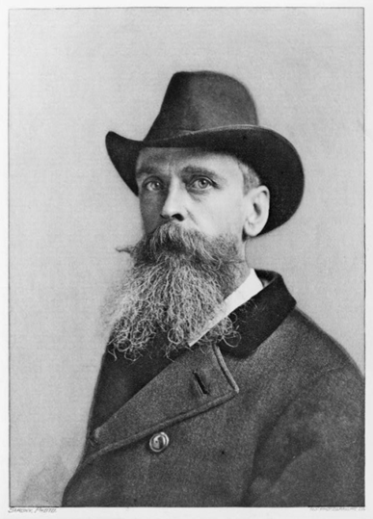
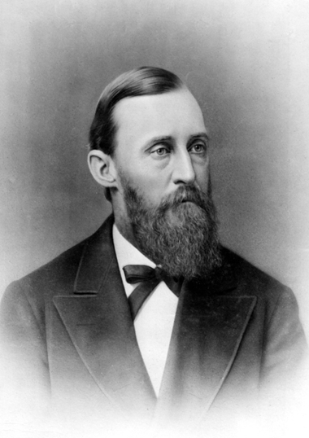
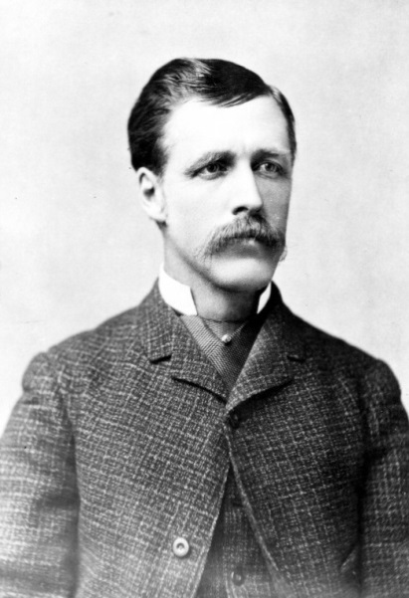
The natural wonders of the U.S.
Mid-19th century- many expeditions into rugged Western landscapes take place, returning reports of beautiful natural landscapes.
Several artists who documented these landscapes gained fame and prestige as “expedition artists.”
  Thomas “Yellowstone” Moran (landscape artist)
  William Henry Jackson (photographer)
Both Moran and Jackson accompanied F.V. Hayden to the Yellowstone region in July 1871.
Thomas Moran
F.V. Hayden
William Henry Jackson

Slide 3
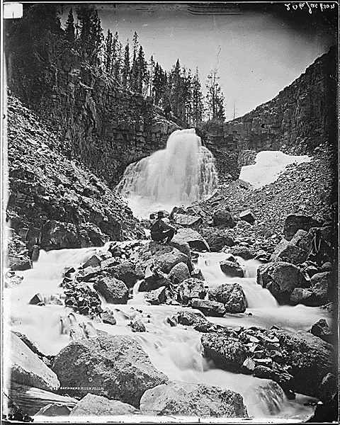
Moran and Jackson often worked side-by-side, selecting views and creating images to bring the Yellowstone region to life.
  Moran appears in several of Jackson’s photos, giving a sense of scale to many of the geological features.
Falls on the Upper to Golden Gate
By, William Henry Jackson
Thomas Moran sits on rock

Slide 4
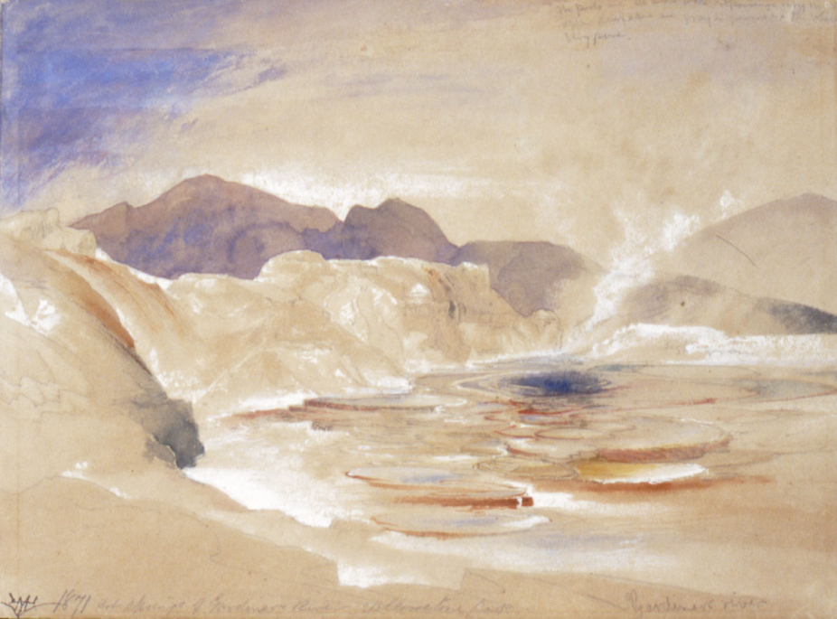
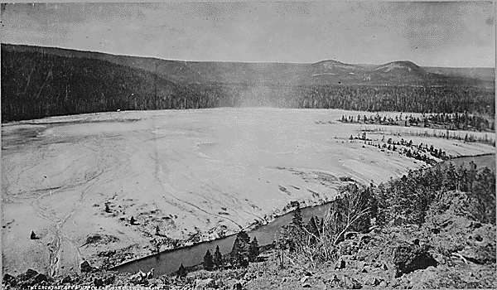
Hot Springs of Gardiner's River, Yellowstone Park
By, Thomas Moran
Hot Springs
By, William Henry Jackson

Slide 5
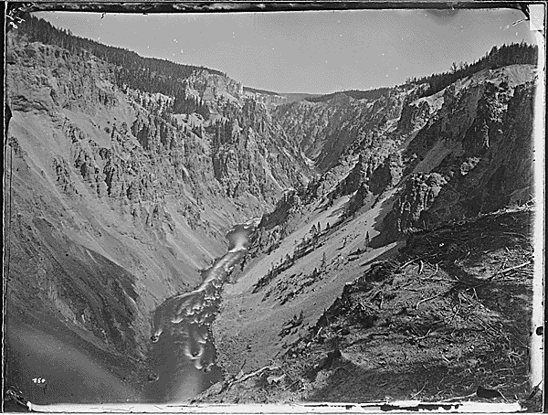
The fight for Yellowstone
Because the wonders of the Yellowstone region had not been seen by more than a handful of people on the East Coast, conveying the features of the amazing landscape to the American public and the U.S. Congress was crucial to ensuring the preservation of Yellowstone.
  Hayden lobbied Congressmen personally, using Jackson’s photographs and Moran’s watercolors as compelling visual supports.
  Jackson later wrote “the watercolors of Thomas Moran and the photographs of the Geology Survey [Jackson’s] were the most important exhibits brought before the [Congressional] Committee.”
Grand Canyon of Yellowstone from East Bank
By, William Henry Jackson

Slide 6
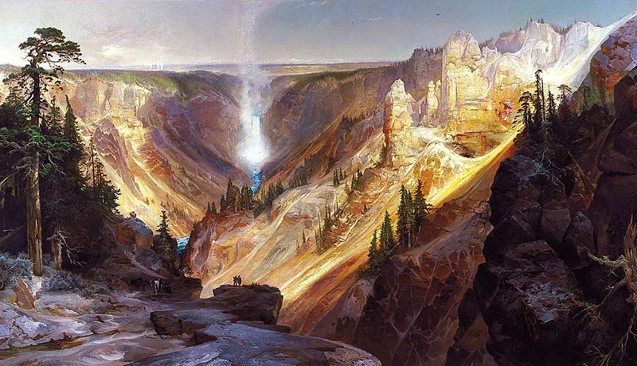
Yellowstone, A NATIONAL TREASURE
On March 1, 1872, President Ulysses Grant signed the Yellowstone Act in law.
Shortly thereafter, Moran completed a monumental 7’x 12’ panoramic painting – The Grand Canyon of the Yellowstone
  It was purchased by Congress on June 10, 1872 and hung in the Capitol Building

Slide 7
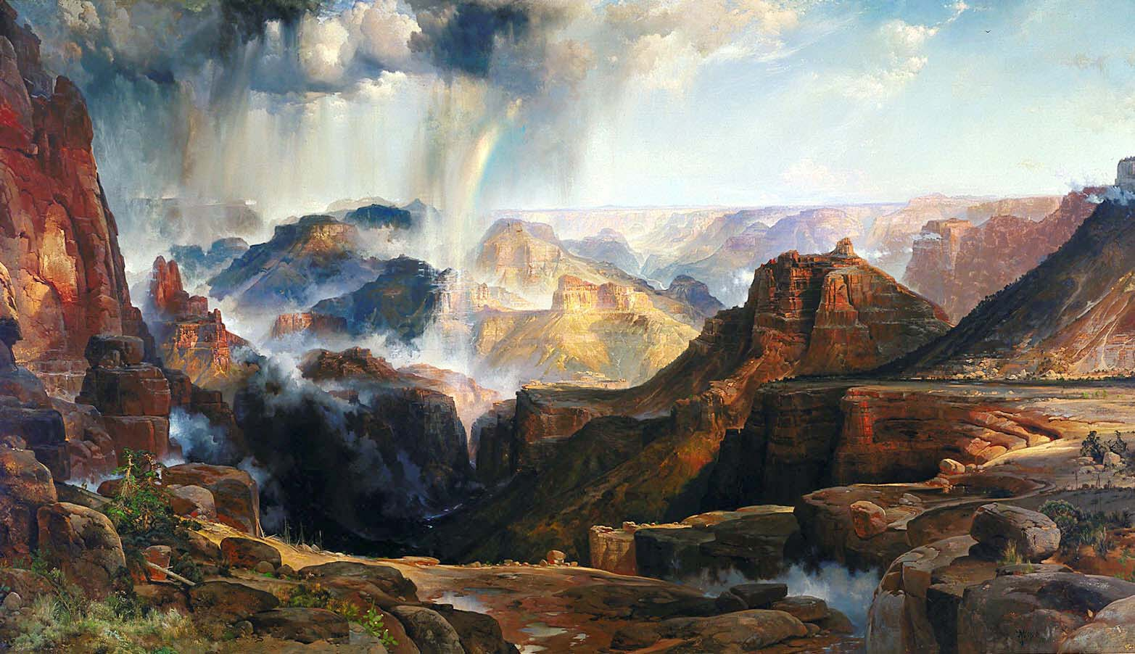
The Grand Canyon of Yellowstone was the first landscape purchased by Congress and the first depiction of American countryside painted by an American-born artist to be displayed in the Capitol Building.
The painting was soon joined by Moran’s The Chasm of the Colorado, depicting the Grand Canyon’s Colorado River, which he painted after an 1873 expedition to the region.

Slide 8
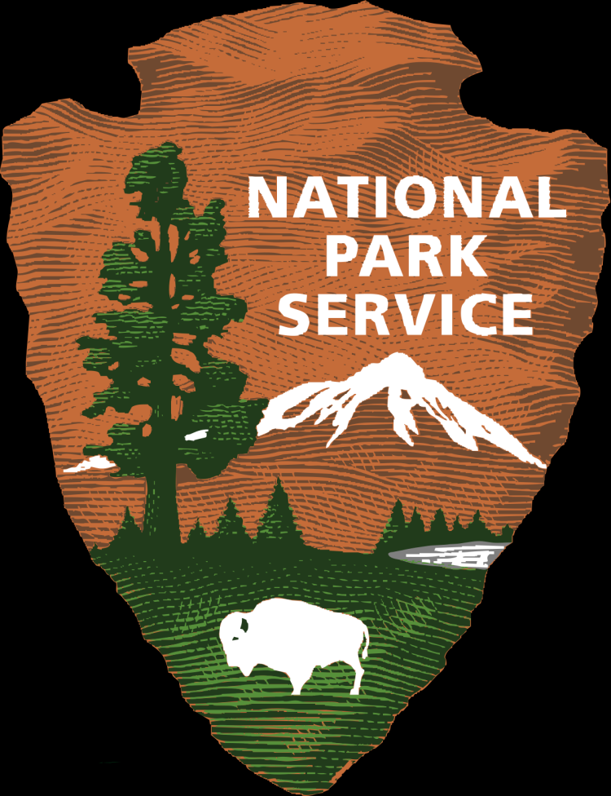
The national park service
Once Yellowstone had been established, other sites began to be set aside as federally protected lands, including Yosemite, Acadia, Crater Lake, and the Hawaii Volcanos.
These places existed as independent sites under the jurisdiction of the Department of the Interior (DOI) until 1916 when the National Park Service Organic Act established the National Park Service as a division within the DOI.
  NPS was given the responsibility “to promote and regulate the use of the Federal areas known as national parks, monuments, and reservations…to conserve the scenery and the natural and historic objects and the wildlife therein and to provide for the enjoyment of the same in such manner and by such means as will leave them unimpaired for the enjoyment of future generations.”

Slide 9
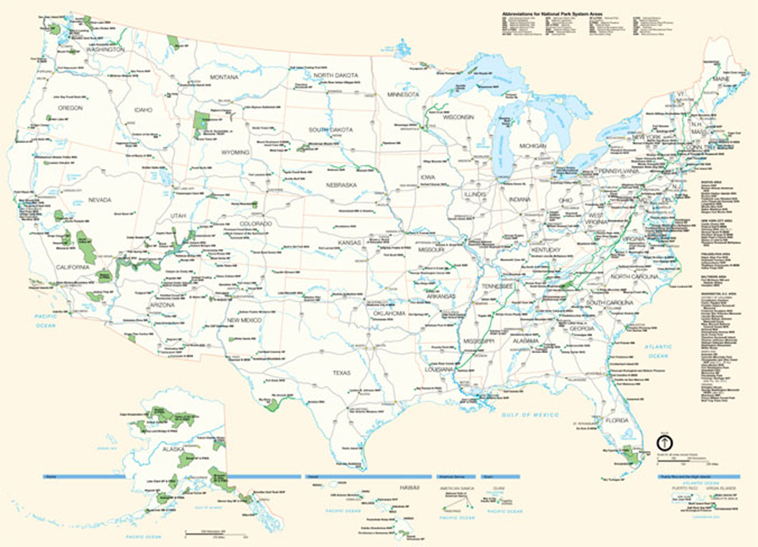
Today’s National parks
Since 1916, the National Park System has expanded from 37 sites of national significance to over 401.
  Each location is a site of natural, historic, or cultural significance, and each brings a collection of objects that contributes to the story of the site’s significance.

