Slide 1
Colonial Currency
Economy and Symbolism

Slide 2
The History of Colonial Currency
Colonists arriving in the colonies were often poor, having spent most of their money for their passage to the new world.
For a variety of reasons, money was almost always in short supply during the early colonial period.
The lack of coins and currency forced the colonists to barter.
The English leaders felt that colonial exports, such as animal skins, dried fish, and tobacco, should be paid for in English goods.
Colonial exports would be accepted in return for an equal value of such goods as fabrics, window panes, pewter dishes, and mirrors.
This barter system- an exchange of goods or services without using money - seemed ideal to the British but was increasingly unpopular with the colonists, who preferred coin for their exports to gain more independence over their buying power.

Slide 3
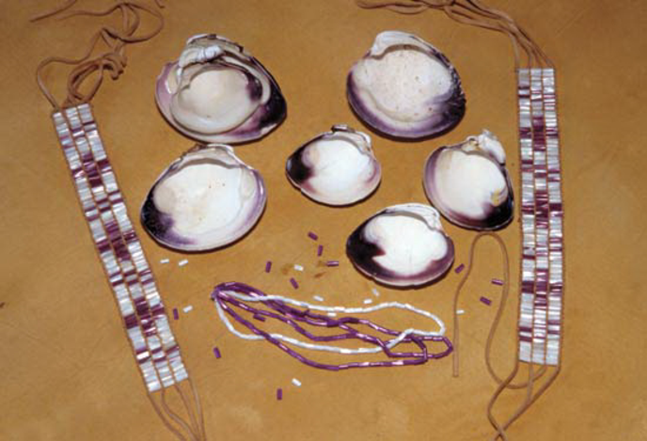
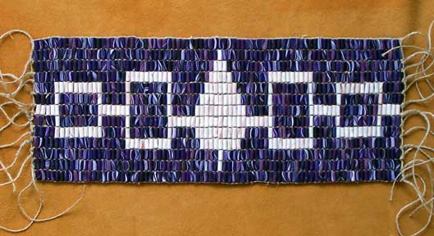
Early Forms of Colonial Currency
Wampum
made of sea shells (quahog shells)
introduced to New England in 1627 by Dutch settlers in New York who traded with Indians.
1637, it was made legal tender and was accepted as payment for taxes
However, the fragility of the shells, the usage of poor shells, along with artificial color, made it lose its value. By 1661 it was no longer considered legal tender.

Slide 4
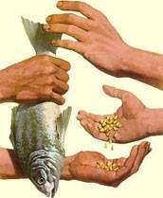
Early Forms of Colonial Currency
Commodity Money (“Country Pay”)
Colonists often resorted to the use of commodity money, where a colony's principal commodity would circulate as a medium of exchange.
The Massachusetts Bay Colony used corn and beaver skins as its medium of exchange.
In the Southern colonies, it was tobacco and rice
Since the market value of commodity money was determined by supply and demand, its value as money often decreased when there was an oversupply in the marketplace.
In addition, commodity money lacked uniform quality, and was prone to spoilage, difficult to transport, and costly to store.

Slide 5
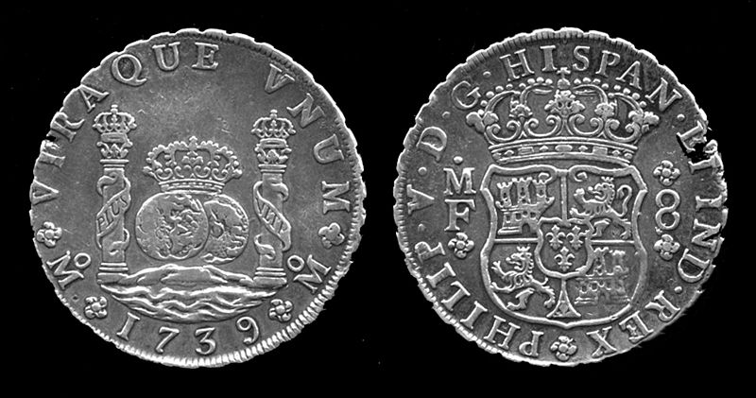
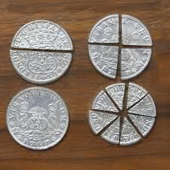
Early Forms of Colonial Currency
Foreign Coins
Colonists always preferred specie (gold and silver coin) to other forms of payment, but, when colonists first arrived, they brought very little precious metal with them from Europe.
Foreign trade succeeded in bringing foreign coins to New England (the colonies traded with England and the Spanish West Indies, where many coins circulated.)
Foreign coins were also supplied by piracy, which was a fairly common practice in the 16th and 17th centuries.
The most common coin circulating in the colonies was the Spanish piece-of-eight, also known as the Spanish dollar. It was divided into eight reals. The coin circulated in the United States as legal tender until 1857. The term "two bits," or reals, meaning a quarter dollar, is still used.
Problems: The value of the coins varied from colony to colony, and attempts to place an equal value on the coins failed

Slide 6
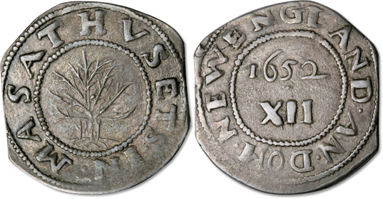
Early Forms of Colonial Currency
New England Coinage
By 1652, the problem resulting from a shortage of coins had become extreme and England had turned a deaf ear to the colonists' plea for specie.
The Massachusetts Bay Colony established an illegal mint in Boston in 1652.
The first coinage was unsuccessful because the simple design invited counterfeiting.
In a second attempt, the colony decreed that all pieces of money coined shall have a double ring on either side, “Massachusetts” and a tree in the center on one side, and “New England” and the year.
These coins were the famous "tree" pieces.
In 1684 the charter of Massachusetts was revoked by the king, and the mint was ordered to close.

Slide 7
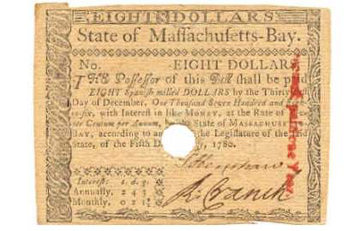
Early Forms of Colonial Currency
Bills of Credit
In 1690, the Massachusetts Bay Colony was authorized to raise troops to help British soldiers fight in King William's War.
The King allowed the colony to pay soldiers with Bills of Credit - a promise to pay in the future - printed on paper by the colony.
The crudely printed notes were issued in denominations of five, ten, and twenty shillings.
The bills issued by the Massachusetts colony circulated freely, and eventually each New England province began to print its own notes.
The bills were meant to represent shares of commodities such as corn, grain, cattle, and ultimately silver.
Some of these early experiments with paper money were successful, but in many cases the bills were seldom redeemed as promised because of the shortage of gold and silver coin.

Slide 8
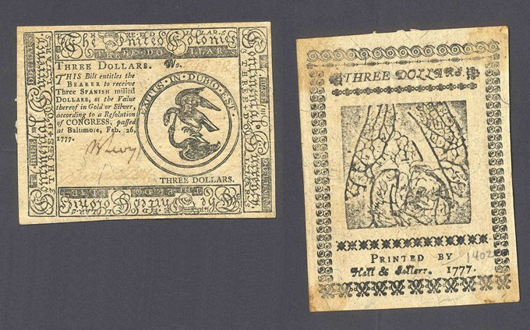
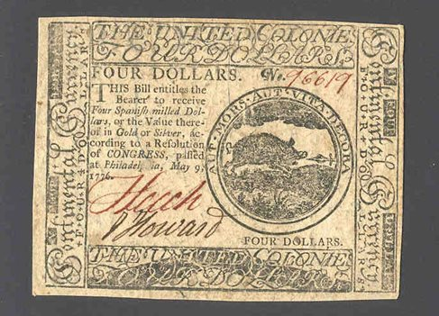
Early Forms of Colonial Currency
Continental Currency
By 1751, the British Parliament passed a law forbidding the Massachusetts Bay Colony to issue money in any form.
When the Revolutionary War broke out in 1775, the Continental Congress issued paper money to finance the war.
These notes were backed by anticipated future tax revenues.
Far too much continental currency was issued, causing it to depreciate rapidly.
By the end of the war, it had become worthless or, as the saying went, "not worth a continental."
This experience was so disastrous that it created a deep distrust of paper money issued by the government. Experiments with paper money and coin continued after the Revolution, with states and private banks printing their own currencies. Bank notes became unpopular when too many banks began issuing too many different paper currencies without sufficient ability to redeem them in coin. It was not until the 1860s, when National Bank Notes were created during the Civil War, that Americans finally achieved a reasonably stable money system.

Slide 9
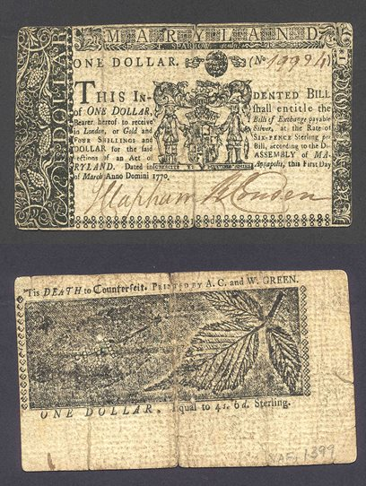
Symbolism in Colonial Currency
Colony: MARYLAND, One Dollar
The Great Seal of the State of Maryland
Counterfeit Warning
Leaf and Branch Pattern helps prevent counterfeit

Slide 10
Symbolism in Colonial Currency
Counterfeit Warning
Colony:
PENNSYLVANIA, Fifty Shillings
Royal Design (Cartouche, crowns, and Corinthian columns), “Mercy and Justice” written below: all symbols of the crown
Nature Scene : similar to leaf and branch pattern, it helps prevent counterfeit

Slide 11
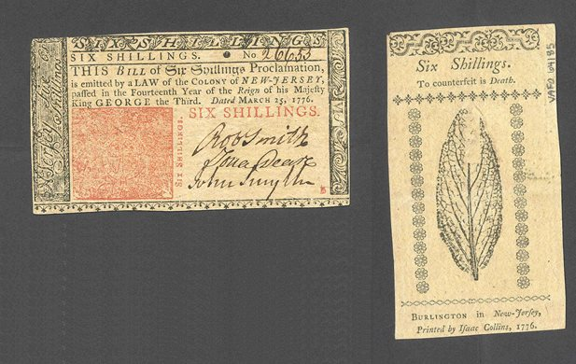
Symbolism in Colonial Currency
Colony: NEW JERSEY, Six Shillings
Leaf pattern helps prevent counterfeit
Intricate red pattern helps prevent counterfeit

Slide 12
Symbolism in Continental Currency
The United Colonies, Three Dollars
Latin Phrase: “The Outcome is in Doubt”
Leaf pattern helps prevent counterfeit
Continental Currency
Birds attaching each other reflects nature of the Revolutionary War (fighting between England and the Colonies

Slide 13
Symbolism in Continental Currency
The United Colonies, Four Dollars
Latin Phrase: “Either Death or Honorable Life”
Continental Currency
Boar being speared, again reflects nature of the war

Slide 14
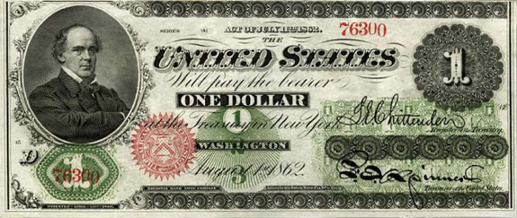
Symbolism in Modern Currency
The first widely circulated $1 bill was issued by the United States during the Civil War and did not depict the likeness of George Washington.
Secretary of the Treasury, Salmon P. Chase
Seal of the Treasury with 34 spikes, each representing the existing states

Slide 15
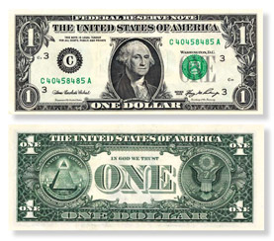
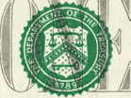
Symbolism in Modern Currency
Current Seal of the Treasury
Scales of Justice
Key of Official Authority
Stars of the 13 colonies
District Seal of the Federal Reserve
Letter, in this case “C.” indicates the issuing Reserve Bank (Philadelphia)

Slide 16
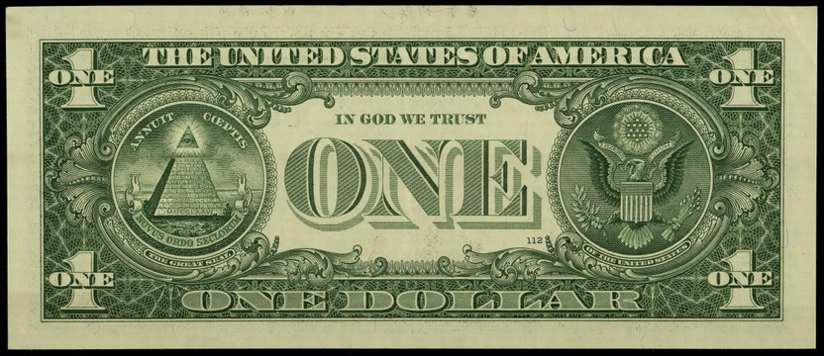
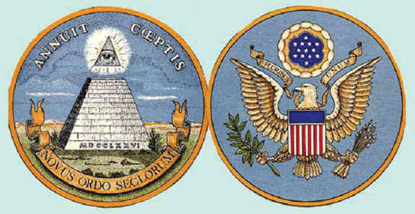
Symbolism in Modern Currency
Color in Symbolism
Blue stands for vigilance, perseverance, and justice
Red signifies hardiness and valor
White indicates purity and innocence
The Great Seal of the United States

Slide 17
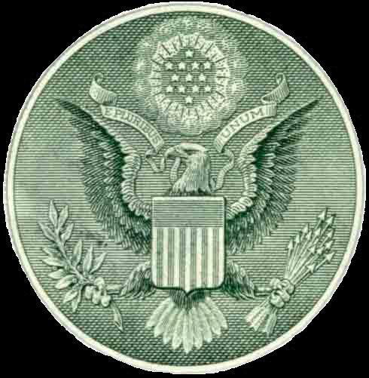
Symbolism in Modern Currency
13 stars = a new constellation taking its place in the universe, like new nation takes its place among the other sovereign nations.
“E Pluribus Unum” = Out of Many, One
Top band of shield = Congress
13 Stripes = 13 colonies
Olive Branch = Peace
Arrows = War

Slide 18
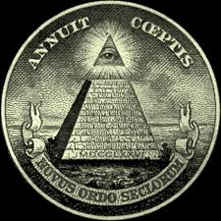
Symbolism in Modern Currency
An eye, with rays that emanate in all directions.
+
The Latin motto "Annuit Coeptis" translates to "Providence Has Favored Our Undertakings,” it alludes to the many signal interpositions of providence (God) in favor of the American cause."
unfinished pyramid, "strength and duration” that will continue.
composed of 13 rows of building blocks
the first block has the Roman numerals representing 1776.
"Novus Ordo Seclorum” = A New Order of the Ages.

