Slide 1
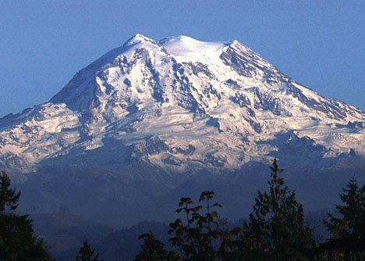
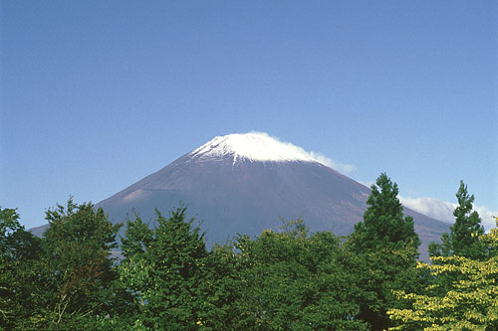
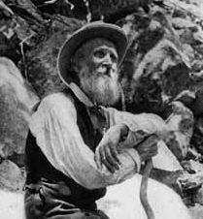
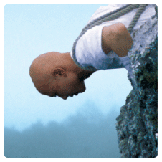
Creating “Sense of Place”
The Human History of Mt. Rainier & Mt. Fuji

Slide 2
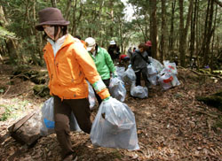
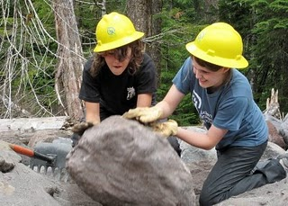
Overview
This lesson is about students learning how humans throughout history have developed a sense of place, or identity, to Mount Rainier and Mount Fuji, and how this identity has led them to conserve and protect these special places.

Slide 3
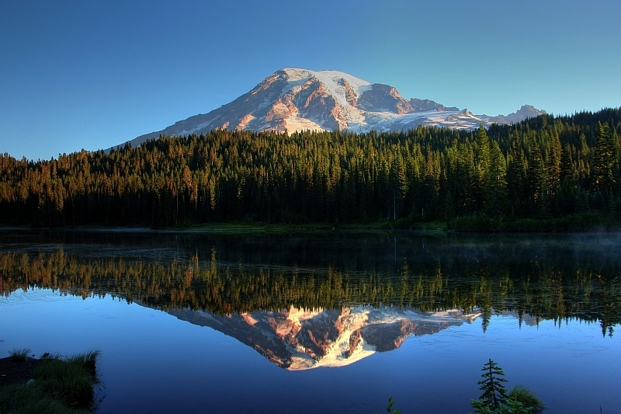

Slide 4
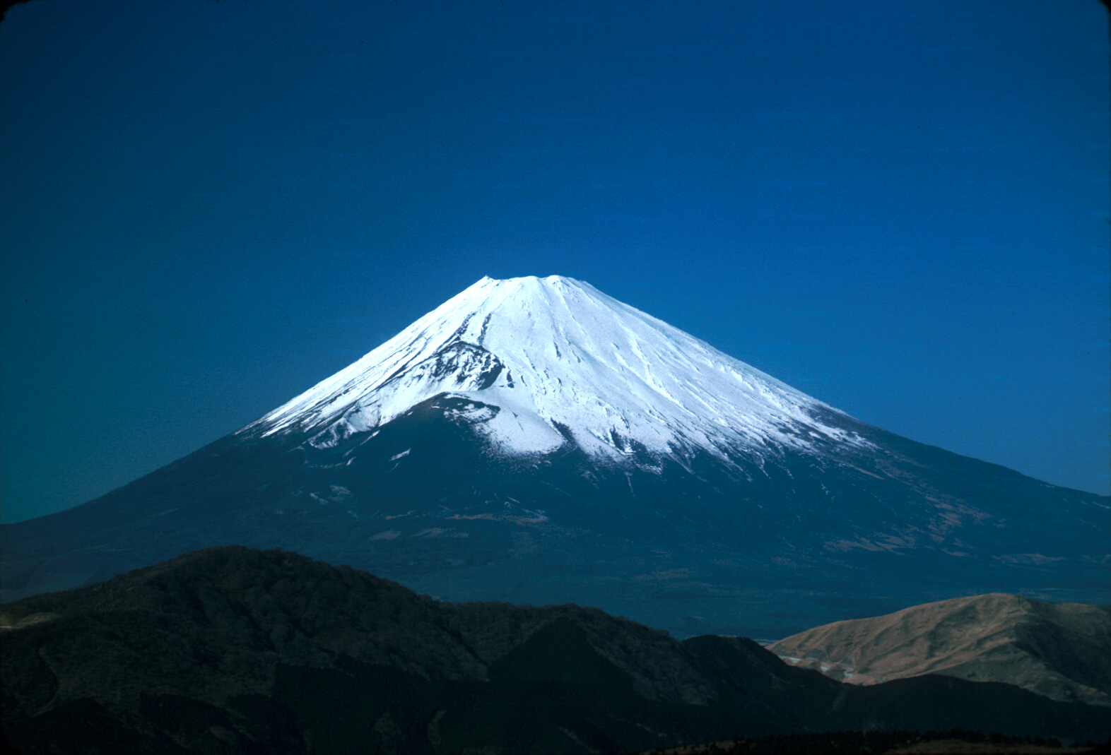

Slide 5
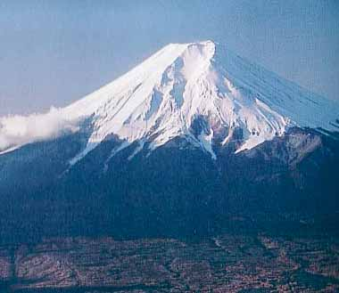
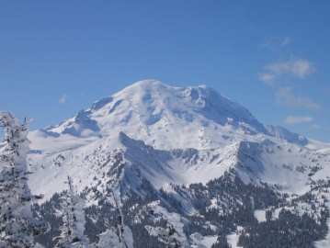
Sense of Place
An individual’s connection and interpretation of a particular area
How we feel about places
Deeply rooted in our history
“where you are, is who you are”
We all hold special connections to various places
Mt. Rainier & Mt. Fuji both have had historical figures who have developed a sense of place

Slide 6
Conservation
Sense of place has led people throughout history to want to protect places
Both mountains have people/groups who have wanted to protect the area

Slide 7
Think about it!
What makes a place special to you?
How are people around the world connected to special places?
Why would people want to preserve and protect special places?
What place would you want to protect? Why?

Slide 8
The Lesson
How humans have interacted with their environment throughout history.

Slide 9
Details…
Created for grades 10-12
Suggested 5-6 days
Classroom based
Field optional with extensions

Slide 10
What will happen
students will develop an understanding of what "sense of place" means
how this idea has led people throughout history to fight for land preservation and protection
apply their understanding of sense of place and preservation/protection
develop a persuasive letter urging the protection on Mt. Rainier/Mt. Fuji.
Various adaptations included

Slide 11
Student Goals
Note important figures from history and their connection to land and the their calls for preservation
Explain what sense of place means and how one creates such a feeling/identity.
Understand what land protection and preservation is and why it is conducted.
Discuss how land preservation and protection has been conducted nationally and internationally.
Understand how there are various stakeholders to one-piece of land and different interpretations of protection exist.
Analyze historical documents and interpret their call for preservation and protection.
Use and understand the mentioned vocabulary in a fluid and cohesive letter.
Write a letter to government officials where they persuade them to protect and preserve an important place using a specific stakeholder’s sense of place as justification.
Analyze text to determine its relation to sense of place and protection/preservation.

Slide 12
Student Vocabulary
Bio-regionalist
Stakeholder
Preservation
Conservation
UNESCO
Empowerment
Composite volcano
Yamabushi
stewardship

Slide 13
Student vocabulary continued
Zenjo
Summit
Shinto
Biosphere reserve
Torii
Empowerment
Takhoma
World heritage site

Slide 14
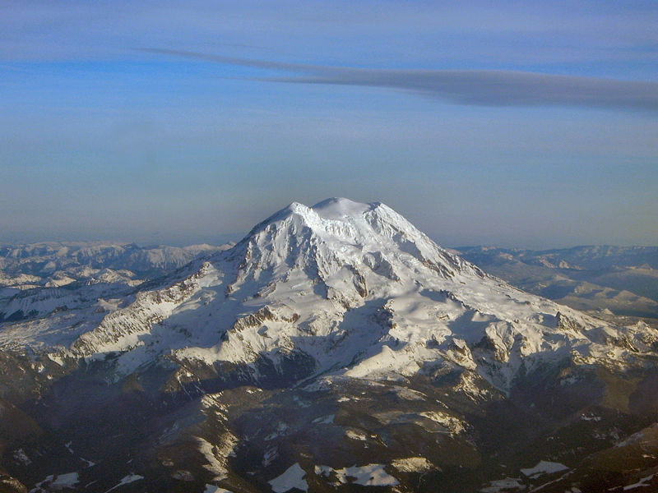
Human History of Mt. Rainier
Nisqually Tribe
John Muir
President William
McKinley
Fay Fuller
James Longmire
Puyallup tribe
U.S. National park service

Slide 15
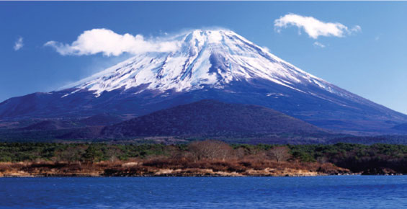
Human History of Mt. Fuji
Matsudai Shonin
Fujisan club
Fuji-Ko
Jikigyo Miroku
Ida
Followers of
Shugendo
Kakugyo hasegawa

Slide 16
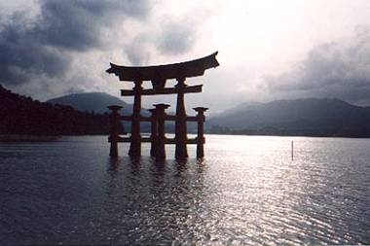
Learning “sense of place”
A Sense of Place | if you don't know where you are, you don't know who you are.
Responsibility to Place | difference between living on the land and dwelling in it—understanding its rhythms, its potential, and its limits.
Knowing Your Bioregion | Your bioregion is a unique place with its own watershed, soils, climate, plants, animals, and history.
Living in Place | Living in place means consciously trying to satisfy your needs and find your pleasures in your local bioregion and working to assure the long-term health of the bioregion
Mapping Your Place | Mapping can be learned by local groups and individuals to give a new sense of place.
Building Local Community | A bioregionalist assumes responsibility for the health and continuity of a place, not only its natural features, but also the social bonds of its people.
Empowerment | Knowing a place can inspire and empower one to take action to preserve it or take part in its restoration

Slide 17
Student Connection
Your sense of place!
(Pick your school, your park, forest, lake, city, state, country, etc.)
1. How are you defined by your place?
2. How do you/can you accept responsibility of your place?
3. What history do you know of your place?
4. How do you find pleasure/happiness in your place?
5. How do you relate to your surroundings of your place?
6. How do you take responsibility of your place?
7. Why do you think empowerment is important in protecting/preserving your place?

Slide 18
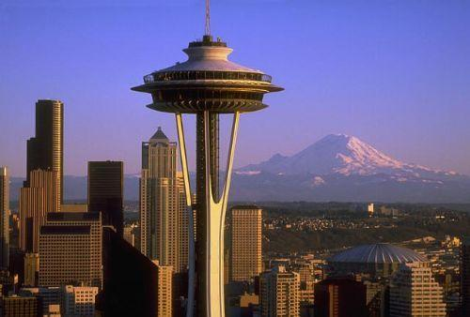
Spiritual & Cultural Significance
Defining sense of place (America’s Best Idea)
“In addition to the scientific value as repositories of geological and biological diversity and knowledge, national parks have profound spiritual and cultural significance for the American people. The idea of nature as a place of inspiration and renewal played a key role in the creation of the National Park Service in 1916”

Slide 19
Student Interpretation
1. How can people escape daily distractions of their “cluttered lives” by visiting national parks?
2. How did John Muir play a key role in creating the national park service?
3. Discuss what the "beauty and grandeur" of national parks have inspired.
4. Explain how the national parks have served as cultural icons of national heritage and identity by providing specific examples from the text.
5. Explain how American Indians hold spiritual values to what are now national parks providing specific examples from the text.
6. How has “America’s best idea” led to others around the world to protect and preserve important places?

Slide 20
Human History
Reading about historical figures and their “sense of place”
Students will read from various sources, including primary documents, from various groups/individuals and interpret what their sense of place is (why the mountain(s) are so important/special to them.

Slide 21
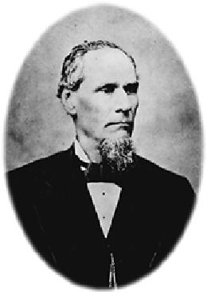
James Longmire’s Sense of Place
[The water was "an antidote for disease, prepared in Nature's own laboratory.... Why go abroad,'' Longmire's ad read, "when you may find Nature's own restoratives at your very doors?" In 1893, with the help of his family and Indian laborers, Longmire widened the trail to the springs into a rough wagon road. By 1896, the road was negotiable by stagecoaches. Gradually, the enterprise grew into a full-fledged tourist attraction, with a hotel, guest cabins, two bathhouse and stables.]

Slide 22
James Longmire’s Sense of Place
"an antidote for disease, prepared in Nature's own laboratory.... Why go abroad,'‘
Longmire saw the mountain as medicine, a cure all.
His sense of place revolved around using the natural medicine as a mode to profit
He wanted to bring as many to see the mountain, and to profit it from it.
It is special because of its natural healing processes, and of course profitability.

Slide 23
Fuji-Ko’s Sense of Place
“When Kakugyo, the founder of Fujii-ko, had stood immobile in his cave inside Mount Fuji, he had been trying through his meditation to restore stability to a nation rocked by political and social unrest. He hoped in this way to transfer the calm serenity of the mountain as the axis of the universe to the people of Japan, who had been fighting against themselves in an endless series of civil wars.”

Slide 24
Fuji-Ko’s Sense of Place
Saw the mountain as a way to promote stability and peace
Used the mountain as a way to express serenity for his people
saw the mountain as a place to meditate- a place to gain inspiration to help his people
It is special because it provides inspiration to help his people.

Slide 25
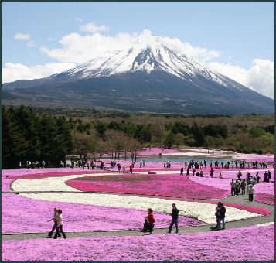
Sense of Place leads to Conservation
Students analyze the historical figures interpretation of “sense of place” and how these special places have lead to conservation.

Slide 26
What is Preservation? (National Park Service)
“Preservation is about deciding what's important, figuring out how to protect it, and passing along an appreciation for what was saved to the next generation. Preservation is hands on.”
“National Park Service archeologists, architects, curators, historians, and other cultural resource professionals work in America’s nearly 400 national parks to preserve, protect, and share the history of this land and its people.”

Slide 27
Preservation means…. (USNPS)
What is important to people, and how it should be protected
Providing access to future generations- a hands on approach
Share the history of our land and it’s people

Slide 28
New Terms for Conservation
How “sense of place” has led to conservation (America’s Best Idea)
“In short, a biosphere reserve enlisted compromise, lest the people living closest to it not be supportive. Outside the core or a protected area and its buffer, a transition zone allowed development. The object of a biosphere reserve remained sustainability for both people and the land. Ideally, any community could learn to respect its surroundings and responsibility to develop a resource base.”

Slide 29
Student Interpretation
1. Explain the roles and functions of the Wilderness Act of 1964.
2. Explain how UNESCO developed ideas of protection and preservation on a global scale.
3. Explain what a biosphere reserve is.
4. Discuss what a world heritage site is and the issues surrounding the idea. Explain the criteria for such a site.
5. Discuss in your own words, why conservation is important to the world as a whole.

Slide 30
Putting it all together
Students will create a persuasive letter, developing a “sense of place” and urging conservation of an important place.

Slide 31
Applying the lesson
Imagine that you hold a special connection to Mt. Rainier/Mt. Fuji, and that you have developed a sense of place to the mountain. Recent economic downturns have led the government to open discussions that would allow for privatization of the entire mountain, meaning an individual would be allowed to purchase a parcel of land and construct permanent buildings or settlements without restrictions. There is a great deal of interest amongst the public, and there are projections that suggest all land would be sold, generating much needed funds for the government. Such actions would destroy current preservation attempts (clean water/air, natural resources, animal protection, etc.) and eliminate public-use of the land.
Your job, as a particular stakeholder, is to write a letter to your government where you address the issue at hand requesting that the land be preserved and protected. You are to discuss the following, always connecting your ideas to sense of place (your connection to the land): The following are suggested criteria for a five paragraph letter. You must also include 3-5 of the vocabulary words within your letter. What is worth more, ones sense of place and preservation/protection, or the profit from the land/resources?

Slide 32
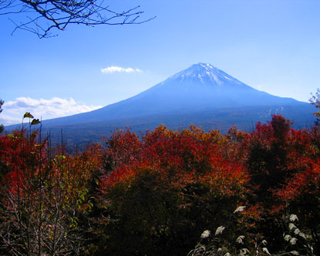
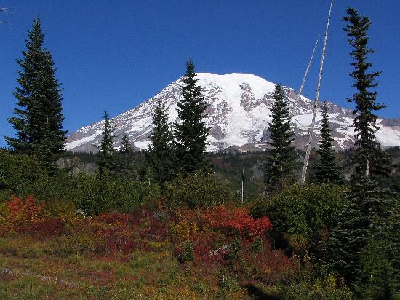
Taking it further- Adaptations
Preservation Presentation: Compare & Contrast
Create a multi-media (PowerPoint, Prezi, etc.) presentation where you complete the following through research. Be sure to address each topic for each mountain.
Pick one historical figure from both Mt. Fuji and Mt. Rainier.
Explain what protection and preservation is.
Explain what “sense of place” means and how it is developed.
Explain how the historical figure developed a “sense of place” to the mountains.
Explain how historical figures promoted preservation and protection of the mountains.
Explain the current state of preservation and protection of the mountains.
Explain how similarities and differences of protection and preservation for each mountain
Include visuals (pictures, videos, charts, etc.)

Slide 33
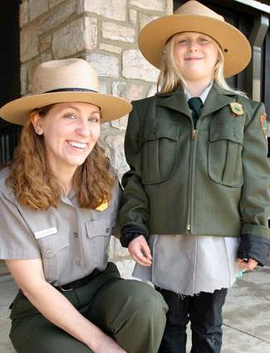
Taking it further- Adaptations
Taking on the Role
Students will take on the role of a historical figure or group from either Mt. Fuji or Mt. Rainier who has/have fought for preservation and protection of the mountain.
Students will dress the part and provide a presentation for their peers where they address how they have developed their “sense of place” to the mountain (why it is a special place to them) and why they believe it is important to protect and preserve it, using information they have learned throughout this lesson.

Slide 34
Taking it further- Adaptations
Investigation
Interview various people who have a connection to Mt. Rainier or Mt. Fuji. This could also be a student-to-student interview where each student picks a location where they have developed a “sense of place” and are asked questions about it. Students will want to focus on an essential question such as (what makes this place special to you and why is it worth protecting?)
Students are to first pick their place of significance and brainstorm possible people to interview (various viewpoints are desired)
Students are to create a series of questions (ten or more) to ask
Students will share their results with the class. Suggestions below.
Mock interview (one student asks, the other responds)
PowerPoint
Play recordings
Place-based options: students can visit a particular place to interview various people and their interpretations of “sense of place”; i.e., at the national park (park ranger, shop owner, climbers, etc.)

Slide 35
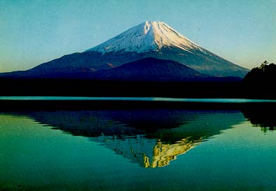
Taking it further- Adaptations
Preservation Pamphlet
Create a pamphlet that urges the community to protect and preserve a particular place (Mt. Rainier/Mt. Fuji, or another place) by completing the following suggested guidelines below.

