Slide 1
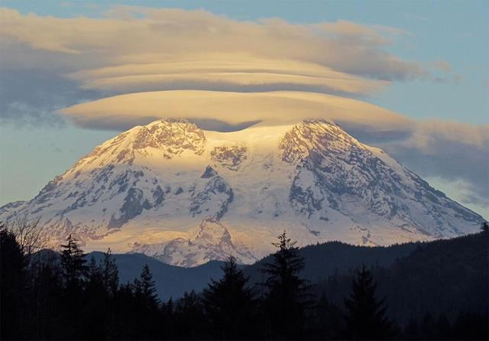
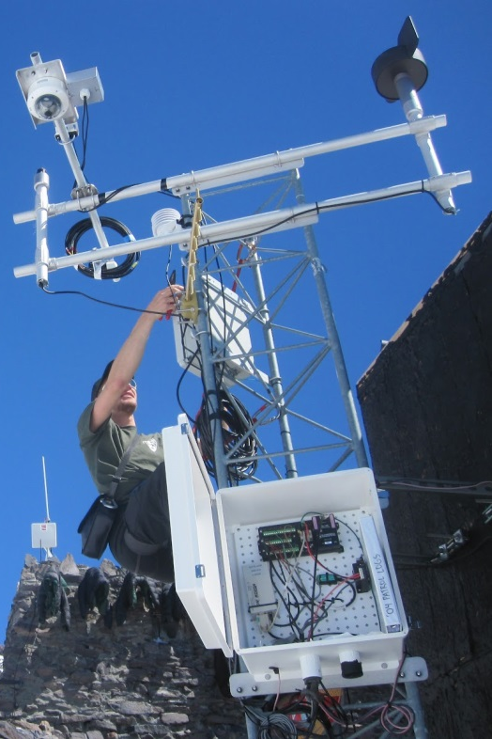
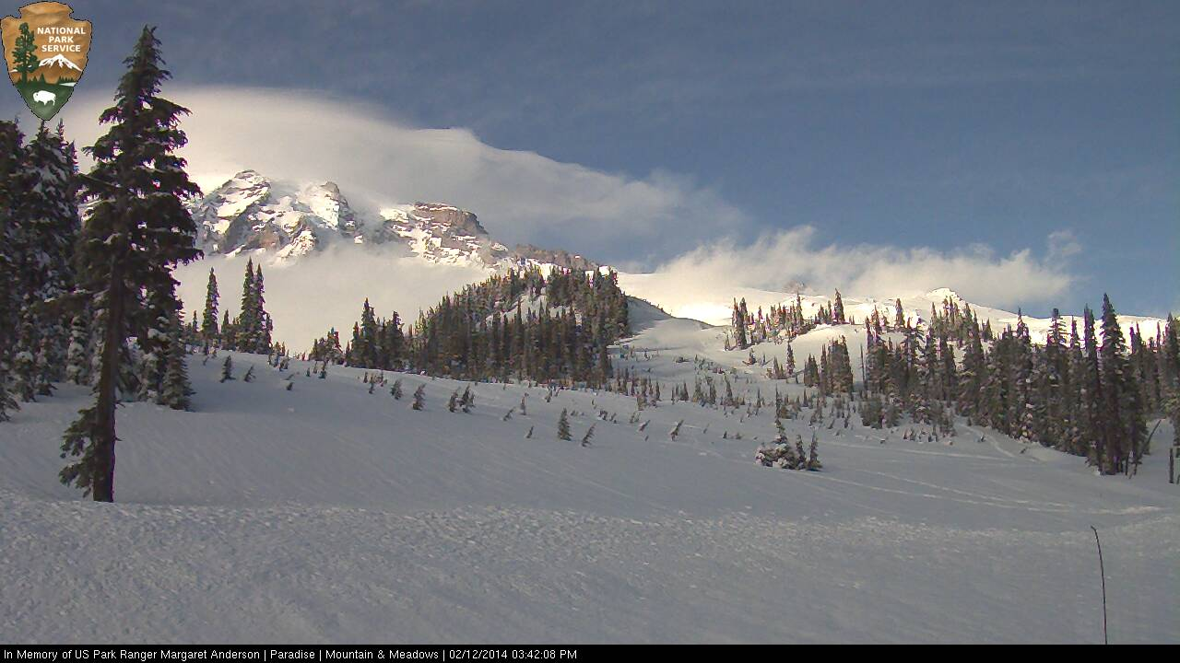
Mount Rainier Weather
Make Observations
Collect Weather Data
Notes:
When the students open up the file, it will look like this.

Slide 2
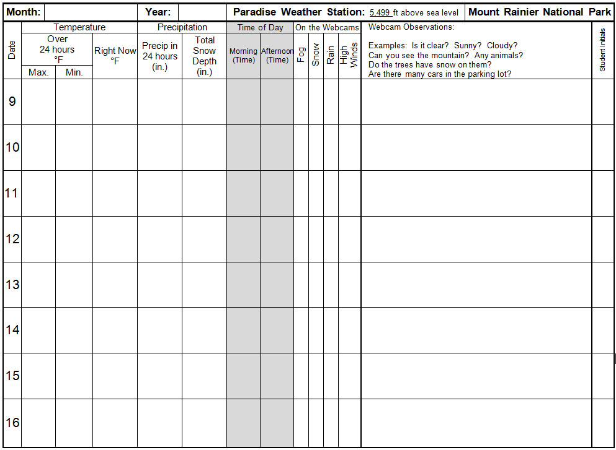
February
2014
Notes:
On the hard copy of the record sheet, students should make sure that the correct month and year is in the box. If it is not there, they should write it in.

Slide 3

Mount Rainier Weather
Make Observations
Collect Weather Data
Notes:
Students should click on the picture that says “Collect Weather Data.”

Slide 4
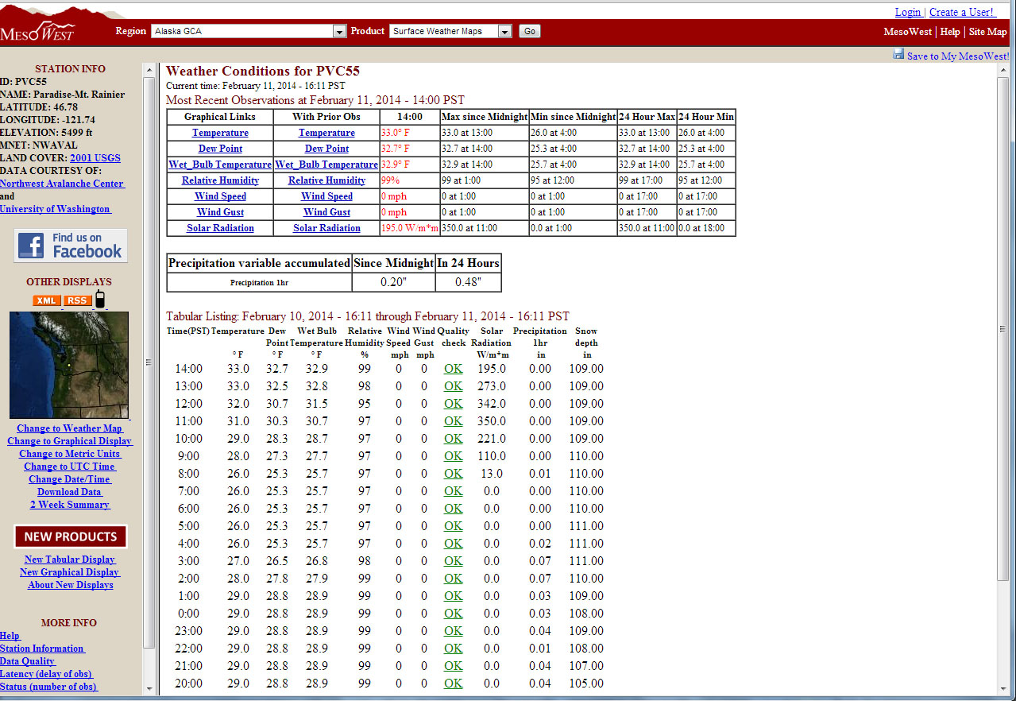
Notes:
It will bring them to the website of a weather station in Paradise, Washington. Paradise is located at approximately 5,400 feet on the southwestern slope of Mount Rainier.

Slide 5
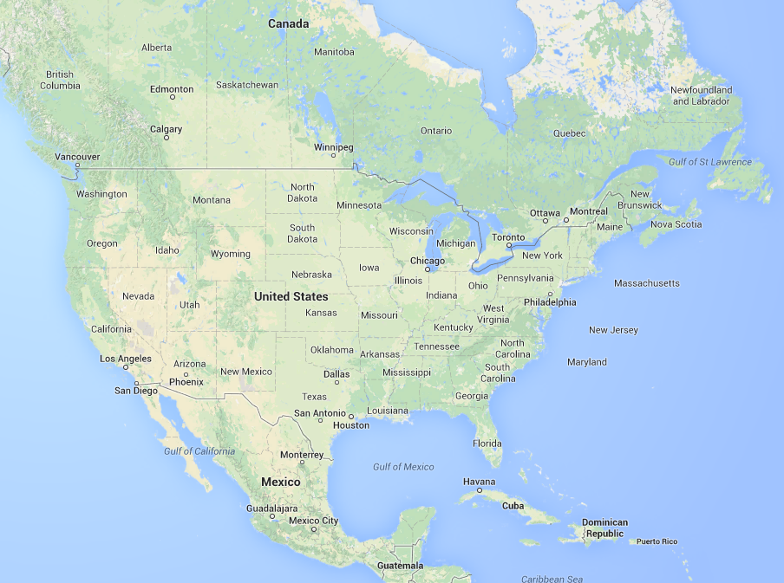
Notes:
Mount Rainier National Park is located in Washington State.

Slide 6
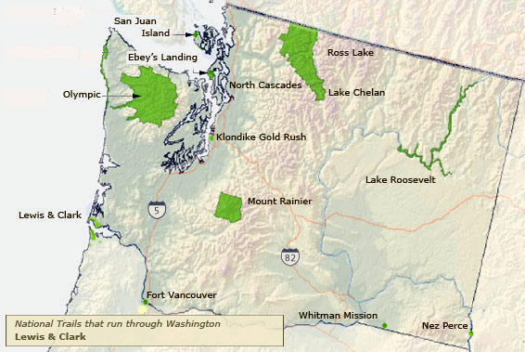
Seattle
Notes:
It is approximately 60 miles south east of Seattle, Washington, a major city.

Slide 7
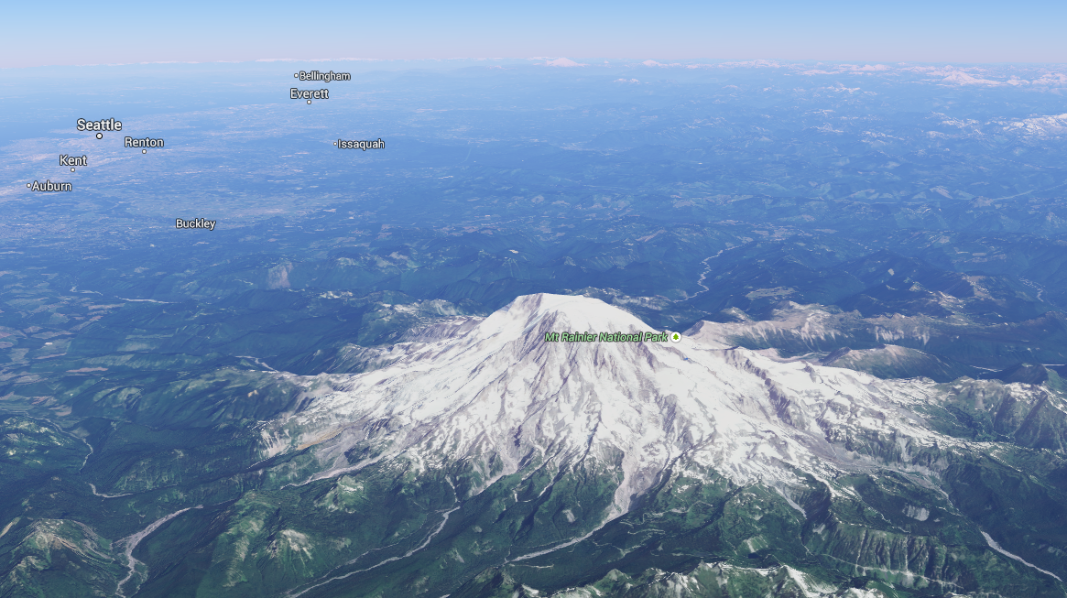
Notes:
Paradise, where the weather station is located, is the 2nd snowiest recorded place on Earth. The weather at Paradise has been observed and recorded for over 100 years. The students will be continuing the tradition!
The red arrow points to the location of the weather station, on the southern flanks of Mount Rainier. For reference, point out the location of Seattle in the picture. Seattle is to the northwest of the mountain.
Extension: Point out the snow and glaciers on Mount Rainier. How does this compare to the lowlands around the mountain?
Why is Mount Rainier so snowy? Warm, moist air from the Pacific Ocean is pushed west towards Mount Rainier. Clouds form as the moisture condenses. At 14,410 feet tall, Mount Rainier acts as a large barriers for clouds moving westward. As the clouds move further and further up the mountain, the air can no longer hold as much moisture and precipitation falls. At high elevations, like Paradise, where much of the year is at or below freezing, this precipitation comes in the form of snow.

Slide 8
Notes:
Students should look at the date on the weather station. In this example, it is February 11th.

Slide 9
February
2014
Notes:
And find the matching date on the reporting form. This is where they will write in their data. This student correctly chose the row labeled “11” since it is the 11th day of the month.

Slide 10
Notes:
Next, students should find the 24 hour maximum temperature.

Slide 11
February
2014
33º
Notes:
And record it on the sheet.

Slide 12
Notes:
Students should find the 24 hour minimum temperature.

Slide 13
February
2014
33º
26º
Notes:
And record it on the sheet.

Slide 14
Notes:
Students should note approximately what the temperature is at Paradise. They will do this by looking at the hour-by-hour reporting of the weather station. The live reporting can be delayed by 2 hours.
If students do not have an understanding of military time, explain to students what military time is and what it means.

Slide 15
February
2014
33º
26º
33º
Notes:
Students should record the current temperature on the sheet.

Slide 16
Notes:
Next, students should look at the precipitation accumulated in 24 hours. From November to May, this number will most likely be in measuring snow. The webcams will be able to give the students more information on whether the precipitation was rain or snow.

Slide 17
February
2014
33º
26º
33º
0.48 in
Notes:
Students will record it in the appropriate column. The next thing students will record is the total snow depth in inches.

Slide 18
Notes:
They will go to the top of the list of the hour-by-hour reports and record the “Snow Depth in” number at the top of the list.

Slide 19
February
2014
33º
26º
33º
0.48 in
109 in

Slide 20
February
2014
33º
26º
33º
0.48 in
109 in
Notes:
Next, they will make an X mark on the time their observation was made.
IMPORTANT: Students should mark the time in Washington state, not where they live.

Slide 21
Notes:
Review military time. Anything after 12:00 PST will be afternoon in Washington state.

Slide 22
February
2014
0.48 in
109 in
X
33º
26º
33º
Notes:
Make an X in the box for either morning or afternoon in WASHINGTON STATE.
Adaptation: You may have students write in the time of observation instead.

Slide 23
Mount Rainier Weather
Make Observations
Collect Weather Data
Notes:
Next, students will click on the picture labeled “Make Observations.”

Slide 24
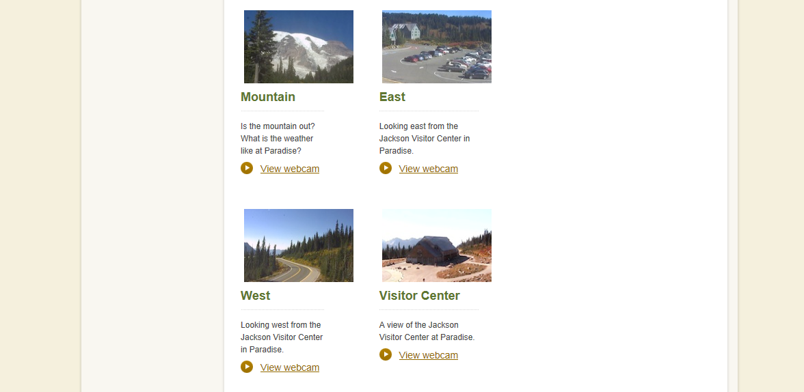

Notes:
This will bring them to the webcam page of the Mount Rainier National Park website. They should click on the Mountain camera.

Slide 25
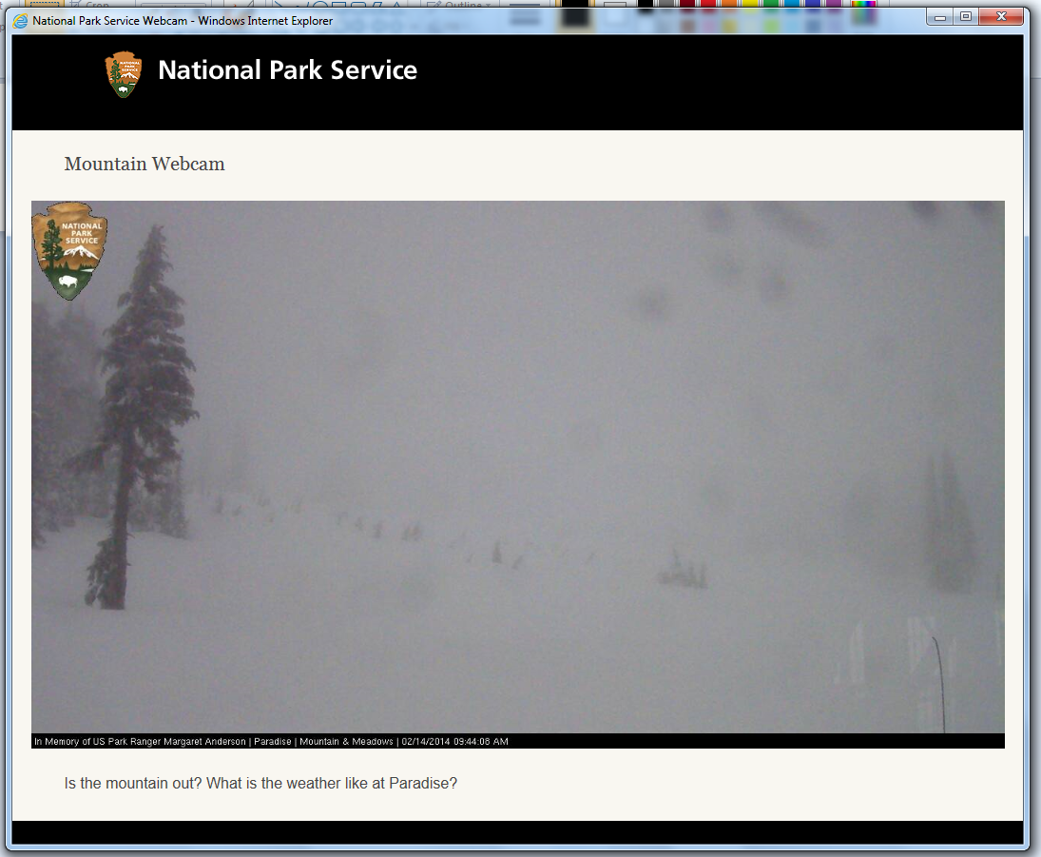
Notes:
And make notes of any observations on the camera. A new image is uploaded every 5 minutes.

Slide 26
February
2014
0.48 in
109 in
X
33º
26º
33º
X
X
Notes:
Students should put x marks in the boxes if they see any of those weather phenomena.

Slide 27
Notes:
Next, they should click on the other webcams at Paradise (there are other webcams at Longmire, Sunrise, Carbon River, and Camp Muir, so make sure they only record observations from the Paradise webcams).

Slide 28
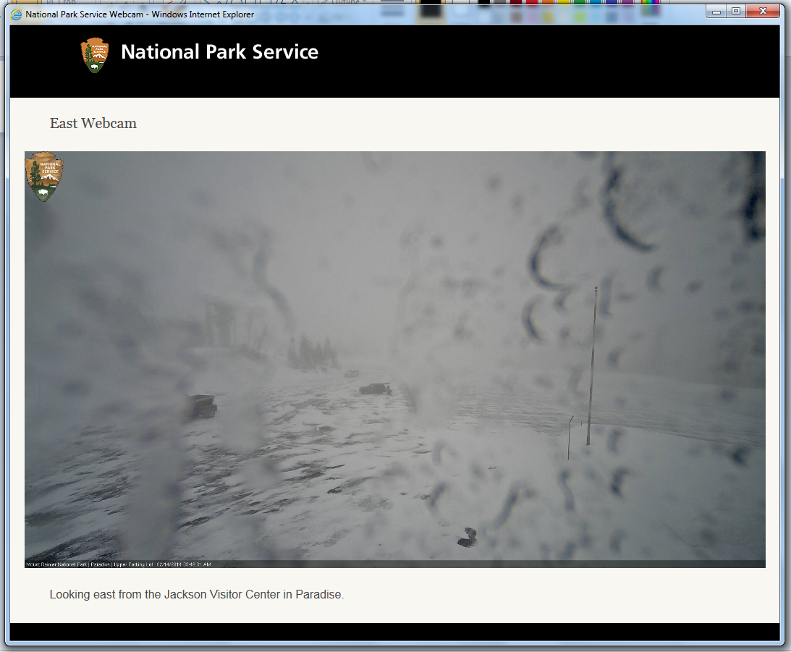
Notes:
Students can save images (with teacher’s permission) from the webcam by right clicking and selecting “Save As.” Students should rename the image with the date.

Slide 29
February
2014
0.48 in
109 in
X
It is very cloudy, and I cannot see the mountain. The trees and roads have snow. There are only a few cars in the parking lot. There is ice on the webcam lens!
33º
26º
33º
X
X
Notes:
Students should write 2-3 sentences on their observations. They can use the questions at the top of the column as writing prompts.

Slide 30
February
2014
0.48 in
109 in
X
It is very cloudy, and I cannot see the mountain. The trees and roads have snow. There are only a few cars in the parking lot. There is ice on the webcam lens!
BLS
33º
26º
33º
X
X
Notes:
Lastly, they should add their initials so the class knows who took the observations for that day.

Slide 31
Questions?

