Slide 1
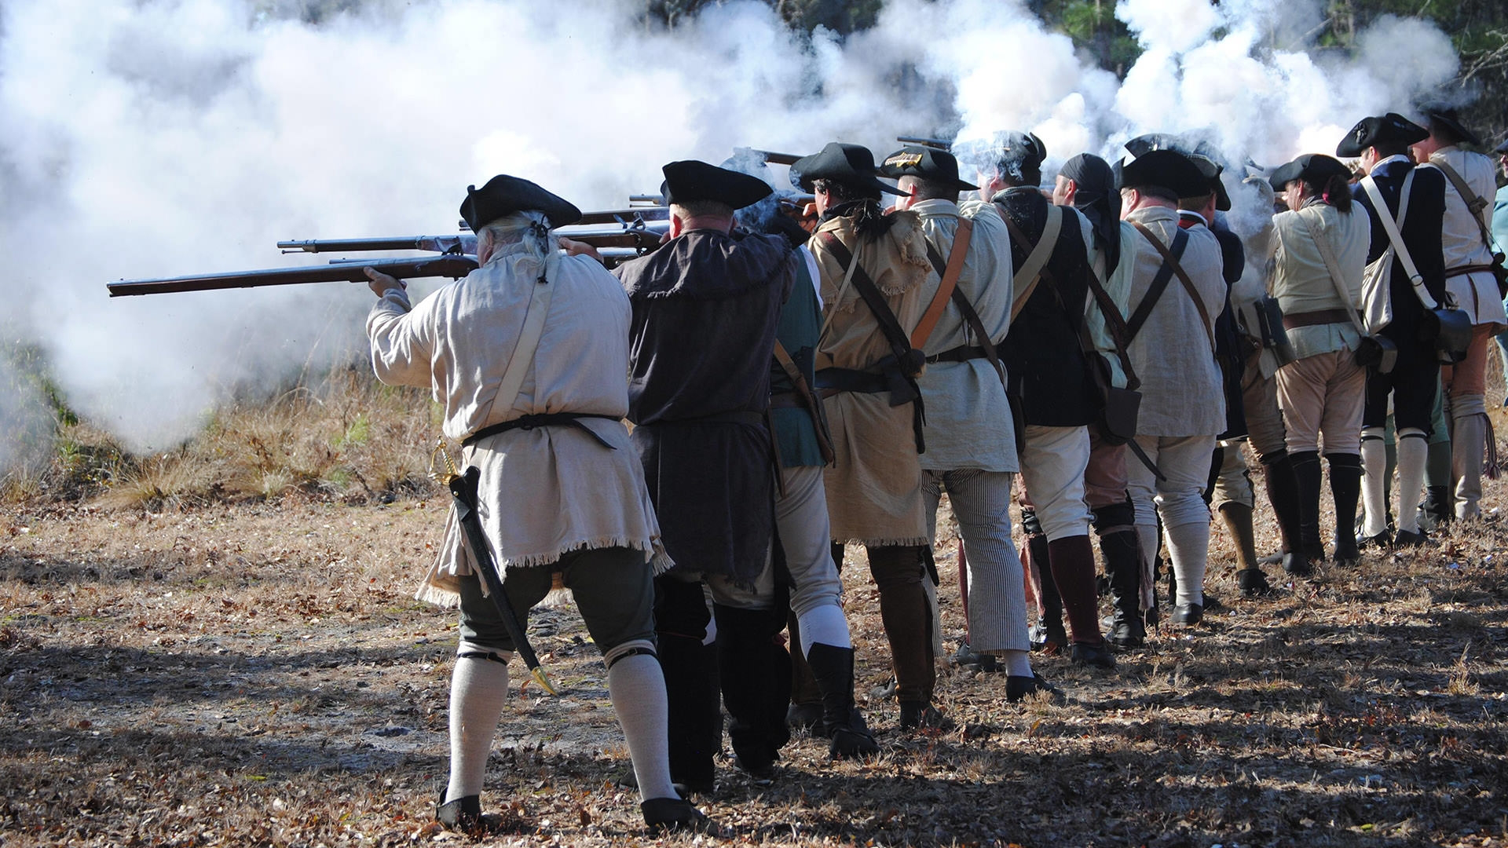
Diversity at the Battle of Moores Creek
Notes:
Image source: https://www.nationalparks.org/explore-parks/moores-creek-national-battlefield

Slide 2
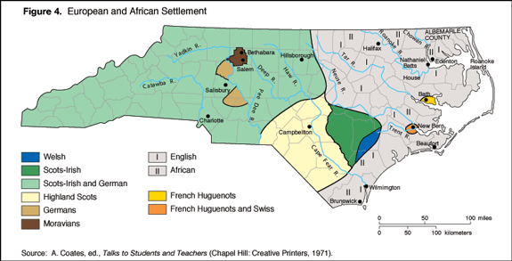
North Carolina’s Diversity Before the American Revolution
Notes:
Source: A. Coates, ed., Talks to Students and Teachers (Chapel Hill: Creative Printers, 1971)
Image retrieved from: https://www.ncpedia.org/history/colonial/early-settlement

Slide 3
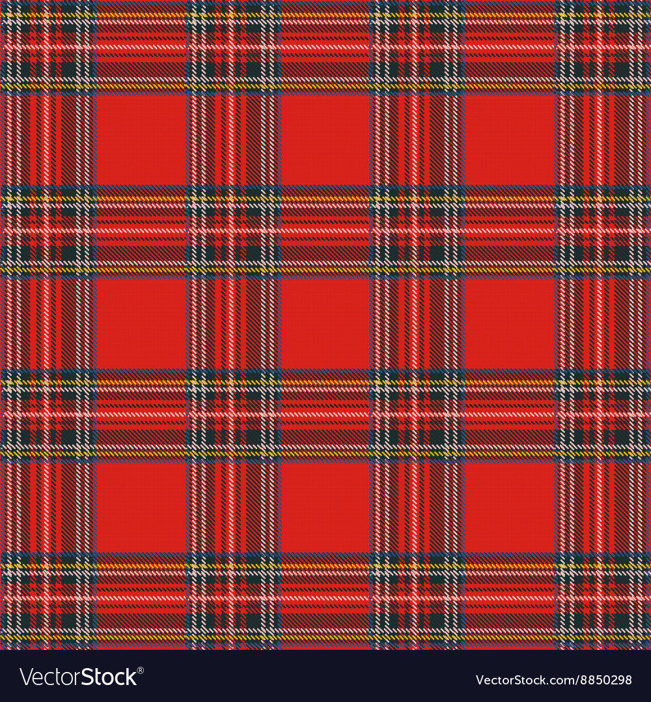
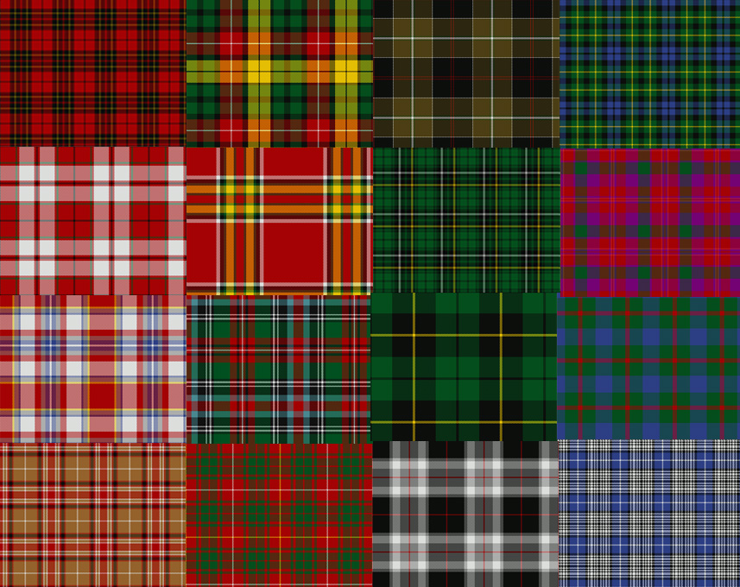
The Meaning of the Tartan
It is unsure when the tradition of tartans identifying clans began.
Today, clans have adopted tartan patterns to represent their last name.
What would your tartan look like?
Notes:
Image found at: https://uncpressblog.com/2010/04/09/its-tartan-time/
Source: Scottish Tartan Museum, https://web.archive.org/web/20060210055101/http://www.scottishtartans.org/tartan.html

Slide 4
The Kilt of the Highland Scots
Originally wore long, baggy yellow shirts with a woolen cloth over it that served as a sleeping blanket.
    Sometimes wore deerskin
”Kilt” means “tuck it up around the body.”
Became popular after King George VI visited Scotland in 1822.
Today, the kilt is essential to wear to important events
Notes:
Source: Green, Cynthia. “How the Highlanders came to Wear Kilts” (JSTOR Daily, 2017). https://daily.jstor.org/how-scottish-highlanders-came-to-wear-kilts/

Slide 5
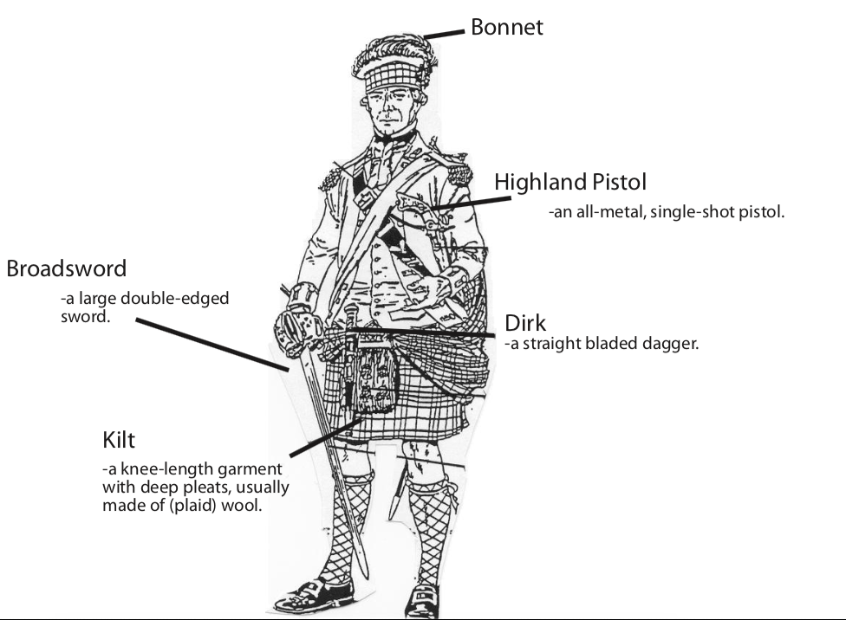
What does a Highland Scots wear?
Notes:
Source: NPS Moores Creek National Battlefield Education Guide

Slide 6
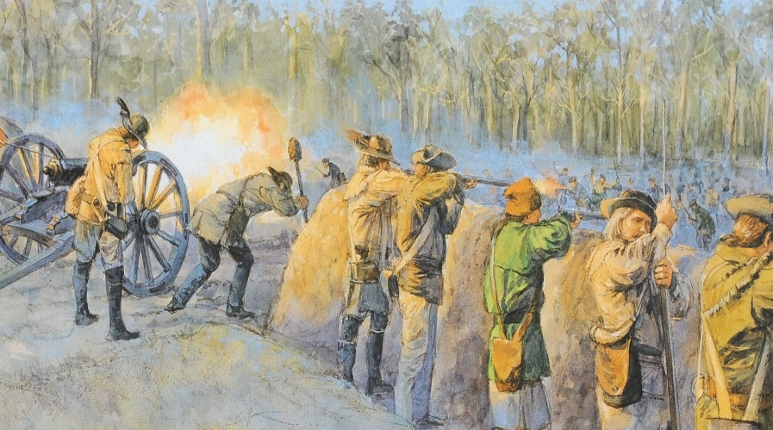
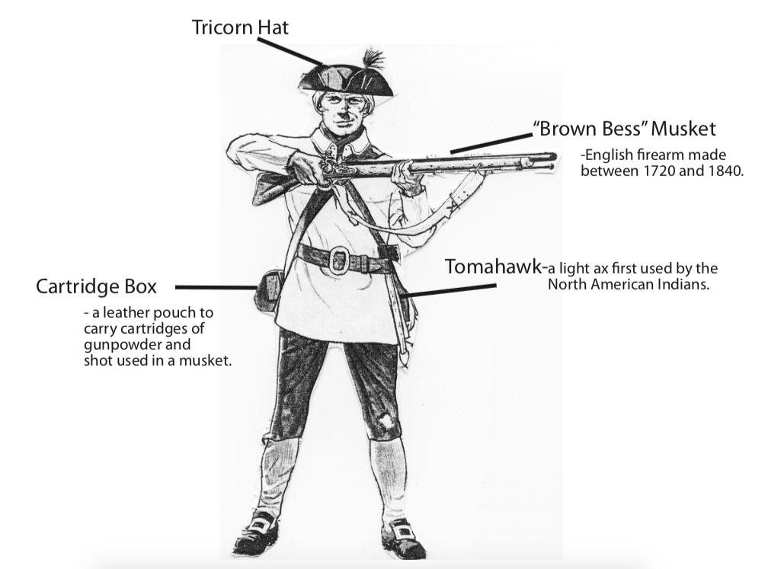
What does a Patriot wear?
Notes:
Source: NPS Moores Creek National Battlefield Education Guide

Slide 7
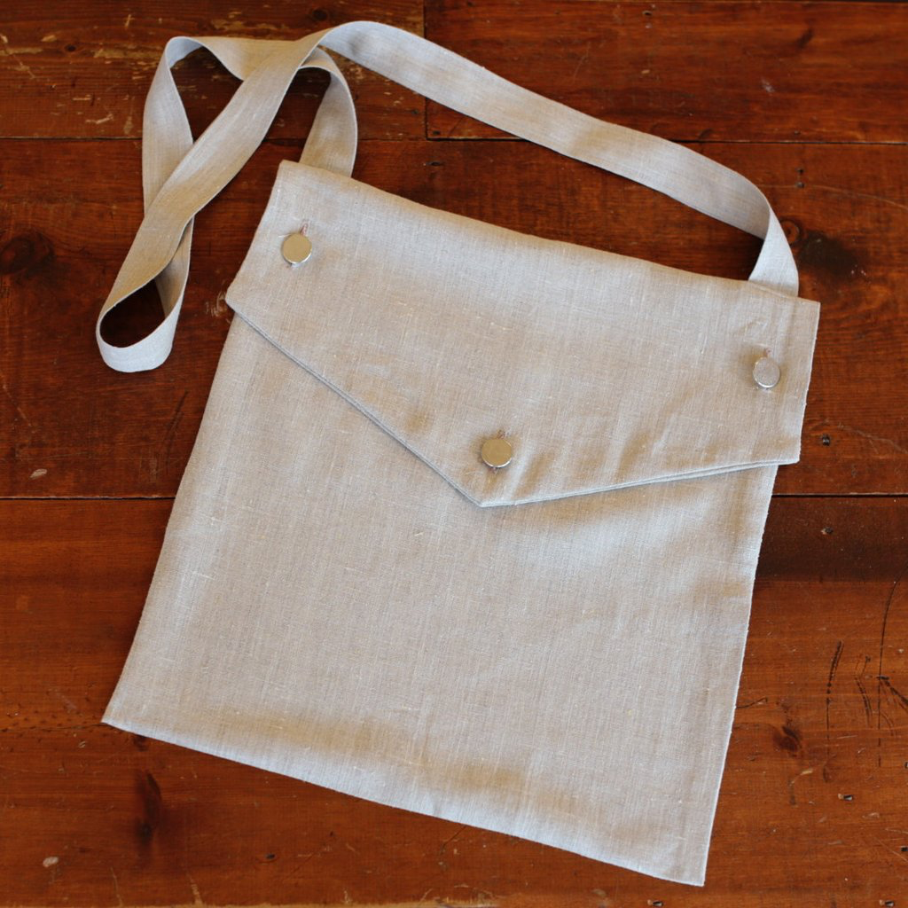
Life of the Militiaman- The Haversack
Much like your bookbag holds many of your personal belongings and school supplies, the haversack served the same purpose for the Patriots at Moores Creek.
Soldiers kept many items in their haversack that they would use for battle, camp, and during personal time.
Notes:
Image source: Townsend and Sons, Inc.

Slide 8
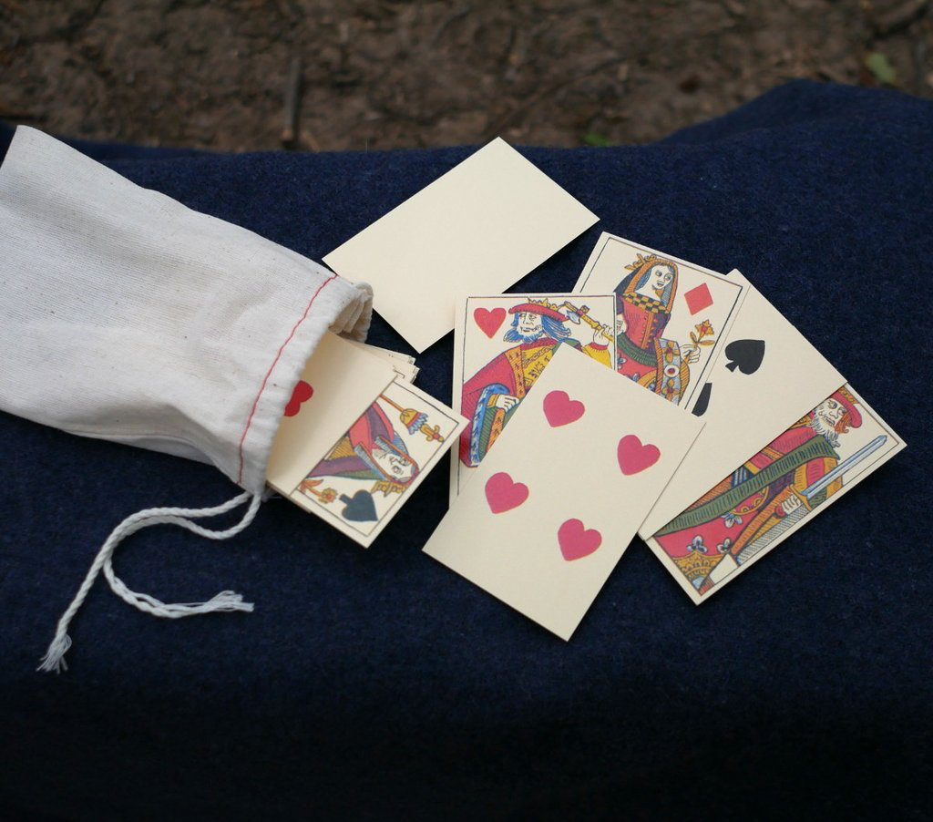
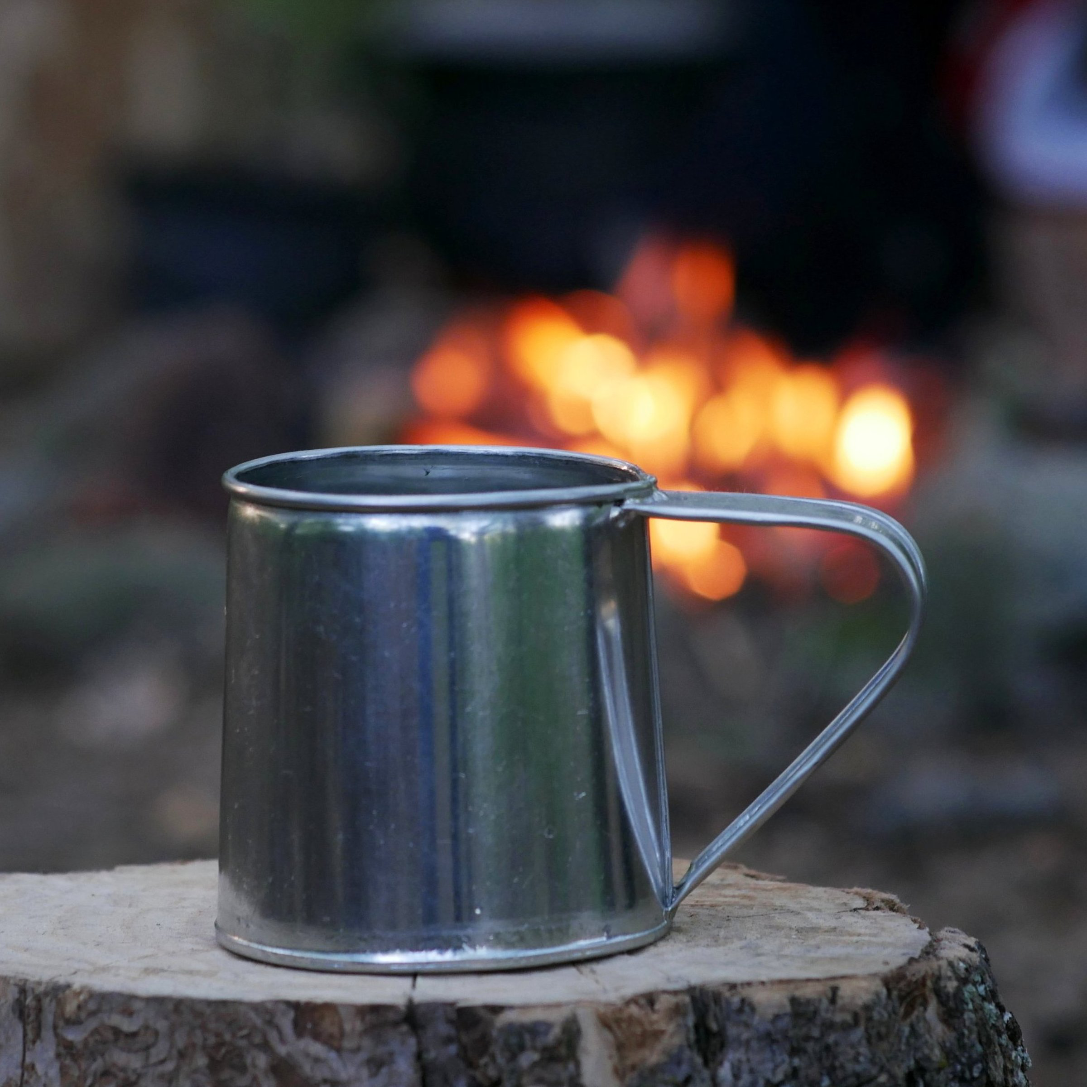
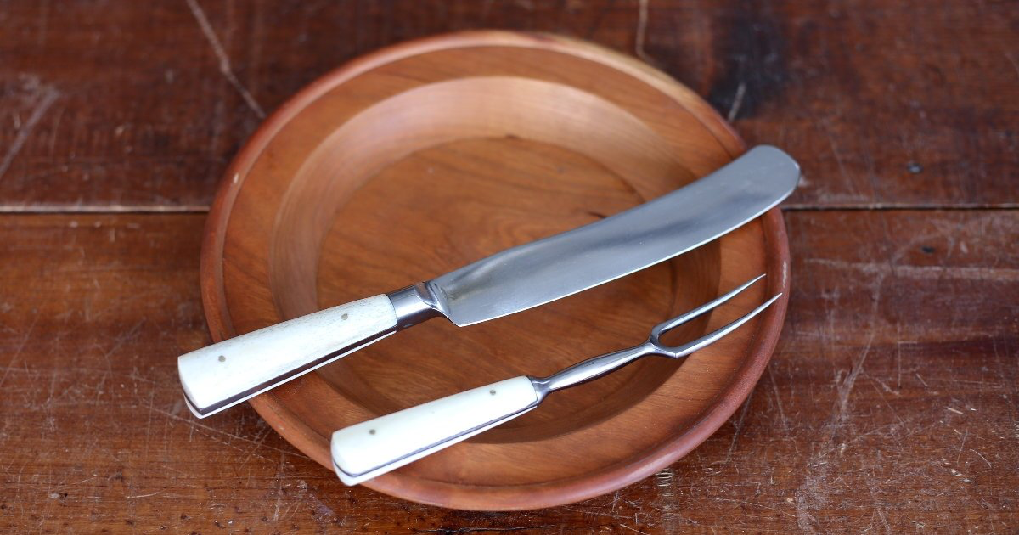
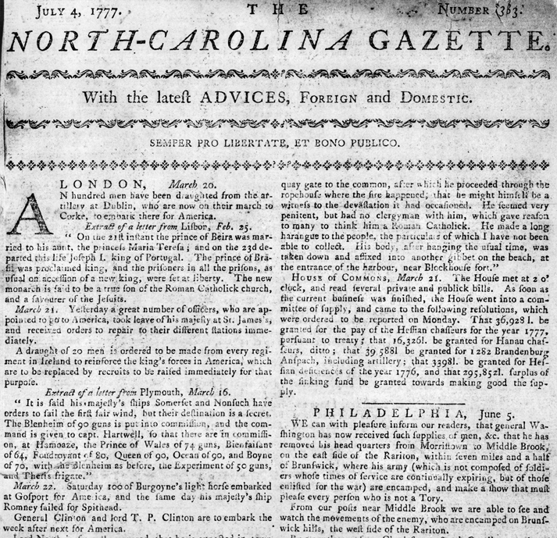
The Haversack
Tin Cup
- Used for beverages and soups.
  Correspondence
    - Personal letters and stationary, newspapers, documents.
Playing Cards
- Used for entertainment around
camp and during personal time.
Plate and Utensils
- Mainly used for meals but could be used for digging if needed.
Notes:
Image Source: James Townsend and Sons, Inc.

