Slide 1
The Geometric Artistry of Mesa Verde Pottery
Students will demonstrate their understanding of symmetry, geometric designs, and parallel lines by defining these terms in their own words.
Students will use their understanding of symmetry, geometric designs, and parallel lines to finish a layout given a shard of pottery.
Students will write a paragraph summarizing what they have learned

Slide 2
Mesa Verde the Living Park
“Mesa Verde ceramic artists …had a vast and fascinating repertoire of abstract geometric designs. There were bands of parallel rings, spirals, scrolls, interlocking curlicues, triangular mazes, elbows that folded in on themselves, stairstep-like ziggurats, lightning-like slashes, and checkerboards. Some of the same figures appear on rock walls as petroglyphs. Designers today see an obsession with symmetry and the tension of tight, parallel lines.”
Notes:
Discuss what this paragraph means
What are some key words or phrases that jump out at you?

Slide 3
Key Words
Geometric Designs
Parallel Lines
Symmetry
Notes:
Geometric: Using simple geometric forms such as circles and squares in design and decoration
Parallel: two or more lines that do not touch or intersect on the same plane
Symmetry: the correspondence in size, form, and arrangement of parts on opposite sides of a plane, line, or point; regularity of form or arrangement in terms of like, reciprocal, or corresponding parts. Beauty based on or characterized by such excellence of proportion.

Slide 4
On Your Own
What does this pottery look like? Do a quick sketch on your worksheet of what
a bowl might look like based on just the information we read (no looking at anyone else’s work!)

Slide 5
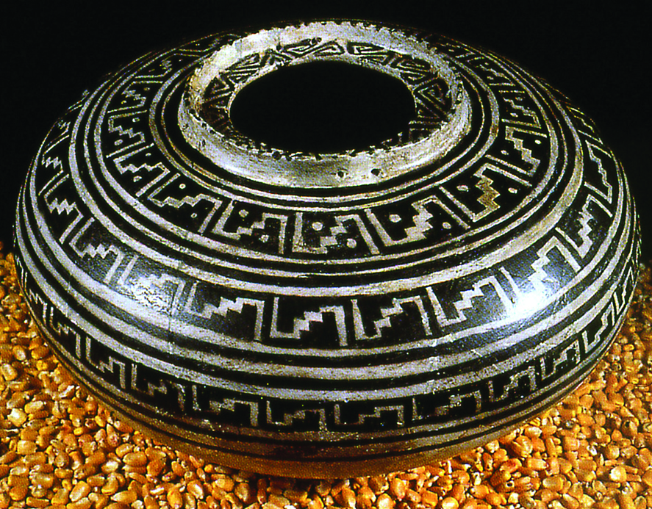
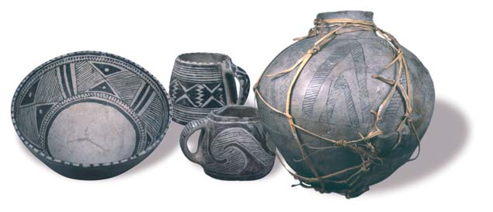
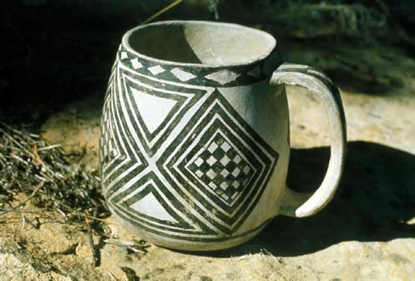
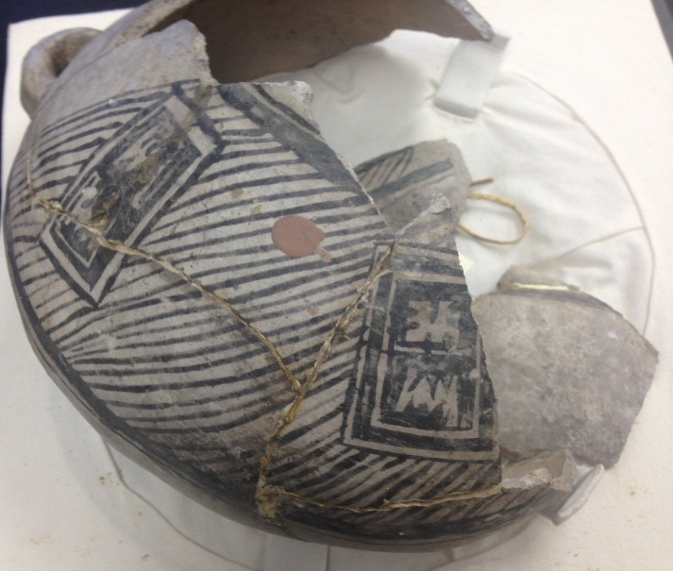
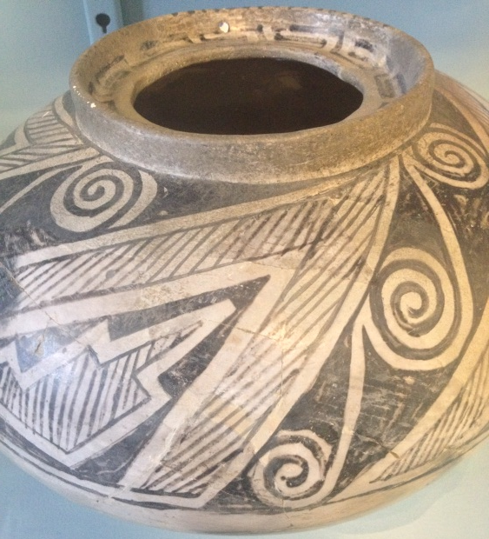
Examples of Pottery
Is your drawing close to these examples?
What are some similarities or differences?

Slide 6
Pithouse
Around A.D. 550 the first Ancestral Pueblo people settled in the Mesa Verde area. They are known as Basketmakers for their skill in crafting baskets.
Instead of being nomadic, the Basketmakers started farming and building permanent structures called pithouses.
They began making pottery and acquired the bow and arrow.
Their food included corn, beans, squash, nuts, fruits, rabbit, deer and turkey.
Notes:
A pithouse is a shallow, rounded pit. A dome of logs, sticks, and mud would be placed over and around the pit for walls and a roof.

Slide 7
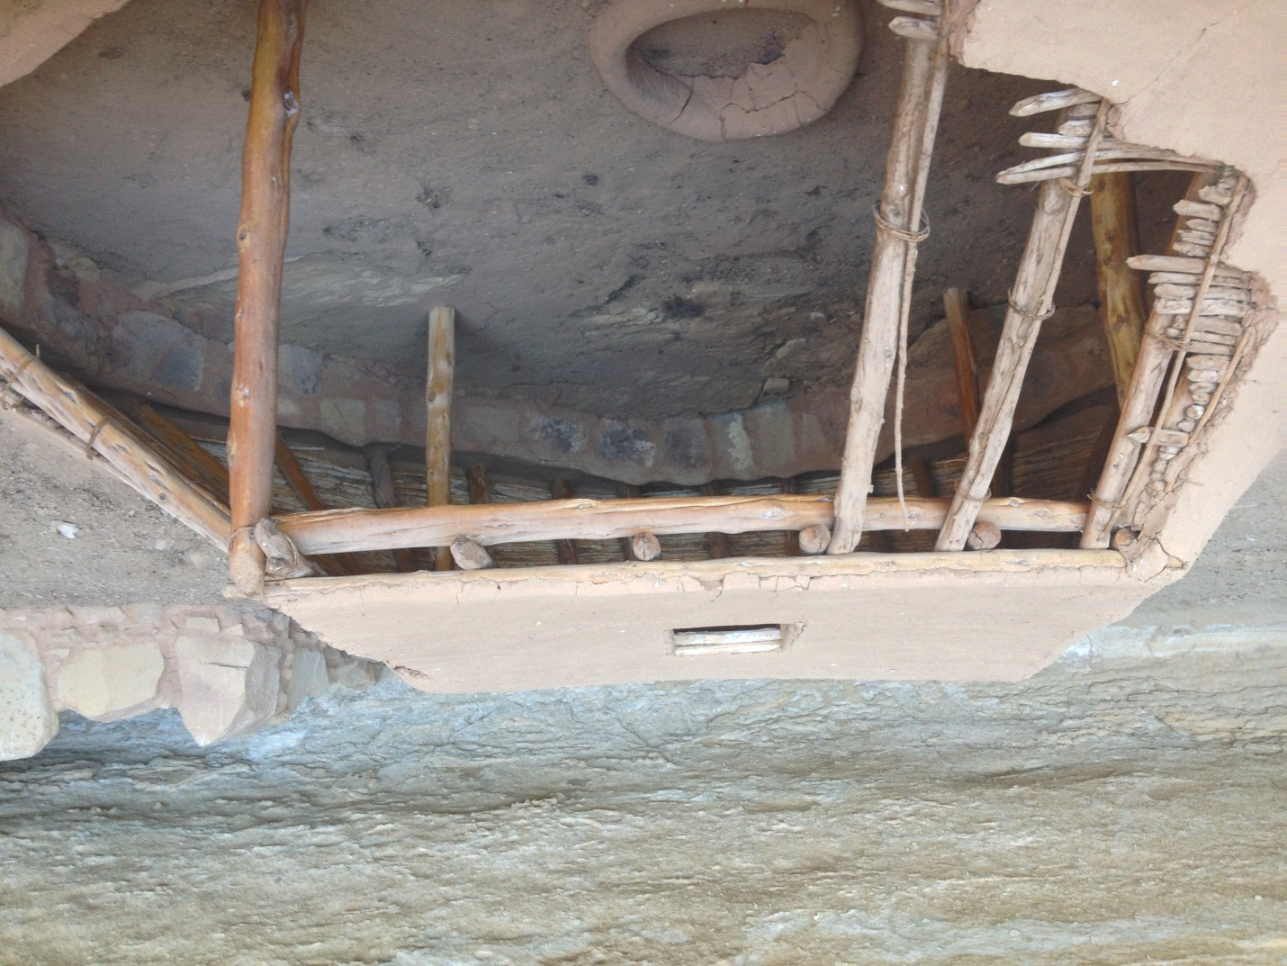
Pithouse

Slide 8
Pueblos
Around A.D. 750 the buildings started to evolve with population expansion.
  Along with pithouses, the Ancestral Pueblo people created structures above ground using poles and mud. These new structures were placed side by side in curving rows to create villages.
  Masonry structures, using sandstone blocks, were developed by A.D. 1000. This skill allowed multi-story housing units.
  Pithouses began evolving into kivas. These new underground rooms became a ceremonial site, meeting space, and occasional winter residence.

Slide 9
The use of pottery increased as they created may different types such as ladles, mugs, bowls, lidded jars, and canteens. Many were painted with organic or mineral based paint using brushes made from yucca.

Slide 10
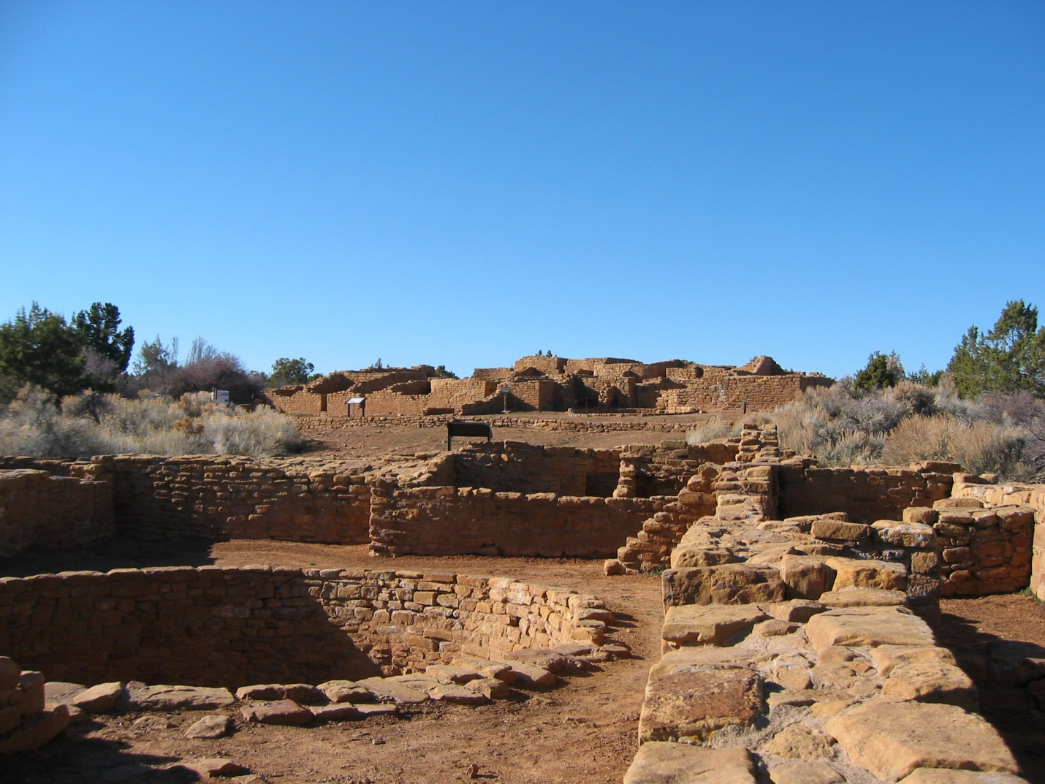
Pueblo

Slide 11
Cliff Dwellings
Around A.D. 1150 many people began moving from their homes on the mesa into the cliff alcoves.
  They started building larger, more complex, densely packed, multistory stone and mortar pueblos.
  Rooms usually housed two or three people. There were also rooms used for storage.
The flat-roofed kivas were built in front of rooms. This created a courtyard, an area for daily routines.
Pottery also changed from simple designs to complicated black geometric designs painted on white backgrounds. Their pottery had progressed to a point where some researchers consider it to be the “highest artistic expression” of the culture.
Notes:
Why did they make this move? We don’t know. Perhaps it was for defense; perhaps they felt it important to move closer to the seep springs, their primary source of water; perhaps it was for religious or psychological reasons; perhaps alcoves offered better protection from the elements.

Slide 12
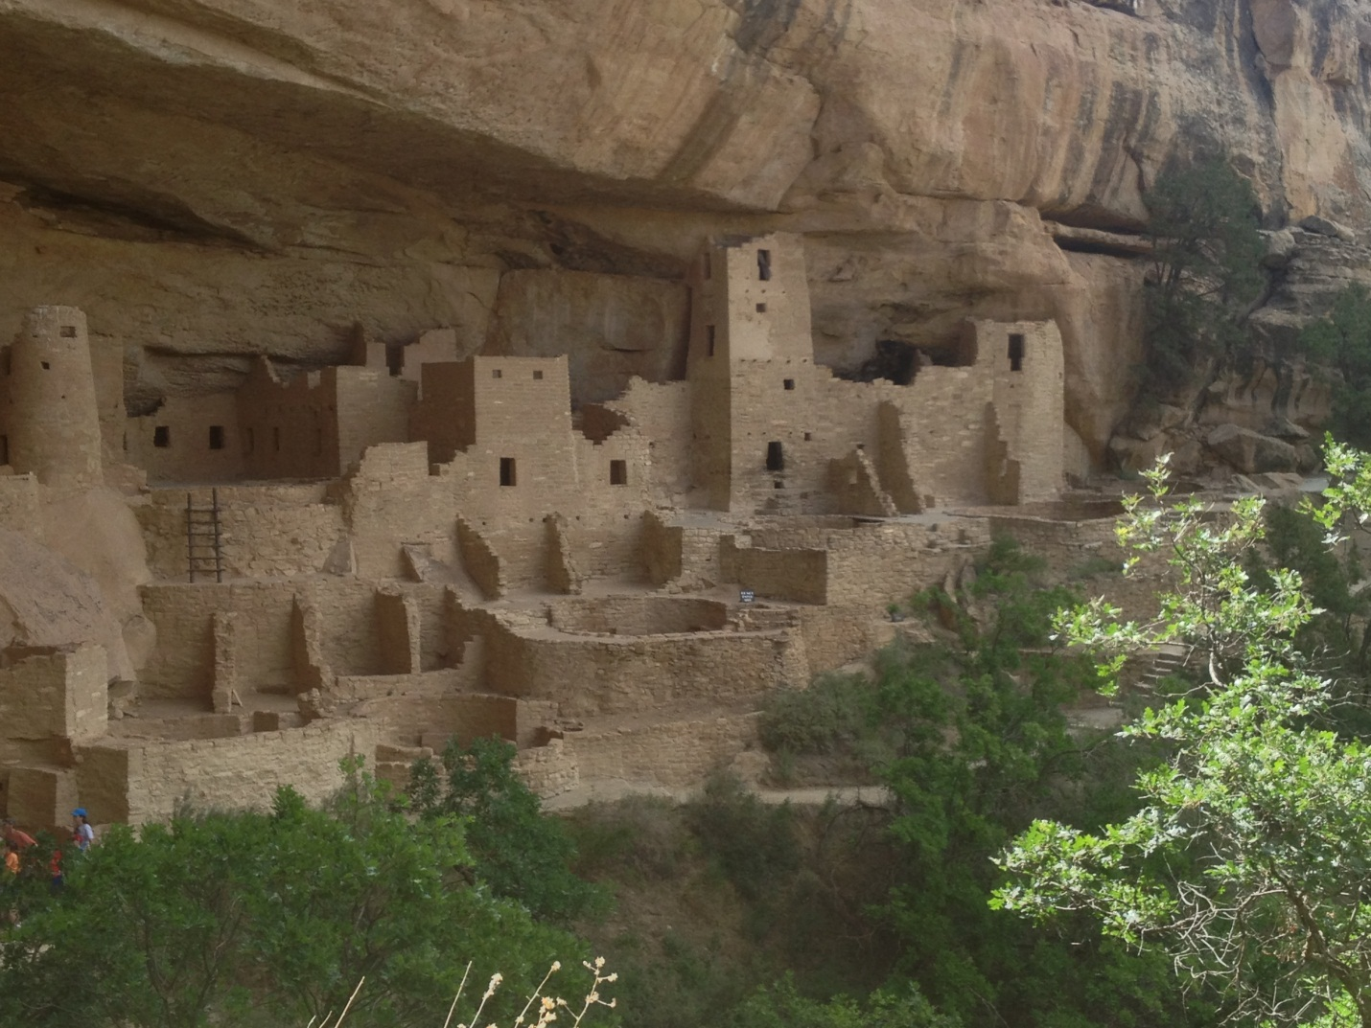
Cliff Dwelling

Slide 13
Leaving Mesa Verde
Sometime after A.D. 1250 the Ancestral Pueblo people started to leave the Mesa Verde area. By A.D. 1300, everyone had moved away, eventually settling along the mesas, rivers, and streams to the south where their descendants live today.
No one knows exactly why they left, but some hypotheses include: drought, social or political problems, depletion of natural resources, religious reasons, or a desire for a change.

Slide 14
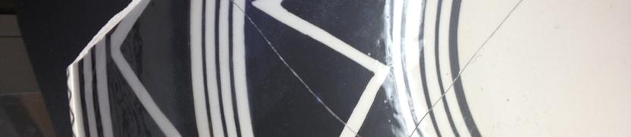
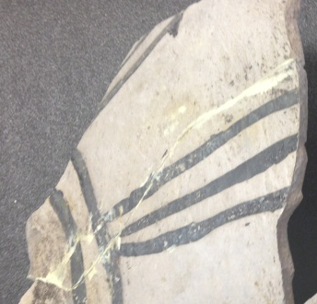
Pottery Shards Easy
Shard 1
Shard 2

Slide 15
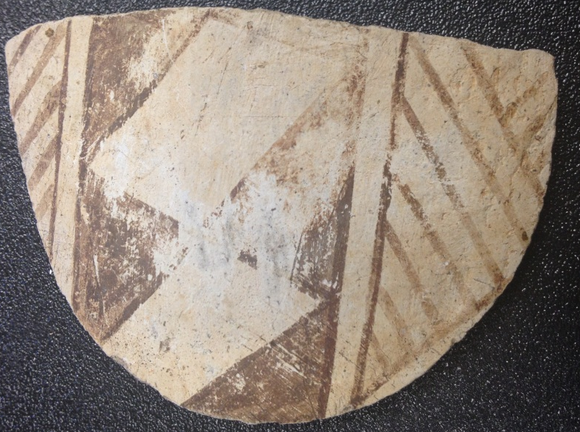
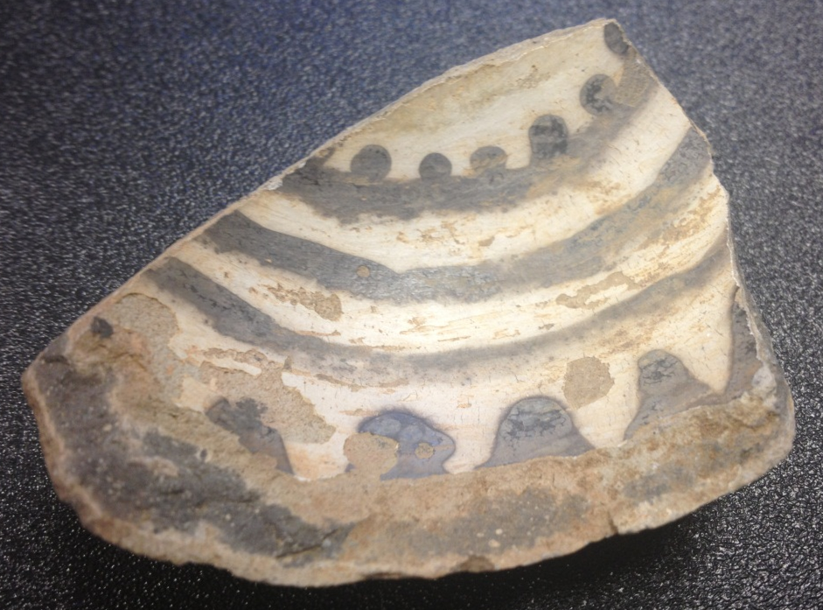
Pottery Shards Hard
Shard 1
Shard 2

Slide 16
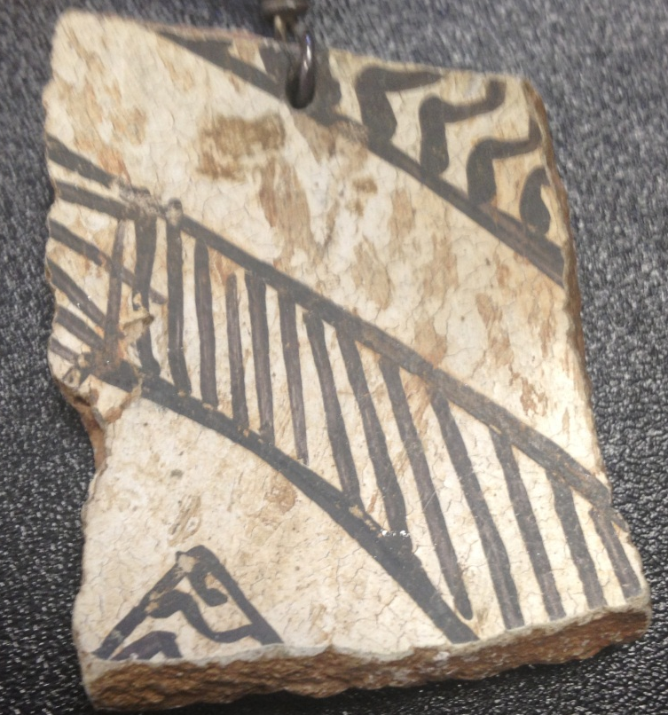
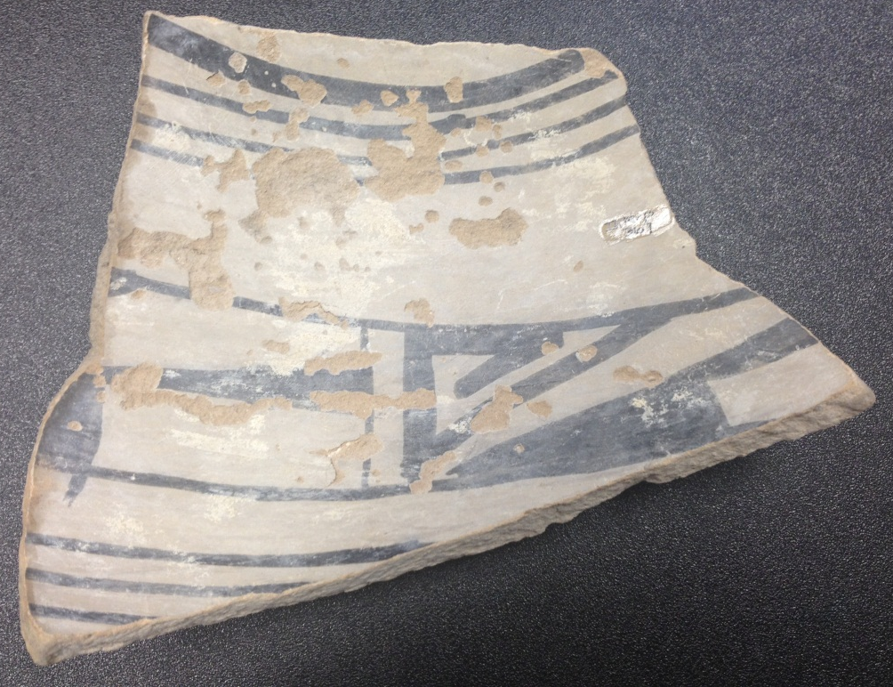
Pottery Shards Challenging
Shard 1
Shard 2

