Slide 1
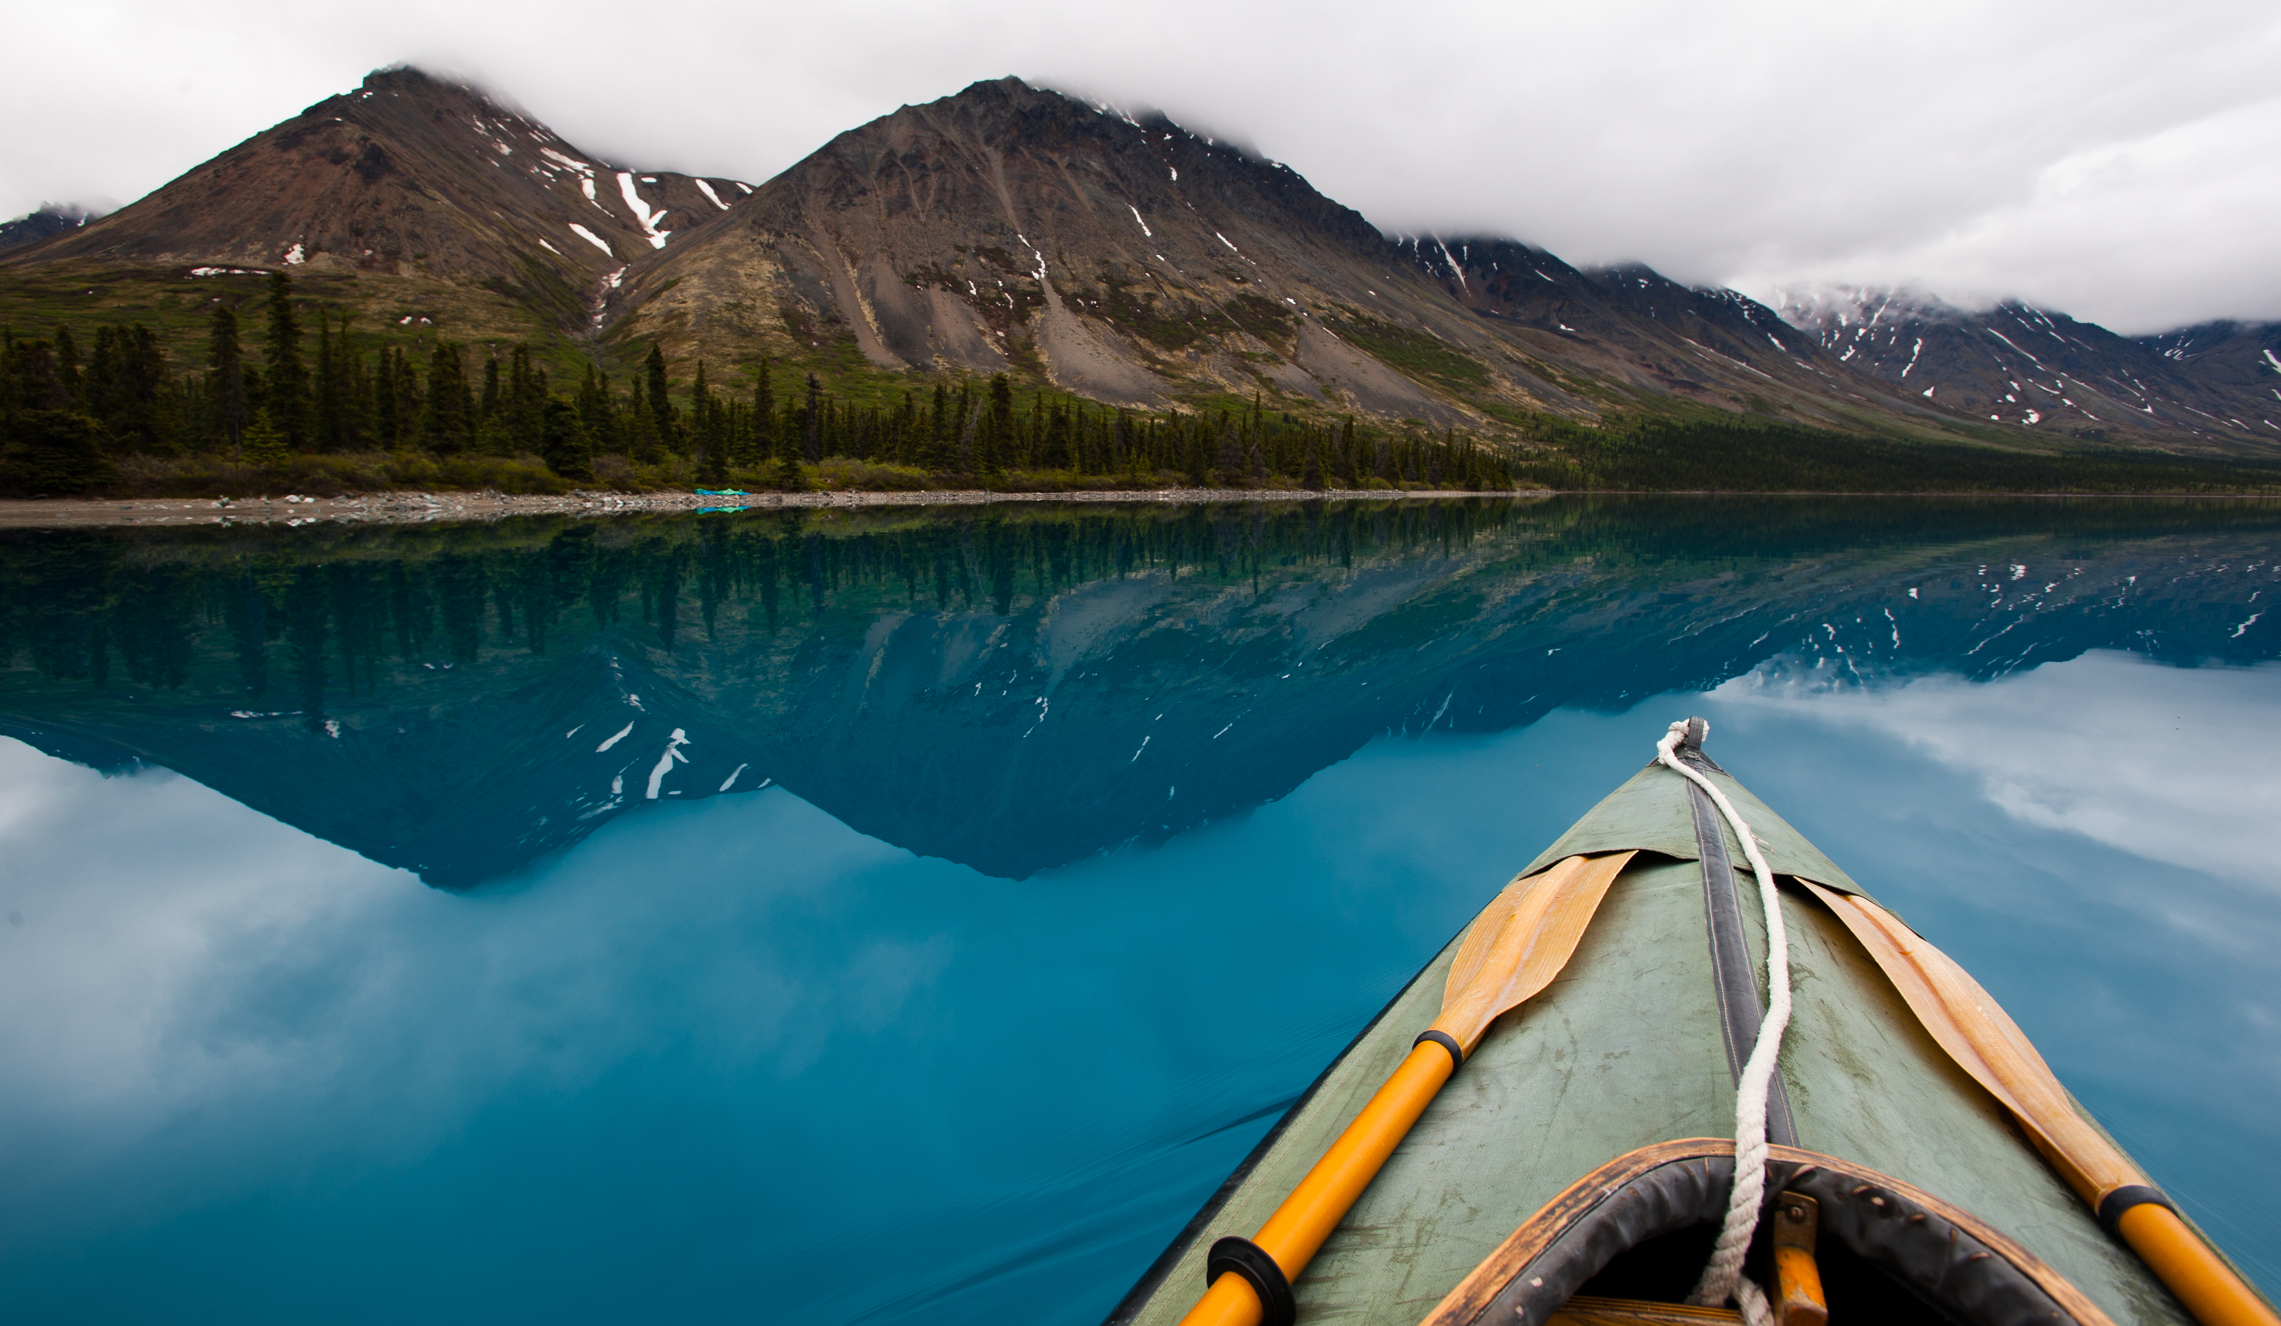

Water Quality and You!
Lake Clark National Park and Preserve
National Park Service
U.S. Department of Interior
A closer look at the importance of a stable environment, water quality, and the ability of organisms to adapt.

Slide 2
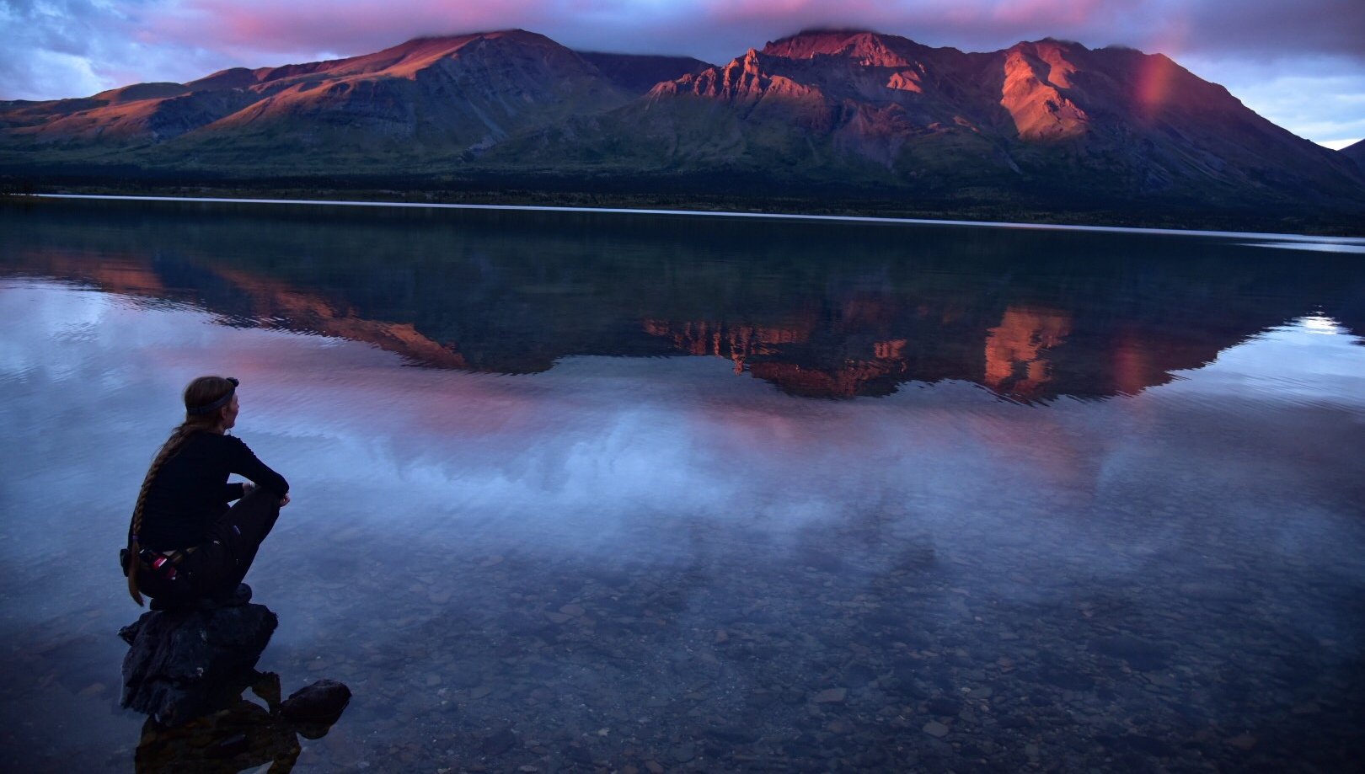
Standards
According to the NGSS (Next Generation Science Standards) this lesson will cover the following standards:
  HS – LS2 Ecosystems: Interactions, Energy, and Dynamics (HS-LS2-2)
  HS – ESS2 Earth’s Systems (HS-ESS24 and HS-ESS2-5)
  HS – ETS1 Engineering Design (HS-ETS1-2)

Slide 3
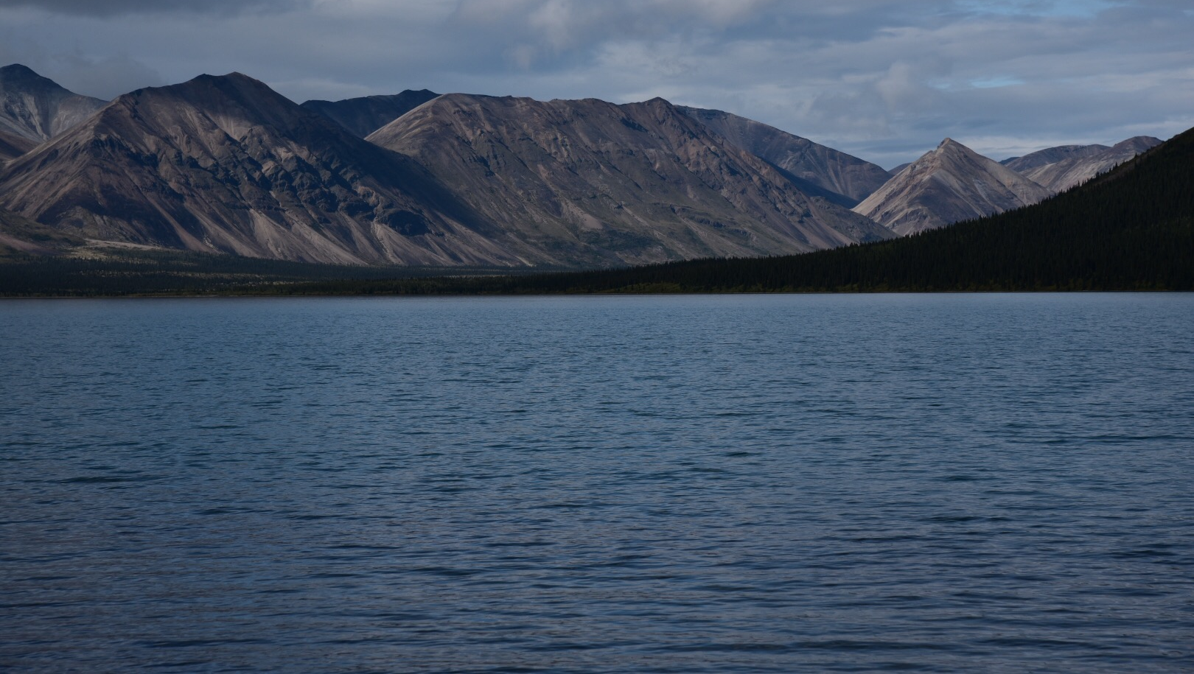
Just a heads up…
When you see a “Let’s Consider” stop and talk with your neighbor or as a group about the concept and knowledge you already have.
When you see an underlined link, head over to the website and get more information on the topic!

Slide 4
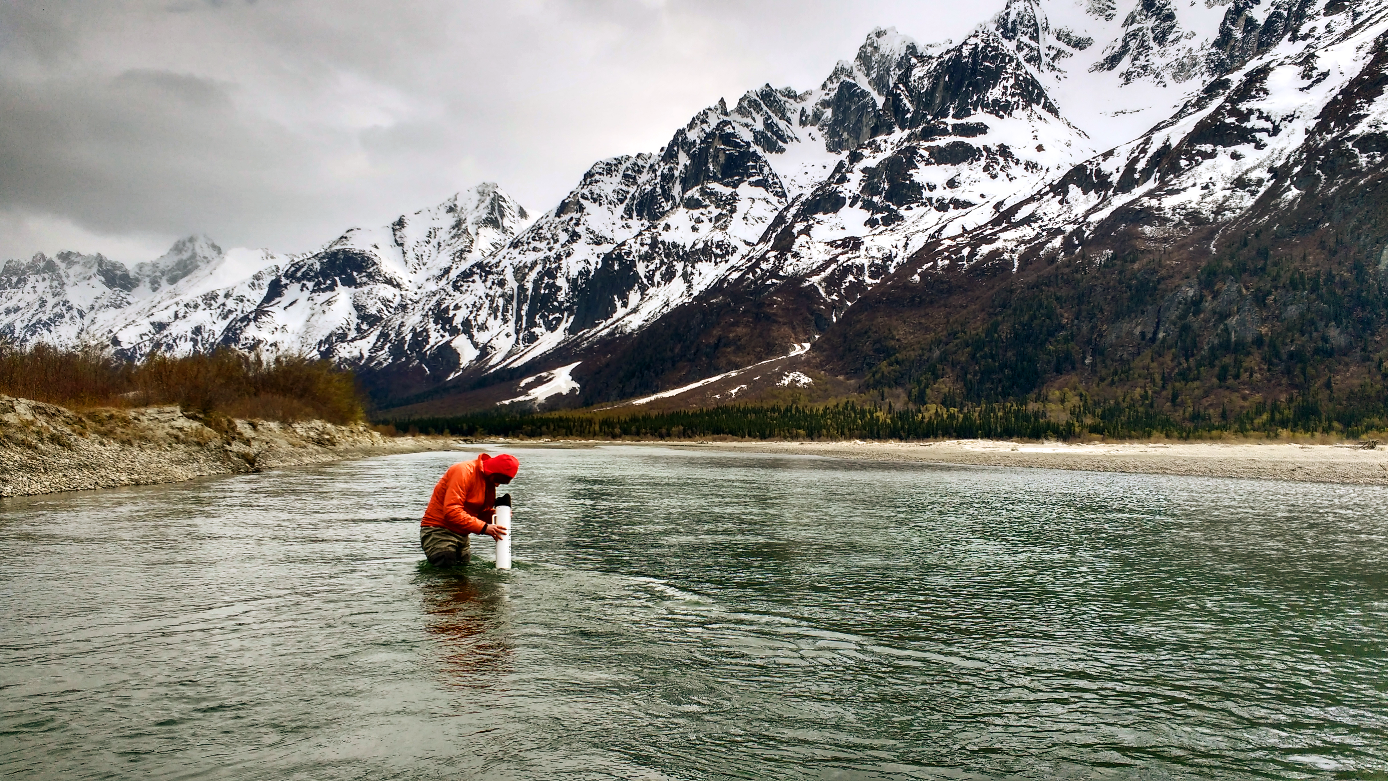
What is Water Quality?
Have you ever looked at a body of water and wondered what really lives in there? What creatures could be lurking under the surface?
Have you been curious how the little fish survive the brutal winter?
Scientists are constantly studying the quality of different bodies of water. They are looking for things that give us clues as to how, why, and what allows different organisms to survive and thrive, while others do not.

Slide 5
What are the main tests scientists use?
Many times scientists will use the following “Big Four” tests when measuring water quality and productivity:
  Dissolved oxygen content
  Turbidity
  pH
  Water temperature

Slide 6
Scientists use high tech probes and sensors to measure most things, but will also use things called Secchi disks for turbidity measurements
Standard Secchi disks

Slide 7
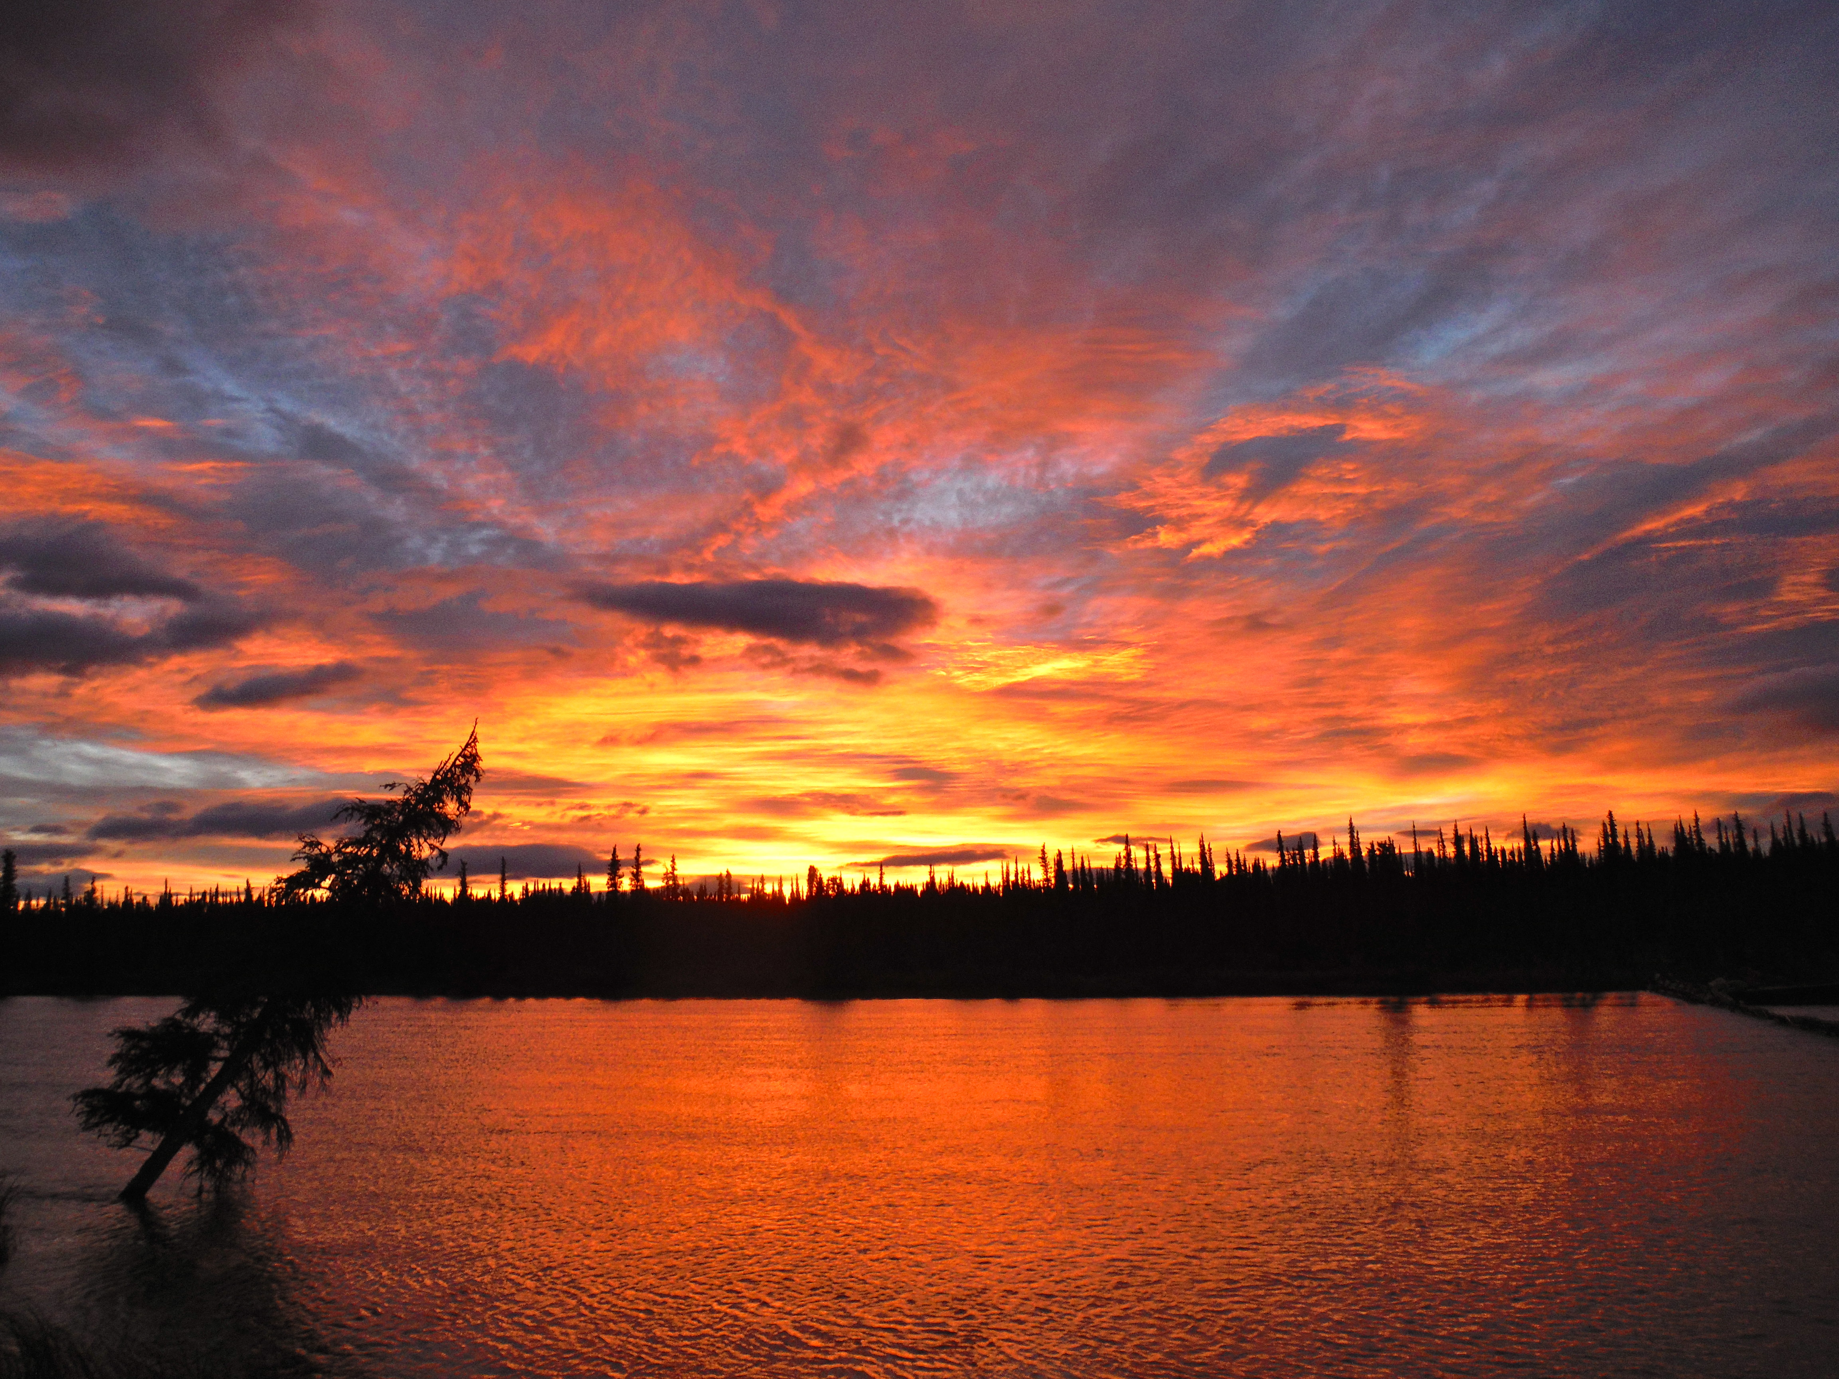
Dissolved Oxygen
Dissolved oxygen (DO) is the amount of oxygen present in bodies of water
Because this dissolved oxygen is used by all forms of aquatic life it can be considered one of the main determinations for productivity of the water.
Productivity is the health and viability of a body of water (whether it can host life and at what level it can host life)

Slide 8
Dissolved Oxygen
Oxygen can be dissolved in the water by one of two main ways:
  Through the atmosphere
  Through the ground-water as it comes up through the earth

Slide 9
Dissolved Oxygen
DO levels can fluctuate based on the season, temperature of water, and photosynthetic rates
  Photosynthesis will occur when there is a lot of light and warmth hence DO will be lower in areas where there is a high concentration of plant life and warm temperatures
Warm, stagnant water can cause a lot of issues with aquatic life as well
  The water near the top of the water is warm – low dissolved oxygen levels
  The water near the bottom has low levels of oxygen because of depth
From that we can see a loss of aquatic life because of levels that are not conducive for life

Slide 10
Dissolved Oxygen
Temperature is inversely related to DO levels
  The colder temperature water can hold more dissolved oxygen than warmer water
  Warmer seasons will show a lower amount of DO Please note the graph for representation and understanding
Areas with a strong glacial input will show a higher dependency on ground water for its DO levels
Want more proof? Check out the studies done at Aialik Bay and Kenai Fjords

Slide 11
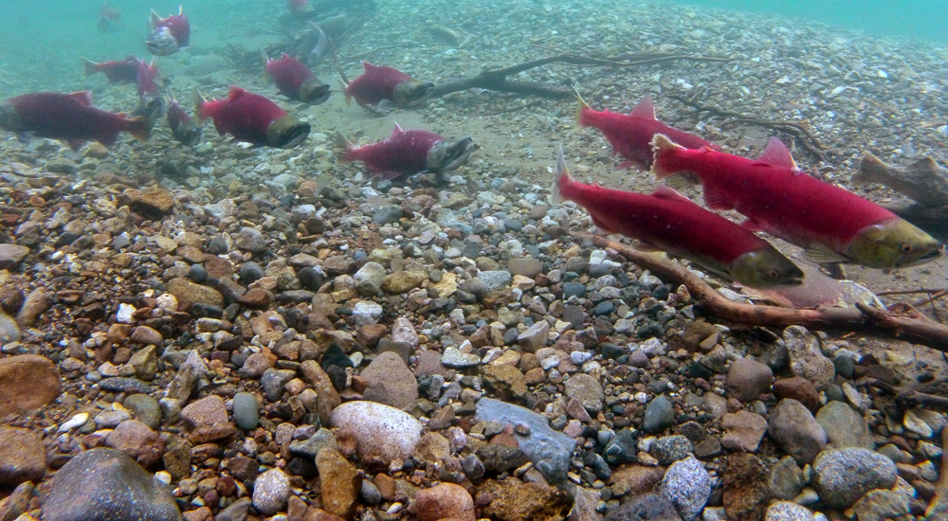
“Let’s Consider”
In Alaska we are seeing an increased rate of melt in the glaciers surrounding Lake Clark. Lake Clark is the largest lake fully contained within a national park and is home to a variety of fish species including a large amount of sockeye salmon that come in from Bristol Bay. The salmon population is one of the last remaining wild populations in the world. As climate changes, the risk of losing this population becomes eminent How might the increased temperatures be effecting the amount of dissolved oxygen in the glacial outlets that support Lake Clark? What might the long term effects of this change?

Slide 12
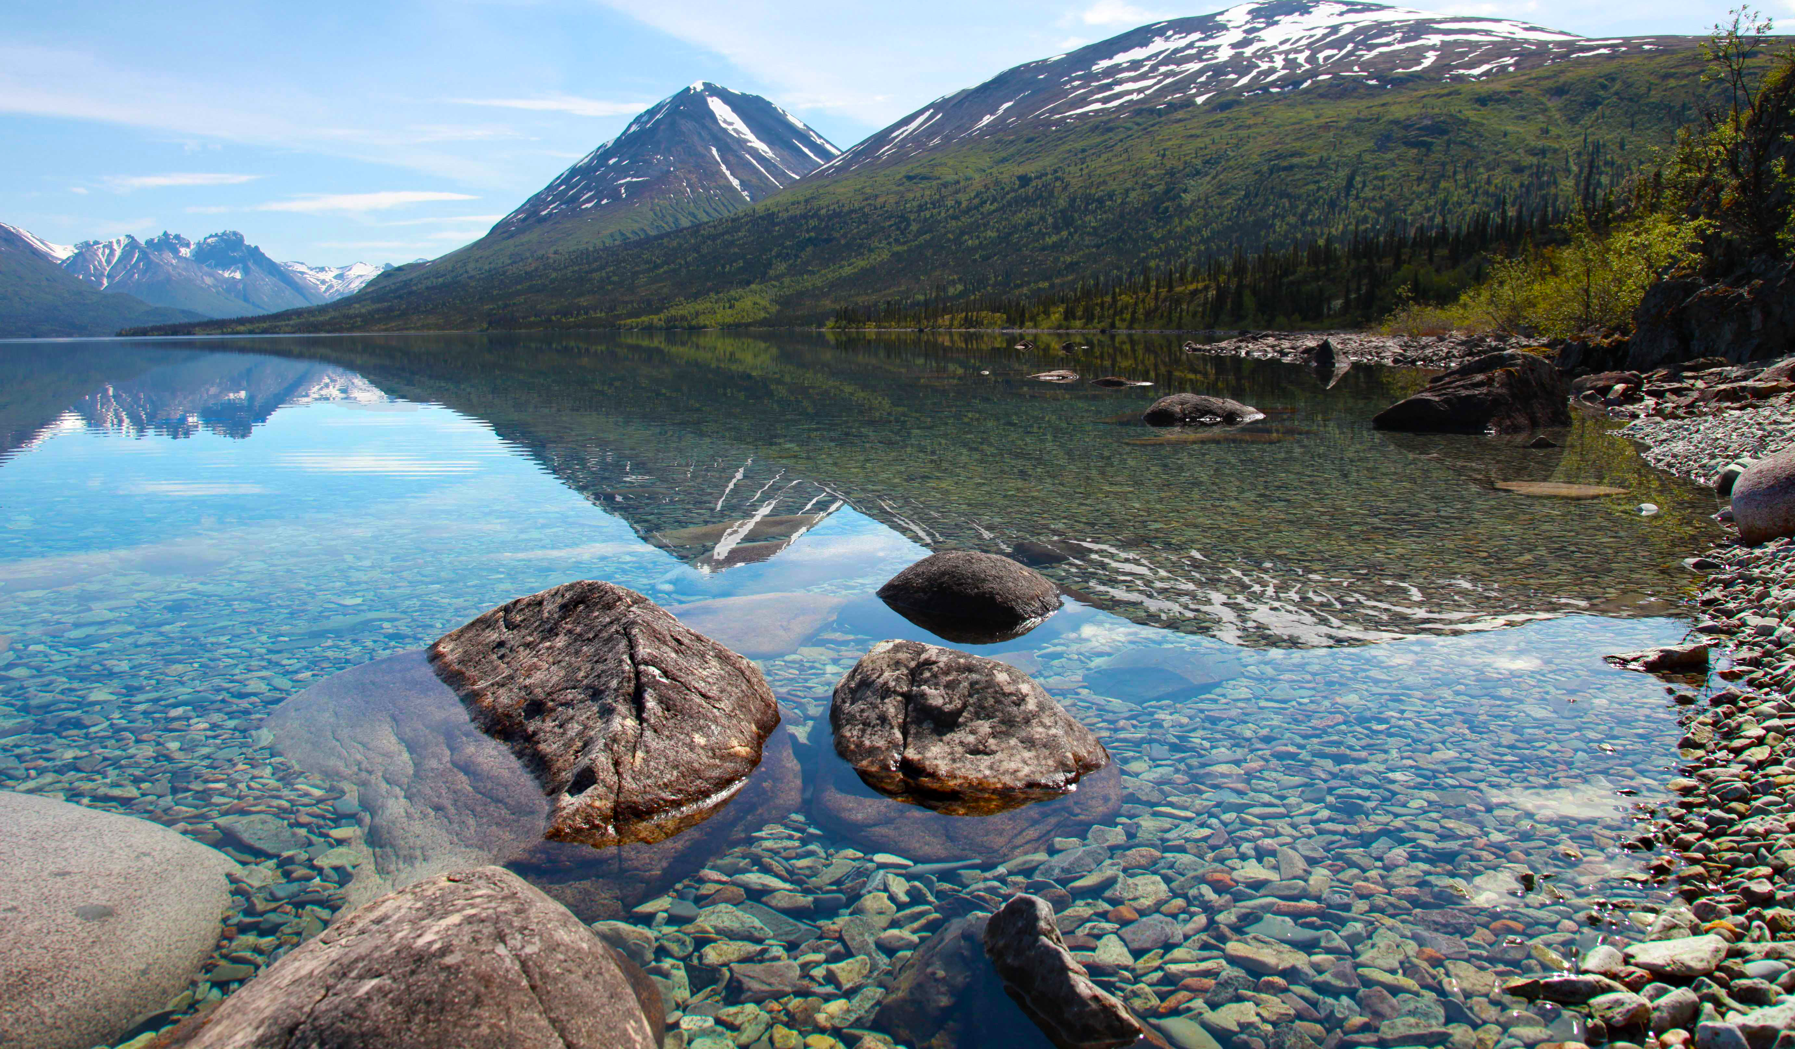
Turbidity
Turbidity is the measure of water clarity (how easy it is to see through the water) It is the amount of light that is scattered by the different materials (dirt, silt, algae, or other microorganisms) in the water giving it a cloudy effect.
The turbidity is measured in NTU’s (nephelometric turbidity units) and can range from 0 – Clear water on up

Slide 13
“Let’s Consider”
This picture was taken of Lake Clark in 2012 by SWAN team member Evan Booher. You can clearly see the sediment plume as it mixes with the fresh water. This mixture of fresh water and glacial silt gives Lake Clark it’s unique color. The sediment also effects the turbidity of the lake. With an increased turbidity, the fish have a harder time swimming up river to spawn. Why might that be?
The salmon that use the Tlikakila River (pictured here at the head of Lake Clark) will wait until late in the year to swim upstream and spawn. Later in the year, as the temperature is cooler and there is less glacial runoff, the amount of silt in the water drops drastically. This leaves a clearer river for the fish to spawn in. Every spring/summer as the glacial runoff increases with warmer temperatures there is a massive sediment plume, pictured here.

Slide 14
Turbidity
Increased levels of sediment can hurt an ecosystem
  Pollution can decrease the amount of light that is able to penetrate the surface of the water killing species or harming the animals
  Depending on the water temperature, turbid waters can host pathogens and bacteria’s which can harm or kill off a population.
Water on the Web Turbidity link

Slide 15
Turbidity–how it’s measured
Turbidity is measured by taking a sample of water from the area of study and measuring it against standard vials of water that have been adjusted.
  The vials are inserted into a machine that sends out a ray of light through the water to measure it against the standard
Image from: http://www.globalw.comproductsturb430.html

Slide 16
Turbidity–how it’s measured
One can also measure turbidity by using a Secchi Disk
A Secchi Disk is a circular disk that is divided into quadrants that alternate black and white. The disk is 8 inches in diameter
  The disk is lowered into the water until it can no longer be seen from the surface
  When the disk is no longer visible, a measurement is taken and recorded as the lake’s turbidity in meters
Image from: http://lakes.chebucto.orgdataparameterssdsd.html/

Slide 17
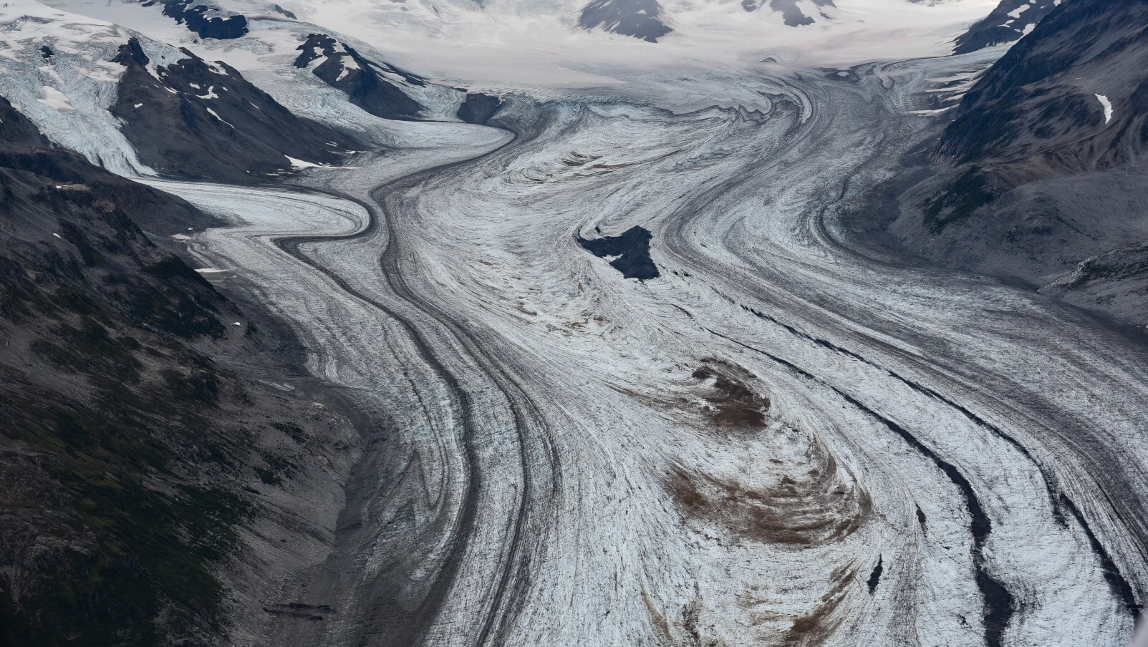
“Let’s Consider”
How might the increasing glacier melt influence turbidity?
How might that effect the aquatic life within lakes and rivers?
Follow the link to the video “350 days in the life of a retreating glacier” by 350.org to watch the video from YouTube about the time lapse of a glacier
http://youtu.be/6dFbuaz130c

Slide 18
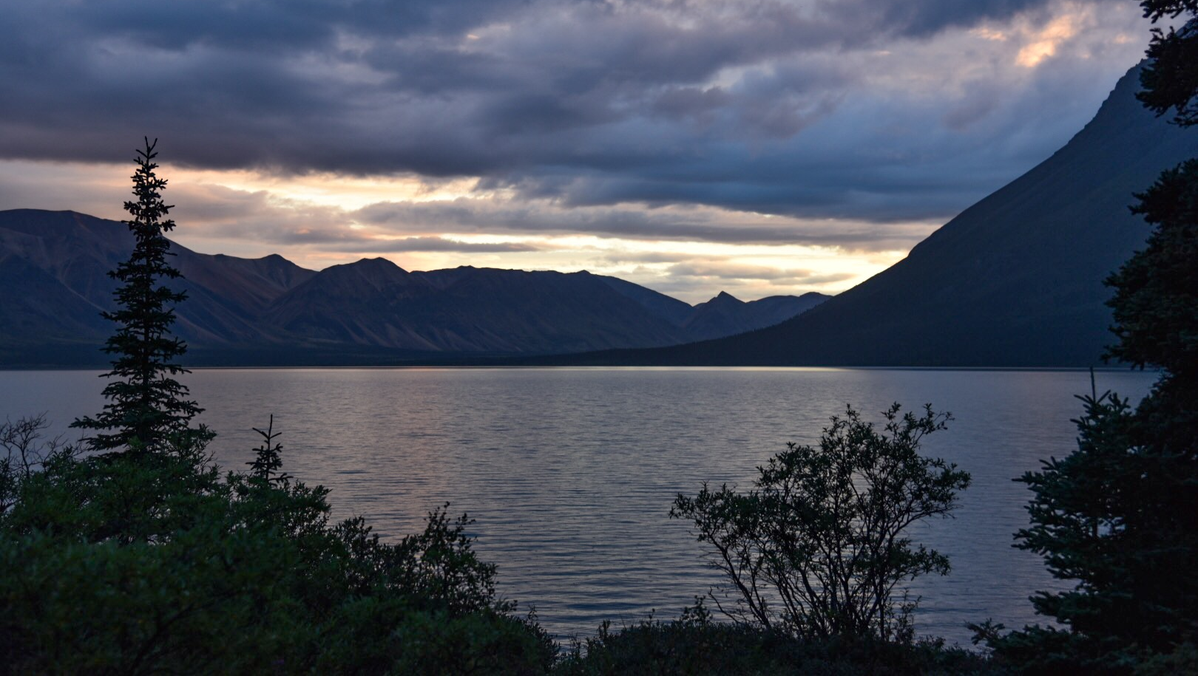
pH
pH is a measure of how acidic/basic water is. How many free ions are available in the water. Water that has more free hydrogen ions would be acidic
Water that has more free hydroxyl ions would be basic
It is based on a 14 point scale
  7 is neutral
  Less than 7 is acidic
  More than 7 is basic

Slide 19
pH- What is it good for?
“The pH of water determines the solubility and biological availability of chemical constituents such as nutrients and heavy metal” (usgs.gov)
  What that means is that water’s ability to dissolve sediment and provide nutrients for aquatic life is determined based on the things dissolved in the water
Image from: http://getwellstaywellathome.comblog201203using-ph-as-a-health-monitor/

Slide 20
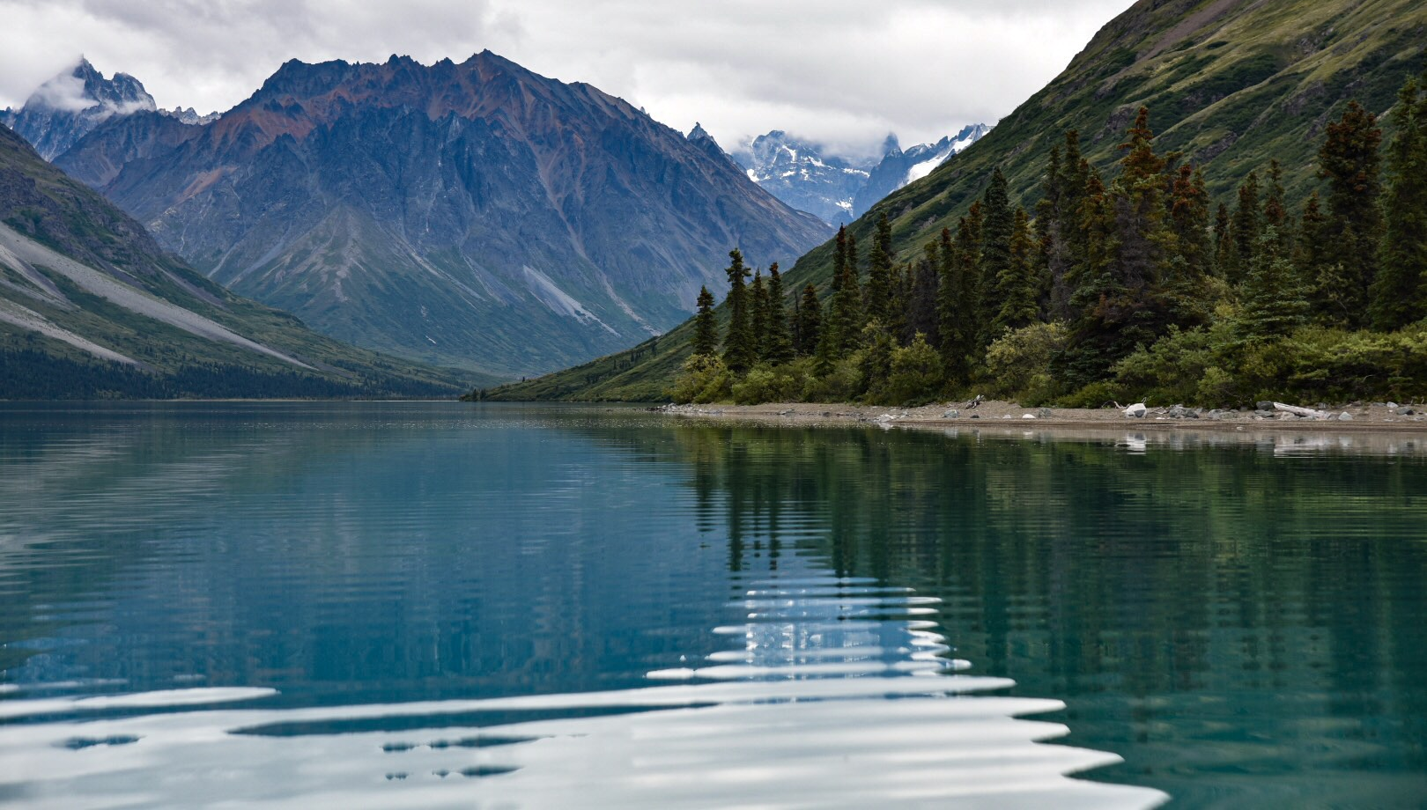
pH- What is it good for?
Water’s pH will determine the amount of nutrients in the water like carbon, nitrogen, and phosphorus and if there is enough for the aquatic life to use
  Nutrients will slightly increase the pH
It will also determine the amount of heavy metals and if they are at toxic levels
  Metals will lower the pH

Slide 21
“Let’s Consider”
Take a look at the graph about pH.
Discuss the importance of a stable pH on the inhabitants of an aquatic ecosystem.

Slide 22
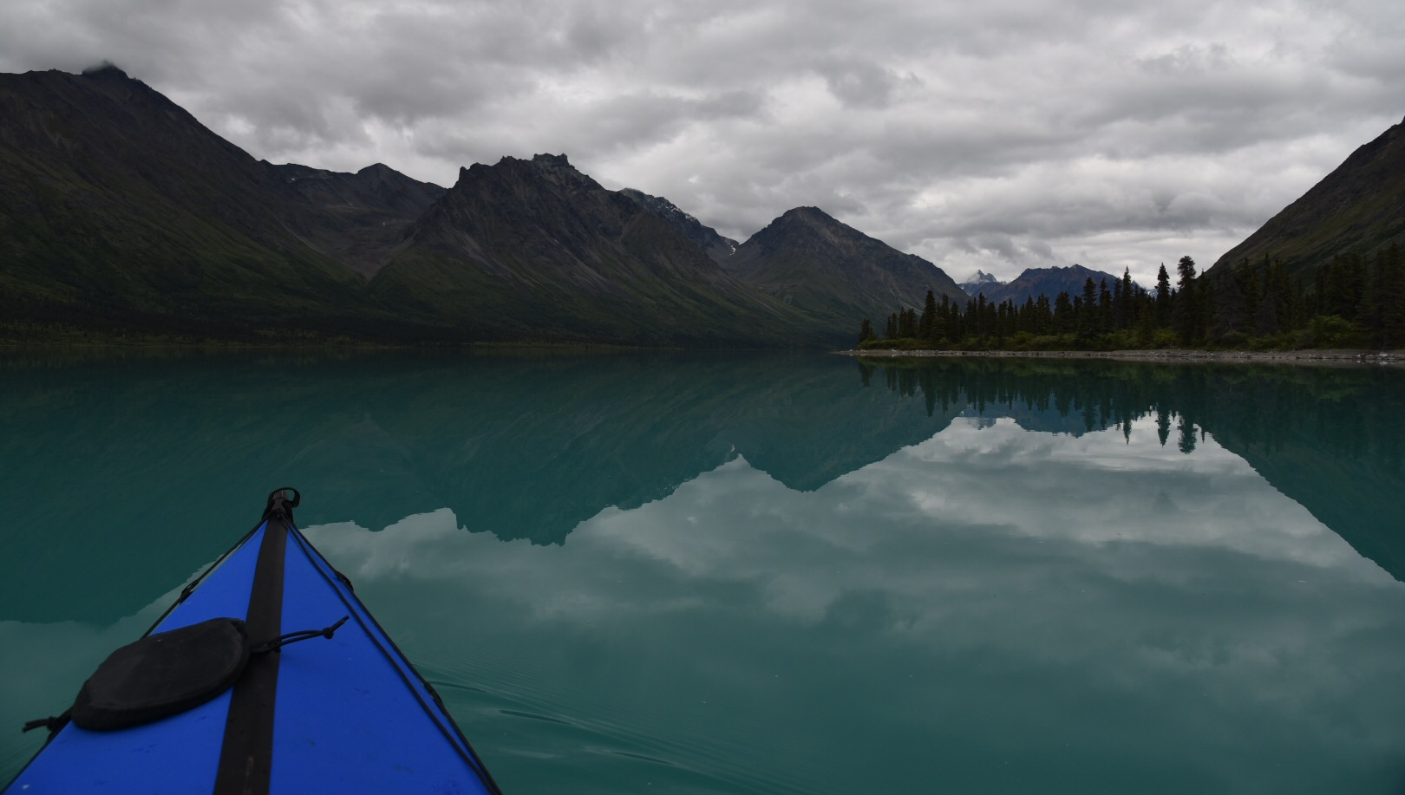
Water Temperature
Throughout the year scientists and technicians use probes to measure the water temperature at different depths to monitor for change
When the water temperature is fairly stable, any minor event can cause a drastic change for those animals and plants living there.

Slide 23
Water Temperature
Remember, Dissolved Oxygen is adversely effected by water temperature
  higher temperature = lower DO levels
  lower temperature = higher DO levels
Water temperature can also effect the electrical conductivity of the body of water The rate of chemical reactions tends to be higher in warmer temperatures therefore has a higher electrical conductivity (higher change for electric current to travel through)

Slide 24
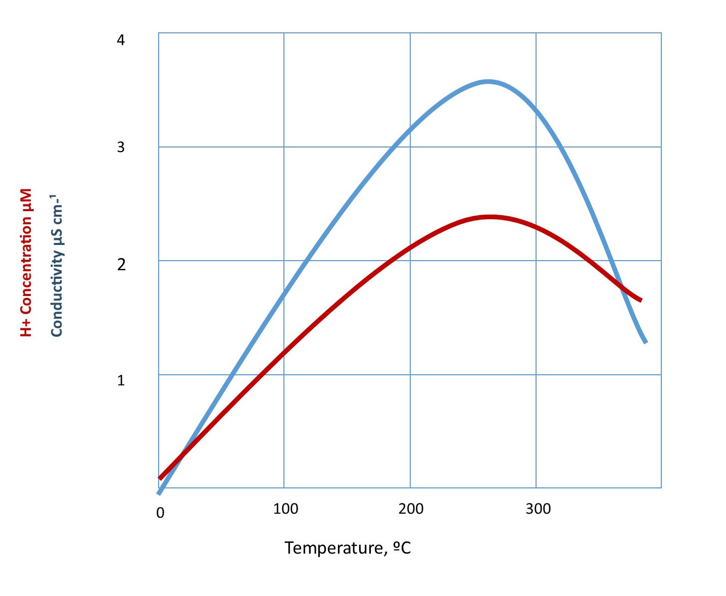
“Let’s Consider”
As illustrated by the graph, you can see as the temperature goes up so does the pH and thereby the conductivity.
Take a moment and discuss why there might be a drop off in conductivity around 250ºF

Slide 25
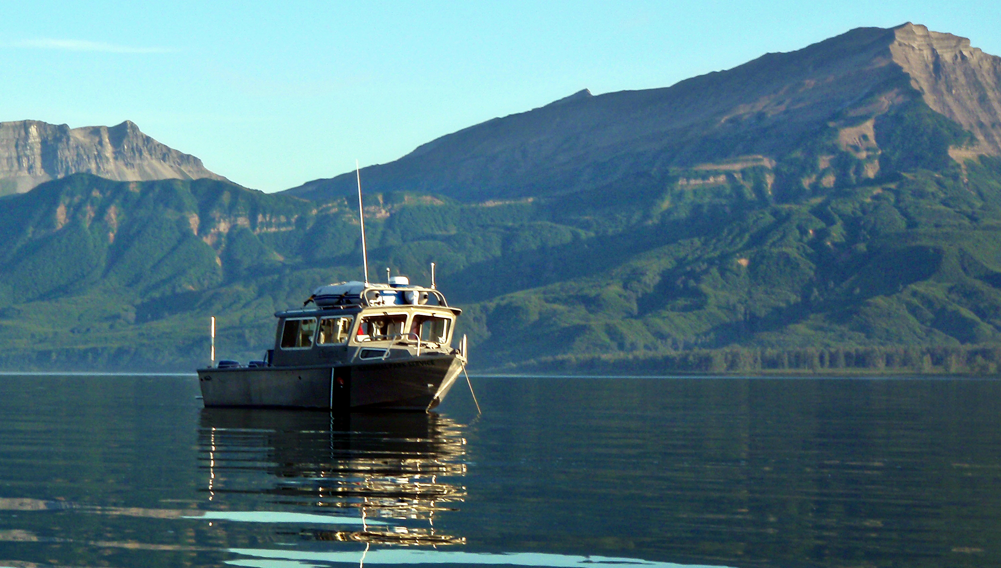
How is water quality monitored?
In Alaska there is a team of scientists and technicians who are responsible for many of the national parks in the state. The team is known as SWAN.
They are hired, mainly seasonally, to monitor the lakes and take different measurements
In different states there are different groups who monitor quality (check your state’s EPA or national park website)

Slide 26
Who is SWAN?
Southwest Alaska Network (SWAN) is a group of scientists and technicians, hired by the National Park Service, who monitor the quality, productivity, and life that is thriving in the water of Lake Clark National Park and Preserve.

Slide 27
Who is SWAN?
These men and women are using high tech equipment to monitor change as they happen.
  They travel all over Alaska measuring water quality. They are taken over bodies of water in float planes or by boat
  They spend all summer living in remote areas studying and gathering data
  They are hiking mountains and swimming in lakes that are only accessible by air

Slide 28
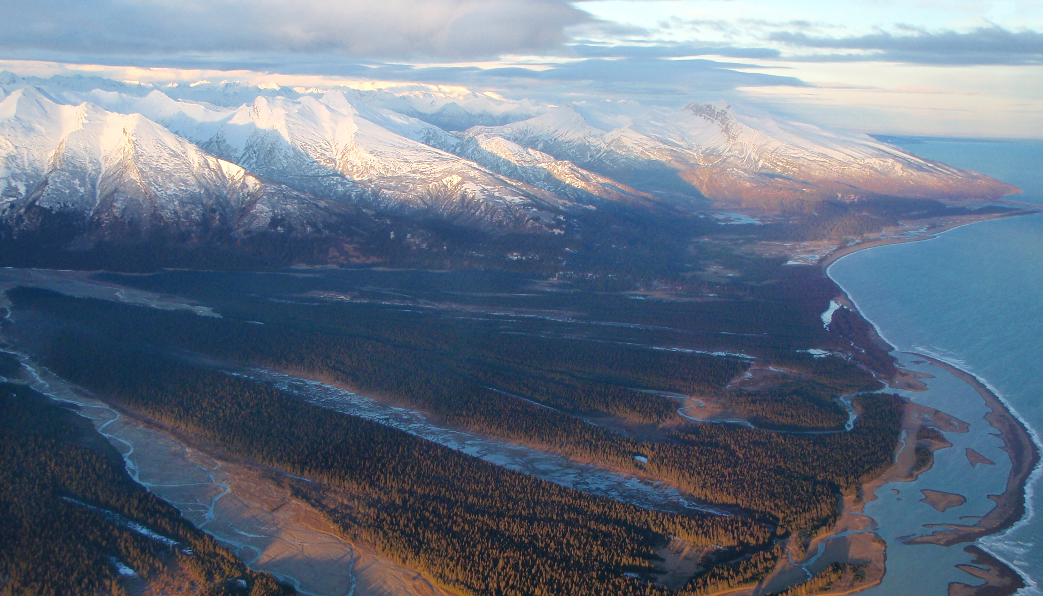
Quick Review
What is Dissolved Oxygen?
What is Turbidity?
What is pH?
What is productivity?
Explain Water Quality.
Who is the SWAN team?
What can you do to help maintain water quality?

Slide 29
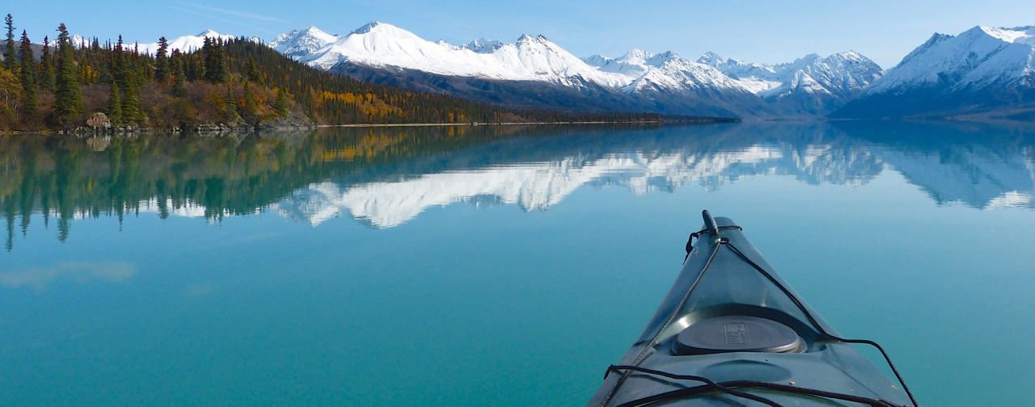

Lake Clark National Park and Preserve
National Park Service
U.S. Department of Interior

Slide 30
Sources
http://water.usgs.gov/edu/turbidity.html
http://serc.carleton.edu/microbelife/research_methods /environ_sampling/turbidity.html
http://water.usgs.gov/edu/ph.html
A Citizen's Guide to Understanding and Monitoring Lakes and Streams
NPS website www.nps.gov
http://science.nature.nps.gov/im/units/swan/assets/do cs/reports/inventories/BennettL_2005_KEFJ_WQInve ntory_050420.pdf

