Slide 1
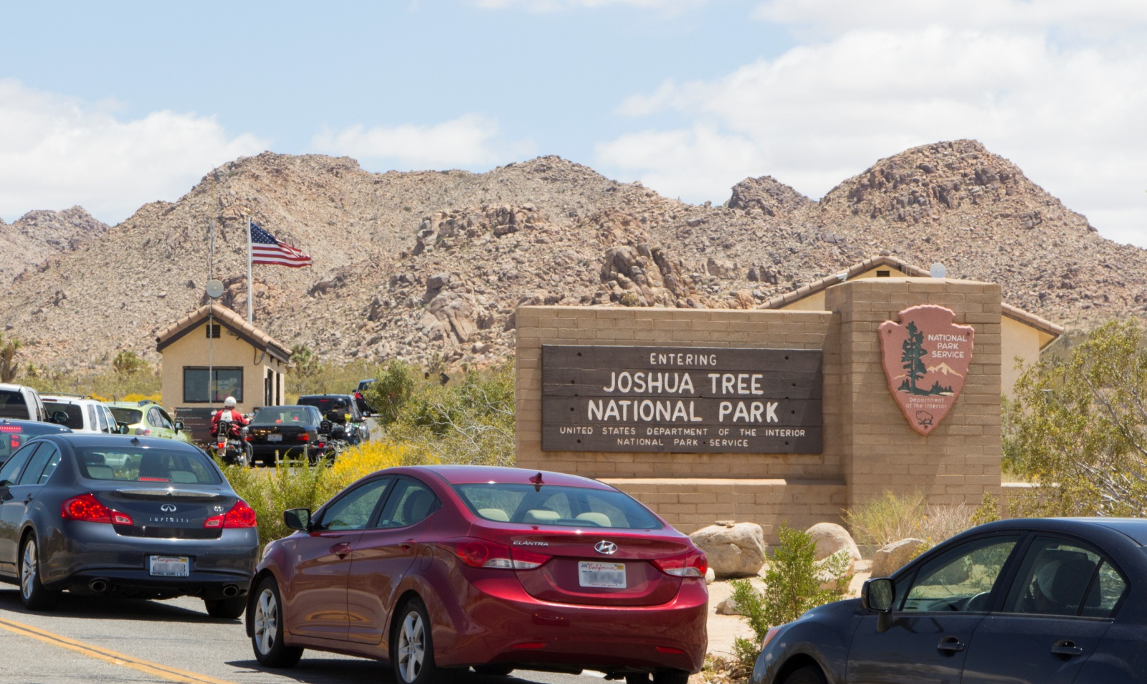
The Arrowhead: Emblem of the National Park Service
Have you ever wondered about that arrowhead you see on signs around Joshua Tree National Park?
That’s the emblem of the National Park Service.

Slide 2
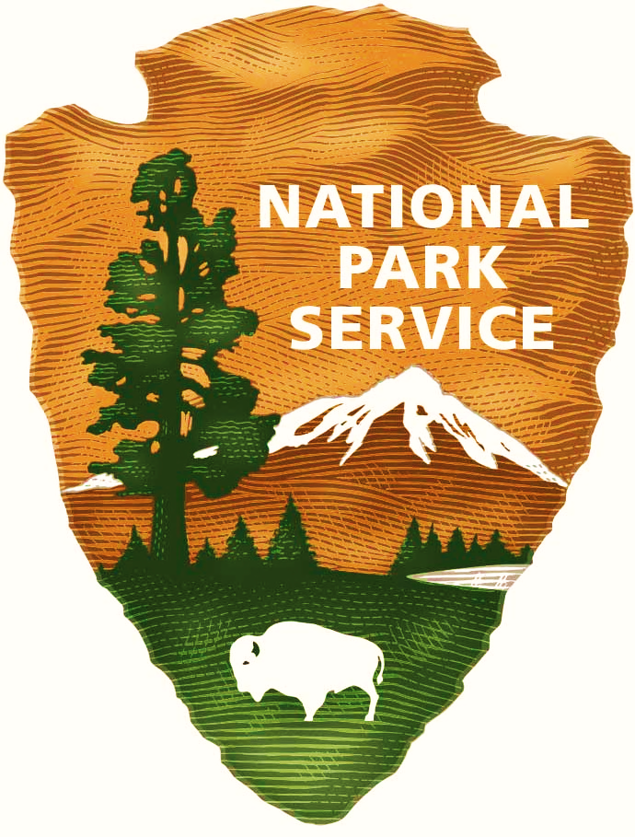
Each part of the emblem symbolizes something the National Park Service was created to protect.

Slide 3
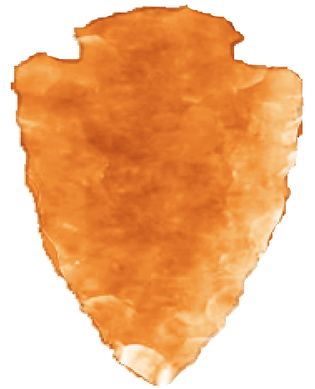
The arrowhead shape represents human culture.

Slide 4
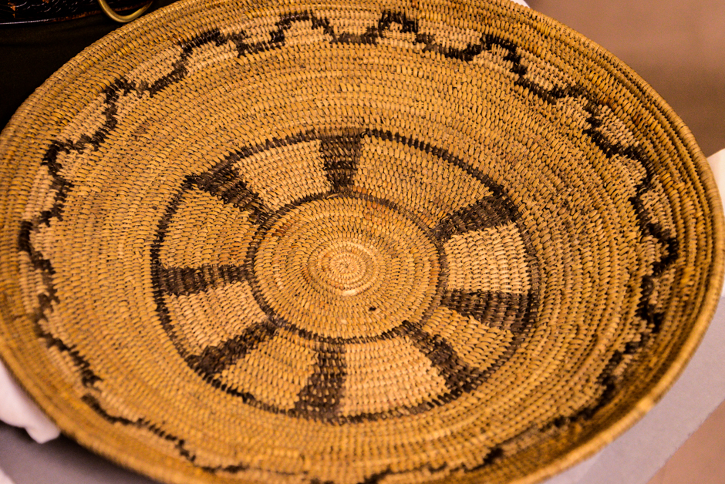
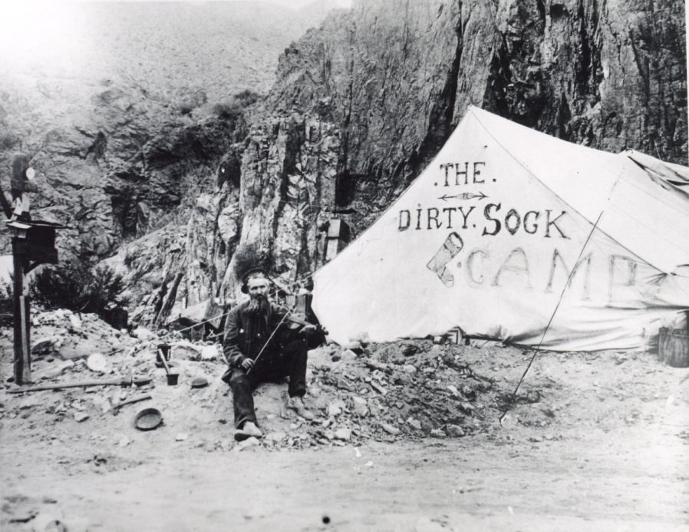
CULTURE: The area that is now Joshua Tree National Park was once home to Native American tribes, the site of cattle ranching and mining operations, and a military training facility. The park protects these stories for future generations to enjoy.
Native American basket
Miner at The Dirty Sock Camp

Slide 5
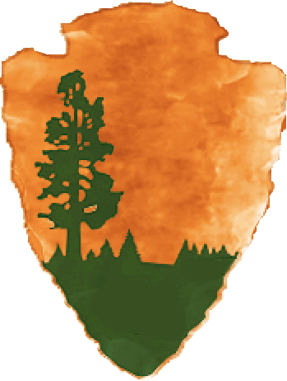
The sequoia tree represents all trees and other plants.

Slide 6
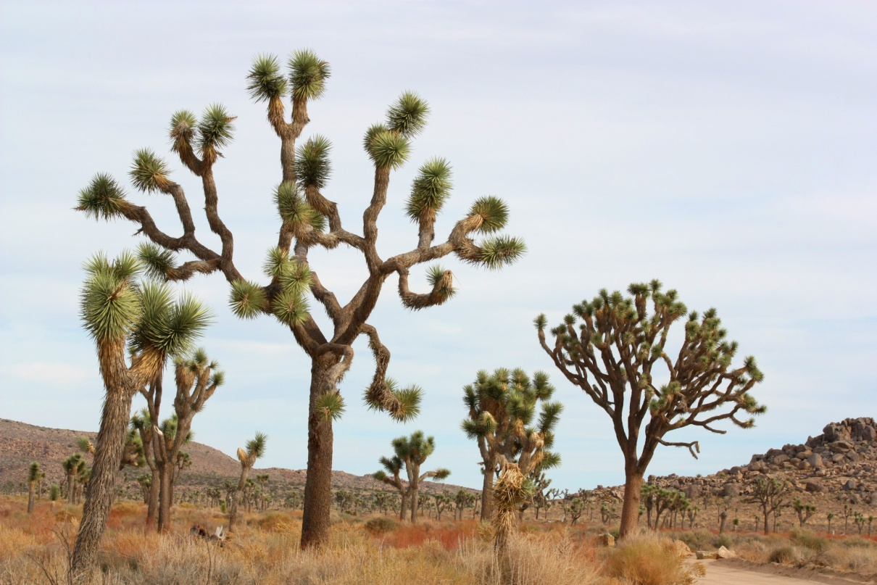
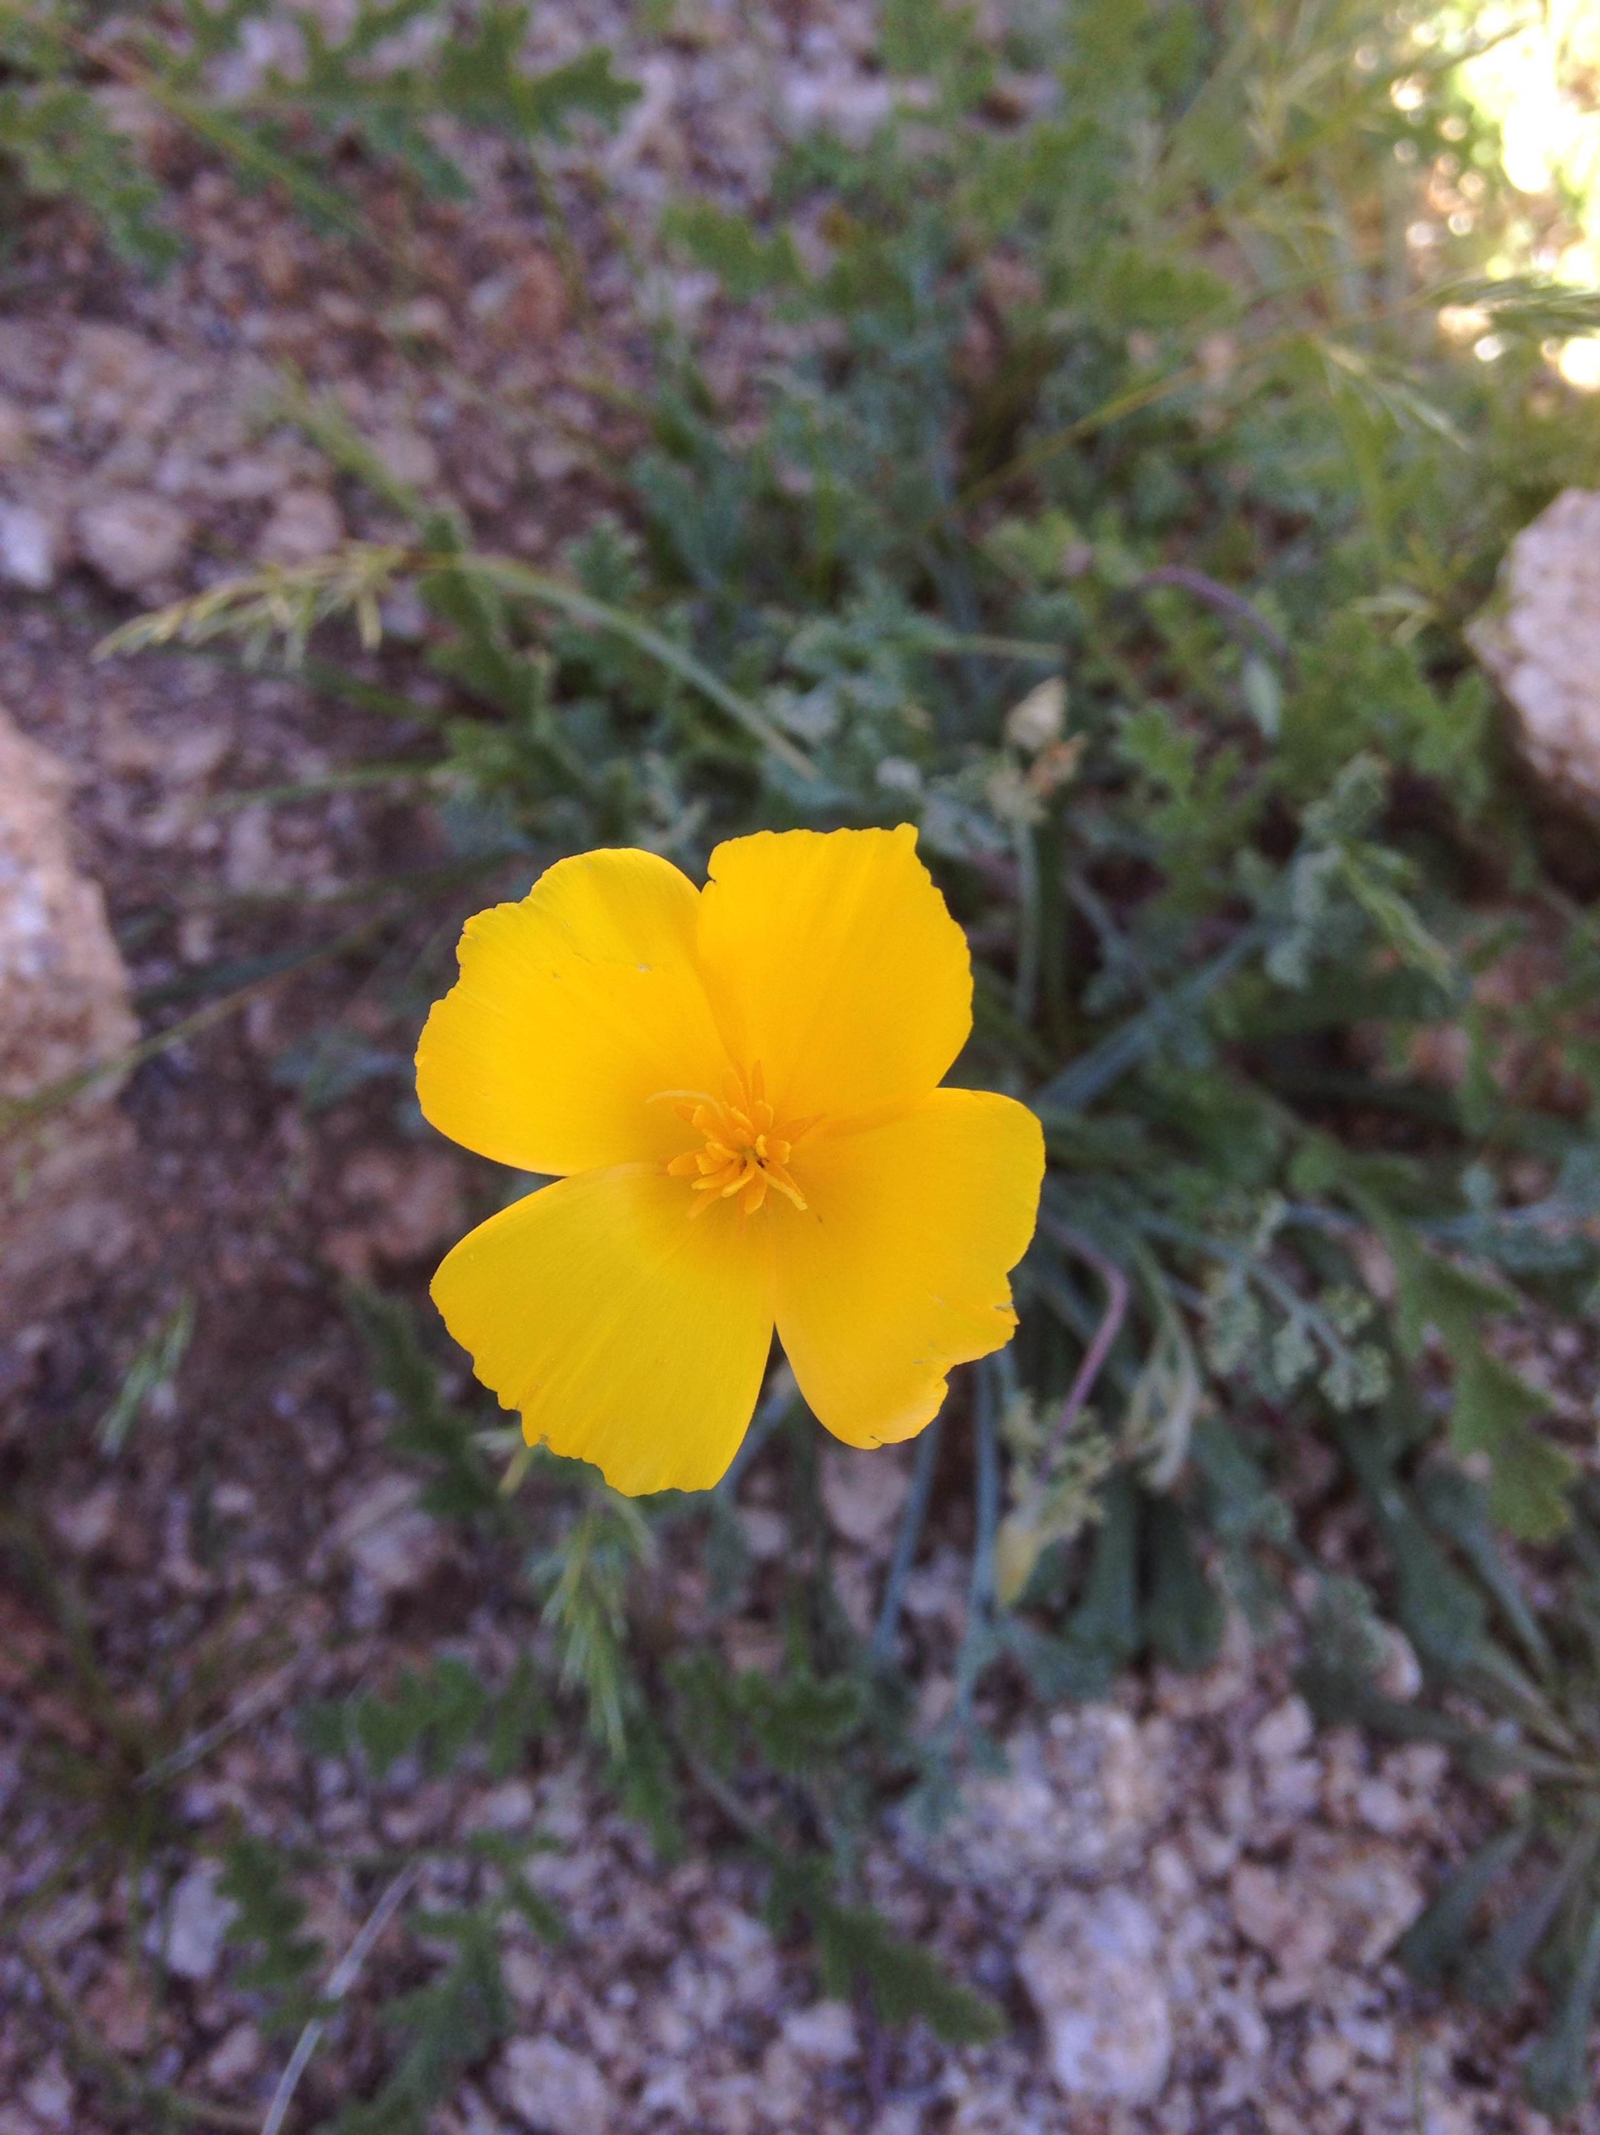
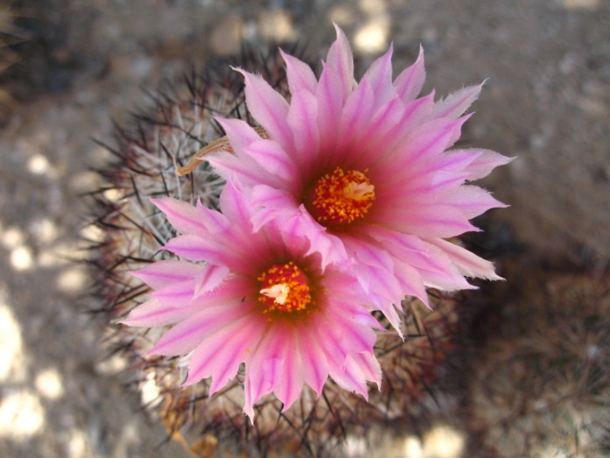
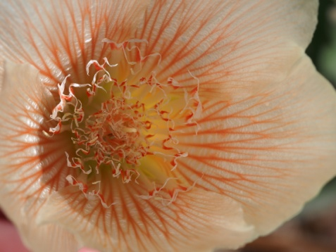
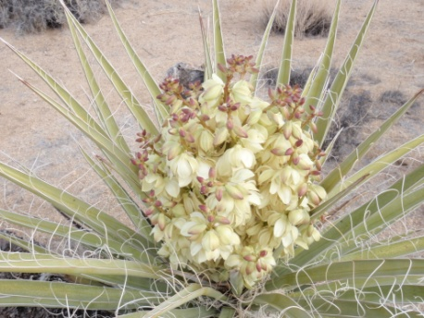
PLANTS: The park is home to special plants like yuccas, cacti, and wildflowers.

Slide 7
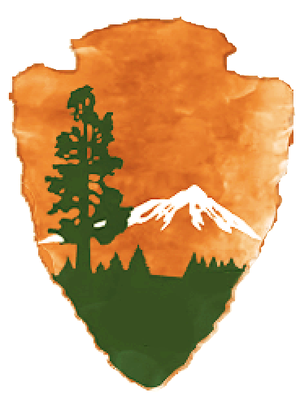
The mountain represents land formations, scenery, and recreational opportunities.

Slide 8
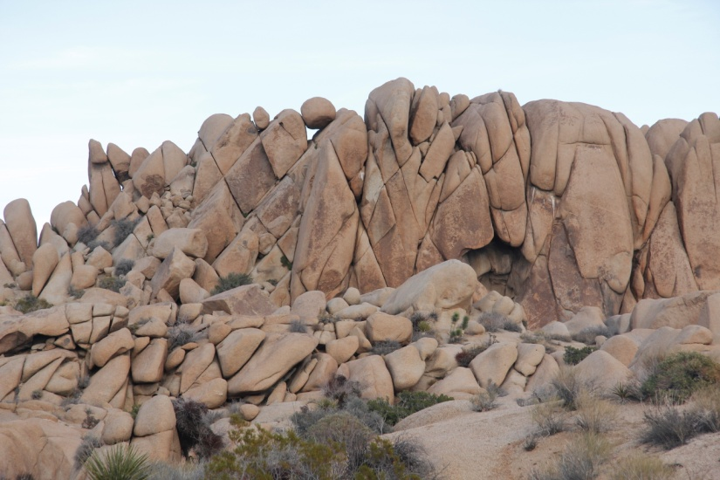
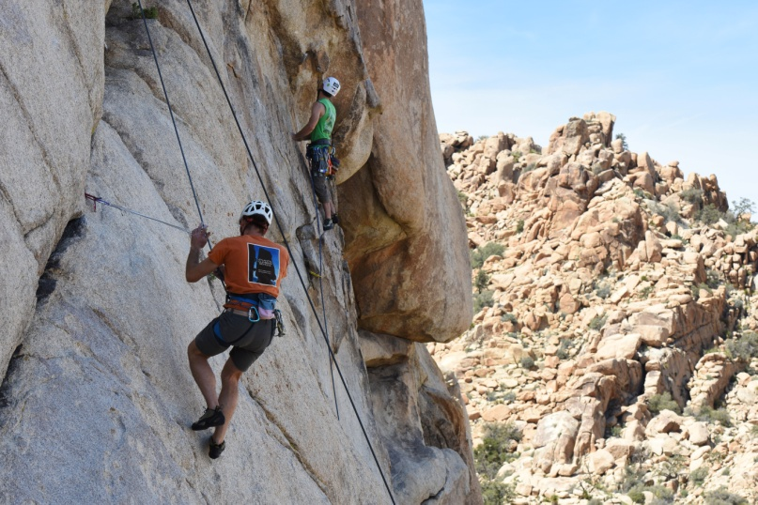
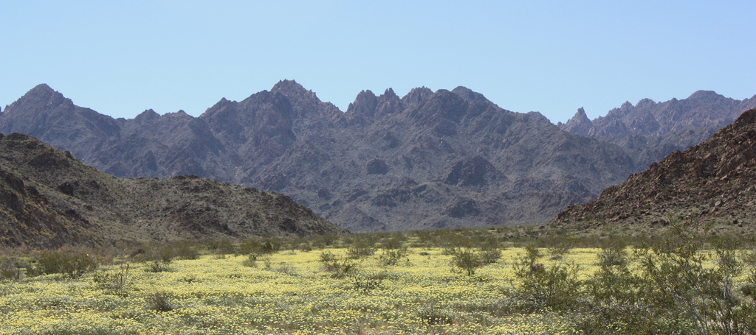
LANDFORMS: Boulder piles and rugged mountains are protected for everyone to enjoy.

Slide 9
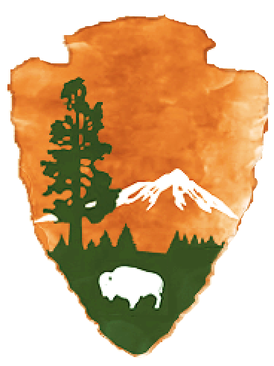
The bison represents all wildlife.

Slide 10
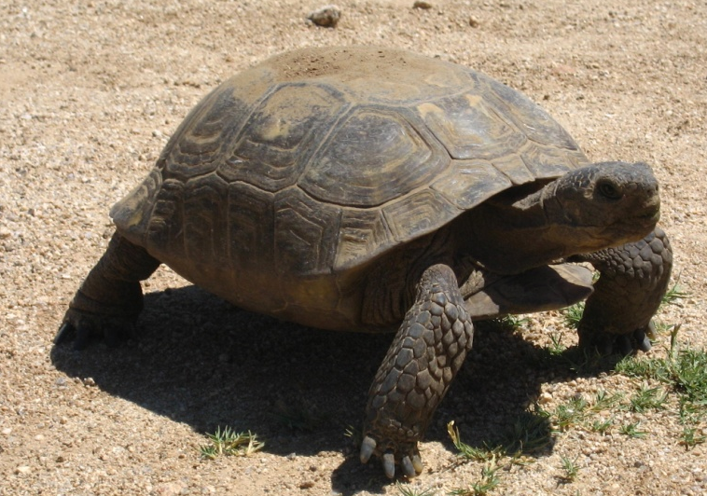
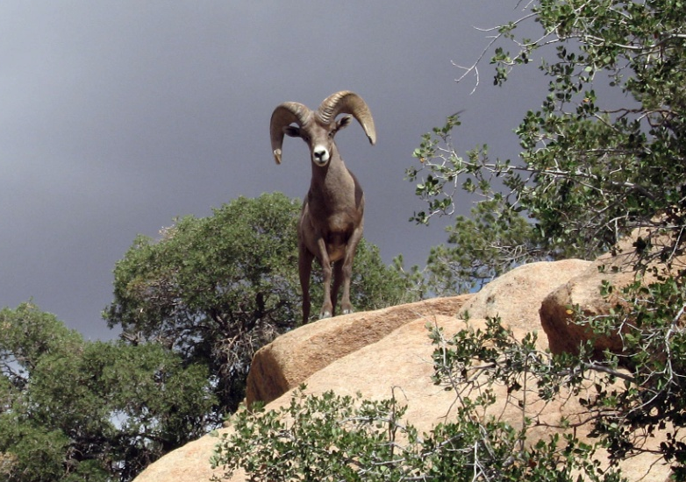
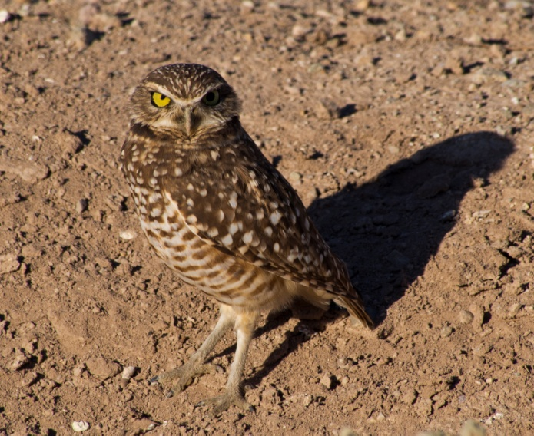
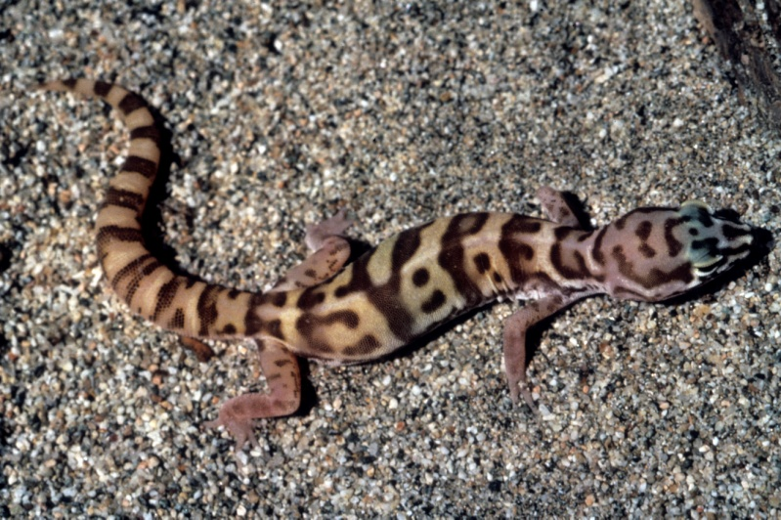
ANIMALS: Joshua Tree National Park is home to many species of animals, including desert tortoises, bighorn sheep, burrowing owls, and banded geckos.

Slide 11
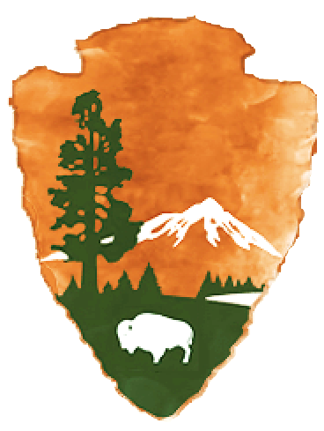
The lake represents clean water and air.

Slide 12
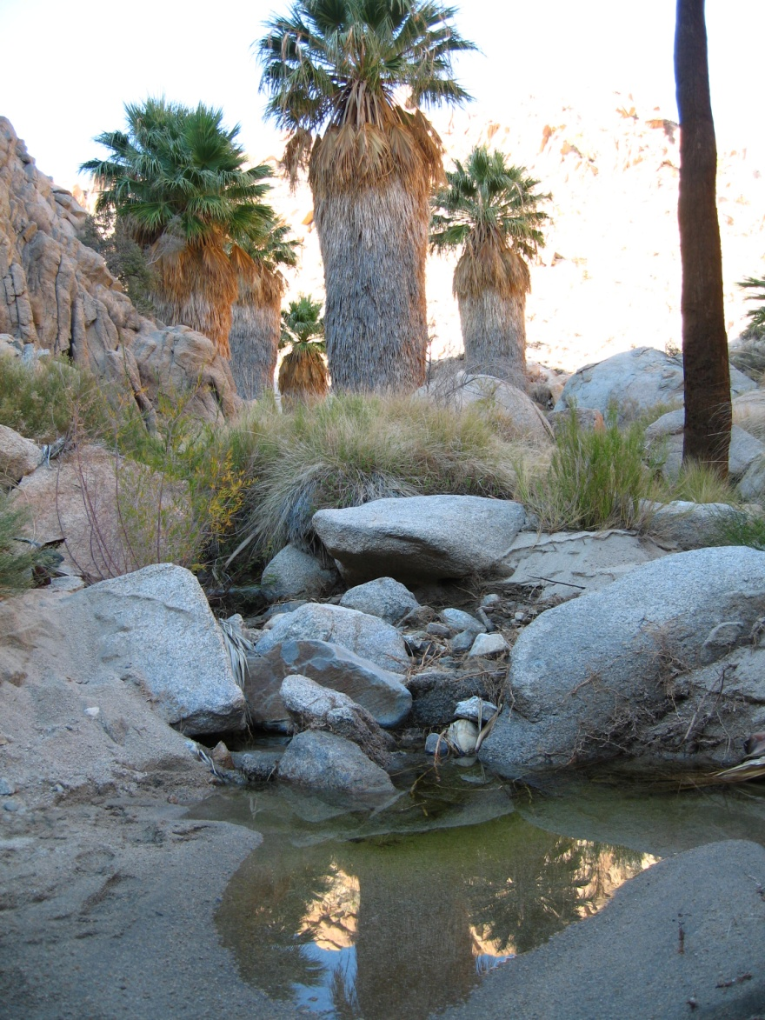
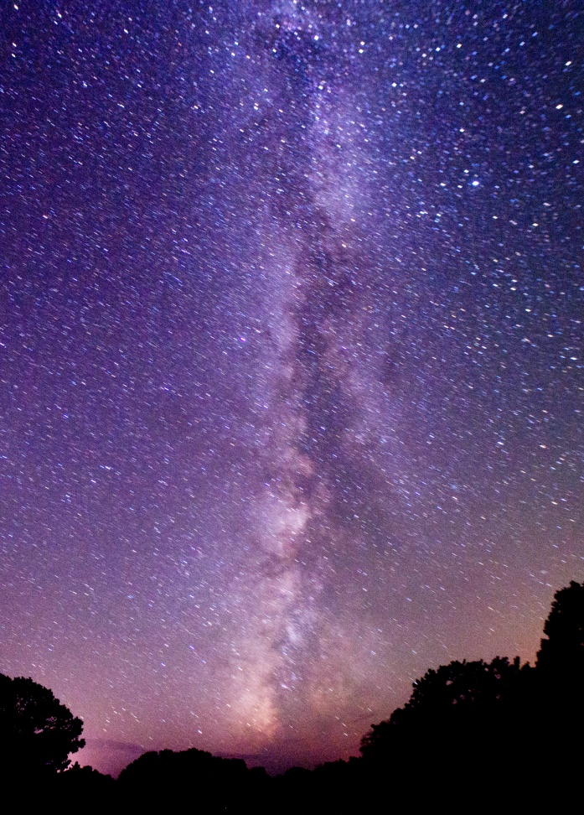
WATER AND AIR: All water in Joshua Tree National Park is protected for wildlife. Clean air and little light pollution allow visitors to see lots of stars and part of our galaxy: the Milky Way.

Slide 13
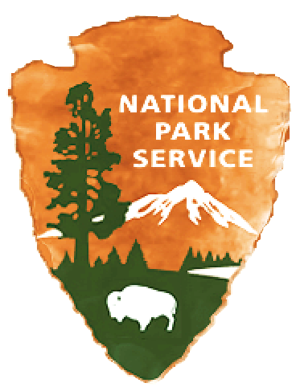
The National Park Service was founded in 1916 to protect and preserve all these things for the enjoyment of everyone.

Slide 14
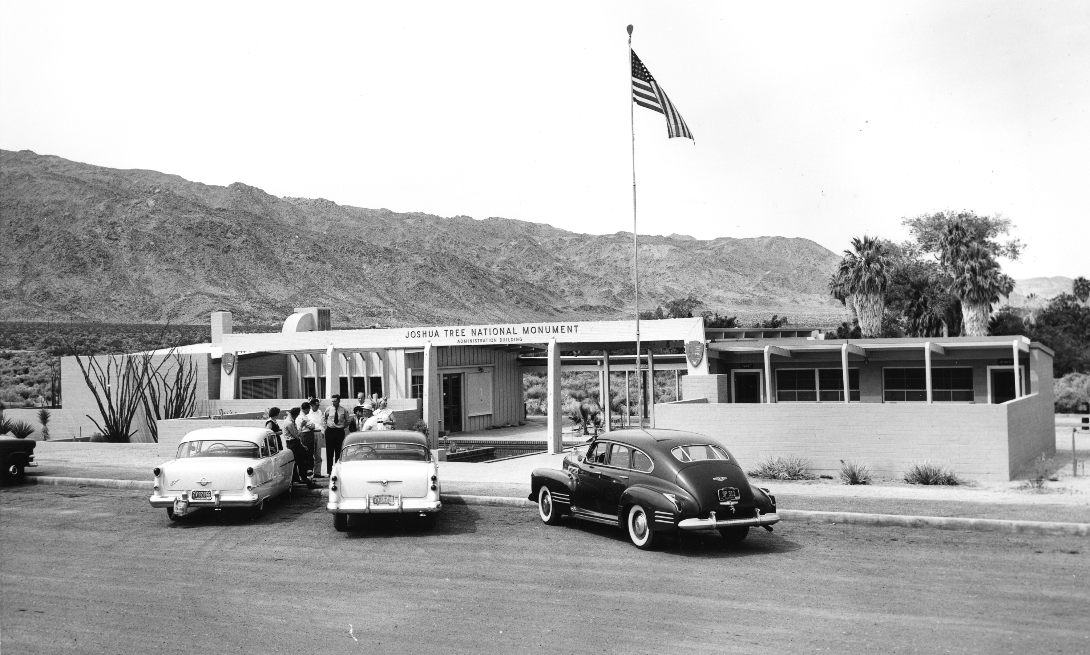
Joshua Tree National Monument was created in 1936.
It became a National Park in 1994.
Historic photograph of the Oasis of Mara Visitor Center in Twentynine Palms, CA

Slide 15


POP QUIZ!
Can you list all the symbols on the National Park Service emblem and tell what each one represents?

