Slide 1
Are these habitats healthy or not healthy?

Slide 2
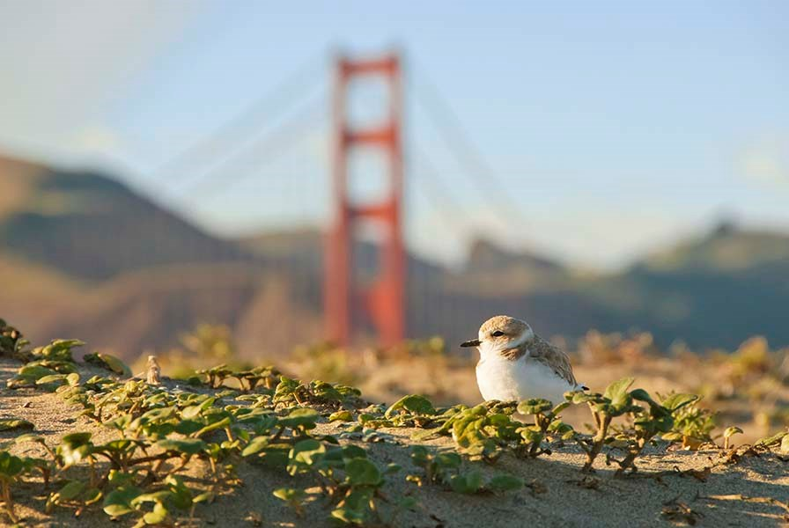
Snowy Plovers on the Beach - Healthy or not healthy?

Slide 3
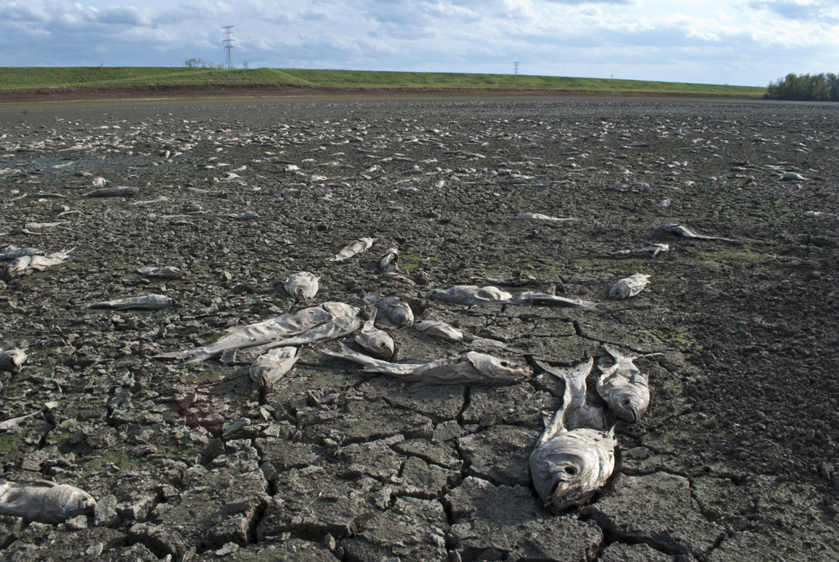
Dead Fish - Healthy or not healthy?

Slide 4
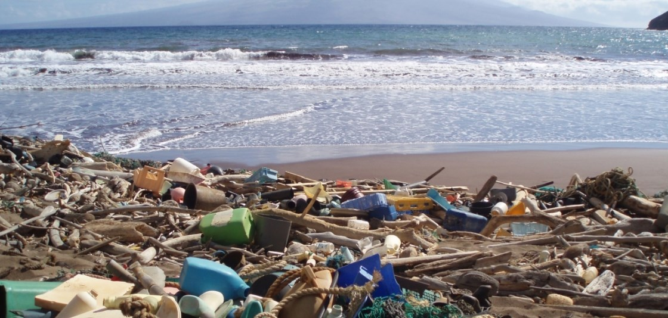
Litter on a beach - Healthy or not healthy?

Slide 5
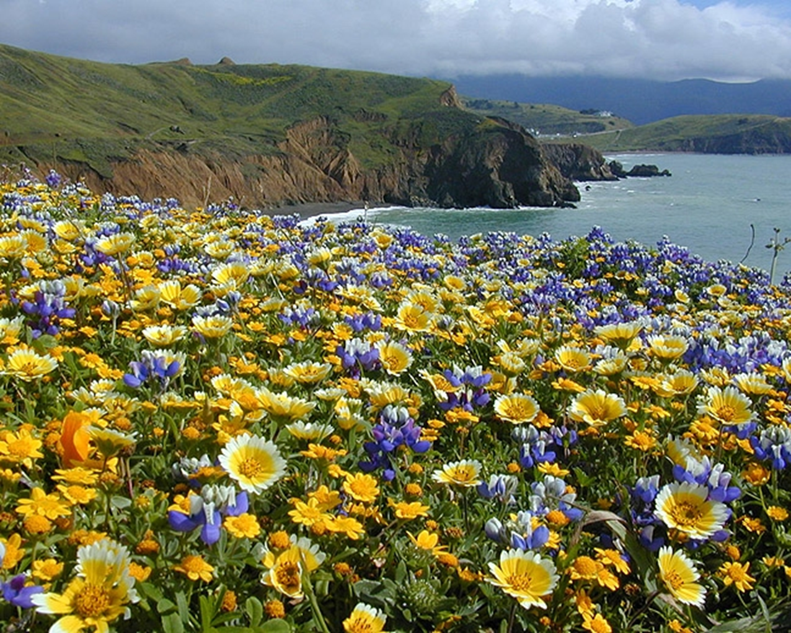
Daisy Flower in the headlands - Healthy or not healthy?

Slide 6
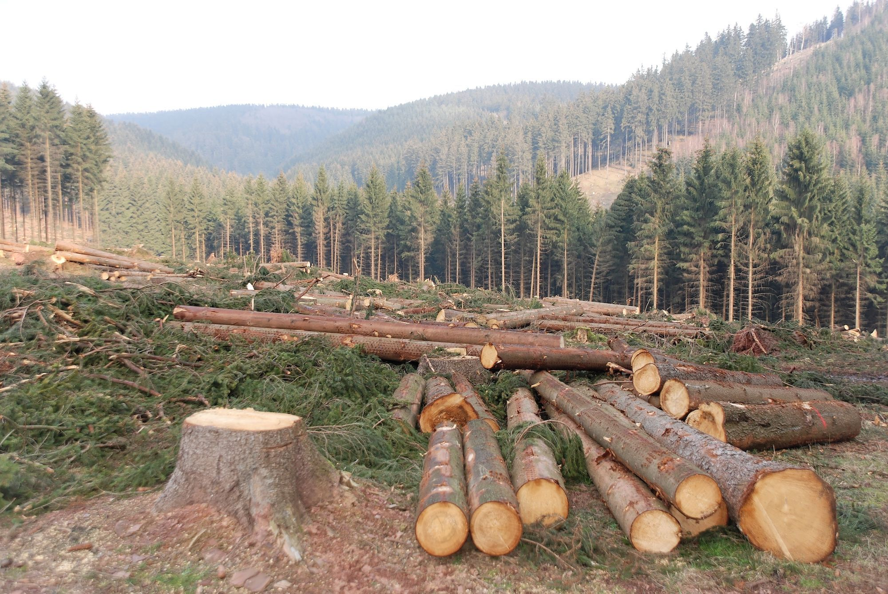
Cutting Trees - Healthy or not healthy?

Slide 7
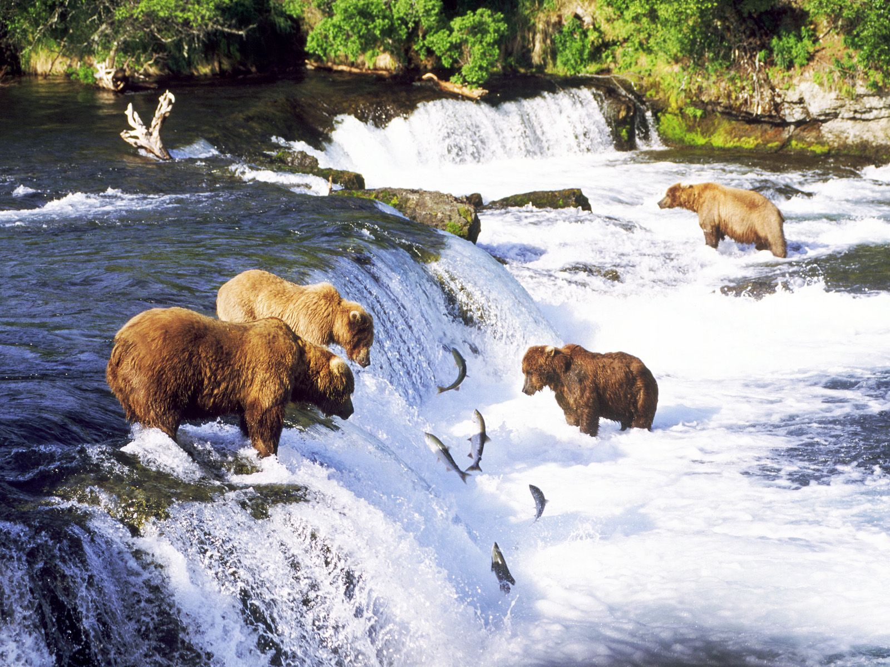
Bears fishing - Healthy or not healthy?

Slide 8
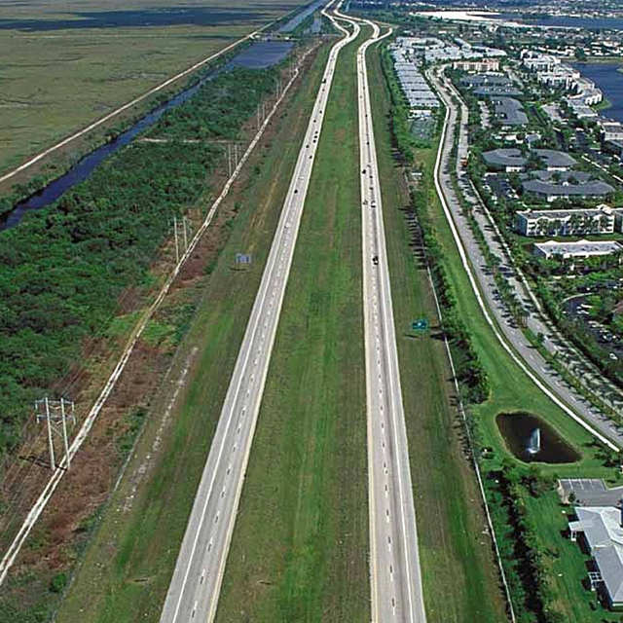
The highway - Healthy or not healthy?

Slide 9
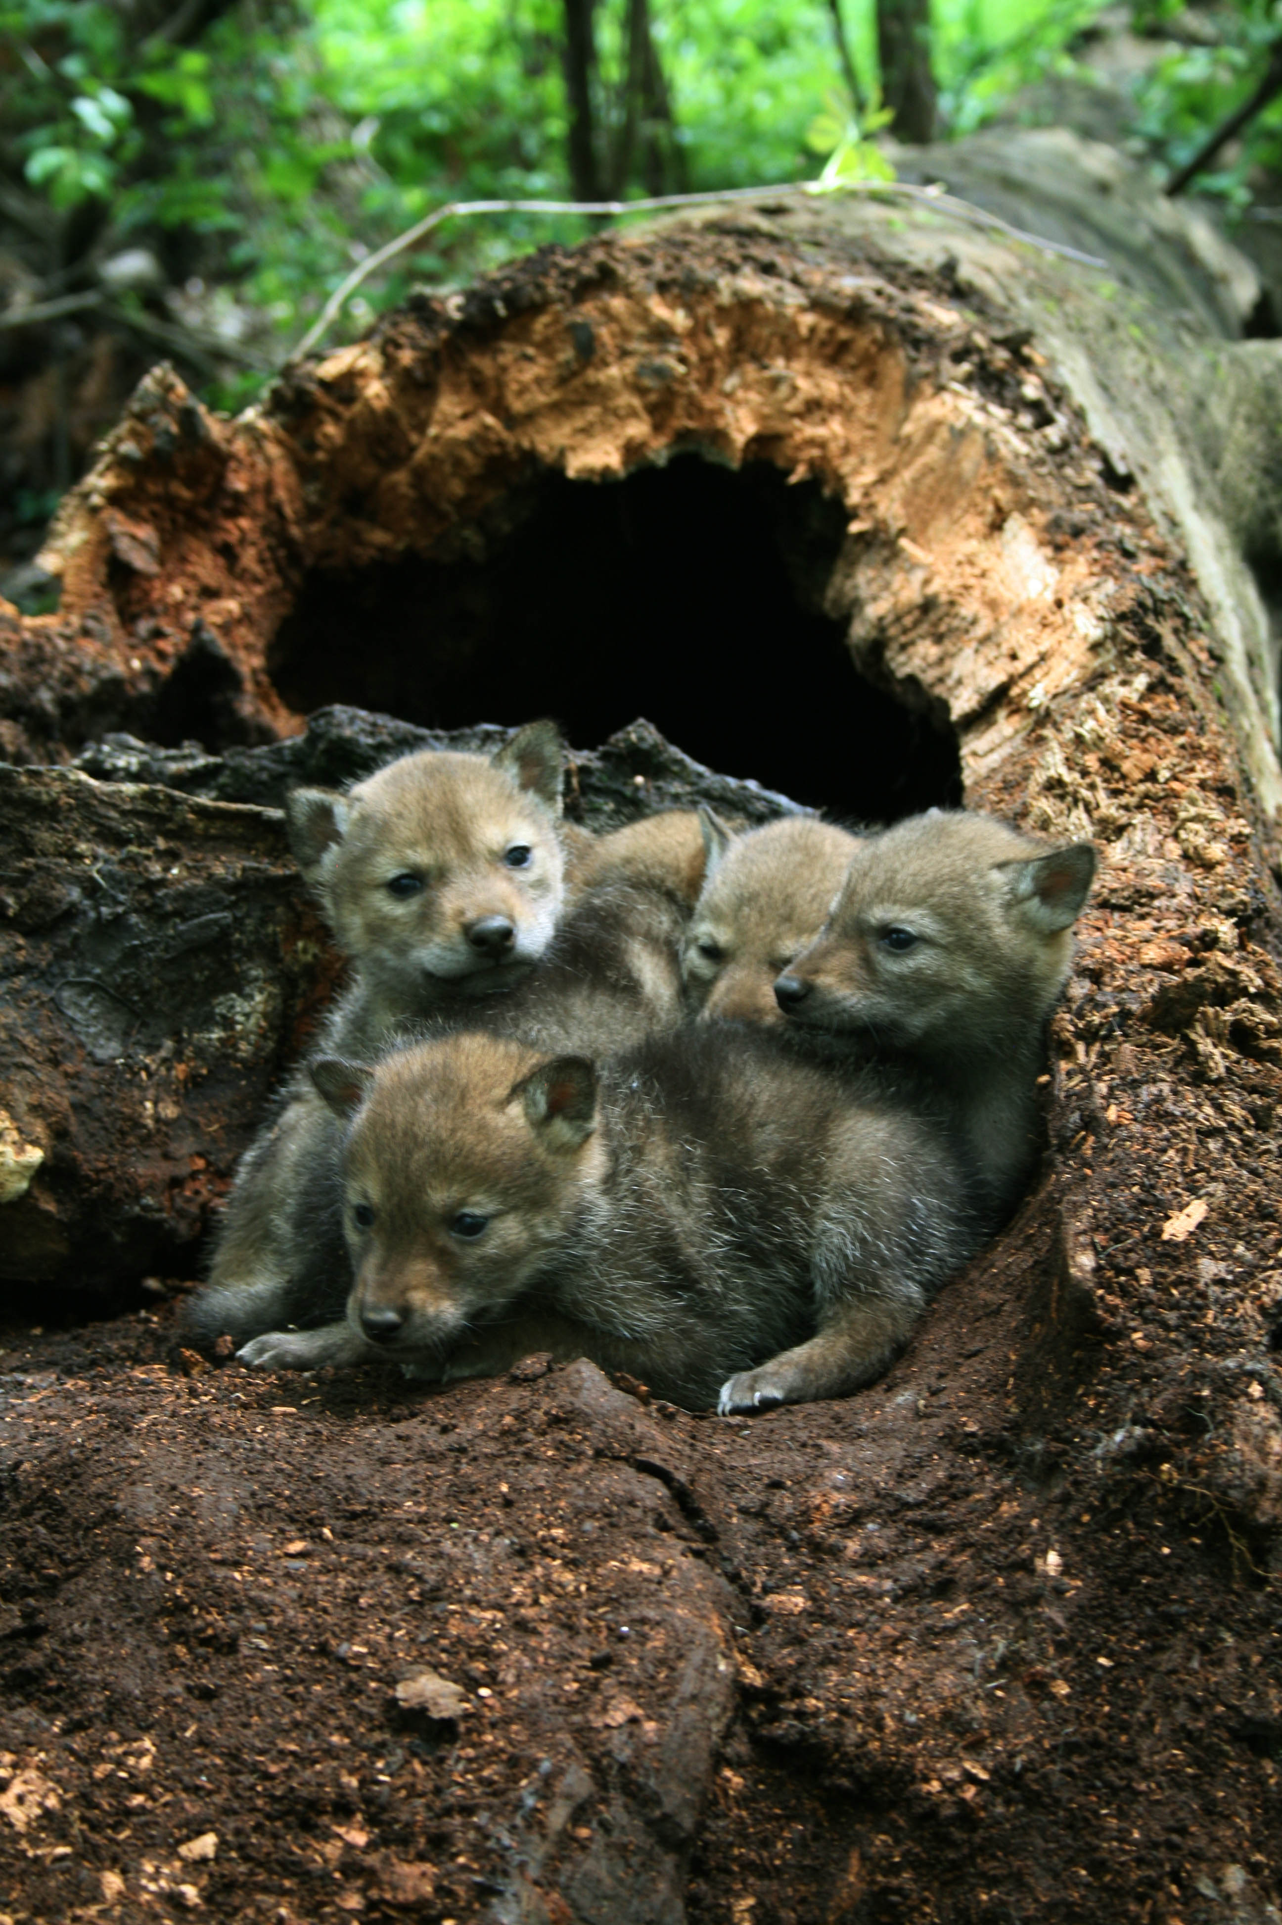
Baby coyotes in a nurse log- Healthy or not healthy?

