Slide 1
Alice Eastwood Lesson

Slide 2
Questions
What is a conservationist?
What is a botanist?

Slide 3
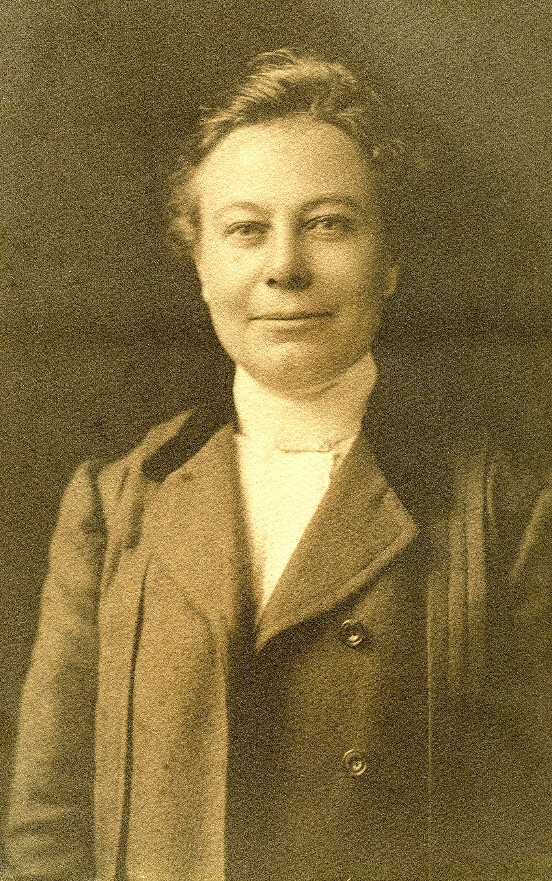
Alice Eastwood
Alice Eastwood was a successful botanist and conservationist. She fought to save Muir Woods National Monument and Mt. Tamalpais State Park! She worked at the California Academy of Science for over 50 years. She collected over 300,000 plants. Alice Eastwood worked hard to save Muir Woods and collect many plants.
Image Description: A black and white picture of Alice Eastwood

Slide 4
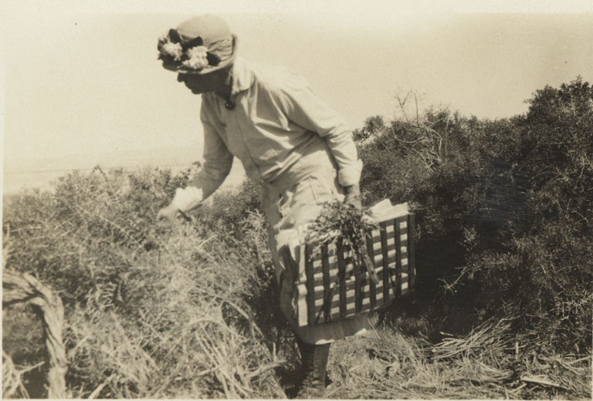
Alice Eastwood’s Early Plant Study
Alice Eastwood started collecting plants when she lived in Colorado. She loved studying plants from an early age. After studying plants in Colorado she moved to San Francisco to work for The California Academy of Science!
Image Description: A black and white picture of Alice Eastwood collecting plants

Slide 5
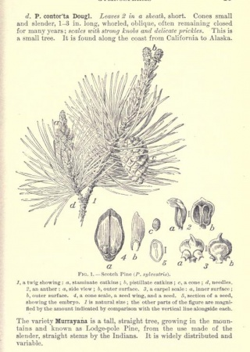
This is Alice Eastwood’s Botanical Drawing.
Image Description: Alice Eastwood’s botanical drawings and writing of a douglas fir

Slide 6
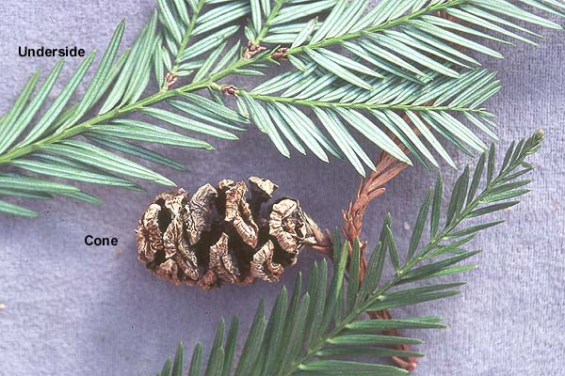
Now try and draw your own for redwood trees. Use the picture here for reference.
Now find a plant outside near you. Do a botanical drawing of that plant.
Give it a Try!
Image Description: A redwood cone and needles

Slide 7
San Francisco Earthquake
On April 18th, 1906 the great San Francisco earthquake shook the city. Eastwood ran into the crumbling Academy of Science building to try to rescue her own and her colleagues’ collections. She was able to rescue 1,211 plant species of immense value. She also saved many books from her colleagues’ collections.
She said of the experience, “Not a book [from my department] was I able to save, nor a single thing of my own, except my favorite lens, without which I should feel helpless... My own destroyed work I do not lament, for it was a joy to me while I did it, and I can still have the same joy in starting it again.”
Over the rest of her career she would rebuild this collection and then some, adding over 300,000 specimens. She also went on to publish over 300 articles, books and scientific papers.

Slide 8
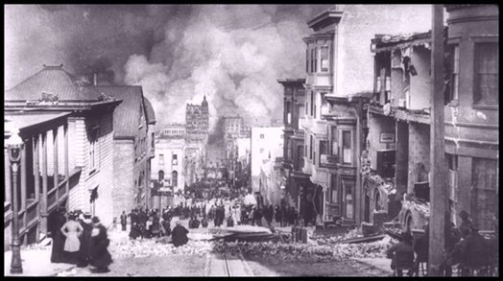
Image of San Francisco after 1906 Earthquake
Image Description: A San Francisco street full of smoke after the 1906 earthquake and resulting fires

Slide 9
Earthquake Questions
Alice Eastwood ran into a crumbling building to rescue her collections and her friend’s collections. Why do you think she did that?
If you were in her situation, what would you run into a crumbling building to get? Why?

Slide 10
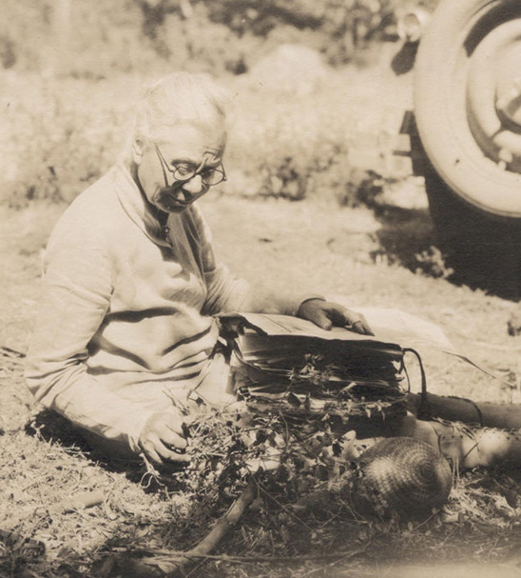
---------OPTIONAL LESSON BREAK----------
Before…
Alice Eastwood’s Legacy of Preservation!
Image Description: Alice Eastwood sitting on the ground collecting plants.

Slide 11
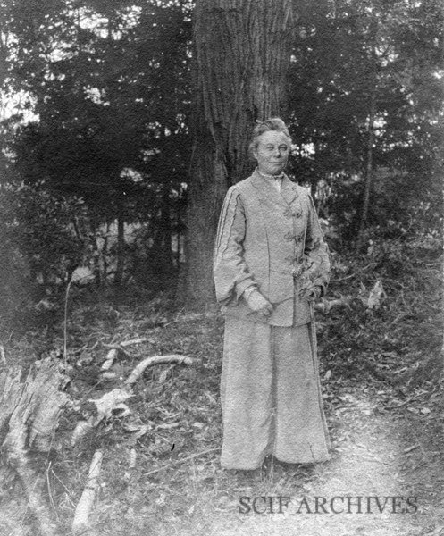
Preservation
On November 20th, 1904 The San Francisco Call Newspaper reported on a women’s club meeting to save what was then called The Redwood Creek Canyon. This area now consists of Muir Woods National Monument and Mt. Tamalpais State Park. Alice Eastwood spoke at this meeting. She said,
"There is only one reason why I wish I had $1,000,000. The only thing I want that amount of money for is to buy Redwood Park and Mount Tamalpais and present them to the State of California for a public reserve"
Image Description: Alice Eastwood in front of a redwood tree

Slide 12
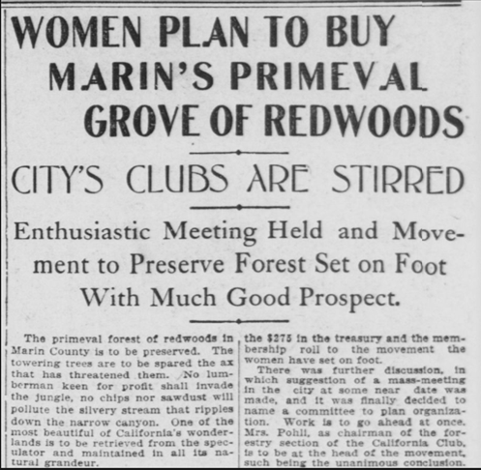
Making Headlines
Alice Eastwood spoke passionately about protecting the landscape. Her speech inspired the crowd and created great support for the cause.
Image Description: Newspaper clipping that says, “Women plan to buy marin’s primeval grove of redwoods. City clubs are stirred. Enthusiastic meeting held and movement to preserve forest set on foot with much good prospect.

Slide 13
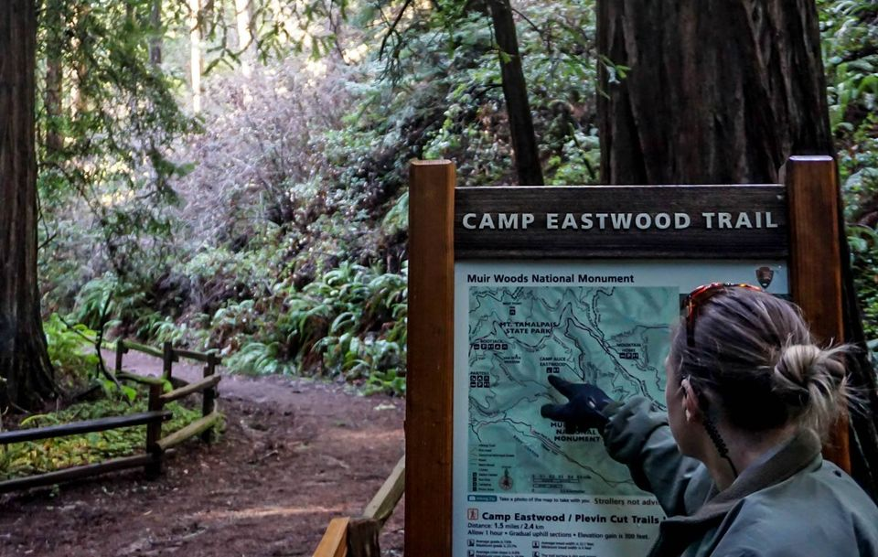
Alice Eastwood Trail
Alice Eastwood retired in 1949 at 90 years old after 57 years. When she retired the Tamalpais Conservation Club named a beautiful campground after her. There is now a trail to that campground from Muir Woods named after her as well. At age 94 she wrote, “I count my age by my friends, and I am rich in friends.” Alice Eastwood passed away in 1953.
Image Description: Ranger points to the sign that reads Camp Eastwood Trail.

Slide 14
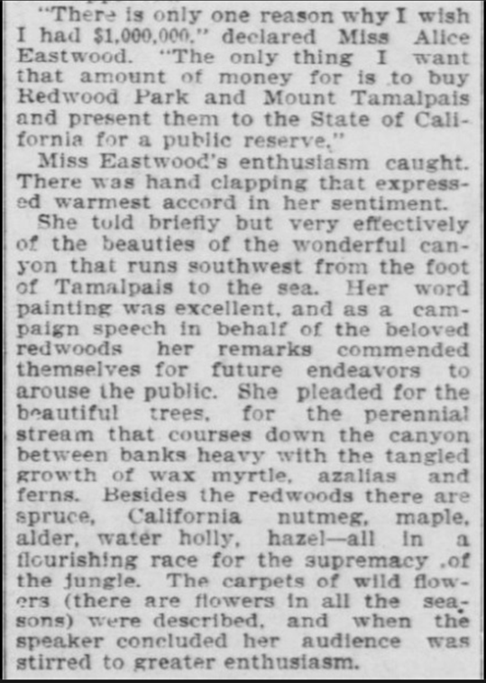
In this Newspaper article from 1904 Alice Eastwood is mentioned.
Newspaper clipping reads:
“There is only one reason why I wish I had $1,000,000” declared Miss Alice Eastwood. “The only thing I want that amount of money for is to buy Redwood Park and Mount Tamalpais and present them to the State of California for a public reserve.”
Miss Eastwood’s enthusiasm caught. There was hand clapping that expressed warmest accord in her sentiment. She told briefly but very effectively of the beauties of the wonderful canyon that runs southwest from the foot of Tamalpais to the sea. Her word painting was excellent, and as a campaign speech in behalf of the beloved redwoods her remarks commended themselves for future endeavors to arouse the public. She pleaded for the stream that courses down the canyon between banks heavy with tangled growths of wax myrtle, azaleas and ferns. Besides the redwood there are spruce, California nutmeg, maple, alder, water holly, hazel - all in a flourishing race for the supremacy of the jungle. The carpets of wild flowers (there are flowers in all the seasons) were described, and when the speaker concluded her audience was stirred to greater enthusiasm.

Slide 15
Journalist Activity
The journalist talks about why the redwood forest was so important to Alice Eastwood. In 1949 a campground was named after Alice Eastwood in the park that she helped save. Write your own newspaper article about the campground being named after her. Please share in your article why this area was named after her.

