Slide 1
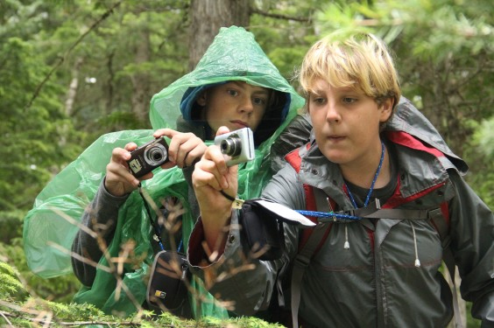
Welcome to our journey!
Total run time: 2 minutes 35 seconds
The 2011 Parks in Focus Montana group, led by Katie Pritchard, spent a day hiking up the Trail of the Cedars with Glacier National Park Artist-in-Residence Helene Fischman. Each participant produced a body of photography and produced poems written in quintain (five lines). Each of the following slides feature the best work of our participants, each displaying a photo and poem produced by the participant whose name appears on the lower right corner.
Click once to the next slide, and the presentation will take over to cascade you through the images while you relax and enjoy.
Photos of students by Elena Gustafson

Slide 2

Photography & Poetry Hike
with Glacier Artist-in-Residence: Helene Fischman
July 26, 2011
Glacier National Park & Parks in Focus
presents
Featuring photography and poetry by the Boys & Girls Club of Missoula County—Ana, Brian, Evelyn, Kayla, Landen, Loran, Olivia, Seth, Sierra, and Trentan
You don’t have to click forward. The presentation will start on its own…
Photo by Helene Fischman

Slide 3
Tree
Green, peaceful
Planting, Growing, aging
It reaches the sky
Elder
Photo & Poem by Evelyn, age 13

Slide 4
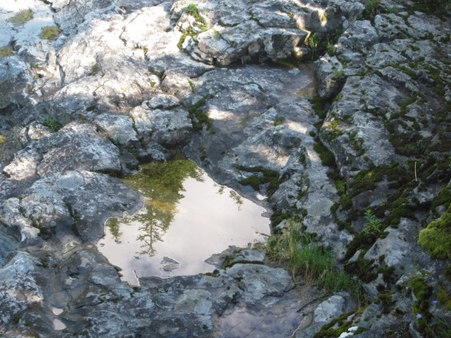
The Trees
Are tall
The animals Are about
And the Water shoots its spout
The
birds Sing
The
sky is blue
The Forest is the place for you
Photo & Poem by Ana, age 10

Slide 5
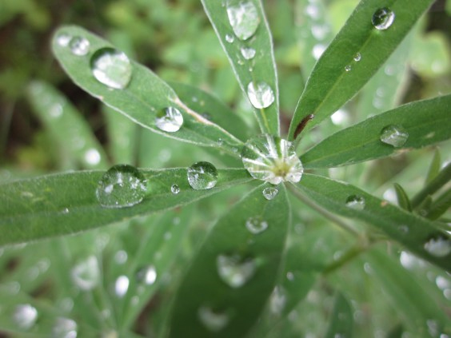
Creek
Cold, wet, fast
Flowing, speeding, sloshing
It is very Loud
Ice Cube
Photo & Poem by Landen, age 13

Slide 6
Water
Wet, calm
Refreshing, Replenishing, Rushing
Running so Freely
Liquid
Photo & Poem by Trentan, age 13

Slide 7
Frog
Slimy, small
Hopping, hiding, Lurking
Staying so still
Amphibian
Photo & Poem by Olivia, age 10

Slide 8
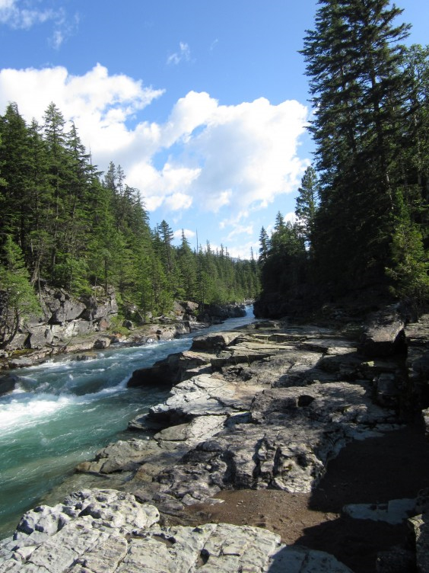
River
Fast and Loud
S i n g i n g
It runs speedy
Cool scene
Photo & Poem by Loran, age 11

Slide 9
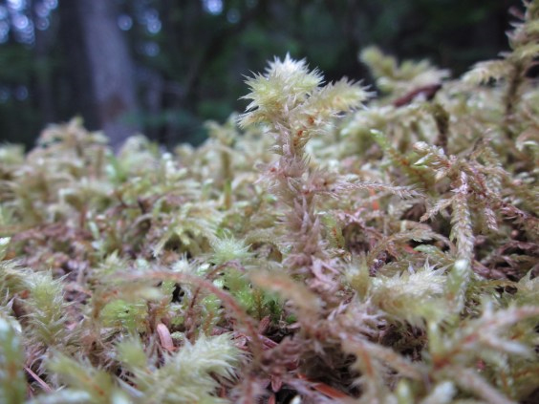
Trees
Big, Tall
Looming, blooming, growing
Sheltering, Large
Bark
Photo & Poem by Seth, age 11

Slide 10
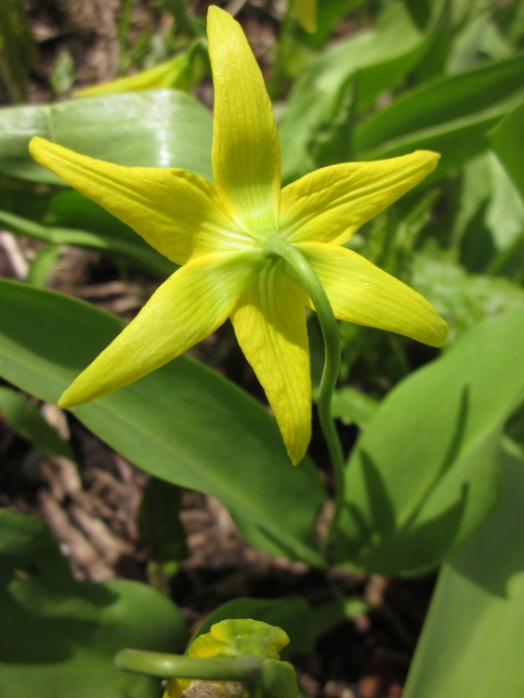
Trees
Green, Big
Floating,
Drifting,
Swerving
Lost in the water
Friends
Photo & Poem by Brian, age 12

Slide 11
Creek
Wet, Loud
Refreshing,
running, Soothing
The creek is amusing
S t r e a m
Photo & Poem by Kayla, age 11

Slide 12
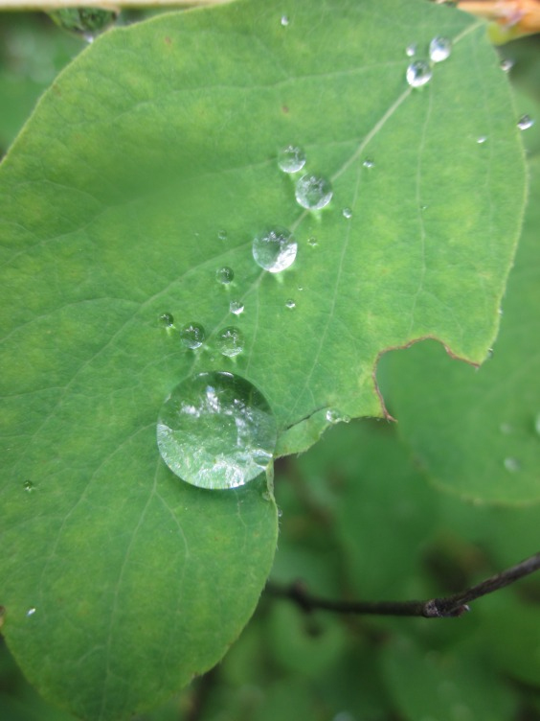
Water
Blue, Rapid
R u s h i n g,
flowing,
moving
Cold rushing
fast
Freezing
Photo & Poem by Sierra, age 12

Slide 13
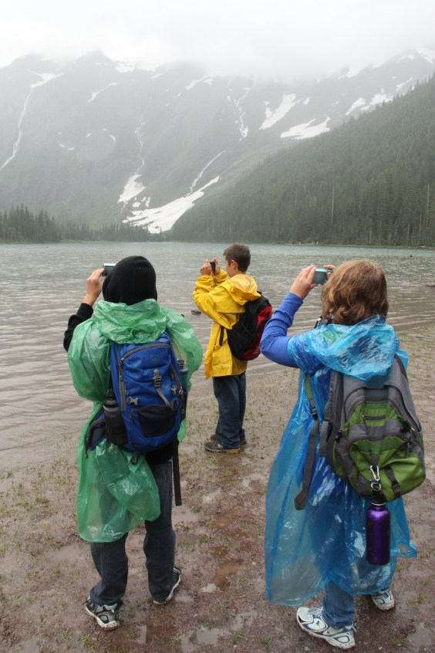
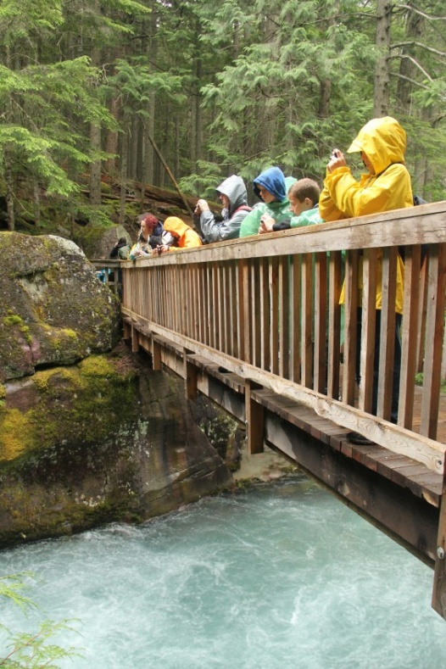
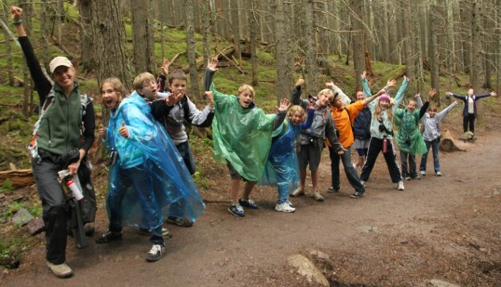
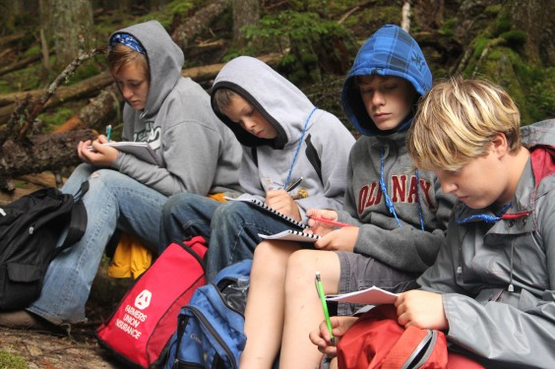
The End
Special thanks to Lauren, Brian, Elena, Camille, Connor, Katie & Debby!
Photos of students by Elena Gustafson

