Slide 1
GATEWAY NATIONAL RECREATION AREA

Slide 2
The Issue
Latinos (as well as many other members of NYC’s population) are not aware of or do not typically identify with the health message put forth by American Heart Association.
Members of Spanish-speaking communities surrounding Gateway typically visit the park for self-guided activities (fishing or picnics). These families miss out on the enrichment and health benefits available through participation in the parks diverse program offerings.
National Parks are not traditionally seen as hubs for community health and fitness.

Slide 3
The Solution
Life’s Simple 7 and our National Parks: A Perfect FIT!
Recruit a team of culturally diverse college-level interns who care about community health and share language, traditions and values in common with immigrant communities.
Interns demonstrate fitness leadership by example and inspire people of all ages and backgrounds to adopt healthy lifestyle choices.
Internship Team shares AHA’s health message and deepens the community connection to National Parks through:
- in person outreach and networking with neighborhood organizations
- leadership of fun, heart-smart outdoor recreation activities
- strategic use of social media

Slide 4
The Expected Outcome
Your Park! Your Health!
¡Tu Parque! ¡Tu Salud!
Introduces hundreds of NYC children and adults to the concept and practice of Life’s Simple 7.
Facilitates active outdoor experiences that bring people together to enjoy a sense of connection to community and nature; and overall improved health.

Slide 5
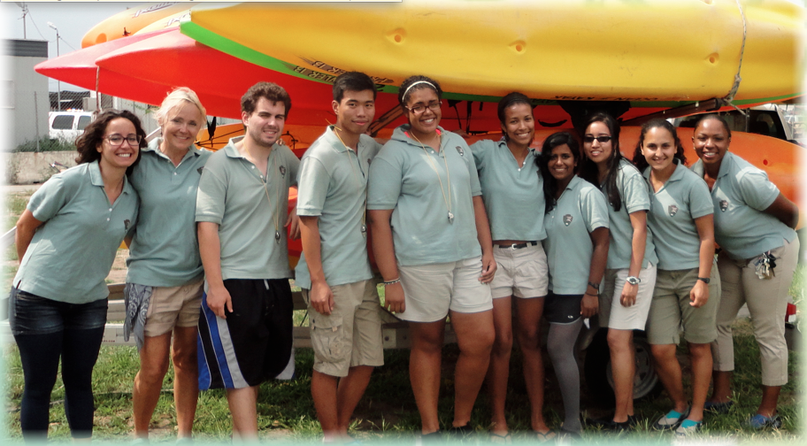
Your Park! Your Health! 2012

Slide 6
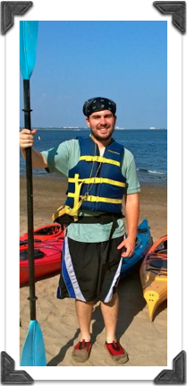
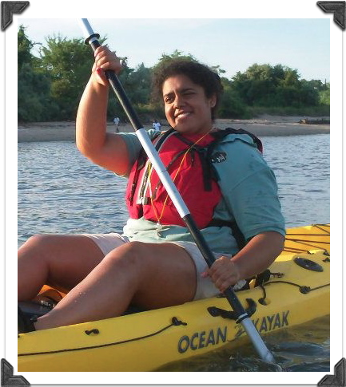
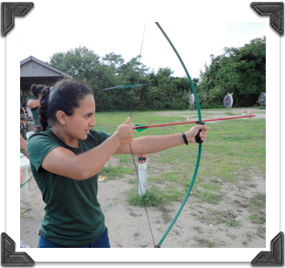
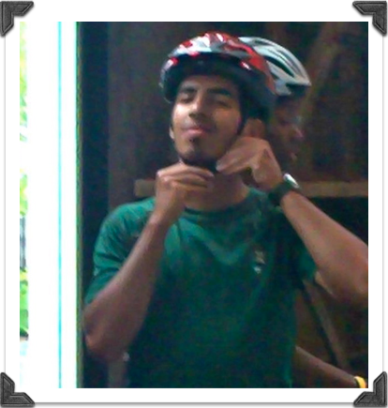
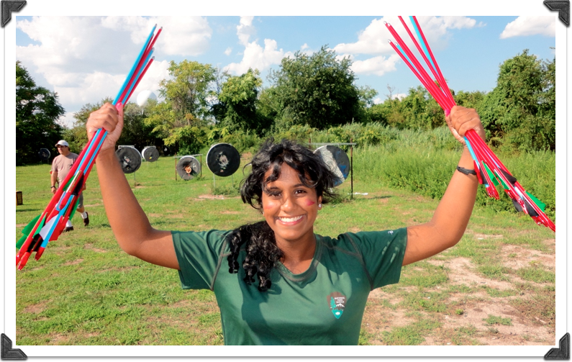
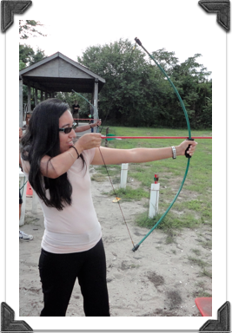
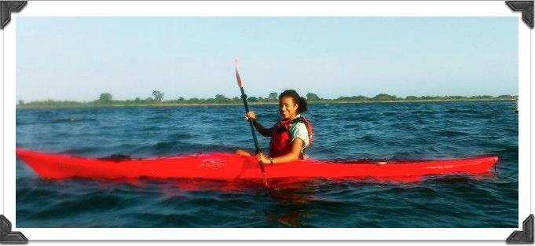
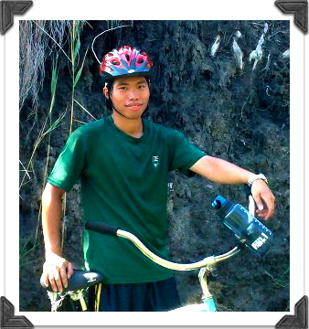
The Crew

Slide 7
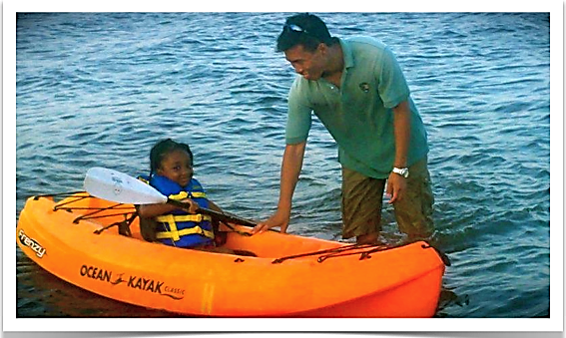
Making a Difference
Environmental Stewardship
Friends and Family
Nutrition
Getting Active
Connection to Nature
Engaging Youth

Slide 8
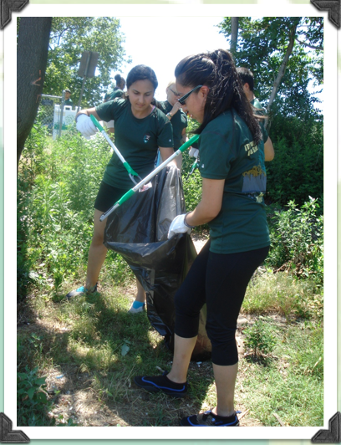
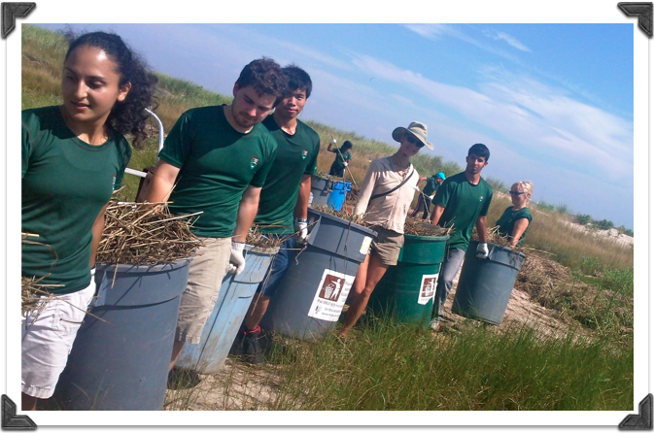
Environmental Stewardship
Working with community to keep our parks healthy and safe.

Slide 9
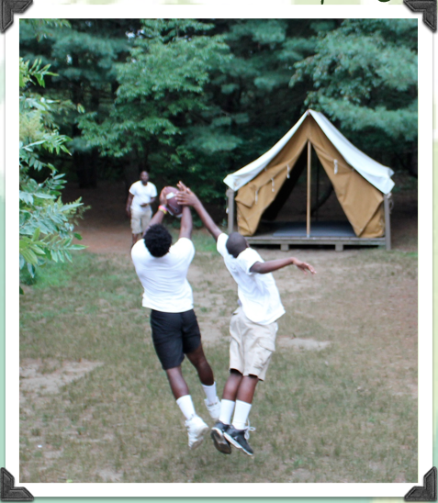
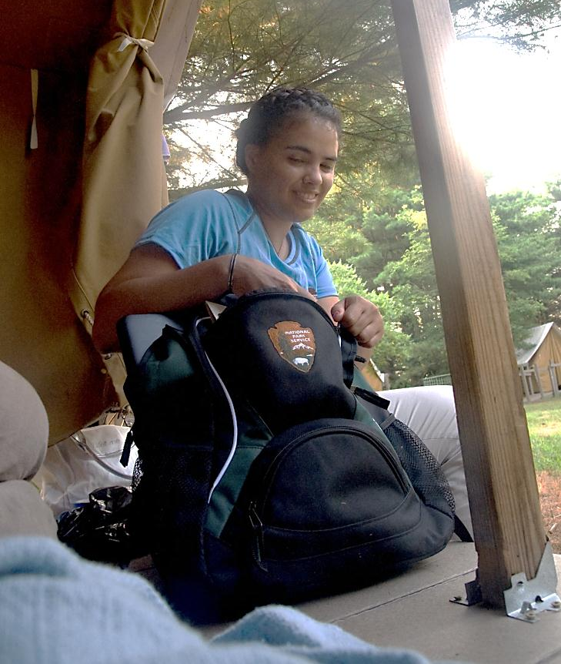
Fun for Friends and Family
Let’s Go Camping!
Learning about ourselves and nature through time spent outdoors.

Slide 10
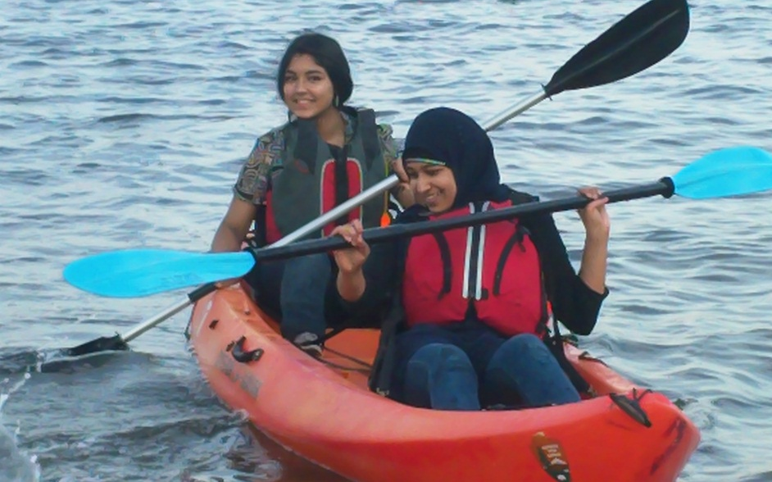
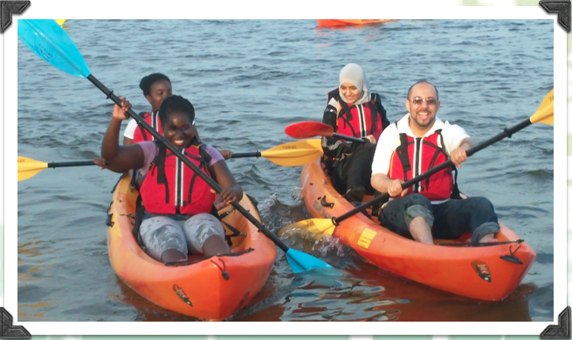
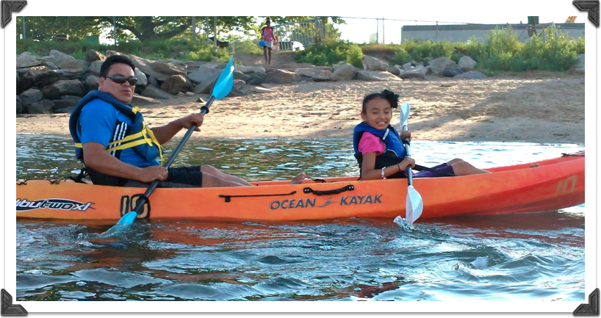
Fun for Friends and Family
Let’s Go Kayaking!
Sharing new experiences and practicing new skills.

Slide 11
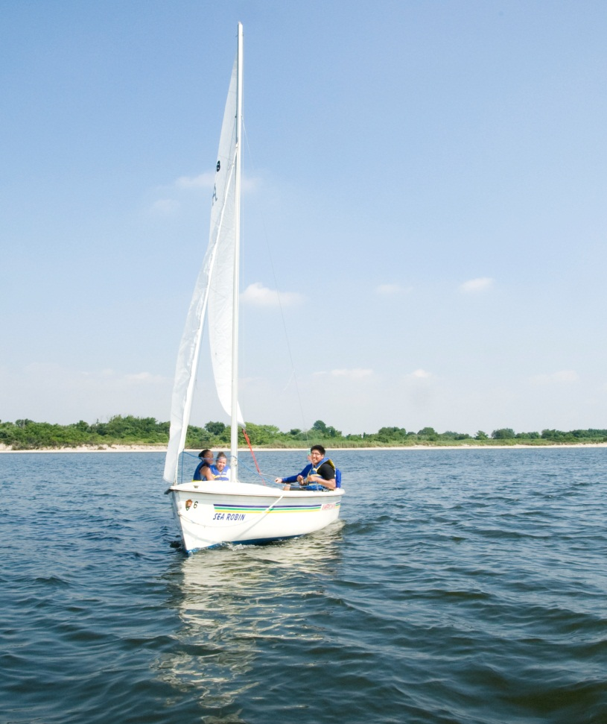
Fun for Friends and Family
Let’s Go Sailing!
Stretching our comfort zones and broadening our horizons.

Slide 12
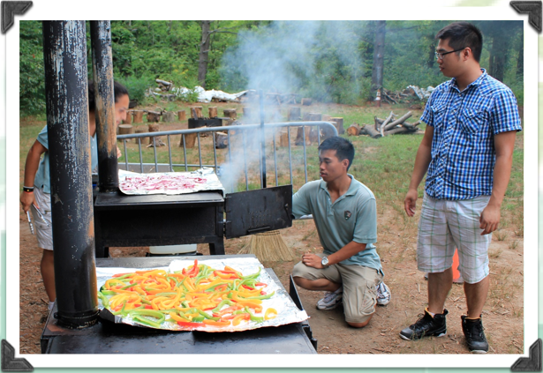
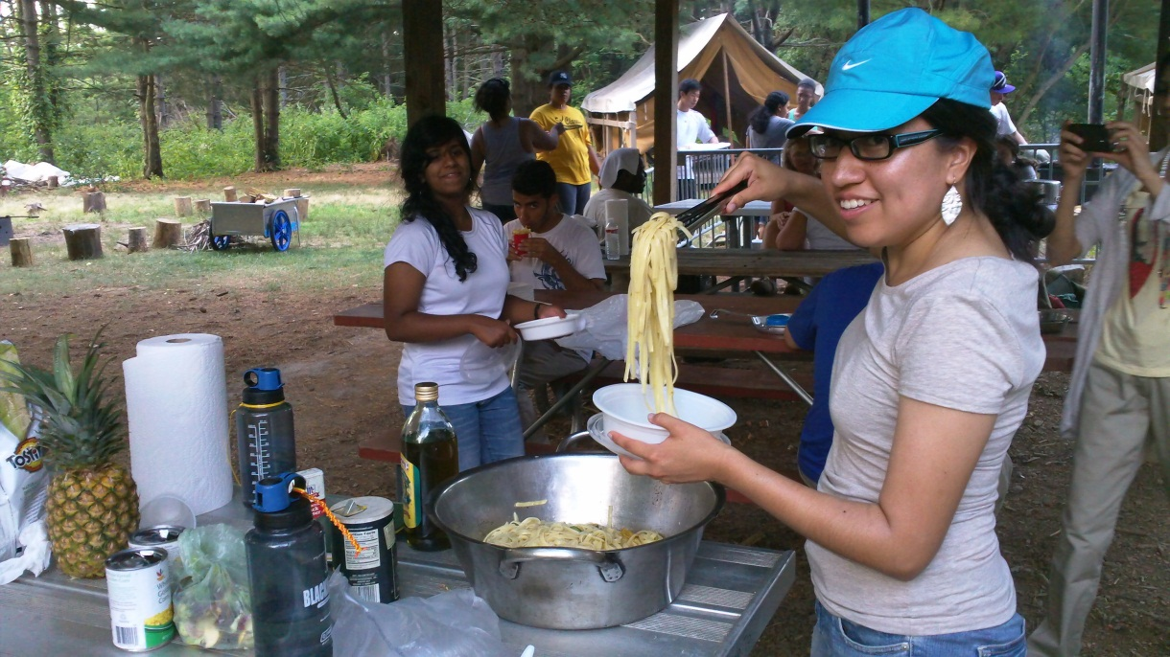
Nutrition
Nutrition
Enjoying fresh air and healthy meals together.

Slide 13
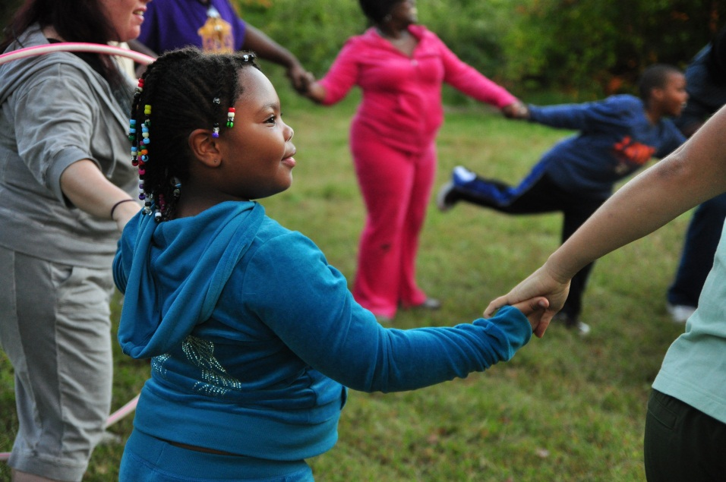
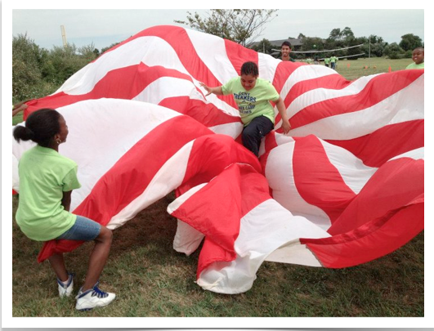
Getting active
Making new friends and exploring special places.

Slide 14
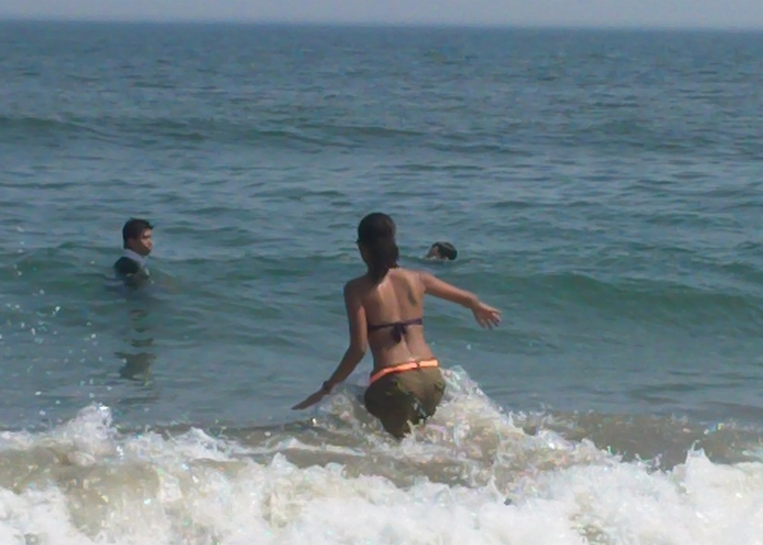
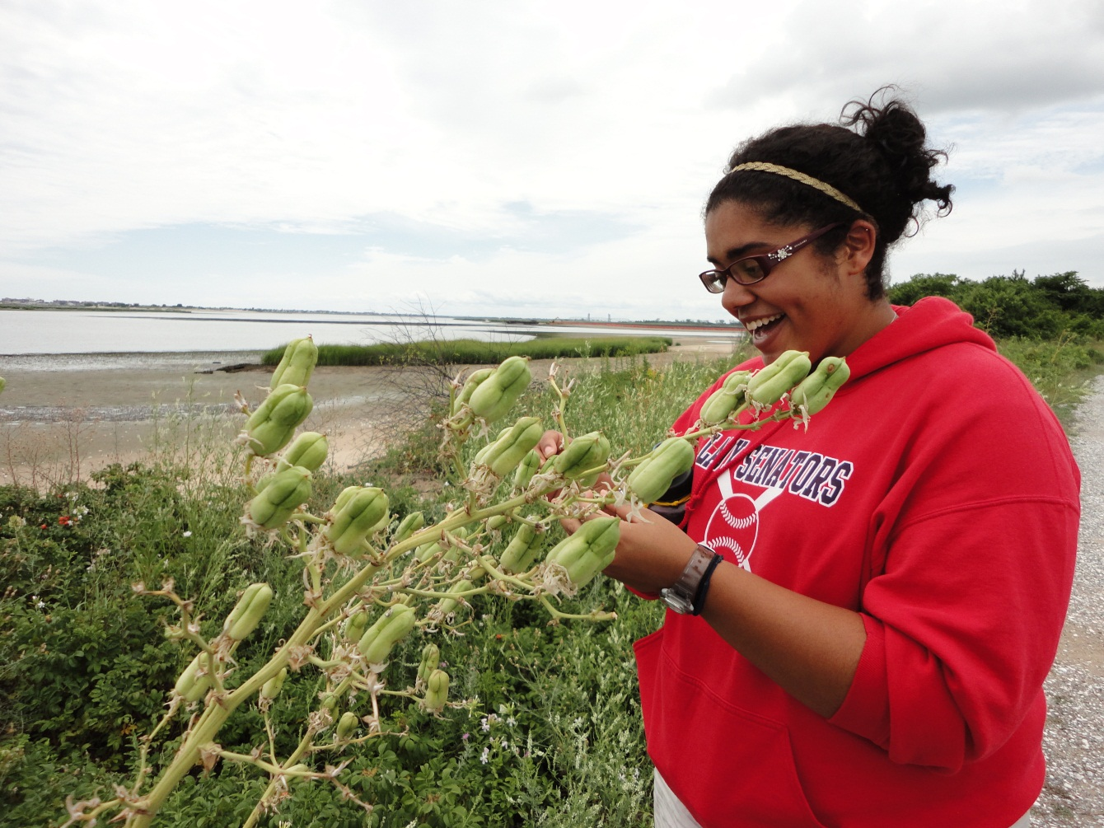
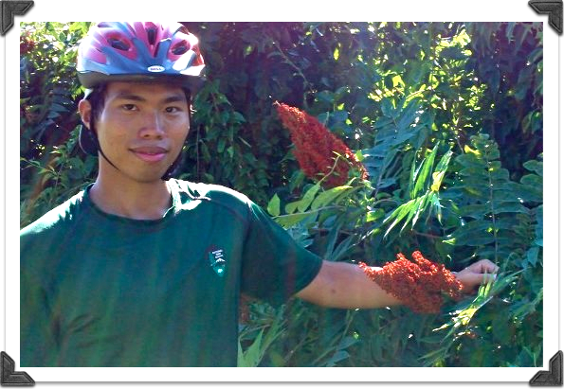
Connection to Natureecti Nature
Connection to Nature

Slide 15
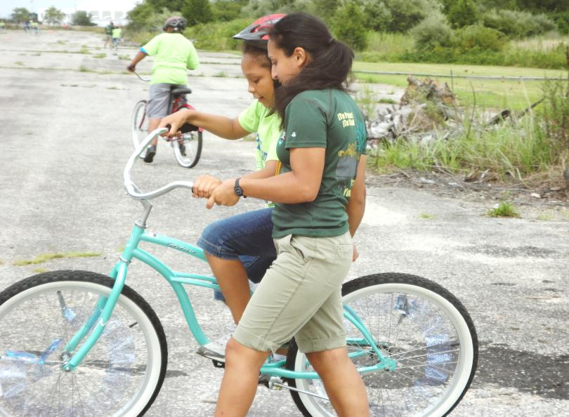
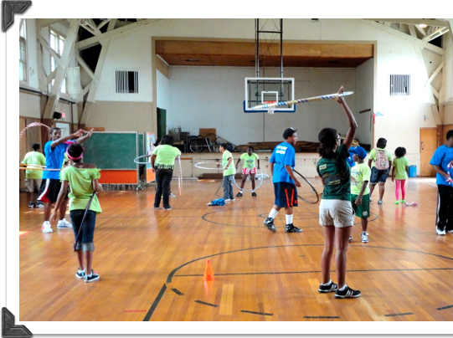
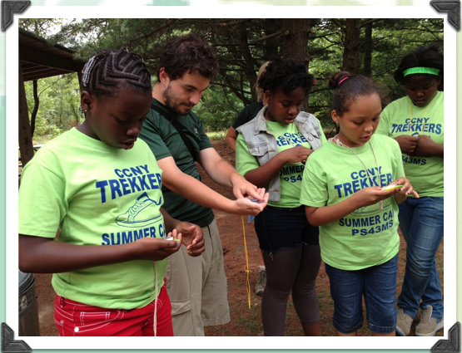
Engaging Youth
Your Park! Your Health!
Field Day

Slide 16
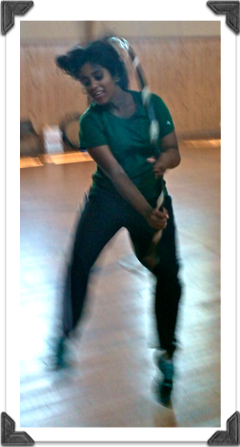
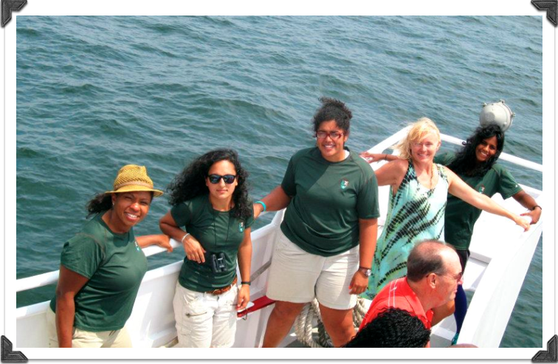
New Experiences

Slide 17
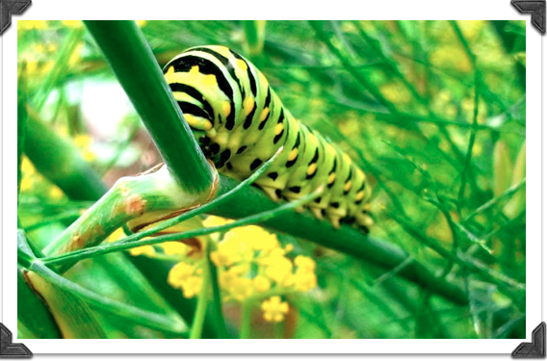
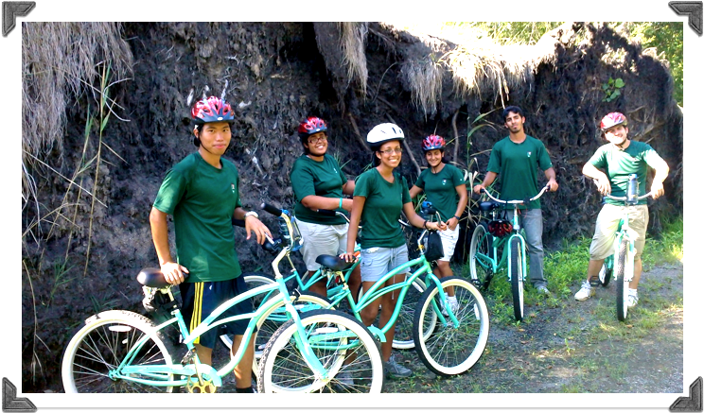
Personal Growth
Trust gained through teamwork leads to personal transformation.

Slide 18
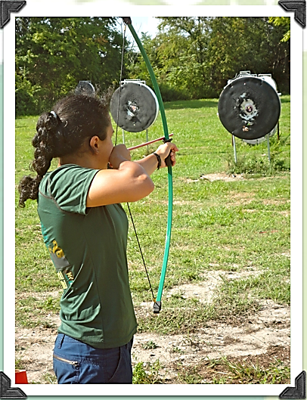
Looking Towards the Future
The National Park Service and American Heart Association partner to provide opportunities for adults and children to enjoy the rewards of leading a heart-healthy active lifestyle.

